Slide 1

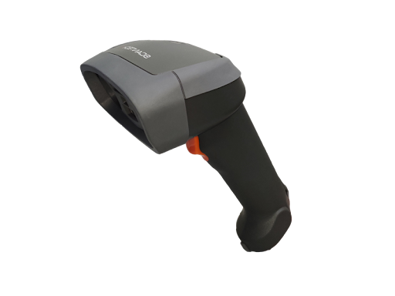

Golang
Barcode
Scanner

Slide 2

Overview
Step 1
Step 2
Step 3
Step 4
Run go
Scan Barcode
Store
In
Neon
Display
HTML

Slide 3
Step 1
go run main.go

Slide 4
Scan Barcode
Scan from USB

Slide 5
Neon Database
Insert Row
=
Scan

Slide 6
Templates HTML
Show Neon in HTML

Slide 7
Future Dev
1) Pricing API
2) Frontend UI

