Slide 1
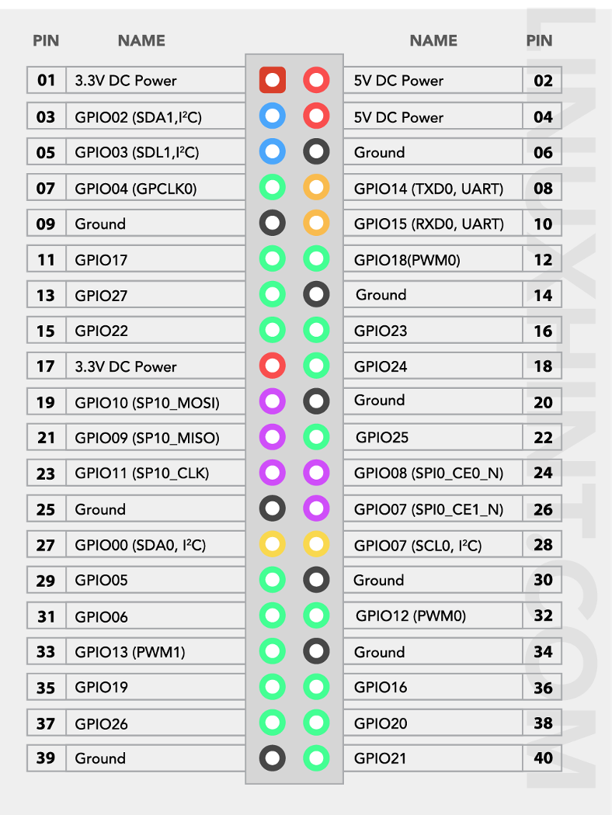
Level converter
Con- i2c 3 V
4 pol
RB
Lamp
Fan
Con- i2c 5 V
4 pol
Sensor moist
5 pol
Relaisboard Pump

