Slide 1
Rstudio Teaching Exam
Supplementary Materials
Matthew McDonald
April 23, 2020

Slide 2
Learner Persona – Alice Analyst
General Background – Alice has been an Analyst for a rating agency for 2.5 years, which is her first job out of college.
Relevant Experience – Alice has been trained extensively on using Excel to perform her daily work, which includes a fair amount of data preparation and visual analysis. She took a statistics course in college that used R and Rstudio, but hasn’t really used it since then.
Perceived Needs – Alice spends a lot of her time doing manual copy/paste type work. She would benefit from some of the tools that the tidyverse provides with regards to data manipulation (dplyr) and visualization (ggplot2). She could make some of those manual tasks more repeatable.
Special Considerations – Alice’s boss is well versed in Excel, and she will still need to use it as a primary means of communicating her results.

Slide 3
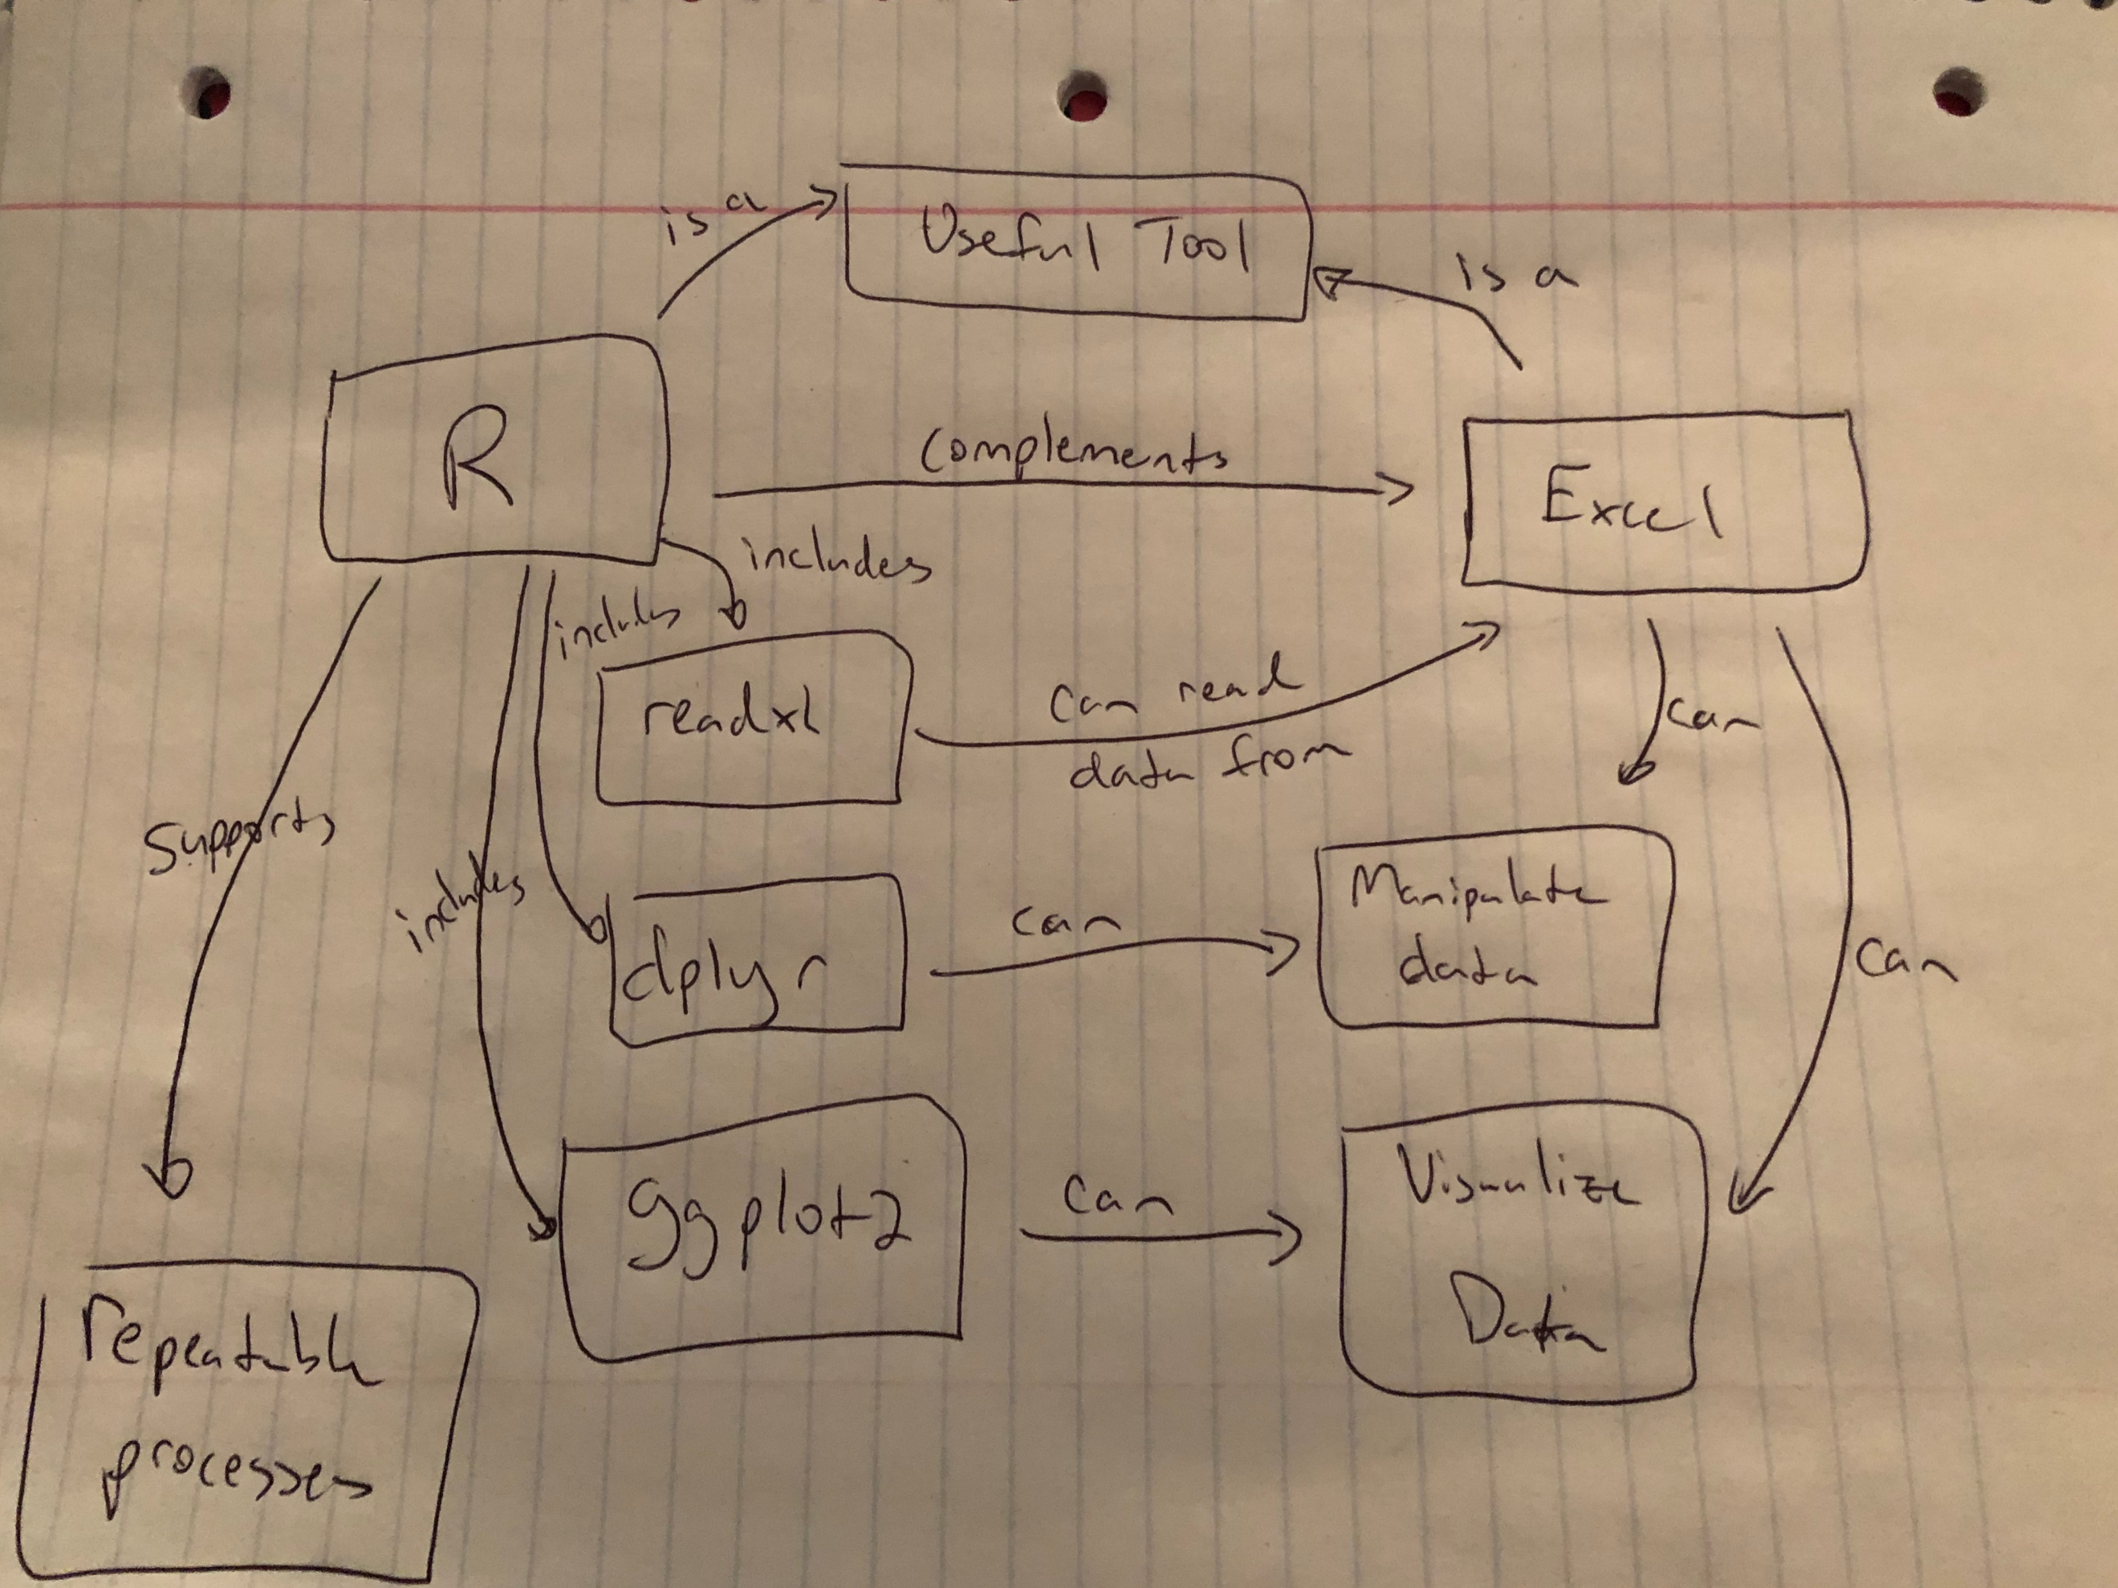
Concept Map

Slide 4
Reorder the steps:
I’d like to load some data from my spreadsheet into R and get a total of the exposure. Reorder the steps so that it works:
1) group_by(rating) %>%
2) portfolio %>%
3) portfolio <- read_excel(“portfolio.xlsx”, sheet=“port”)
4) summarize(avg_exp = mean(exposure))
5) library(tidyverse)
(answer: 5, 3, 2, 1, 4)

Slide 5
Variable Assignment
Which is the correct way to read a spreadsheet into R?
1) data <- read_excel(data.xlsx)
data <- read_excel(“data.xlsx”)
data read_excel(data.xlsx)
data <- read.table(data.xlsx)
data = read_excel(data.xlsx)
(answer: 2; 5 would work too, but is way less cool)

