Slide 1
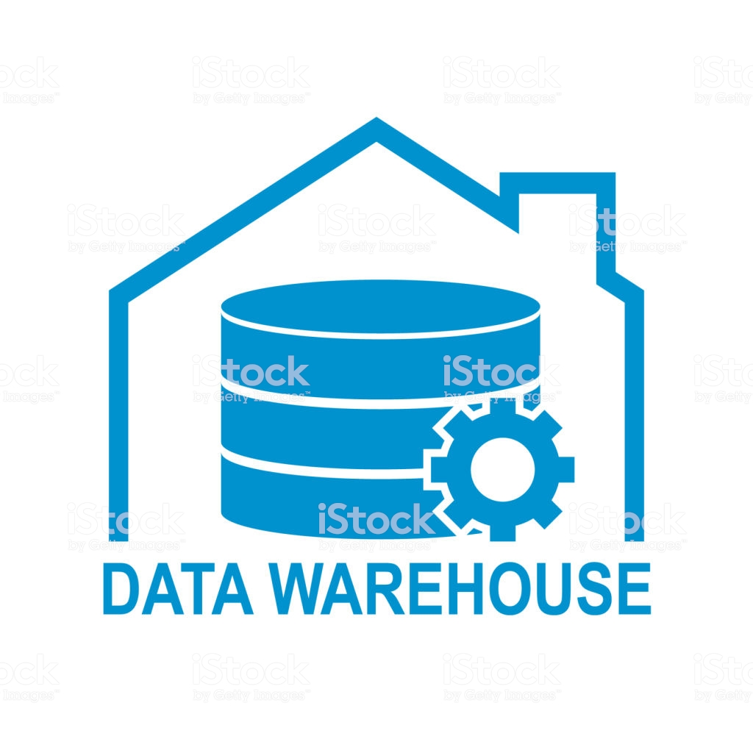
Data Warehousing and Online Analytical Processing
Section 4.1 from:
Jiawei Han, Micheline Kamber, Jian Pei (2012). Data Mining Concepts and Techniques, 3rd ed. Morgan Kaufmann.
https://www.istockphoto.com/vector/data-warehouse-icon-symbol-design-vector-illustration-technology-solution-tend-gm892634420-247027572

Slide 2
What Is a Data Warehouse?
4.1.1
A data repository that is maintained separately from an organization’s operational databases. Data warehouse systems allow for integration of a variety of application systems. They support information processing by providing a solid platform of consolidated historic data for analysis.
- Data Mining Concepts and Techniques

Slide 3
What Is a Data Warehouse?
4.1.1
A subject-oriented, integrated, time-variant, and nonvolatile collection of data in support of management’s decision making process.
- William H. Inmon

Slide 4
Subject-oriented
4.1.1
organized around major subjects
customer
supplier
product
sales
Doesn't track day-to-day operations and transaction processing
Rather modeling and analysis of data for decision makers.
Provides concise view of particular subject issues
Excludes data not useful in the decision support process

Slide 5
Integrated
4.1.1
Constructed by integrating multiple heterogeneous sources
Relational databases
Flat files
Online transaction records
Data cleaning and integration techniques ensure consistency
Naming conventions
Encoding structures
Attribute measures

Slide 6
Time-variant
4.1.1
Stored Data provide information from historic perspective
E.g., past 5–10 years
Every key structure in the data warehouse contains time element
Explicitly or implicitly

Slide 7
Nonvolatile
4.1.1
Physically separate store of data transformed
From the application data
Separation prevents need for mechanisms:
Transaction processing
Recovery
Concurrency control
Usually requires only two data access operations:
initial data loading
data access

Slide 8
What Is a Data Warehouse?
4.1.1
A semantically consistent data store that serves as a physical implementation of a decision support data model.
- Data Mining Concepts and Techniques
Stores information an enterprise needs to make strategic decisions
Viewed as an architecture, constructed by integrating data from multiple heterogeneous sources to support structured and/or ad hoc queries, analytical reporting, and decision making.

Slide 9
Data Warehousing
4.1.1
The process of constructing and using data warehouses.
- Data Mining Concepts and Techniques
Useful for heterogeneous database integration.
Organizations typically collect diverse data types

Slide 10
Update-driven Approach
4.1.1
Information from multiple heterogeneous sources
Pre-integrated and stored for direct querying and analysis
Maintain large databases from multiple information sources
Heterogeneous, autonomous or distributed
Brings high performance to the integrated heterogeneous database system
Data are copied, preprocessed, integrated, annotated, summarized, and restructured into one semantic data store

Slide 11
Differences between Operational Database Systems and Data Warehouses
4.1.2
Online Transaction Processing (OLTP) systems.
cover most of the day-to-day operations of an organization
Online Analytical Processing (OLAP) systems.
serve users or knowledge workers in the role of data analysis and decision making
Organize and present data in various formats in order to accommodate the diverse user needs

Slide 12
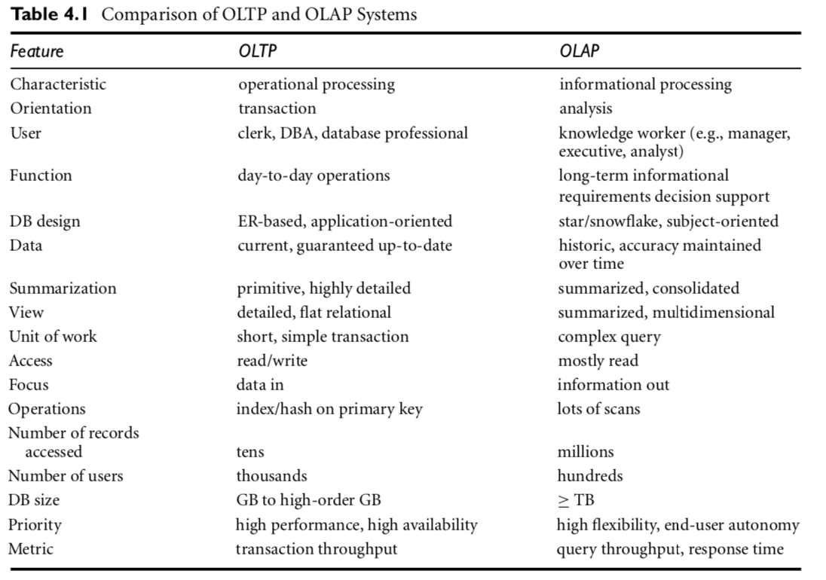

4.1.2

Slide 13
Why Have a Separate Data Warehouse?
4.1.3
Separation helps promote the high performance of both systems
Based on the different structures, contents, and uses of the data in these two systems
Operational databases are designed for known tasks and workloads
Indexing, hashing, using primary keys, searching for particular records, optimizing known queries
Data warehouse queries are complex
Involve the computation of large data groups at summarized levels
May require use of special data organization, access, and implementation methods based on multidimensional views
Processing OLAP queries in operational databases not ideal
Substantially degrade the performance of operational tasks

Slide 14
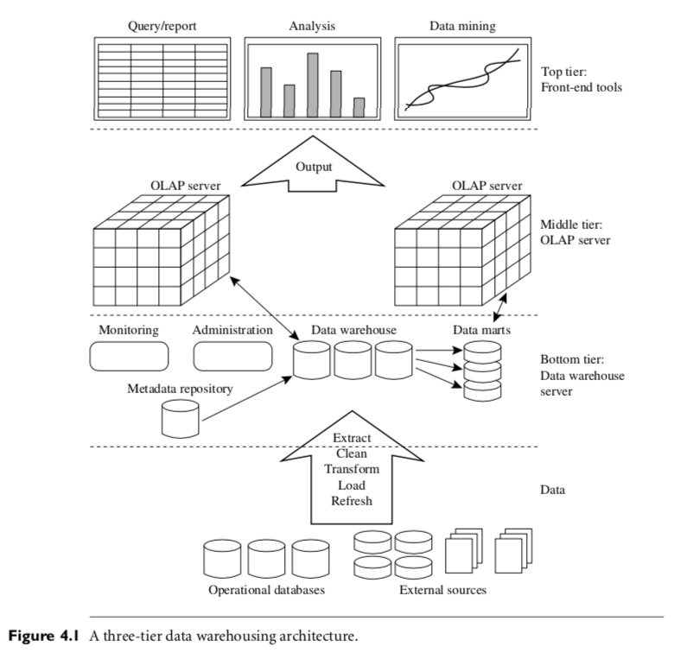
Data Warehousing: Multitiered Architecture
4.1.4
The top tier is a front-end client layer, which contains query and reporting tools, analysis tools, and or data mining tools
Middle tier is an OLAP server using relational OLAP (ROLAP) or a multi-dimensional OLAP (MOLAP) model.
Bottom tier is a warehouse database server usually RDBS. Data are extracted using gateways APIs supported by the underlying DBM. Allowing client programs to generate SQL code to be executed at a server.

Slide 15
Data Warehouse Models: Enterprise Warehouse, Data Mart, and Virtual Warehouse
4.1.5
Top-down approach
Enterprise warehouse
Collects information about subjects spanning the entire organization
Provides corporate-wide data integration, from multiple operational systems or external information providers
Contains detailed and summarized data
Variable size: few gigabytes to hundreds of gigabytes, terabytes, or more.
May be implemented on traditional mainframes, computer super-servers, or parallel architecture platforms.
Requires extensive business modeling may take years to design and build.

Slide 16
Data Warehouse Models: Enterprise Warehouse, Data Mart, and Virtual Warehouse
4.1.5
Bottom-up approach
Data mart
Contains a subset of corporate-wide data that is of value to a specific group of users.
Scope confined to specific selected subjects.
Data are typically summarized.
Example marketing data mart could have customer, item, and sales.
Implemented on low-cost departmental servers
Created in weeks rather than months or years.
Depending on data source can be as independent or dependent.
Independent
Sourced from data from multiple operational systems, external information providers, or locally generated data
Dependent
Sourced directly from enterprise data warehouses

Slide 17
Data Warehouse Models: Enterprise Warehouse, Data Mart, and Virtual Warehouse
4.1.5
Virtual Warehouse
Set of views over operational databases
For efficient query processing, only some of the possible summary views may be materialized
Easy to build but requires excess capacity on operational database servers

Slide 18
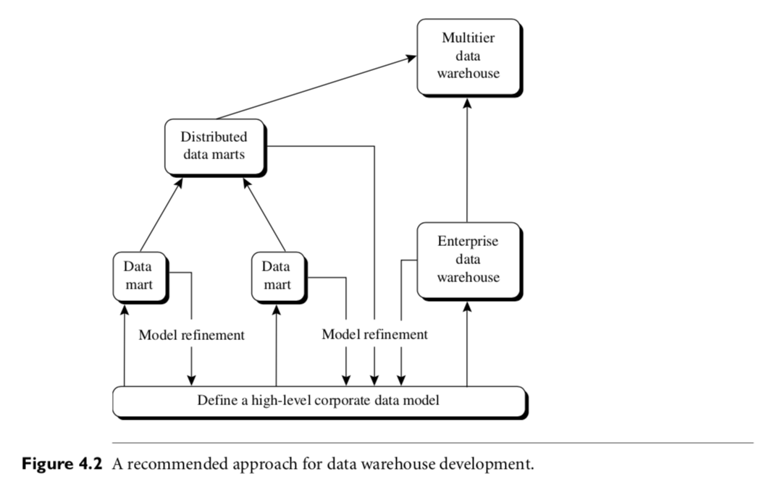
Data Warehouse Development
4.1.5
Finally, a multi-tier data warehouse is constructed where the enterprise warehouse is the sole custodian of all warehouse data, which is then distributed to the various dependent data marts.
Third, distributed data marts are constructed to integrate different data marts via hub servers.
Second, independent data marts are implemented in parallel with the enterprise warehouse based on the same data model set.
First define high-level data model in short frame which provides a enterprise-wide, consistent, integrated view of data among different subjects and potential usages.

Slide 19
Extraction, Transformation, and Loading
4.1.6
Systems use back-end utilities to populate and refresh data:
Data extraction: gathering data from multiple, heterogeneous, and external sources
Data cleaning: detecting and rectifies data errors
Data transformation: converting data from legacy or host format to warehouse format
Load: sorting, summarizing, consolidating, computing views, checking integrity, building indices and partitions
Refresh: propagating updates from the data sources to the warehouse

Slide 20
Metadata Repository Contents
4.1.7
data about data
Description of data warehouse structure
warehouse schema, views, dimensions, hierarchies, derived data definitions, data mart locations and contents
Operational metadata
Data lineage (history of migrated data and transformations applied)
Currency of data (active, archived, or purged)
Monitoring information (usage statistics, error reports, and audit trails)
Summarization algorithms
Measure and dimension definition algorithms
Data on granularity, partitions, subject areas, aggregation, summarization, and predefined queries and reports
Mapping from operational environment to data warehouse,
Source databases, their contents, gateway descriptions, data partitions, data extraction, cleaning
Transformation rules and defaults
Data refresh and purging rules, and security
Data related to system performance
Indices and profiles to improve data access and retrieval performance
Rules for timing and scheduling of refresh, update, and replication cycles.
Business metadata
Terms and definitions
Data ownership information, and charging policies

Slide 21
Data Warehouse Summary
Consolidate data in multidimensional space
Construction
data cleaning, integration, transformation
Important preprocessing step for data mining
Provide online analytical processing (OLAP) tools
Interactive analysis of multidimensional data of varied granularities
Facilitates effective data generalization and data mining
Integrate other data mining functions
Association
Classification
Prediction
Clustering
Integrate with OLAP operations
Enhance interactive mining of knowledge at multiple levels of abstraction

Slide 22
Questions?
Query, reporting, analysis, and or data mining tools
A subject-oriented, integrated, time-variant, and nonvolatile collection of data in support of management’s decision making process.
data about data
Metadata

