Slide 1

Notes:
Speaker Notes: - Welcome to our second session on Deploying Edge AI - Today we'll focus on the crucial process of taking models from development frameworks and preparing them for efficient edge deployment - We'll cover conversion workflows, common challenges, and how to evaluate model performance - By the end of this session, you'll understand how to convert models to ONNX and begin assessing their suitability for edge deployment

Slide 2

Notes:
Speaker Notes: - In this first section, we'll explore how to convert models from various frameworks to the ONNX format - ONNX (Open Neural Network Exchange) provides a unified representation for different frameworks - This standardization is key for deploying models across diverse hardware and software platforms - We'll look at the conversion process for PyTorch, TensorFlow, and other popular frameworks

Slide 3
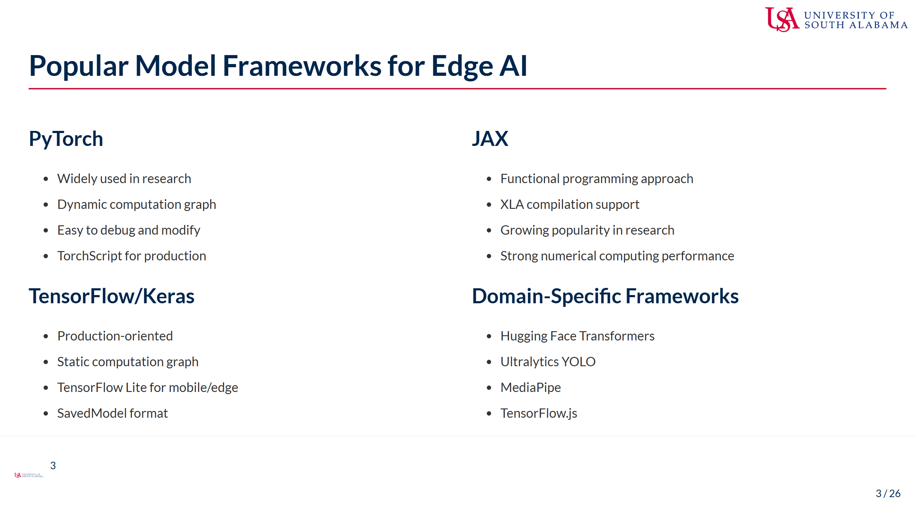
Notes:
Speaker Notes: - These are the most common frameworks we'll be converting FROM when preparing models for edge deployment - PyTorch is exceptionally popular in research contexts, offering flexibility and ease of use - TensorFlow provides strong production support with tools specifically designed for edge deployment - JAX is gaining traction for its functional approach and excellent performance characteristics - Domain-specific frameworks like Hugging Face often have their own export tools with ONNX support - Understanding the source framework is crucial for successful conversion - Each framework has its own unique features and limitations that will impact the conversion process - Ask students which frameworks they're most familiar with to gauge class experience

Slide 4
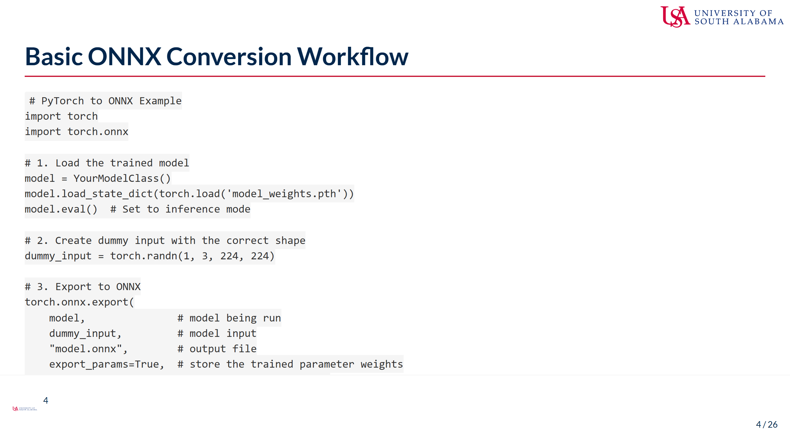
Notes:
Speaker Notes: - This slide shows the basic workflow for converting a PyTorch model to ONNX - First, we load the trained model and set it to inference mode with model.eval() - Next, we create a dummy input tensor that matches the expected input shape - The torch.onnx.export function handles the actual conversion process - Key parameters include: - export_params: ensures weights are included in the ONNX file - opset_version: defines which ONNX operations are available (higher is newer) - do_constant_folding: an optimization that pre-computes constant expressions - input_names/output_names: human-readable names for model inputs/outputs - dynamic_axes: allows for flexible dimensions like variable batch sizes - This basic pattern applies across frameworks, though syntax differs - Common issues include tensor shape mismatches and unsupported operations

Slide 5
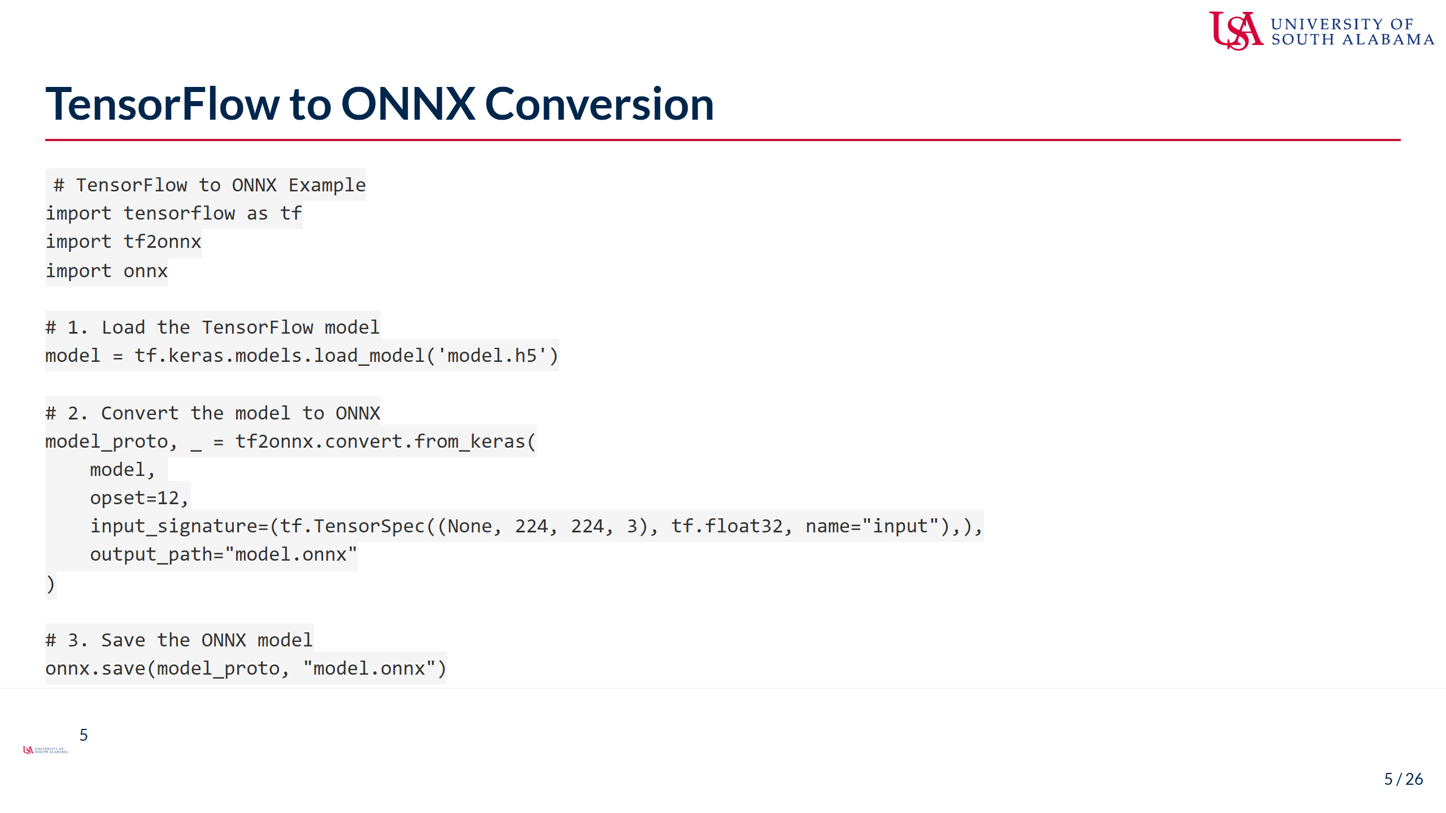
Notes:
Speaker Notes: - For TensorFlow models, we typically use the tf2onnx package - The conversion process starts with loading your TensorFlow/Keras model - We then use tf2onnx.convert.from_keras to convert the model - Key parameters include: - opset: ONNX version (similar to PyTorch's opset_version) - input_signature: defines input tensor shapes and types - output_path: where to save the converted model - Note that TensorFlow uses NHWC format (batch, height, width, channels) while ONNX typically uses NCHW - The converter handles this transformation automatically in most cases - The command-line alternative is often simpler for SavedModel format models - Common challenges include custom operations, control flow, and dynamic shapes - For TensorFlow Lite models, a different conversion path might be necessary

Slide 6
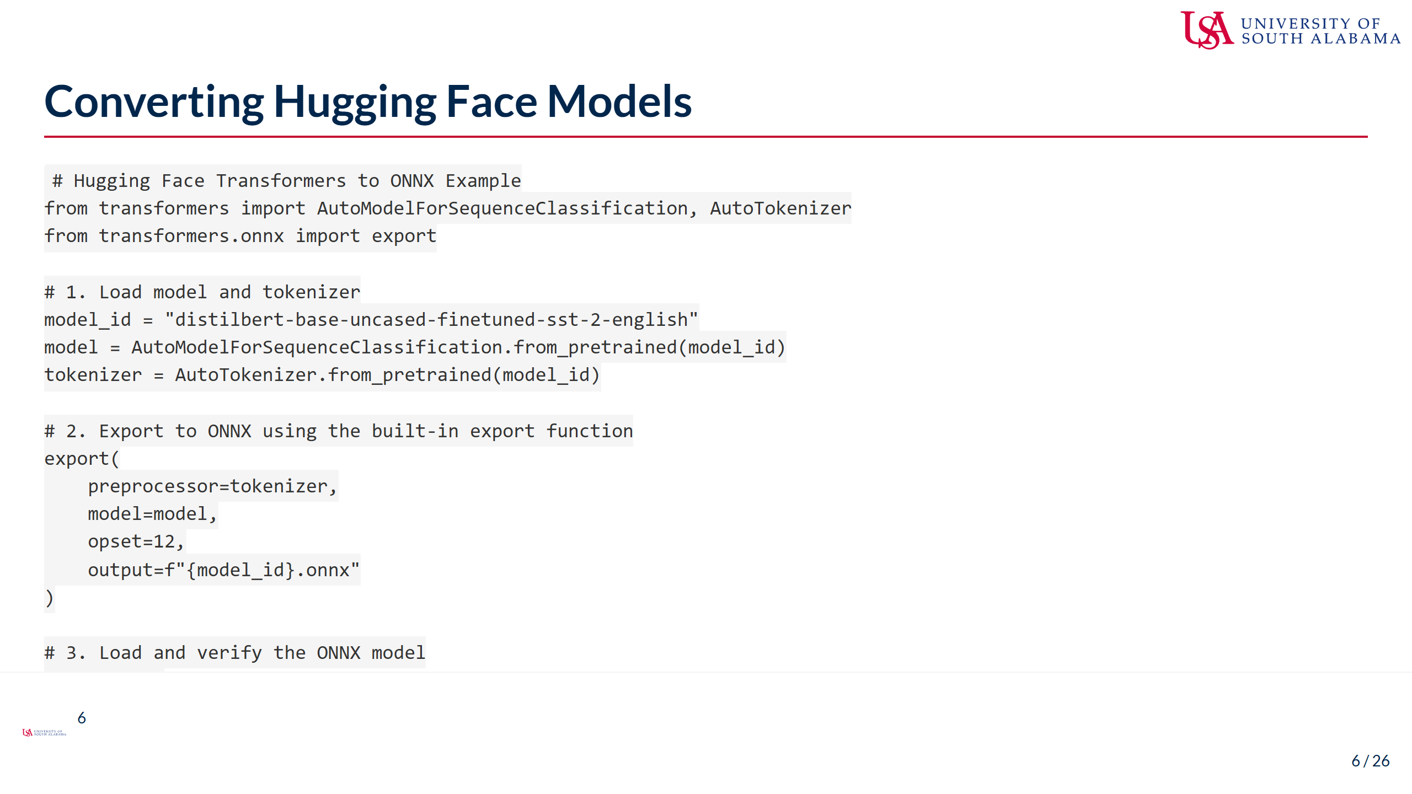
Notes:
Speaker Notes: - Hugging Face provides direct ONNX export support for its Transformers models - The transformers.onnx.export function handles the conversion process - This function manages the complexity of exporting transformer architectures correctly - We provide both the model and tokenizer to ensure proper input preprocessing - The export function creates a pipeline that includes both tokenization and inference - This approach works for a wide range of models: BERT, GPT, T5, etc. - For transformer models, proper handling of dynamic sequence lengths is crucial - The resulting ONNX model can be directly loaded into ONNX Runtime - This simplified workflow hides many of the complexities of transformer architecture - For more control, you can export just the model component without preprocessing - Common pitfalls include missing the preprocessing steps or incorrect sequence handling

Slide 7
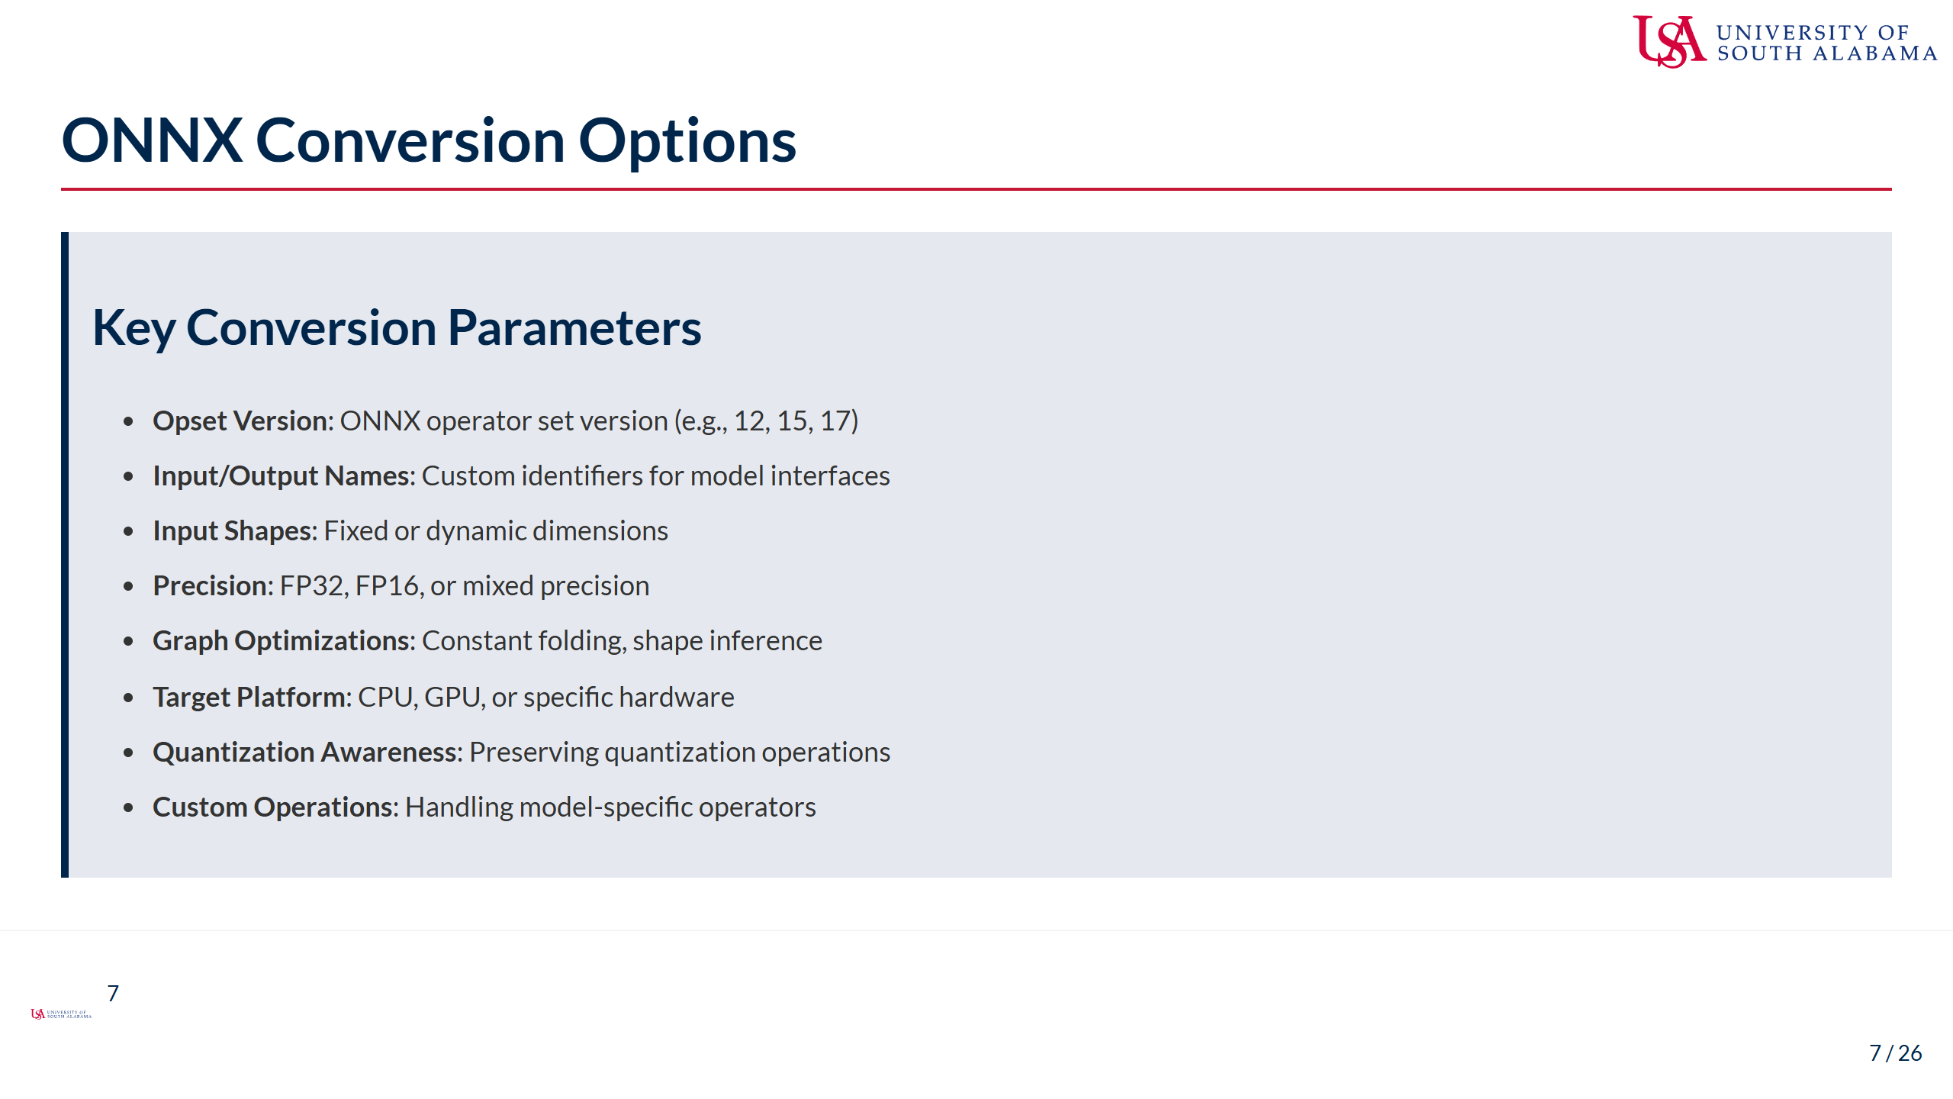
Notes:
Speaker Notes: - These parameters significantly impact the quality and compatibility of your converted model - Opset version determines which ONNX operators are available - newer isn't always better - Lower opset versions have wider hardware support but fewer operations - Input/output naming helps with model inspection and debugging - Dynamic input shapes (using None or -1) allow flexibility but may reduce optimization potential - Precision selection affects both model size and inference speed - FP16 can be significantly faster on compatible hardware, but with some accuracy loss - Graph optimizations like constant folding can greatly improve inference speed - Target platform may affect how operations are represented - Quantization awareness is critical if you're working with quantized models - Custom operations need special handling - either through conversion to standard ops or custom implementations - Always check the documentation for your specific framework's conversion tool

Slide 8
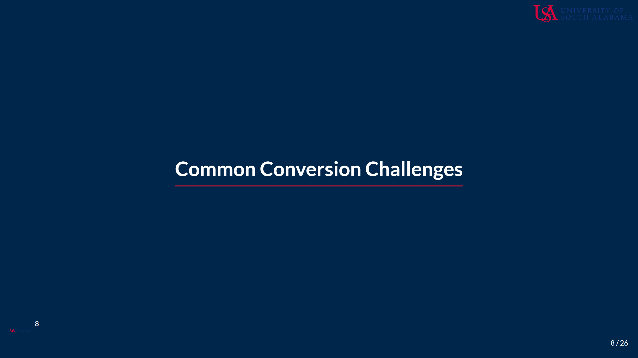
Notes:
Speaker Notes: - In this section, we'll discuss the common challenges you'll face when converting models to ONNX - Converting a model is rarely as straightforward as the basic examples suggest - Modern deep learning models often include operations or structures that don't map cleanly to ONNX - Understanding these challenges helps you troubleshoot conversion issues - We'll look at both framework-specific and general conversion problems - Most importantly, I'll show you strategies for addressing these challenges

Slide 9
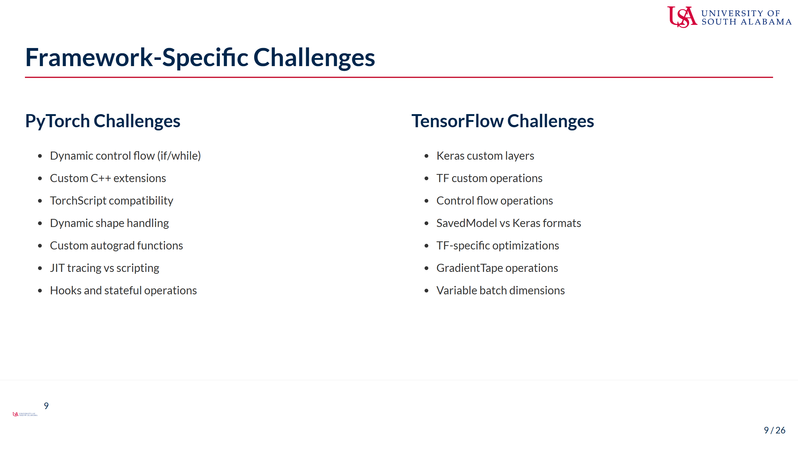
Notes:
Speaker Notes: - Each framework has its own set of conversion challenges stemming from their architectural differences - PyTorch challenges often involve its dynamic nature: - Control flow within models (if/else statements, loops) may not export cleanly - Custom C++ extensions need special handling or reimplementation - Dynamic shapes can be particularly problematic without proper tracing - PyTorch's flexible autograd doesn't always translate to static graphs - JIT tracing captures a single execution path, potentially missing branches - TensorFlow challenges tend to relate to its abstractions: - Custom Keras layers need careful implementation to be convertible - TensorFlow-specific optimizations may not have ONNX equivalents - The distinction between SavedModel and Keras format affects conversion - Variable dimensions require explicit handling during export - The key is to recognize these issues early in your model development process - Design your models with export compatibility in mind when targeting edge deployment

Slide 10
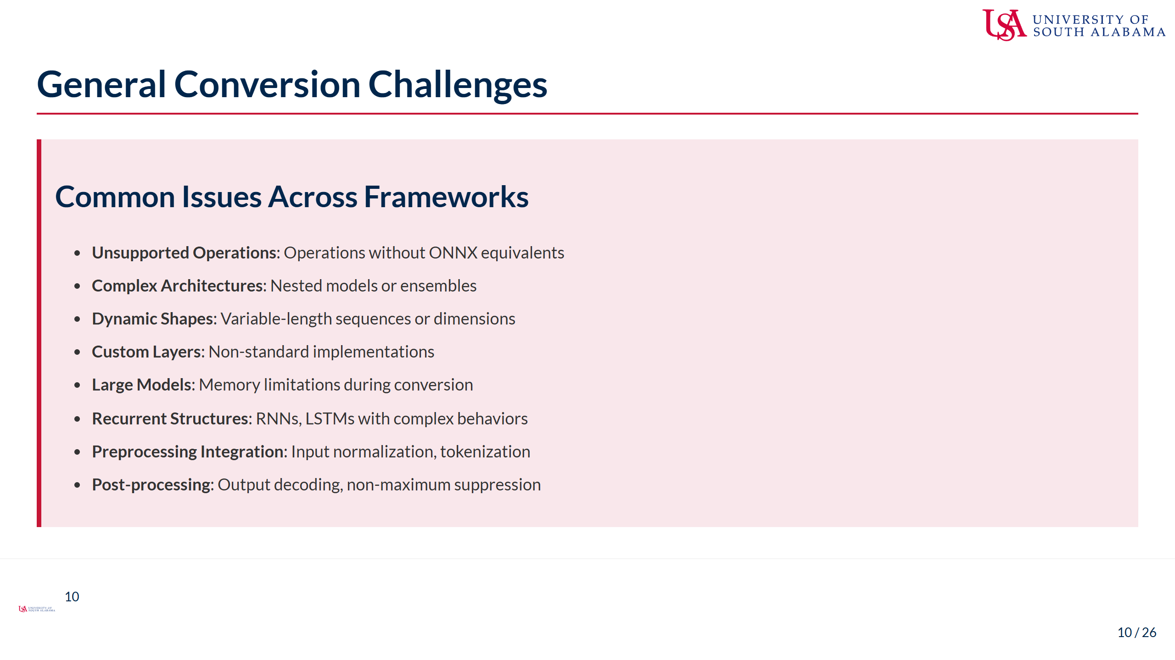
Notes:
Speaker Notes: - These challenges appear regardless of which framework you're converting from - Unsupported operations are among the most common issues - not everything has an ONNX equivalent - Complex architectures like model ensembles may need to be exported as separate models - Dynamic shapes are particularly challenging for edge deployment where static shapes are often preferred - Custom layers typically need reimplementation or conversion to a sequence of standard operations - Memory limitations during conversion can be severe - large models may require special handling - Recurrent structures like LSTMs can have framework-specific behaviors that don't translate cleanly - Preprocessing and post-processing steps are often overlooked but critical for correct inference - For example, image normalization or text tokenization should be consistent between training and deployment - Non-maximum suppression for object detection is particularly problematic to convert - Understanding these challenges helps you design more portable models from the start - You'll encounter these issues repeatedly throughout the course, so developing strategies is essential

Slide 11
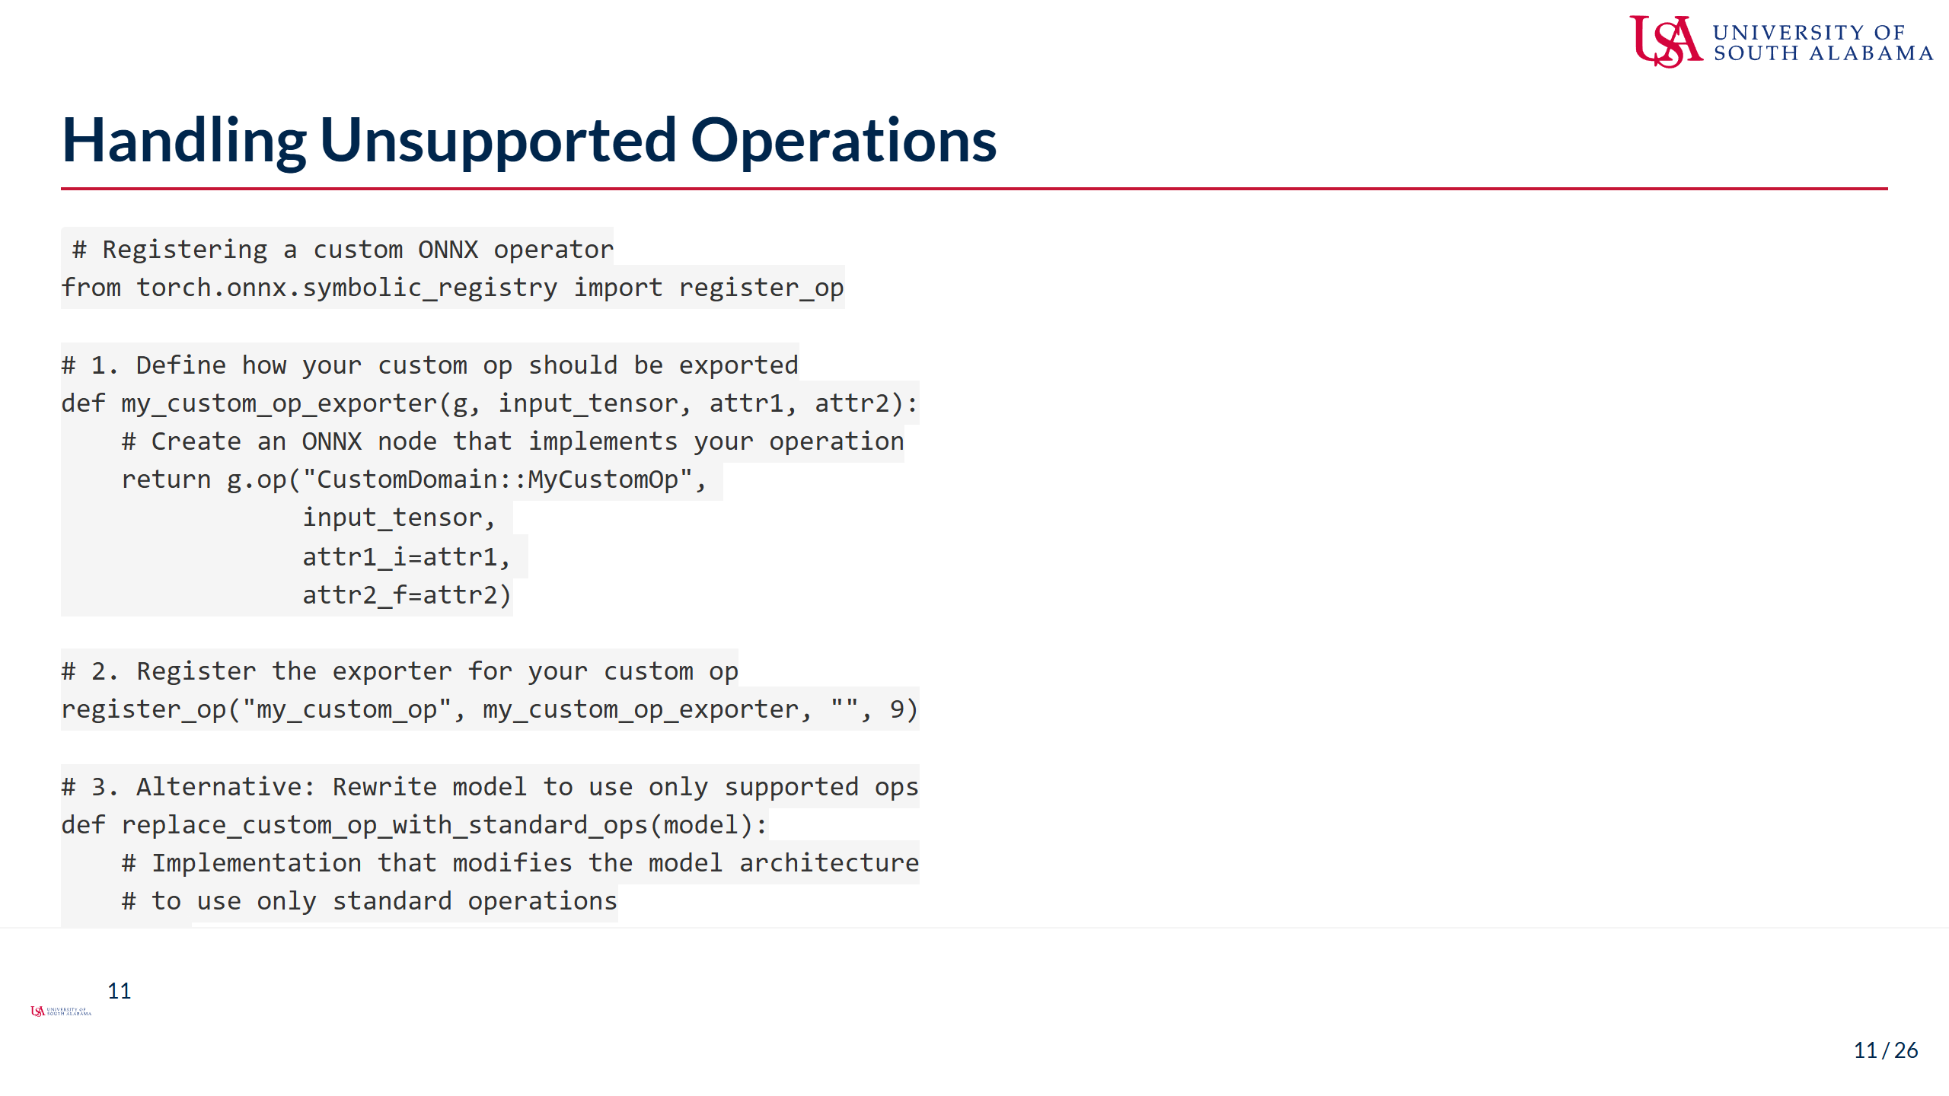
Notes:
Speaker Notes: - There are two main approaches to handling unsupported operations - First approach: Register custom operators with the ONNX conversion system - This requires defining how your operation maps to ONNX primitives - You need to specify the operation's domain, name, and attributes - This is framework-specific - the example shows PyTorch's approach - Be aware that custom ops may require special runtime support - Second approach: Rewrite your model to avoid custom operations - Replace custom ops with equivalent sequences of standard operations - This might require reimplementing layers or changing model architecture - More portable but can be labor-intensive - A third option (not shown) is to separate your model at the unsupported operation - Export what you can to ONNX and handle the rest in your application code - This creates a more complex deployment pipeline but might be necessary - The best strategy depends on your specific use case and deployment constraints - For edge AI, favoring standard operations usually leads to better portability

Slide 12
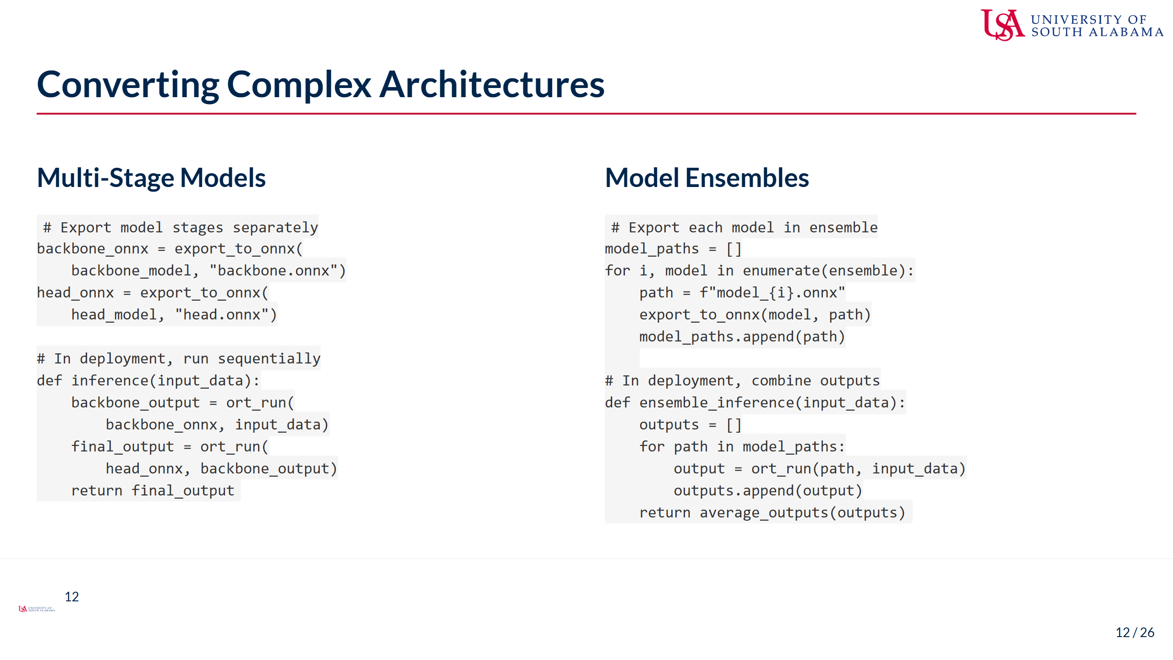
Notes:
Speaker Notes: - Complex architectures often require decomposition into simpler components - For multi-stage models (like encoder-decoder architectures): - Export each stage as a separate ONNX model - In your deployment code, connect the stages by passing outputs as inputs - This approach simplifies conversion and can improve memory usage - You may lose some optimization opportunities across model boundaries - For ensemble models: - Export each ensemble member separately - Implement the ensembling logic (averaging, voting, etc.) in your application - This gives you flexibility in how you deploy and schedule ensemble inference - The same principle applies to other complex architectures: - GANs (generator and discriminator) - Teacher-student models - Multi-modal models with separate processing paths - This approach lets you optimize each component separately - It also allows for more flexible deployment options (like skipping components when not needed) - Remember that the connections between components need careful handling for correct results

Slide 13
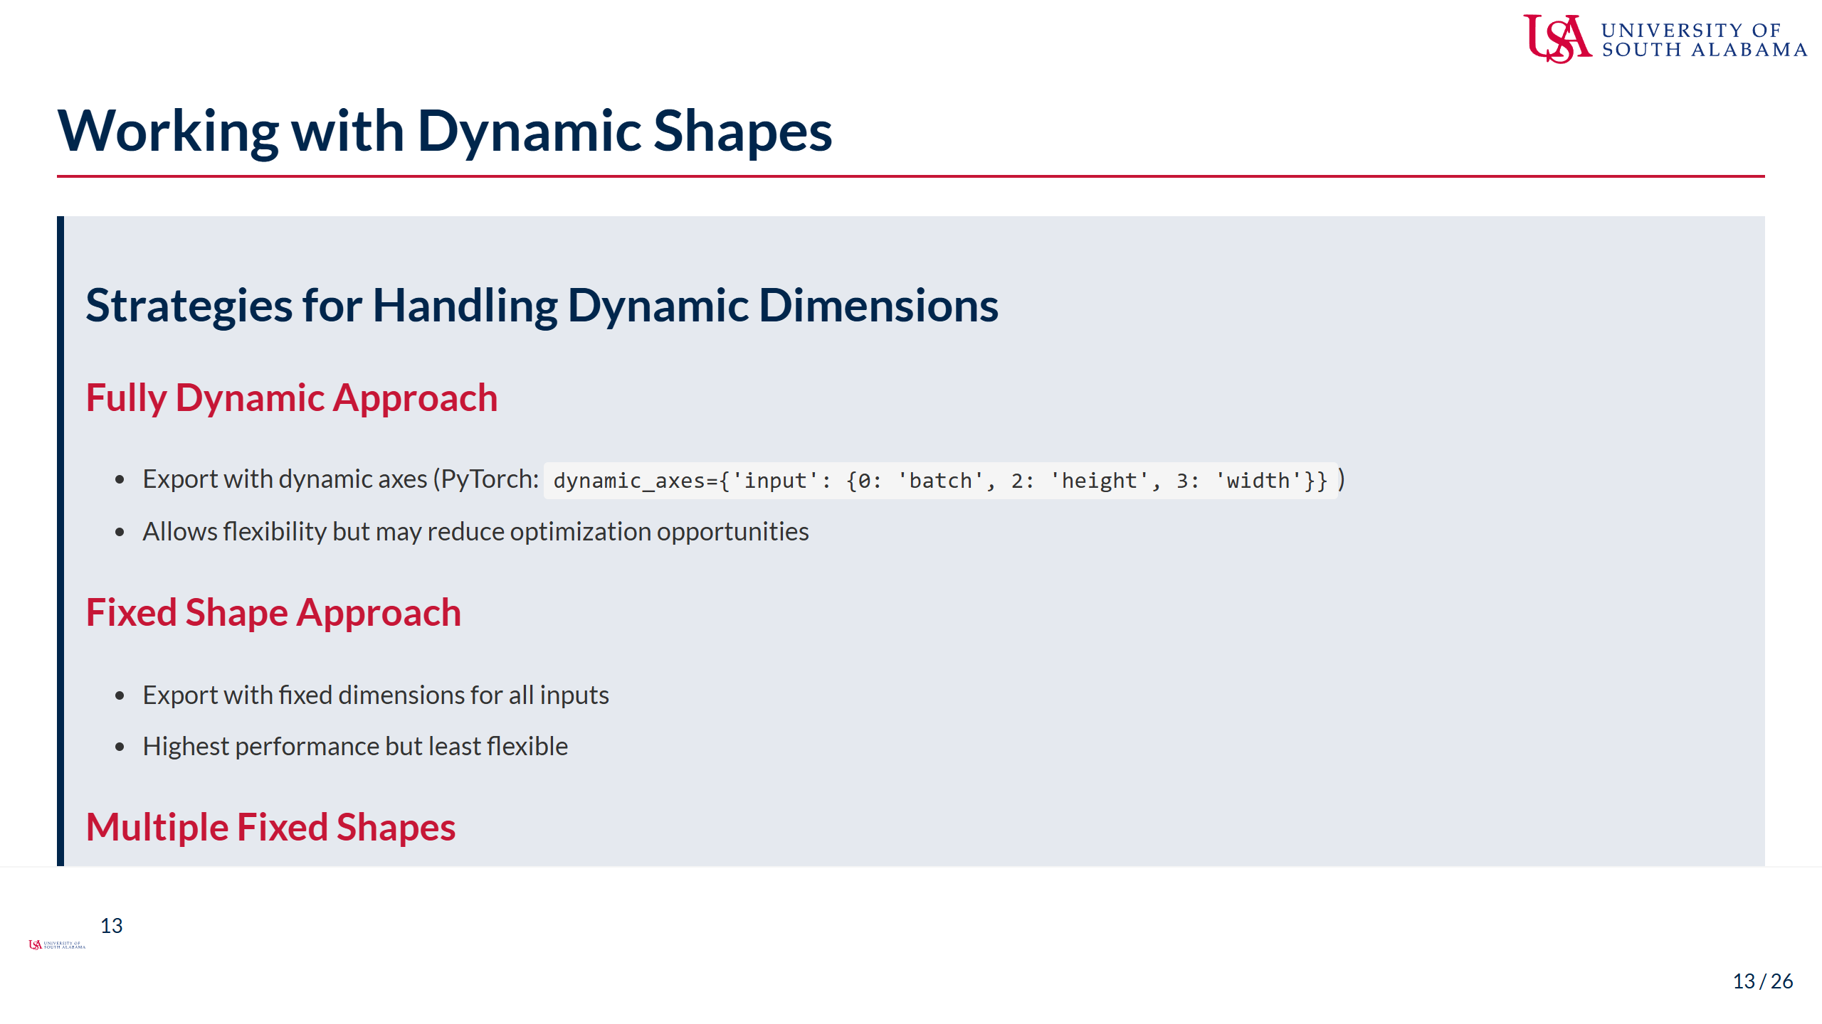
Notes:
Speaker Notes: - Dynamic shapes are particularly challenging for edge deployment - The fully dynamic approach: - Most flexible, accepting varying input dimensions - Some optimizations may not be applicable with dynamic shapes - Runtime performance can be lower than with fixed shapes - Memory allocation may be less efficient - The fixed shape approach: - Highest optimization potential and most predictable performance - Input must be resized/padded to match the expected shape - This is often preferred for edge deployment with severe constraints - Multiple fixed shapes strategy: - Export several versions optimized for different shapes - Select the appropriate model based on incoming data - Increases deployment complexity but can balance flexibility and performance - Shape optimization: - Analyze your actual deployment data to identify common shapes - Choose fixed shapes that minimize preprocessing overhead - Consider batching strategy for throughput vs. latency tradeoffs - For edge AI, fixed shapes often win on performance, but consider your specific requirements

Slide 14

Notes:
Speaker Notes: - Now that we've covered conversion, let's understand what's inside an ONNX model - ONNX models follow a specific graph-based structure that's important to understand - This knowledge helps with debugging conversion issues and optimizing models - We'll explore the key components that make up an ONNX model file - Understanding this structure is critical for effective model optimization later

Slide 15
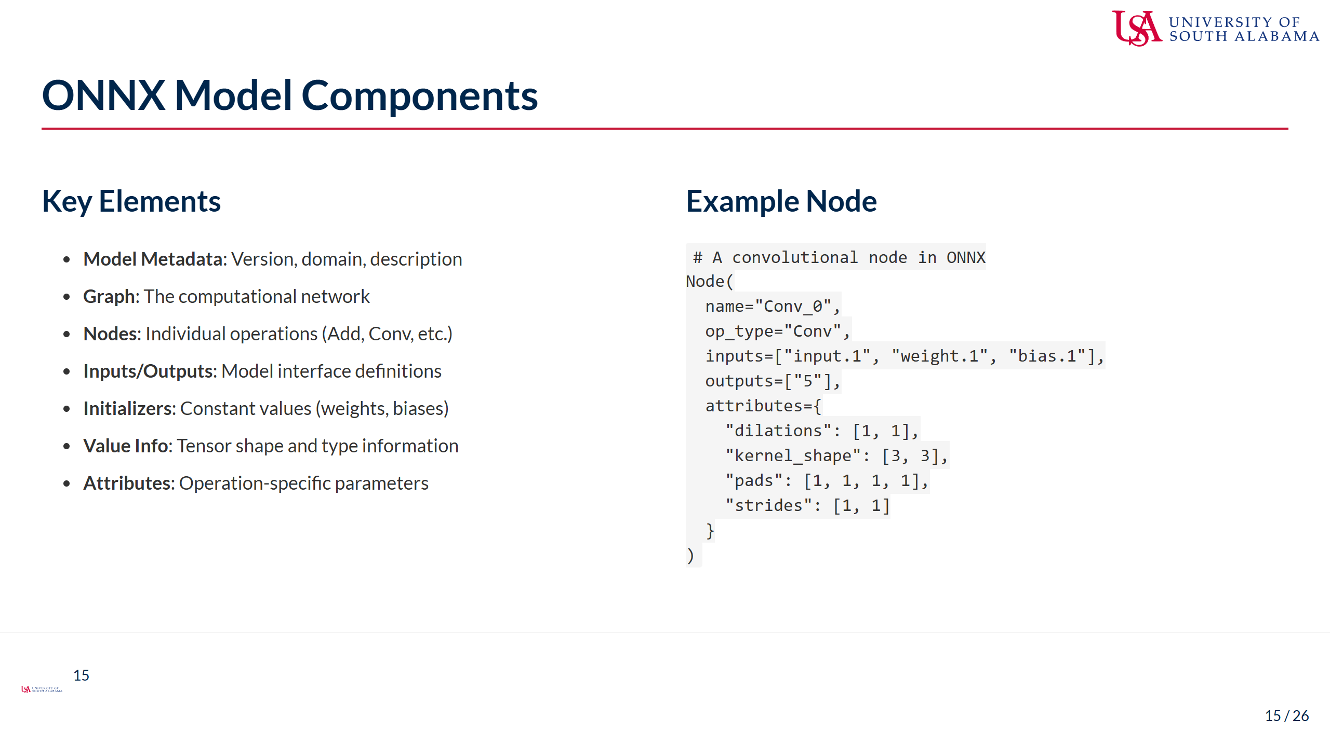
Notes:
Speaker Notes: - The ONNX format represents models as computational graphs - Model metadata includes version information and documentation - The graph is the core component containing the model's computational structure - Nodes represent individual operations like convolutions, activations, etc. - Each node has: - Inputs: Tensors consumed by the operation - Outputs: Tensors produced by the operation - Attributes: Parameters that configure the operation - Initializers are constant values like weights and biases - Value info provides shape and type information for intermediate tensors - The example shows a typical convolutional node: - Takes input, weight, and bias tensors - Specifies kernel size, padding, and stride through attributes - Produces a single output tensor - This graph structure is what makes ONNX models portable across frameworks - It's also what enables framework-independent optimizations

Slide 16
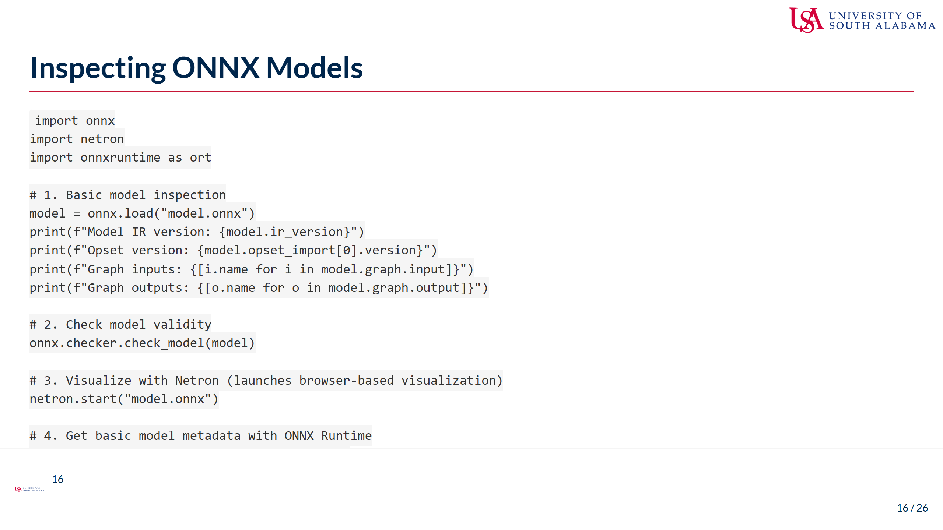
Notes:
Speaker Notes: - These tools help you understand and debug your converted ONNX models - The onnx package provides programmatic access to model structure - You can check IR version, opset version, and input/output configuration - The onnx.checker.check_model function validates model correctness - Netron is an essential visual tool for ONNX model inspection - It provides an interactive visualization of the model graph - You can explore nodes, connections, and tensor shapes - Highly recommended for understanding complex models - ONNX Runtime provides information from the execution perspective - Shows what the inference engine actually sees - Helps verify input/output specifications - When debugging conversion issues: 1. First check model validity with onnx.checker 2. Visualize with Netron to identify problematic operations 3. Examine input/output specifications with ONNX Runtime 4. Trace the error back to the original framework model - These inspection capabilities are crucial for the optimization work we'll do later

Slide 17
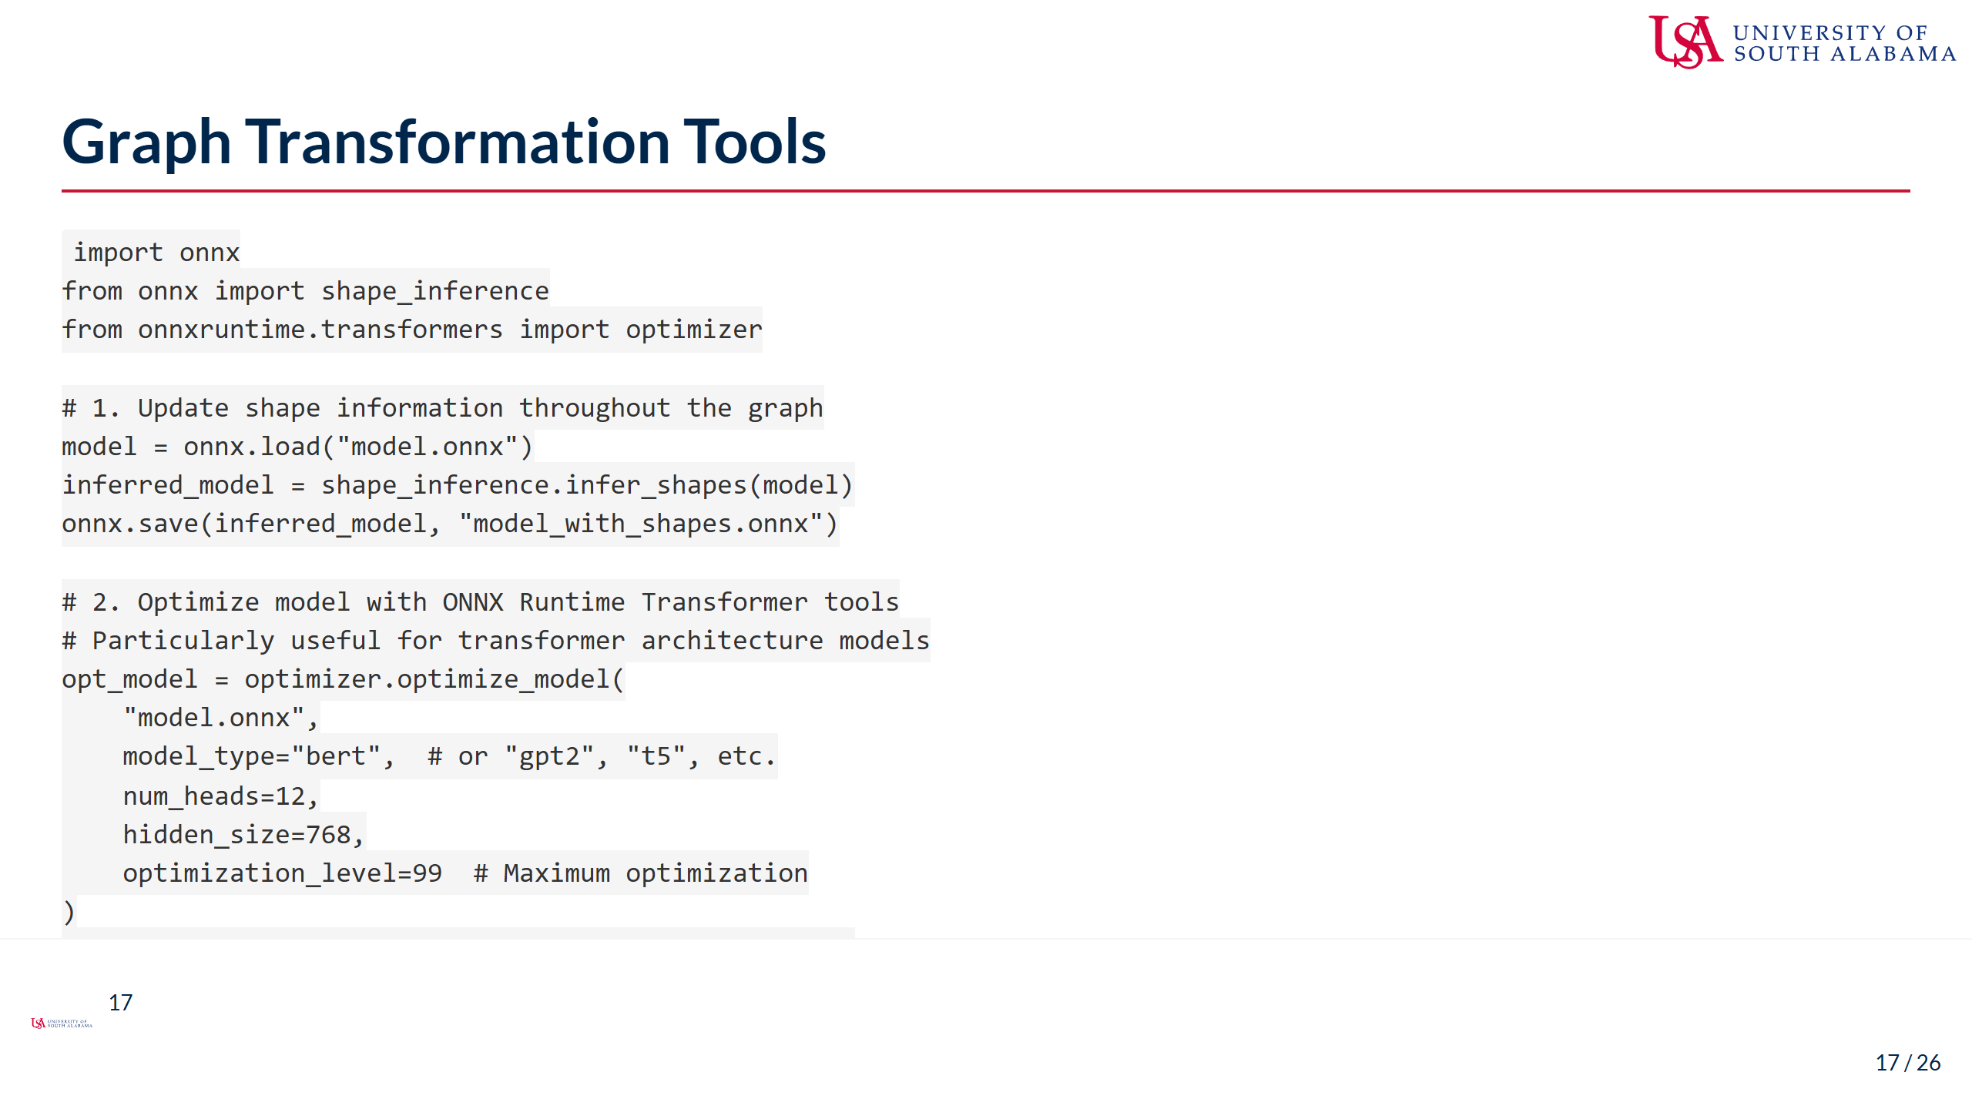
Notes:
Speaker Notes: - ONNX provides tools for graph transformation and optimization - Shape inference is crucial for optimization: - Propagates shape information through the entire graph - Helps identify potential issues with tensor shapes - Enables downstream optimizations that depend on shape information - ONNX Runtime Transformer tools offer specialized optimizations: - Designed specifically for transformer architectures like BERT, GPT-2 - Implements optimizations like attention fusion and layer normalization fusion - Can dramatically improve performance of transformer models - Requires model-specific parameters like hidden size and number of heads - The onnxoptimizer package provides general graph optimizations: - Constant folding: pre-computing constant expressions - Node elimination: removing redundant operations - Node fusion: combining operations for better performance - For edge deployment, these optimizations are often essential - We'll dive deeper into optimization in Week 2, but basic optimizations should be applied during conversion - Different optimization tools have different strengths - often applying multiple tools in sequence yields best results

Slide 18

Notes:
Speaker Notes: - Now that we can convert models, we need to assess their performance - Profiling helps us identify bottlenecks and optimization opportunities - For edge deployment, understanding resource requirements is critical - We'll look at tools and techniques for measuring model performance - This assessment informs both optimization strategies and deployment decisions - The metrics we gather now will serve as our baseline for measuring optimization success

Slide 19
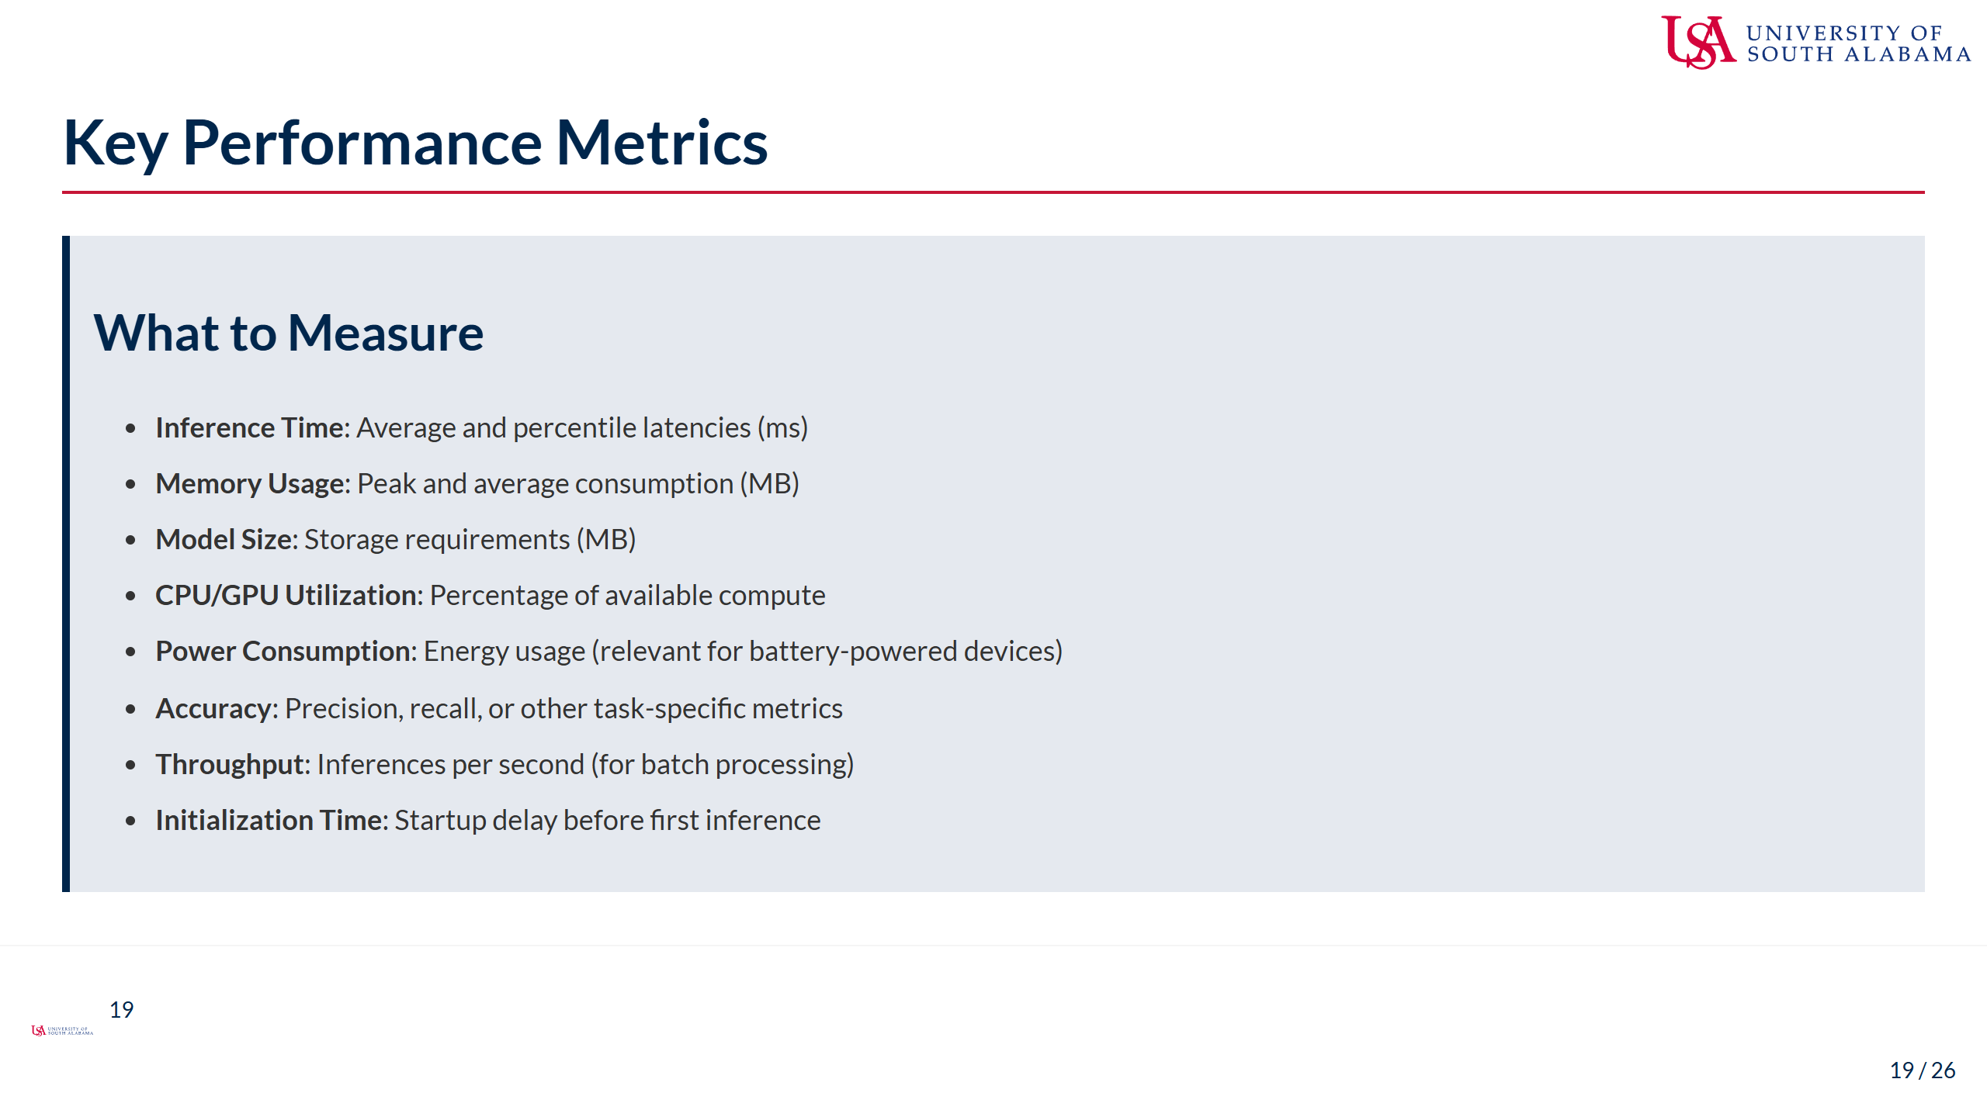
Notes:
Speaker Notes: - These metrics help evaluate a model's suitability for edge deployment - Inference time is usually the primary concern: - Measure both average latency and percentiles (p95, p99) - Latency variations can be as important as the average - Background processes can cause unexpected spikes - Memory usage dictates hardware requirements: - Peak memory determines minimum device specifications - Excessive memory usage can cause device throttling or crashes - Model size affects storage and loading time: - Particularly important for embedded systems with limited storage - Also affects over-the-air update feasibility - CPU/GPU utilization shows efficiency: - High utilization may indicate good hardware use - But can also cause thermal throttling on mobile devices - Power consumption is critical for battery-powered devices: - Directly impacts device runtime - Often overlooked but can be a deployment blocker - Accuracy vs efficiency tradeoff must be quantified: - Measure how optimizations affect model performance - Establish acceptable accuracy thresholds - For server-edge hybrid systems, throughput may matter more than latency - Initialization time can be significant for on-demand models

Slide 20
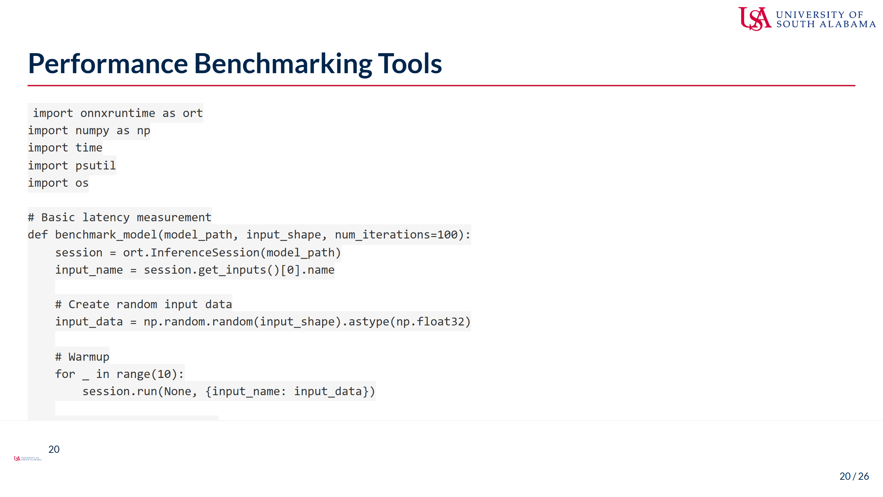
Notes:
Speaker Notes: - This code demonstrates a basic benchmarking approach for ONNX models - It measures key performance metrics like latency and memory usage - The benchmarking process includes: - Creating a session with ONNX Runtime - Generating appropriate synthetic input data - Performing warmup iterations to stabilize performance - Collecting metrics over multiple runs for statistical validity - Important benchmarking practices shown here: - Always include warmup runs to avoid cold-start penalties - Measure multiple iterations to account for variability - Track both average and percentile metrics - Monitor memory usage throughout inference - Include model size as a deployment consideration - More sophisticated benchmarking would also include: - CPU/GPU utilization monitoring - Power consumption measurement (device-specific) - Thread utilization and thread-count experiments - Thermal impact assessment - For accurate results, benchmarking should be performed on target hardware - These metrics serve as your baseline for optimization efforts - Consistent benchmarking methodology is essential for valid comparisons

Slide 21
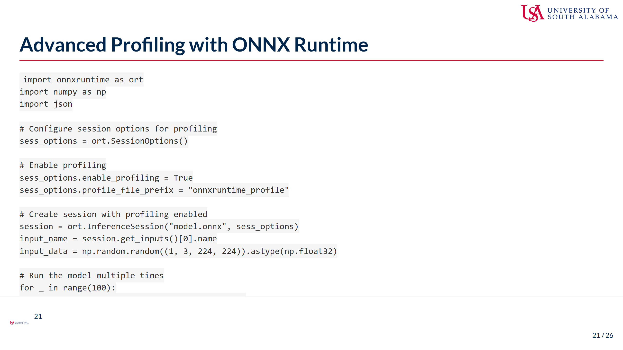
Notes:
Speaker Notes: - ONNX Runtime provides built-in profiling capabilities that go beyond basic timing - This example demonstrates how to enable and use ONNX Runtime's profiling - Key components of advanced profiling: - Enabling profiling through session options - Running the model multiple times to gather statistics - Parsing the profiling output to identify bottlenecks - Analyzing operation-level performance - The profiling output contains detailed timing for each operation in the graph - This helps identify specific bottlenecks rather than just overall latency - For example, you might discover that: - A specific convolution layer is taking 40% of inference time - Memory transfers are causing unexpected delays - Certain operations aren't being optimized as expected - This operation-level insight drives targeted optimization: - Focus efforts on the most expensive operations - Consider restructuring the model to avoid bottlenecks - Apply operation-specific optimizations - The profiling data can be visualized with tools like Chrome Tracing - For edge deployment, identifying the critical path is essential - This detailed profiling is a key step before applying the optimizations we'll learn in Week 2

Slide 22
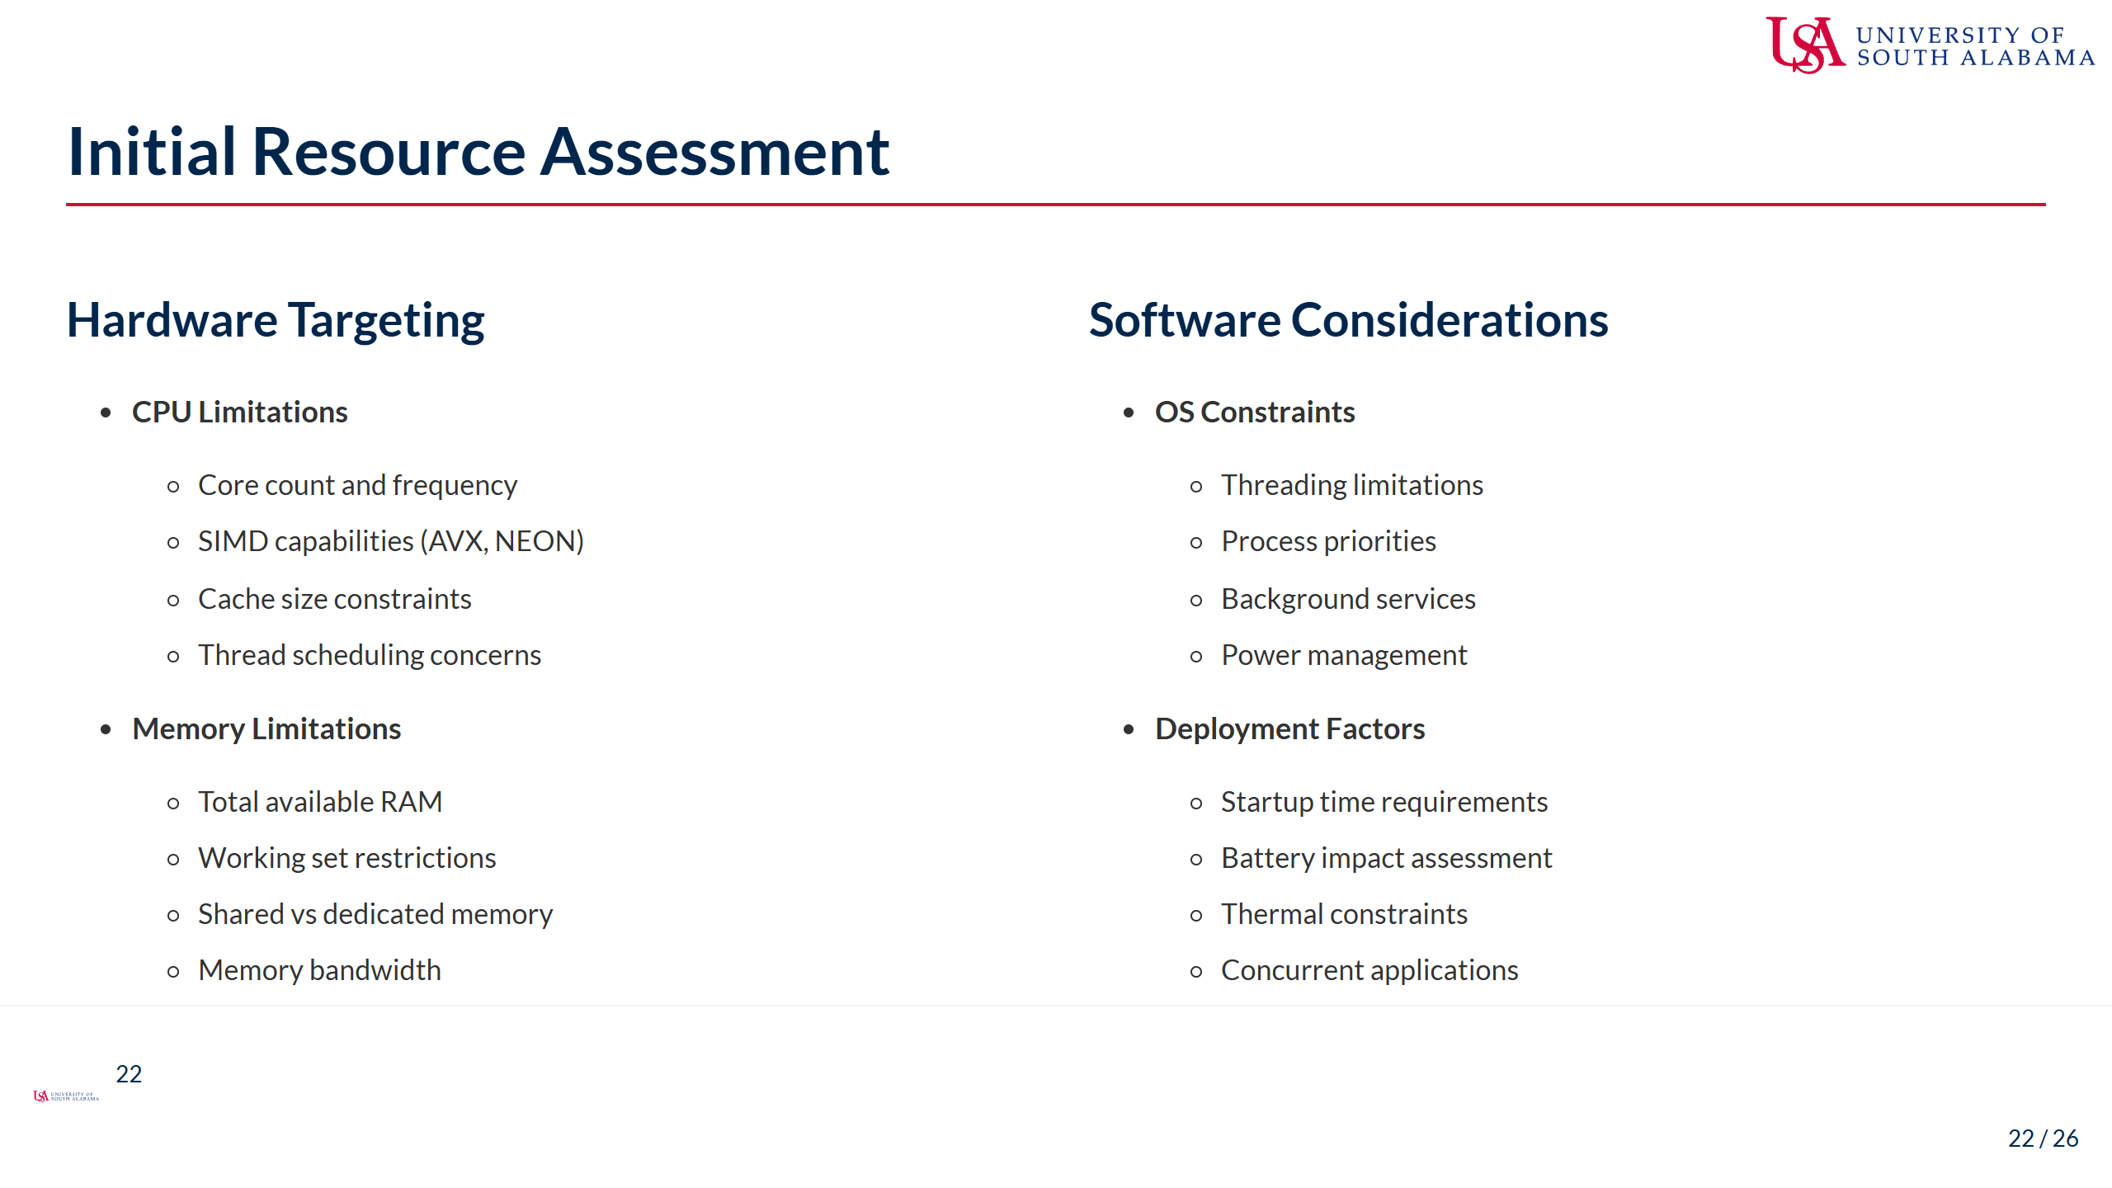
Notes:
Speaker Notes: - Resource assessment connects performance metrics to deployment constraints - CPU limitations impact model structure and optimization: - Core count affects parallelization strategy - SIMD capabilities enable vectorized operations - Cache size determines optimal tensor blocking - Thread scheduling can cause performance variability - Memory limitations define feasible model size: - Total RAM limits model size and batch size - Working set restrictions may require model splitting - Shared memory systems (like mobile GPUs) have unique constraints - Memory bandwidth often becomes the bottleneck, not compute - OS constraints affect deployment architecture: - Threading limitations may restrict parallelization - Process priorities impact real-world performance - Background services can cause unexpected interference - Power management may throttle performance - Other deployment factors to consider: - Startup time requirements may affect model loading approach - Battery impact determines feasibility for mobile deployment - Thermal constraints can cause unexpected throttling - Concurrent applications may compete for resources - This assessment defines your optimization targets for the coming weeks - The goal is to identify the specific constraints that will guide your optimization efforts

Slide 23
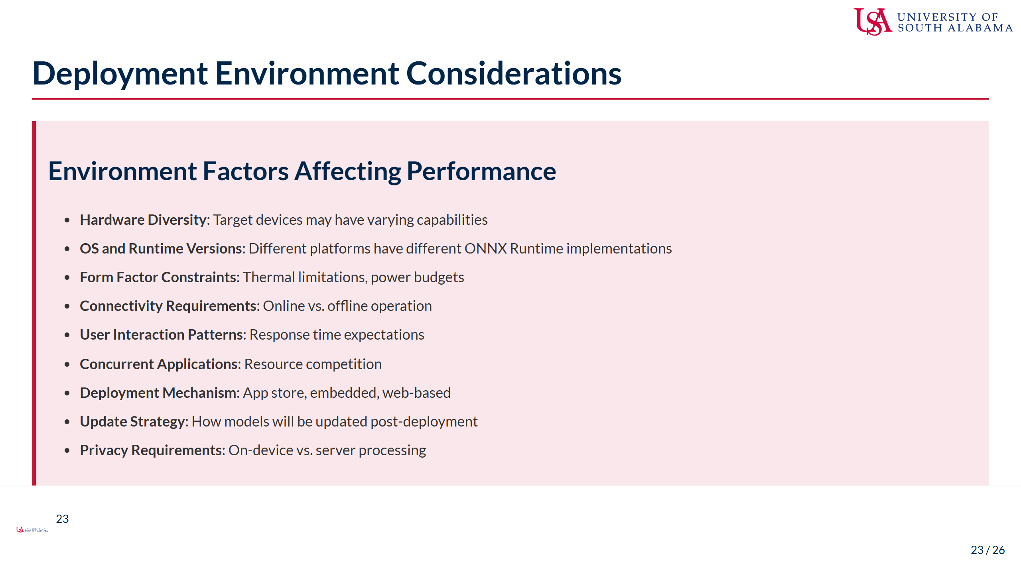
Notes:
Speaker Notes: - The deployment environment shapes both conversion and optimization strategies - Hardware diversity requires careful planning: - Consider the range of devices you need to support - Test on lowest-spec target hardware - Plan for graceful degradation or tiered models - OS and runtime variations affect compatibility: - ONNX Runtime versions may have different optimizations - Some operations may behave differently across platforms - Test on representative environments - Physical constraints impact sustained performance: - Mobile devices throttle under thermal pressure - Power considerations limit complexity for battery-powered devices - Form factor may restrict memory or cooling - User experience sets performance requirements: - Interactive applications typically need sub-100ms responses - Batch processing may prioritize throughput over latency - Consider the full pipeline, not just model inference - Real-world device usage includes: - Multiple applications running concurrently - Variable resource availability - Unpredictable background processes - Deployment mechanism affects packaging: - App store size limits may constrain model size - Web deployment has different optimization priorities - Embedded systems may have custom runtimes - Update strategy influences model design: - How will you deliver model updates? - Is incremental learning required? - What's the update frequency? - Privacy considerations may mandate on-device processing

Slide 24
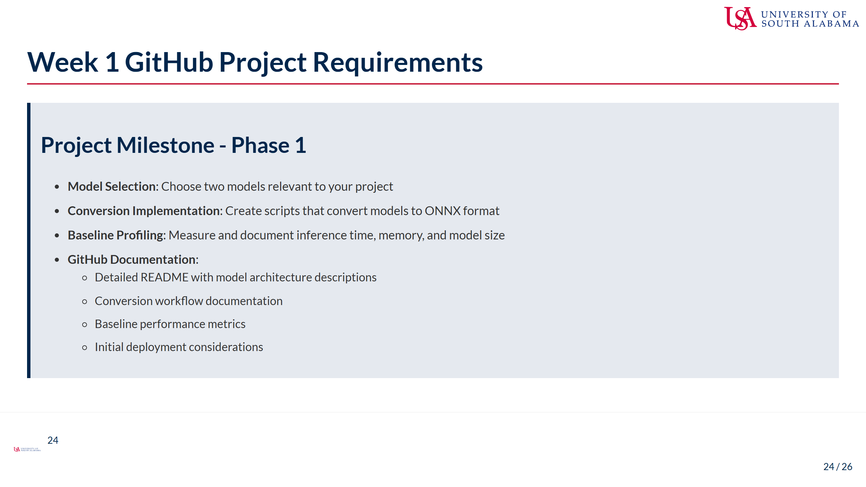
Notes:
Speaker Notes: - For this week's project milestone, you'll apply what we've learned about conversion and profiling - Start by selecting two models relevant to your chosen project area: - Choose models with different characteristics (size, architecture, etc.) - Consider models that represent different aspects of your application - Ensure they're suitable for edge deployment (not excessively large) - Implement conversion pipelines for your selected models: - Create reproducible scripts that handle the conversion process - Document any challenges and how you addressed them - Ensure the conversion preserves model accuracy - Establish baseline performance metrics: - Measure inference time, memory usage, and model size - Document the testing environment clearly - Create visualizations of key performance characteristics - Compare performance between your selected models - Set up your GitHub repository with proper documentation: - Well-structured README with project overview - Clear documentation of the conversion workflow - Baseline metrics with interpretation - Initial thoughts on deployment considerations - This milestone establishes the foundation for the optimization work in Week 2 - Focus on thorough documentation of both successes and challenges - Remember that this baseline will be your reference point for measuring optimization impact

Slide 25
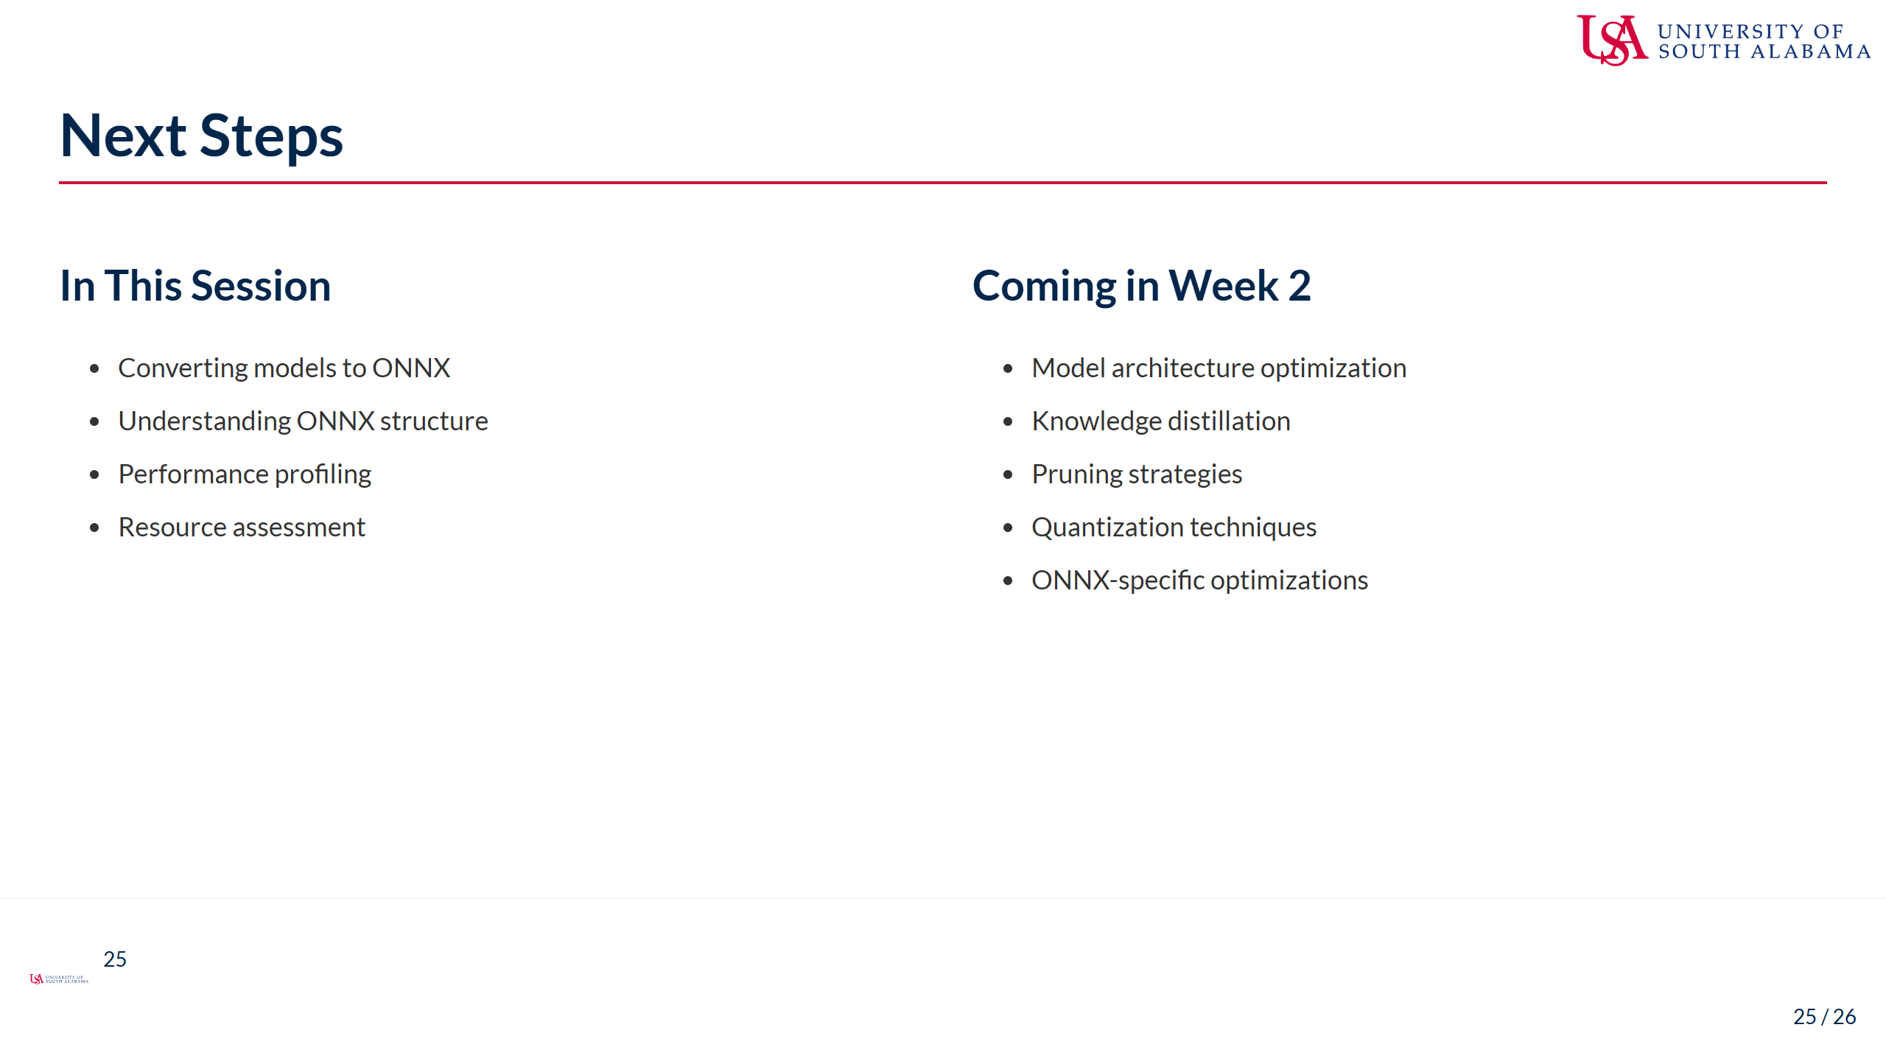
Notes:
Speaker Notes: - Today we learned the fundamental processes for converting models to ONNX format - We covered: - Converting from various frameworks (PyTorch, TensorFlow, Hugging Face) - Understanding and addressing common conversion challenges - Exploring the structure of ONNX models - Profiling models to establish performance baselines - Assessing resource requirements for deployment - These skills form the foundation for our optimization work - In Week 2, we'll build on this by exploring: - How to optimize model architectures specifically for edge deployment - Knowledge distillation to create smaller, faster models - Pruning strategies to remove unnecessary weights - Quantization techniques to reduce precision requirements - Advanced ONNX-specific optimizations - For your project work this week: - Apply the conversion techniques we discussed - Document any challenges you encounter - Establish thorough performance baselines - Begin thinking about which optimization strategies might be most effective - Remember that successful edge deployment starts with proper model conversion and assessment - Questions about any of the topics we covered today?

Slide 26

Notes:
Speaker Notes: - We've covered a lot of ground today in our exploration of model conversion and preparation - Converting models to ONNX is a critical first step in the edge deployment process - The techniques we've discussed lay the groundwork for the optimization work to come - Take time this week to experiment with converting models for your projects - Document challenges and solutions - this documentation is valuable for both your learning and project evaluation - Feel free to ask questions now or reach out via email with specific conversion challenges - In our next session, we'll begin exploring optimization techniques to improve model performance - For your project milestone, focus on establishing a solid conversion workflow and baseline metrics - Remember that these baseline measurements will be your reference point throughout the course

