Slide 1
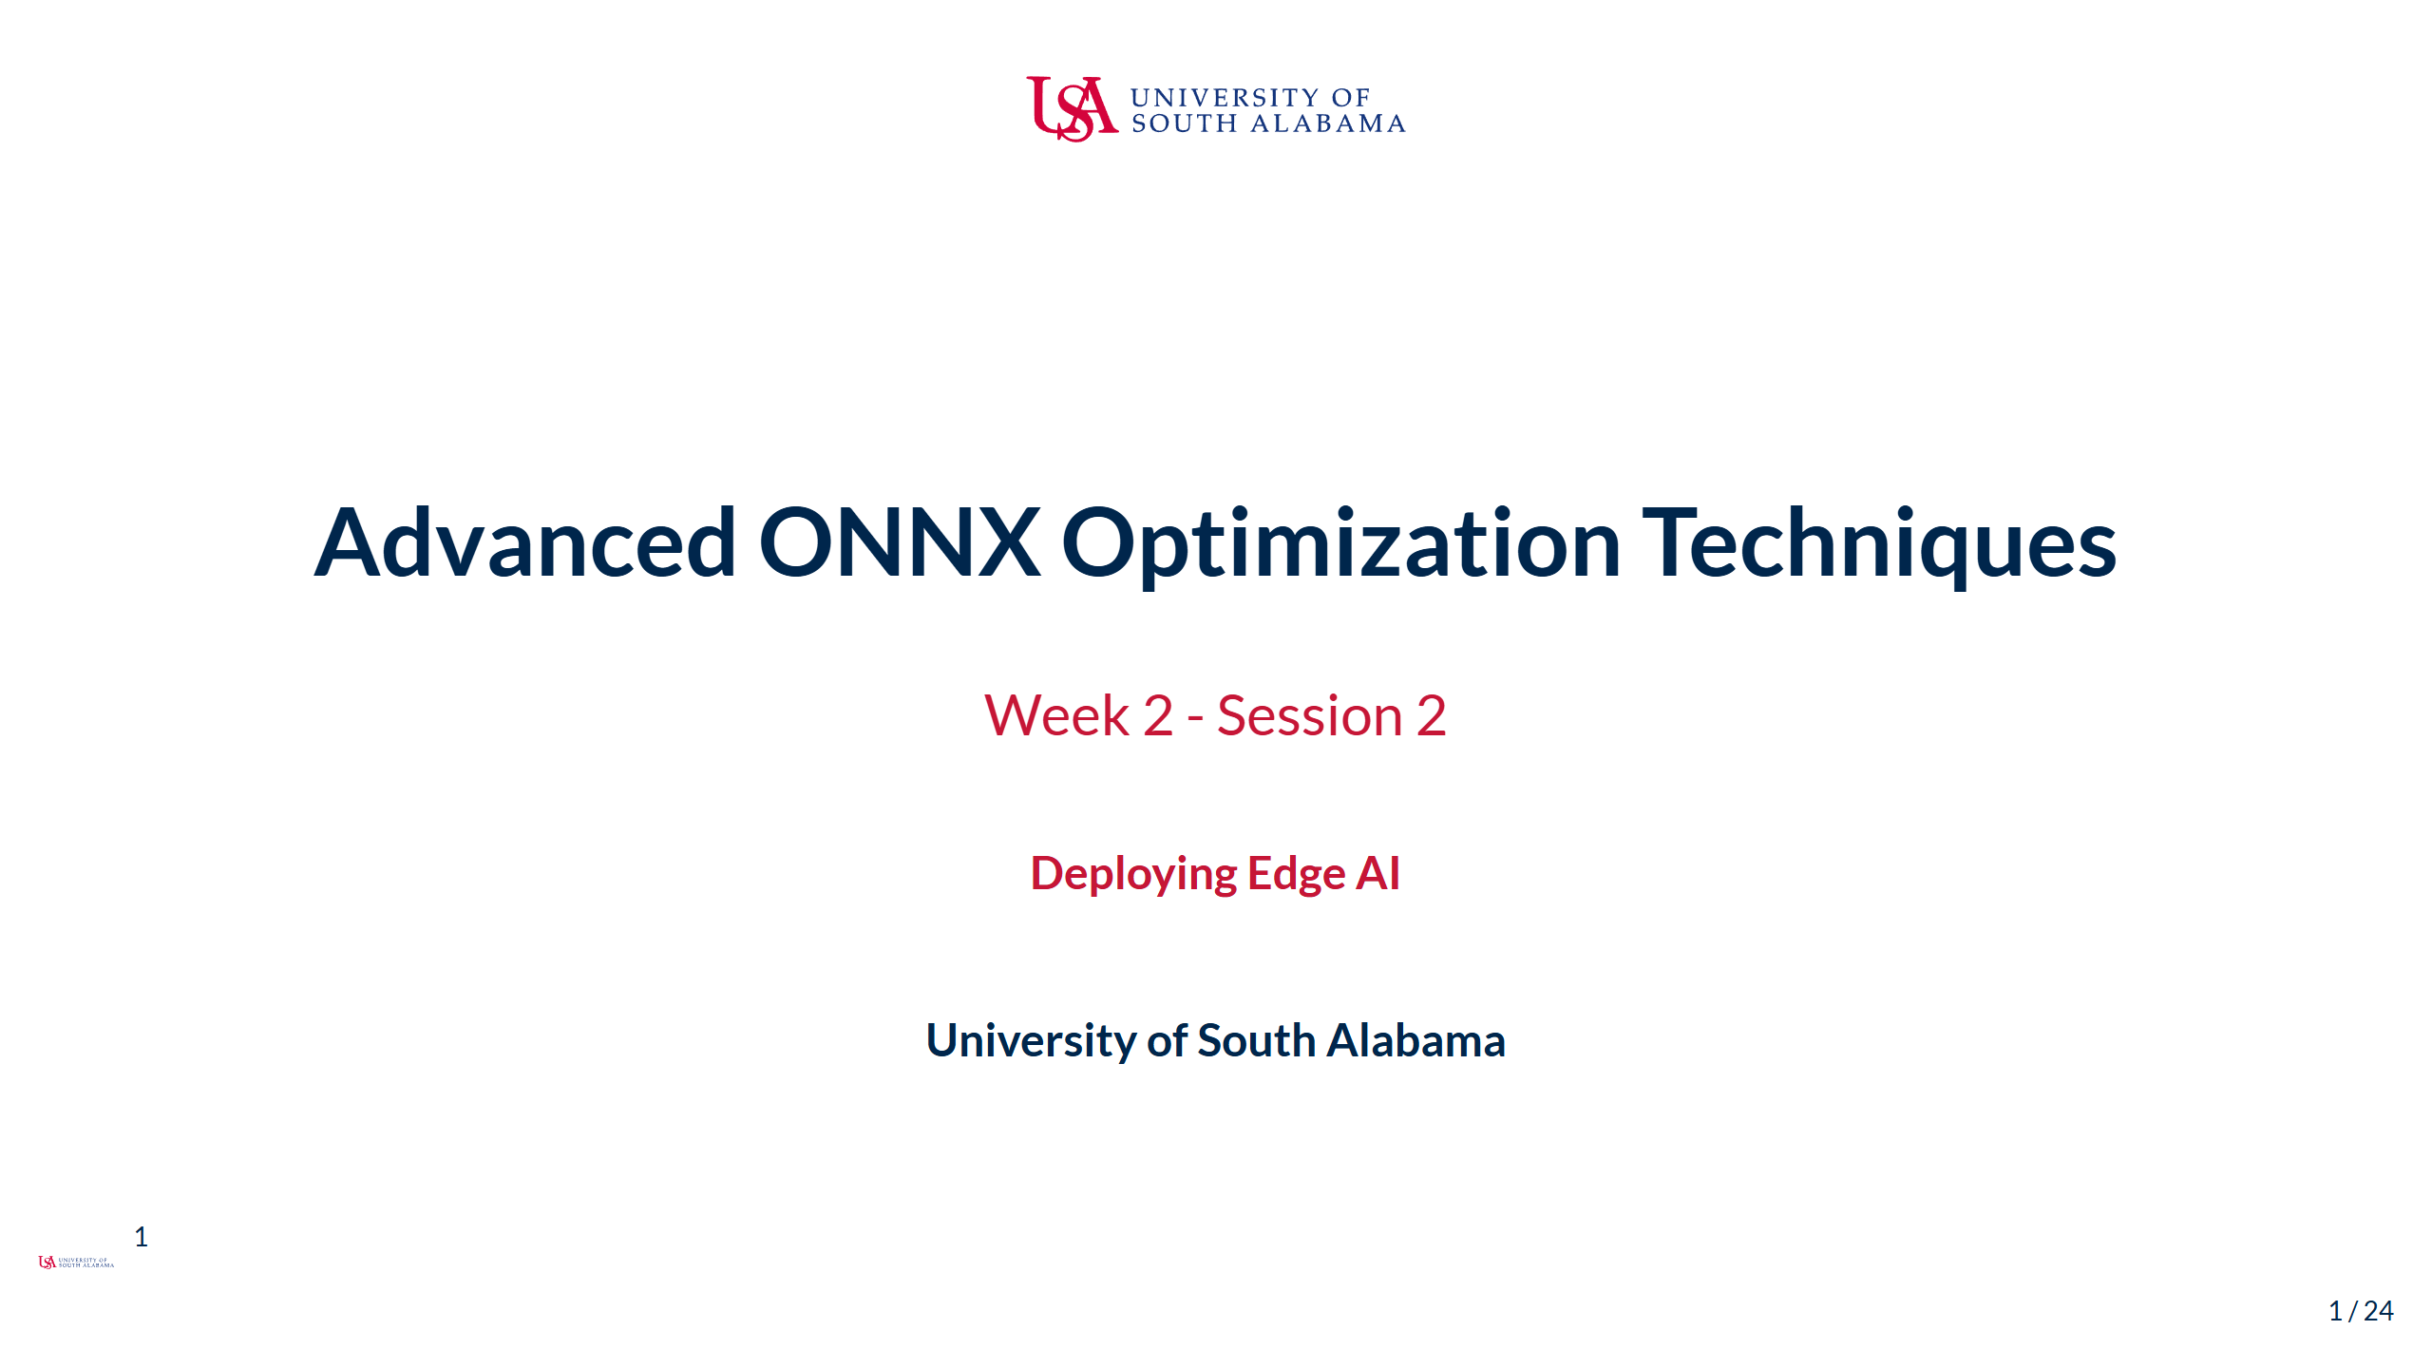
Notes:
Speaker Notes: - Welcome back to Week 2 of Deploying Edge AI - In our last session, we explored model architecture optimization techniques - Today we'll dive deep into ONNX Runtime's optimization capabilities - These optimizations can dramatically improve performance without changing model architecture - By the end of this session, you'll be able to create comprehensive optimization pipelines - We'll see how ONNX-specific optimizations complement the techniques from Session 1

Slide 2
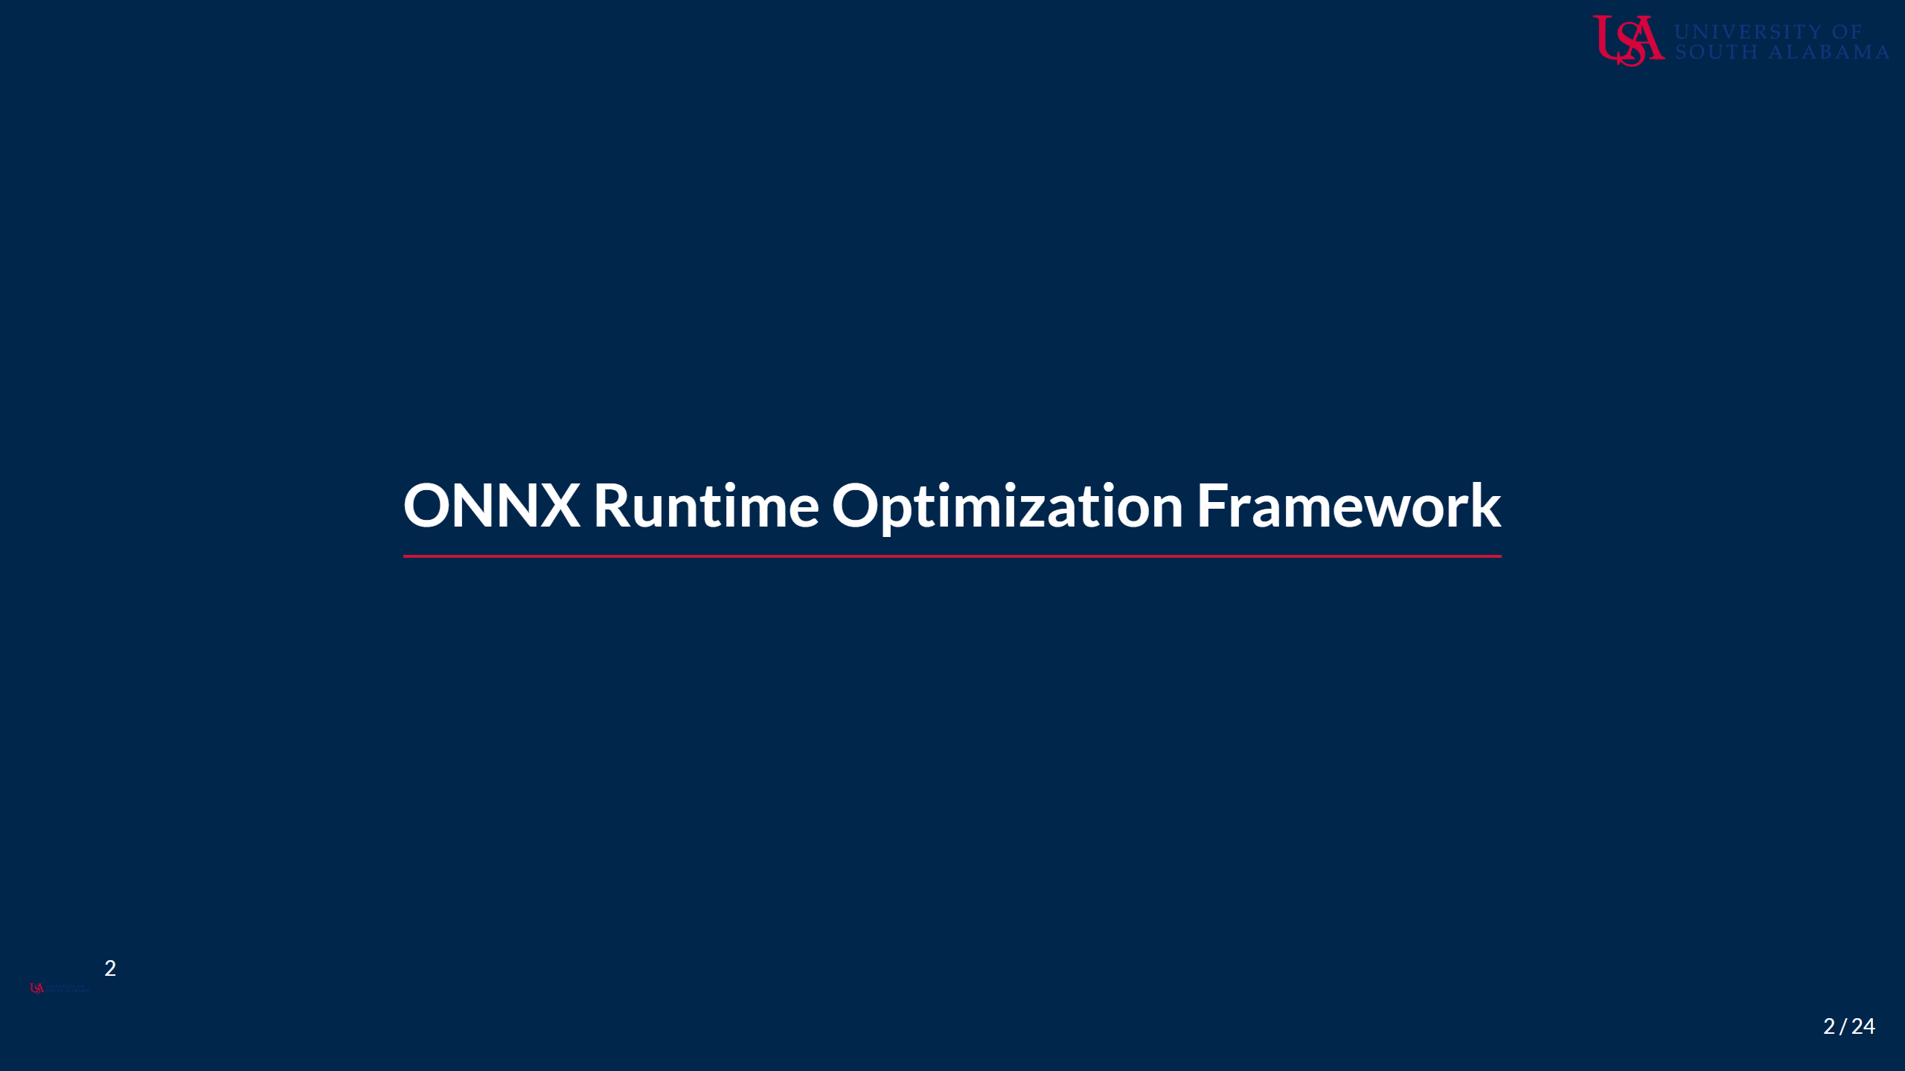
Notes:
Speaker Notes: - ONNX Runtime is more than just an inference engine - It includes a sophisticated optimization framework - These optimizations happen automatically but can be controlled and customized - Understanding how they work helps you maximize performance - We'll explore the different optimization levels and their impact

Slide 3
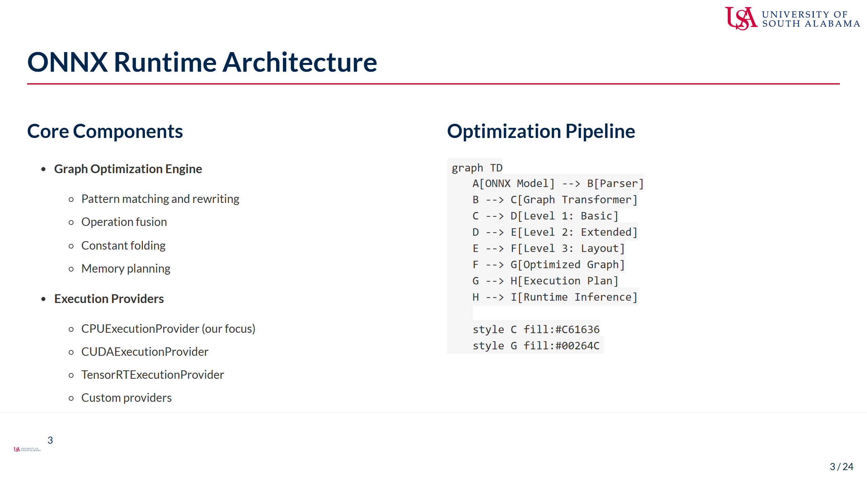
Notes:
Speaker Notes: - ONNX Runtime's architecture is designed for optimization from the ground up - The Graph Optimization Engine is the heart of the system: - Analyzes the computational graph for optimization opportunities - Applies transformations that preserve semantics but improve performance - Works at multiple levels of abstraction - Execution Providers handle the actual computation: - CPUExecutionProvider is our focus for edge deployment - Includes optimized kernels for common operations - Can leverage SIMD instructions (AVX, NEON) - Memory management is critical for edge devices: - Reduces allocation overhead through pooling - Shares buffers between operations when possible - Optimizes cache usage patterns - The optimization pipeline is multi-stage: - Each level applies increasingly aggressive optimizations - Higher levels may require more analysis time - Can be controlled through session options - Understanding this architecture helps predict optimization behavior

Slide 4
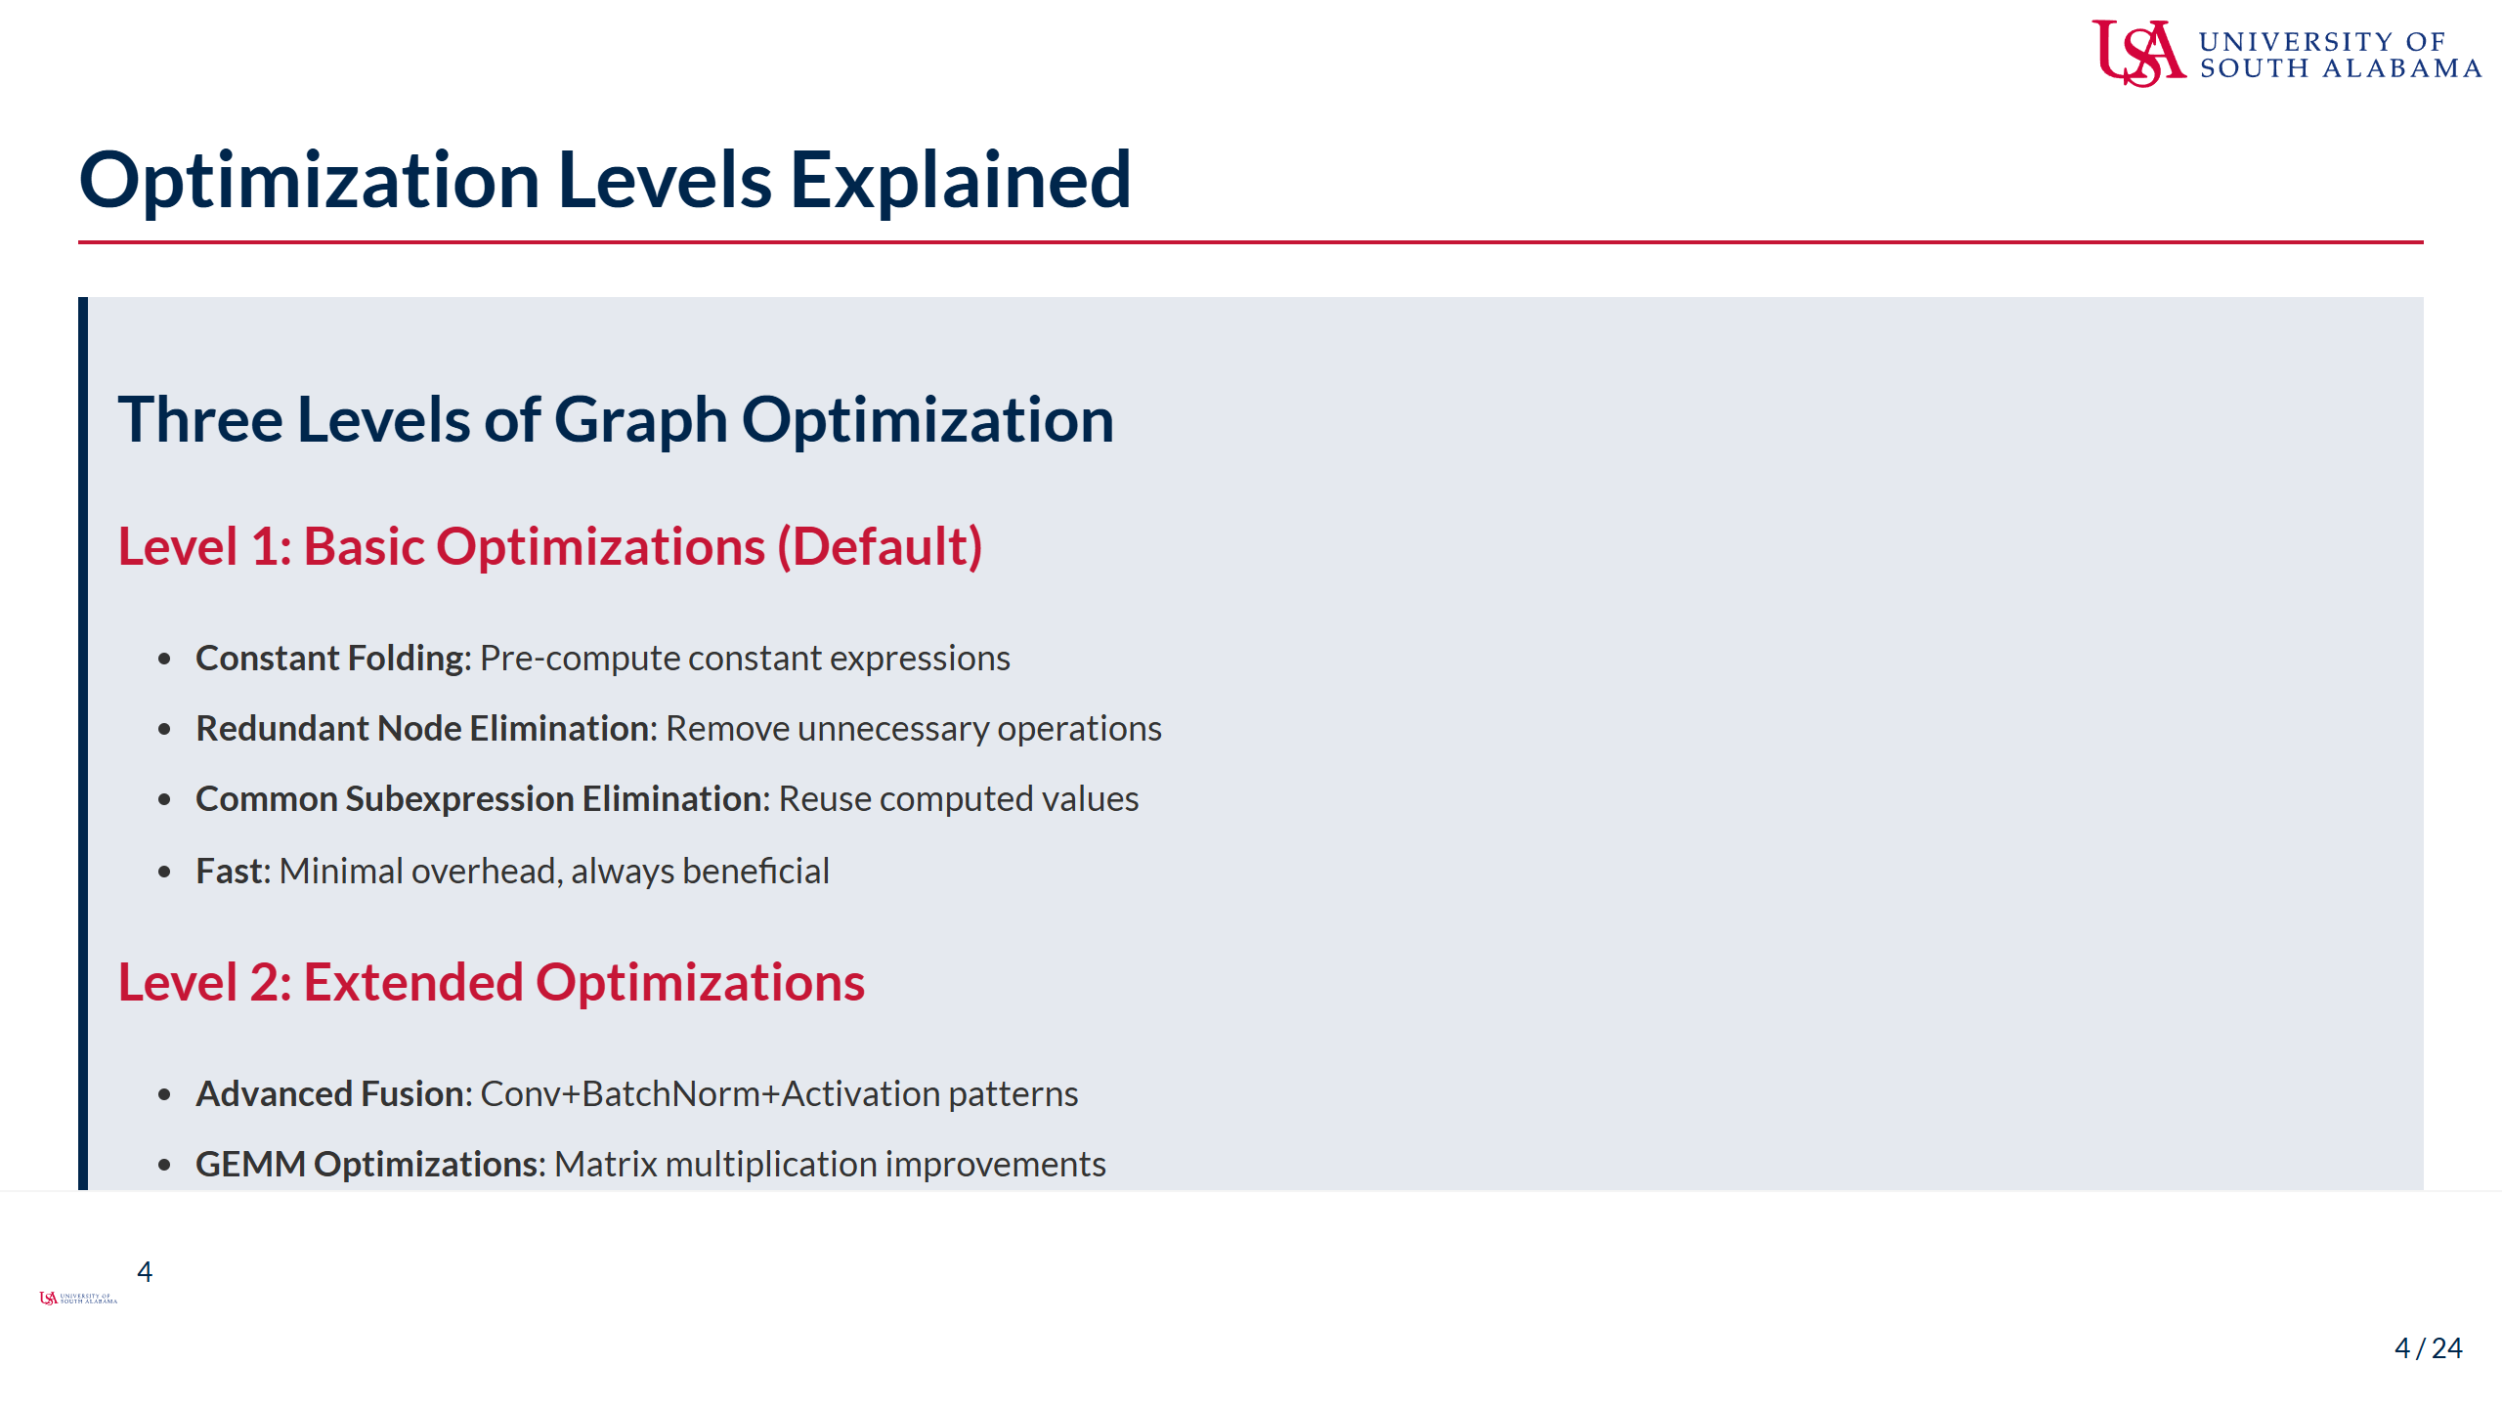
Notes:
Speaker Notes: - ONNX Runtime provides three optimization levels with different tradeoffs - Level 1 (Basic) optimizations are always recommended: - Constant folding pre-computes operations on constants - Eliminates operations that don't affect output - Reuses intermediate results when possible - Virtually no overhead, significant benefits - Level 2 (Extended) adds more sophisticated optimizations: - Fuses common patterns like Conv+BN+ReLU into single operations - Optimizes matrix multiplications for CPU cache - Special optimizations for transformer architectures - Small compilation overhead but usually worth it - Level 3 (Layout) includes aggressive transformations: - May reorder data layout for better memory access - Platform-specific optimizations - Can have significant compilation time - Best used when model won't change frequently - Choosing the right level: - Development: Level 1 for fast iteration - Testing: Level 2 for good balance - Production: Level 3 for maximum performance - Can be set per session based on requirements

Slide 5
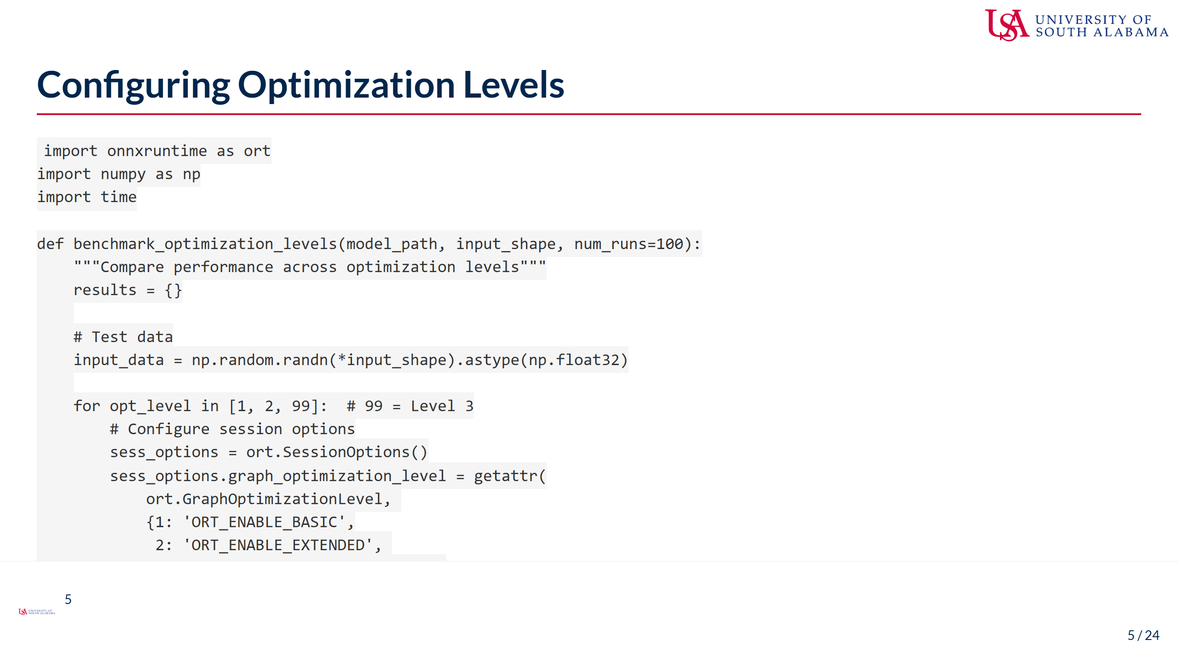
Notes:
Speaker Notes: - This code demonstrates how to configure and benchmark optimization levels - Key implementation details: - GraphOptimizationLevel enum controls optimization aggressiveness - Session creation time increases with optimization level - Inference time typically decreases with higher optimization - Important considerations: - Creation time matters for models loaded frequently - For long-running services, creation overhead is amortized - Level 3 (ORT_ENABLE_ALL) can take several seconds for large models - Benchmarking best practices shown: - Always include warmup runs - Measure both creation and inference time - Consider total time based on usage pattern - Real-world guidance: - Mobile apps: May prefer Level 1-2 for faster startup - Servers: Level 3 for maximum throughput - Edge devices: Balance based on model reload frequency - The results help make informed optimization decisions - Plot creation vs inference tradeoffs - Choose based on deployment scenario - Document the choice in your optimization pipeline

Slide 6
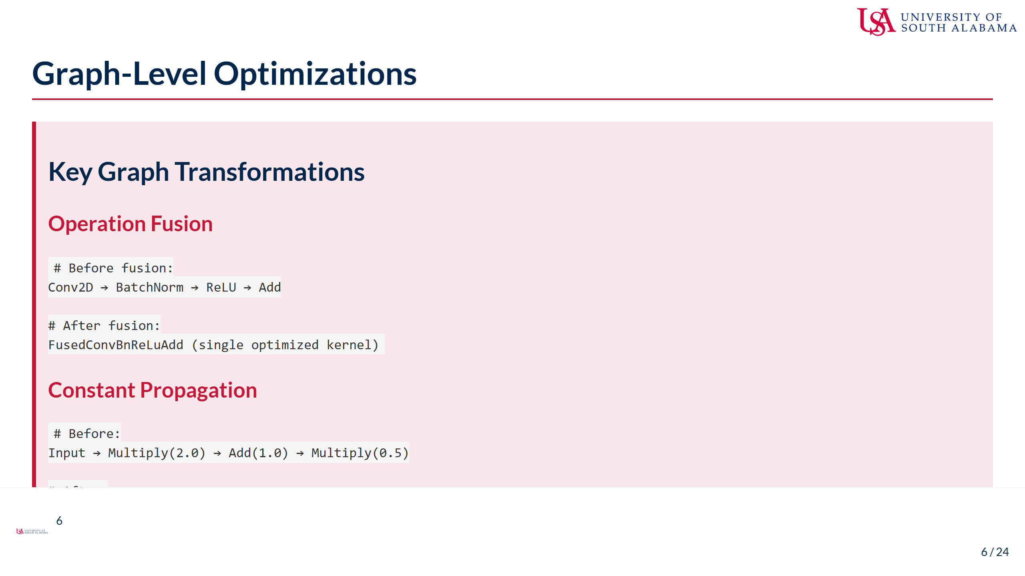
Notes:
Speaker Notes: - Graph-level optimizations transform the entire computational graph - Operation fusion is one of the most impactful optimizations: - Combines multiple operations into single kernels - Reduces memory bandwidth requirements - Eliminates intermediate tensor materialization - Common patterns like Conv+BN+ReLU are prime targets - Constant propagation simplifies the graph: - Pre-computes operations on constants - Chains of operations can often be reduced - Particularly effective after quantization - Shape inference enables further optimizations: - Removes redundant shape operations - Enables better memory planning - Allows operation-specific optimizations - Other important graph optimizations include: - Dead code elimination - Common subexpression elimination - Memory layout optimization - Algebraic simplifications - These optimizations work together synergistically - The order of application matters and is carefully designed - Understanding these helps predict optimization effectiveness

Slide 7
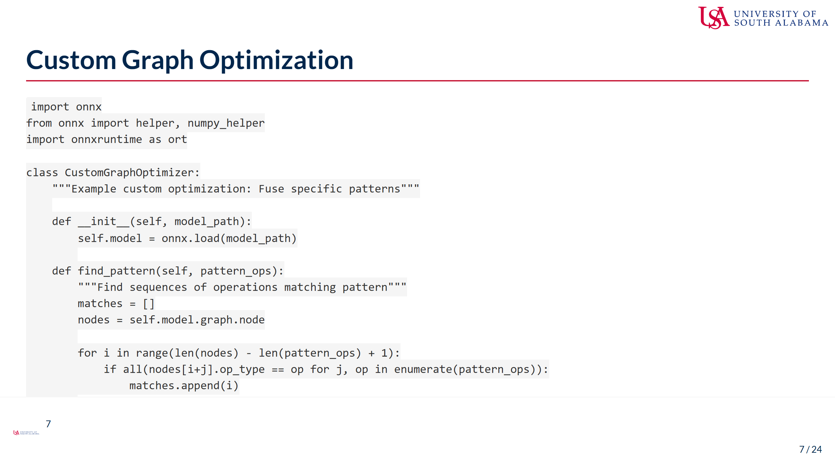
Notes:
Speaker Notes: - Sometimes you need custom optimizations beyond what ONNX Runtime provides - Custom graph optimization allows domain-specific improvements - The example shows fusing a GELU activation pattern: - GELU is common in transformers but may be split into basic ops - Fusing into single operation improves performance - Pattern matching identifies optimization opportunities - Key steps in custom optimization: 1. Load and analyze the graph structure 2. Identify patterns that can be optimized 3. Create replacement nodes or subgraphs 4. Validate the transformed model - Common custom optimization targets: - Domain-specific activation functions - Model-specific patterns - Hardware-specific transformations - Quantization-aware patterns - Best practices: - Always validate transformed models - Test numerical equivalence - Benchmark improvements - Document custom optimizations - When to use custom optimization: - ONNX Runtime doesn't optimize your specific pattern - You have domain knowledge about the model - Hardware-specific optimizations needed

Slide 8
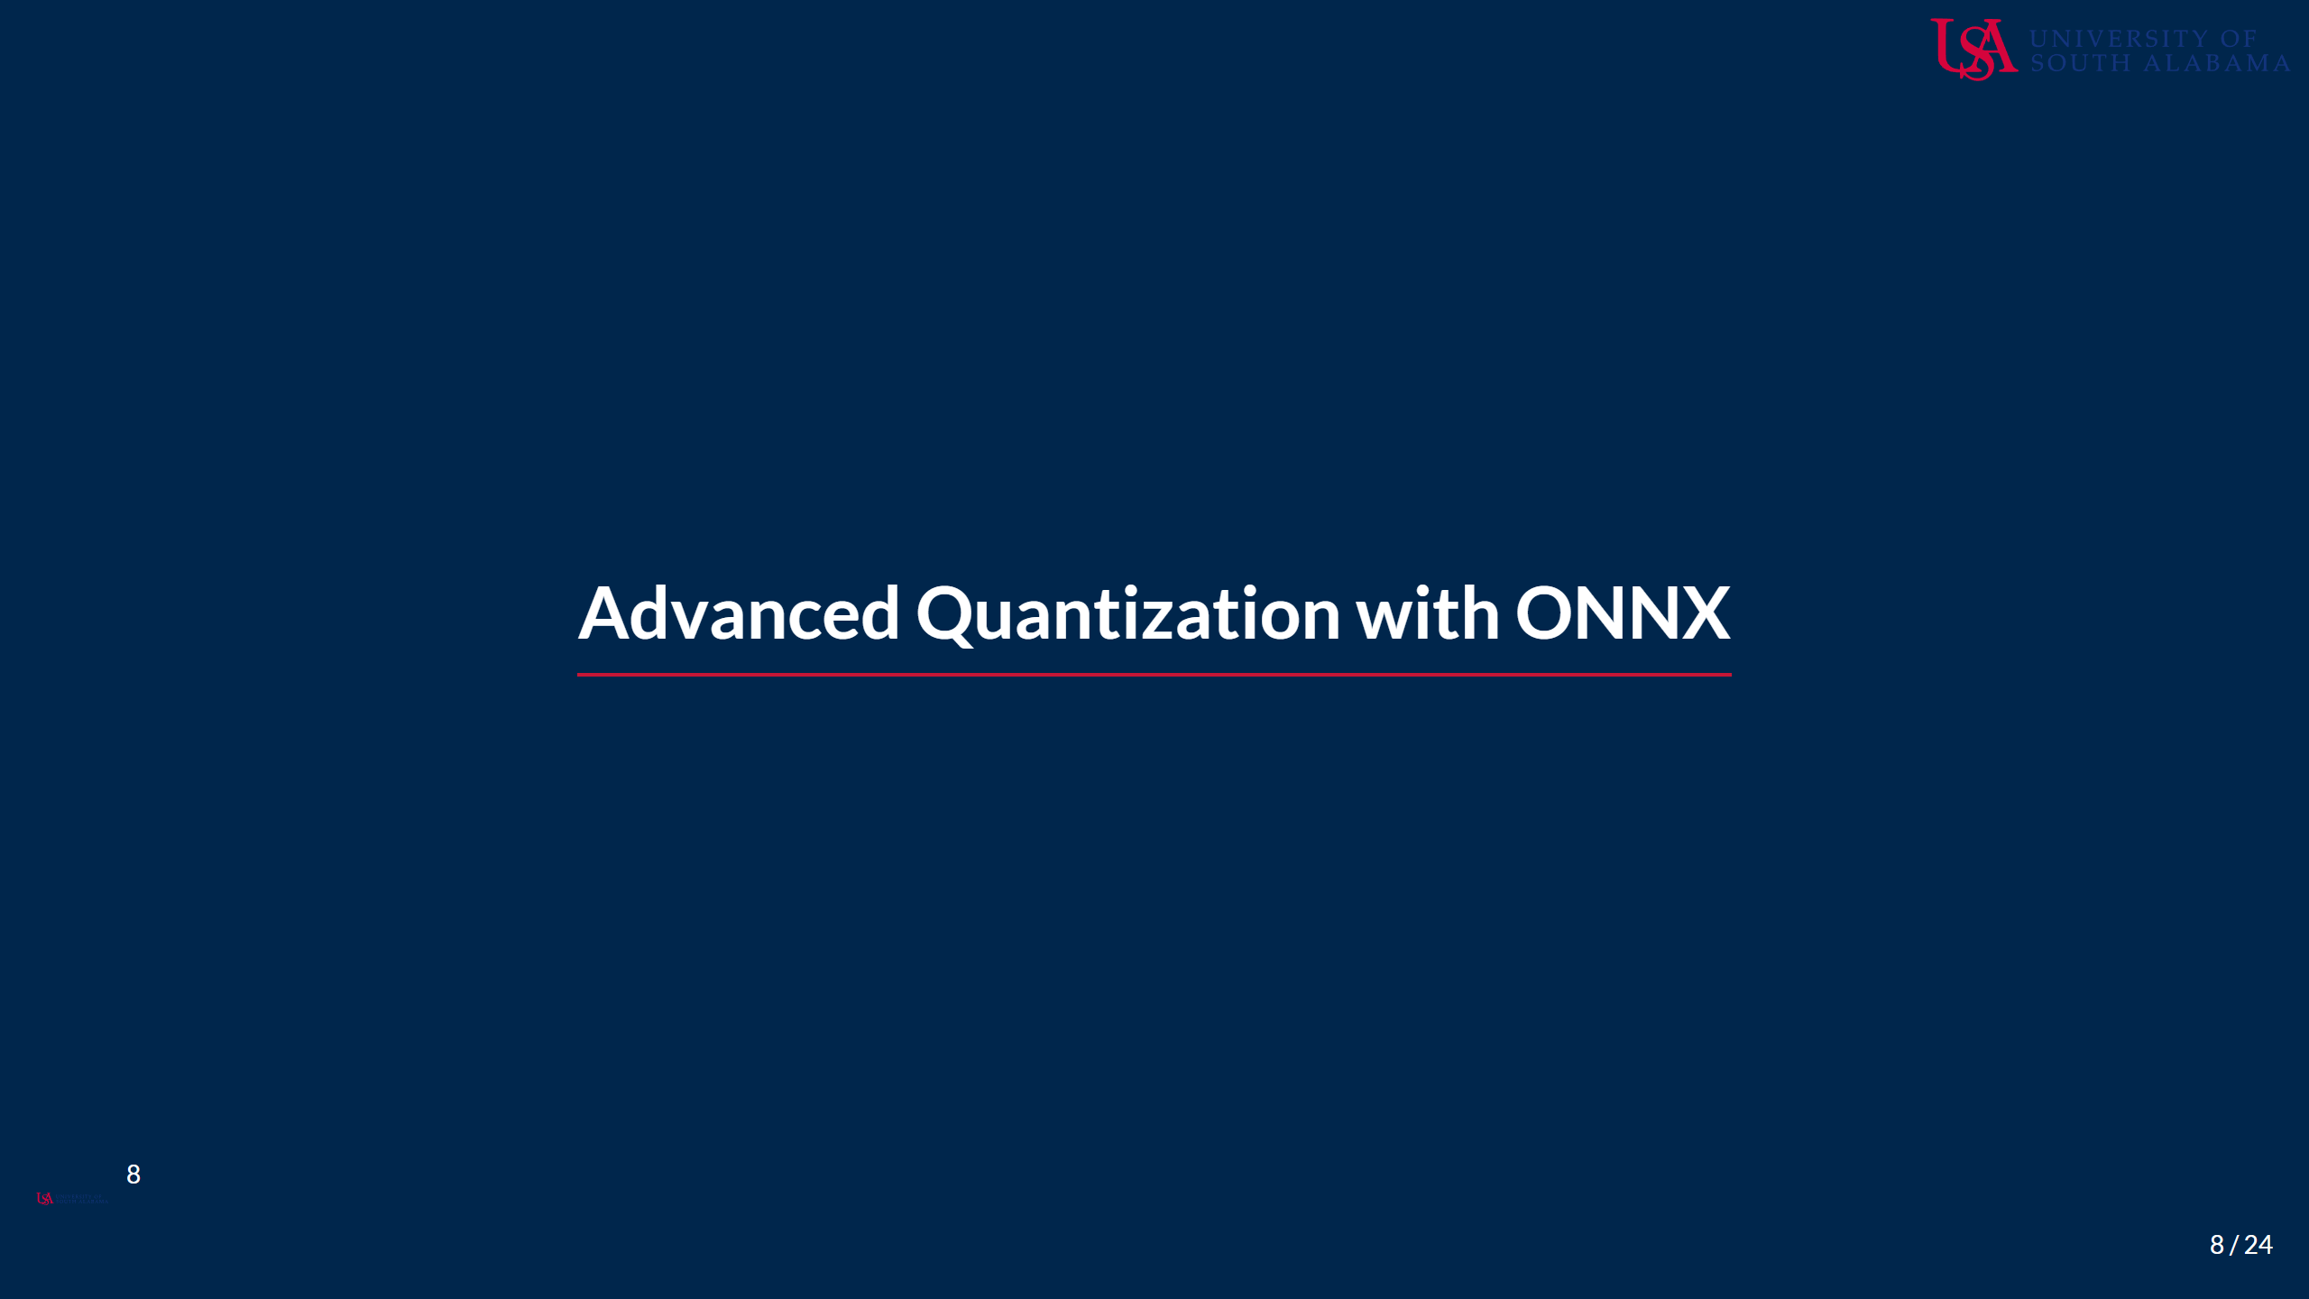
Notes:
Speaker Notes: - Building on the quantization fundamentals from Session 1 - ONNX Runtime provides sophisticated quantization capabilities - We'll explore both static and dynamic quantization approaches - Focus on practical implementation and optimization strategies

Slide 9
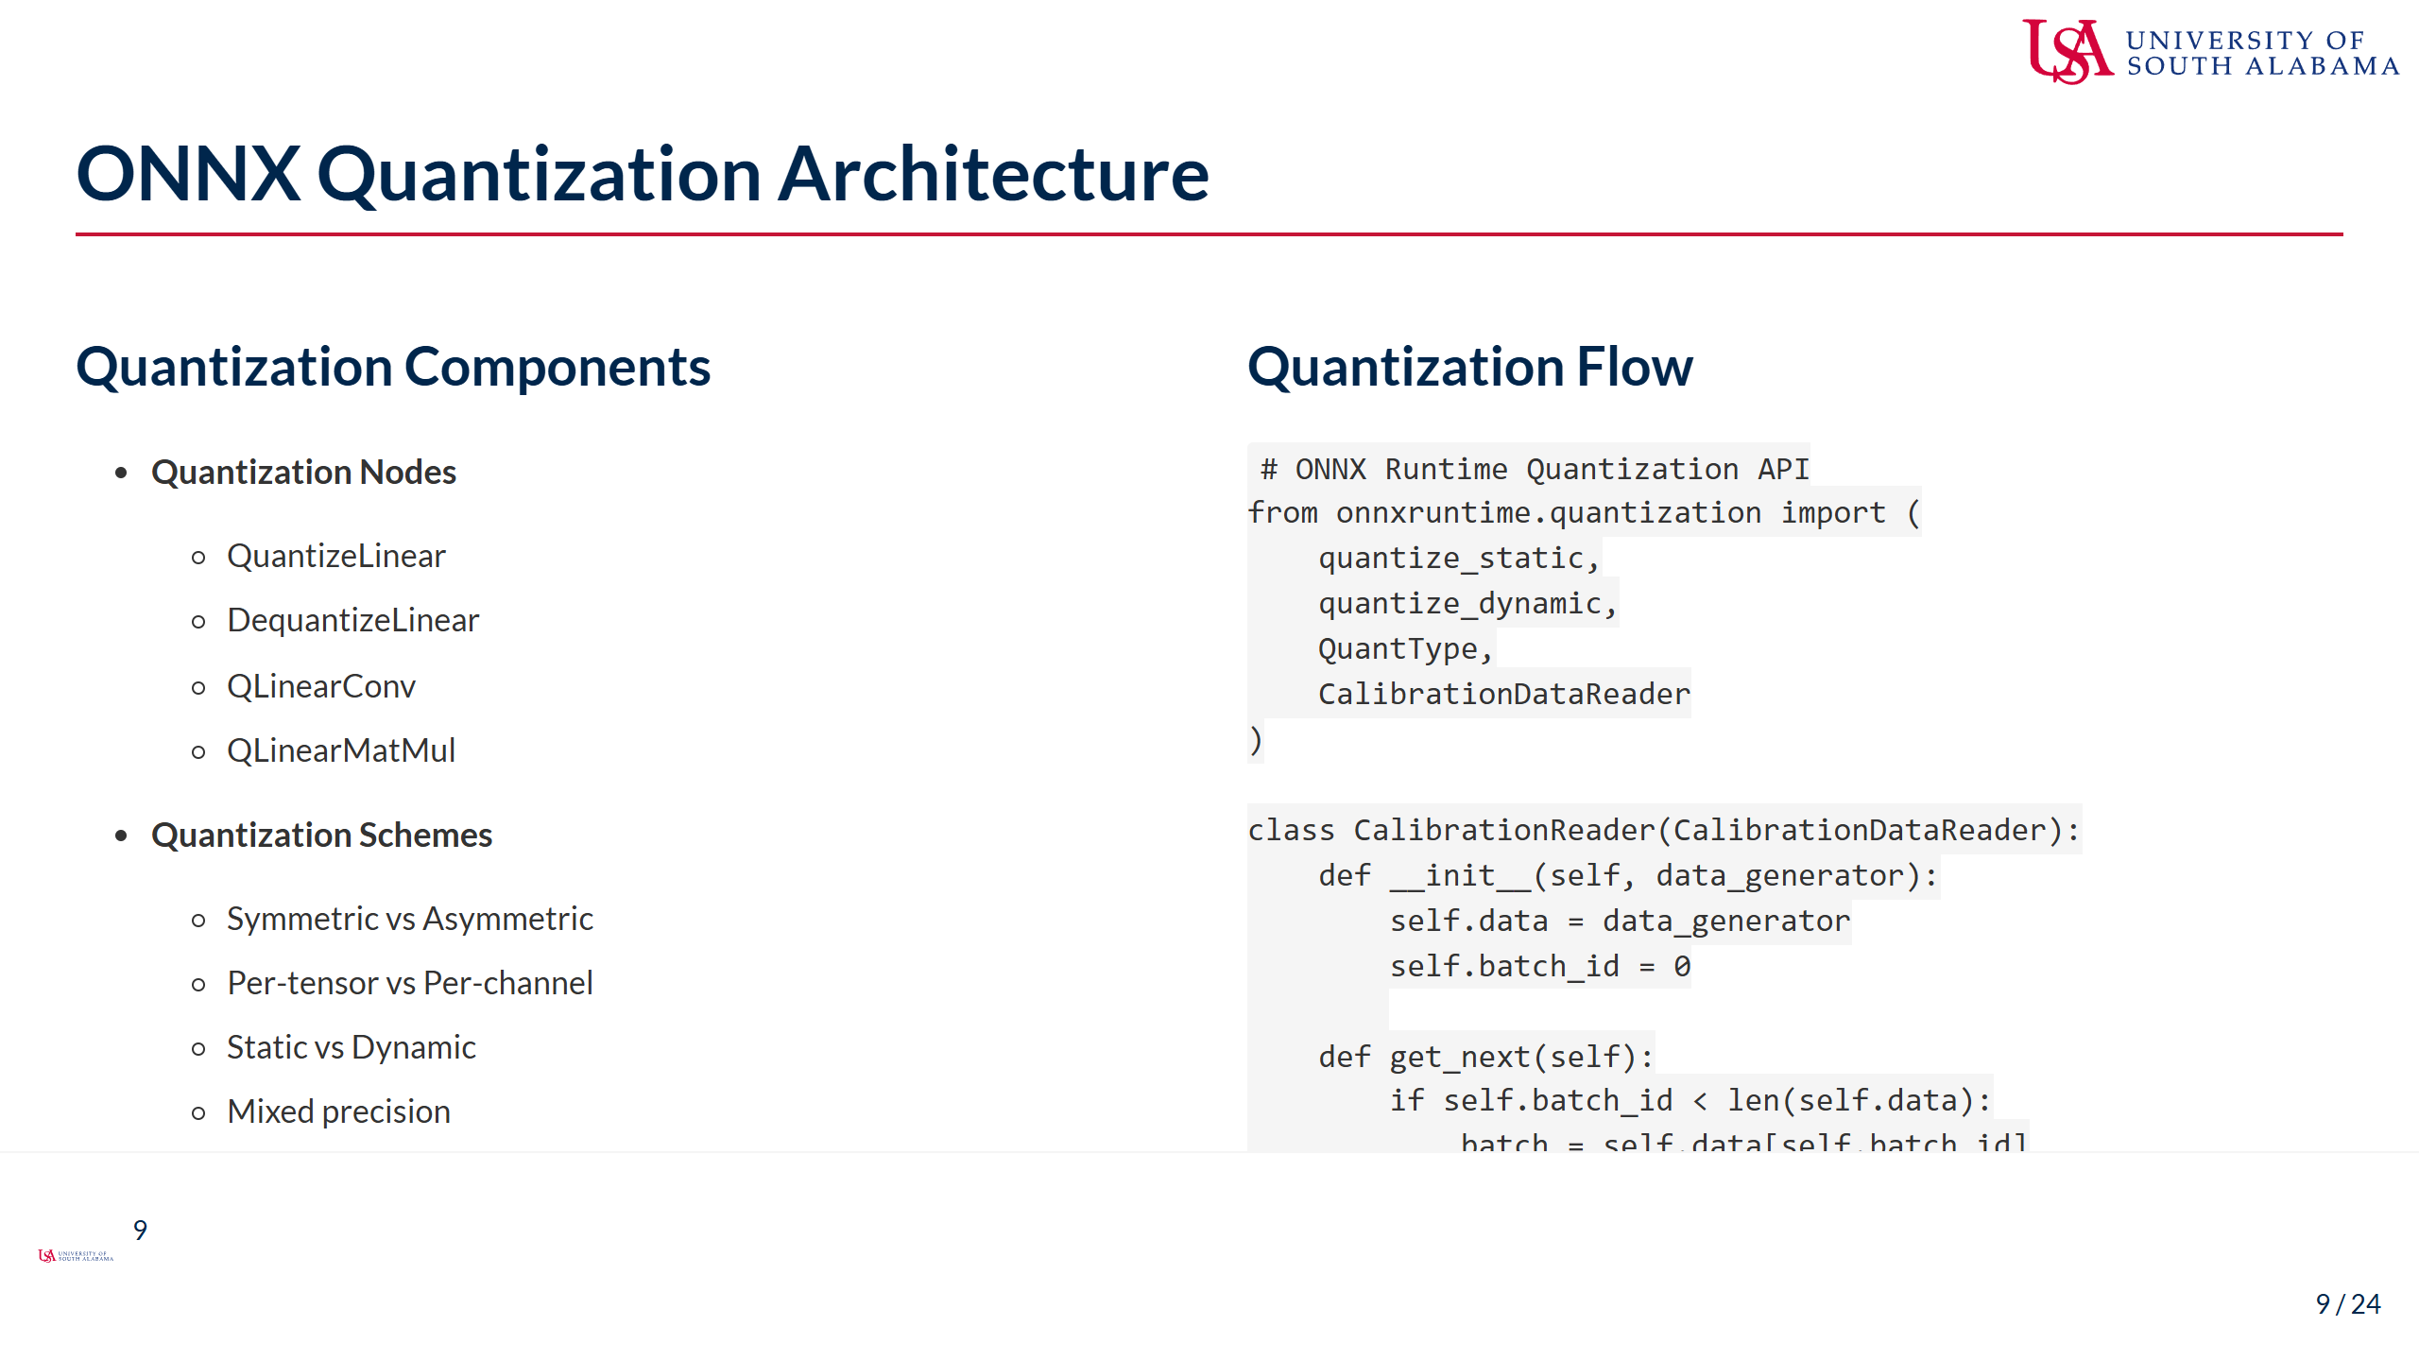
Notes:
Speaker Notes: - ONNX Runtime's quantization is built into the graph structure - Quantization nodes are explicit in the graph: - QuantizeLinear converts FP32 to INT8 - DequantizeLinear converts back to FP32 - QLinear operations work directly on quantized values - Different quantization schemes offer tradeoffs: - Symmetric: Simpler, zero point = 0 - Asymmetric: Better range utilization - Per-channel: Better accuracy for convolutions - Per-tensor: Simpler, less overhead - Calibration is crucial for static quantization: - MinMax: Simple, uses value range - Entropy: Minimizes information loss - Percentile: Robust to outliers - KL-Divergence: Balances range and precision - The CalibrationDataReader interface: - Provides data for calibration - Should use representative samples - Typically 100-1000 samples sufficient - QDQ (Quantize-Dequantize) format: - More flexible than QOperator format - Better for mixed precision - Easier to analyze and debug

Slide 10
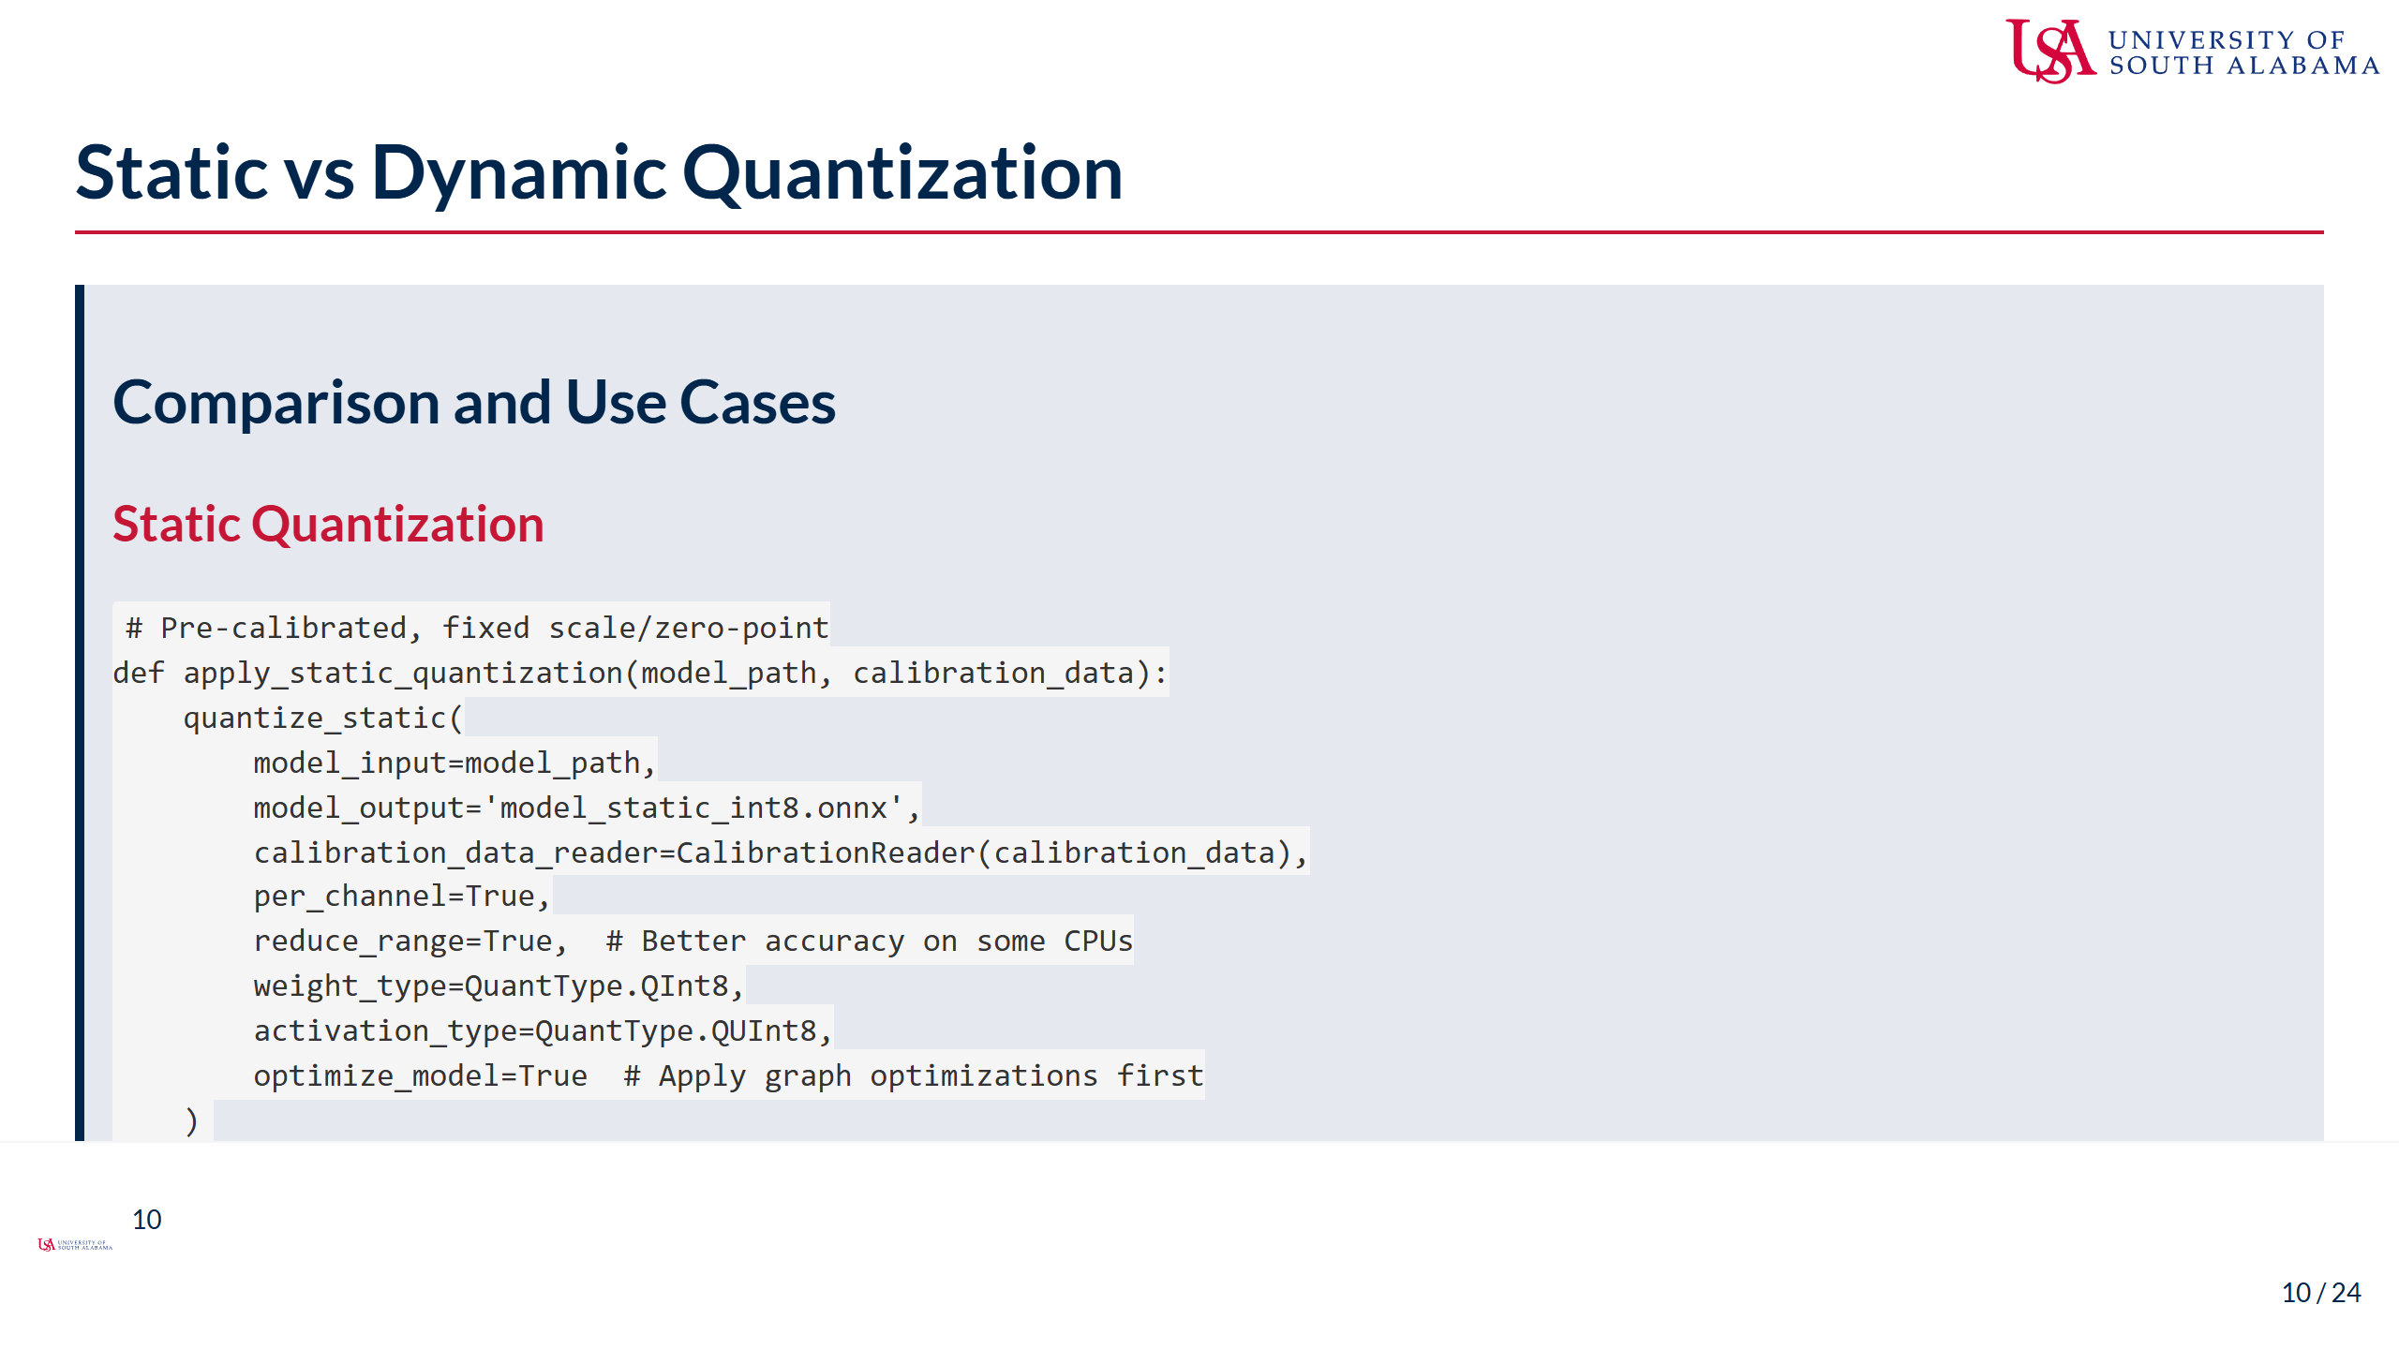
Notes:
Speaker Notes: - Static and dynamic quantization serve different use cases - Static quantization characteristics: - Requires calibration data - Fixed quantization parameters - Fastest inference (no runtime calculation) - Best when input distribution is known and stable - Ideal for production deployments - Dynamic quantization characteristics: - No calibration needed - Computes parameters per batch - Small runtime overhead - Adapts to input distribution - Good for models with varying inputs - Key differences in implementation: - Static needs representative calibration data - Dynamic only quantizes weights statically - Static typically gives better performance - Dynamic is more flexible - Advanced options: - reduce_range: Uses 7-bit for better accuracy - per_channel: Different scales per conv channel - ActivationSymmetric: Forces symmetric quantization - Selection criteria: - Deployment constraints - Input variability - Accuracy requirements - Development time - Can also use hybrid approaches for different layers

Slide 11
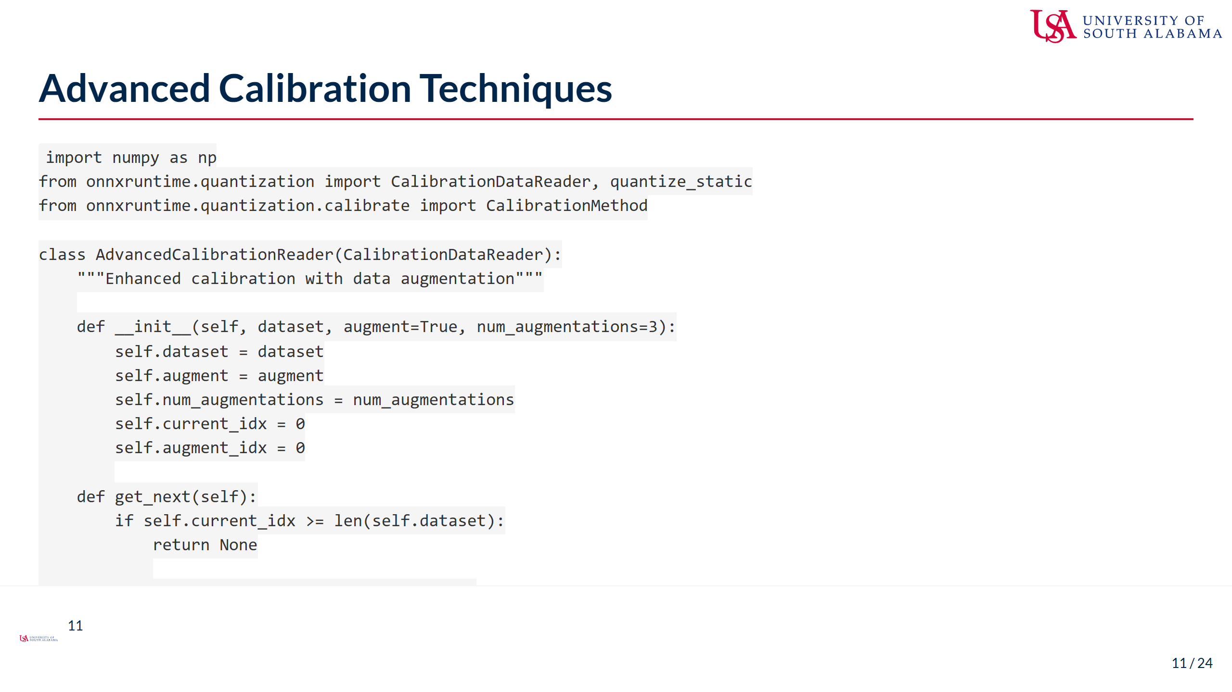
Notes:
Speaker Notes: - Advanced calibration can significantly improve quantization quality - Data augmentation during calibration: - Helps capture input variability - Improves robustness to input variations - Particularly important for edge deployment - Simple augmentations often sufficient - Different calibration methods have different strengths: - MinMax: Fast, works well for uniform distributions - Entropy: Minimizes information loss, good for accuracy - Percentile: Robust to outliers, good for real-world data - KL-Divergence: Balances range coverage and precision - Advanced calibration options: - CalibTensorRangeSymmetric: Forces symmetric ranges - CalibMovingAverage: Smooths calibration statistics - CalibMovingAverageConstant: Controls smoothing (0.9-0.99) - Best practices for calibration: - Use representative data covering edge cases - Include difficult examples - Validate on separate test set - Compare multiple methods - Calibration dataset size: - 100-1000 samples usually sufficient - More samples for high variability - Diminishing returns beyond 1000 - Monitor calibration quality through test metrics

Slide 12
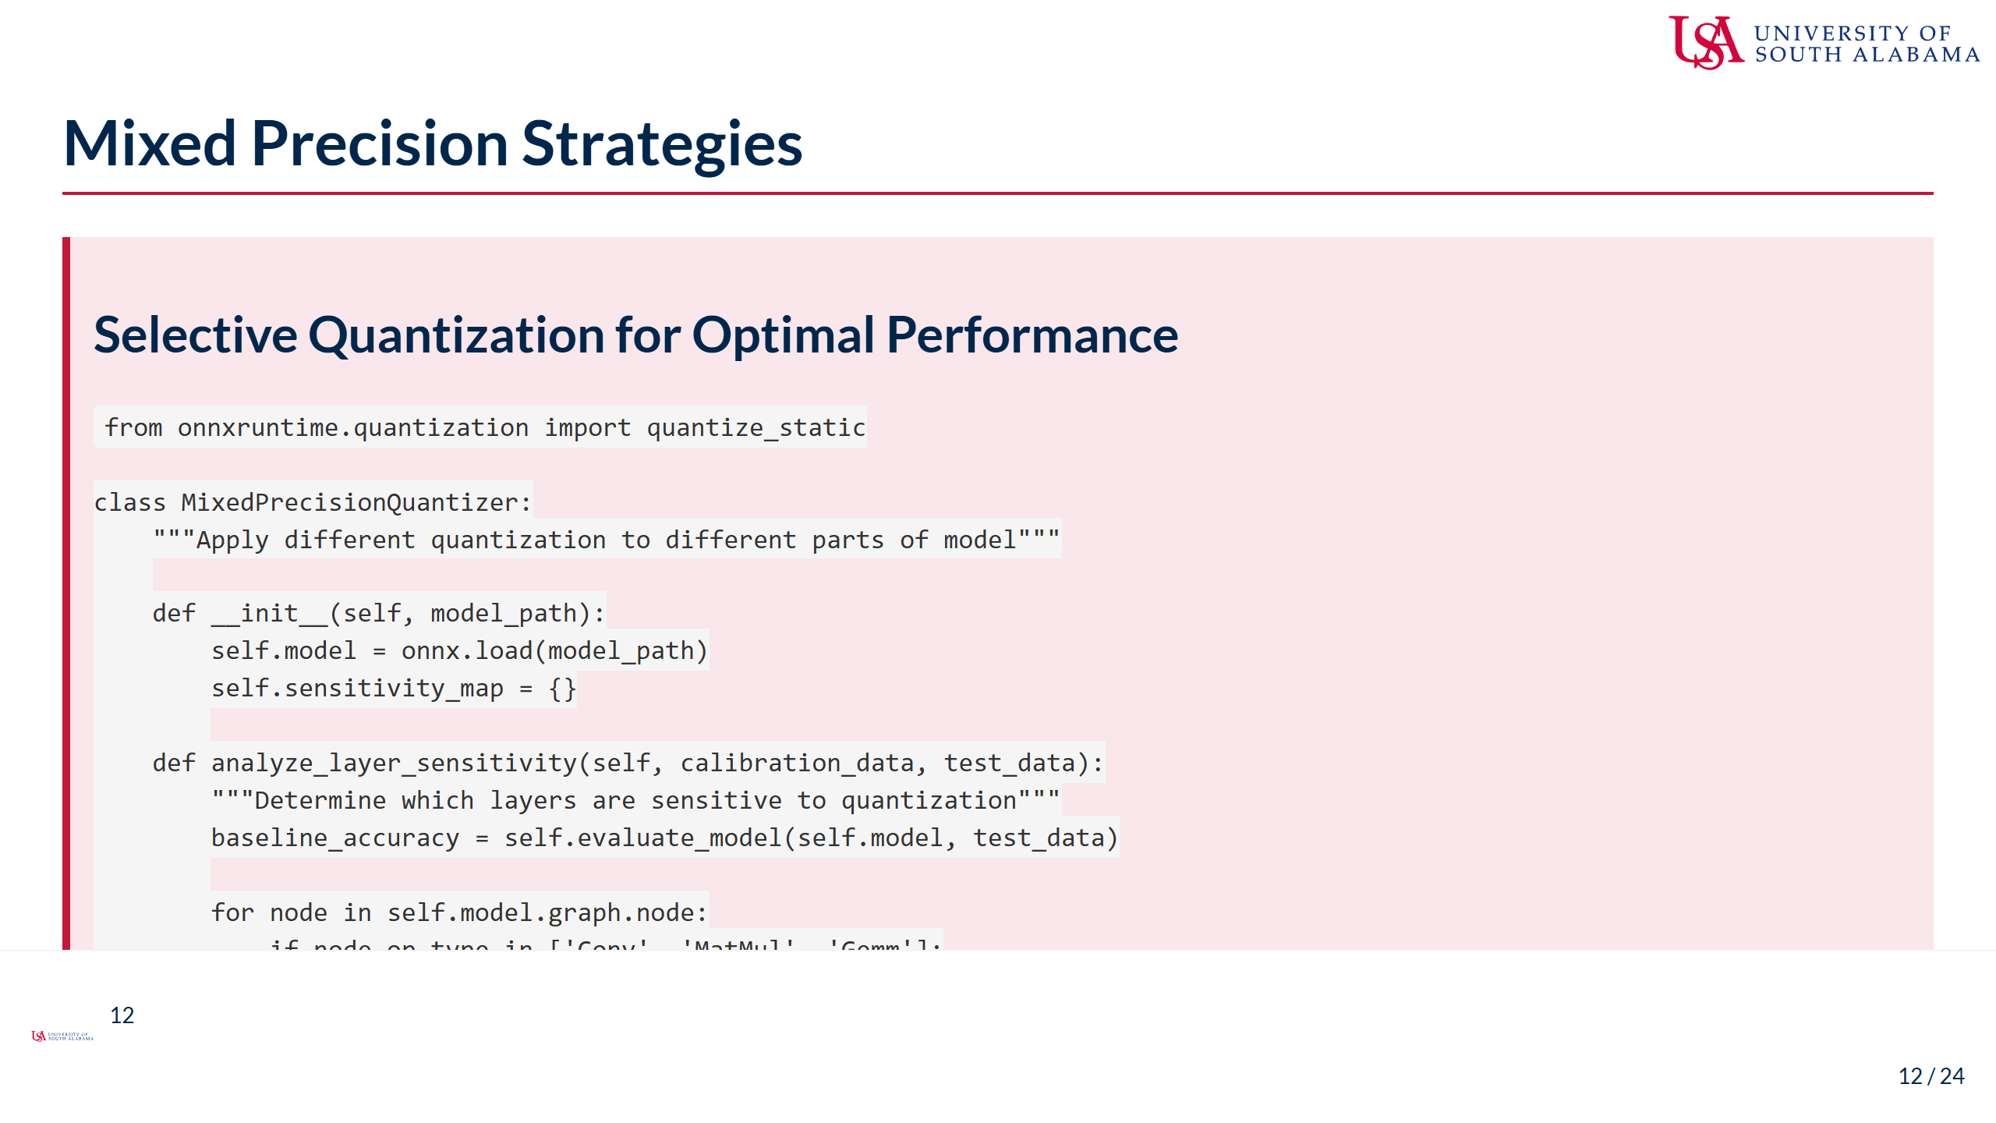
Notes:
Speaker Notes: - Mixed precision quantization balances accuracy and performance - Not all layers respond equally to quantization: - First/last layers often most sensitive - Attention mechanisms need careful handling - Depthwise convolutions may need higher precision - Batch normalization parameters often stay FP32 - Layer sensitivity analysis is crucial: - Quantize one layer at a time - Measure accuracy impact - Build sensitivity map - Use threshold to decide quantization - Implementation strategies: - Exclude sensitive nodes from quantization - Use different bit widths for different layers - Keep critical paths in higher precision - Quantize bulk of computation - Advanced mixed precision options: - INT8 for most layers, INT16 for sensitive - FP16 for extremely sensitive operations - Dynamic quantization for variable layers - Per-channel for convolutions, per-tensor for FC - Practical guidelines: - Start conservative, increase aggressiveness - Monitor accuracy continuously - 90% of benefit from quantizing 90% of ops - Focus on computational bottlenecks - This approach often achieves near-FP32 accuracy with INT8 speed

Slide 13
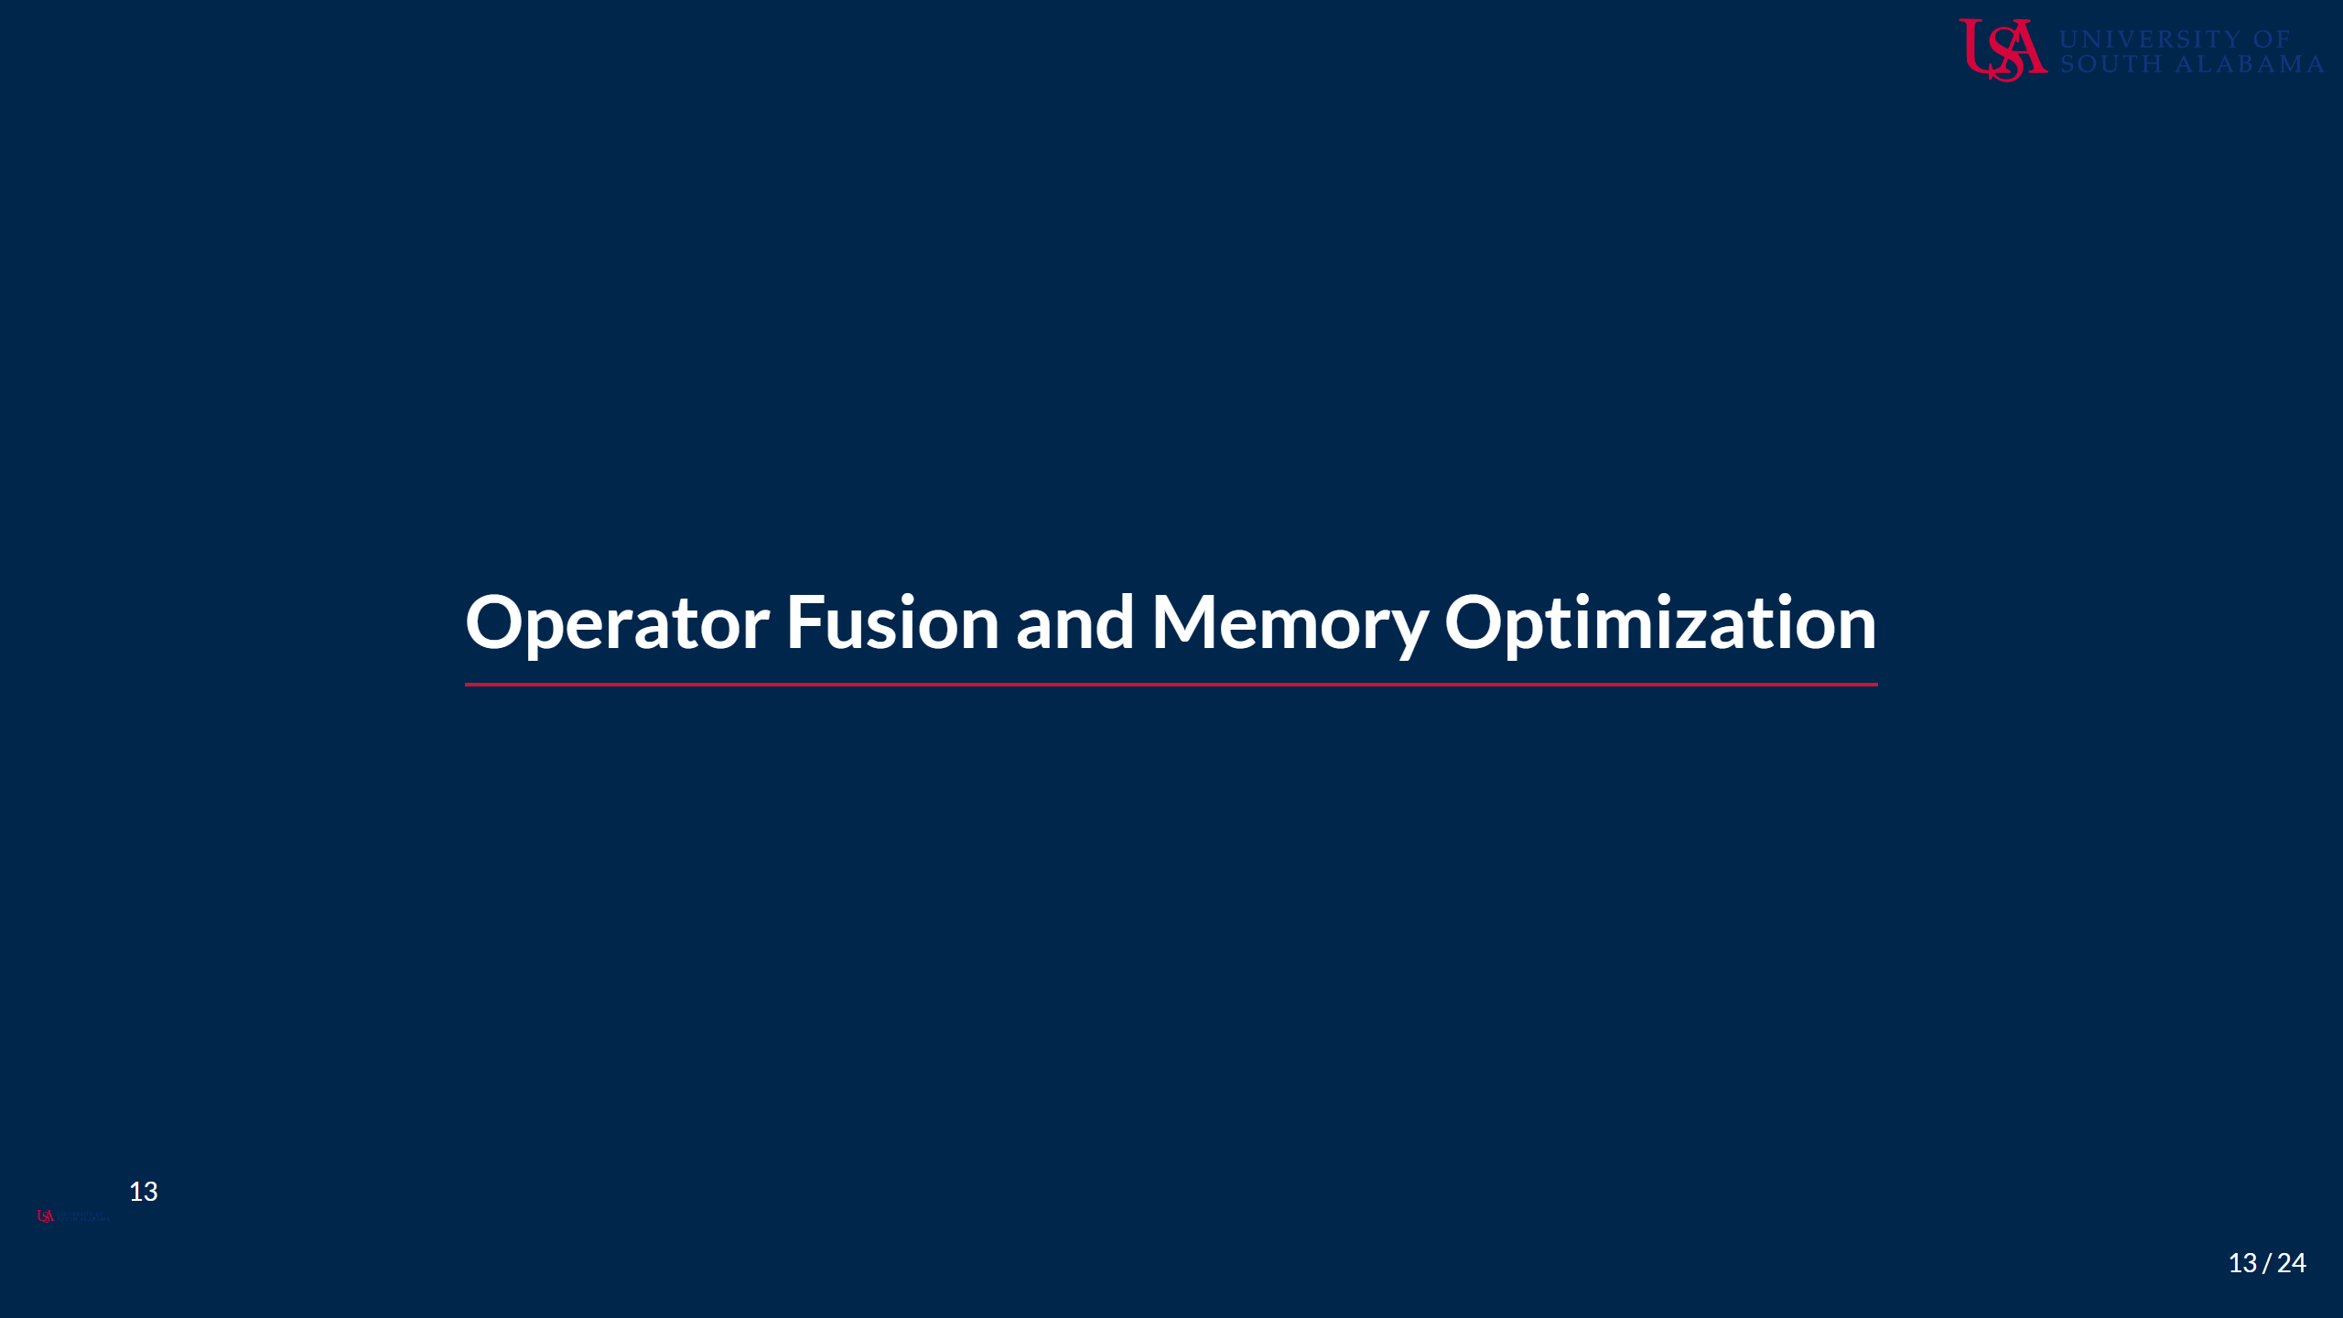
Notes:
Speaker Notes: - Operator fusion and memory optimization are crucial for edge performance - These techniques reduce memory bandwidth requirements - Particularly important for memory-constrained edge devices - We'll explore both automatic and custom fusion strategies

Slide 14
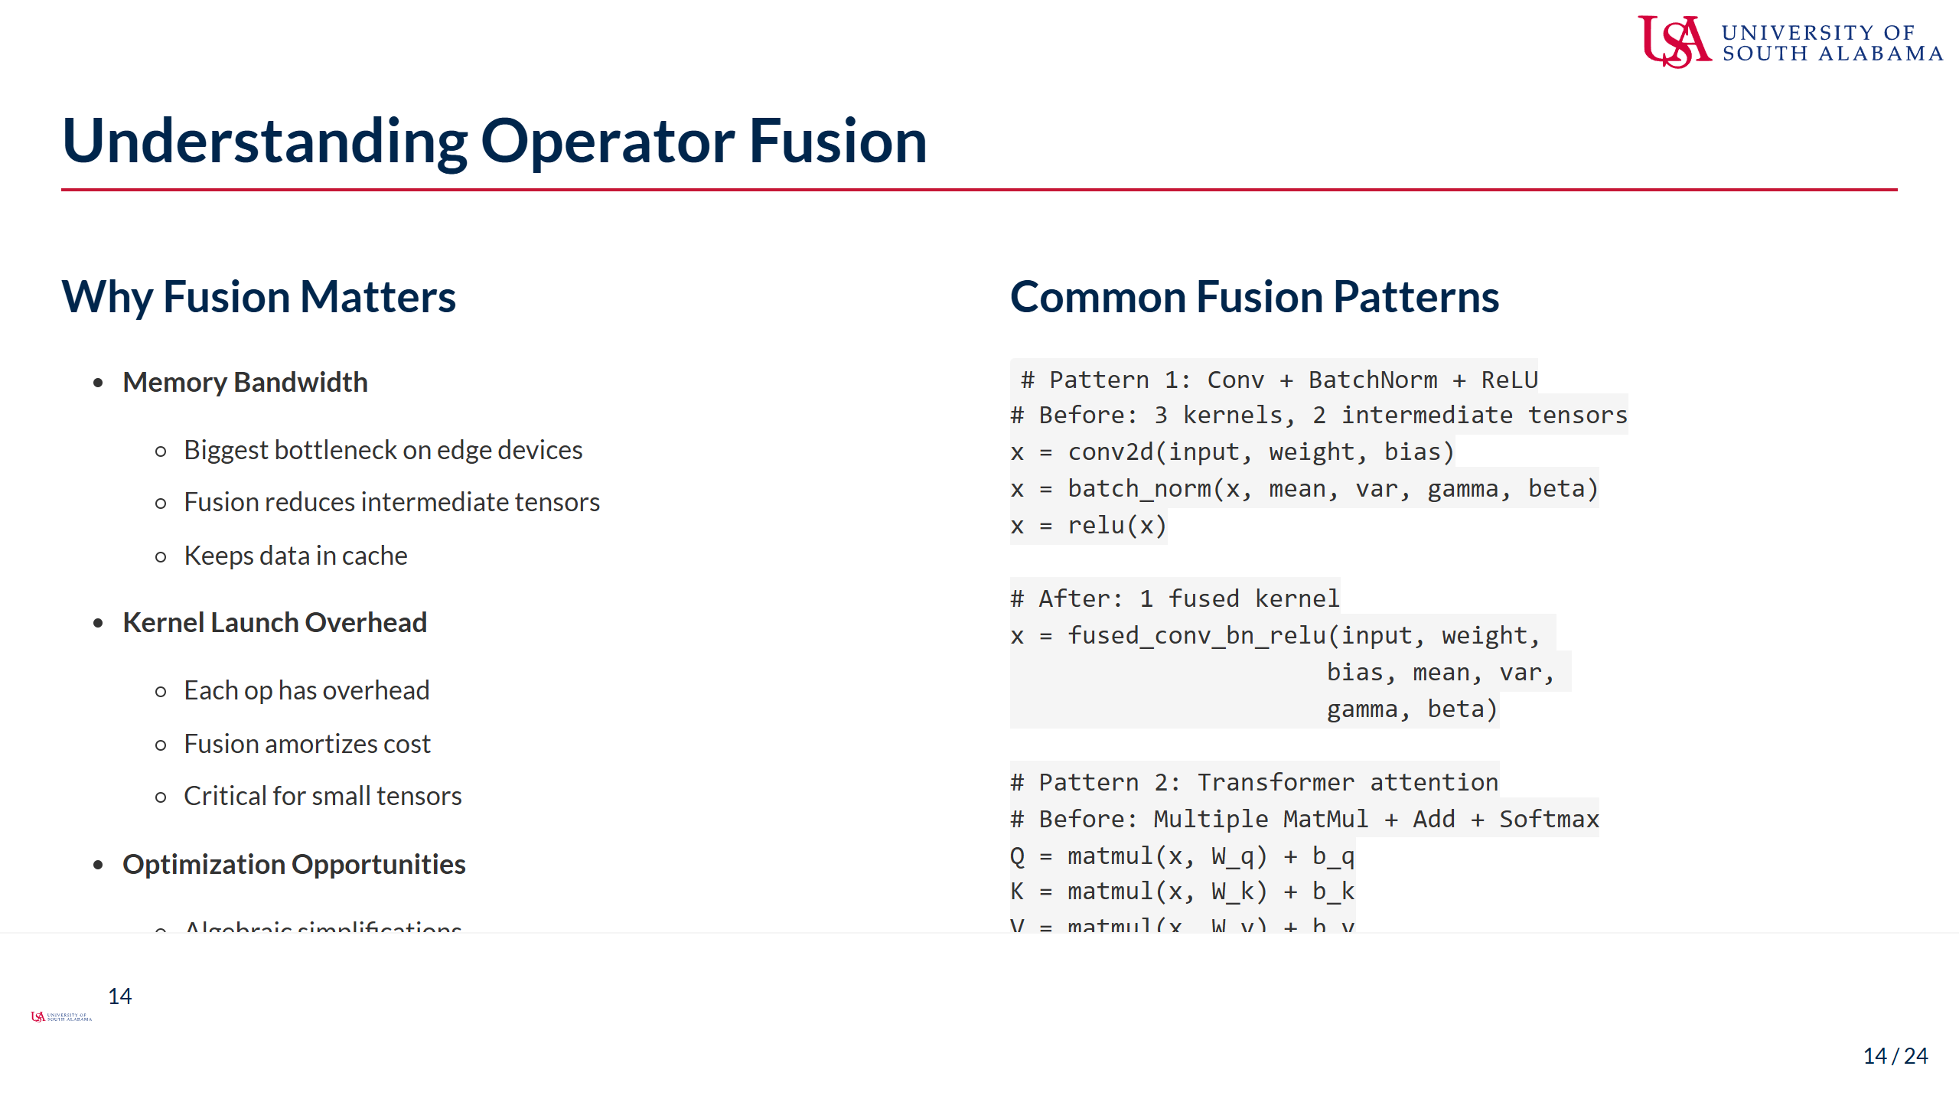
Notes:
Speaker Notes: - Operator fusion is one of the most impactful optimizations - Memory bandwidth is often the limiting factor: - Modern CPUs can compute faster than memory can feed data - Each intermediate tensor requires memory read/write - Fusion keeps values in registers/cache - Kernel launch overhead matters for edge: - Each operation has setup cost - Significant for small tensors - Fusion dramatically reduces total overhead - Common fusion patterns in ONNX Runtime: - Conv+BN+Activation: Universal in CNNs - MatMul+Add+Activation: Common in transformers - Normalization sequences: LayerNorm, InstanceNorm - Elementwise sequences: Add+Mul+Add - The examples show typical improvements: - Conv+BN+ReLU: 3x memory bandwidth reduction - Attention: Can be 10x faster when fused - Fusion also enables better optimization: - Compiler can optimize across operations - Shared memory access patterns - Better instruction scheduling

Slide 15
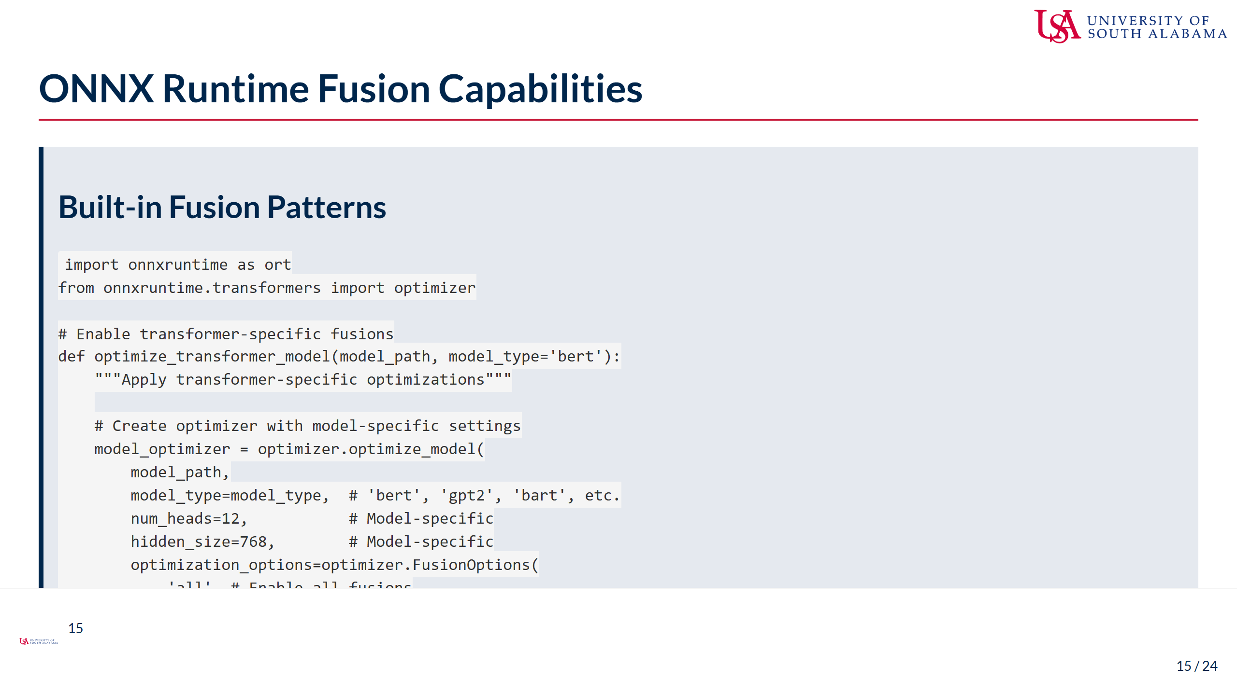
Notes:
Speaker Notes: - ONNX Runtime includes sophisticated fusion capabilities - Transformer-specific optimizations are particularly powerful: - Attention fusion: Combines Q,K,V projections and attention - LayerNorm fusion: Merges normalization with adjacent ops - Gelu/FastGelu fusion: Optimizes activation functions - SkipLayerNorm: Fuses residual connections - The optimizer detects and applies fusions automatically: - Analyzes model structure - Identifies fusion opportunities - Validates correctness - Applies transformations - Different model types have specific optimizations: - BERT: Attention, LayerNorm, Gelu fusions - GPT-2: Similar plus causal attention - T5: Encoder-decoder specific patterns - Custom models: May need manual fusion - Fusion statistics help understand impact: - Number of operations reduced - Memory savings estimates - Performance improvement potential - Important settings: - opt_level controls aggressiveness - use_gpu=False ensures CPU-specific optimizations - only_onnxruntime avoids external dependencies - Always validate fused models maintain accuracy

Slide 16
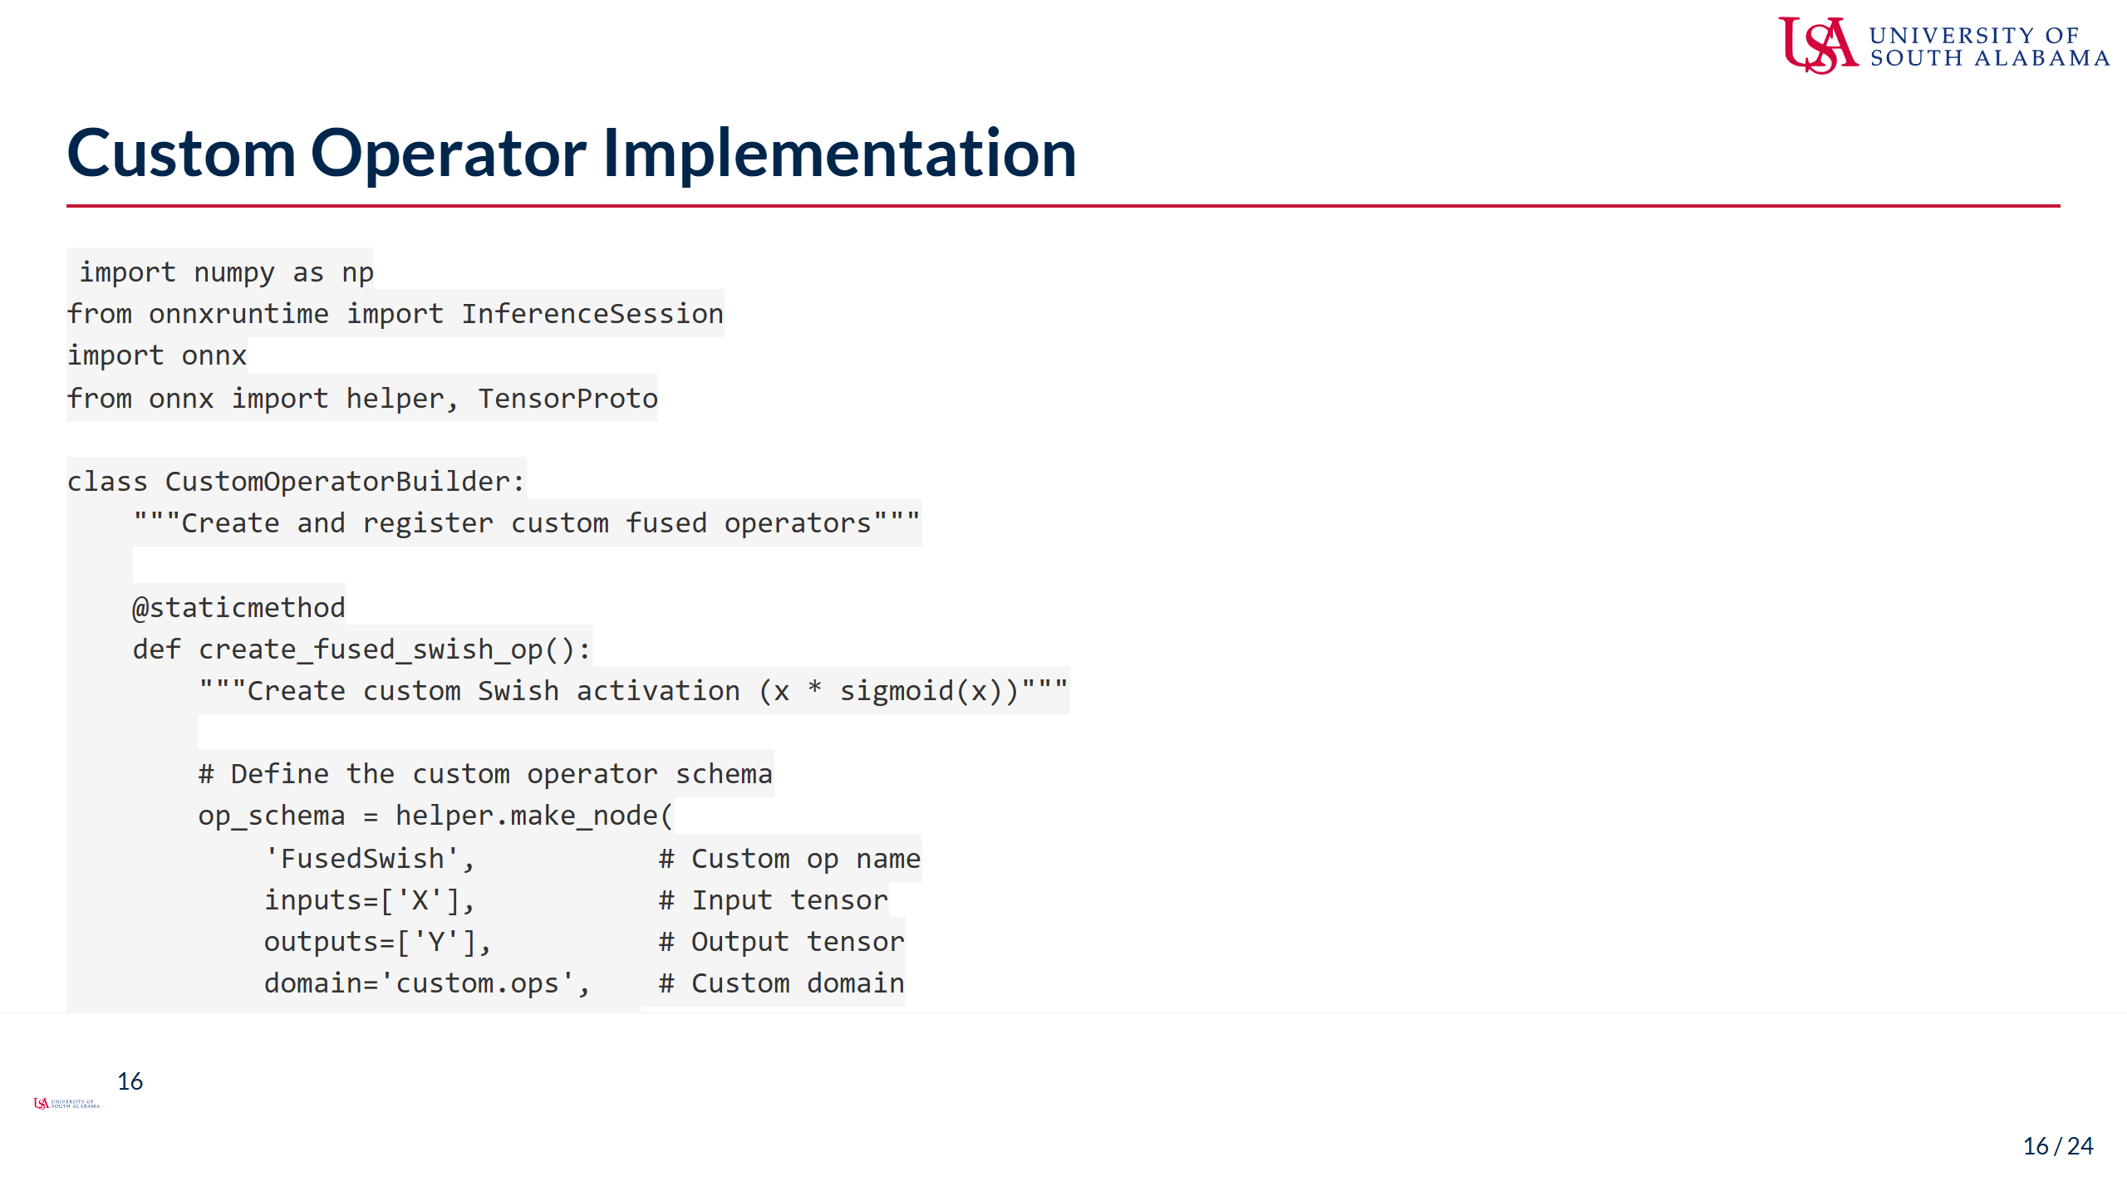
Notes:
Speaker Notes: - Custom operators enable domain-specific optimizations - Use cases for custom operators: - Fusing complex patterns not recognized by ONNX Runtime - Hardware-specific optimizations - Novel architectures with unique operations - Performance-critical paths - Implementation approaches: - Python: Good for prototyping, slower execution - C++: Production performance, more complex - Can start with Python, move to C++ if beneficial - The Swish example shows a simple custom activation: - Common in modern architectures - Can be optimized with approximations - Fusing prevents intermediate tensor - Grouped convolution fusion is more complex: - Identifies parallel convolution patterns - Combines into single efficient operation - Common in inception-style architectures - Best practices: - Validate numerical accuracy - Benchmark against unfused version - Consider maintenance burden - Document custom operations well - When to create custom ops: - Repeated patterns taking significant time - ONNX Runtime doesn't recognize the pattern - Hardware-specific optimization opportunity - Clear performance benefit justifies complexity

Slide 17
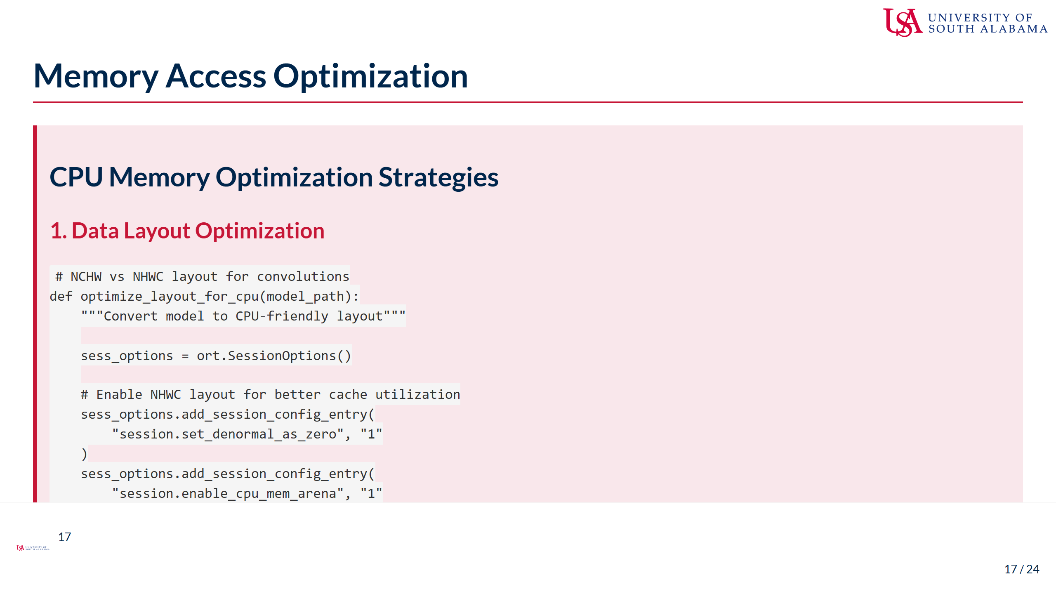
Notes:
Speaker Notes: - Memory access patterns critically impact CPU performance - Data layout optimization: - NCHW (channels first) vs NHWC (channels last) - CPU caches work better with NHWC for convolutions - Reduces cache misses and improves vectorization - ONNX Runtime can transform layouts automatically - Memory pool configuration: - Reduces allocation overhead - Reuses memory buffers across operations - Arena allocator minimizes fragmentation - Critical for embedded systems - Inplace operations: - Modify tensors directly instead of creating new ones - Reduces memory footprint - Improves cache utilization - Particularly effective for element-wise ops - Additional optimizations: - Tensor memory alignment for SIMD - Prefetching strategies - Working set minimization - Cache-aware blocking - Platform-specific considerations: - x86: Optimize for AVX/AVX2/AVX512 - ARM: Optimize for NEON instructions - Consider cache sizes (L1/L2/L3) - Thread affinity and NUMA awareness - Measurement is crucial: - Use performance counters - Monitor cache misses - Track memory bandwidth - Profile hot spots

Slide 18
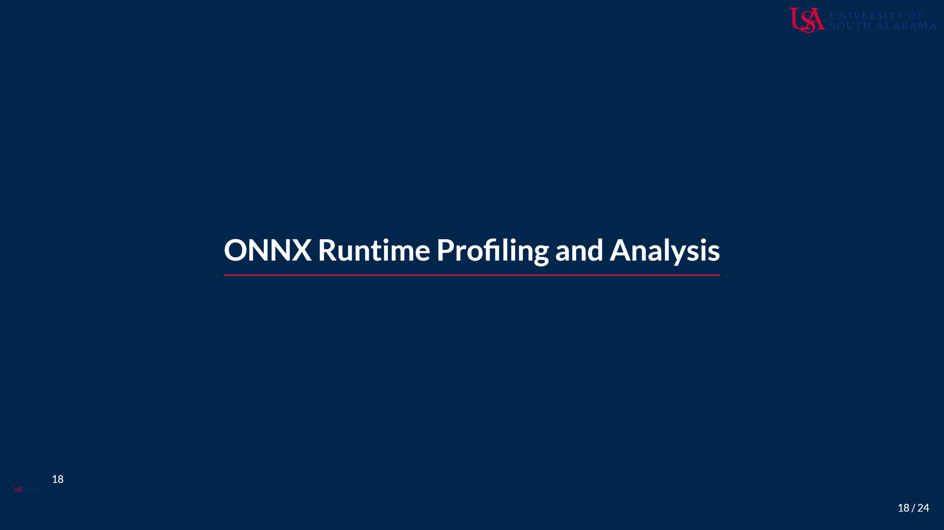
Notes:
Speaker Notes: - Profiling is essential for understanding optimization impact - ONNX Runtime provides detailed profiling capabilities - We'll explore how to use profiling to guide optimization - This forms the feedback loop for continuous improvement

Slide 19
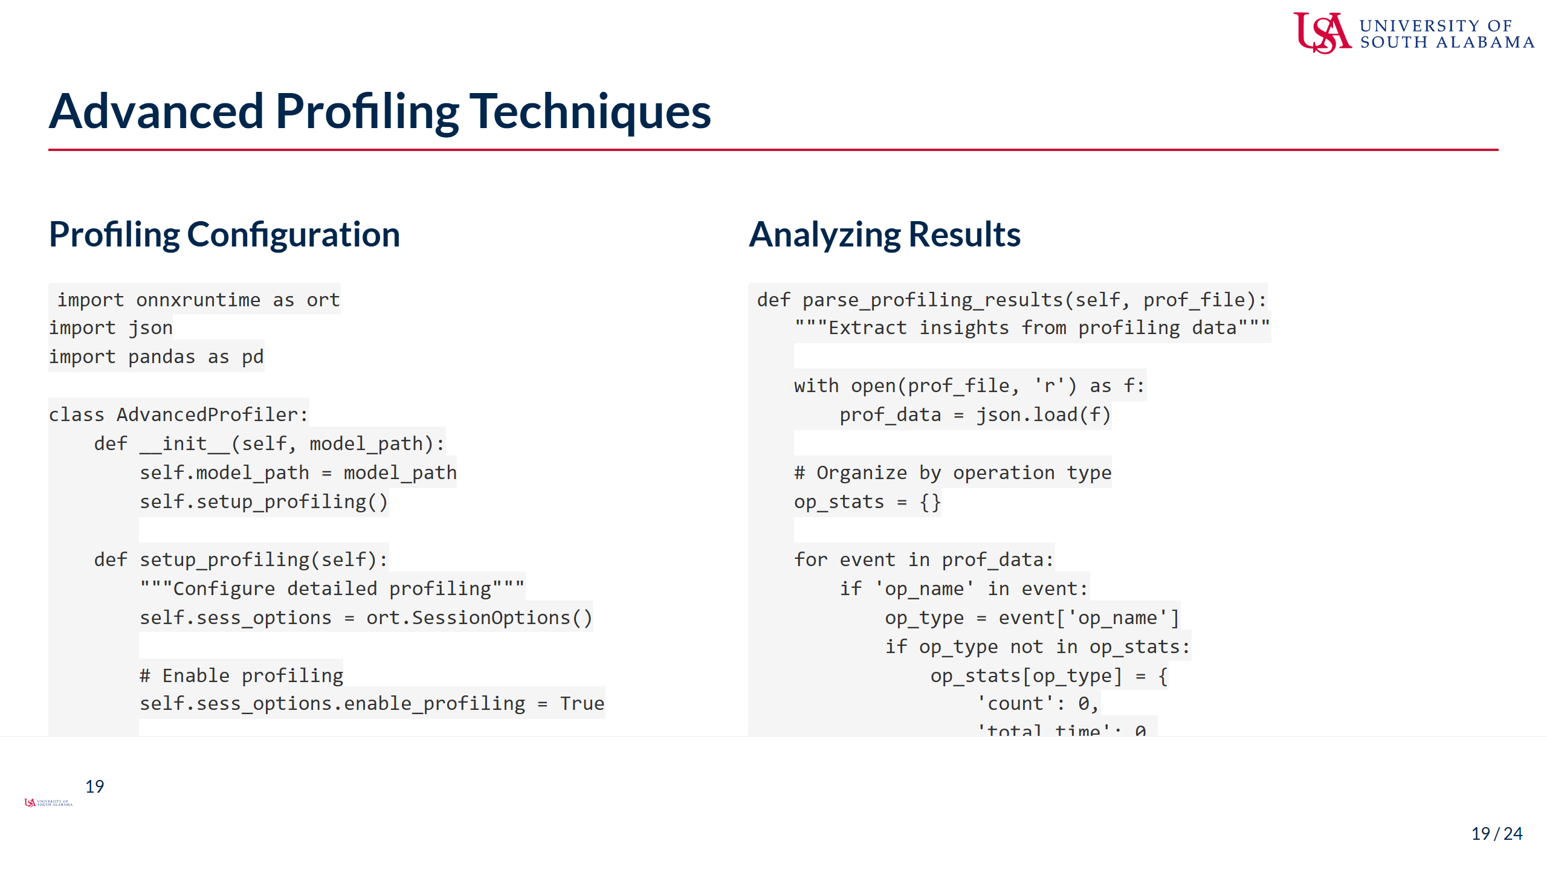
Notes:
Speaker Notes: - Advanced profiling reveals optimization opportunities - Configuration options provide different levels of detail: - Basic: Operation times only - Detailed: Include memory allocations - All: Complete execution trace - The profiler captures: - Operation execution times - Memory allocation/deallocation - Kernel launch overhead - Data transfer times - Parsing profiling results: - Group by operation type - Calculate aggregate statistics - Identify bottlenecks - Find optimization targets - Key metrics to analyze: - Total time per operation type - Average time per instance - Percentage of total runtime - Memory allocation patterns - Common findings: - Convolutions dominating runtime - Unexpected memory copies - Inefficient layouts - Unfused operations - Use profiling to guide optimization: - Focus on top time consumers - Look for fusion opportunities - Identify memory bottlenecks - Validate optimization impact - Profiling overhead is minimal but non-zero

Slide 20
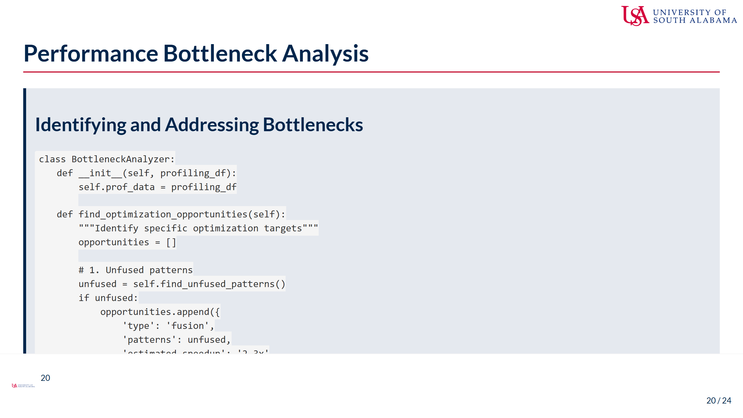
Notes:
Speaker Notes: - Bottleneck analysis transforms profiling data into actionable insights - The analyzer identifies three main opportunity types: 1. Fusion opportunities: Unfused sequences 2. Memory bottlenecks: Operations limited by memory bandwidth 3. Quantization targets: FP32 ops that could be INT8 - Finding unfused patterns: - Look for common sequences (Conv+BN+ReLU) - Estimate potential speedup from fusion - Prioritize by total time consumed - Memory bottleneck indicators: - High memory bandwidth operations - Poor cache utilization - Frequent allocations/deallocations - Quantization candidates: - Large matrix multiplications - Convolutions with many channels - Operations taking significant time - Visualization helps communicate findings: - Bar charts show relative impact - Pie charts show category distribution - Time series show execution flow - Action items from analysis: - Apply recommended optimizations - Re-profile to verify improvements - Iterate until goals met - Remember: 80/20 rule often applies - 80% of time in 20% of operations - Focus optimization efforts accordingly

Slide 21
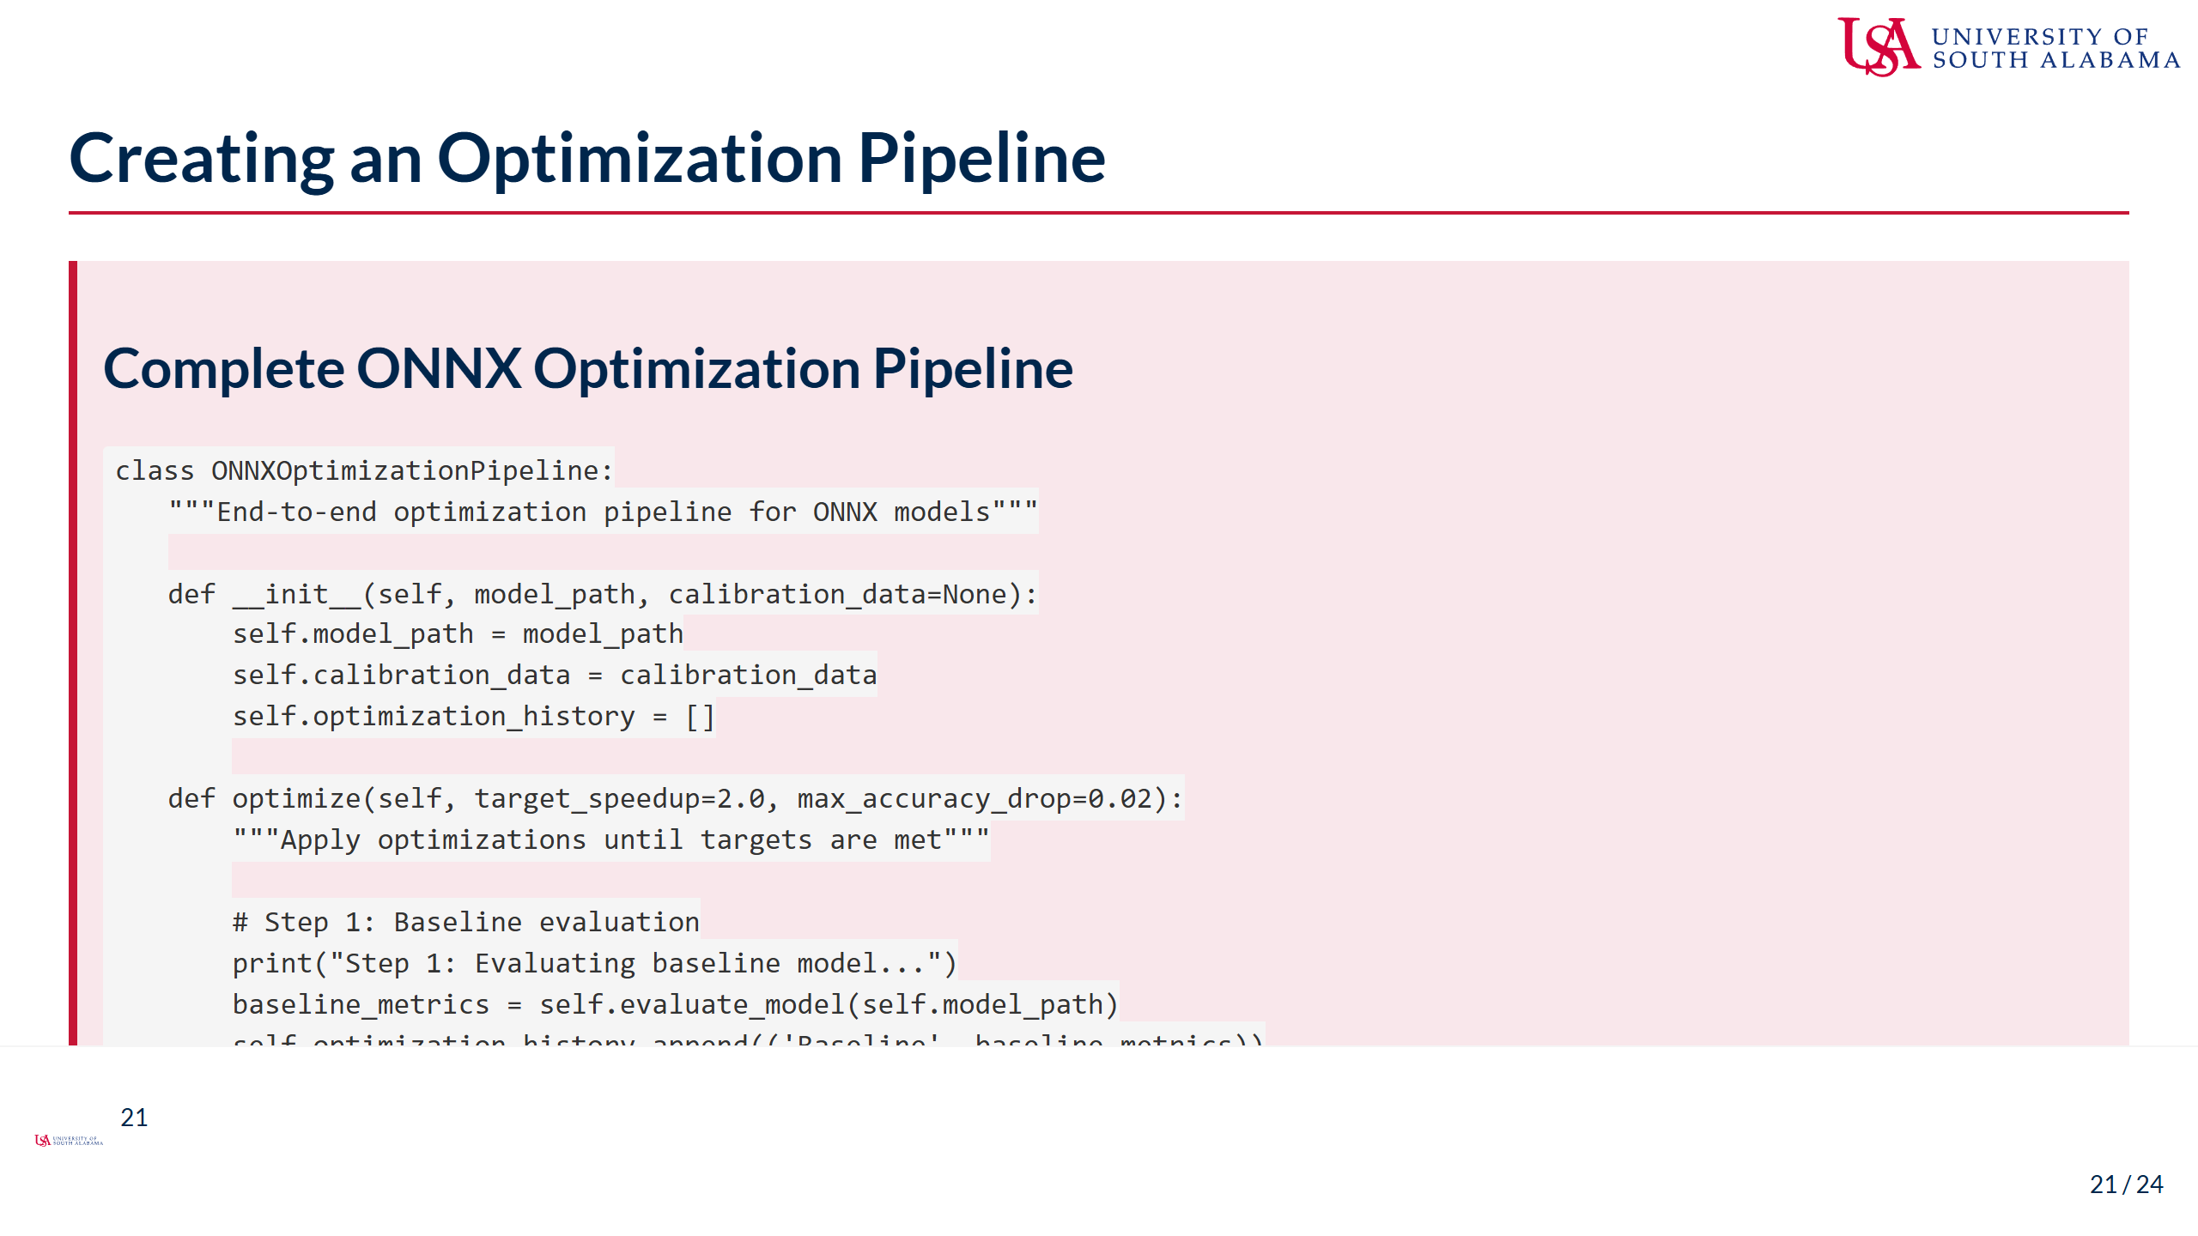
Notes:
Speaker Notes: - A complete optimization pipeline automates the optimization process - The pipeline follows a systematic approach: 1. Establish baseline metrics 2. Apply graph-level optimizations 3. Implement operator fusion 4. Consider quantization if appropriate 5. Optimize memory patterns - Each step is evaluated for impact: - Speed improvement - Size reduction - Accuracy maintenance - Key design principles: - Modular stages for flexibility - Continuous evaluation - Configurable targets - Comprehensive reporting - The pipeline can be customized: - Add/remove optimization stages - Adjust thresholds - Target specific metrics - Platform-specific optimizations - Automation benefits: - Reproducible results - Consistent methodology - Easy experimentation - Documentation built-in - Best practices: - Save intermediate models - Log all metrics - Version control configs - Test on target hardware - This pipeline becomes a reusable asset for future models

Slide 22
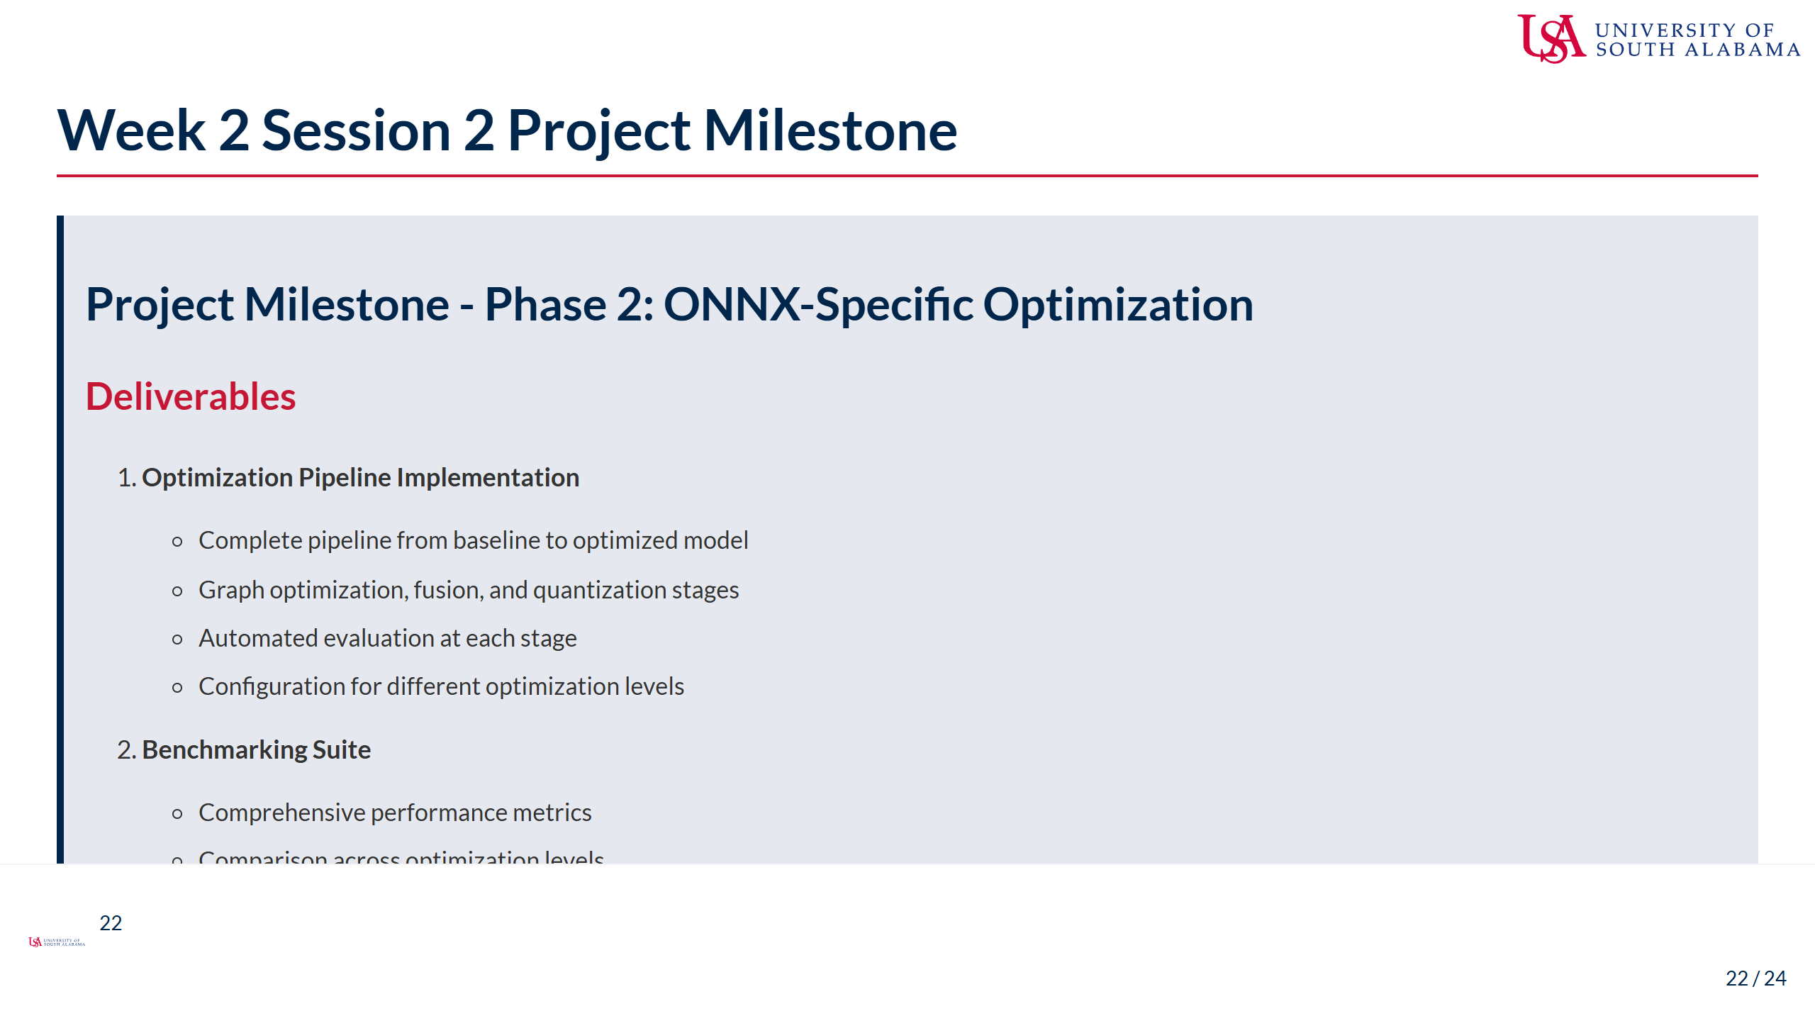
Notes:
Speaker Notes: - This milestone focuses on ONNX-specific optimizations - Building on the architectural optimizations from Session 1 - Key deliverables: 1. Working optimization pipeline that others can use 2. Thorough benchmarking on realistic hardware 3. Professional optimization report 4. Well-documented code repository - Pipeline requirements: - Should handle different model types - Configurable optimization strategies - Clear logging and error handling - Reproducible results - Benchmarking should include: - Multiple test runs for statistical validity - Real hardware testing (not just cloud) - Memory profiling, not just speed - Power consumption if possible - The report should tell a story: - What was the baseline? - What optimizations were applied? - What worked and what didn't? - What are the final recommendations? - GitHub repository should be professional: - Clear folder structure - Comprehensive documentation - Example usage scripts - Results visualization - This milestone prepares you for next week's generative AI deployment

Slide 23
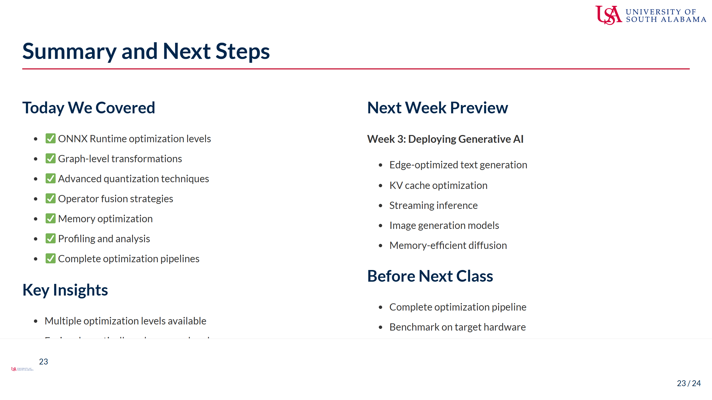
Notes:
Speaker Notes: - Today we explored ONNX Runtime's powerful optimization capabilities - Key takeaways: - ONNX Runtime does much more than just inference - Graph optimizations can provide significant speedups - Quantization is powerful but requires care - Fusion is critical for edge performance - Memory optimization often overlooked but crucial - Your optimization pipeline will be valuable beyond this course: - Reusable for future projects - Foundation for production deployments - Demonstrates systematic approach - Next week we tackle generative AI: - Special challenges for edge deployment - Memory constraints are severe - New optimization techniques needed - Exciting applications possible - To prepare: - Finish your optimization pipeline - Start thinking about generative models - Consider memory requirements - Review transformer architectures - Remember: Good optimization is iterative - Measure, optimize, validate, repeat - Document everything - Share your learnings

Slide 24
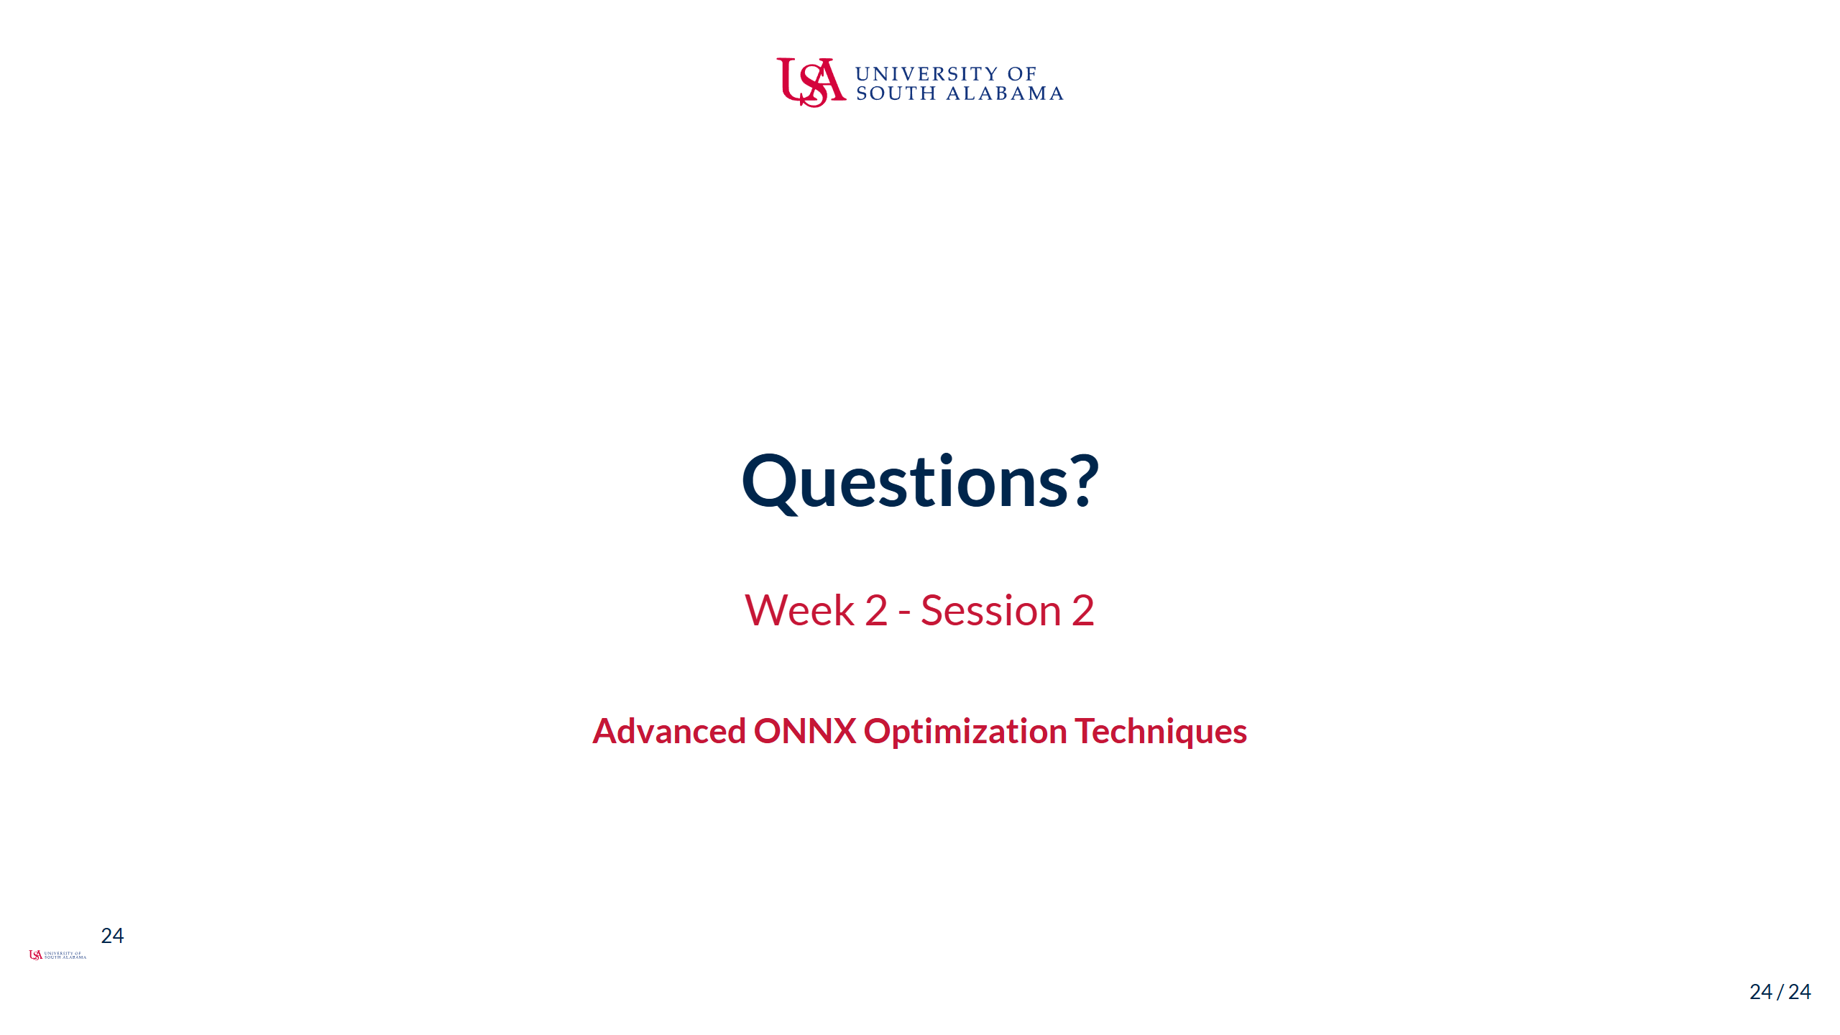
Notes:
Speaker Notes: - We've covered extensive ONNX optimization techniques today - These optimizations will dramatically improve your model performance - The optimization pipeline you create will be valuable for future projects - Questions about any of the optimization strategies? - Need clarification on the project milestone requirements? - Want to discuss specific optimization challenges you're facing? - Remember: office hours available for one-on-one help - Great work diving deep into ONNX optimizations! - Looking forward to seeing your optimization results - Next week's generative AI deployment will build on these skills

