Slide 1
User Data Insights
Visualizations for Client Review

Slide 2
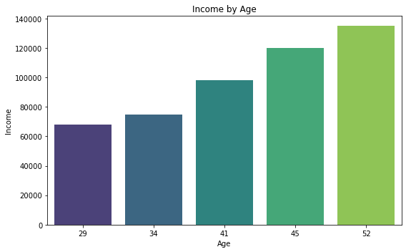

Income by Age

Slide 3
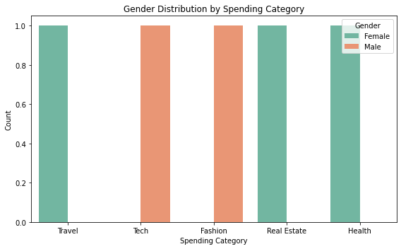
Gender Distribution by Spending Category

