Slide 1
Using a service mesh to add security to a 5g network
Matthew Nitschke

Slide 2
Overview
Background
Progress
Next Steps

Slide 3
What is a service mesh?
A service mesh is a dedicated infrastructure layer (sitting on top of kubernetes in this case) that deals with service to service communication and can adds features.
Some of these features include service discovery, load balancing, traffic management, security, etc.
Notes:
In the case for my project I will be using a service mesh to add security.

Slide 4
What are sidecars?
A sidecar is a utility container used to add behavior to the “main” container without changing it.
This sidecar will technically work as a service proxy that will intercept incoming and outgoing network traffic from the pod.
From there the sidecar can potentially manipulate packets, reroute traffic, apply security features, etc.
Notes:
Basically a second container that runs alongside the main container

Slide 5
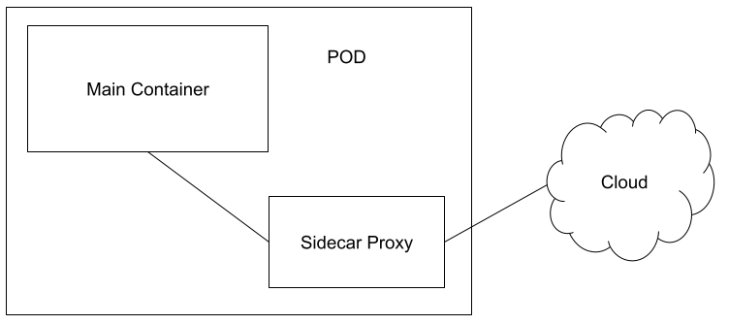

Slide 6
Sidecar benefits
Using these sidecar one can add additional features without needing to change code in the “core” area.
In the case of my project, I am using sidecar proxies to add TLS to communication within my 5g network.

Slide 7
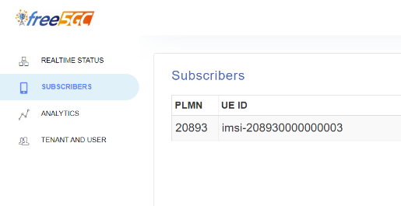
Free5gc
Free5GC is an open-source project for 5th generation (5G) mobile core networks

Slide 8
Istio
An open source service mesh that helps with the complexity of managing microservices deployments by providing a uniform way to manage, monitor and control microservices
I can add sidecars to microservices without needing to change the fundamental architecture on the application level
In the case of Istio it is a utility container inside of Kubernetes Pod.
Istio has two planes:
Data plane
Control Plane

Slide 9
Istio Data Plane
The data plane is responsible for handling the communication between nodes inside the system and network traffic itself.
Whether traffic is entering or leaving the mesh, the service traffic is directed into the service proxy for handling
This data plan touches every packet/request in the system and is the key to service discovery. routing, loading balancing etc.
Envoy: Data plane service proxy that intercepts all incoming and outgoing requests at runtime
Can be implemented as a sidecar

Slide 10
Istio Control Plane
The control plane is responsible for being the authoritative source for configuration and policy
Three primary Istio services:
Pilot: Programming the data plane, gateways, and service proxies in an Istio deployment
Mixer: Handling telemetry reports and policy enforcement
Citadel: Responsible for the generation and rotation of keys and certificates used for secure communication between services within the mesh
Notes:
Galley->Manages Istio’s configuration

Slide 11
Istio Peer Authentication
mTLS is TLS when both parties, clients and servers present certificates to each other.
Allows clients to verify the identity of the server but also allows the server is verify the client
This is done via the sidecars of each pod
To enable peer authentication this is done istio configuration settings
Notes:
Configure on control

Slide 12
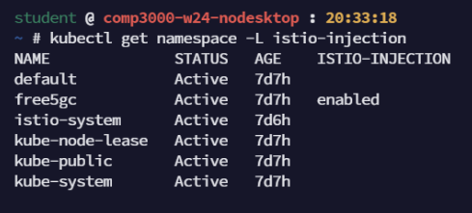
Istio deployment

Slide 13
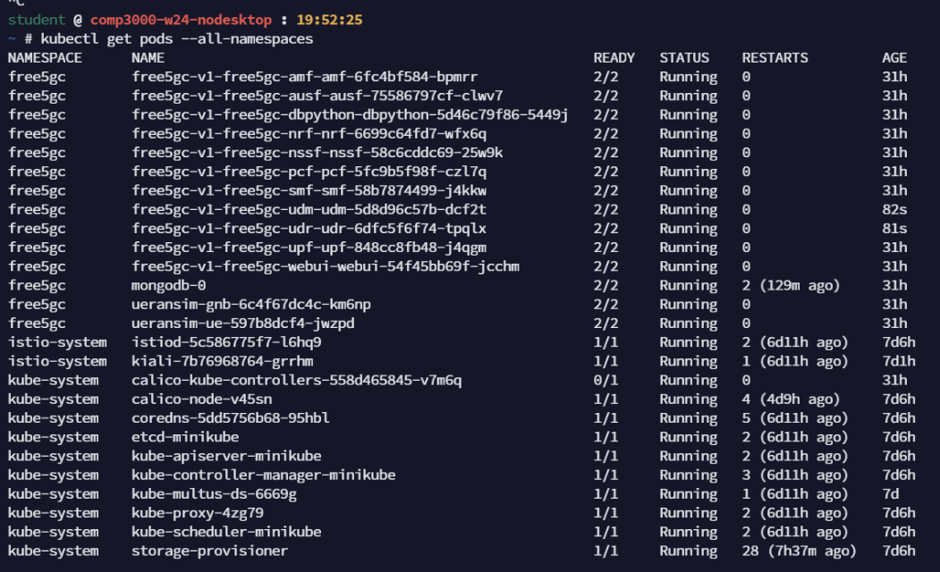

Slide 14
Ueranism
Is the open source state-of-the-art 5G UE and RAN (gNodeB) simulator
This is being used to simulate network traffic through my 5g network

Slide 15
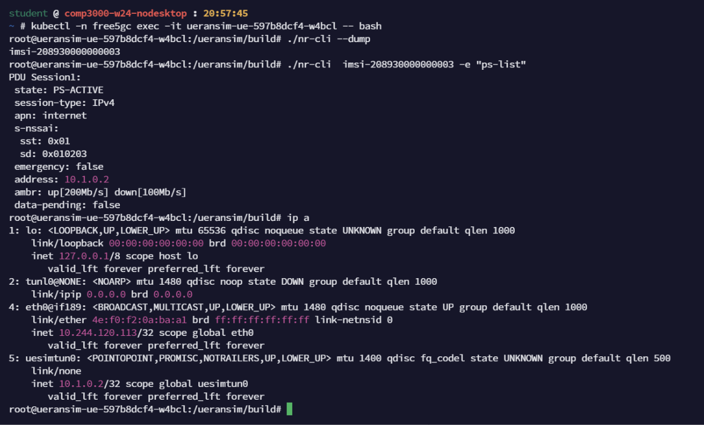

Slide 16
Memory Issues
At first the specs were 8GB of ram and 4 cores Intel® Core™ i7-13700K Processor
Needed to up to 20GB of ram plus 8 cores due to memory issues

Slide 17
Traffic Issues
Currently:
5g network functioning
Added sidecars to 5g nodes in network
Can establish connection between image and real world through a tunnel
Have configurations needed to establish mTLS through the network

Slide 18
Traffic Issues
Currently:
5g network functioning
Added sidecars to 5g nodes in network
Can establish connection between image and real world through a tunnel
Have configurations needed to establish mTLS through the network
Issue:
Having trouble simulating traffic through 5g network

Slide 19
For more information check the set up guide

