Slide 1
DistributedHART:
A Distributed Real-Time Scheduling System for WirelessHART Networks
Matt Krueger
Oct. 15, 2025

Slide 2
Introduction
1

Slide 3
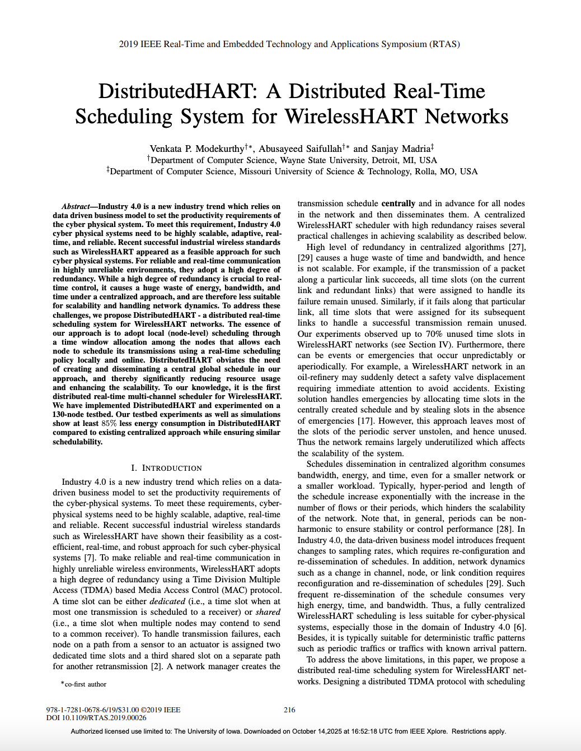
Background
2019 IEEE Real-Time and Embedded Technology and Applications Symposium (RTAS)
Wayne State University, Detroit, MI, USA
Missouri University of Science and Technology, Rolla, MO, USA

Slide 4
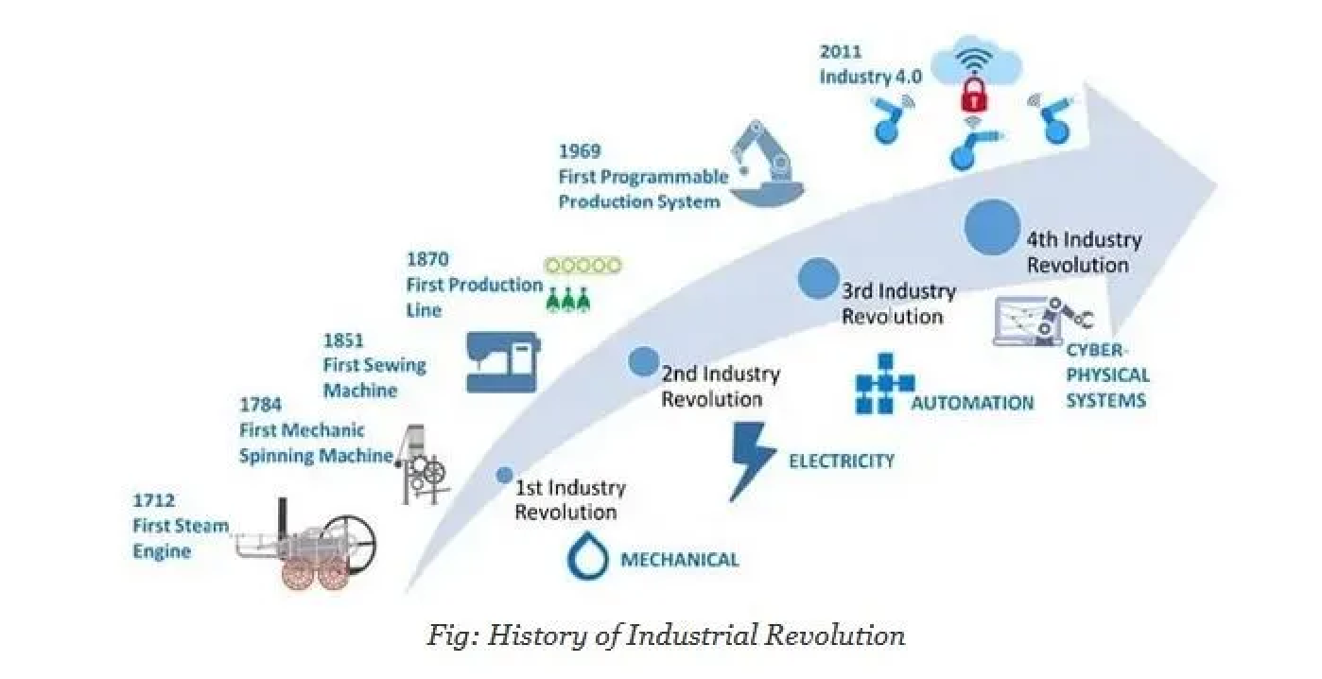
Industry 4.0
Notes:
Industry 4.0: new industrial revolution focused on data-driven business model. CPS must be highly scalable, adaptive, real-time and reliable

Slide 5

Industry 4.0
DistributedHART
(this paper) 2019
Approved ~ 2007
Notes:
WirelessHART has shown its robustness in harsh environments making highly unreliable wireless networks reliable by probiding a high degree of redundanc\y using TDMA

Slide 6
Motivation
Address WirelessHART’s limitations:
  Industry 4.0 suitability
  Network utilization
  Energy intensive
Maintain Performance:
  Scalable
  Adaptive
  Reliable
  Real-time
Notes:
Although wirelessHART is capable at providing reliable wireless communication, this isnt without some key drawbacks from the approach used.
Scalability and network dynamics are subotimal

Slide 7
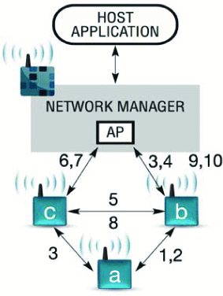
Limitation 1: High Level of Redundancy
Multiple paths
  Exponential scalability
  Network Manager globally tracks
Underutilization under periodic conditions
  Up to 70% unused slots ^{[27]}
Figure 1: An example of scheduling in WirelessHART
Notes:
High redundancy in several algorithms causes a huge waste of time and bandwith. Not to mention unscalable. If a packet success means that none of the other time slots are used. Experiments show up to 70% unused time slots within wirelessHART networks
Management overhead grows from the perspective of the network manager
Network is built for the worst case. Very good at its job of being robust but tradeoff is the underutilization

Slide 8
Limitation 2: Global Dissemination
Exponential Growth with Number of Flows
  Hyper-period
  Schedule length
Non-Adaptive
  Full re-dissemination
  High cost
Figure 1: An example of scheduling in WirelessHART
Notes:
Hyper-period: LCM of flow periods; defines a full cycle after which the schedule pattern repeats
Schedule length: total number of time slots required within that hyper period to execute transmissions without conflict.
Hyper period and length increase exponentially with the increase in the number of flows
Industry 4.0: frequent changes to sampling rates, requiring full reconfiguration and redissemination of schedules by the network manager

Slide 9
Proposed Architecture
WirelessHART
DistributedHART
802.15.4
16 channels
TDMA MAC
Multi-Hop
Graph routing
Scheduling performed by the Network Manger
802.15.4
16 channels
TDMA MAC
Multi-Hop
With or without graph routing
Scheduling performed locally by nodes, online
Notes:
We are not changing anything about the network topology, what devices are used, or the application of the system. This still uses the WirelessHART protocol, however the major change is in the software; allocation and scheduling algorithms are performed by the nodes rather than the network manager.

Slide 10
Outcomes of Paper
Introduction of DistributedHART
Schedulability test to determine real-time performance with a high probability
Tests and simulations displaying DistributedHART’s effectiveness
Key Finding
- DistributedHART reduces energy consumption

Slide 11
DistributedHART Design
2

Slide 12
Design of DistributedHART
Bulk of work done at node level
  Nodes schedule their transmissions locally online
  If first slot successful, nodes can use other windows to transmit
Execution Order
  1. Network Manager generates routes (global)
  2. Channel Allocation (distributed, offline)
  3. Time Window Allocation (distributed, online)
  4. Real-Time Scheduling (local, online)
Notes:
Each node maintains a physical interference model of the network and knows the channel conditions between itself and other local nodes.
This requirement can be met in practice, even in scenarios with fast channel fading or network dynamics since a central manager blacklists these channels at deployment time or through maintenance cycles as specified in the WirelessHART standard
If the transmission on the first slot is successful, then the other slots in the time window can be used to transmit other packets; which is not feasible to other algorithms == reduce wastage of time slots compared to centralized algorithms

Slide 13
Channel Allocation
Signal-to-Noise plus Interference Ratio (SNIR)
  If SNIR exceeds threshold at radio, then two nodes in conflict
*Receiver conflict graph
  Each node maintains a physical interference model using SNIR
  Use vertex coloring to assign channels
Outcome
- Channel conditions known; ability to handle network dynamics
Notes:
Conflict free if the signal to noise plus interference ratio exceeds a threshold.
Each node is assigned a fixed channel to receive messages. This is used by its neighbors to
Ability to handle blacklisting, maintenance cycles, or fast channel fading.

Slide 14
Time Window Allocation
*Transmitter conflict graph
  Graph over remaining conflicting nodes after channel allocation
  Two nodes have an edge if transmissions by both will lead to a collision at the recipients
  Use vertex coloring to assign time windows
Outcome
- Nodes are aware of their neighbors and can save energy
Notes:
After creating the time window allocation the node is aware of its neighbors and their respective time windows.
Each node knows when to expect a packet and when to go to sleep -> energy saving]]

Slide 15
Epoch
Epoch
  - defines 1 full cycle of all assigned time windows, after which the sequence repeats.
W: time slots
γ: total number of unique time windows
epoch = γ × w
Goal: minimize γ
Assumption: Each node has equal length w
Notes:
Minimize worst case chromatic number: → smaller epoch → lower end-to-end flow delay
While assigning a longer time window to a node v_{i} may reduce the delays on flows passing through v_{i}, it may increase the delay for other flows (due to the increase in γ). This trade-off between uniform and non-uniform window assignment is out of the scope of this paper and will be studied in the future.
number of time slots allocated for a node is dependent on the traffic through the node. For simplicity authors assume that each node selects a equal length w for its window.
Distributed hart can still handle non-uniform time window lengths by assigning multiple equal length time windows to a node. Tradeoff studied in the future

Slide 16
Real-Time Scheduling
Works on both fixed or dynamic policies
Deadline Monotonic (DM)
Earliest Deadline First (EDF)
Each node schedules autonomously
Each node knows priorities of packets at buffer
Source nodes determine their sampling period/deadline
Nodes respond to aperiodic events locally without global dissemination
Notes:
DM assigns priorities to flows according to their deadlines (fixed)
EDF assigns priorities dynamically to packets according to their absolute deadlines (dynamic)
The local scheduling of packets within a window obviates the need for creating a schedule in advance and disseminating == reduction in bandwith

Slide 17
DistributedHART EDF Scheduling Example
Assumptions:
only one channel
Each node has equal length w
Nodes: 5
Flows: 2
Epoch: 3
F = {F₁, F₂}
T₁= 6
T₂= 12
D₁< D₂
Flow
Flow: F_{i}
Period: T_{i}
Deadline: D_{i}
D_{i} <= T_{i}
Notes:
DM assigns priorities to flows according to their deadlines (fixed)
EDF assigns priorities dynamically to packets according to their absolute deadlines (dynamic)
Management and diagnostic superframes can run in parallel with the highest priority

Slide 18
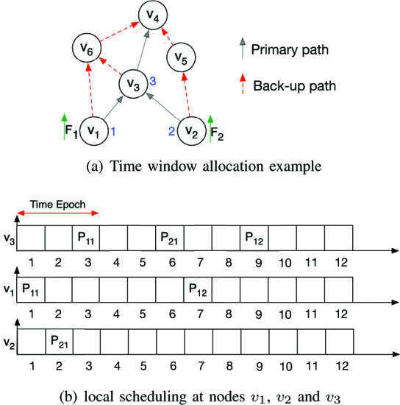
DistributedHART EDF Scheduling Example
F = {F₁, F₂}
T₁= 6
T₂= 12
Figure 2a: Time window allocation example
Figure 2b: local scheduling at nodes v1, v2, v3
Notes:
v1, v2, and v3 are in transmission conflict ==> each node executes vertex coloring to select unique time window.
Epoch length 3
P11, P12 represent first and second packet of flow f1
At time window 1, v1 transmits packet P11 to node v3

Slide 19
DistributedHART EDF Scheduling Example
F = {F₁, F₂}
T₁= 6
T₂= 12
P11
Figure 2a: Time window allocation example
Figure 2b: local scheduling at nodes v1, v2, v3
Notes:
v1, v2, and v3 are in transmission conflict ==> each node executes vertex coloring to select unique time window.
Epoch length 3
P11, P12 represent first and second packet of flow f1
At time window 1, v1 transmits packet P11 to node v3
At time window 2, v2 transmits P21 to node v3
At Time window 3, v3 has P11 and P21. Based on EDF, P11 is chosen because the deadline is 6; packet P21 is held in the queue of node v3 until next epoch

Slide 20
DistributedHART EDF Scheduling Example
F = {F₁, F₂}
T₁= 6
T₂= 12
P11
P21
Figure 2a: Time window allocation example
Figure 2b: local scheduling at nodes v1, v2, v3
Notes:
v1, v2, and v3 are in transmission conflict ==> each node executes vertex coloring to select unique time window.
Epoch length 3
P11, P12 represent first and second packet of flow f1
At time window 1, v1 transmits packet P11 to node v3
At time window 2, v2 transmits P21 to node v3
At Time window 3, v3 has P11 and P21. Based on EDF, P11 is chosen because the deadline is 6; packet P21 is held in the queue of node v3 until next epoch

Slide 21
DistributedHART EDF Scheduling Example
F = {F₁, F₂}
T₁= 6
T₂= 12
P11
P21
Figure 2a: Time window allocation example
Figure 2b: local scheduling at nodes v1, v2, v3
Notes:
v1, v2, and v3 are in transmission conflict ==> each node executes vertex coloring to select unique time window.
Epoch length 3
P11, P12 represent first and second packet of flow f1
At time window 1, v1 transmits packet P11 to node v3
At time window 2, v2 transmits P21 to node v3
At Time window 3, v3 has P11 and P21. Based on EDF, P11 is chosen because the deadline is 6; packet P21 is held in the queue of node v3 until next epoch

Slide 22
DistributedHART EDF Scheduling Example
F = {F₁, F₂}
T₁= 6
T₂= 12
P21
Figure 2a: Time window allocation example
Figure 2b: local scheduling at nodes v1, v2, v3
Notes:
v1, v2, and v3 are in transmission conflict ==> each node executes vertex coloring to select unique time window.
Epoch length 3
P11, P12 represent first and second packet of flow f1
At time window 1, v1 transmits packet P11 to node v3
At time window 2, v2 transmits P21 to node v3
At Time window 3, v3 has P11 and P21. Based on EDF, P11 is chosen because the deadline is 6; packet P21 is held in the queue of node v3 until next epoch

Slide 23
DistributedHART EDF Scheduling Example
F = {F₁, F₂}
T₁= 6
T₂= 12
P21
Figure 2a: Time window allocation example
Figure 2b: local scheduling at nodes v1, v2, v3
Notes:
v1, v2, and v3 are in transmission conflict ==> each node executes vertex coloring to select unique time window.
Epoch length 3
P11, P12 represent first and second packet of flow f1
At time window 1, v1 transmits packet P11 to node v3
At time window 2, v2 transmits P21 to node v3
At Time window 3, v3 has P11 and P21. Based on EDF, P11 is chosen because the deadline is 6; packet P21 is held in the queue of node v3 until next epoch

Slide 24
DistributedHART EDF Scheduling Example
F = {F₁, F₂}
T₁= 6
T₂= 12
P21
Figure 2a: Time window allocation example
Figure 2b: local scheduling at nodes v1, v2, v3
Notes:
v1, v2, and v3 are in transmission conflict ==> each node executes vertex coloring to select unique time window.
Epoch length 3
P11, P12 represent first and second packet of flow f1
At time window 1, v1 transmits packet P11 to node v3
At time window 2, v2 transmits P21 to node v3
At Time window 3, v3 has P11 and P21. Based on EDF, P11 is chosen because the deadline is 6; packet P21 is held in the queue of node v3 until next epoch

Slide 25
DistributedHART EDF Scheduling Example
F = {F₁, F₂}
T₁= 6
T₂= 12
P12
Figure 2a: Time window allocation example
Figure 2b: local scheduling at nodes v1, v2, v3
Notes:
v1, v2, and v3 are in transmission conflict ==> each node executes vertex coloring to select unique time window.
Epoch length 3
P11, P12 represent first and second packet of flow f1
At time window 1, v1 transmits packet P11 to node v3
At time window 2, v2 transmits P21 to node v3
At Time window 3, v3 has P11 and P21. Based on EDF, P11 is chosen because the deadline is 6; packet P21 is held in the queue of node v3 until next epoch

Slide 26
Slot Sharing
Dedicated Slots
  time slots within a node’s time window used immediately
Shared Slots
  - time slots within or outside a node’s time window, used opportunistically if idle.
If transmission failure is handled by nodes locally:
  1. After failure, node waits for some Θ.
  2. After Θ, If no transmissions sensed, take slot as “shared”.
  3. wait random back-off and transmit packet.
Θ: sensing delay
Notes:
To use a time slots as a shared slot, many nodes need to transmit to the same node simultaneously
Random backoff desynchronizes simultaneous starts
Failure is when there is no ACK

Slide 27
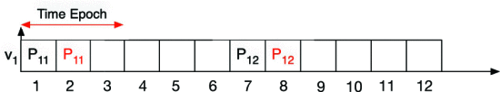
Slot Sharing Re-Transmission Example
Figure 3: An example of scheduling as dedicated and shared slot
Figure 2a: Time window allocation example
Notes:
Packet P11 fails on time window 1 → v1 can use the time slots in time window 2 even though it lies outside of transmission window v1
Shared slot logic is event driven; not opportunistic scanning.
Considers reusing a slot when there is a dedicated transmission failure.

Slide 28
Slot Sharing Re-Transmission Example
Figure 3: An example of scheduling as dedicated and shared slot
P11
Figure 2a: Time window allocation example
Notes:
Packet P11 fails on time window 1 → v1 can use the time slots in time window 2 even though it lies outside of transmission window v1
Shared slot logic is event driven; not opportunistic scanning.
Considers reusing a slot when there is a dedicated transmission failure.

Slide 29
Slot Sharing Re-Transmission Example
  1. After failure, node waits for some Θ.
  2. After Θ, If no transmissions sensed, take slot as “shared”.
  3. wait random back-off and transmit packet.
Figure 3: An example of scheduling as dedicated and shared slot
P11
Figure 2a: Time window allocation example
Notes:
Packet P11 fails on time window 1 → v1 can use the time slots in time window 2 even though it lies outside of transmission window v1
Shared slot logic is event driven; not opportunistic scanning.
Considers reusing a slot when there is a dedicated transmission failure.

Slide 30

Slot Sharing Re-Transmission Example
Figure 3: An example of scheduling as dedicated and shared slot
P11
Figure 2a: Time window allocation example
Notes:
Packet P11 fails on time window 1 → v1 can use the time slots in time window 2 even though it lies outside of transmission window v1
Shared slot logic is event driven; not opportunistic scanning.
Considers reusing a slot when there is a dedicated transmission failure.

Slide 31
Hidden Terminals
Overlapping packet re-transmissions
  Two nodes cannot hear each other, and both transmit to a third node
  Failure in carrier sensing
P11
P21
Figure 2a: Time window allocation example
Notes:
To use a time slots as a shared slot, many nodes need to transmit to the same node simultaneously
Random backoff desynchronizes simultaneous starts
Algorithmic! Not due to redundancy. Redundancy is in place such that any broken/unresponsive node can be bypassed!
Carrier sense multiple access with collision avoidance (CSMA/CA)

Slide 32
Capture Effect
802.15.4 Radio Behavior
  1. Detect and locks preamble with strongest Received Signal Strength (RSS)
  2. Once locked, raise interrupt, and stop searching
  3. Decode packet and ignore subsequent packets
Exploit
If in dedicated slot, transmit at full power immediately
If a re-transmission in shared slot, transmit at weaker power after Θ
Notes:
To use a time slots as a shared slot, many nodes need to transmit to the same node simultaneously
Random backoff desynchronizes simultaneous starts
Failure is when there is no ACK
Ensure that the correct (packet in its dedicated transmission window) is transmitted

Slide 33
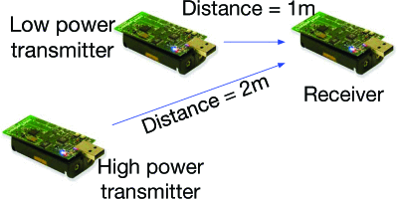
Capture Effect Experiment
Setup
  3 TesloB motes
Goals
  Determine Θ before re-transmission
  Determine re-transmission Tx power
  Observe distance variation
Metric
  Packet Reception Rate (PPR)
Figure 4: Capture effect experiment setup
Notes:
Determine θ (time offset):
-Two transmitters, both at 0 dBm power.
-Varied θ between transmissions.
-Measured Packet Reception Rate (PRR).
-Found θ = 3 ms gives reliable capture effect.
Determine Tx power difference:
-Fixed θ = 3 ms.
- One transmitter kept at 0 dBm, the other’s power reduced gradually.
- Found 3 dB power difference yields strong capture effect.
Evaluate under distance variation:
-Used θ = 3 ms and 3 dB power difference.
- Varied distance between transmitters and receiver.
- Sent 1500 packets per node, 14-byte payloads, every 10 ms on channel 15.
- Repeated 10 iterations; results stable across runs.

Slide 34
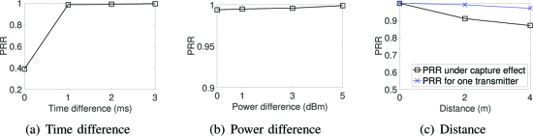
Capture Effect Experiment
Figure 5a: Time difference
Figure 5b: Power difference
Figure 5c: Distance
5a Conditions
- Transmitters at 0dBm power
- Varied θ between transmissions
5b Conditions
- Fixed θ = 3 ms.
- One transmitter kept at 0dBm, other reduced.
5c Conditions
- Fixed θ = 3 ms
- Fixed 3 dB power difference.
- Varied distance between transmitters and receiver.
Notes:
5a) time varying difference. Significant PRR improvement with a larger theta
5b) average PRR under varying power difference; increasing power increases reception rate
5c) varying distance. PRR decrease minimal at distance (0.1)

Slide 35
DistributedHART Analysis
3
(Probabilistic Worst Case)
Notes:
Deterministic local assessment; globally probablilistic

Slide 36
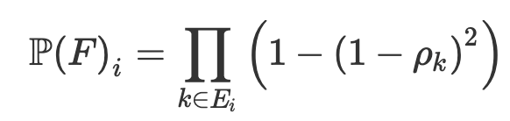
Flow Reception
k: index representing a link
E_{i} : set of links making up primary route of flow F
p_{k} : probability successful transmission over link k
Equation 1: P(successful reception of packet through primary path of graph a route)
Notes:
Pk = probability of 2 dedicated transmissions of link k => 1 - (1-pi^k)^2
Pi^k = probability of successful transmission for a link k in the set of links on the primary path Ei of a graph route of Fi
We don’t consider the secondary paths because the probability is very small and neglibible
Pk = .9, hops =4 => 0.96

Slide 37
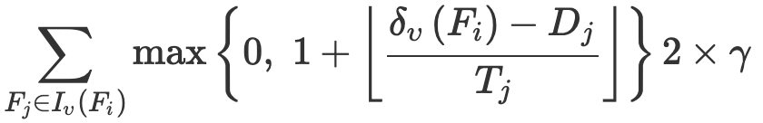

Flow Delay
V_{j} = set of nodes in primary path F_{j}
I_{v} (F_{i} ) = { F_{j} | v ∈ V_{j} } = set of flows passing through node v
Equation 2: total delay experience by a flow F_{i} at node v
Notes:
since time window repeats after every time epoch or γ × w slots, a packet waits for γ ×w time slots for every w time units delay.
A packet also experiences a delay of (γ −1)×w time slots between its arrival and first transmission window.

Slide 38
Flow Delay
V_{j} = set of nodes in primary path F_{j}
I_{v} (F_{i} ) = { F_{j} | v ∈ V_{j} } = set of flows passing through node v
Links typically
scheduled on 2 time slots
Equation 2: total delay experience by a flow F_{i} at node v
Packet response time delay
Delay from other flows
Notes:
Response time delay: waiting time between the packets arrival and its next available transmission window
Execution time of a transmission: 1 for transmission 1 for acknowledgement
Slots have 1 if there is acceptable loss

Slide 39
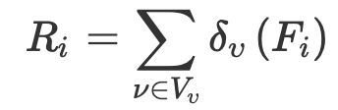
Flow Response Time
Flow Reception: P(F_{i})
Flow Delay: δυ
Equation 3: response time experienced by a control loop DistributedHART
Notes:
DistributedHART is an online scheduling algorithm where a packet experiences a different delay at each node on the path.
Thus, we express the total delay (experienced by a flow) as the sum of delays experienced at each node on the primary path.
In DistributedHART, nodes adopt real-time scheduling policies like EDF or DM to schedule packets autonomously.
Therefore, we can leverage on existing processor demand bound analysis (or response time analysis) of EDF (or DM) algorithms to determine the worst-case delay of flows.
In this section, we show the worst case delay computation for flows in DistributedHART with EDF local scheduling using processor demand function proposed in [40]. A similar approach can be used for DM to obtain the end-to-end delay bounds.

Slide 40
Test Results
4

Slide 41
Testbed Setup
Setup
  - Platform: TinyOS 2.2 running TelosB motes
  - Network Size: 130 nodes
  - Transmit Power: -28.7 dBm
  - Topology: 4-hop
  - Routing Baseline: Centralized graph routing
  - Manager Role: Computed initial channel and time-window allocations centrally
  - Scheduling Policies: EDF and DM (with spatial reuse)
  - Energy Estimation:
    USBs used for power, use product of # transmissions x energy consumed
    5.5ms Tx time, 0.22mg consumed per communication
Metrics
  1. Energy: energy consumed per node (J)
  2. Memory: memory consumed to store a schedule (KB)
  3. Convergence Time: average time taken for all nodes to obtain a schedule (s)
  4. Schedulability Ratio: fraction of test cases schedulable among all cases
Notes:
Some other setup not mentioned (Flooding Time Synchronization Protocol FTSP)

Slide 42
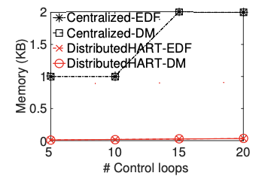
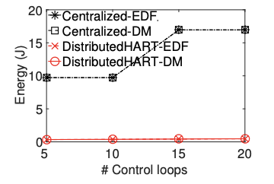
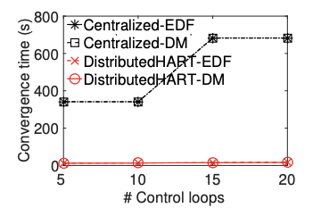
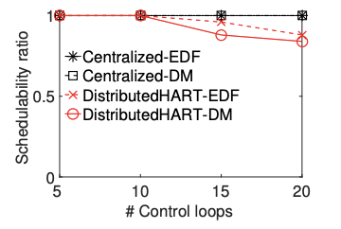
Experiment Results
WirelessHART vs DistributedHART
Figure 6a: Memory Consumption
Figure 6b: Energy Consumption
Figure 6c: Convergence Time
Figure 6d: Schedulability Ratio
Notes:
Memory consumption in centralized proportional to hyper-period ➔ bad. DistributedHart 75% less memory
Enery consumption at a node is dependent of the length of the schedule ➔ bad. DistributedHart 95% less energy
Convergence dependent on hyper-period, with a step increase ➔ bad. DistributedHart 95% less convergence time
DistributedHART Performs poorly due to lack of global information, but still competitive

Slide 43
Simulation Results
5

Slide 44
Simulation Setup
Setup
  - Simulator: TOSSIM (TinyOS Simulator)
  - Network Size: 148 nodes
  - Transmit Power: -28.7 dBm
  - Fully-Distributed: channel and time window allocated by nodes (both initially and operationally)
  - Test-Cases:
    50 randomly selected sensor/actuators
    Sensor/Actuators assigned random harmonic periods in the range of 2¹¹⁻¹³ time slots
    Every 10 flows, double the range
  - Scheduling Policies: WirelessHART/DistributedHART EDF and DM, Orchestra, DiGS
Metrics
  1. Energy: energy consumed per node (J)
  2. Memory: memory consumed to store a schedule
  3. Convergence Time: average time taken for all nodes to obtain a schedule
  4. Schedulability Ratio: fraction of test cases schedulable among all cases
Notes:
Orchestra and DiGS as distributed baselines. Using EDF for orchestra and Digs

Slide 45
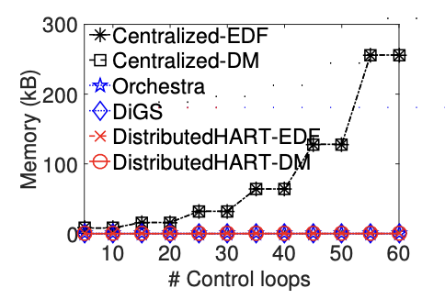
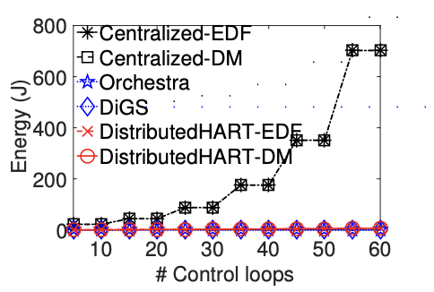
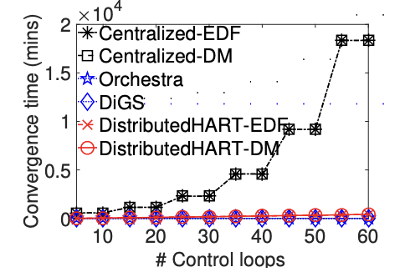
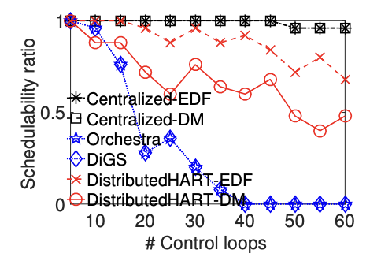
Simulation Results
Centralized vs Decentralized
Figure 7a: Memory Consumption
Figure 7b: Energy Consumption
Figure 7c: Convergence Time
Figure 7d: Schedulability Ratio
Notes:
7a) consumes 95% less memory compared to centralized
7b) consumes 95% less energy compared to centralized
7c) consumes 90% less time to converge compared to centralized
7d) centralized algorithms show a higher schedulability ratio

Slide 46
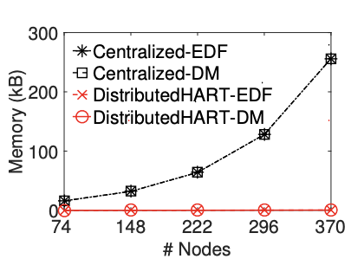
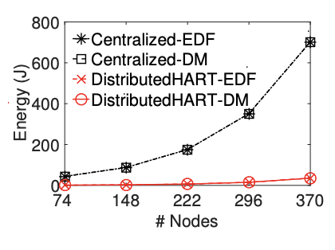
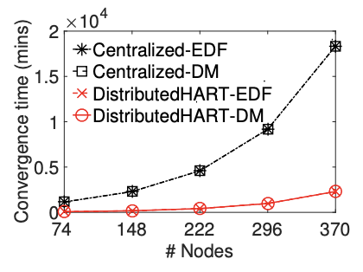
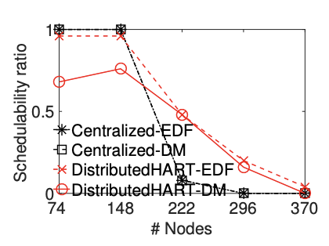
Simulation Results
Network Size
Figure 8a: Memory Consumption
Figure 8b: Energy Consumption
Figure 8c: Convergence Time
Figure 8d: Schedulability Ratio
Notes:
8a) 99% less memory than centralized
8b) 94% less energy
8c) 85% less convergence time
8d) IMPORTANT even though scheduling ratios were shown to favor WirelessHART under various control loops, increasing the nodes favors DistributedHART

Slide 47
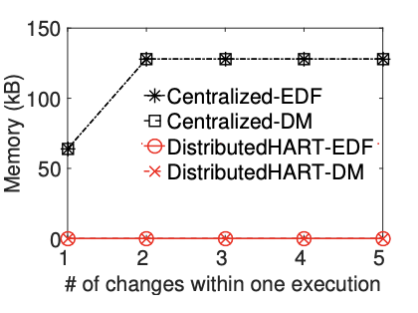
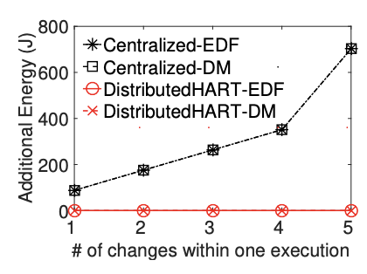
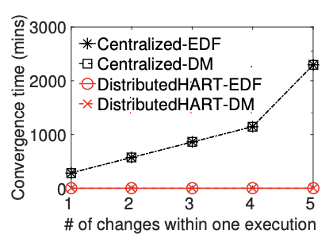
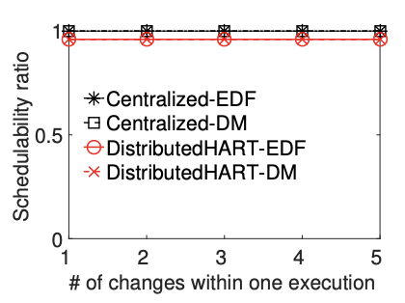
Simulation Results
Network Dynamics
Figure 9a: Memory Consumption
Figure 9b: Energy Consumption
Figure 8c: Convergence Time
Figure 8d: Schedulability Ratio
Notes:
9a) hyper period at most doubles for centralized; no effect on distributed
9b) energy consumed in changes grows linearly; limited effect on distributed hart
9c) linear increase for centralized; limited increase for distributed
9d) centralized performs 4% better than distributed.

Slide 48
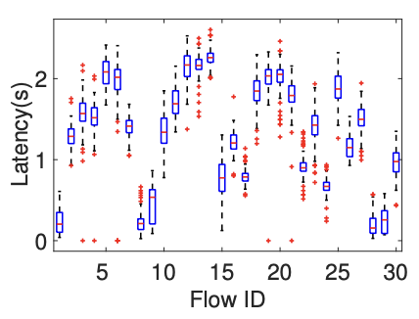
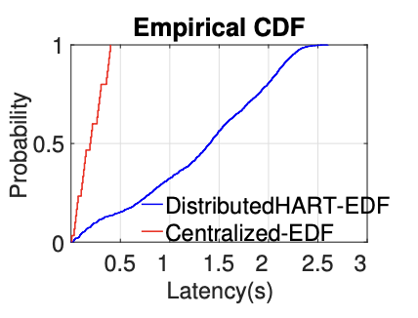
Simulation Results
Latency
Figure 10: Latency under DistributedHART
Figure 11: Latency comparison between Centralized-EDF and DistributedHART-EDF
Jitter: variation in packet delay
Notes:
Variations in jitter because of local conditions and scheduling outcomes
Latency experienced
10) average latency of 1.5s for all flow with flow 14 experiencing maximum latency in the network of 2.5
Dependency is on the route length because each packet must sait a minimum γ (gamma) time units
Cumulative distribution
11) comparison between centralized and distributed
Time slots are γ units apart from eachother

Slide 49
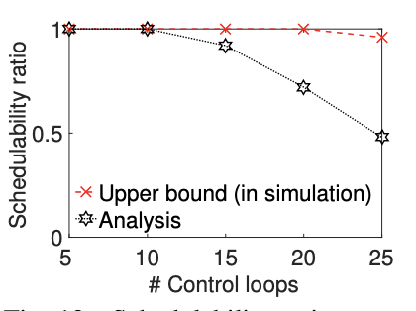
Simulation Results
End-to-End Delay Analysis
Equation 3: response time experienced by a control loop DistributedHART
Figure 12: Schedulability ratio comparison with an upper bound
Notes:
Compare simulated scheduability ratio to what was calculated using the analysis equations.

Slide 50
Conclusion
DistributedHART
  More suitable for Industry 4.0
  Higher network utilization
  85% less energy intensive
Performance
  Highly scalable
  Improved adaptability
  Preserves reliability
  Questionable latency
  Decreased Schedulability in small networks
Notes:
Orchestra and DiGS are local

Slide 51
Closing Slide Header

Slide 52
Works Cited
This presentation was part of the University of Iowa’s CS:4980:0007 Course
Presentation not affiliated with Wayne State University, Missouri University of Science and Technology, or the authors of “DistrbutedHART: A Distributed Real-Time Scheduling System for WirelessHART Networks”.
Paper: https://ieeexplore.ieee.org/document/8743267
DOI: 10.1109/RTAS.2019.00026
Figures [1,2,3,4,5,6,7, 8, 9, 10, 11]
Other Images:
Industry 4.0 graph: https://www.texspacetoday.com/step-towards-sustainability-from-industry-4-0-to-industry-5-0/
WirelessHART: https://www.emerson.com/en-us/automation/measurement-instrumentation/industrial-wireless-technology/wireless-gateways

