Slide 1
DistributedHART:
A Distributed Real-Time Scheduling System for WirelessHART Networks
Matt Krueger
Oct. 15, 2025

Slide 2
Introduction
1

Slide 3
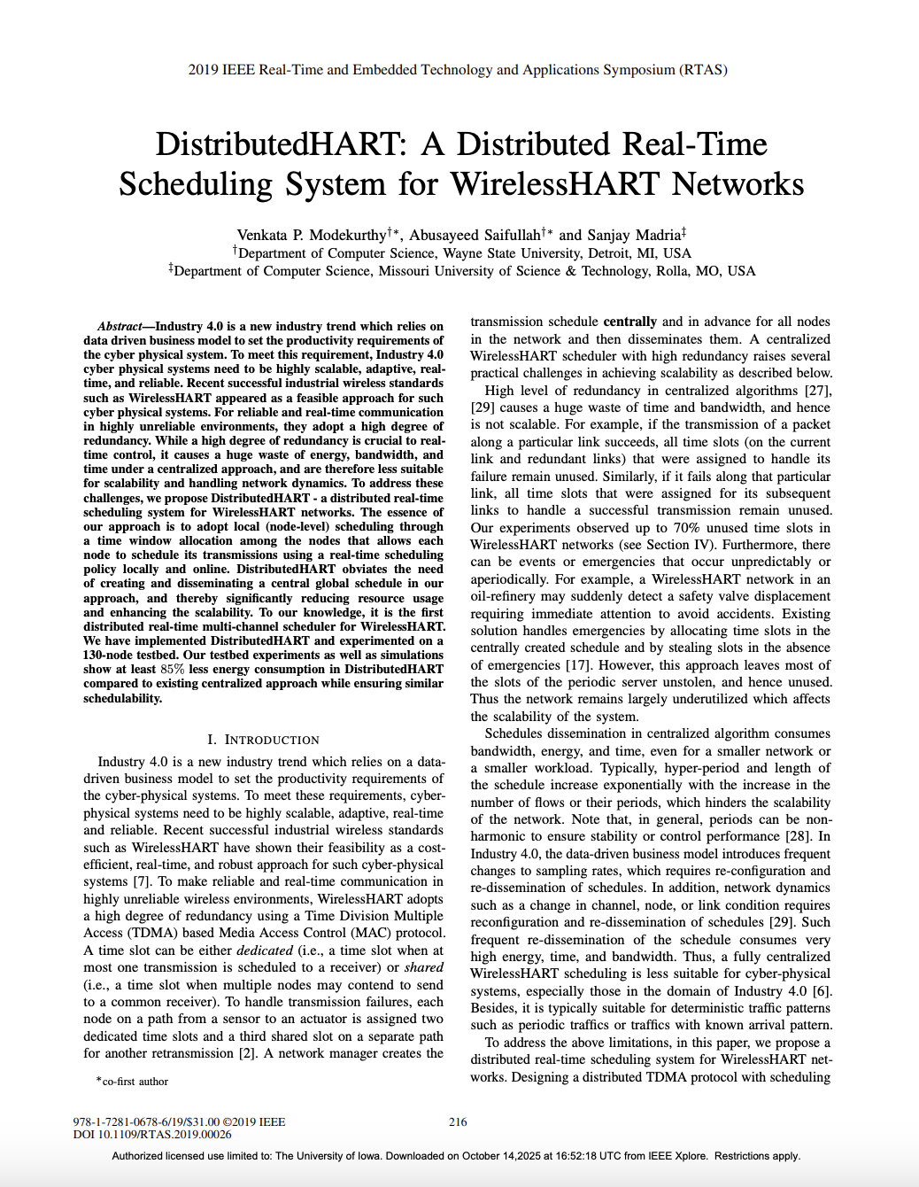
Background
2019 IEEE Real-Time and Embedded Technology and Applications Symposium (RTAS)
Wayne State University, Detroit, MI, USA
Missouri University of Science and Technology, Rolla, MO, USA

Slide 4
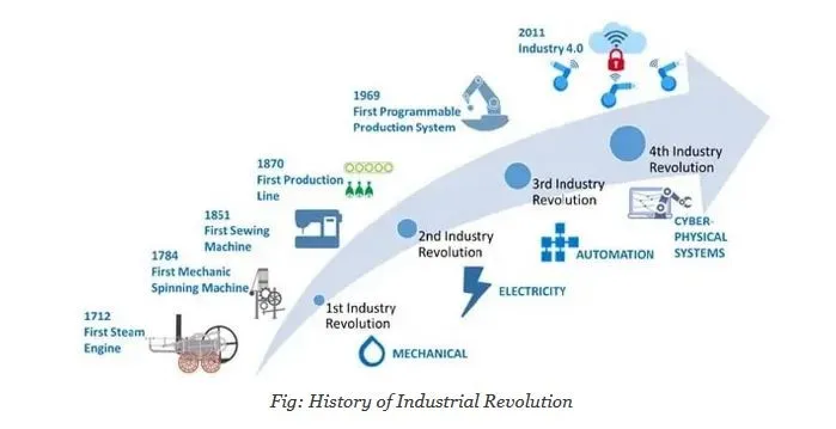
Industry 4.0

Slide 5

Industry 4.0
DistributedHART
(this paper) 2019
Introduced ~ 2007

Slide 6
Motivation of DistributedHART
Address WirelessHART’s limitations:
  Industry 4.0 suitability
  Network utilization
  Energy intensive
Maintain Performance:
  Scalable
  Adaptive
  Reliable
  Real-time

Slide 7
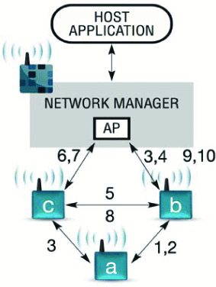
Limitation 1: High Level of Redundancy
Multiple paths
  Exponential scalability
  Underutilization under periodic conditions
70% unused slots ^{[27]}
  30 flows
  69 nodes
Figure 1: An example of scheduling in WirelessHART
Notes:
Expirment performed in . Abusayeed Saifullah, Dolvara Gunatilaka, Paras Tiwari, Mo Sha, Chenyang Lu, Bo Li, Chengjie Wu, and Yixin Chen. Schedulability analysis under graph routing in wirelesshart networks. In Real-Time Systems Symposium, 2015 IEEE, pages 165–174. IEEE, 2015.

Slide 8
Limitation 2: Global Dissemination
Exponential Growth
  Hyper-period
  Schedule length
Non-Adaptive
  Full re-dissemination
  High cost
Figure 1: An example of scheduling in WirelessHART

Slide 9
Proposed Architecture
WirelessHART
DistributedHART
802.15.4
16 channels
TDMA MAC
Multi-Hop
Graph Routing
Offline centralized scheduling
802.15.4
16 channels
TDMA MAC
Multi-Hop
Graph Routing
Online decentralized scheduling
Notes:
Network manager is limited to network organization and relinquished of scheduling control

Slide 10
Outcomes of Paper
Addressed WirelessHART’s limitations
  More suitable for Industry 4.0
  Higher network utilization
  85% less energy intensive
Maintained Performance
  Highly scalable
  Improved adaptability
  Preserves reliability
  Questionable latency but improved long-term Real-Time performance
  Decreased Schedulability but competive

Slide 11
DistributedHART Design
2

Slide 12
Design of DistributedHART
Bulk of work done at node level
  Nodes schedule their transmissions locally online
  Each node performs channel/time allocations, and scheduling
Execution Order
  1. Network Manager generates routes (global)
  2. Channel Allocation (distributed, offline)
  3. Time Window Allocation (distributed, online)
  4. Real-Time Scheduling (local, online)
Notes:
Execution order:
NM – disseminated to all nodes
CA – each node knows which channel to listen on and which channels are used to reach neighbors
TWA – each node knows when it is allowed to schedule transmissions

Slide 13
Channel Allocation
Signal-to-Noise plus Interference (SNIR)
  If exceeds threshold, then two nodes in conflict
Receiver conflict graph
  Each node maintains a physical interference model using SNIR
  Use vertex coloring to assign channels
Notes:
To minimize such conflicts, each node first performs a receiver based channel allocation based on vertex coloring as the one used in [26].
OUTCOME: Each node is assigned a fixed channel to receive messages; its neighbors use this channel to send messages to it.
**Each node knows only its incoming and outgoing communication and interference edges
RID protocol

Slide 14
Time Window Allocation
Transmitter conflict graph
  Graph over remaining conflicting nodes after channel allocation
  Two nodes have an edge if transmissions by both will lead to a collision at the recipients
  Use vertex coloring to assign time windows
Notes:
MAINTAINED: spatial reuse
DistributedHART allows spatial reuse where many non-conflicting nodes will have the same time window and transmit simultaneously
OUTCOME: each node is now aware of its neighbors time window.
==> knows when to expect a packet and when to sleep
MINIMIZE total number of unique windows to minimize the end-to-end latency

Slide 15
Epoch
Epoch
  - defines 1 full cycle of all assigned time windows, after which the sequence repeats.
W: time slots
γ: total number of unique windows
epoch = γ × w
Goal: minimize γ → smaller epoch → lower end-to-end delay
Notes:
MINIMIZE total number of unique windows to minimize the end-to-end latency
While assigning a longer time window to a node v_{i} may reduce the delays on flows passing through v_{i}, it may increase the delay for other flows (due to the increase in γ). This trade-off between uniform and non-uniform window assignment is out of the scope of this paper and will be studied in the future.

Slide 16
Scheduling
Works on both fixed or dynamic policies
Deadline Monotonic (DM)
Earliest Deadline First (EDF)
Each node adopts policy locally
Network manager does not assign priorities
Each node knows priorities of packets at buffer
Source nodes determine their sampling period/deadline
Nodes respond to aperiodic events locally locally without global dissemination
Notes:
DM assigns priorities to flows according to their deadlines (fixed)
EDF assigns priorities dynamically to packets according to their absolute deadlines (dynamic)
Management and diagnostic superframes can run in parallel with the highest priority

Slide 17
DistributedHART EDF Scheduling Example
Assumption: only one channel
5 Nodes
2 Flows
F = {F₁, F₂}
T₁= 6
T₂= 12
D₁< D₂
Flow
Flow: F_{i}
Period: T_{i}
Deadline: D_{i}
D_{i} <= T_{i}
Notes:
DM assigns priorities to flows according to their deadlines (fixed)
EDF assigns priorities dynamically to packets according to their absolute deadlines (dynamic)
Management and diagnostic superframes can run in parallel with the highest priority

Slide 18
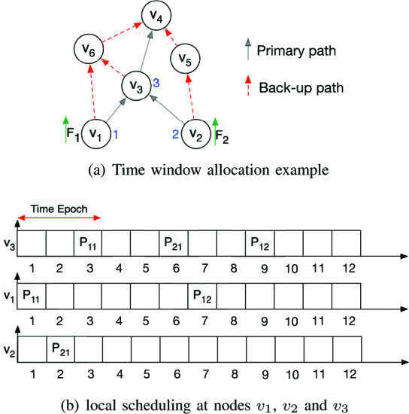
DistributedHART EDF Scheduling Example
F = {F₁, F₂}
T₁= 6
T₂= 12
Figure 2a: Time window allocation example
Figure 2b: local scheduling at nodes v1, v2, v3
Notes:
v1, v2, and v3 are in transmission conflict ==> each node executes vertex coloring to select unique time window.
Epoch length 3
P11, P12 represent first and second packet of flow f1
At time window 1, v1 transmits packet P11 to node v3

Slide 19
DistributedHART EDF Scheduling Example
F = {F₁, F₂}
T₁= 6
T₂= 12
P11
Figure 2a: Time window allocation example
Figure 2b: local scheduling at nodes v1, v2, v3
Notes:
v1, v2, and v3 are in transmission conflict ==> each node executes vertex coloring to select unique time window.
Epoch length 3
P11, P12 represent first and second packet of flow f1
At time window 1, v1 transmits packet P11 to node v3
At time window 2, v2 transmits P21 to node v3
At Time window 3, v3 has P11 and P21. Based on EDF, P11 is chosen because the deadline is 6; packet P21 is held in the queue of node v3 until next epoch

Slide 20
DistributedHART EDF Scheduling Example
F = {F₁, F₂}
T₁= 6
T₂= 12
P11
P21
Figure 2a: Time window allocation example
Figure 2b: local scheduling at nodes v1, v2, v3
Notes:
v1, v2, and v3 are in transmission conflict ==> each node executes vertex coloring to select unique time window.
Epoch length 3
P11, P12 represent first and second packet of flow f1
At time window 1, v1 transmits packet P11 to node v3
At time window 2, v2 transmits P21 to node v3
At Time window 3, v3 has P11 and P21. Based on EDF, P11 is chosen because the deadline is 6; packet P21 is held in the queue of node v3 until next epoch

Slide 21
DistributedHART EDF Scheduling Example
F = {F₁, F₂}
T₁= 6
T₂= 12
P11
P21
Figure 2a: Time window allocation example
Figure 2b: local scheduling at nodes v1, v2, v3
Notes:
v1, v2, and v3 are in transmission conflict ==> each node executes vertex coloring to select unique time window.
Epoch length 3
P11, P12 represent first and second packet of flow f1
At time window 1, v1 transmits packet P11 to node v3
At time window 2, v2 transmits P21 to node v3
At Time window 3, v3 has P11 and P21. Based on EDF, P11 is chosen because the deadline is 6; packet P21 is held in the queue of node v3 until next epoch

Slide 22
DistributedHART EDF Scheduling Example
F = {F₁, F₂}
T₁= 6
T₂= 12
P21
Figure 2a: Time window allocation example
Figure 2b: local scheduling at nodes v1, v2, v3
Notes:
v1, v2, and v3 are in transmission conflict ==> each node executes vertex coloring to select unique time window.
Epoch length 3
P11, P12 represent first and second packet of flow f1
At time window 1, v1 transmits packet P11 to node v3
At time window 2, v2 transmits P21 to node v3
At Time window 3, v3 has P11 and P21. Based on EDF, P11 is chosen because the deadline is 6; packet P21 is held in the queue of node v3 until next epoch

Slide 23
DistributedHART EDF Scheduling Example
F = {F₁, F₂}
T₁= 6
T₂= 12
P21
Figure 2a: Time window allocation example
Figure 2b: local scheduling at nodes v1, v2, v3
Notes:
v1, v2, and v3 are in transmission conflict ==> each node executes vertex coloring to select unique time window.
Epoch length 3
P11, P12 represent first and second packet of flow f1
At time window 1, v1 transmits packet P11 to node v3
At time window 2, v2 transmits P21 to node v3
At Time window 3, v3 has P11 and P21. Based on EDF, P11 is chosen because the deadline is 6; packet P21 is held in the queue of node v3 until next epoch

Slide 24
DistributedHART EDF Scheduling Example
F = {F₁, F₂}
T₁= 6
T₂= 12
P21
Figure 2a: Time window allocation example
Figure 2b: local scheduling at nodes v1, v2, v3
Notes:
v1, v2, and v3 are in transmission conflict ==> each node executes vertex coloring to select unique time window.
Epoch length 3
P11, P12 represent first and second packet of flow f1
At time window 1, v1 transmits packet P11 to node v3
At time window 2, v2 transmits P21 to node v3
At Time window 3, v3 has P11 and P21. Based on EDF, P11 is chosen because the deadline is 6; packet P21 is held in the queue of node v3 until next epoch

Slide 25
Slot Sharing
Dedicated Slots
  time slots within a node’s time window used immediately
Shared Slots
  - time slots within or outside a node’s time window, used opportunistically if idle.
If transmission failure is handled by nodes locally:
  1. After failure, node waits for some Θ.
  2. After Θ, If no transmissions sensed, take slot as “shared”.
  3. wait random back-off and transmit packet.
Θ: sensing delay
Notes:
To use a time slots as a shared slot, many nodes need to transmit to the same node simultaneously
Random backoff desynchronizes simultaneous starts
Failure is when there is no ACK

Slide 26
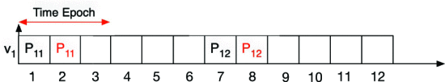
Slot Sharing Re-Transmission Example
F = {F₁, F₂}
T₁= 12
T₂= 24
Figure 3: An example of scheduling as dedicated and shared slot
Figure 2a: Time window allocation example
Notes:
Packet P11 fails on time window 1 → v1 can use the time slots in time window 2 even though it lies outside of transmission window v1
Shared slot logic is event driven; not opportunistic scanning.
Considers reusing a slot when there is a dedicated transmission failure.

Slide 27
Hidden Terminals
Overlapping packet re-transmissions
  Two nodes cannot hear each other, and both transmit to a third node
  Failure in carrier sensing
P11
P21
Figure 2a: Time window allocation example
Notes:
To use a time slots as a shared slot, many nodes need to transmit to the same node simultaneously
Random backoff desynchronizes simultaneous starts
Algorithmic! Not due to redundancy. Redundancy is in place such that any broken/unresponsive node can be bypassed!
Carrier sense multiple access with collision avoidance (CSMA/CA)

Slide 28
Capture Effect
802.15.4 Radio Behavior
  1. Detect and locks preamble with strongest Received Signal Strength (RSS)
  2. Once locked, raise interrupt, and stop searching
  3. Decode packet and ignore subsequent packets
Exploit
If in dedicated slot, transmit at full power immediately
If a re-transmission in shared slot, transmit at weaker power after Θ
Notes:
To use a time slots as a shared slot, many nodes need to transmit to the same node simultaneously
Random backoff desynchronizes simultaneous starts
Failure is when there is no ACK
Ensure that the correct (packet in its dedicated transmission window) is transmitted

Slide 29
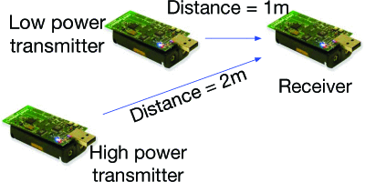
Capture Effect Experiment
Goals
  Determine Θ before re-transmission
  Determine re-transmission Tx power
  Observe distance variation
Metric
  Packet Reception Rate (PPR)
Figure 4: Capture effect experiment setup
Notes:
Determine θ (time offset):
-Two transmitters, both at 0 dBm power.
-Varied θ between transmissions.
-Measured Packet Reception Rate (PRR).
-Found θ = 3 ms gives reliable capture effect.
Determine Tx power difference:
-Fixed θ = 3 ms.
- One transmitter kept at 0 dBm, the other’s power reduced gradually.
- Found 3 dB power difference yields strong capture effect.
Evaluate under distance variation:
-Used θ = 3 ms and 3 dB power difference.
- Varied distance between transmitters and receiver.
- Sent 1500 packets per node, 14-byte payloads, every 10 ms on channel 15.
- Repeated 10 iterations; results stable across runs.

Slide 30
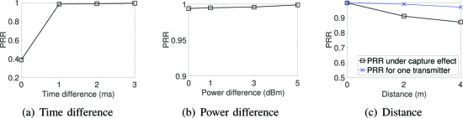
Capture Effect Experiment
Figure 5a: Time difference
Figure 5b: Power difference
Figure 5c: Distance
5a Conditions
- Transmitters at 0dBm power
- Varied θ between transmissions
5b Conditions
- Fixed θ = 3 ms.
- One transmitter kept at 0dBm, other reduced.
5c Conditions
- Fixed θ = 3 ms
- Fixed 3 dB power difference.
- Varied distance between transmitters and receiver.

Slide 31
DistributedHART Analysis
3

Slide 32
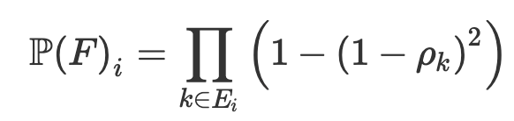
Flow P(Success)
k: index representing a link
E_{i} : set of links making up primary route of flow F
p_{k} : probability successful transmission over link k
Equation 1: P(successful reception of packet through primary path of graph a route)
Notes:
Pk = probability of 2 dedicated transmissions of link k => 1 - (1-pi^k)^2
Pi^k = probability of successful transmission for a link k in the set of links on the primary path Ei of a graph route of Fi
We don’t consider the secondary paths because the probability is very small and neglibible

Slide 33
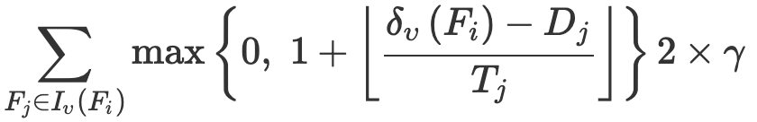

Flow Delay
V_{j} = set of nodes in primary path F_{j}
I_{v} (F_{i} ) = { F_{j} | v ∈ V_{j} } = set of flows passing through node v
Equation 2: total delay experience by a flow F_{i} at node v
Notes:
since time window repeats after every time epoch or γ × w slots, a packet waits for γ ×w time slots for every w time units delay.
A packet also experiences a delay of (γ −1)×w time slots between its arrival and first transmission window.

Slide 34
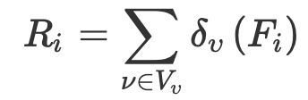
Flow Response Time
Flow Probability: P(F_{i})
Flow Delay: δυ
Equation 3: response time experienced by a control loop DistributedHART
Notes:
DistributedHART is an online scheduling algorithm where a packet experiences a different delay at each node on the path.
Thus, we express the total delay (experienced by a flow) as the sum of delays experienced at each node on the primary path.
In DistributedHART, nodes adopt real-time scheduling policies like EDF or DM to schedule packets autonomously.
Therefore, we can leverage on existing processor demand bound analysis (or response time analysis) of EDF (or DM) algorithms to determine the worst-case delay of flows.
In this section, we show the worst case delay computation for flows in DistributedHART with EDF local scheduling using processor demand function proposed in [40]. A similar approach can be used for DM to obtain the end-to-end delay bounds.

Slide 35
Comparison to WirelessHART
4

Slide 36
Testbed Setup
Setup
  - Platform: TinyOS 2.2 running TelosB motes
  - Network Size: 130 nodes
  - Transmit Power: -28.7 dBm
  - Topology: 4-hop
  - Routing Baseline: Centralized graph routing
  - Manager Role: Computed initial channel and time-window allocations centrally
  - Scheduling Policies: EDF and DM (with spatial reuse)
Metrics
  1. Energy: energy consumed per node (J)
  2. Memory: memory consumed to store a schedule (KB)
  3. Convergence Time: average time taken for all nodes to obtain a schedule (s)
  4. Schedulability Ratio: fraction of test cases schedulable among all cases
Notes:
Some other setup not mentioned (Flooding Time Synchronization Protocol FTSP)

Slide 37
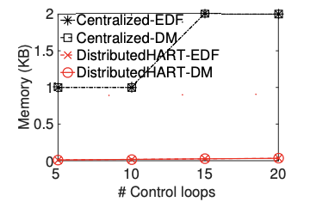
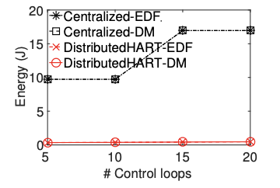
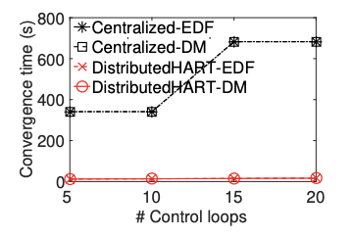
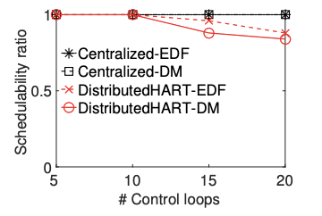
Experiment Results
Figure 6: Experimental result under varying number of flows considering harmonic periods
Figure 6a: Memory Consumption
Figure 6b: Energy Consumption
Figure 6c: Convergence Time
Figure 6d: Schedulability Ratio
Notes:
Memory consumption in centralized proportional to hyper-period ➔ bad. DistributedHart 75% less memory
Enery consumption at a node is dependent of the length of the schedule ➔ bad. DistributedHart 95% less energy
Convergence dependent on hyper-period, with a step increase ➔ bad. DistributedHart 95% less convergence time
DistributedHART Performs poorly due to lack of global information, but still competitive

Slide 38
Simulation Setup
Setup
  - Simulator: TOSSIM (TinyOS Simulator)
  - Network Size: 148 nodes
  - Transmit Power: -28.7 dBm
  - Fully-Distributed: channel and time window allocated by nodes (both initially and operationally)
  Test-Cases:
    50 randomly selected sensor/actuators
    Sensor/Actuators assigned random harmonic periods in the range of 2¹¹⁻¹³ time slots
    Every 10 flows, double the range
  - Scheduling Policies: WirelessHART/DistributedHART EDF and DM, Orchestra, DiGS (
Metrics
  1. Energy: energy consumed per node (J)
  2. Memory: memory consumed to store a schedule
  3. Convergence Time: average time taken for all nodes to obtain a schedule
  4. Schedulability Ratio: fraction of test cases schedulable among all cases
Notes:
Orchestra and DiGS are local

Slide 39
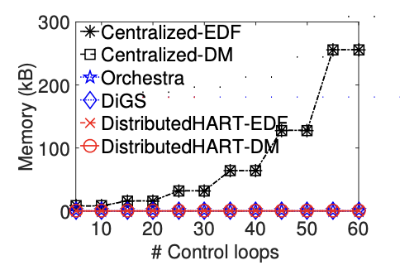
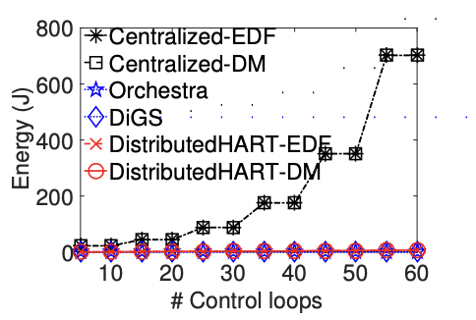
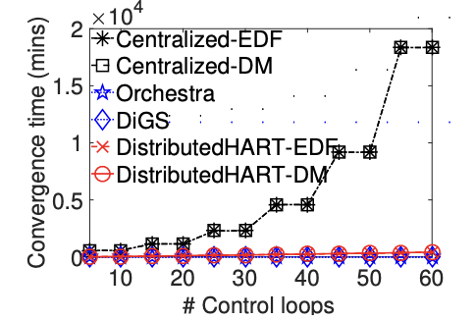
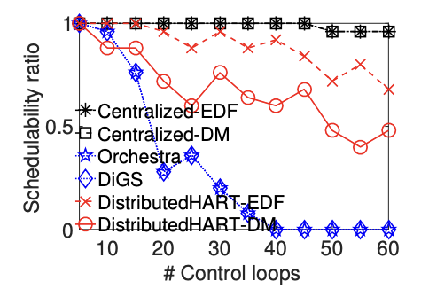
Simulation Results
Figure 7: Performance under varying number of control loops considering harmonic periods
Figure 7a: Memory Consumption
Figure 7b: Energy Consumption
Figure 7c: Convergence Time
Figure 7d: Schedulability Ratio

Slide 40
Simulation Results
Figure 8: Performance under varying number of nodes
Figure 8a: Memory Consumption
Figure 8b: Energy Consumption
Figure 8c: Convergence Time
Figure 8d: Schedulability Ratio

Slide 41
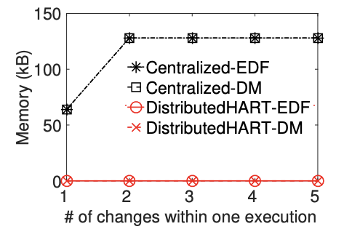
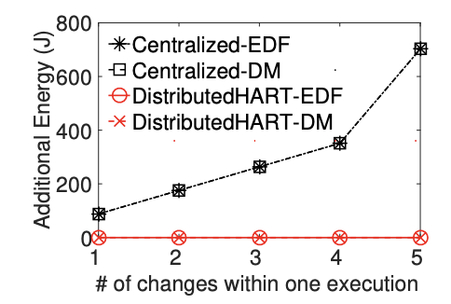
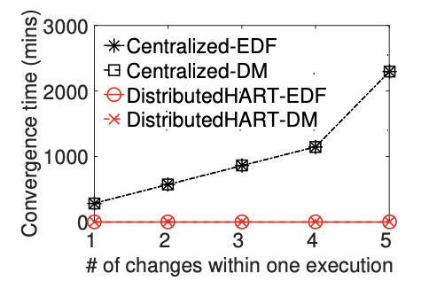
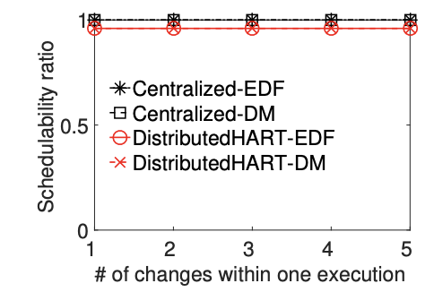
Simulation Results
Figure 9: Performance under varying workload dynamic
Figure 7a: Memory Consumption
Figure 7b: Energy Consumption
Figure 7c: Convergence Time
Figure 7d: Schedulability Ratio

Slide 42
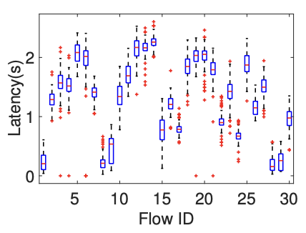
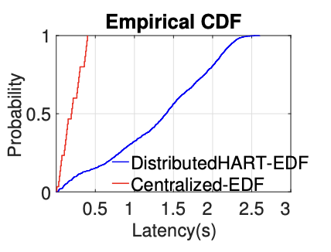
Simulation Results
Figure 10: Latency under DistributedHART
Figure 11: Latency comparison between Centralized-EDF and DistributedHART-EDF

Slide 43
Conclusion
Compelling argument for decentralized scheduling
  More suitable for Industry 4.0
  Higher network utilization
  85% less energy intensive
  Highly scalable
  Improved adaptability
  Preserves reliability
  Questionable latency but improved long-term Real-Time performance
Notes:
Orchestra and DiGS are local

Slide 44
Closing Slide Header

Slide 45
Works Cited
This presentation was part of the University of Iowa’s CS:4980:0007 Course
Presentation not affiliated with Wayne State University, Missouri University of Science and Technology, or the authors of “DistrbutedHART: A Distributed Real-Time Scheduling System for WirelessHART Networks”.
Paper: https://ieeexplore.ieee.org/document/8743267
DOI: 10.1109/RTAS.2019.00026
Figures [1,2,3,4,5,6,7, 8, 9, 10, 11]
Other Images:
Industry 4.0 graph: https://www.texspacetoday.com/step-towards-sustainability-from-industry-4-0-to-industry-5-0/
WirelessHART: https://www.emerson.com/en-us/automation/measurement-instrumentation/industrial-wireless-technology/wireless-gateways

