Slide 1
Comparison of Thread, Zigbee and Z-Wave for Home Automation
Matt Krueger
December 19, 2025

Slide 2
Quick Note
This “presentation” contains many short form paragraphs in contrast to a typical bulleted format to more clearly explain ideas and thinking.
I felt this to be sufficient as I did not verbally present this material.

Slide 3
Agenda
Project Motivation
Protocols
Thread
Zigbee
Z-Wave
Comparison
Future Work (an automation I will build)
Conclusion
Thank You!

Slide 4
Project Motivation
What am I trying to achieve

Slide 5
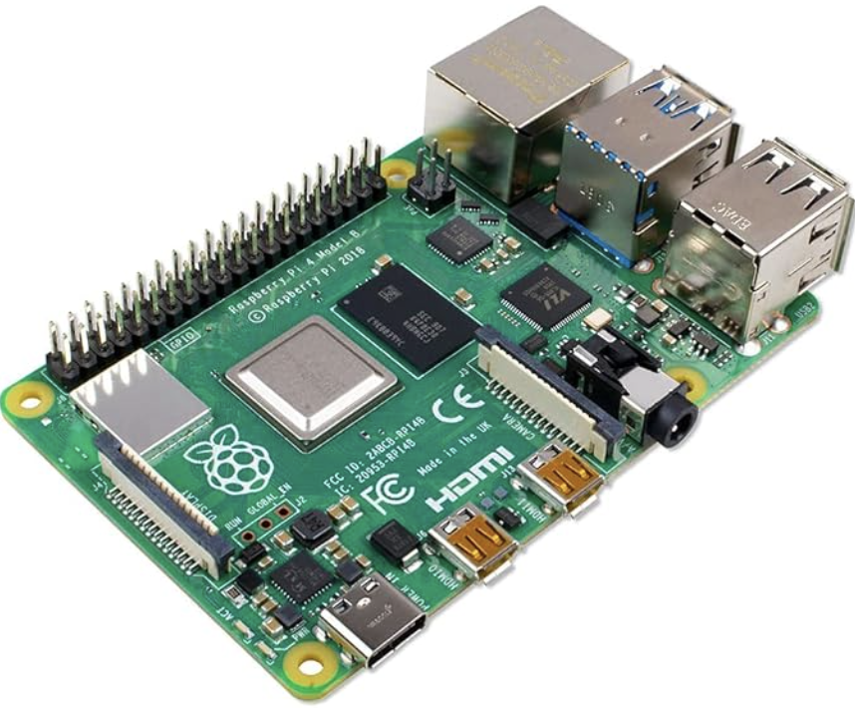
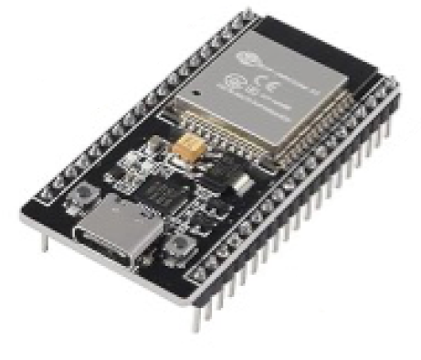
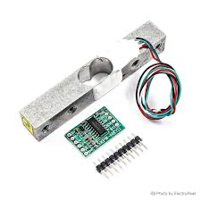

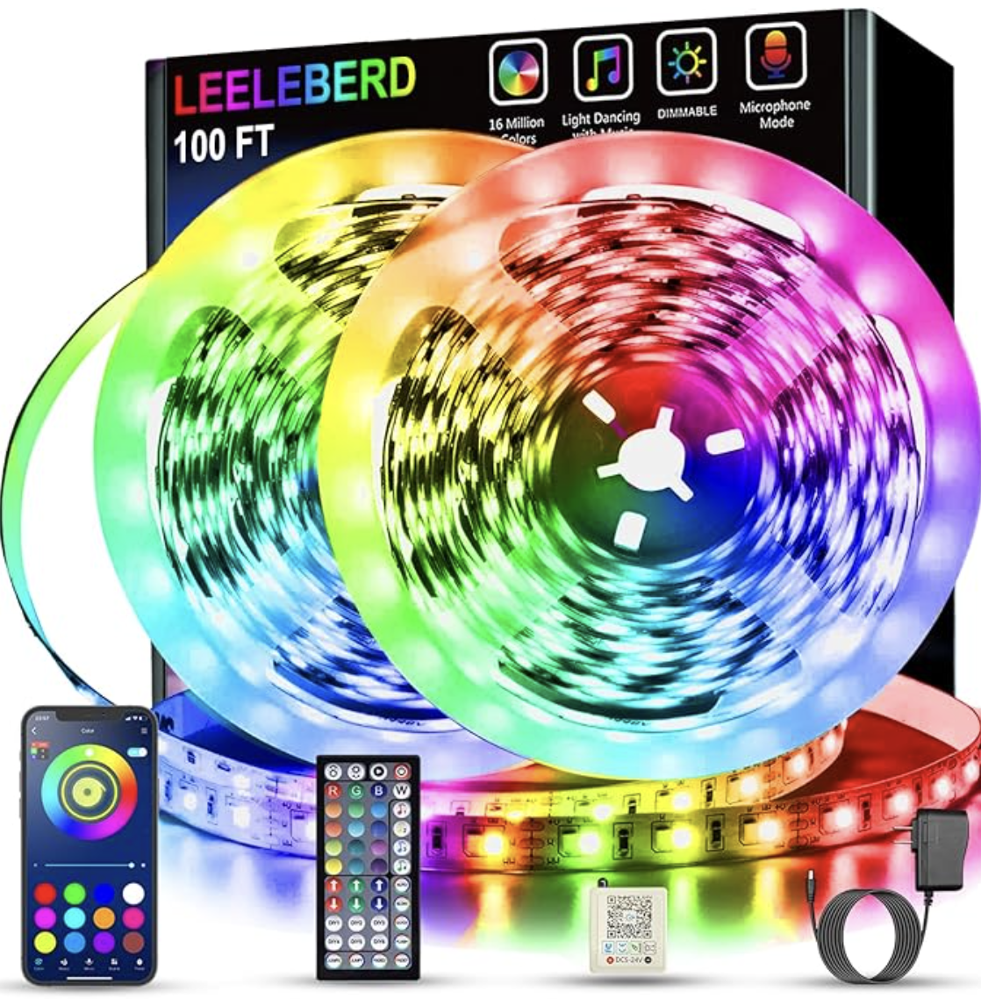
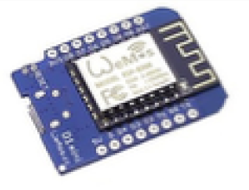
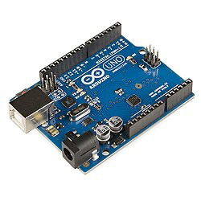
Motivation pt1
After taking Embedded Systems course at the University of Iowa, I was opened to the possibilities of using microcontrollers to develop smart home automations for my future apartment.
Last summer, I collected an assortment of different devices with the intention of experimenting with wireless area networks and simple automations. Unfortunately, work was busy and I never got around to accomplish anything meaningful with these devices.

Slide 6
Motivation pt2
Fortunately, Topics in Computer Science II: Real-Time Cyber Physical Systems was offered during the fall semester, which immediately caught my eye.
After learning the theory behind wireless network systems from 802.11, 802.15.4, and 5G, participating in literary analysis through presentations, and reading multiple academic papers we were assigned a final project. The project goals are either a study or an implementation.
Having already purchased many of the necessary devices, I thought that there was no better time study smart home protocols to serve as preliminary research for my future personal smart home.

Slide 7
Project Goals
My goals of this study were simple:
Compare OSI models of protocols
Compare protocol capabilities
Highlight major considerations for each protocol
Devise a simple automation that uses a suitable of choice
Create a slideshow to aid in my future smart home development
This project was intended to be a high-level comparison, drawing from many different sources – both academic and non-academic – to get a holistic view of chosen protocols.

Slide 8
Protocols Chosen
This project looks at the architecture, usage, and personal considerations of the following WLAN protocols:
Thread
Zigbee
Z-Wave
Protocols that were not selected:
- WiFi: I require a dedicated, local network
- Bluetooth: limited by coverage range
- Wired: far too cumbersome and obtrusive

Slide 9



Summary of Protocols
Sources: [10], [11], [12], [13], [14], [15]
Thread
Zigbee
Z-Wave
Thread Alliance formed 2014
Mesh network
Supports ~16000 devices
Open standard
Low power smart home devices
Introduced 2005
Mesh network
Supports ~65000 devices
Open standard
Home automation, medical device data collection
Introduced 1999
Mesh network
Supports 232 devices
Proprietary (Silicon Labs)
Residential and commercial
building automation

Slide 10
Thread
Protocol 1/3

Slide 11
Thread Background
Sources: [12], [1]
Thread Group: July 15, 2014 (Founded by Silicon Labs + six others)
OpenThread: open source implementation (Founded by Google)
Protocol used for Google Nest
Features:
IPv6 Over Low Power Wireless Personal Networks (6LoWPAN)
Several to 100s of devices, scalable to 10,000s of devices
Life Expectancy: years under typical conditions(powered by AA batteries or main power)
Network can additionally function using WiFi or Ethernet

Slide 12
Thread Device Nomenclature
Sources: [1]
Border Routers: connect 802.15.4 to external WiFi/Ethernet networks
Leader: manages Thread network, assigns router IDs, and selects routers
Thread Routers: provides routing, joining, and security to network devices; cannot sleep
Router-Eligible End Devices (REED): can become Thread Router or Leader, however they cannot route messages
End Devices: not router-eligible; can be full end or minimal end devices
Sleepy End Devices: can communicate only through their Thread Router parent; cannot relay messages to other devices
Synchronized Sleep End Devices: Sleepy End Devices that use CSL for synchronized, low-power communication

Slide 13
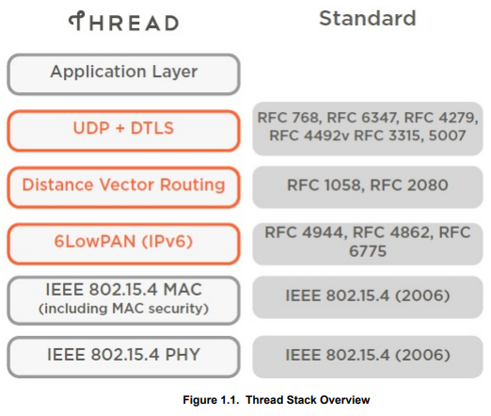
Thread Architecture – Diagram
Sources: [1]

Slide 14
Thread Architecture – High Level
Sources: [1], [12]
IEEE 802.15.4 PHYS:
2.4 GHz
250 kbps
IEEE 802.15.4 MAC:
Carrier Sense Multiple Access (CSMA)
MAC layer encryption enabled by higher layers
Thread’s Optimizations:
Enhanced Frame Pending – Acknowledges data with ‘pending’ status to save sleepy device battery
Enhanced Keepalive – Data messages function as ‘keepalives’ reducing link maintenance traffic
Coordinated Sampled Listening (CSL) – Synchronized transmit/receive perieds for improved synchronicity and reduced power
Enhanced ACK Probing –Reuses data for link metrics to provide granular control and to save energy

Slide 15

Thread Architecture – What Makes Thread Unique?
Sources: [1]
Thread is unique in that it provides IPv6 addressing!
Native IPv6 Support:
End-to-end IPv6 addressing with no application layer translation
Devices can communicate directly via IP
Interoperability with IP-based ecosystems like WiFi and Ethernet
6LoWPAN Link Layer Forwarding:
Header compression and fragmentation optimized for lowpower/constrained devices
Efficient multi-hop forwarding

Slide 16
Thread Routing
Sources: [1]
1. Distance-Vector Routing:
Next-Hop Selection: each router maintains a table containing the best “next-hop” to another router
Hop Count Metric: ”distance” is measured as the number of hops between devices. Maximum is typically set by manager to ensure network efficiency
Periodic Updates: routers regularly update routing costs for direct neighbors
2. Mesh Link Establishment (MLE):
Link Quality Sensing: measures RSSI of incoming messages to assign ”quality” [0-3]; 0 unknown cost
Bidirectional Verification: ensures link is reliable in BOTH directions before including in routing table
Route Propagation: Leader sends advertisement messages containing routing costs disseminated every few seconds
3. Retries (**note Thread uses UDP**)
Employs MAC level retries and Application level retries
Currently, Thread supports <32 routers

Slide 17
Thread Joining & Network Operation
Sources: [1]
ALL JOINING IS USER INITIATED OVER WiFi
A device joins a Thread network using credentials via user mobile device. This authenticates securely and ensures device recievs network parameters and security material.
Again, this is not something which I would like in my network as there is security threat for some remote access/authentication of devices which I did not authorize.
Once a device has joined, it uses MLE exchange to configure or exchange information about neighbors, device capabilities and device type, link costs, and security information.
After the joining and configuration process is complete, the mesh network is built.

Slide 18
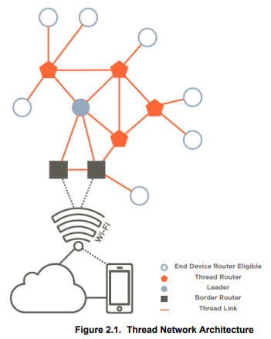
Thread Usage – Home Mesh Network
Sources: [1]
External Connectivity:
Border Routers bridge the Thread network to Wi-Fi or Ethernet
Network Management:
A Leader manages router IDs and assigns network addresses
Message Routing:
Thread Routers provide security services and relay data packets
Dynamic Roles:
REEDs can automatically become routers if the network needs expansion
Device Communication:
End devices communicate through a parent router to save power
Power Efficiency:
Sleepy devices use synchronized schedules to minimize radio usage

Slide 19
Thread Usage – Home Mesh Network
Sources: [1]
External Connectivity:
Border Routers bridge the Thread network to Wi-Fi or Ethernet
Network Management:
A Leader manages router IDs and assigns network addresses
Message Routing:
Thread Routers provide security services and relay data packets
Dynamic Roles:
REEDs can automatically become routers if the network needs expansion
Device Communication:
End devices communicate through a parent router to save power
Power Efficiency:
Sleepy devices use synchronized schedules to minimize radio usage
User can control the Thread Network using a mobile device over internet!
This is concerning to me!

Slide 20
Thread – My Concerns + Security Guarantee?
Sources: [1], [12]
As the Thread Border Router is accessed over WiFi, there is the inherent ability for an attacker to access my home network and thus all of my smart Thread devices. (not that it would be that catastrophic, but I would like control over my smart devices, etc ☺)
The Border Router is the main threat, as IPv6 != Open Access. Additionally, Thread protocol provides the following security assurances:
Secure against Over-the-Air (OTA) wireless attacks outside of the network, protected by 802.15.4-2006. Thread enhances this by exchanging frame counters in MLE handshaking.
Internet-Based Attacks: the network manager is protected by Datagram Transport Layer Security (DTLS) connection to the Border Router. Protected by passphrase
Yet, if my home network is compromised, I would hope my entire house isn’t compromised too… This is a dealbreaker for me; I want my devices and automations to be controlled locally by me only.

Slide 21
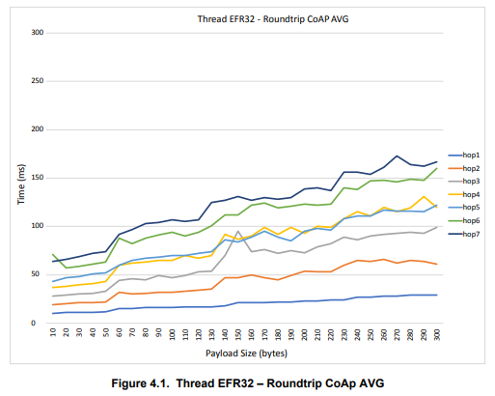
Thread Performance
Sources: [2]
Latency (shown in figure): <200ms (this is super fast, “instant-on” human interaction)
Reliability: stable even in high-traffic multicast environments
Scalability: performance unwavering even as network grows
This is the summary of extensive testing done by
Silicon Labs: Thread Mesh Network Performance

Slide 22
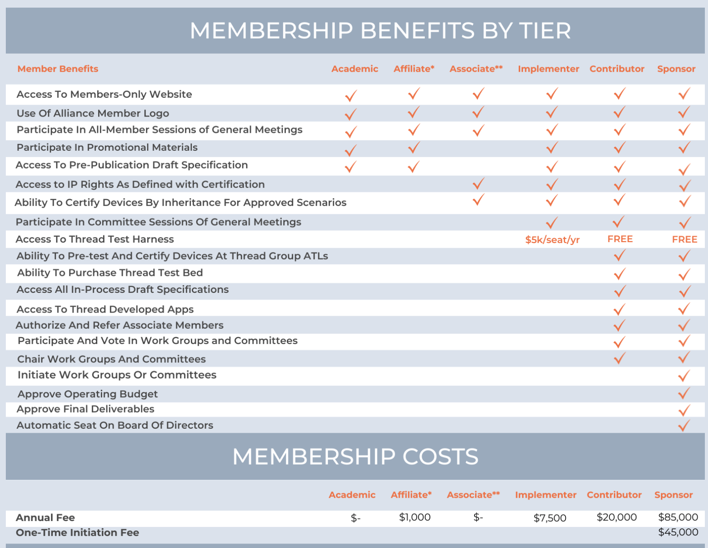
Thread Membership
Sources: [12], [15]
This is not a concern for me as I would be simply developing a smart home using Thread devices, however the Thread Group provides a six-tier membership.
The tiers distinguish organizations by how deeply they participate in Thread development and how much influence they have over specification, certification processes, and standard.

Slide 23
Thread Summary
Sources: [1], [2], [12], [15], [16]
Architecture:
802.15.4 + IPv6
Security:
Thread Border Router accessible via internet
Performance:
Extremely fast and scalable
Personal Comment:
At this point in time, I do not want WiFi enabled smart devices. Thread is not for me

Slide 24
Zigbee
Protocol 2/3

Slide 25
Zigbee Background
Sources: [10], [6]
Introduced: June 13, 2005 (Founded by Silicon Labs + six others)
Connectivity Standards Alliance: maintain and publish Zigbee and Matter standard (formed 2002, formerly Zigbee Alliance)
Features:
Chips are integrated with radios and microcontrollers
Includes network and application layers
Zigbee Device Object (ZDO) provided to manage devices, keys, and policies
Source routing

Slide 26
Zigbee Device Nomenclature
Sources: [6]
Coordinator: configures Zigbee network. Assigns and manages network addresses. Always-on “brain”.
Router (relay): full-function node that forwards packets to extend coverage and redundancy.
End Device (leaf): simple node that only sends and receives data via its parent (coordinator or router). Never forwards traffic for others.
Gateway/Hub: border device that combines Zigbee coordinator with IP interface to expose Zigbee mesh to external systems

Slide 27
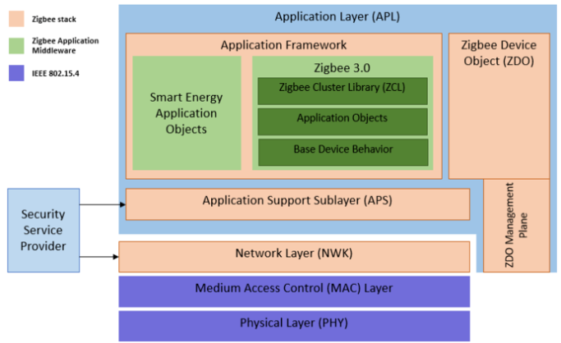
Zigbee Architecture - Diagram
Sources: [6]

Slide 28
Zigbee Architecture – High Level
Sources: [3], [6], [13]
IEEE 802.15.4 PHYS:
2.4 GHz
250 kbps
IEEE 802.15.4 MAC:
Carrier Sense Multiple Access (CSMA)
Zigbee’s Optimizations:
Network Layer Mesh & Routing – adds multi-hop networking, address assignment, and self-healing routes
Application Support Sublayer – provides binding, addressing, mapping, and reliable delivery services. Acts as service bus for all applications and ZDO.
Zigbee Device Object (ZDO) – handles device and service discovery and role assignment. Central point for network management and security control.

Slide 29
Zigbee Architecture – What Makes Zigbee Unique?
Sources: [6], [13]
Zigbee provides a comprehensive application layer! (It is also very mature)
Zigbee utilizes the Zigbee Cluster Library (ZCL)
Built-in logic – define behaviors for lights, sensors, and other devices
Direct Device Binding – allows switches to control lights without a hub
Out-of-the-Box-Interoperability – devices from different brands understand each other natively under ZCL
Ultimately, this reduces the software complexity as developers do not need to define custom formats or schemas.

Slide 30
Zigbee Routing
Sources: [3], [6]
Reactive AODV Protocol: ad-hoc on demand routing to find paths
Route Discovery (Broadcast): source broadcasts requests to all neighbors to find destinations
Route Reply (Unicast): nodes stores the next hop address and path costs
Source Routing: packets carry full list of relays to destination

Slide 31
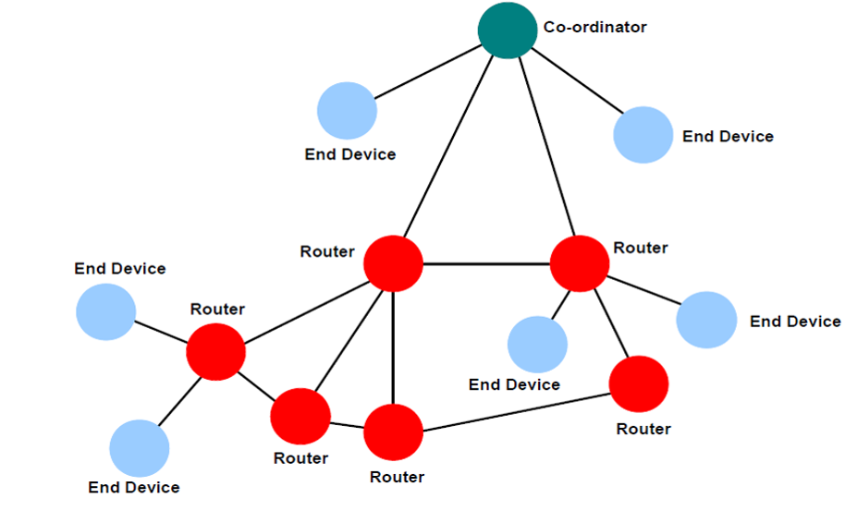
Zigbee Usage – Home Mesh Network
Sources: [6]

Slide 32
Zigbee Security
Sources: [5]
Strong AES-128 Cryptography:
Zigbee secures data using symmetric AES-128 encryption in CCM* mode to provide confidentiality, integrity, authentication, and replay protection in network
Centralized Trust Center (TC):
A trust center manages device authentication, key distribution, and access control
Key Hierarchy and Scope:
Security relies on network keys (broadcast), link keys (unicast), and optional master keys for key establishment; improper key handling directly weakens network security
** Key Management is the Main Weakness **
Compromise of a shared Network Key can expose the entire network ☹

Slide 33
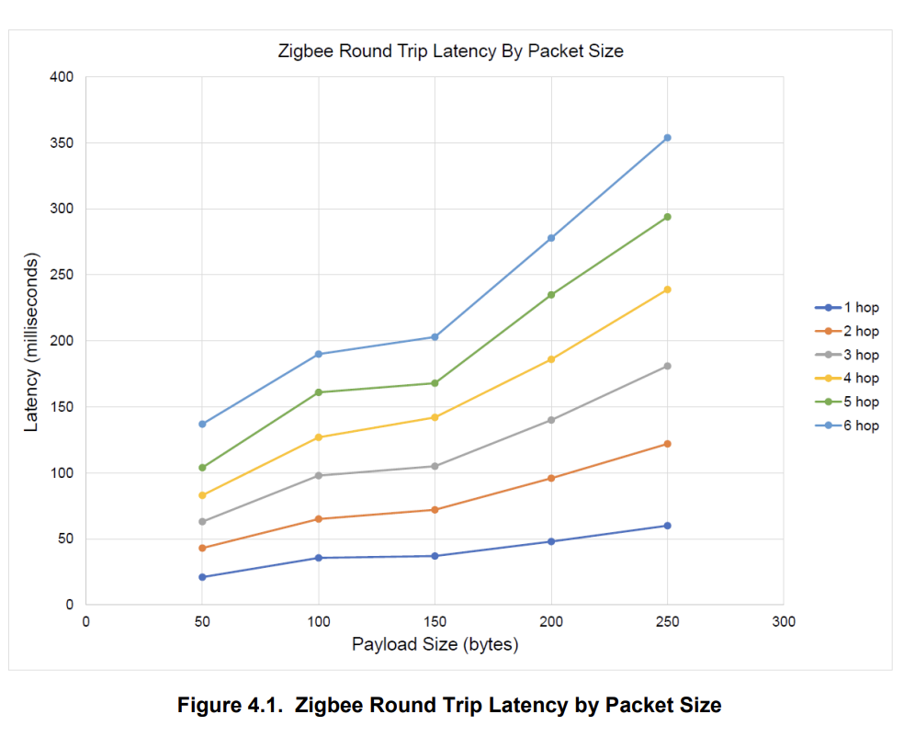
Zigbee Performance
Sources: [4]
Zigbee shows similar performance to Thread
Latency (shown in figure): <200ms (this is super fast, “instant-on” human interaction)
Reliability: latency increases as packet payload increases (in contrast to Thread)
Scalability: performant up to 192 nodes, which is plenty for home networks
This is the summary of extensive testing done by
Silicon Labs: Zigbee Mesh Network Performance

Slide 34
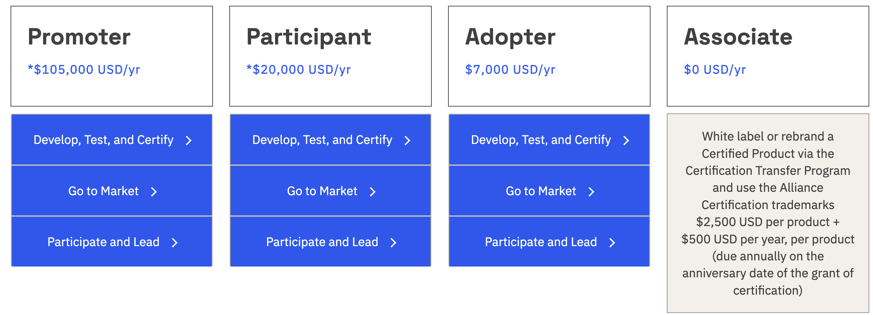
Zigbee Membership
Sources: [13]
This is not a concern for me as I would be simply developing a smart home using Zigbee devices, however the Connectivity Standards Alliance provides a four-tier membership.
The tiers distinguish members by how much influence they have over the Matter (another protocol) and Zigbee standards and how deeply they can participate.

Slide 35
Zigbee Summary
Sources: [3], [4], [5], [6], [10], [13], [17]
Architecture:
802.15.4 + application layer
Security:
Strong cryptography, but network key can compromise entire network
Performance:
As fast as Thread, but not as scalable as Thread
Personal Comment:
Zigbee satisfies my needs. Additionally, the provided application layer is an added benefit

Slide 36
Z-Wave
Protocol 3/3

Slide 37
Z-Wave Background
Sources: [11], [7], [8], [9]
Introduced: 1999 (developed by Zensys, acquired by Silicon Labs in 2018)
Z-Wave Alliance: maintains and certifies the Z-Wave standard
Features:
Integrated RF transceiver with embedded protocol stack
Includes MAC, networking, application layers
Can be long range (up to 1.5mi)

Slide 38
Z-Wave Device Nomenclature
Sources: [7], [8]
Primary Controller: configures and manages the Z-Wave network. There is only one primary controller that is always on. Assigns home ID and node IDs and maintains authoritative routing table.
Slave Nodes: execute commands and can additionally route traffic if always powered. However, battery powered slaves typically do not route.
Gateway/Hub (VERA): used to create scenes, events, timers. Used for remote control.

Slide 39
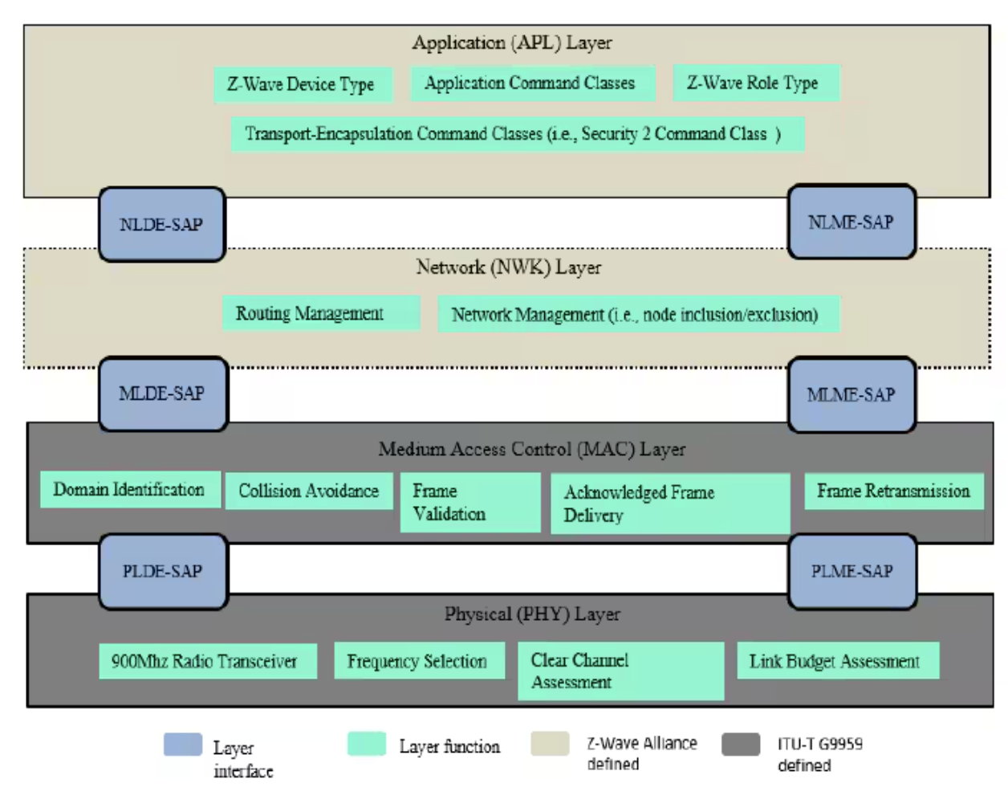
Z-Wave Architecture - Diagram
Sources: [7]

Slide 40
Z-Wave Architecture – High Level
Sources: [7], [8]
Proprietary Z-Wave PHY/RF:
Sub-GHz ISM band RF
Optimized for reliable transmission through walls and floors
Proprietary Z-Wave MAC:
Collision avoidance
Data encoded using Manchester or PE coding
Z-Wave Optimizations:
Mesh & Routing – provides multi-hop mesh networking using routing tables, automatic path discovery, and route repair (although maximum of 4 hops using source routing)
Transfer Layer – ability for acks, retransmissions, checksum validation. Supports singlecast, multicast, and broadcast
Application Layer – executes Z-Wave command classes, decodes payloads, and perform device specific actions (e.g. light switch or lock)

Slide 41
Z-Wave Architecture – What Makes Z-Wave Unique?
Sources: [9], [11]
In particular, there are two reasons that makes Z-Wave unique:
Long-Ranze Z-Wave (Z-Wave LR):
Extends communication range well beyond classic Z-Wave mesh
Larger addressing space to support up to 4000 nodes
Very practical for automation within apartment complexes and hospitality markets
2. Z-Wave is a Close Source/Proprietary Protocol:
The standard is governed by the Z-Wave alliance
Strict certification and compliance testing
A consequence of this is that it is also harder to understand/study – personal experience from this project
Because I understand this protocol less (proprietary vs based on 802.15.4), this protocol is not for me ☹

Slide 42
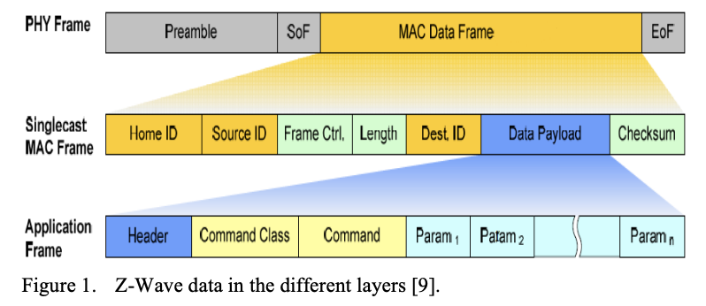
Z-Wave Routing
Sources: [7], [8]
Mesh Routing Protocol: uses multi-hop mesh routing to deliver frames beyond direct radio range
Controller-Based Path Discovery: the primary controller maintains network topology and routing table built during analysis rather than on-demand
ACK-Based: frames are forwarded hop-by-hop using routed singlecast with acknowledgments
Source Routing: packets carry routing information defining the relay nodes to be used to reach the packet’s destination. Maximum of 4 hops (although sources disagree on 4 or 5. Silicon Labs says 4).

Slide 43
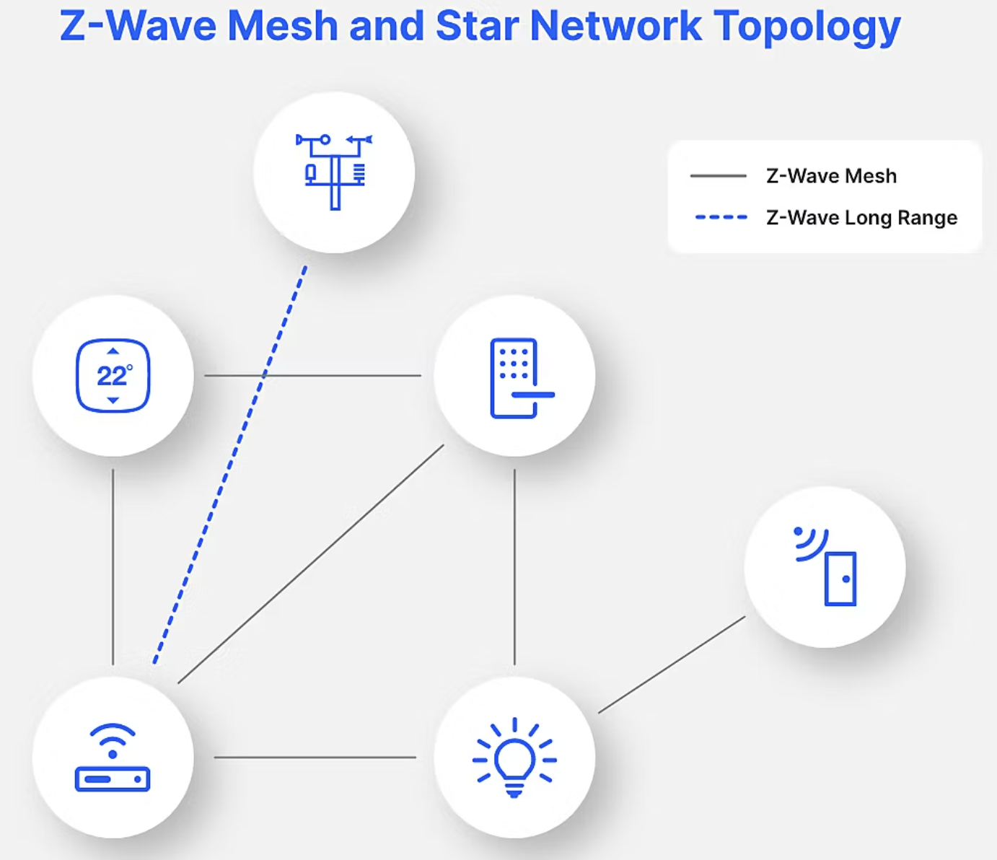
Z-Wave Usage – Home Mesh Network
Sources: [7]

Slide 44
Z-Wave Security
Sources: [7], [8]
Application Layer Security: there are two security command classes: Security 0 (S0) and Security 2 (S2). S0 uses single shared network key while S2 introduces an authenticated key exchange
Secure Key Exchange: during secure inclusion, devices perform security bootstrapping using PIN code, QR, or smart-start methods
Access-Level Protection: S2 defines different security levels to match risk profiles

Slide 45




Z-Wave Performance
Sources: Google
I could not any paper/source that looks at the Z-Wave performance. Doing a quick glance, sentiments regarding Z-Wave performance are not positive:
Searching Z-Wave Performance:
Obviously, this is not a very good way to quantify performance…

Slide 46
Z-Wave Summary
Sources: [7], [8], [9], [11]
Architecture:
Proprietary Architecture
Security:
S0 and S2 Security with multiple layers of security
Performance:
I could not find any data/studies on the performance of Z-Wave
Personal Comment:
Z-Wave was the most difficult protocol to research during this project. I believe this is because it is a proprietary protocol.

Slide 47
Comparison
High-level comparison and my personal selection

Slide 48
High Level Comparison – Decision Matrix
 | Thread | Zigbee | Z-Wave
Maximum Devices | 16384 | 65535 | 232
Devices on Market | 300> (unverified) | 4900> | 4500>
Protocol Age | 11 years | 20 years | 26 years
Development Kit | OpenThread | Expressif Zigbee | OpenZWave
Build Custom Device? | Yes | Yes | Yes
Open Standard | Yes | Yes | No
Protocols | 802.15.4 + IP | 802.15.4 | Proprietary SoC
Data Rate | 250 Kbps | 250 Kbps | 100 Kbps
Range | 30 m | 10-100 m | 100 m – 1 mi
Frequency | 2.4 GHz | 2.4 GHz | 868 MHz – 908 MHz
Fully Local Network | No | Yes | Yes

Slide 49
My Takeaways
The three protocols are all viable and proven options for smart home automation:
Zigbee is the most proven smart home automation protocol, providing strong mesh network capabilities, large number of devices, and easy configuration.
Thread is similar to Zigbee, but provides additional benefits of IP-addressability and multiple hosts. Simple sentiment analysis of YouTube videos is that Thread may overtake Zigbee.
Z-Wave is another viable option that can enable longer ranges, however its closed standard and the Z-Wave Alliance requirement makes learning, understanding, and building Z-Wave automations more difficult.
For my personal needs, Zigbee is the clear winner:
Ease of development and access to many devices
Ability to create custom devices using ESP32
Previous knowledge of 802.15.4 from Topics in Computer Science II
Well known and easy to use application layer managers

Slide 50
Future Work
How I use my learning from this course & project

Slide 51
Smart Home Automation
This project has given me a theoretical understanding of smart home mesh networks protocols, and now I would like to implement what I have learned.
After graduation this may, I will be moving into a new home/apartment. This is the perfect opportunity for me to experiment with simple automations.

Slide 52
Smart Home Automation Goals
Ideally, I would like the ability to do the following:
Automate my mornings/nights: lights, music, body heat regulation
Enhance home security: camera, network anomaly detection
Everything runs locally: limit outside access to the personal data
These are just a few... Too many ideas and not enough time! ☺

Slide 53


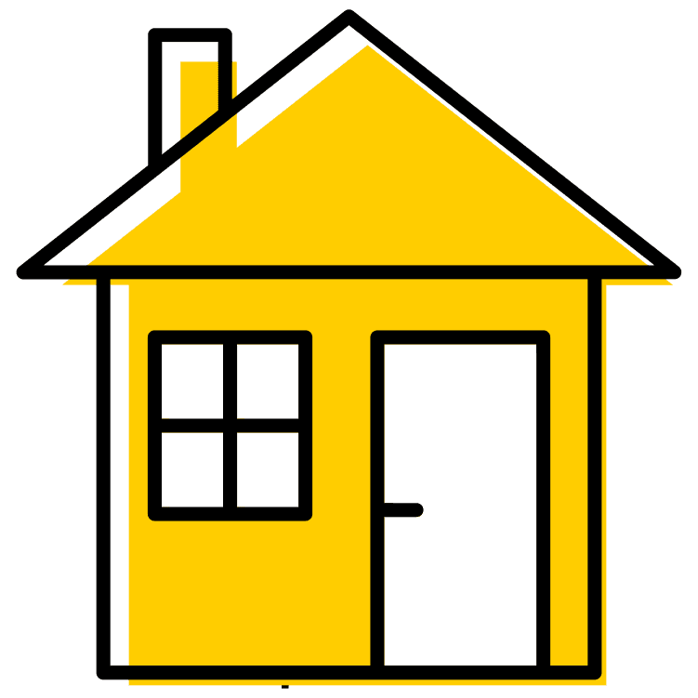
Future Work Roadmap
Smart Home Study
Smart Home Planning
Smart Home Implementation
This Project
Notes:
Download the full brand icon set at brand.uiowa.edu/graphic-elements

Slide 54
Example Plan
After conducting thorough research for this project, I will use Zigbee to implement my smart home due to its ubiquity and interoperability.
There are nearly 5000 supported devices from over 500 vendors. The large number of devices means lots of opportunity to automate my apartment. An ESP32 can also be programmed to support Zigbee.
A Raspberry Pi will be used as the central host to coordinate across devices within the network.

Slide 55
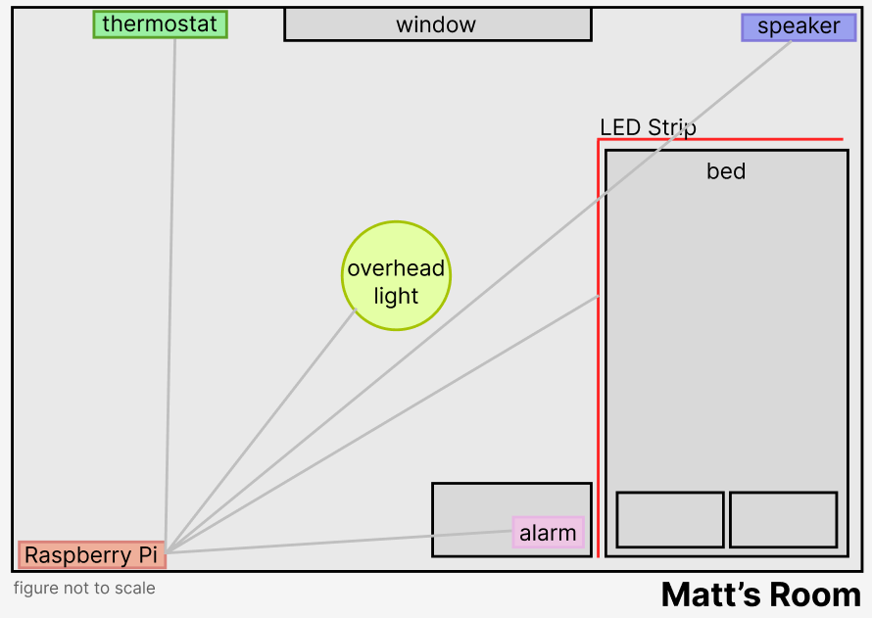
Example Topology
Coordinator:
Raspberry Pi
End Devices:
Overhead Lightbulb
LED Strip
Thermostat
Alarm Clock
Non-Zigbee Device:
Speaker (this will require a BT signal)
This creates a Star Topology which will work well within the small space of my room (<100m)

Slide 56
Example Implementation (Morning Routine)
The first automation I would create a simple morning automation to help to not snooze in the morning.
(something I struggle with ☺). This uses automated lighting and temperature setting to help me start the day!
Functionality:
1. 30 minutes before wakeup:
raise the temperature to 72 deg (from 63)
2. When wakeup occurs:
Raise alarm
Turn on LED strip to red
Play ”Good Morning” by Kanye West
3. After song end:
Turn off LED strip
Turn on Lightbulbs
Set temperature to 68 deg
Components:
Zigbee Lightbulb
Zigbee LED Strip
Zigbee Alarm Clock
Bluetooth Speaker
Zigbee Device List

Slide 57
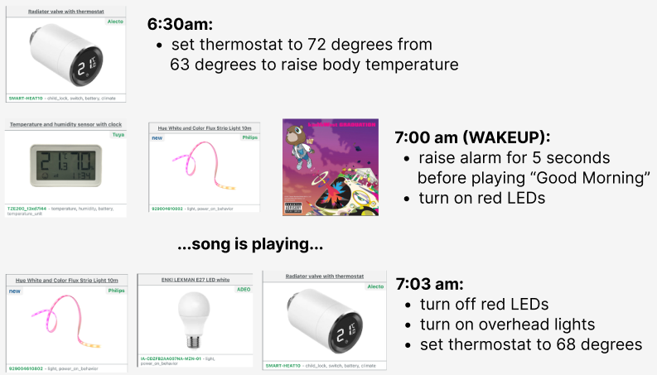
Morning Automation

Slide 58
Example Implementation (Nighttime Routine)
The second automation I would create a simple nighttime automation to help me fall asleep quicker.
This is very similar to the morning routine, using automated lighting and temperature setting to help me start the day!
Functionality:
1. 30 minutes before sleep:
drop the temperature to 63 deg (from 68)
Turn on LED strip to red
2. When bedtime occurs:
Turn on ”White Noise”
Turn off LED strip
Components:
Zigbee Lightbulb
Zigbee LED Strip
Zigbee Alarm Clock
Bluetooth Speaker
Zigbee Device List

Slide 59
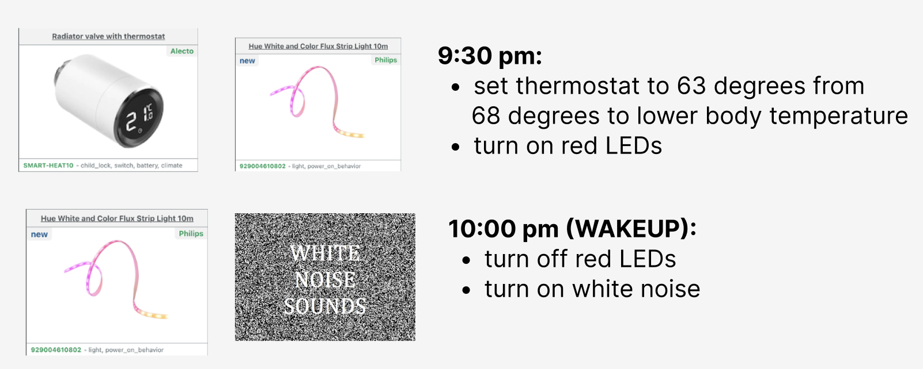
Nighttime Automation

Slide 60
Conclusion
Project Retrospective and Thanks

Slide 61
Project Retrospective
What was good:
This project was reading heavy as I incorporated many sources to gain enough information to compare each of the three protocols in detail. In this regard, it was a success as I now understand key differences between the three protocols. Additionally, I answered my question of which protocol I will personally use for future smart home development – Zigbee!
What could have been improved upon:
However, this project lacked a tangible result. During my project proposal, your feedback was to look into setting up a testbed/experiment. I did not take this route due to my semester workload and part-time work obligations. To compensate for this, I did design a sample automation that is feasible using Zigbee.

Slide 62
Thank you, Professor Zhang!
Topics in Computer Science II has given me perspective on how the digital and physical worlds interacts in ways which no other class has given me. The underlying topics of computer networking, scheduling policies, and data transmission has given me a deeper understanding of how RTCPS works - and the intuition to have an educated guess on a glance.
Also, thank you very much for your dedication to us students! I am super appreciative of the thoughtful and actionable feedback you gave during each of our presentations. This is advice I will take with me into industry.
Enjoy your winter break!
Sincerely,
Matt Krueger

Slide 63
Closing Slide Header

Slide 64
Primary Sources
Thread:
[1] Thread Fundamentals
[2] Thread Mesh Network Performance
Zigbee:
[3] Lecture 8 Zigbee and WirelessHART (Topics in Computer Science II)
[4] Zigbee Mesh Network Performance
[5] Analysis on the Security Architecture of ZigBee Based on IEEE 802.15.4
[6] Getting Started with Zigbee for STM32WB and STM32WBA Series
Z-Wave:
[7] Introduction of Z-Wave
[8] Smart Homes Automation using Z-wave Protocol
[9] Z-Wave Long Range

Slide 65
Secondary Sources
Wikipedia:
[10] Zigbee
[11] Z-Wave
[12] Thread
Device Counts:
[13] Zigbee
[14] Z-Wave
[15] Thread
Memberships:
[16] Thread Group
[17] Connectivity Standards Alliance
[18] Z-Wave Alliance

Slide 66
Assets
Images:
Thread logo
Zigbee logo
Z-Wave logo
Kanye West ”Good morning”
White noise
University of Iowa:
PowerPoint Template

