Slide 1
Multi-Traffic Resource Optimization for Real-Time Applications with 5G Configured Grant Scheduling
Matt Krueger
Nov. 21, 2025

Slide 2
Agenda
Background
System Model
Experiments

Slide 3
BACKGROUND

Slide 4
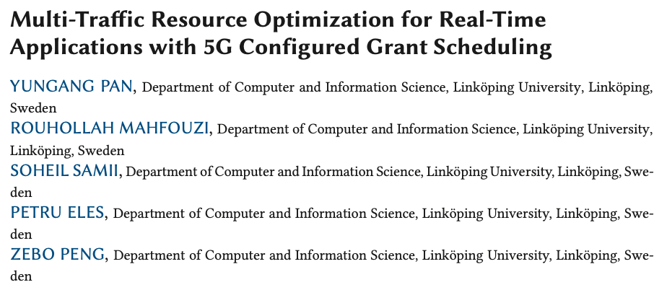
Paper
2024

Slide 5
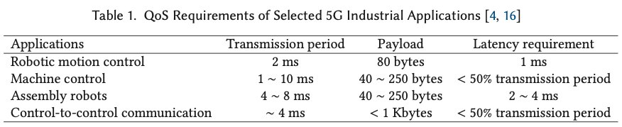
5G and Configuration Grant (CG) Background
Fifth generation of cellular networks:
  Faster speeds (Gbps >> Mbps)
  lower latency (as low as 1ms)
  Use cases in industrial settings where traffic is deterministic and periodic

Slide 6
Why CG? Dynamic Scheduling Issues
Handshaking process:
user equipment (UE) <--> base station (bs)
Base station grants resources for single data transmission
Two control signals for one uplink data transmission

Slide 7
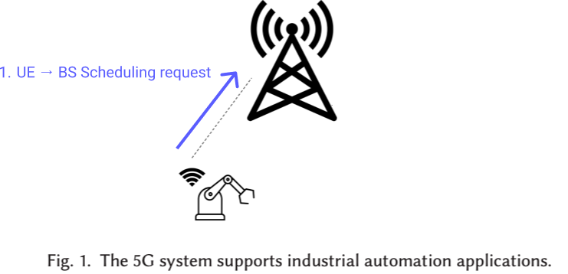
Dynamic Scheduling for Uplink Traffic

Slide 8
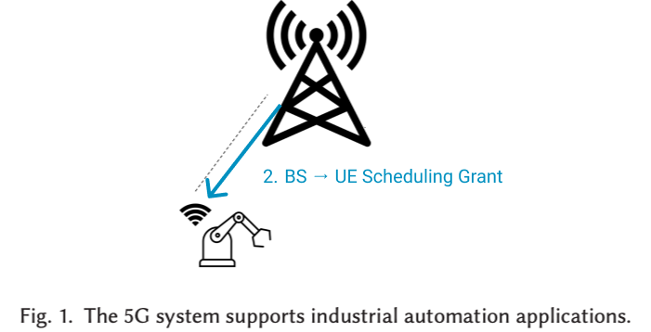
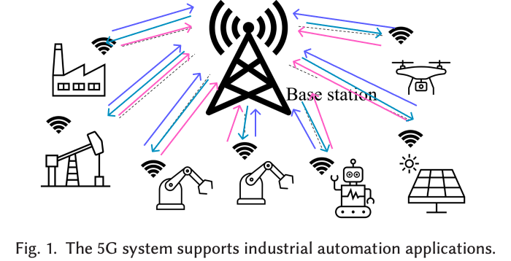



Dynamic Scheduling for Uplink Traffic

Slide 9
Dynamic Scheduling for Uplink Traffic

Slide 10

Dynamic Scheduling for Uplink Traffic

Slide 11
Dynamic Scheduling for Uplink Traffic

Slide 12
Dynamic Scheduling for Uplink Traffic

Slide 13
Dynamic Scheduling for Uplink Traffic
One Uplink / Two Control

Slide 14
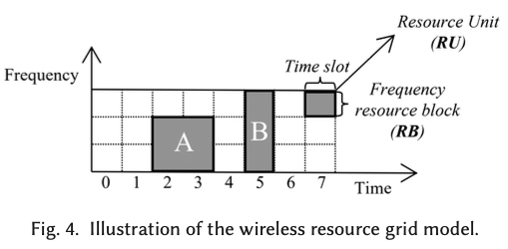
Configured Grant Scheduling
5G Standard:
  Ultra-Reliable Low Latency Communication
  Mitigates handshaking overhead and latency between base station and user
  Enables 5G for use in industrial applications
Grants Resources per Packet:
  Frequency
  Time Slots
  Transmission period
Notes:
Adds configurations for each traffic flow

Slide 15
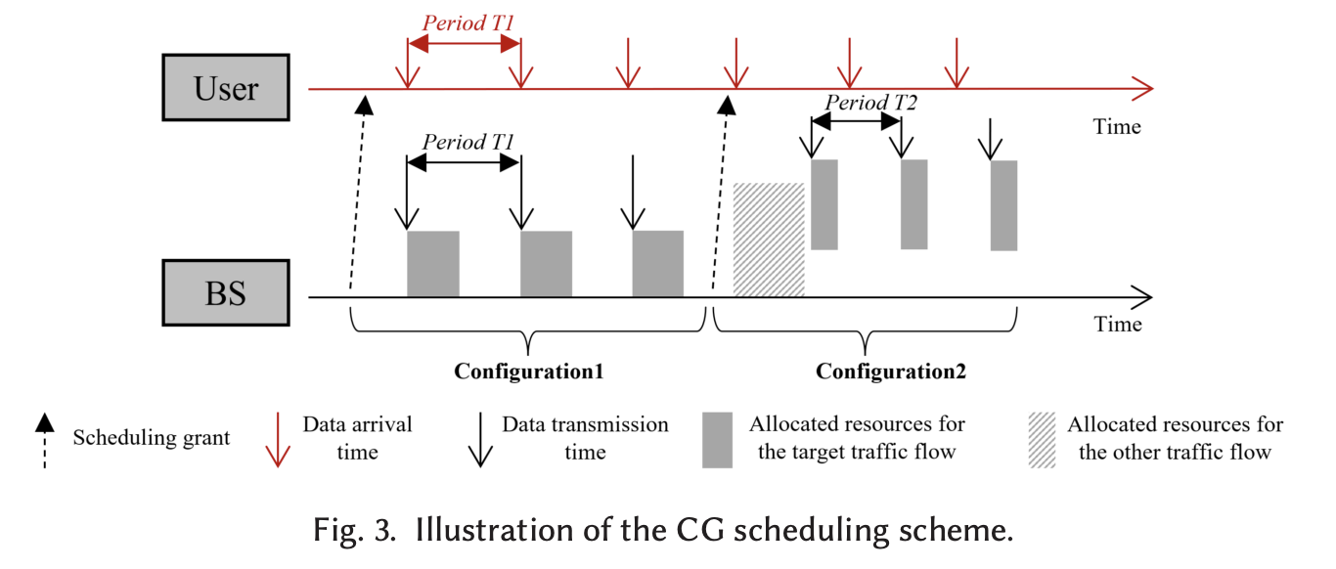
Configured Grant Scheduling
Many Uplink / One Configuration
frequency
Notes:
Configuration 1 is valid for the first three data transmissions
Configuration 2 is valid for the last three data transmissions
Transmissions can have different resource configurations

Slide 16
Why CG Scheduling Fails at URLLC Applications
Historically Optimized for Statistical Metrics:
  Throughput
  Transmission delay
  Spectral Efficiency
  Average Queue Length
However, RTCPS requires a different type of optimization:
  Schedulability of each traffic flow
Notes:
Usually, statistical metrics are regarded as the scheduling optimization goal, such as the total throughput, the transmission delay, the av- erage spectral efficiency, and the average queue length. Typical scheduling algorithms include first-come-first-served, round-robin, maximum throughput, and proportional fair.
Statistical metrics don’t guarantee end-to-end delay constraints.

Slide 17
Connection to Previous Paper
Contention-Free Configured Grant Scheduling for 5G URLLC Traffic:
  CG Scheduling algorithms for multiple periodic traffics
  Looks only at single configurations
  Ignores trade-off between scheduling flexibility and control overhead
Notes:
Usually, statistical metrics are regarded as the scheduling optimization goal, such as the total throughput, the transmission delay, the av- erage spectral efficiency, and the average queue length. Typical scheduling algorithms include first-come-first-served, round-robin, maximum throughput, and proportional fair.
Statistical metrics don’t guarantee end-to-end delay constraints.

Slide 18
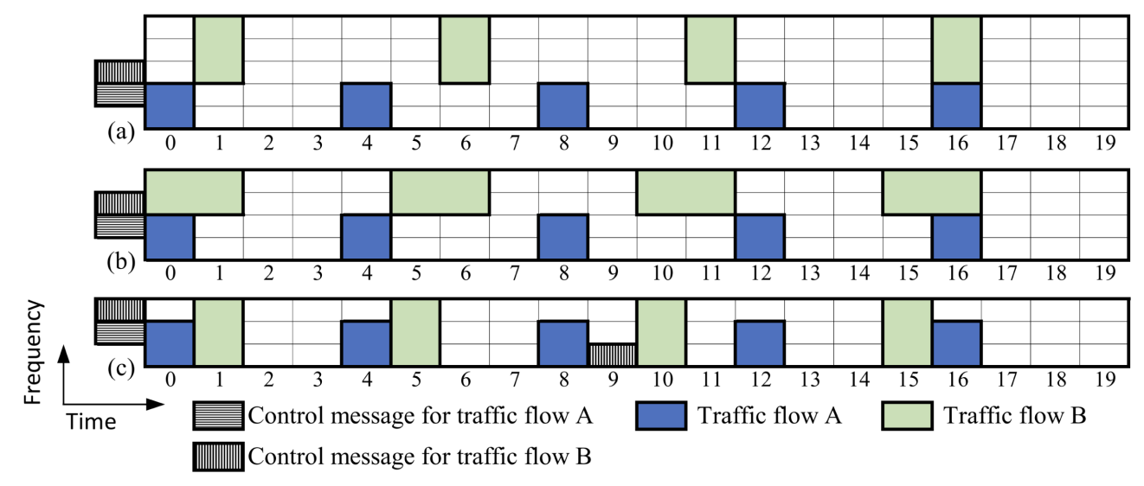
Importance of Schedule Flexibility
Flow A: Transmission Period: 4 ts, Payload: 2 RUs, Latency Req: 1 ts
Flow B: Transmission Period: 5 ts, Payload: 3 RUs, Latency Req: 2 ts
Notes:
Usually, statistical metrics are regarded as the scheduling optimization goal, such as the total throughput, the transmission delay, the av- erage spectral efficiency, and the average queue length. Typical scheduling algorithms include first-come-first-served, round-robin, maximum throughput, and proportional fair.
Statistical metrics don’t guarantee end-to-end delay constraints.

Slide 19
Importance of Schedule Flexibility
Configuration a) 5RBs, Flow A: 1 configuration, Flow B: 1 configuration
Notes:
Usually, statistical metrics are regarded as the scheduling optimization goal, such as the total throughput, the transmission delay, the av- erage spectral efficiency, and the average queue length. Typical scheduling algorithms include first-come-first-served, round-robin, maximum throughput, and proportional fair.
Statistical metrics don’t guarantee end-to-end delay constraints.

Slide 20
Importance of Schedule Flexibility
Configuration b) 4 RBs, Flow A: 1 configuration, Flow B: 1 configuration
Notes:
Usually, statistical metrics are regarded as the scheduling optimization goal, such as the total throughput, the transmission delay, the av- erage spectral efficiency, and the average queue length. Typical scheduling algorithms include first-come-first-served, round-robin, maximum throughput, and proportional fair.
Statistical metrics don’t guarantee end-to-end delay constraints.

Slide 21
Importance of Schedule Flexibility
Configuration C) 3 RBs, Flow A: 1 configuration, Flow B: 2 configurations
Notes:
Usually, statistical metrics are regarded as the scheduling optimization goal, such as the total throughput, the transmission delay, the av- erage spectral efficiency, and the average queue length. Typical scheduling algorithms include first-come-first-served, round-robin, maximum throughput, and proportional fair.
Statistical metrics don’t guarantee end-to-end delay constraints.

Slide 22
Importance of Schedule Flexibility
Configuration C minimizes RBs at the cost of control overhead
5 RB, 1 C
4 RB, 1 C
3 RB, 2 C
Notes:
Usually, statistical metrics are regarded as the scheduling optimization goal, such as the total throughput, the transmission delay, the av- erage spectral efficiency, and the average queue length. Typical scheduling algorithms include first-come-first-served, round-robin, maximum throughput, and proportional fair.
Statistical metrics don’t guarantee end-to-end delay constraints.

Slide 23
Motivation
Goals:
  Optimize CG resource usage for flexibility multiple periodic traffic flows
  Explore trade-off between transmission flexibility vs control overhead
Contributions:
  SMT solvers for optimal multi-traffic resource optimization problem (SMT-1, SMT-U)
  Heuristic algorithms for practical use (Co1, CoU)
Notes:
**professors paper considers consider the scenario of a single configuration and ignores the tradeoff between scheduling flexibility and control overhead

Slide 24
SYSTEM MODEL

Slide 25
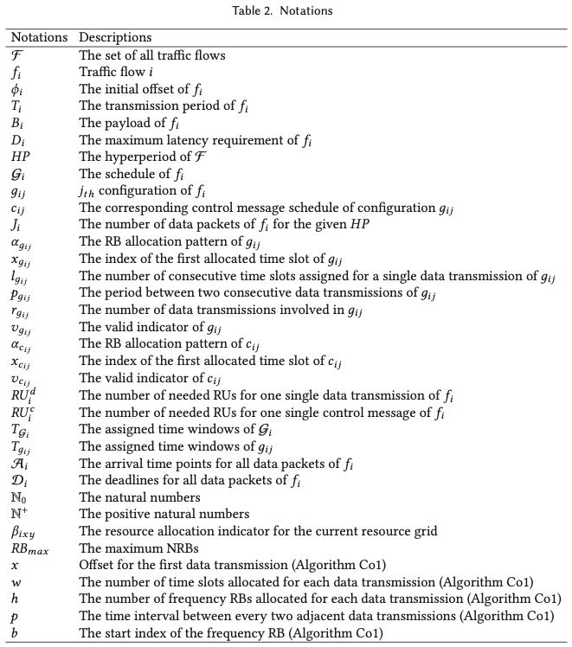
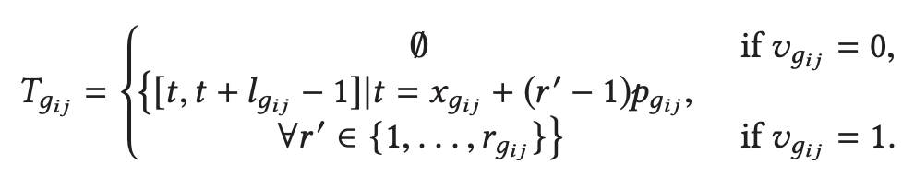

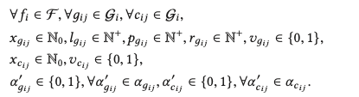




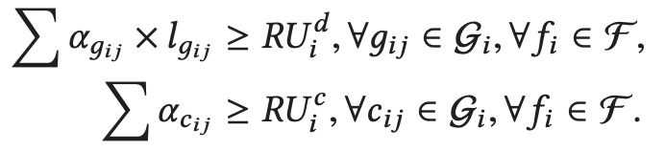



Note before continuing
Opting for a high-level approach
Notes:
Intentionally spending less time within this section as there are 35 notations, 14 mathematical equations. Do my best to explain the behavior of the optimization problem

Slide 26
System Overview
Key Ideas:
  Traffic Model
  Network Model
  Schedule/Configurations
  Constraints
  Optimization Techniques
Notes:
Intentionally spending less time within this section as there are 35 notations, 14 mathematical equations. Do my best to explain the behavior of the optimization problem

Slide 27
Traffic Model
Assume multiple periodic traffic flows (TF) exist
TF Structure:
  Initial Offset
  Transmission Period
  Payload
  Latency Requirement
All Time periods are normalized to the time duration of a single time slot
Notes:
Intentionally spending less time within this section as there are 35 notations, 14 mathematical equations. Do my best to explain the behavior of the optimization problem

Slide 28
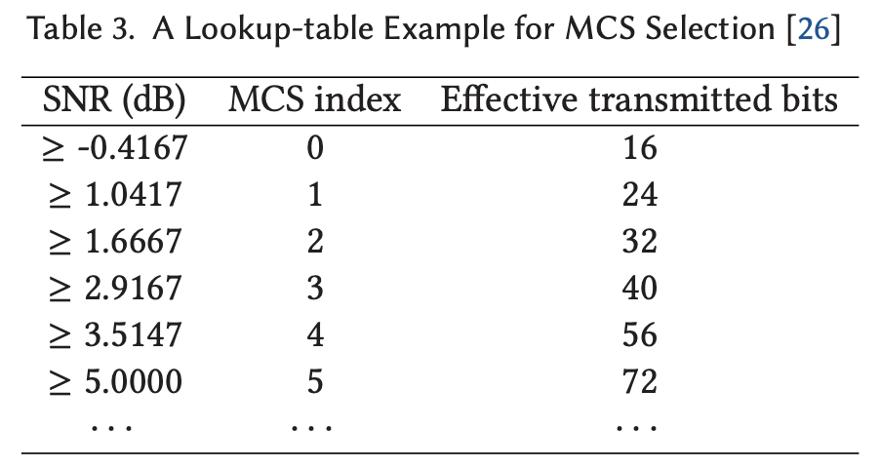
Network Model
Two-Dimensional Resource Grid depicting a hyper period:
  X-axis: Time Slots
  Y-axis: Frequency
Signal to Noise Ratio (SNR)
  Quantifies signal quality
  Used to select appropriate MCS
Modulation and Encoding Scheme:
  Higher MCS == More Effective RU == Fewer Resources
Notes:
Intentionally spending less time within this section as there are 35 notations, 14 mathematical equations. Do my best to explain the behavior of the optimization problem

Slide 29

Schedules/Configurations
Each TF Schedule is its own sequence of candidates:
Each control message is a 6 tuple:
Each configuration is a 3 tuple:
Notes:
Intentionally spending less time within this section as there are 35 notations, 14 mathematical equations. Do my best to explain the behavior of the optimization problem

Slide 30
Constraints
Number of RUs required
Deadlines
Control Overhead
Range Constraint
Data Transmission
Resource Unit Collision
Notes:
1. The allocated RUs have to support the transmission of: (1) data transmission for the payload; and (2) control message.
2. The latency requirements must be fulfilled
3. The number of valid configurations determines the number of control messages
4. Range of vairables
5. Each data packets should only be allocated once
6. RU in time slot x, RB y is assigned. Builds the NRBs

Slide 31
Optimization Techniques
Optimal: satisfied all TF deadlines in smallest number of RBs
NP-HARD: Reduces to Strip Packing Problem (finite width, infinite height packing)
Satisfiability Modulo Theories (SMT):
  Single Configuration: SMT-12.
  Unlimited Configuration: SMT-U
Heuristic Techniques:
  1. Single Configuration: Co1
  2. Unlimited Configuration: CoU
Notes:
SPP -> CG:
Rectangles in SPP :: data transmissions in CG ;; Width :: time slots, Height :: NRBs
Finite width in SPP :: Finite width in hyperperiod of CG
Goal: minimize the height of the SPP, minimize the NRBs in CG (also height)
Co1 follows the basic idea of CG scheduling that all packets are scheduled by one configuration per TF WITH NO SIGNALING OVERHEAD
CoU, to explore the trade-off between scheduling flexibility and control overhead.

Slide 32



Heuristic Approaches
Single Configuration: Co1
Unlimited Configurations: CoU
Runtime:
Runtime:
: Number of TFs
: Average number of packets for given HP
: Average Latency Requirement of all TFs
: Average Transmission Period of all TFs
: Maximum number of RBs
: Hyperperiod
Notes:
Co1 follows the basic idea of CG scheduling that all packets are scheduled by one configuration per TF WITH NO SIGNALING OVERHEAD
CoU, to explore the trade-off between scheduling flexibility and control overhead.

Slide 33
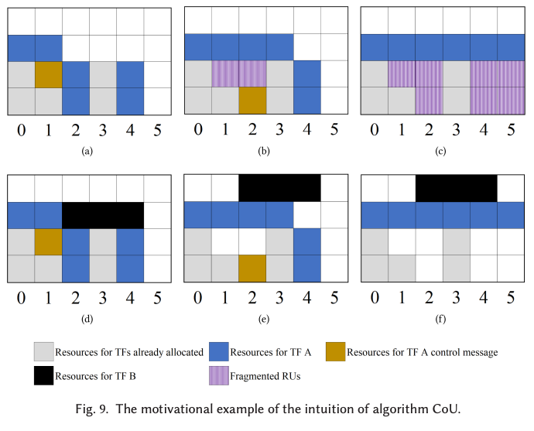
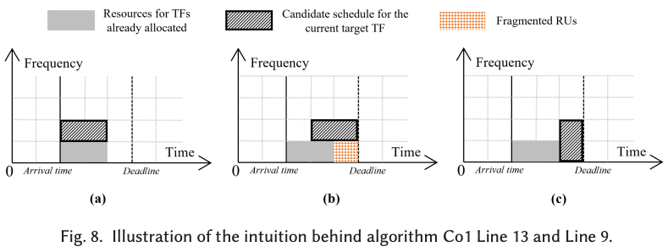
Heuristic Approaches
Single Configuration: Co1
Unlimited Configurations: CoU
Notes:
All combinations

Slide 34
EXPERIMENTS

Slide 35
Experiments
Application Size:
Small Scale Systems (SSS)
Large Scale Systems (LSS)
Realistic Case Study
Goals:
  Compare heuristic solutions to SMT solutions (experiment 1)
  Comparison between Co1 and CoU (experiments 2,3)
Metrics:
  Number of Resource Blocks (NRB)
  Schedulability Ratio
  Scalability & Time Efficiency
  Simulation Setup:
  Intel Xeon W-1250 CPU
  32 GB main memory
  C++, run on Windows

Slide 36

Small Scale Systems
Number of Traffic Flows: 3
Algorithms: Co1, CoU, SMT-1, SMT-U
Results:
Co1 competitive to SMT-1
CoU competitive to SMT-U
SMT solutions are impractical
Unlimited configuration solutions more flexible
Notes:
TF tuple: <[min offset, max offset] ms, period ms, payload B, latency ms>
– [0,1],1,20,1
– [0,1],2,30,1
– [0,2],3,50,1
– [0,2],5,80,3
Results:
– SMT-U best: NRB 4.35, ratio 43 %, but 3 000s IMPRACTICAL
– SMT-1: NRB 4.49, ratio 32 % (SMT1 lacks scheduling flexibility)
– CoU: ratio 39 %, NRB ≈ SMT-1/Co1
Take-away: CoU closes most of the optimality gap while staying microseconds-fast → scalable to large systems

Slide 37
Small Scale Systems
Number of Traffic Flows: 3
Algorithms: Co1, CoU, SMT-1, SMT-U
Results:
Co1 competitive to SMT-1
CoU competitive to SMT-U
SMT solutions are impractical
Unlimited configuration solutions more flexible
Notes:
TF tuple: <[min offset, max offset] ms, period ms, payload B, latency ms>
– [0,1],1,20,1
– [0,1],2,30,1
– [0,2],3,50,1
– [0,2],5,80,3
Results:
– SMT-U best: NRB 4.35, ratio 43 %, but 3 000s IMPRACTICAL
– SMT-1: NRB 4.49, ratio 32 % (SMT1 lacks scheduling flexibility)
– CoU: ratio 39 %, NRB ≈ SMT-1/Co1
Take-away: CoU closes most of the optimality gap while staying microseconds-fast → scalable to large systems

Slide 38
Small Scale Systems: Procedure
Traffic Flow 4 tuple:
<[minimum initial offset (ms), maximum initial offset (ms)], transmission period (ms), payload (bytes), latency requirement (ms)>
Three random selections:
  <[0, 1], 1, 20, 1>
  <[0, 1], 2, 30, 1>
  <[0, 2], 3, 50, 1>
  <[0, 2], 5, 80, 1>
MARB: 200
SNR: [2,20] dB applied to each TF
200 test cases for each algo
Notes:
TF tuple: <[min offset, max offset] ms, period ms, payload B, latency ms>

Slide 39
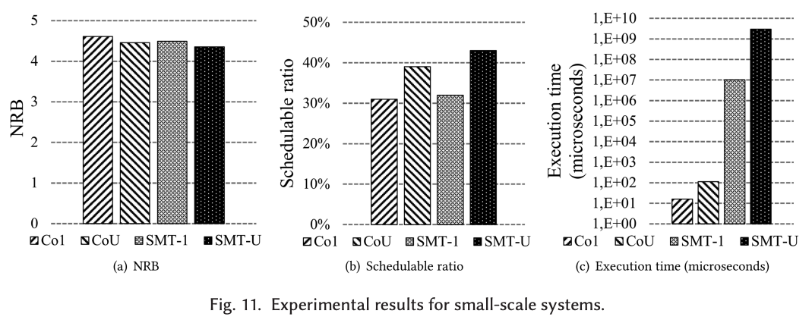
Small Scale Systems
Notes:
KEY TAKEAWAY:
SMT-U performs the best among all approaches, however it is orders of magnitude slower than all other algorithms.
SUPPORTING POINTS:
Solutions that have single configurations per TF have lower flexibility than its unlimited opponents. This results in lower schedulability ratio compared to unlimited approaches.

Slide 40
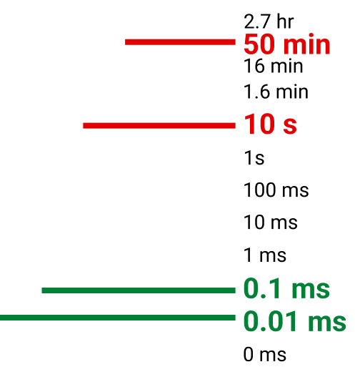
Why not SMT?
This is only for 3 TFs!!!
Imagine 50 TFs
Notes:
KEEP IN MIND THIS IS ONLY FOR 3 FLOWS!!!!
Why not SMT:
- Runtime Explosion due to search space growing exponentially.
- There is no bound that keeps the model within a reasonable budget for computation time
CoU is 3×10⁷× faster than SMT-U

Slide 41
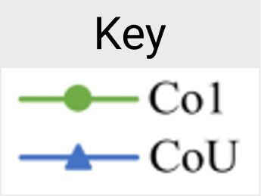
Experiment 2: Large Scale Systems
Number of Traffic Flows: 10+
Algorithms: Co1, CoU
Varying Parameters:
  Number of TF, Latency Requirements, Transmission Period, Payload Size
Results:
CoU outperforms Co1 as it is more flexible
Speed vs Spectral Efficiency Tradeoff
Notes:
Stress testing the CoU and Co1 heuristic algorithms under realistic industrial load.

Slide 42
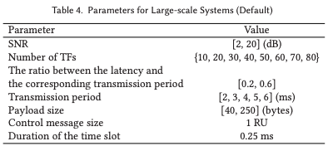
LSS: Default Parameters
Notes:
Experiements:
1. Default Scenario
2. Latency Requirements
3. Diversity of Transmission Periods
4. Payload Sizes

Slide 43
LSS Relationship: Number of TFs
** Parameter Changes/Test Cases:
  Traffic Flows {10, 20, 30, 40, 50, 60, 70, 80}
Metrics:
  NBR Improvement
  Schedulability Ratio
  Execution Time

Slide 44
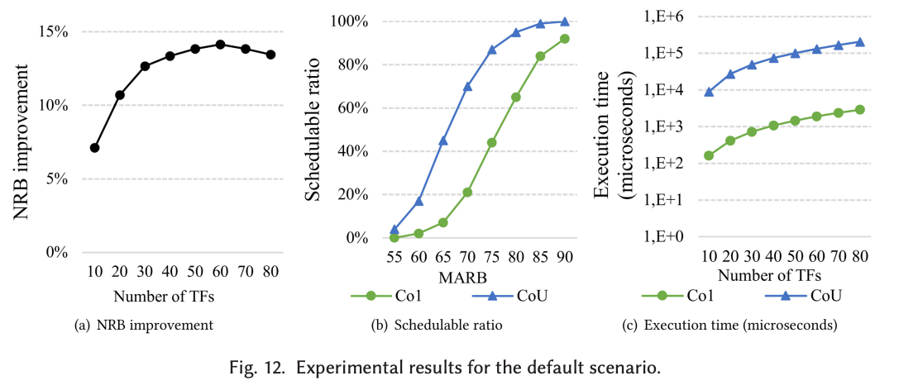
LSS Results: Number of TFs
Notes:
KEY TAKEAWAY:
CoU consistently outperforms Co1 by reducing the NRB usage, increasing the scheduability ratio
SUPPORTING POINTS:
CoU NRB savings 7-14% more than Co1
CoU Schedulability ratio up to 50% more than Co1 at the same amount of resource blocks => MORE FLEXIBILITY
Co1 is a ~1 order of magnitude faster

Slide 45
LSS Relationship: Latency Requirements
** Parameter Changes/Test Cases:
  Latency Intervals [0.1, 0.2], [0.2, 0.4], [0.4, 0.6], [0.6, 0.8], [0.8, 1.0]
Metrics:
  NBR Improvement
  Schedulability Ratio
  Execution Time
stringent
relaxed

Slide 46
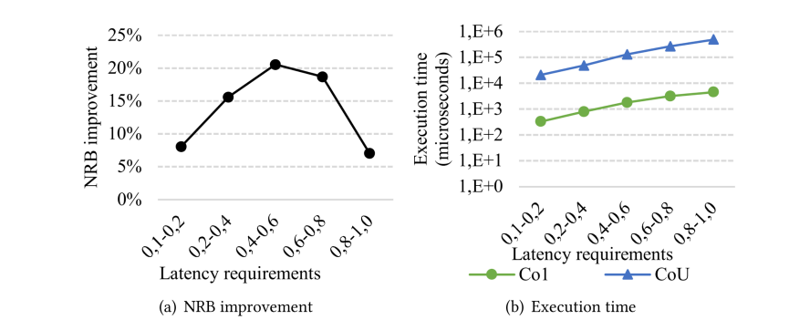
LSS Results: Latency Requirements (pt1)
Notes:
KEY TAKEAWAYS:
Performance is equal at both extremes of the latency requirements
CoU’s advantage over Co1 is greatest when latency requirements are neither too tight nor too loose
SUPPORTING POINTS:
NRB & schedualability gaps between CoU and Co1 are only ~7% at stringent and loose requirements (extremes)
Mid range intervals CoU outperforms Co1 by up to 20%

Slide 47
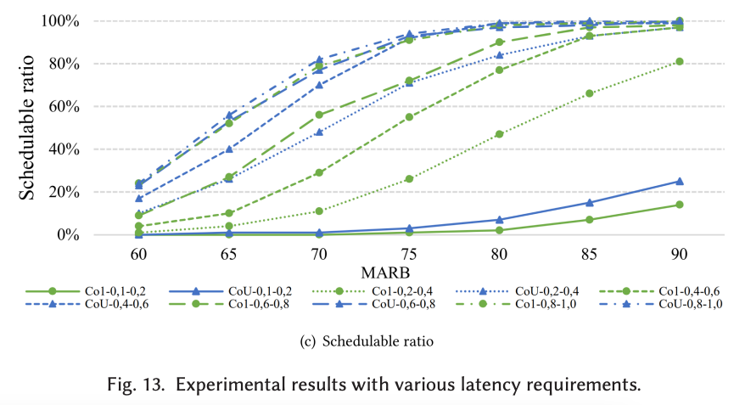
LSS Results: Latency Requirements (pt2)
Notes:
KEY TAKEAWAYS:
Performance is equal at both extremes of the latency requirements
CoU’s advantage over Co1 is greatest when latency requirements are neither too tight nor too loose
SUPPORTING POINTS:
NRB & schedualability gaps between CoU and Co1 are only ~7% at stringent and loose requirements (extremes)
Mid range intervals CoU outperforms Co1 by up to 20%

Slide 48
LSS Relationship: Transmission Period Diversity
** Parameter Changes/Test Cases:
  Transmission period groups {2}, {2,3}, {2,3,4}, {2,3,4,5}, {2,3,4,5,6}
Metrics:
  NBR Improvement
  Schedulability Ratio
  Execution Time

Slide 49
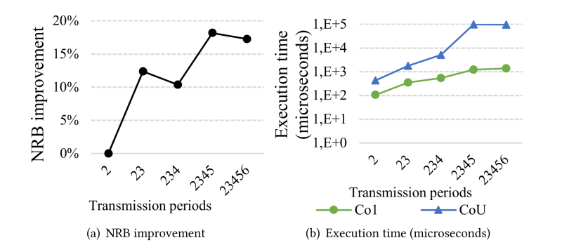
LSS Results: Transmission Period Diversity (pt1)
Notes:
KEY TAKEAWAY:
CoU outperforms Co1 as transmission-period diversity rises
Co1 execution time far better than CoU
SUPPORTING POINTS:
CoU outperforms Co1 as transmission-period diversity rises as there is more potential for TF interleaving. As CoU is more flexible than Co1 it performs better with a higher diversity of transmission periods
Co1 execution time far better than CoU

Slide 50
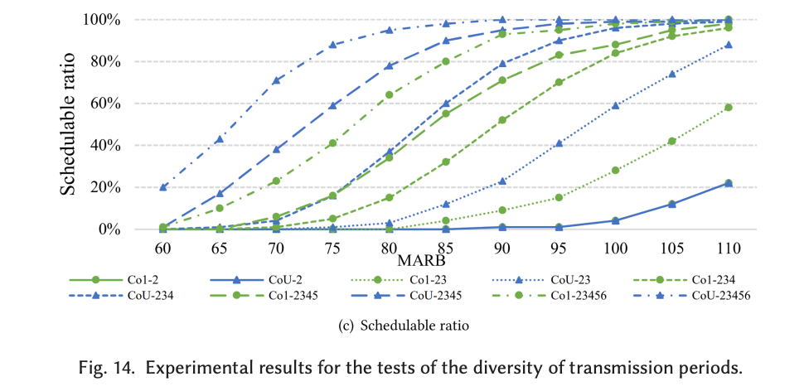
LSS Results: Transmission Period Diversity (pt2)
Notes:
KEY TAKEAWAY:
CoU outperforms Co1 as transmission-period diversity rises
Co1 execution time far better than CoU
SUPPORTING POINTS:
CoU outperforms Co1 as transmission-period diversity rises as there is more potential for TF interleaving. As CoU is more flexible than Co1 it performs better with a higher diversity of transmission periods
Co1 execution time far better than CoU

Slide 51
LSS Relationship: Payload Size
** Parameter Changes/Test Cases:
  Average payload sizes [150, 150], [120, 180], [90, 210], [60, 240], and [30, 270] (NO CHART) → no significant variance between Co1 and CoU
  Increasing size of payloads {40, 80, 120, 160, 200}
Metrics:
  NBR Improvement
  Schedulability Ratio
  Execution Time
Notes:
THERE ARE TWO TESTS PERFORMED.
First test which looks at the diversity of payloads has ~5% variance when comparing the results of Co1 and CoU

Slide 52
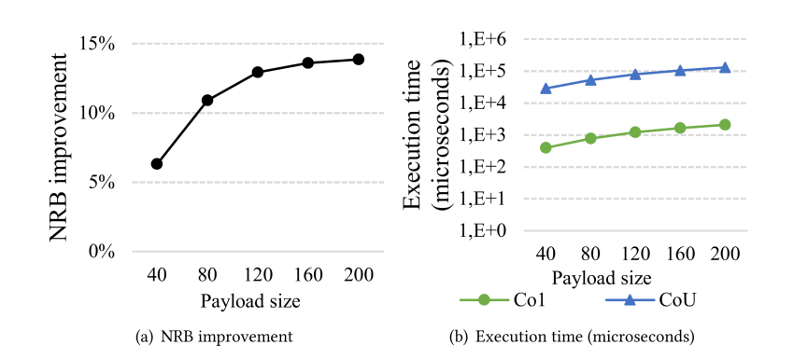
LSS Results: Payload Size (pt1)
Notes:
KEY TAKEAWAY:
CoU’s scheduling advantage grows as payload size increases as the control overhead to payload ratio shrinks. CoU’s flexibility wins
Co1 execution time far better than CoU
SUPPORTING POINTS:
Extreme sizes only slightly hurt because both schemes adapt the RB/slot allocations
Larger payloads increase the execution time however the payoff in throughput outweighs the cost

Slide 53
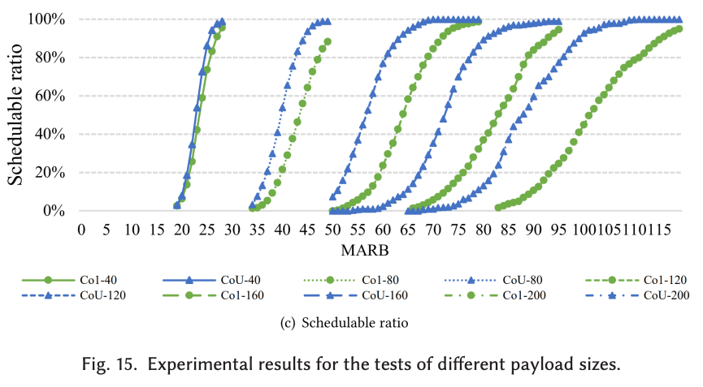
LSS Results: Payload Size (pt2)

Slide 54
Experiment 2: Large Scale Systems
Number of Traffic Flows: 10+
Algorithms: Co1, CoU
Varying Parameters:
  Number of TF, Latency Requirements, Transmission Period, Payload Size
Results:
CoU outperforms Co1 as it is more flexible
Speed vs Spectral Efficiency Tradeoff
Notes:
Stress testing the CoU and Co1 heuristic algorithms under realistic industrial load.

Slide 55
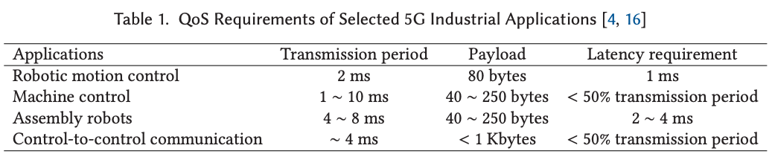
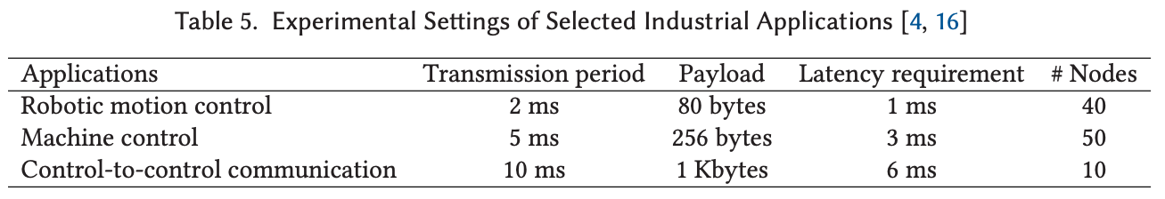
Experiment 3: Realistic Case Study
Number of Traffic Flows: 100
Algorithms: Co1, CoU
Parameters:
  Table 5 (industrial applications)
Results:
  CoU slower, but more performant than Co1

Slide 56
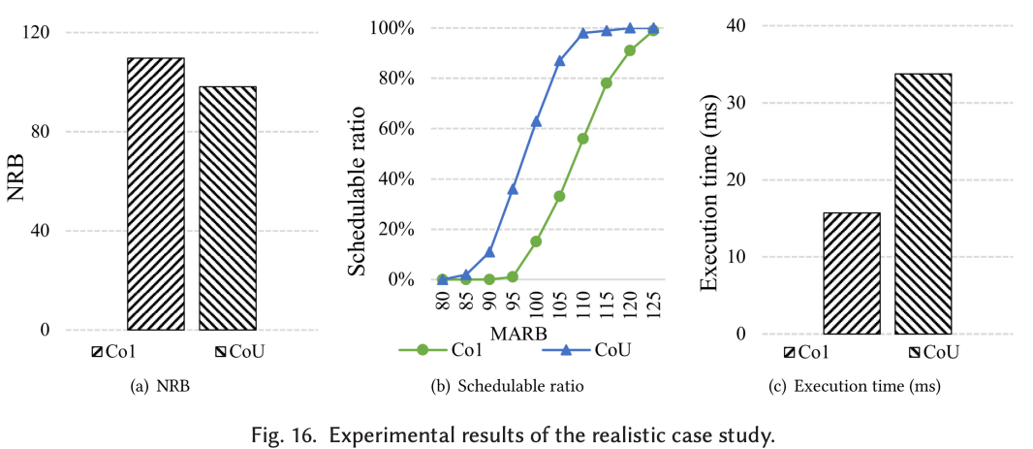
Results: Realistic Case Study
Notes:
KEY TAKEAWAYS:
SUPPORTING POINTS:
11% NRB improvement compared to Co1
CoU’s chedualability ratio up to 54% greater than Co1
- CoU’s execution time 2x slower than Co1

Slide 57
Conclusion
Configured Grant scheduling problem optimization is NP-Hard:
  SMT Solutions do not meet requirements of 5G
  heuristic algos Co1 and CoU do
Unlimited Configurations (CoU) >> Single Configuration (Co1):
  Greater Resource Efficiency
  Greater Schedulability
  Greater Flexibility
Trade-offs:
  Control Signaling vs Flexibility
  Speed vs Flexibility
Notes:
Paper provides SMT and heuristic algorithms that aim to optimize the configured grant scheduling problem

Slide 58
Closing Slide Header

