Slide 1

My Classroom AI Bot
Can a classroom AI help a class reach their goal?
MyClassroomAIbot

Slide 2
Outline
1 What it is
2 How it works
3 Privacy by design
4 Shaping your AI
5 The pilot
6 Setting it up

Slide 3

The Big Idea
Can a semi-autonomous AI assistant help students and their teacher solve a problem in the classroom?
Build an AI, give it a real job, and watch how it thinks. Inspired by Project Vend.

Slide 4
My class
Missing work snowballs:
Failing grades
Missing work
Lower attendance
Disengagement

Slide 5

What it is
A semi-autonomous AI assistant for the classroom that focuses on one goal.
Inspired by Anthropic's 'Project Vend' experiment.
• Uses evidence-based practices
• Develops and continuously adjusts its own plan
• Acts and communicates through the teacher
• An experiment to learn about using AI
Acts through
the teacher

Slide 6

Why it matters
• Aimed at a real class goal
• Your class's AI, shaped by students
• Research-backed, and it shows its work
• Private by design

Slide 7
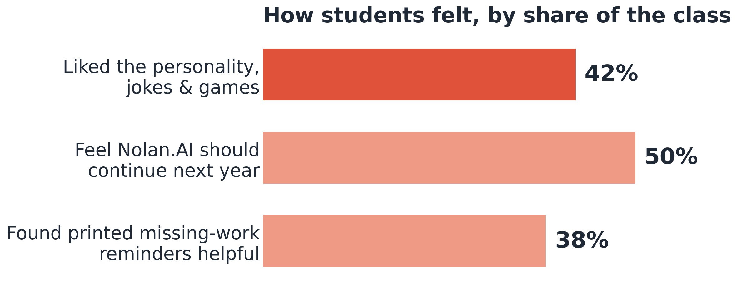
The pilot — one class, one semester
8
assignments, week one
12%
less missing work
Our class named theirs Nolan.AI · one class · self-reported · directional, not proof.

Slide 8





Chat vs. Cowork
Claude (chat)
Cowork (agentic)
C
Describe the task once
You type a prompt
Claude responds
You copy, paste, prompt again
Slides & docs
Curriculum map
C
Claude responds again
You do the work with the output
Messages
Research
Works autonomously, then hands you finished work to review.
RESULT: manual, step-by-step — high effort.
RESULT: autonomous, multi-step — low effort.

Slide 9



YOU
research strategies
LMS export
gradebook
student messages
Online AI
Claude Cowork
Offline Apps
cleaned
the class AI's
Brain & Personality

Slide 10

Privacy by design
AI
Student data
• Names
• Grades
• Student IDs
• Attendance
never sent raw
cleaned, aggregate
Local app
/teacher-app-builder builds apps that live on your computer to handle student data.

Slide 11






Choose its mission
Pick one challenge for it to tackle:
Missing work
Attendance
Motivation
Participation
Transitions
Routines
Or define your own.

Slide 12
The Brain
The folder it reads every session:
• Mission — the one goal
• Personality and voice
• Constraints and limits
• Class context — aggregate, no names
• Instructional style
• Physical resources

Slide 13



The four constraints
A personality
One clear goal
Students help name and shape it.
One mission for the whole unit.
Evidence-based
Aggregated data only
Its defaults come from research.
It never sees individual students.

Slide 14

Built with students
Students help shape it — and gain ownership:
• They vote on its name and personality
• They help choose its mission
• Buy-in from day one
• They learn what AI can — and can't — do

Slide 15
Themes for classroom projectors
Ocean Depths theme
Built for low contrast,
small screens.
Cream
High contrast
Large text
Ink
Deep navy
Deep teal
Seafoam

Slide 16

What you need to run it
• A Mac or Windows computer with Claude Cowork
• A Claude $20/month plan or higher
• A class you see regularly
• A gradebook you can export — CSV or Excel
• 15–30 minutes, twice a week

Slide 17

Try it without your students
Open the dashboard, drop in the sample gradebook, and print a card. Then open the folder in Cowork and ask your AI for Monday's slide.

