Slide 1

My Classroom AI Bot
Can a classroom AI help a class reach their goal?
MyClassroomAIbot

Slide 2
Outline
1 What it is
2 How it works
3 Privacy by design
4 Shaping your AI
5 The pilot
6 Setting it up

Slide 3

The Big Idea
Can a semi-autonomous AI assistant help students and their teacher solve a problem in the classroom?
Build an AI, give it a real job, and watch how it thinks. Inspired by Project Vend.

Slide 4

What it is
A semi-autonomous AI assistant for the classroom that focuses on one goal.
Inspired by Anthropic's 'Project Vend' experiment.
• Uses evidence-based practices
• Develops and continuously adjusts its own plan
• Acts and communicates through the teacher
• An experiment to learn about using AI
Acts through
the teacher

Slide 5

Why it matters
• Aimed at a real class goal
• Your class's AI, shaped by students
• Research-backed, and it shows its work
• Private by design

Slide 6

Privacy by design
Claude never sees student data.
• Exports stay offline — read on your machine
• Aggregate only — never a name
• Teacher in the middle — every message routes through you
• Students get a random ID — S04, S17… the AI never knows names

Slide 7
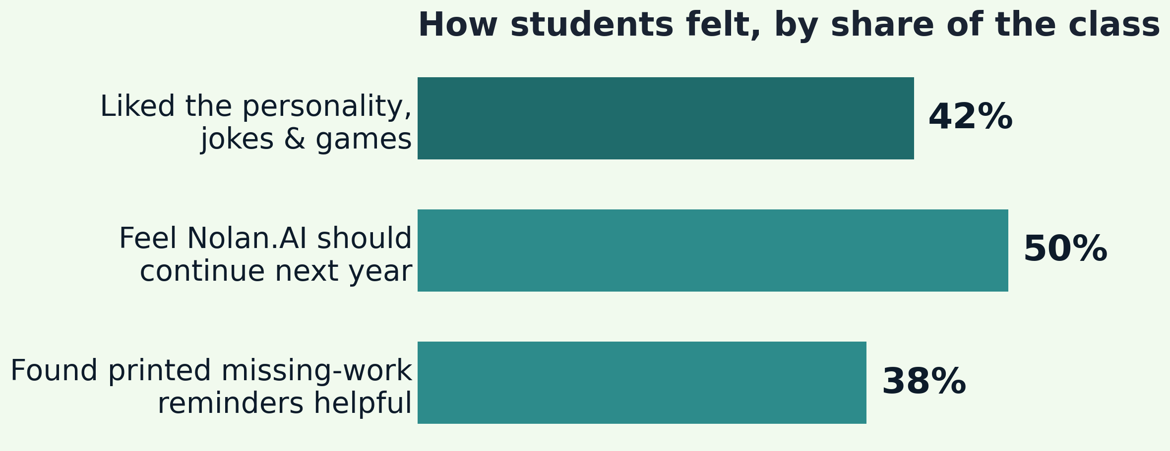
The pilot — one class, one semester
8
assignments, week one
12%
less missing work
Our class named theirs Nolan.AI · one class · self-reported · directional, not proof.

Slide 8

CoWork (Agentic AI)
Like an employee or agent.
Give it a job — it makes a plan, does a variety of tasks, and comes back with the completed work.

Slide 9

Chat vs. agentic
Claude (chat)
Cowork (agentic)
You prompt, it replies, then you do the work.
You describe the task; it plans, does the steps, and delivers finished output.
Manual, step by step.
Autonomous, multi-step.

Slide 10




How It Works
1
2
3
4
Teacher feeds it data
AI analyzes + plans
AI takes action
You see the results
attendance, assignments, messages
finds patterns, builds strategies
messages, challenges, rewards
weekly progress updates

Slide 11

Classroom Loop
Daily or weekly:
1 Teacher provides updates and data
2 AI develops a plan and materials
research, constraints, history
3 Teacher reviews and implements
4 The class moves

Slide 12
The teacher sits in the middle
Grounded in research
The Brain
AI in Cowork
TEACHER
Students
approves everything
mission + data
makes content
see the output
feedback loops back
Students and the AI never talk directly.

Slide 13

Two halves, two different jobs
Claude Cowork
Offline apps
The brain: thinks and creates
Makes slides, notes, and tools
Sees only aggregates
The data: does the number work
Run offline on your laptop
Outputs a name-free summary

Slide 14




Choose its mission
The AI gets ONE goal. Pick one:
Boost Attendance
Crush Missing Work
Get more people showing up
Fewer late or missing assignments
Tracked: daily attendance %
Tracked: on-time submissions
Level Up Participation
Beat the Clock
More people engaged in class
Reduce tardiness
Tracked: participation score
Tracked: daily tardy count
Or define your own goal.

Slide 15
The Brain
The folder it reads every session:
• Mission — the one goal
• Personality and voice
• Constraints and limits
• Class context — aggregate, no names
• Instructional style
• Physical resources

Slide 16




The four constraints
A personality
One clear goal
Students help name and shape it.
One mission for the whole unit.
Evidence-based
Aggregated data only
Its defaults come from research.
It never sees individual students.

Slide 17

Built with students
Students help shape it — and gain ownership:
• They vote on its name and personality
• They help choose its mission
• Buy-in from day one
• They learn what AI can — and can't — do

Slide 18
Themes for classroom projectors
Ocean Depths theme
Built for low contrast,
small screens.
Cream
High contrast
Large text
Ink
Deep navy
Deep teal
Seafoam

Slide 19

What you need to run it
• A Mac or Windows computer with Claude Cowork
• A Claude $20/month plan or higher
• A class you see regularly
• A gradebook you can export — CSV or Excel
• 15–30 minutes, twice a week

Slide 20

Try it without your students
Open the dashboard, drop in the sample gradebook, and print a card. Then open the folder in Cowork and ask your AI for Monday's slide.

