Slide 1
Matthew O'Leary
UX Designer | Making Complex Systems Human

Slide 2
The Pattern I've Seen Repeatedly
Engineers build incredibly sophisticated systems—smart, powerful, feature-rich.
But they design for themselves: assuming users have the same technical knowledge, expecting them to understand complex relationships immediately, presenting all features at once with equal weight.
This creates products that are brilliant but bewildering.
My role: Bridge that gap. Translate technical complexity into intuitive human experiences.

Slide 3
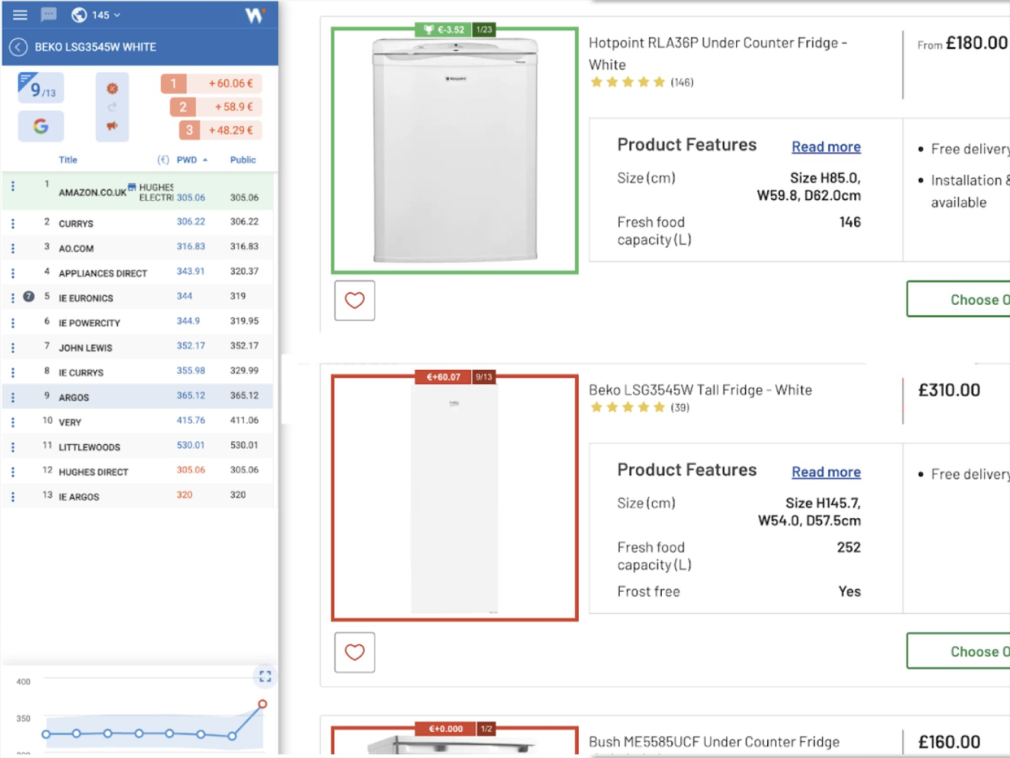
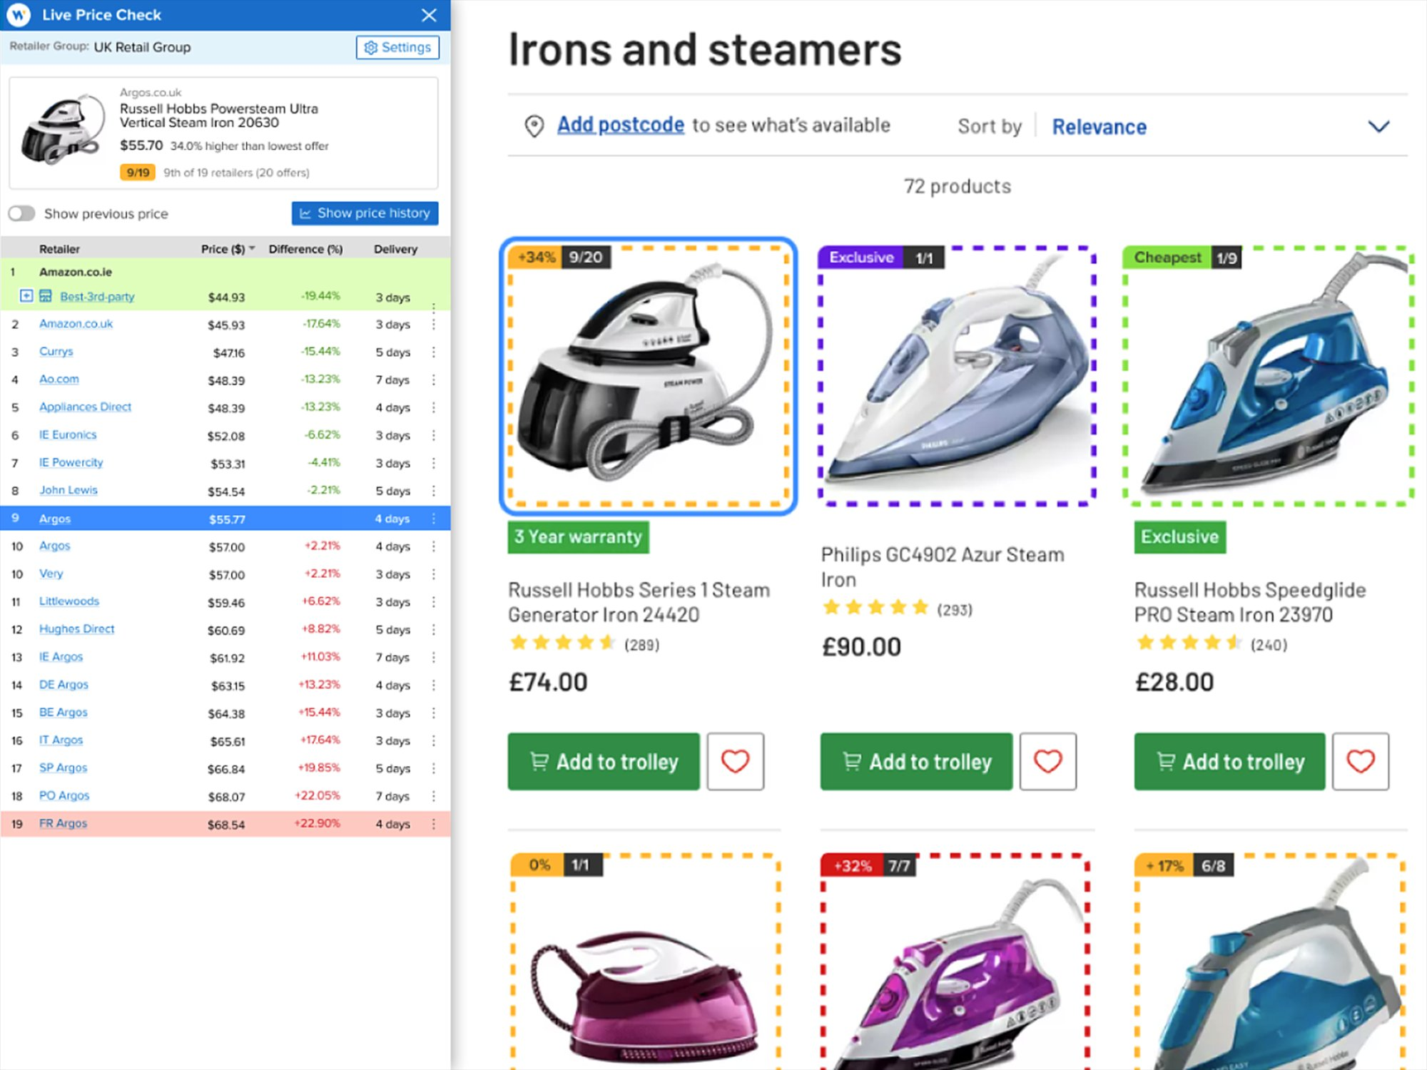
Live Price Check: Simplifying Complex Data
Engineer-Designed: Data Overload
Simplified: Clear Hierarchy

Slide 4
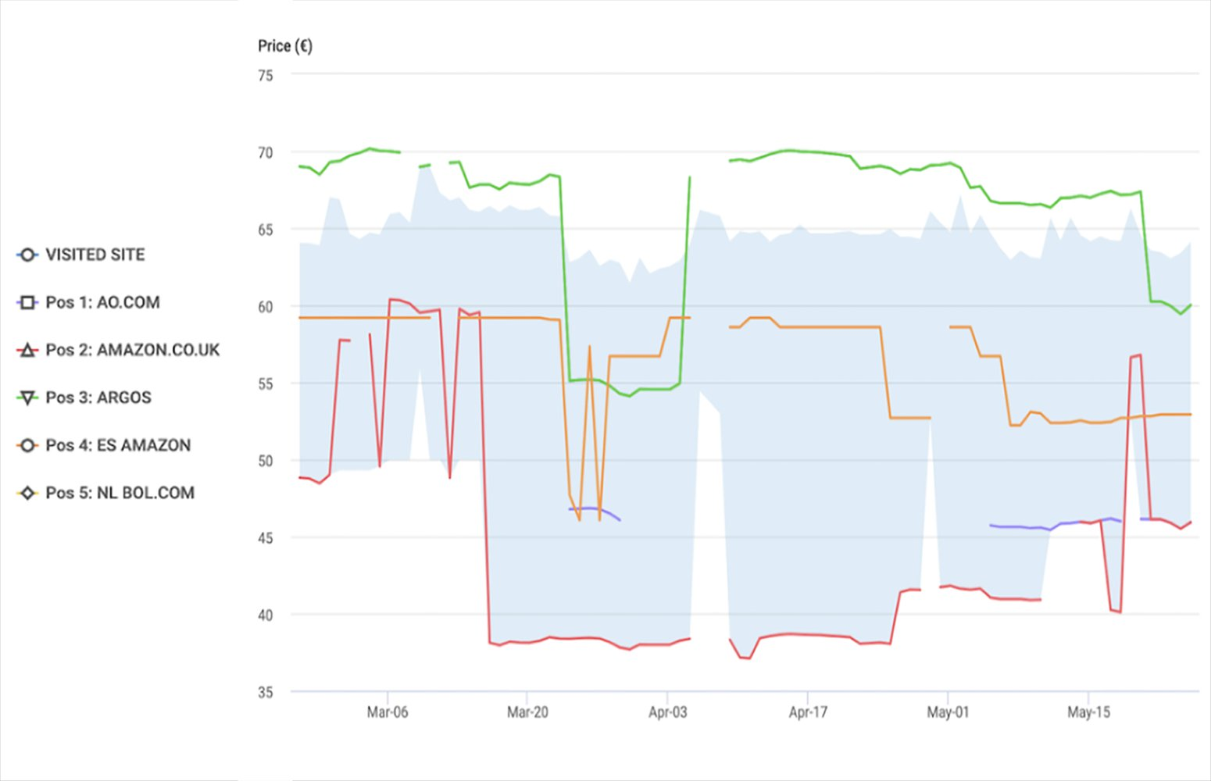
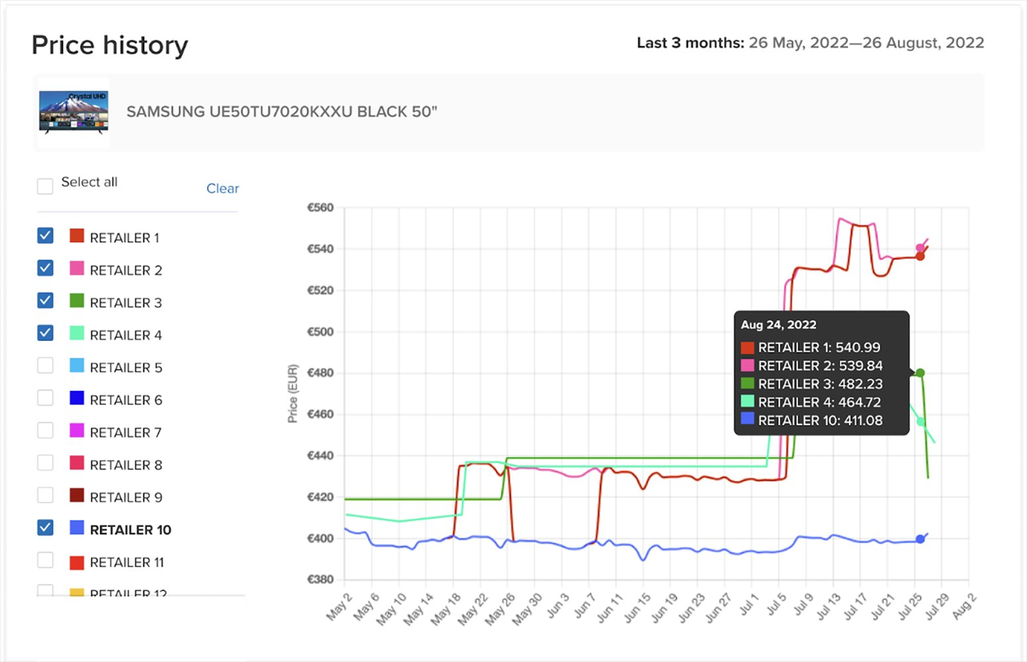
Live Price Check: Making Data Scannable
Before: Unclear Legend - No Ability to Interact
After: Obvious Legend and Ability to Customize

Slide 5
How I Make Technical Products Human
• Ruthless simplification: Remove cognitive load, surface only what matters now
• Progressive disclosure: Guide users from simple to complex, reveal features as they're needed
• Clear information hierarchy: Show relationships, not just features
• Collaboration with engineering: Respect technical constraints while advocating for users
• Iterative refinement: Test, learn, simplify further

Slide 6
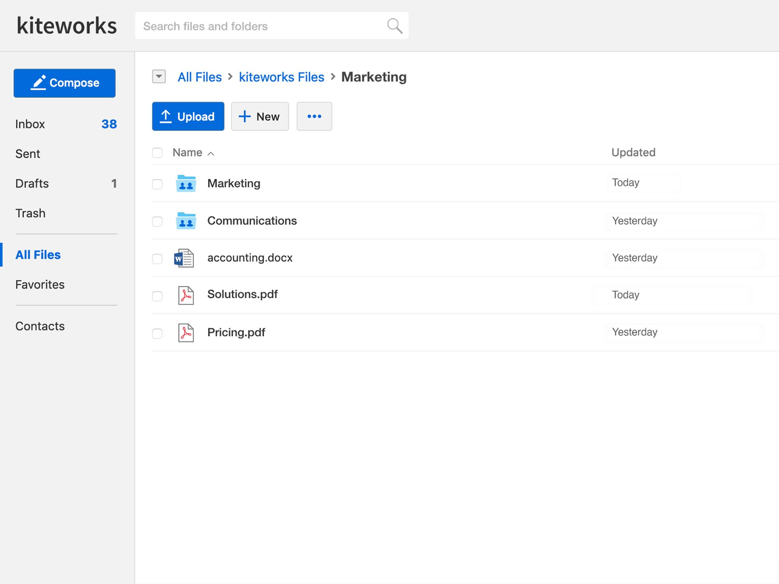
Kiteworks: Enterprise File Sharing
Clean, intuitive interface for complex permission systems and secure collaboration

Slide 7
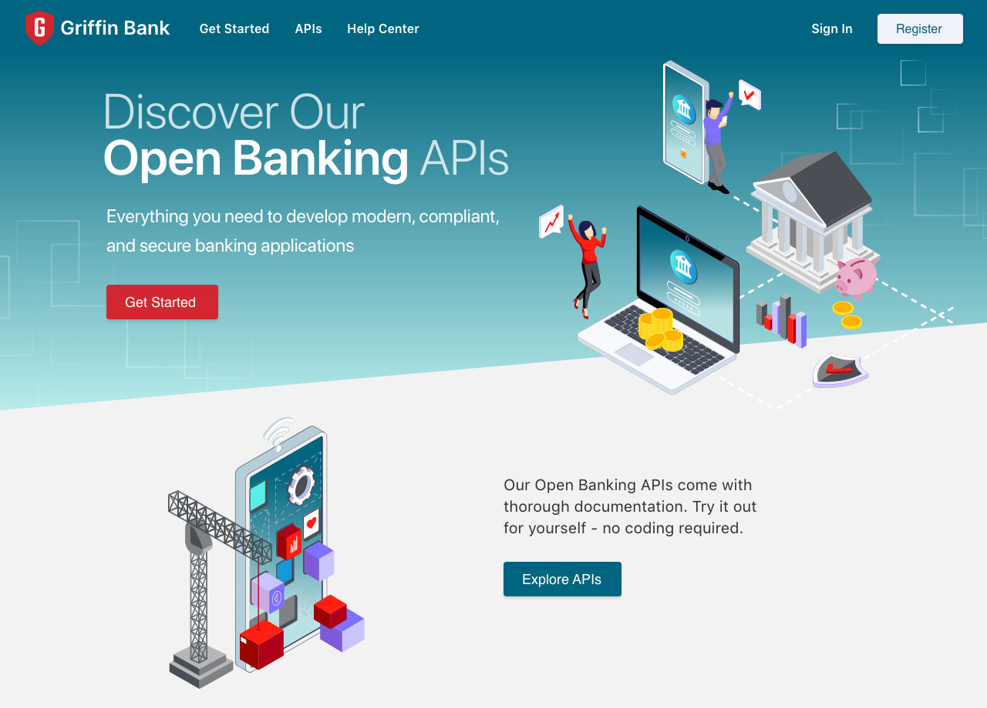
Open Banking: Fintech Platform Design
Designed developer-facing banking APIs and integration flows

Slide 8
Where I've Applied This Approach
Kiteworks – Enterprise file sharing & collaboration platform
Redesigned complex permission systems and sharing workflows for non-technical users
Open Banking (Axway) – Fintech data aggregation platform
Simplified bank connection flows and financial data visualization
Live Price Check – Retail pricing intelligence SaaS
Created intuitive dashboards from complex competitive pricing data
Transformed engineer-designed data tables into scannable, actionable interfaces

Slide 9
Why I'm Right for This Role
Job Requirements:
• Bridge system architecture and UX ✓
I've done this repeatedly
• Transform complex requirements into intuitive patterns ✓
This is my core skill
• Compliance & regulatory flows ✓
Enterprise experience with legal constraints
• Design systems maintenance ✓
Built and evolved UI libraries
My Differentiators:
• 10+ years UX across SaaS, fintech, enterprise
• Deep technical knowledge—I code (HTML/CSS/JS, modern frameworks)
• Production mindset—understand implementation constraints
• Commerce experience—designed checkout/payment flows
• Proven stakeholder collaboration—engineers and PMs trust me

Slide 10
My Recent Path
2022-2024: Transitioned from full-time UX to entrepreneurial projects
• Launched Walk Santa Cruz (historical tour business) - designed entire customer journey
• Maintained technical skills: built sites with Astro.js, Tailwind CSS, modern workflows
• Freelance web design - kept design thinking sharp across varied projects
• Stayed current: AI-assisted workflows, modern design/dev tools
Why return to enterprise UX?
I miss working on complex systems at scale. I miss collaborating with brilliant engineering teams. I miss solving hard UX problems that impact millions of users.
I'm ready to bring fresh perspective + proven experience to high-impact product work.

Slide 11
What You Get From Day One
• Immediate productivity: I've designed these flows before (trials, pricing, cancellations)
• Engineering partnership: I understand technical constraints and speak their language
• User advocacy with pragmatism: I push for users without creating impossible requirements
• Design systems thinking: I build for scale and reusability
• Global perspective: Experience with international markets and accessibility
• Fast iteration: Modern prototyping tools, rapid validation cycles

Slide 12
About My Portfolio
Full transparency: I don't have a traditional case study portfolio.
Like many experienced designers who focused on shipping products rather than documenting process, my work lives in production systems and confidential repositories.
What I can provide:
• Detailed walkthrough conversations about my process and decisions
• References from directors and PMs I've worked with (including Credit Karma)
• Quick spec work on relevant problem spaces to demonstrate current thinking
• My live portfolio site showing range across digital/print/web
I'm happy to discuss any project in depth or tackle a design challenge to demonstrate approach.

Slide 13
Let's Talk
I've spent 10+ years making engineer-brilliant products human-simple.
This role is exactly that: complex commerce systems, regulatory requirements, global scale—all needing intuitive user experiences.
I'm ready to dig in, collaborate with your teams, and ship designs that make a difference.
Matthew O'Leary
mattosurf@icloud.com
(831) 275-2566
mattoleary.design

