Slide 1




Processes of internal variability of the air-sea CO2 flux in IPSLCM6A and insights for ocean carbon sink prediction
Matthew Menary, Juliette Mignot, Laurent Bopp, Cosme Mosneron Dupin
4C March 2022 | Towards decadal predictions of fgco2 variability in IPSLCM6 | Slide 1
Notes:
Hi, my name is Matthew Menary and I am a postdoc at LMD with Laurent Bopp, although I actually spend most of my time working nearby at LOCEAN with Juliette Mignot, focussing on decadal predictions.
I’m going to present some initial work that we’ve done, on assessing the processes driving air-sea CO2 fluxes in the North Atlantic, and how we can perhaps work towards making annual to decadal predictions of this. This is in collaboration with Juliette, Laurent, and Cosme Mosneron Dupin who was a student with Juliette and Laurent.

Slide 2
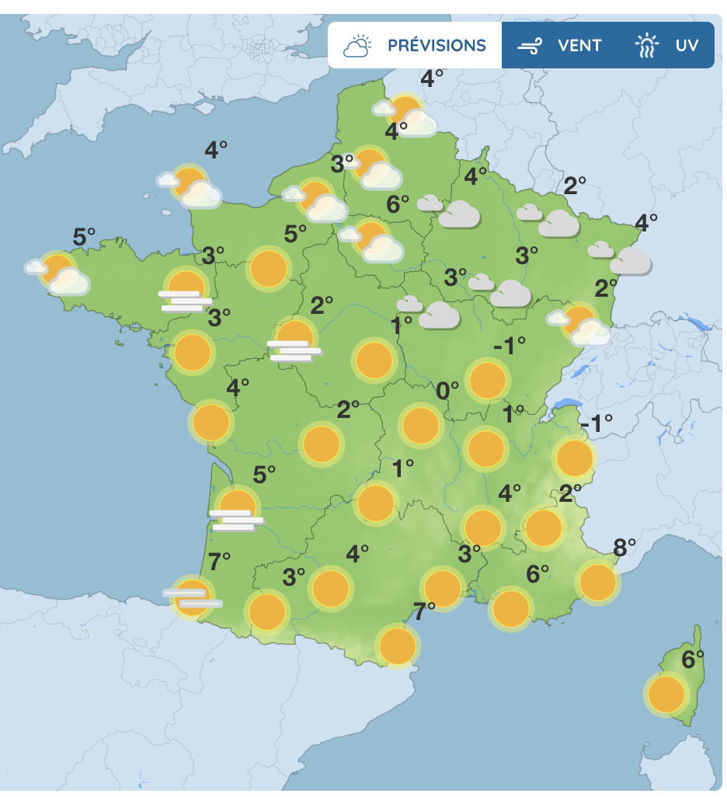
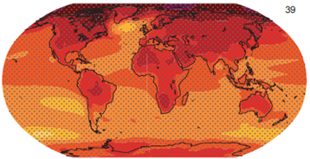
Background
Background
Goal
The subpolar gyre – annual to decadal
What drives fgco₂ variability?
What drives dpco₂ variability?
Multimodel results
Conclusions
Boundary condition problem
Initial condition problem
Day
Week
Month
Season
Year
Decade
Century
Meteo France
IPCC AR6
4C March 2022 | Towards decadal predictions of fgco2 variability in IPSLCM6 | Slide 2
Notes:
So I’ll begin with a slide very briefly describing decadal climate prediction. This lives at the cross roads between weather forecasts, which are an “initial condition” problem, and long term, century timescale, climate projections. These are a “boundary condition” problem, largely greenhouse gases.
And the timescales of the near term predictions I’m interested in are from 1 year to several decades, and we usually just call them decadal predictions.
Decadal climate prediction has been around for a while now, and we’ve made a lot of progress in understanding why we get the predictions we do, and what we need to do to improve them. But they are mostly focussed on physical variables, such as sea surface temperatures, or even ocean heat content and so a key challenge is making predictions of other variables, where we might have fewer verifying observations, or our models might not be as good at simulating them.

Slide 3
Goal
Background
Goal
The subpolar gyre – annual to decadal
What drives fgco₂ variability?
What drives dpco₂ variability?
Multimodel results
Conclusions
Our question:
What physical variables do we need to be able to reliably predict - if we want to make annual to decadal predictions of fgco2?
4C March 2022 | Towards decadal predictions of fgco2 variability in IPSLCM6 | Slide 3
Notes:
So this leads me on to our key scientific question in this work, which is “What physical variables do we need to be able to reliably predict - if we want to make annual to decadal predictions of the air sea CO2 flux?"

Slide 4
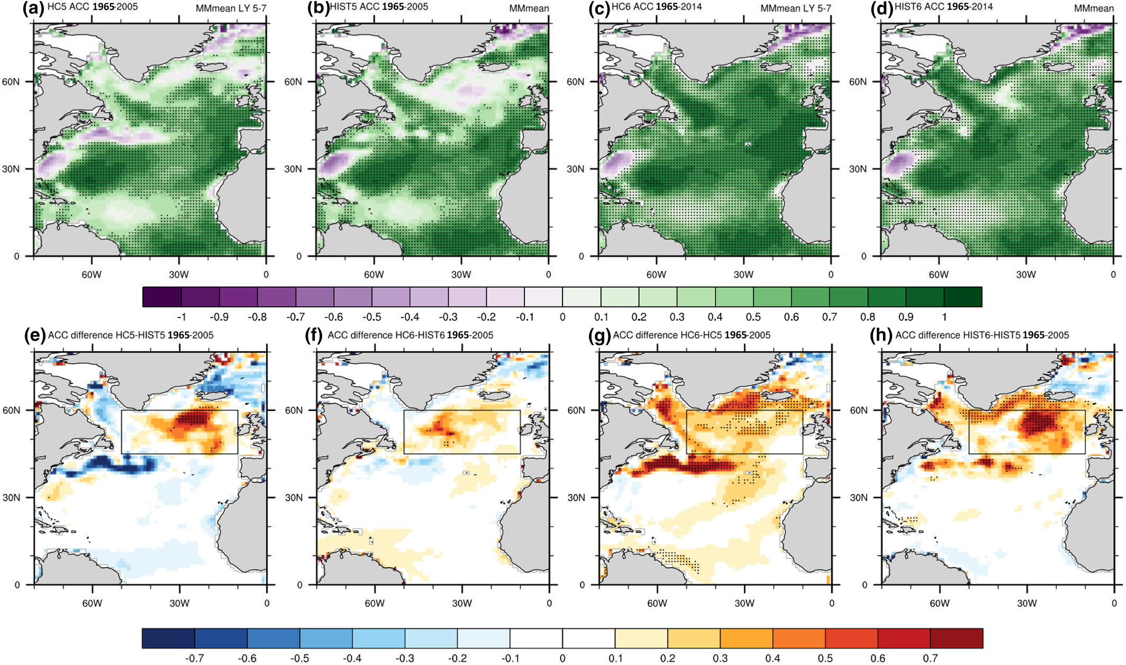
Subpolar Gyre
Background
Goal
The subpolar gyre – annual to decadal
What drives fgco₂ variability?
What drives dpco₂ variability?
Multimodel results
Conclusions
Subpolar gyre (and extended)
Sea Surface Temperature correlation skill in CMIP6 (multi-model mean)
Borchert et al. (2020) GRL
4C March 2022 | Towards decadal predictions of fgco2 variability in IPSLCM6 | Slide 4
Notes:
And a related question is where do we need to be able to make good predictions? But to answer that question, we’ll instead just begin with where we know we can make good decadal predictions of physical variables, which is primarily the North Atlantic Ocean, and specifically the subpolar gyre. Here I’m showing the multimodel skill of decadal timescale sea surface temperature predictions in the North Atlantic from recent work by Leo Borchert. As you can see, there is high skill everywhere, and in particular in the extended subpolar gyre region, which I’ve highlighted with the red box. This skill arises largely from the forcings, which is a bit of a problem in decadal climate prediction, but I won’t talk about that for now.
The subject of our analysis will be IPSLCM6, the latest CMIP6 model from IPSL. And we’ll be looking at piControl simulations, i.e. with no interannually varying forcing.

Slide 5
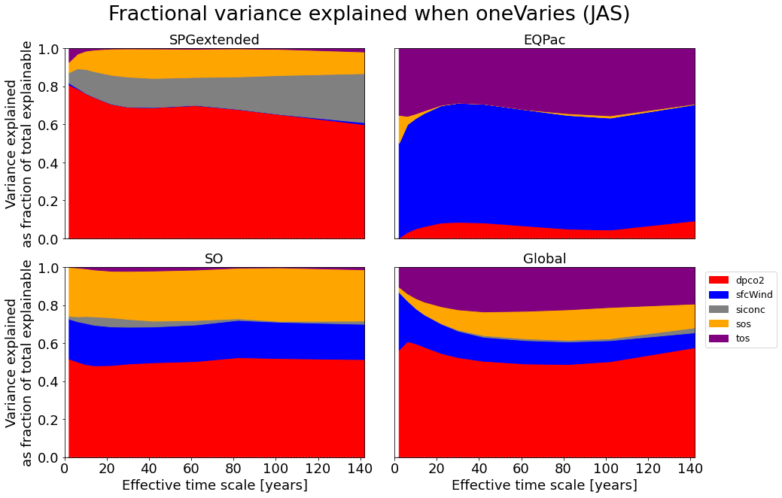

fgco2 variability
Background
Goal
The subpolar gyre – annual to decadal
What drives fgco₂ variability?
What drives dpco₂ variability?
Multimodel results
Conclusions
SSS SST
fgco2 ∝ dpco₂ x sfcWind² x siconc x f(SSS) x f(SST)
4C March 2022 | Towards decadal predictions of fgco2 variability in IPSLCM6 | Slide 5
Notes:
[2:35]
So, to jump straight into some results – what drives the air-sea CO2 flux (fgco2) in our model IPSLCM6? And the answer, for the subpolar gyre region, is largely dpco2 on all annual to decadal timescales.
Here, we’ve taken the online equation for the air-sea CO2 flux and recomputed it offline, where we can then hold individual elements of it constant whilst letting the others vary. We used the actual online equations, along with the various constants etc rather than just doing a multiple linear regression. The ”functions” of Sea Surface Salinity and Sea Surface Temperature are just shorthand for the longer calculations like the solubility and Schmidt number.
So dpco2 dominates overall, with then limited roles for sea ice concentrations and sea surface salinity. The increasing role of the sea ice might be an artefact, or result of, strong centennial variability in sea-ice and indeed global climate in IPSLCM6, apparently modulated through the AMOC.
On the other hand sea surface temperatures show almost no role, but remember that these might be themselves driving dpco2 variability, and this is the reason we didn’t do a multiple linear regression here, as we didn’t want to confound these different pathways.
This is averaged over the entire region, and so specific regions such as the ice edge might be locally even more important. This will become apparent in the maps I show next.

Slide 6
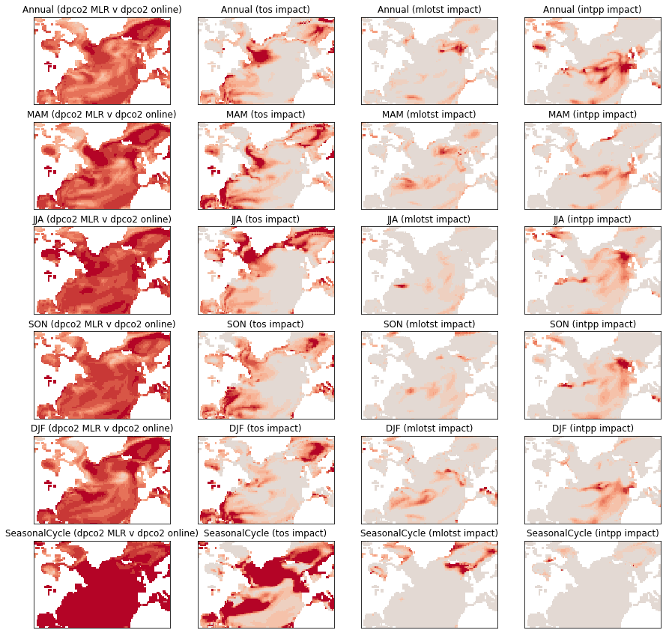
dpco2 variability
Background
Goal
The subpolar gyre – annual to decadal
What drives fgco₂ variability?
What drives dpco₂ variability?
Multimodel results
Conclusions
Full correlation (verification)
Impact (correlation difference; clim. minus full)
dpco2
SST
MLD
IntPP
Decadal (>5y)
dpco2 output from model
dpco2 calculated from multiple linear regression
dpco2 = ⍺ SST + β MLD + ɣ IntPP + ε
4C March 2022 | Towards decadal predictions of fgco2 variability in IPSLCM6 | Slide 6
Notes:
[4:10]
So, given that dpco2 is generally the most important driver in a spatially averaged sense at least, what physical variables that we might be able to predict, or at least investigate ways of predicting, drive this?
Here, I have now done an offline multiple linear regression of Sea Surface Temperatures (SST), Mixed Layer Depths (MLD), and column integrated primary productivity (IntPP) on to dpco2. The left hand column is then a verification of this against the actual, online calculation of dpco2. What I’m showing here is for decadal timescales, which I’ve specified as anything over 5 years.
So, the first thing to note is that the offline multiple linear regression works okay.
Secondly, I’m then showing the impact of setting each one of those input variables to their climatological values and then recomputing the dpco2. I take the difference between this and the truth (the left column), which basically leaves me with maps of where each of these variables is important to the overall dpco2 calculation. Red being important.
So this shows us that on decadal timescales, within the subpolar gyre, SSTs in the Labrador Sea region between Greenland and Canada are quite important.

Slide 7
dpco2 variability
Background
Goal
The subpolar gyre – annual to decadal
What drives fgco₂ variability?
What drives dpco₂ variability?
Multimodel results
Conclusions
Full correlation (verification)
Impact (correlation difference; clim. minus full)
dpco2
SST
MLD
IntPP
Decadal (>5y)
Decadal summer
4C March 2022 | Towards decadal predictions of fgco2 variability in IPSLCM6 | Slide 7
Notes:
That relationship seems to be dominated by the decadal variability within the summer season. Here I am showing the same as before, but only using summer data rather than the whole year. As you can see, these maps look quite similar. I’ve also done the same for the other seasons but in the interests of time I won’t show those here.

Slide 8
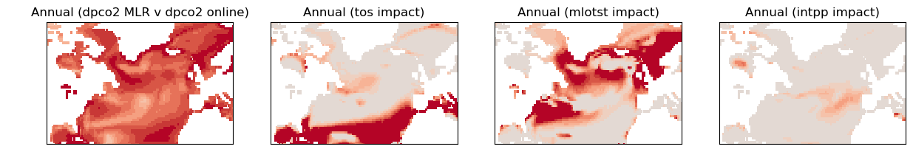
dpco2 variability
Background
Goal
The subpolar gyre – annual to decadal
What drives fgco₂ variability?
What drives dpco₂ variability?
Multimodel results
Conclusions
Full correlation (verification)
Impact (correlation difference; clim. minus full)
dpco2
SST
MLD
IntPP
Decadal (>5y)
Decadal summer
Annual
4C March 2022 | Towards decadal predictions of fgco2 variability in IPSLCM6 | Slide 8
Notes:
[5:45]
And finally I looked on shorter, annual timescales, rather than decadal timescales. Once again, we are able to faithfully reproduce the online dpco2 calculation using our offline multiple linear regression. Now though, the maps are slightly different with mixed layer depths becoming the primary driver of annual dpco2 variability in the subpolar gyre. This would suggest that being able to predict mixed layer depths might be a pre-requisite for making skilful predictions of dpco2 and thus the air-sea CO2 flux. This is something that we should be able to make good predictions of, and we have half decent observations of, but at the moment it isn’t something we’ve really tried that hard to predict, and I don’t think we have that much skill in it either due to model deficiencies in simulating the physical processes driving mixed layer variability – namely overflows and convection.

Slide 9
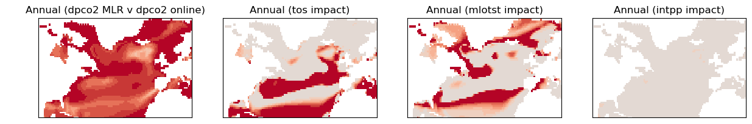
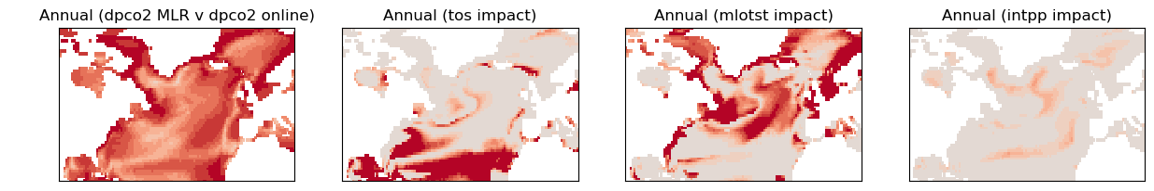
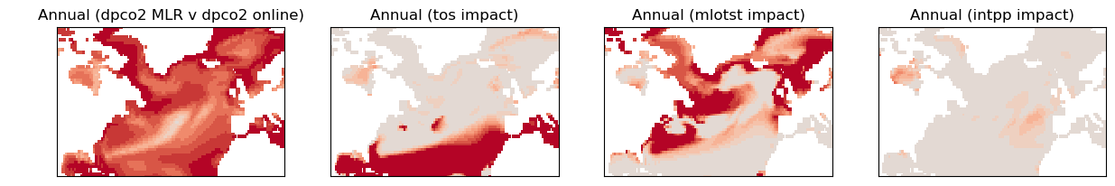
Multimodel
Background
Goal
The subpolar gyre – annual to decadal
What drives fgco₂ variability?
What drives dpco₂ variability?
Multimodel results
Conclusions
Full correlation (verification)
(Annual)
Impact (correlation difference; clim. minus full)
dpco2
SST
MLD
IntPP
IPSLCM6
CESM2-WACCM
CNRM-ESM2-1
UKESM1
4C March 2022 | Towards decadal predictions of fgco2 variability in IPSLCM6 | Slide 9
Notes:
[6:35]
Finally, we’ve extended this work to look at some other models, of which I’m just showing a handful here. Basically, the other models largely agree with IPSLCM6 that mixed layers are important for driving annual dpco2 variability on annual timescales within the norther subpolar gyre.

Slide 10
Conclusions
Background
Goal
The subpolar gyre – annual to decadal
What drives fgco₂ variability?
What drives dpco₂ variability?
Multimodel results
Conclusions
dpco2 dominates fgco2 variability in IPSLCM6 on annual to decadal timescales
IPSLCM6 and other models agree that dpco2 variability in SPG is dominated by:
MLDs on annual timescales
Lab Sea SSTs on decadal timescales
These physical variables are likely predictable on annual to decadal timescales
Next steps: Assess predictability of these physical variables in a multi-model context
4C March 2022 | Towards decadal predictions of fgco2 variability in IPSLCM6 | Slide 10
Notes:
So to conclude.
I’ve shown that dpco2 dominates the air-sea CO2 flux in IPSLCM6 on annual to decadal timescales. I haven’t shown that this is the case in other models, as we didn’t have access to their online code for calculating fgco2, but it is a reasonable assumption.
Indeed, the models do agree that dpco2 variability itself is dominated by mixed layer depth variability on annual timescales, and perhaps Labrador Sea SSTs on longer timescales.
And these physical variables are likely predictable on annual to decadal timescales.
So our next steps will be to assess this predictability in a mutli-model context and then go from there.
Now though, I’ll pass over to Juliette to talk about some new simulations that are available using IPSLCM6.
[7:45]

