Slide 1
Phylogenetics
cytochrome oxidase and insulin 1 in rodents
Panteleev Dmitry

Slide 2
Muridae
Species | Areas | Lifestyle | Size
Rattus norvegicus * Muridae | almost worldwide | omnivorous | 45 cm (including the tail)
Rattus losea | Southwest China, Thailand, Taiwan | omnivorous | 20 to 25 centimeters, excluding the tail
Rattus rattus | almost worldwide | omnivorous | 16 to 22 cm, with tails 17-24 cm
Mus musculus * Muridae | almost worldwide | omnivorous | 6 to 10 cm in body length, with tails 6 to 10.5 cm
Mus caroli | South China, Taiwan, Vietnam | omnivorous | about 6 to 10 cm body length, with tails can be slightly longer
Mus pahari | Northeast India, Southern China | omnivorous | about 6 to 10 cm in body length, with tails can be slightly longer
Mastomys coucha | sub-Saharan Africa | omnivorous | 20 to 25 cm, including the tail
Onychomys torridus *Cricetidae | Western and southwestern United States and northern Mexico | primarily carnivorous | between 9 to 13 cm (approximately 3.5 to 5 inches) in body length, with tails measuring about 3 to 6 cm
Mesocricetus auratus * Muridae | northern Syria and southern Turkey | omnivorous | 128 to 165 mm and tail 13 to 21 mm
https://ru.ruwiki.ru/

Slide 3
Markers
- The Ins1 gene - encodes insulin 1
- The cytochrome c oxidase subunit I (COI) gene is a widely used molecular marker in phylogenetic studies

Slide 4
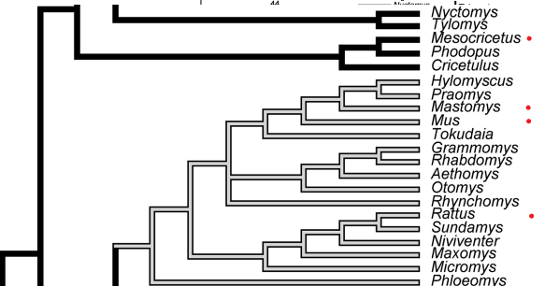
From article
Phylogeny of muroid rodents: relationships within and among major lineages as determined by IRBP gene sequences
doi:10.1016/j.ympev.2003.07.002

Slide 5
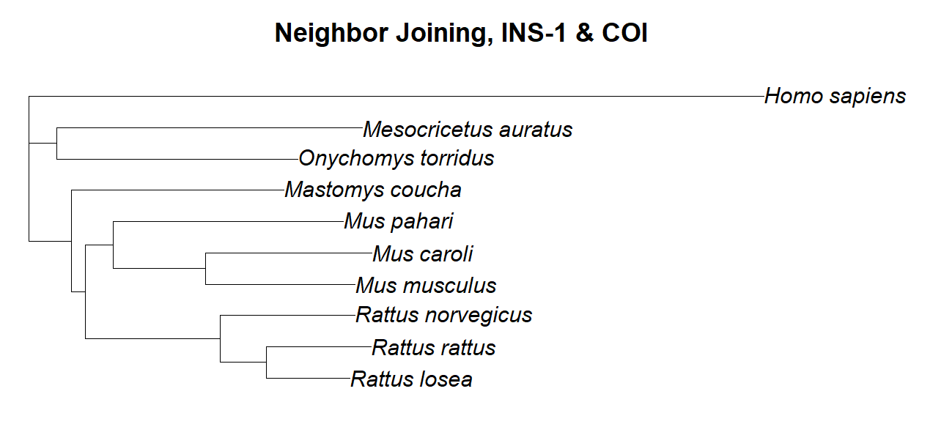

Slide 6
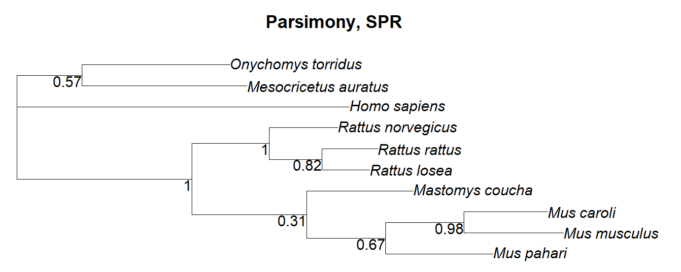
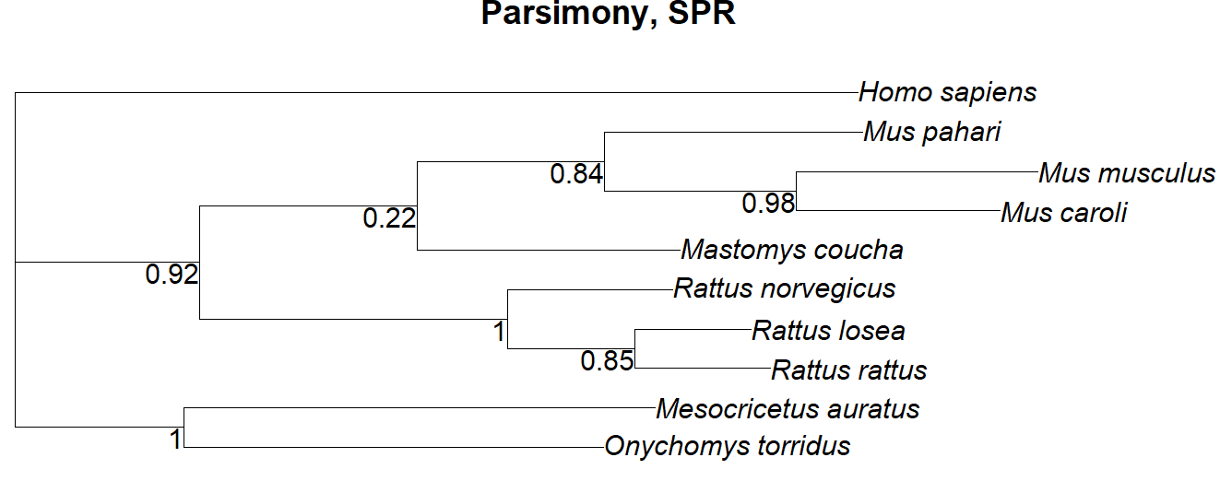

Slide 7
