Slide 1
BLUESTOCK FINTECH
Mutual Fund Analytics Platform
End-to-End Data Engineering, ETL Pipeline & Interactive Dashboard
Rihen | Data Analyst Intern, Bluestock Fintech Individual Capstone Project — 7 Working Days

Slide 2
THE CHALLENGE
Problem & Objective
THE PROBLEM
THE OBJECTIVE
Fragmented data: NAV, AUM, and SIP data live in different formats across AMFI's site — no unified database. No risk-adjusted comparison: investors can't easily compare funds on Sharpe, Alpha, or drawdown. No benchmark tracking: most retail investors don't know if their fund beats its index. Slow reporting: monthly MF reports are static PDFs taking days to prepare.
Build a full-stack Mutual Fund Analytics Platform that:
Ingests AMFI/mfapi.in data via an automated ETL pipeline
Stores it in a normalised SQL star schema
Computes Sharpe, Sortino, Alpha, Beta, VaR, Max Drawdown
Benchmarks funds against Nifty 50 / Nifty 100
Analyses investor behaviour across geography & demographics
Delivers an executive-ready interactive dashboard
BLUESTOCK FINTECH — Mutual Fund Analytics Capstone
2

Slide 3
FOUNDATION
Data Sources
40
10
87K+
4.4 Yrs
Real Fund Schemes
Datasets Provided
Transaction & NAV Rows
History (Jan 2022 - May 2026)
1
AMFI India
NAV, AUM, Folio, SIP — daily/monthly
DATA AUTHENTICITY
NAV values are anchored to real AMFI/mfapi.in figures. Investor transaction data is synthetically generated using realistic Indian MF market demographic and geographic distributions. No proprietary or confidential data was used.
2
mfapi.in
Historical NAV via REST API (JSON, no auth)
3
NSE / BSE
Benchmark index prices — daily
BLUESTOCK FINTECH — Mutual Fund Analytics Capstone
3

Slide 4
SYSTEM DESIGN
Architecture: 5-Layer Pipeline
1
2
3
4
5
EXTRACT
TRANSFORM
LOAD
ANALYSE
VISUALISE
▶
▶
▶
▶
10 CSVs +
mfapi.in API
Pandas cleaning,
validation, dedup
SQLite star
schema (11 tables)
3 Jupyter
notebooks
4-page BI
dashboard
This mirrors real-world fintech data pipelines used at companies like Zerodha, Groww, and Paytm Money.
Database schema: a star schema with 2 dimension tables (dim_fund, dim_date) and 9 fact tables, indexed on amfi_code and date. Every table's row count was verified against its source CSV after load — all 11 matched exactly, zero data loss.
BLUESTOCK FINTECH — Mutual Fund Analytics Capstone
4

Slide 5
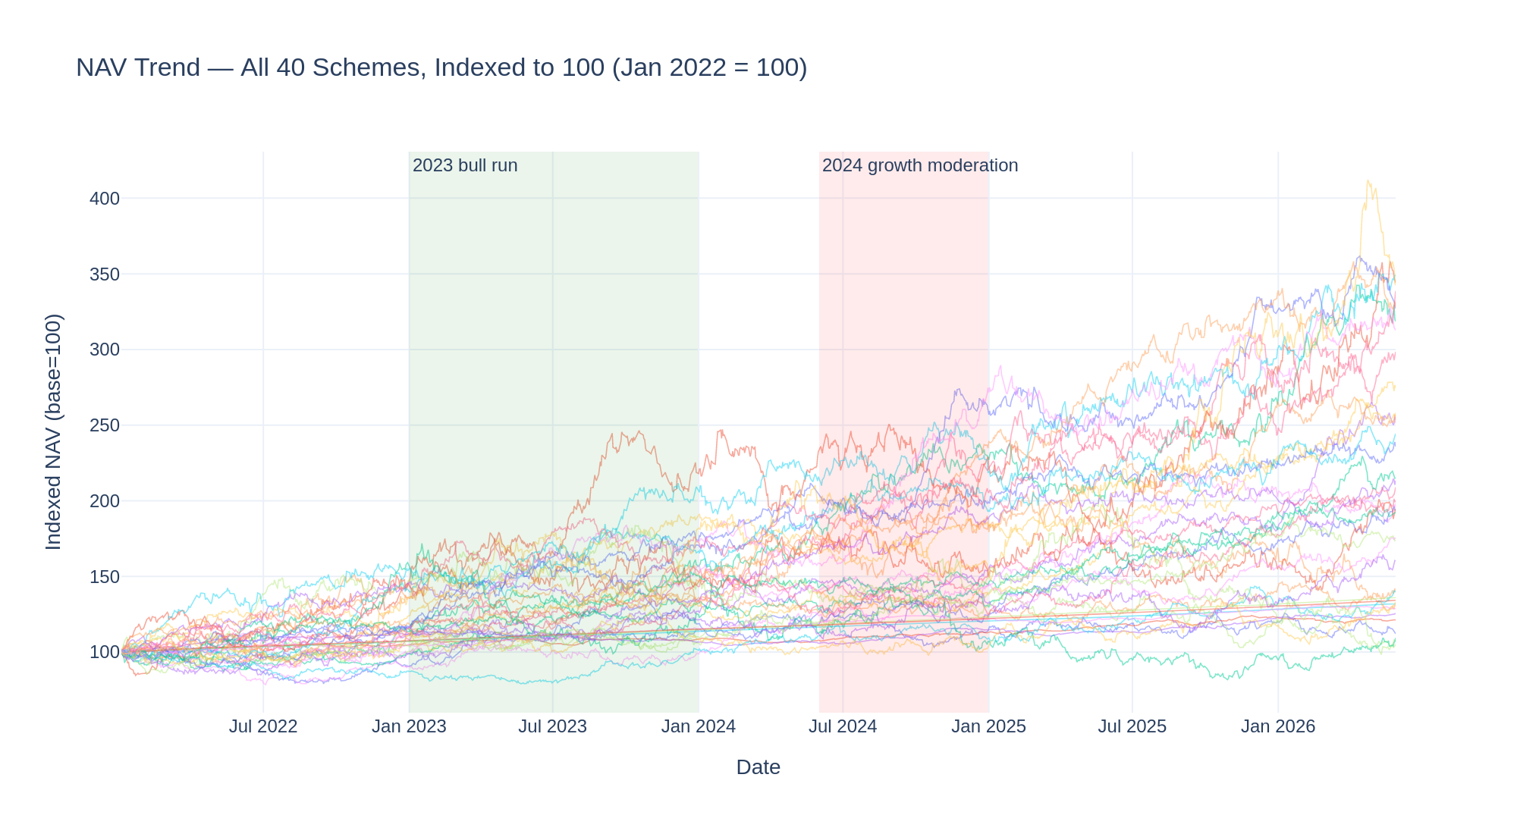
EXPLORATORY ANALYSIS · 1 OF 2
NAV Trends: A Rally, Then a Slowdown
+15.7%
2023 bull run — average NAV gain across all 40 schemes
+4.1%
2024: a slowdown, not a decline — growth continued at a slower pace; the series never drops more than ~1% from its running peak across the full window.
BLUESTOCK FINTECH — Mutual Fund Analytics Capstone
5

Slide 6
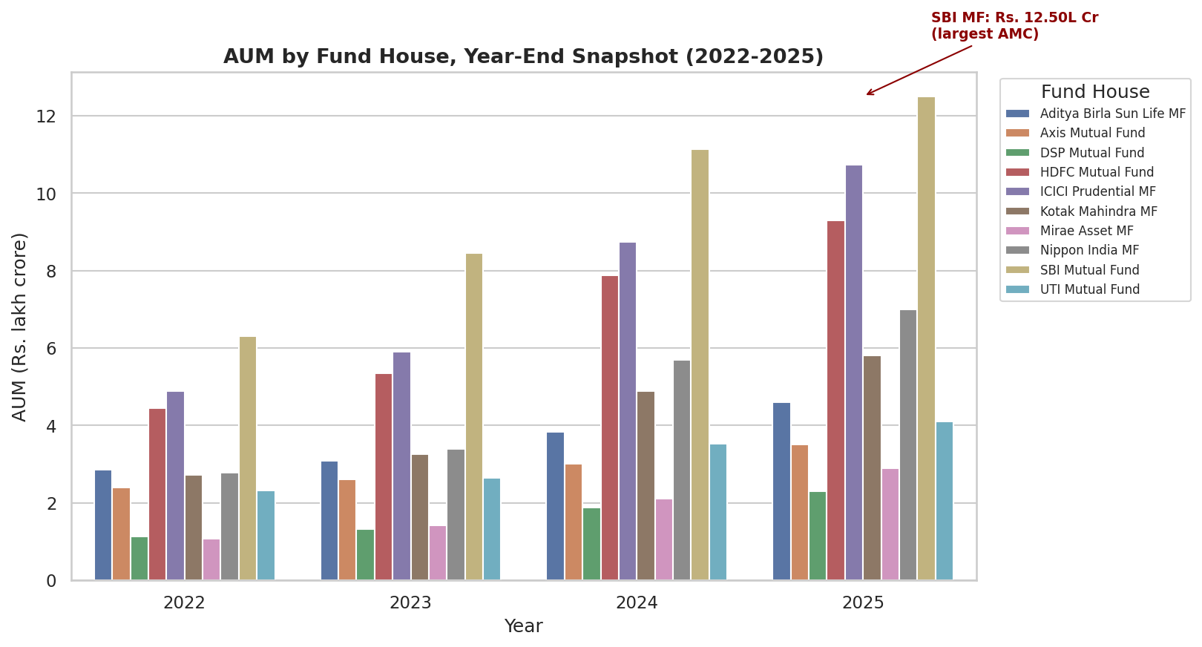
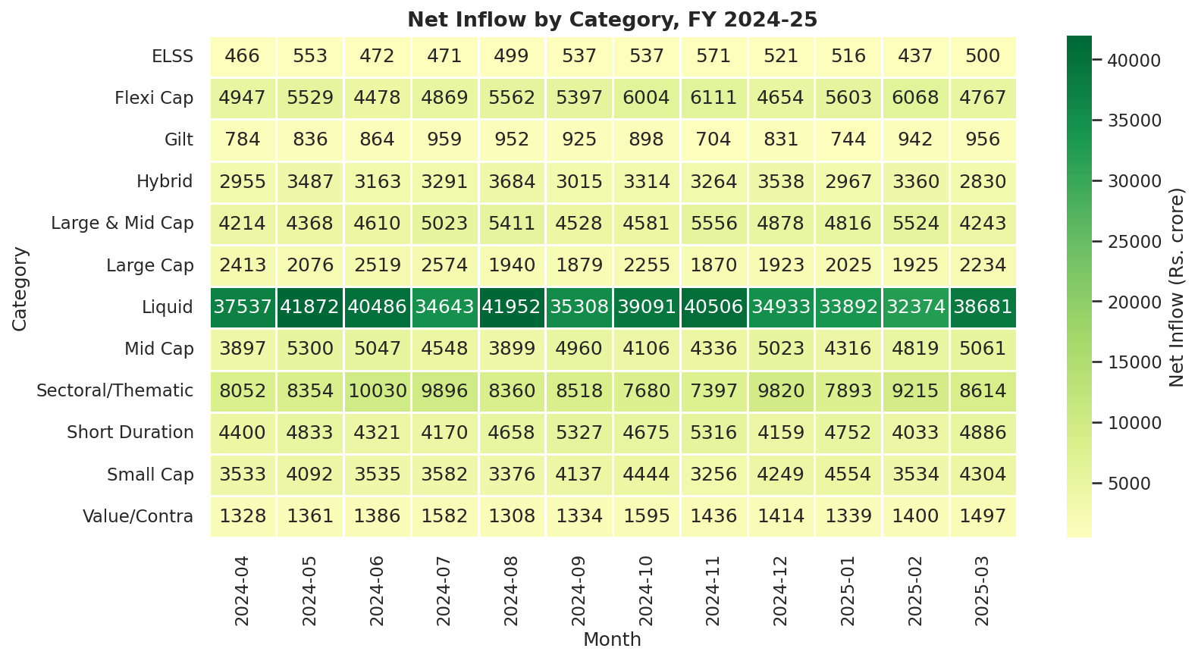
EXPLORATORY ANALYSIS · 2 OF 2
AUM Growth & the SIP All-Time High
SBI Mutual Fund holds Rs. 12.50 lakh crore AUM (FY25) — the largest of the 10 fund houses tracked, consistent with its real-world #1 position. Liquid funds dominate category inflow volume, while SIP inflows hit an all-time high of Rs. 31,002 crore in December 2025.
BLUESTOCK FINTECH — Mutual Fund Analytics Capstone
6

Slide 7
PERFORMANCE ANALYTICS · 1 OF 2
Fund Scorecard: Top 5 of 40
Composite score (0-100): 30% × 3yr return + 25% × Sharpe + 20% × Alpha + 15% × expense ratio (inverse) + 10% × max drawdown (inverse)
Rank | Scheme | Fund House | 3yr Return | Sharpe | Score /100
1 | UTI Mid Cap Fund | UTI | -0.8% | -0.21 | 88.2
2 | HDFC Top 100 Fund | HDFC | 1.3% | -0.20 | 88.1
3 | Axis Small Cap Fund | Axis | -11.7% | -0.08 | 85.2
4 | ABSL Small Cap Fund | Aditya Birla SL | -4.2% | 0.16 | 80.4
5 | Axis Bluechip Fund | Axis | 0.5% | 0.03 | 79.9
Note: the top-ranked funds by composite score don't necessarily have the highest raw 3-year return — the formula deliberately weights risk-adjusted characteristics (Sharpe, Alpha, drawdown) alongside return. This is the formula working as specified.
BLUESTOCK FINTECH — Mutual Fund Analytics Capstone
7

Slide 8
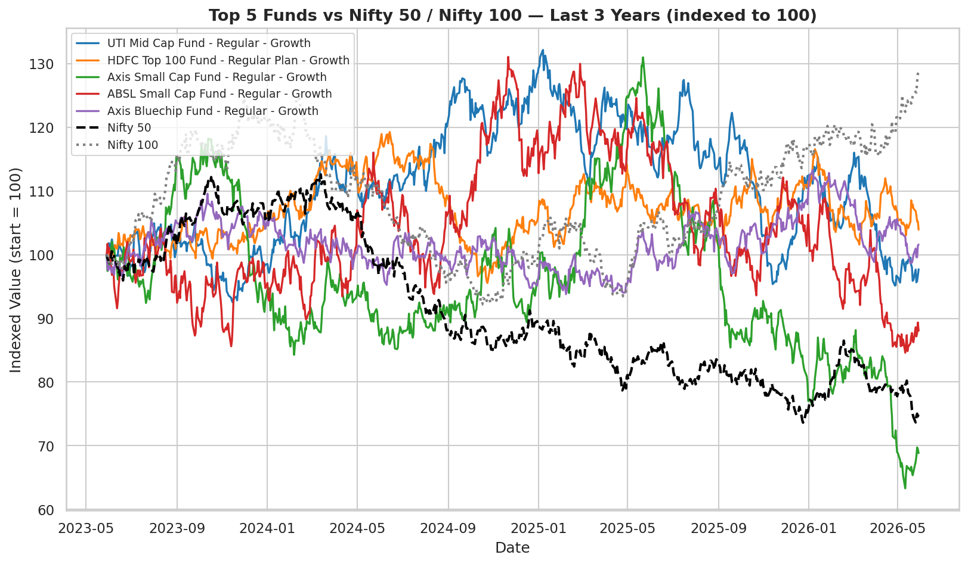
PERFORMANCE ANALYTICS · 2 OF 2
Alpha & Beta: A Finding Worth Flagging
R² = 0.0006
Average R² across all 40 Alpha/Beta regressions vs. Nifty 100 — essentially zero market explanatory power.
Why this matters: real Equity Large Cap funds typically show R² of 0.7-0.9+ against Nifty 100. The Alpha/Beta values here are mathematically correct — formula followed exactly — but carry very little statistical signal given this R². Flagged explicitly rather than presented as reliable market sensitivity.
BLUESTOCK FINTECH — Mutual Fund Analytics Capstone
8

Slide 9
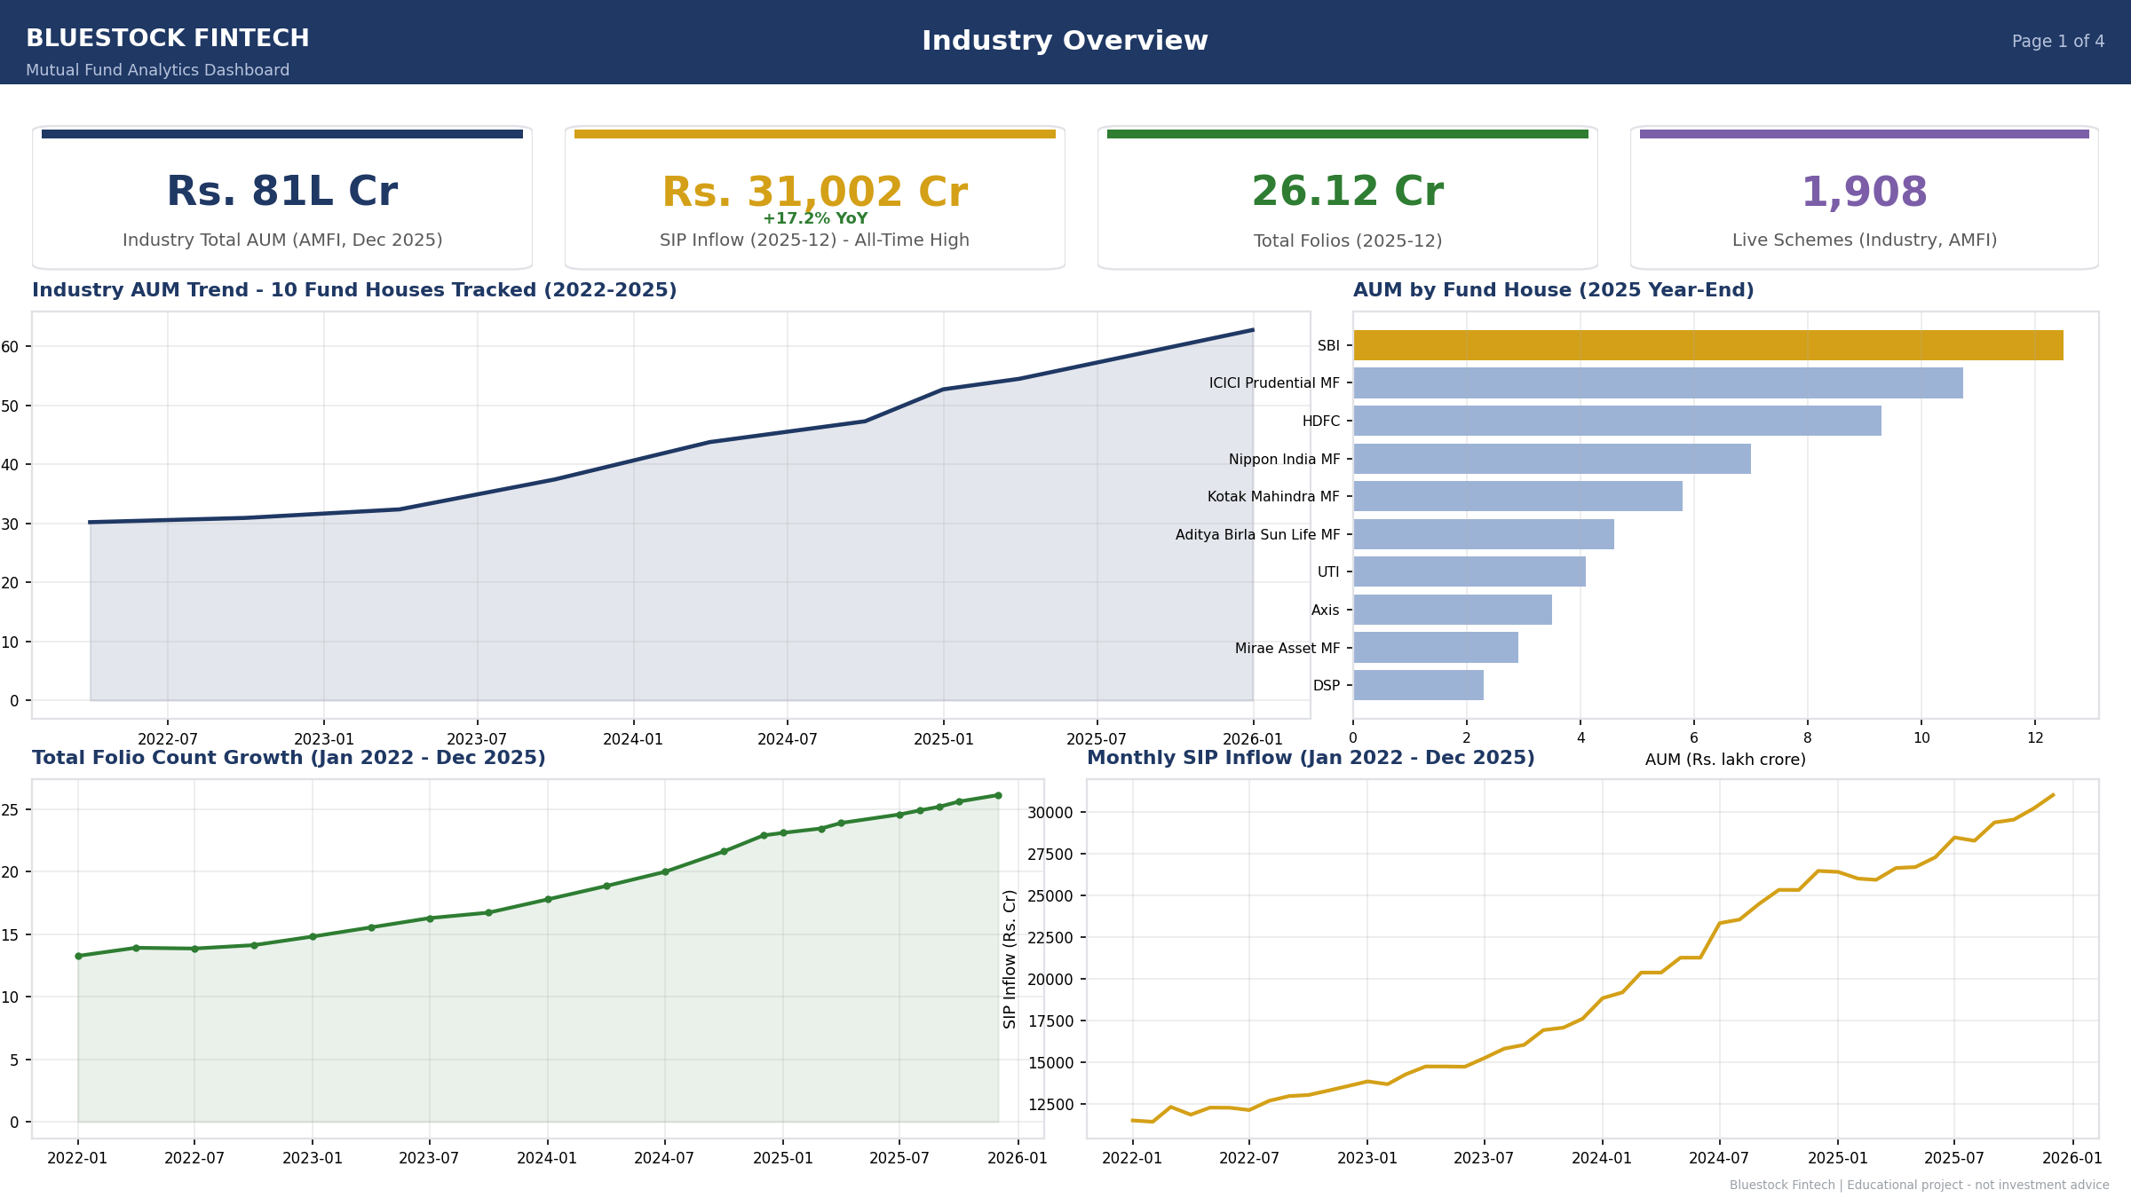
DASHBOARD · 1 OF 2
Industry Overview
BLUESTOCK FINTECH — Mutual Fund Analytics Capstone
9

Slide 10
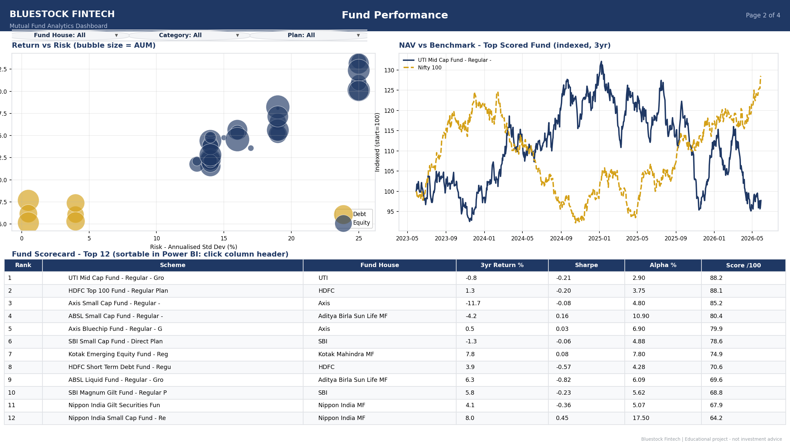
DASHBOARD · 2 OF 2
Fund Performance
BLUESTOCK FINTECH — Mutual Fund Analytics Capstone
10

Slide 11
SUMMARY
Key Findings
✓
SBI Mutual Fund dominates AUM
Rs. 12.50 lakh crore (FY25) — the largest of the 10 fund houses tracked, matching its real-world position.
✓
SIP inflows hit an all-time high
Rs. 31,002 crore in December 2025, capping a multi-year uptrend.
✓
Top scorecard fund scores 88.2/100
Driven by strong Sharpe & Alpha, not raw 3-year return — the weighting works as designed.
!
Market correlation is near-zero
Alpha/Beta R² of 0.0006 vs. Nifty 100 — a dataset limitation flagged throughout, not a real market pattern.
!
97.8% of investors flagged "at-risk"
Traced to sparse SIP cadence (~65-day gaps) in the simulated data, not a genuine behavioural signal.
BLUESTOCK FINTECH — Mutual Fund Analytics Capstone
11

Slide 12
Thank You
Questions & discussion welcome.
Rihen | Data Analyst Intern, Bluestock Fintech Full project: GitHub repo (bluestock_mf_capstone) — see README.md for setup Final_Report.pdf and Bluestock_MF_Presentation.pptx included in the repo

