Slide 1
Pens and Printers
Product Sales Analysis

Slide 2
PROJECT OVERVIEW and BUSINESS GOALS
Six weeks ago, we launched a new line of office stationery. Three sales strategies were tested for this, targeted email and phone calls, as well as combination of the two.
We need to find the best sales strategy by looking at :
How many customers were there for each approach?
What does the spread of the revenue look like overall? And for each method?
Was there any difference in revenue over time for each of the methods?
Are there any other differences between the customers in each group?
Based on the data, which method should we continue to use?

Slide 3
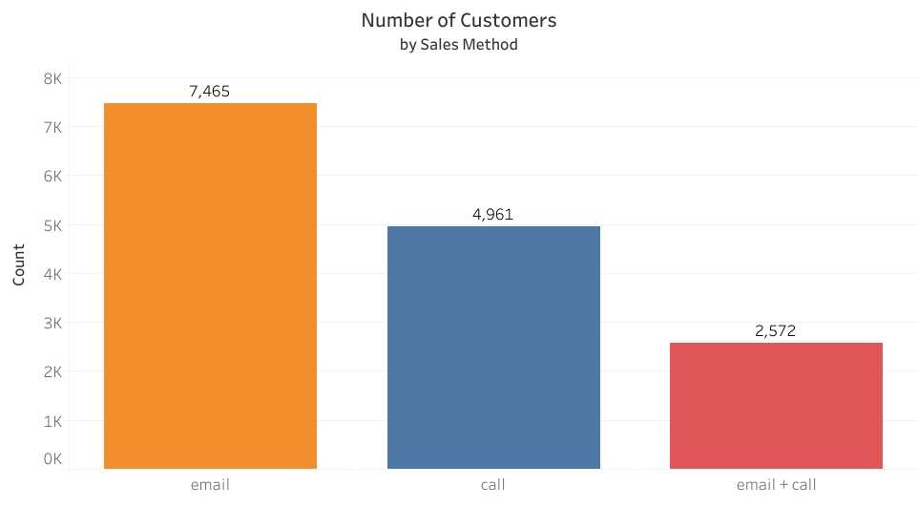
How many Customers were there for each Approach?
Three Sales Approaches Used:
The "e-mail" only customers accounted for 49.77% of all customers.
The "call" only customers accounted for 33.08% of all customers.
The "email + call" customers accounted for 17.15% of all customers.

Slide 4
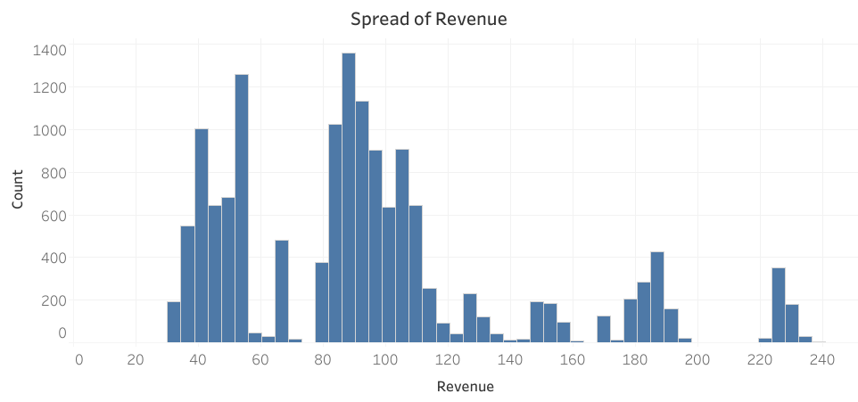
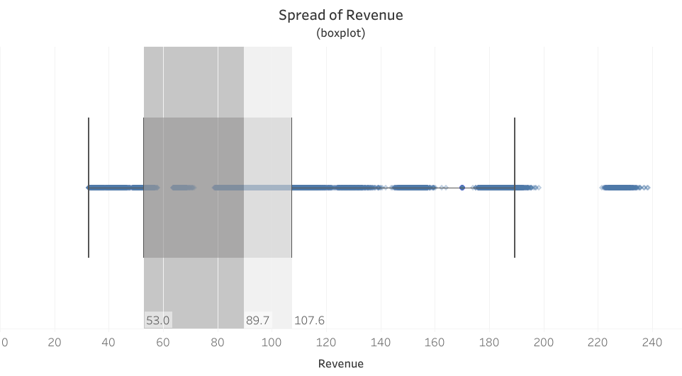
What does the overall spread of revenue look like?
The spread of revenue shows a distribution of revenue from a minimum of 32.54 to a maximum of 238.32, with multimodal distribution.
The box plot shows that 50% of revenue ranged between 53.00 and 107.60, with a median revenue of 89.70

Slide 5
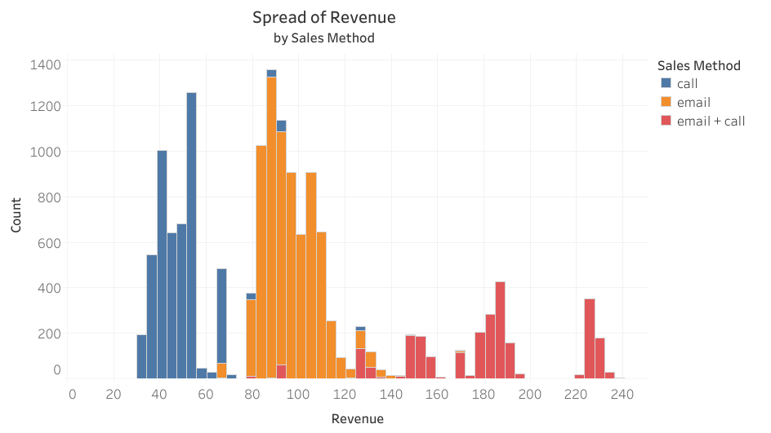
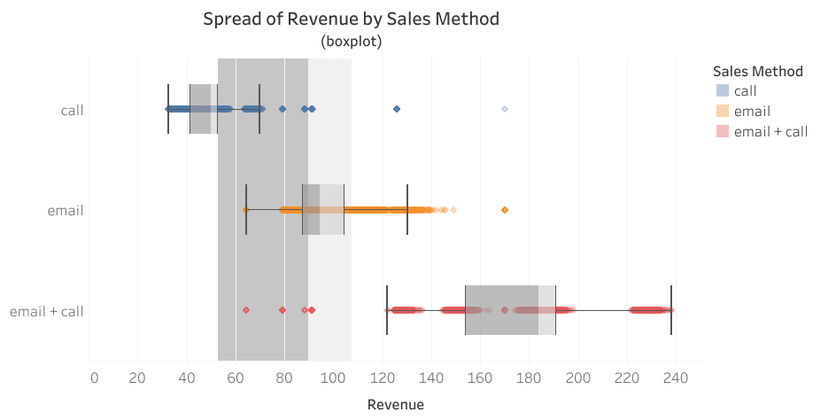
The spread of revenue for each Sales approach:
The "call" sales method is associated with the lower end spread of revenue, having a median of 49.9.
The "e-mail" sales method is associated with the average spread of revenue, having a median of 94.4 close to the median of the entire spread of revenue.
The "e-mail + call" sales method is associated with the upper end spread of revenue, having a median of 183.7.

Slide 6
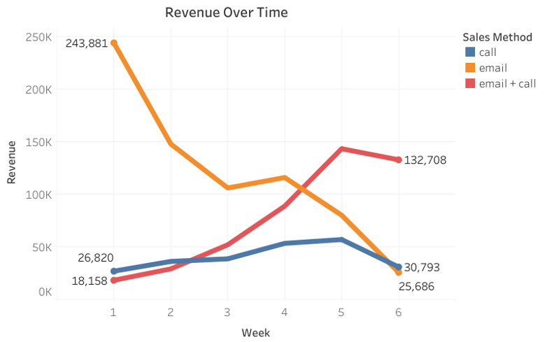
Difference of Revenue over time
The "call" sales had the lowest total revenue. It saw its revenue increase by 14% through the first six weeks of the product launch.
The "e-mail" sales method accounted for 84% of total revenue in week 1 and had the highest total revenue. However, It saw its revenue decrease by 89% through the first six weeks of the product launch.
The "e-mail + call" sales method started week 1 accounting for only 6% of week 1 total revenue, but it ended the trial accounting for 70% of total revenue in week 6. It also saw revenue increase the most through the first six weeks of the product launch.

Slide 7
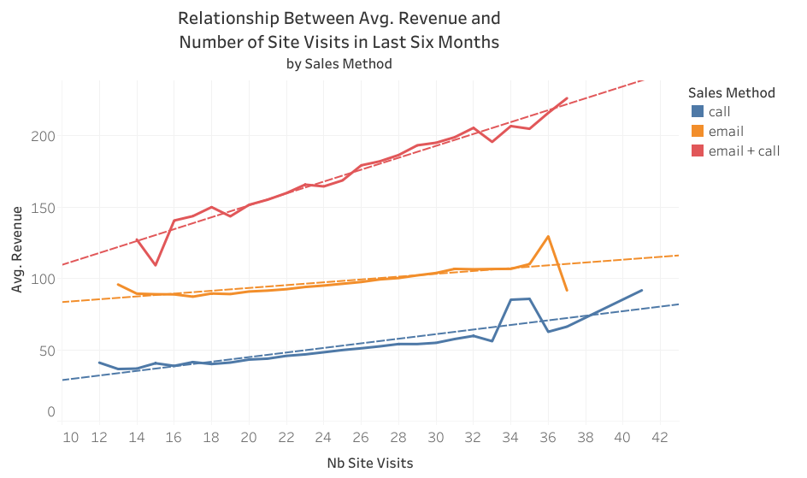
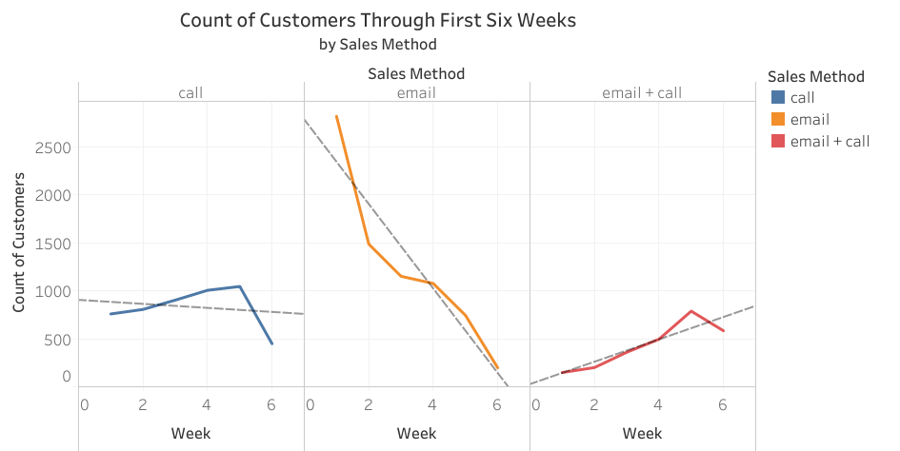
Differences Between customers in each group
Through the first six weeks, the “e-mail + call” sales method was the only group to see an increase in customers, gaining 116 customers per week.
The “email + call” sales method averaged more revenue per site visit. Site visits are also strongly correlated with revenue.

Slide 8
Business metrics
Since our goal is to use the best sales approach to ensure the new product line is a success, I would recommend we use 6-week revenue growth as our metric.
Based on the last 6 weeks of data, we had a 6-week revenue growth rate of -34.5%. Therefore, if the 6-week revenue growth rate should increase or turn positive, it is a strong indicator that the recommended sales approach is the right one.

Slide 9
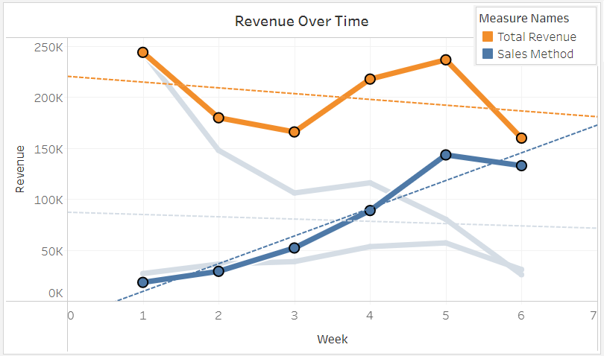
Business metrics / Recommendation
The sales method that has the most positive 6-week revenue growth is the
“e-mail + call” approach.

Slide 10
Recommendation
Based on the data, my recommendation would be to continue using the "e-mail + call" sales approach. The data tells us that the "e-mail + call" sales approach:
has the most positive revenue growth.
is the only sales approach that increases in customers weekly.
brings in more revenue per customer site visit.
brings in more revenue per customer order, accounting for 32% of total revenue despite being used on only 17% of the customers.
For initial launch, "e-mail" only sales approach was great, but it was not sustainable. For continued sales success and revenue growth, the "e-mail + call" sales approach is the recommended approach.
Further data collection of sale success rates for customers contacted could provide more valuable insights.

