Slide 1

Technology Skills Analysis
Analysis of
2019 Stack Overflow Developer Survey
Matthew Phelps
April 19, 2022

Slide 2

OUTLINE
Executive Summary
Introduction
Methodology
Results
Visualization – Charts
Dashboard
Discussion
Findings & Implications
Conclusion
Appendix

Slide 3

EXECUTIVE SUMMARY
The following slides will give insight into trends on emerging skills as provided by a combination of job postings, training portals, and surveys.
The data collected provides insights into areas including:
Current Technology Use
Future Technology Trends
Demographics
The following insights should help identify future skills requirements to remain competitive and keep pace with the current technology trends

Slide 4

INTRODUCTION
An analysis of the 2019 Stack Overflow Developer Survey provides valuable insight into current and future technology trends.
This analysis should be useful for IT consultants, organizations with an IT focus, and job applicants in the IT field.
We will analyze programming language trends for when the survey was taken and predict future language trends.
We will analyze database trends for when the survey
was taken and predict future database trends.
We will analyze platform and web frame trends for when the survey was taken and predict future trends.

Slide 5
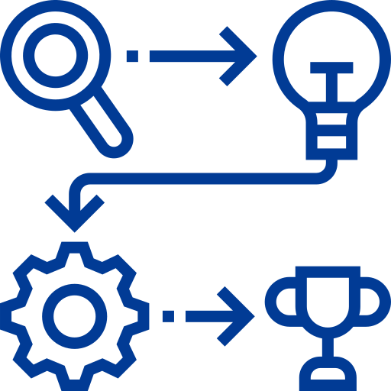
METHODOLOGY
Data Sources:
2019 Stack Overflow Developer Survey
Data Wrangling: Datasets were cleaned using SQL and Python
pandas. Cleaning methodology consisted of:
Identifying and removing duplicate rows
Finding and imputing missing values
Normalizing the data
Data Analysis: Python pandas used to :
Find how the data is distributed
Identify and remove outliers
Finding correlation
Data Visualization: IBM Cognos dashboard created to show:
Current Technology Use
Future Technology Trends
Demographics

Slide 6
RESULTS
The following slides analyze:
Programming Languages
Databases
Web Frames
Platforms
They are arranged in Top 5 lists using Bar Charts for
2019 and the “Next Year” (2020)
The findings and implications follow the bar charts to
give insights into what the data is showing

Slide 7
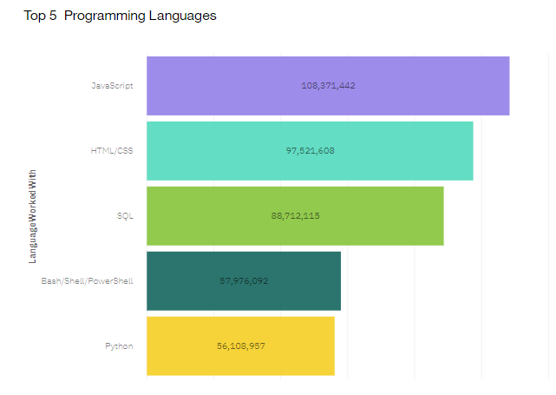
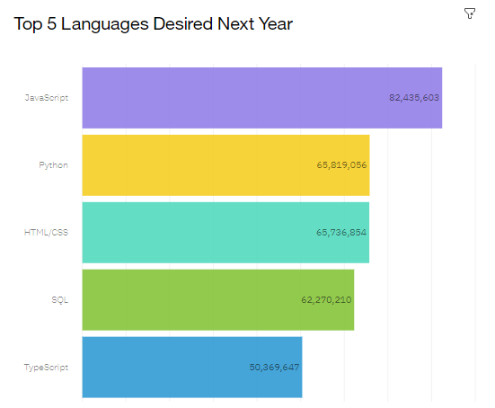
PROGRAMMING LANGUAGE TRENDS
2019
Next Year

Slide 8
PROGRAMMING LANGUAGE TRENDS - FINDINGS & IMPLICATIONS
Findings Implications
Javascript is the current leader in programming language used and is also the most desired language for the next year.
Python was the 5th most used language in 2019 but the 2nd most desired for the next year.
Bash/Powershell was 4th most used language but failed to make the Top 5 for most desired language next year
Javascript should remain the leading programming language for the foreseeable future
Python has a significant increase in desire to work with, and should climb to a popularly used language very soon
Bash/Powershell seem to be losing popularity and are being replaced with languages such as Typescript

Slide 9
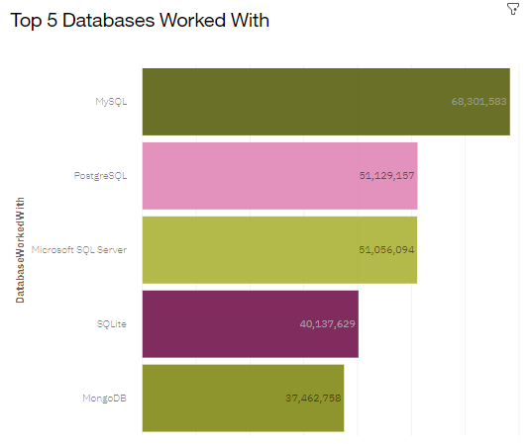
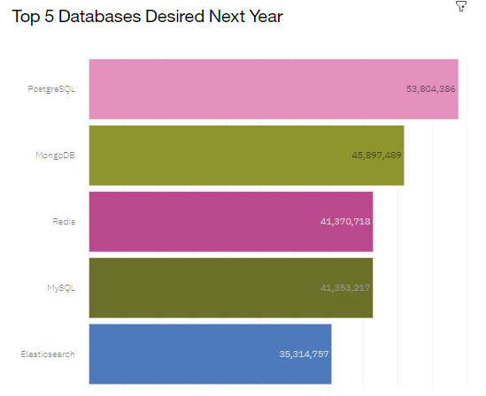
DATABASE TRENDS
2019
Next Year

Slide 10
DATABASE TRENDS - FINDINGS & IMPLICATIONS
Findings Implications
MySQL was the leading Database for 2019 but had lower desirability for the next year
PostgreSQL and Mongo DB were Top 5 databases worked with and both climbed in desirability for the next year
SQLite and Microsoft SQL Server did not make the desired database list for the next year, replaced instead by Elasticsearch and Redis
Though MySQL led in database used in 2019, a few other databases have replaced MySQL as the most desired database to use
PostgreSQL and MongoDB desirability results imply they are the future of databases
Microsoft SQL Server and SQLite are not as popular and may be replaced by emerging databases such as Elasticsearch and Redis

Slide 11
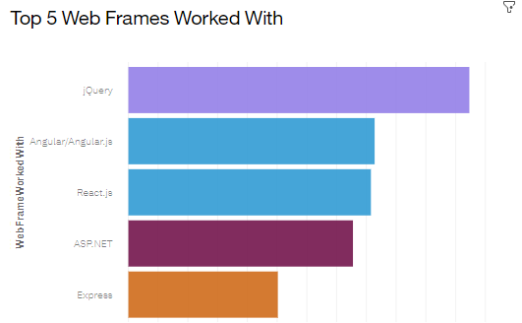
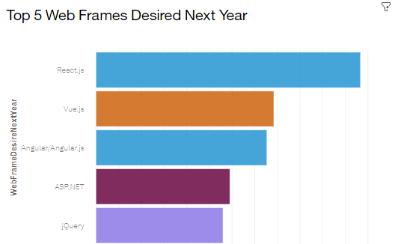
WEB FRAME TRENDS
2019
Next Year

Slide 12
WEB FRAME TRENDS - FINDINGS & IMPLICATIONS
Findings Implications
React.ja was the 3rd most worked with Web Frame and the 1st most desired Web Frame to work with
jQuery was the most worked with Web Frame in 2019, but only the 5th most desired Web Frame to work with for the next year.
Express was the 5th most worked with Web Frame, but failed to make the top 5 list for desired web frames to work with
React.ja and Angular.js are consistent in usage and desirability, and should lead the web frame area for the near future
jQuery is quickly losing favorability and may not be as in demand in the near future
Express seems to have lost favor and is being replaced with emerging web frames such as Vue.js

Slide 13
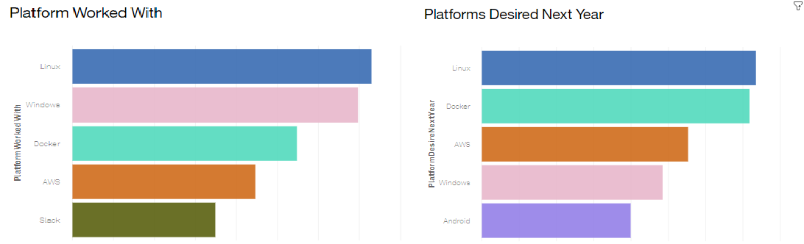
PLATFORM TRENDS
2019
Next Year

Slide 14
PLATFORM TRENDS - FINDINGS & IMPLICATIONS
Findings Implications
Linux led the list as the most used platform and the most desired platform to use for the next year
Windows was the 2nd most used platform in 2019, but only the 4th most desired platform to work with for the next year
Slack made the top 5 for platforms used, but was replaced in the desirability top 5 by Android
Linux seems to be the staple for platforms and should continue to lead the way in both usage and desirability to work with
Popular platform Windows is losing its desirability in favor of other platforms such as Docker and AWS
Slack seems to be losing desirability to other platforms that aren’t being used as much such as Android

Slide 15

DASHBOARD
An interactive dashboard was created to help visualize the survey respondents regarding:
Current technology use
Future technology trends
Demographics
To access the dashboard, click here.

Slide 16
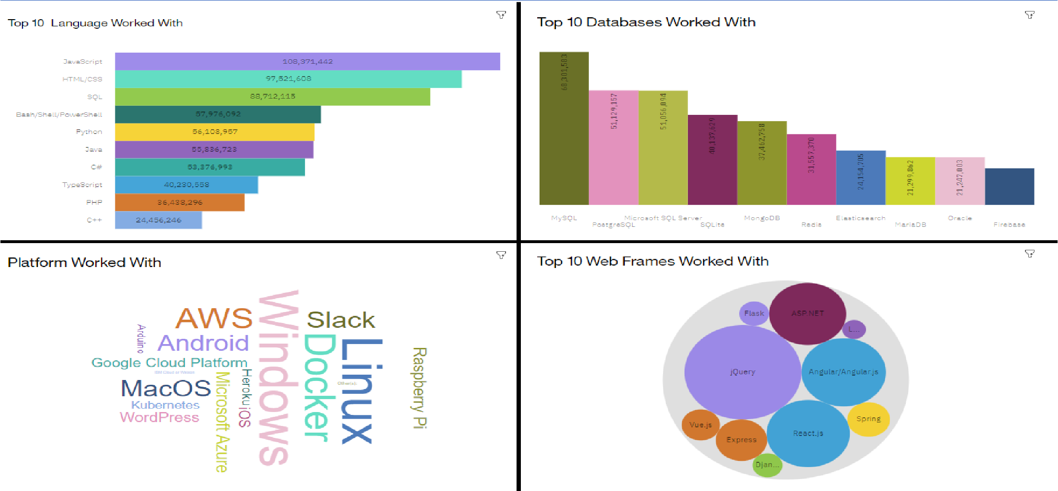
CURRENT TECHNOLOGY USE DASHBOARD

Slide 17
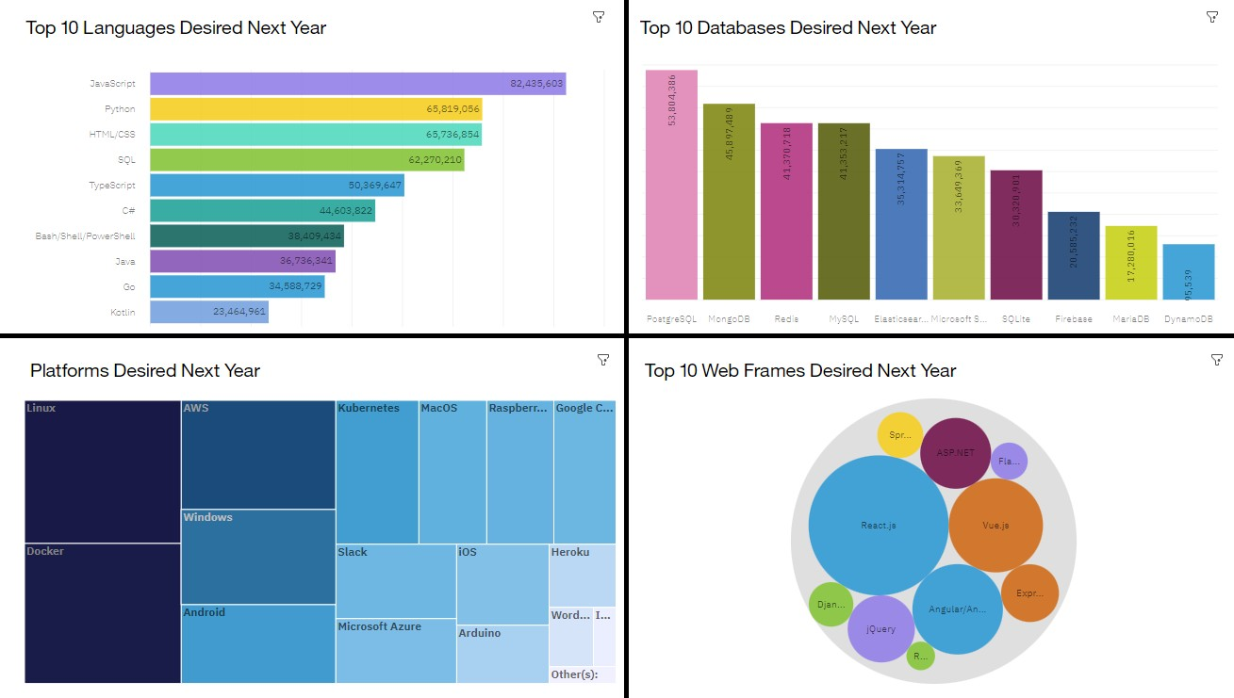
FUTURE TECHNOLOGY TREND DASHBOARD

Slide 18
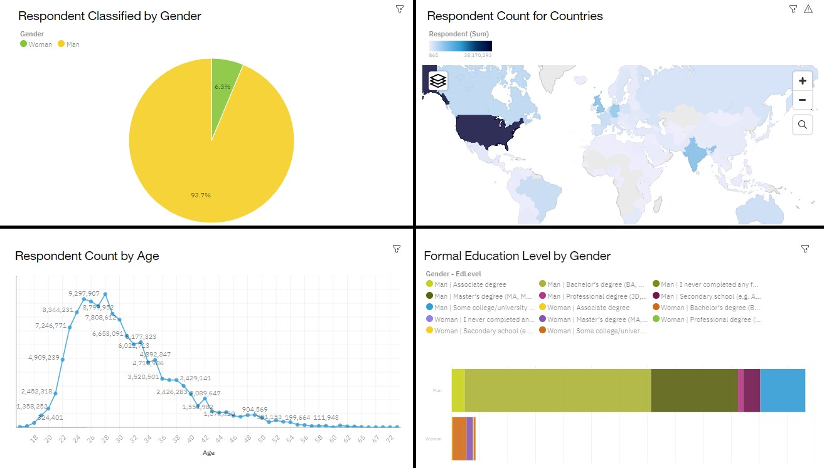
DEMOGRAPHICS DASHBOARD

Slide 19

DISCUSSION
The data analyzed has given some insights into:
What are the top programming languages in demand?
What are the tope database skills in demand?
What are the most used and desired platforms?
What are the most used and desired
web frames?
What are the demographics of developers (that responded to the survey)?
What are the education levels of
developers?

Slide 20
OVERALL FINDINGS & IMPLICATIONS
A closer look at the Demographics Dashboard
Findings Implications
Respondents to the survey were overwhelmingly men
Respondents to the survey overwhelmingly from United States
Respondents to the survey were mostly between the ages of 22- 34
Some of the information we have analyzed have a male bias
Some of the information we have analyzed has a United States bias
Some of the information we have analyzed have an age bias

Slide 21

CONCLUSION
Javascript is the most used and desired programming language
Linux is the most used and desired platform
MySQL is the most used database, but other databases, such as PostgreSQL are more desirable to work with
Though jQuery is the most used Web Frame, React.js seems to be the future of Web Frames as it is both highly used and highly desired

Slide 22


APPENDIX A:
GITHUB JOB POSTINGS
Number of GitHub Jobs Postings
C
187
JAVA
91
JAVASCRIPT
64
PYTHON
53
SCALA
47
C++
23
POSTGRESQL
16
SQL SERVER
16
C#
14
ORACLE
6
MYSQL SERVER
5
MONGODB 4
0
20
40
60
80
100
120
140
160
180
200
Data Source: IBM’s GitHub Jobs API, April 2022

Slide 23

APPENDIX B: POPULAR LANGUAGES
Average Annual Salary
SWIFT
130801
PYTHON
114383
C++
113865
JAVASCRIPT
110981
JAVA
101013
GO
94082
R
92037
C#
88726
SQL
84793
PHP
84727
0
20000
40000
60000
80000
100000
120000
140000
Data Source: IBM’s Popular Programming Languages

