Slide 1
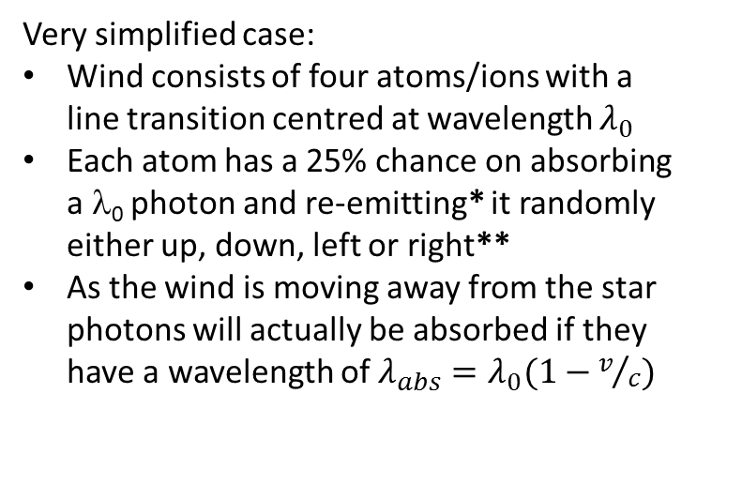
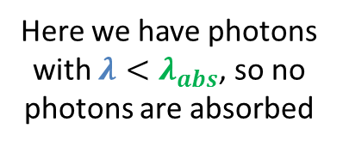
Formation of the P-Cygni profile: a schematic diagram
Very simplified case:
Wind consists of four atoms/ions with a line transition centred at wavelength $λ_{0}$
Each atom has a 25% chance on absorbing a λ₀ photon and re-emitting* it randomly either up, down, left or right**
As the wind is moving away from the star photons will actually be absorbed if they have a wavelength of $λ_{abs}=λ_{0}(1−v/c)$
Star
To observer
Flux (photon count)
Outflowing stellar wind with velocity v
Here we have photons with $λ<λ_{abs}$, so no photons are absorbed
Wavelength, λ
*The probability for absorption and emission are really set by the Einstein coefficients of the transition, and will be much smaller than 25%
**Re-emission will actually be isotropic

Slide 2
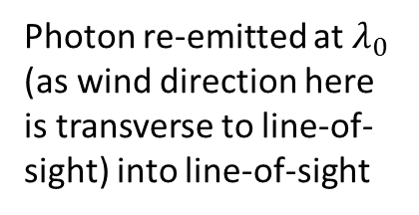
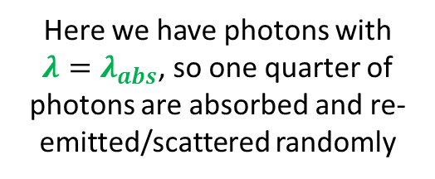
Here we have photons with $λ=λ_{abs}$, so one quarter of photons are absorbed and re-emitted/scattered randomly
Photon re-emitted in different direction and lost from line-of-sight
Star
To observer
Flux (photon count)
Outflowing stellar wind with velocity v
Photon re-emitted at $λ_{0}$ (as wind direction here is transverse to line-of-sight) into line-of-sight
Wavelength, λ

Slide 3
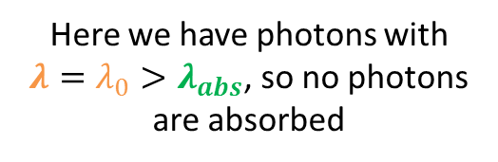
Here we have photons with $λ=λ_{0}>λ_{abs}$, so no photons are absorbed
Star
To observer
Flux (photon count)
Outflowing stellar wind with velocity v
Wavelength, λ

Slide 4
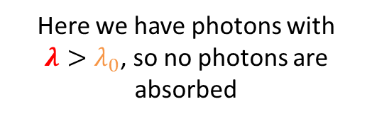
Here we have photons with $λ>λ_{0}$, so no photons are absorbed
Simplified P-Cygni line profile
Star
To observer
Flux (photon count)
Outflowing stellar wind with velocity v
Wavelength, λ
Note that in reality different shells in the wind with different velocities, and the turbulent nature of the wind, will lead to Doppler broadening of the absorption and emission line profiles.

