Slide 1
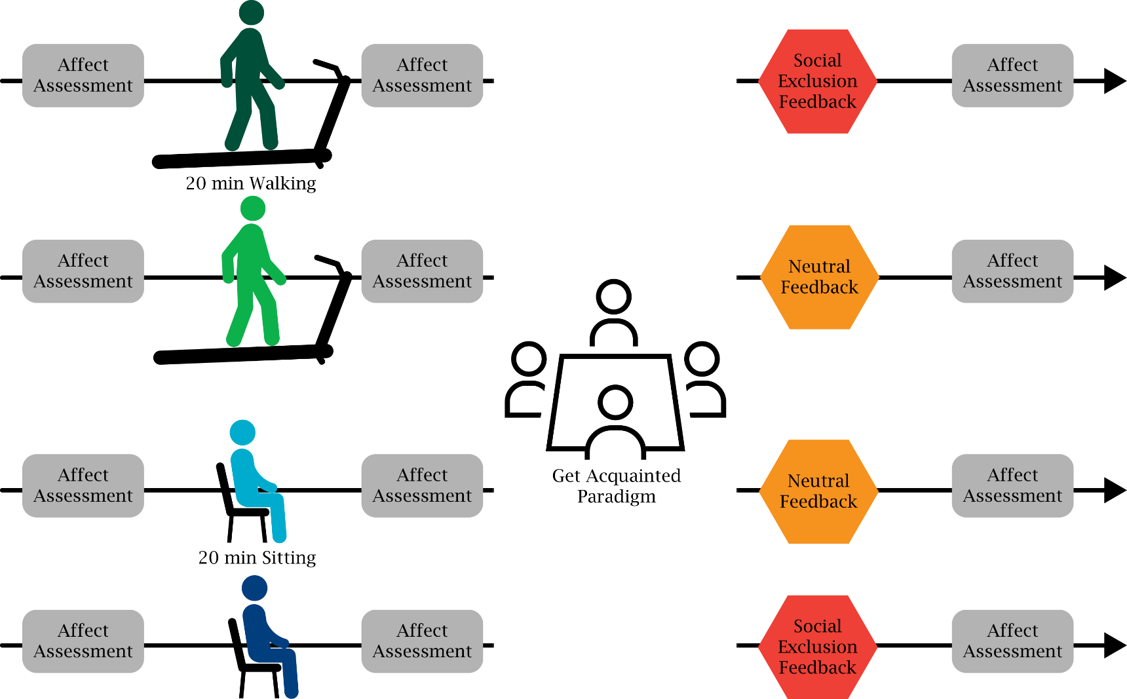
Physical Activity Mitigates Social Exclusion
N = 96 college-aged females
N = 24
N = 24
N = 24
N = 24
Delli Paoli, et al. (2017). Journal of Sport & Exercise Psychology.
Notes:
Within some of our recent work in this area, we have found that even a single bout of physical activity appears to reduce the effects of negative social experiences.
Under the guise of an exercise and team building study, we brought a total of 96 college-aged females.

Slide 2
Physical Activity Mitigates Social Exclusion
N = 96 college-aged females
N = 24
N = 24
N = 24
N = 24
Delli Paoli, et al. (2017). Journal of Sport & Exercise Psychology.
Notes:
We brought participants in to the lab in groups of 4 females who had limited prior interactions with each other.
Once they were in the lab, for the next 20 minutes two of the participants exercised at a moderate intensity and two of the participants sat quietly, each in their own separate rooms.

Slide 3
Physical Activity Mitigates Social Exclusion
N = 96 college-aged females
N = 24
N = 24
N = 24
N = 24
Delli Paoli, et al. (2017). Journal of Sport & Exercise Psychology.
Notes:
The quartet of participants was then brought together and went through a get to know you paradigm where they each talked about where they were from and what they were studying.
After 10 minutes of this, participants were taken to separate rooms and asked to choose two of the three other people that they would most like to partner with for a subsequent task.

Slide 4
Physical Activity Mitigates Social Exclusion
N = 96 college-aged females
N = 24
N = 24
N = 24
N = 24
Delli Paoli, et al. (2017). Journal of Sport & Exercise Psychology.
Notes:
The experimenter left the room and came back a few minutes later with everyone’s team choices. Prior to the experiment…

Slide 5
Physical Activity Mitigates Social Exclusion
N = 96 college-aged females
N = 24
N = 24
N = 24
N = 24
Delli Paoli, et al. (2017). Journal of Sport & Exercise Psychology.
Notes:
participants were randomized into receiving either neutral feedback “We are going to have you do some other tasks before doing the partner task”
Or social exclusion feedback, where participants were told “ I hate to tell you this, but nobody chose you as someone they wanted to work with. So because of that you will have to independently complete these other tasks”.

Slide 6
Physical Activity Mitigates Social Exclusion
N = 96 college-aged females
N = 24
N = 24
N = 24
N = 24
Delli Paoli, et al. (2017). Journal of Sport & Exercise Psychology.
Notes:
Participants were then asked to complete a cognitive task and were asked to rate their affective state.

Slide 7
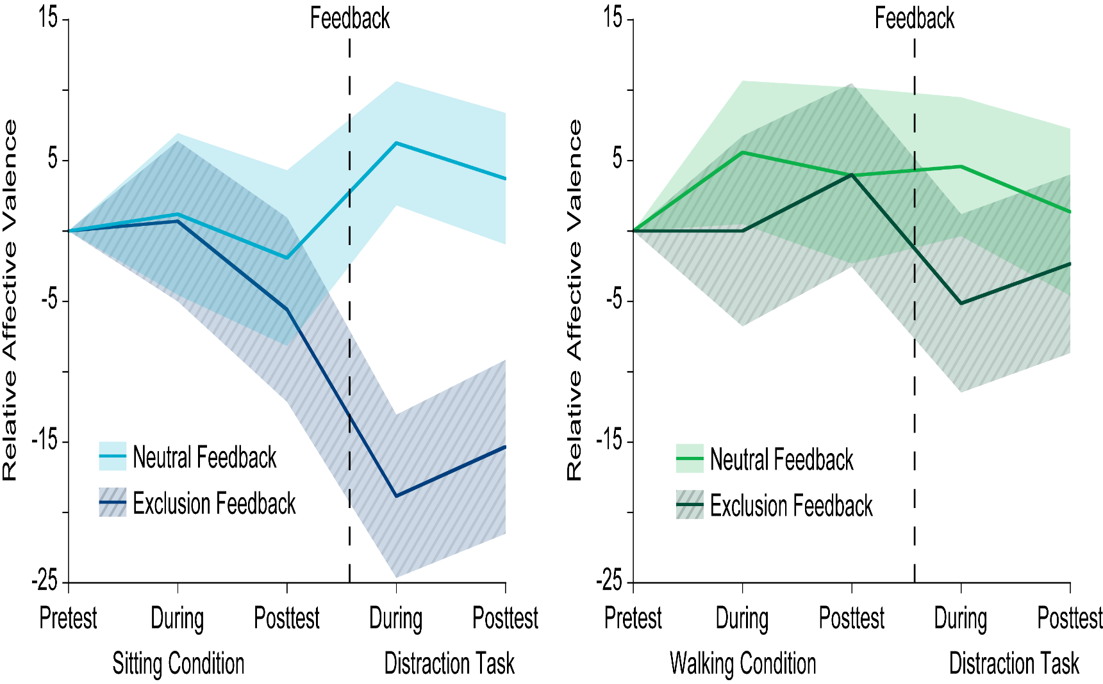
Physical Activity Mitigates Social Exclusion
Sitting Condition
Delli Paoli, et al. (2017). Journal of Sport & Exercise Psychology.
Notes:
In those participants that did the sitting condition, we saw a substantial reduction in affective valence following the exclusionary feedback (in the darker blue, striped lines) relative to following the neutral feedback (in the light blue line)

Slide 8
Physical Activity Mitigates Social Exclusion
Sitting Condition
Walking Condition
Delli Paoli, et al. (2017). Journal of Sport & Exercise Psychology.
Notes:
Whereas following a 20 minute bout of exercise, we found that the effect of social exclusion was mitigated relative to the neutral feedback condition.
Suggesting that bouts of physical activity might be an effective means to help individuals cope with negative social experiences.

