Slide 1

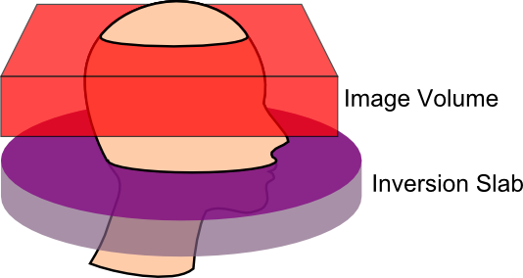
Acute Exercise Induced Transient Changes In Hemodynamics
Pontifex, et al. (2018). International Journal of Psychophysiology.
Notes:
Another popular assertion is that these acute exercise induced enhancements in cognition may result from increases in cerebral blood flow.
So I obtained a NIH R21 to begin testing this hypothesis,

Slide 2
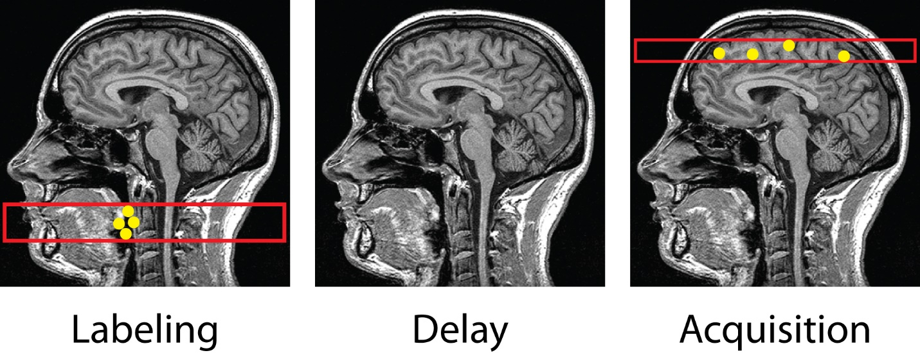
Acute Exercise Induced Transient Changes In Hemodynamics
Pontifex, et al. (2018). International Journal of Psychophysiology.
Notes:
Using an MRI technique known as Arterial Spin Labeling, which allows us to magnetically tag arterial blood flowing towards the brain

Slide 3
Acute Exercise Induced Transient Changes In Hemodynamics
Pontifex, et al. (2018). International Journal of Psychophysiology.
Notes:
and determine where in the brain that blood perfuses.

Slide 4
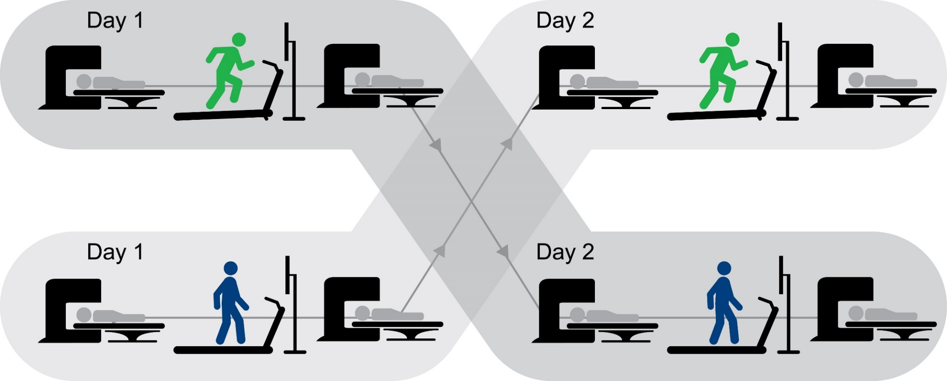
Acute Exercise Induced Transient Changes In Hemodynamics
N = 41
20 minutes of moderate intensity
aerobic exercise
20 minutes of moderate intensity
aerobic exercise
20 minutes of active control
20 minutes of active control
Pontifex, et al. (2018). International Journal of Psychophysiology.
Notes:
We then used this technique to assess changes in cerebral blood flow following aerobic exercise on a treadmill, relative to walking on the treadmill at the slowest possible speed in order to control for potential blood pressure related changes in body position. Again utilizing the emotionally neutral video clip to reduce confounds associated with psychosocial factors.
A total of 41 preadolescent children between the ages of 8 and 11

Slide 5
Acute Exercise Induced Transient Changes In Hemodynamics
N = 41
20 minutes of moderate intensity
aerobic exercise
20 minutes of moderate intensity
aerobic exercise
20 minutes of active control
20 minutes of active control
Pontifex, et al. (2018). International Journal of Psychophysiology.
Notes:
completing the experimental conditions in a counterbalanced order using a within-subjects pre-post test design with participants cerebral blood flow assessed before and approximately 25 minutes after each experimental condition.
[so effectively, each child is undergoing 4 different MRI assessments…]

Slide 6
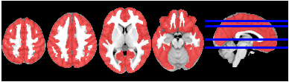
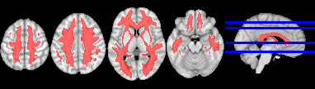
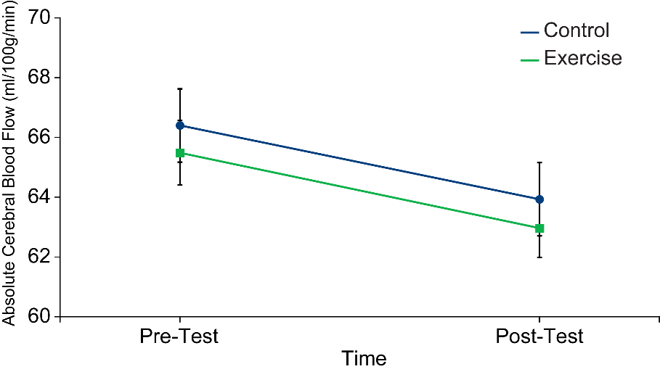
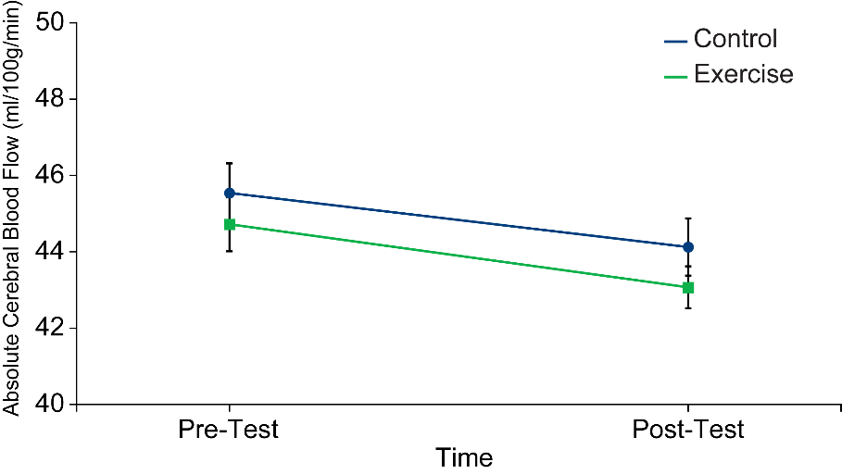
Acute Exercise Induced Transient Changes In Hemodynamics
Gray Matter
White Matter
Pontifex, et al. (2018). International Journal of Psychophysiology.
Notes:
And what we observed was that there were no differences in cerebral perfusion between control – in blue – and exercise – in green – suggesting that while arterial blood flow may be elevated after exercise
such blood flow is not actually perfusing into either the gray or white matter to a greater extent than in response to the control condition.
This lack of differentiation between conditions ultimately suggests that these changes in cerebral blood flow may NOT be a mechanism underlying exercise induced modulations in cognition.
[PAUSE]
Gray matter – cell bodies
White matter – mylenated axon tracts

