Slide 1
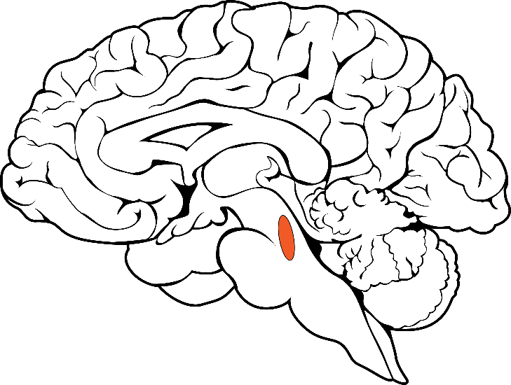
How Then is Exercise Creating These Changes in Cognition?
Notes:
Because the locus-coeruleus norepinephrine system is involved in regulating alertness and attention

Slide 2
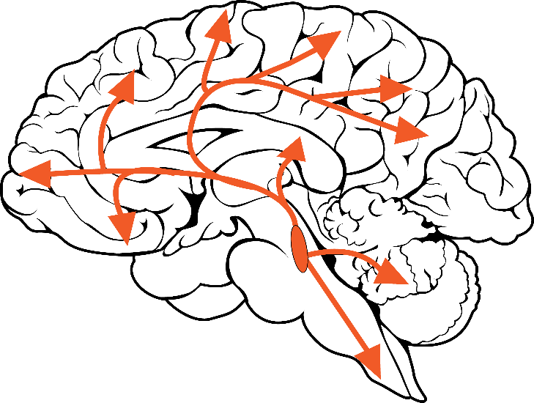
How Then is Exercise Creating These Changes in Cognition?
Notes:
the emerging perspective is that an acute bout of exercise may regulate this system to maintain more optimal levels of activation.
As when activiation is too low, you exhibit lethargy and if the activiation is to high you exhibit a greater level of distractibility in both cases negatively impacting upon attention.
While moderate levels of activation enable phasic bursts and associated relase of norepinephrine to entrain other neural systems to limit responsiveness to irrelevant stimuli, thereby preventing spurious distractions

Slide 3
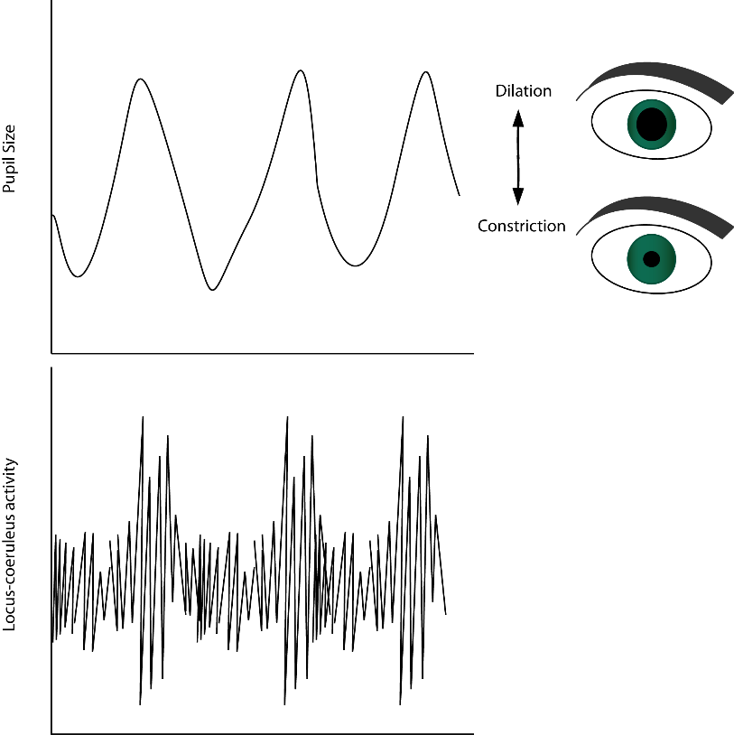
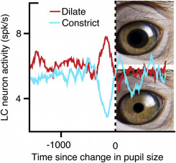
How Then is Exercise Creating These Changes in Cognition?
(Costa & Rudebeck, 2016)
Notes:
One means to index the activation of the locus-coeruleus is through pupillometry, given the strong correlation between moment-to-moment fluctuations in pupil size and the firing rate of this neural structure

Slide 4
How Then is Exercise Creating These Changes in Cognition?
(Costa & Rudebeck, 2016)
Notes:
with changes in neuronal activity reliably preceding changes in pupil diameter
Although changes in luminance provide a potent extrinsic driver of pupil size, an extensive body of literature has demonstrated that pupillometry enables the characterization of the dual pattern of activation in the locus-coeruleus.
With baseline pupil size indexing tonic activation that is characterized by sustained low-frequency discharge while task-evoked pupillary reactivity provides an index of phasic activation in response to salient task-related stimuli.

Slide 5
Acute Exercise Effects on Pupillometric Indices of Locus-Coeruleus Activation
N = 58
McGowan et al., (2019). International Journal of Psychophysiology.
Notes:
Accordingly, given that this system is hypothesized to underlie exercise induced changes in cognition, we conducted an initial investigation in a sample of 58 college aged adults

Slide 6
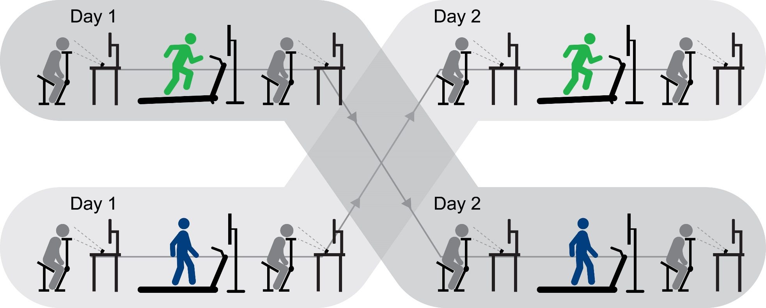
Acute Exercise Effects on Pupillometric Indices of Locus-Coeruleus Activation
N = 58
20 minutes of moderate intensity
aerobic exercise
20 minutes of moderate intensity
aerobic exercise
20 minutes of active control
20 minutes of active control
McGowan et al., (2019). International Journal of Psychophysiology.
Notes:
examining the extent to which tonic and phasic pupillary reactivity were modulated by acute aerobic exercise.
Using a counterbalanced within subjects crossover design,

Slide 7
Acute Exercise Effects on Pupillometric Indices of Locus-Coeruleus Activation
N = 58
20 minutes of moderate intensity
aerobic exercise
20 minutes of moderate intensity
aerobic exercise
20 minutes of active control
20 minutes of active control
N N M N N
McGowan et al., (2019). International Journal of Psychophysiology.
Notes:
tonic and phasic pupillary reactivity were assessed alongside behavioral and neuroelectric measures in response to the letter version of the Erickson flanker task prior to and 10 minutes following a 20 minute bout of moderate intensity aerobic exercise
relative to a 20 minute active control where participants walked on the treadmill at the lowest possible speed. And to reduce potential confounds related to psycho-social factors, during both the exercise and control periods, participants watched a 20 minute emotionally neutral video clip.

Slide 8
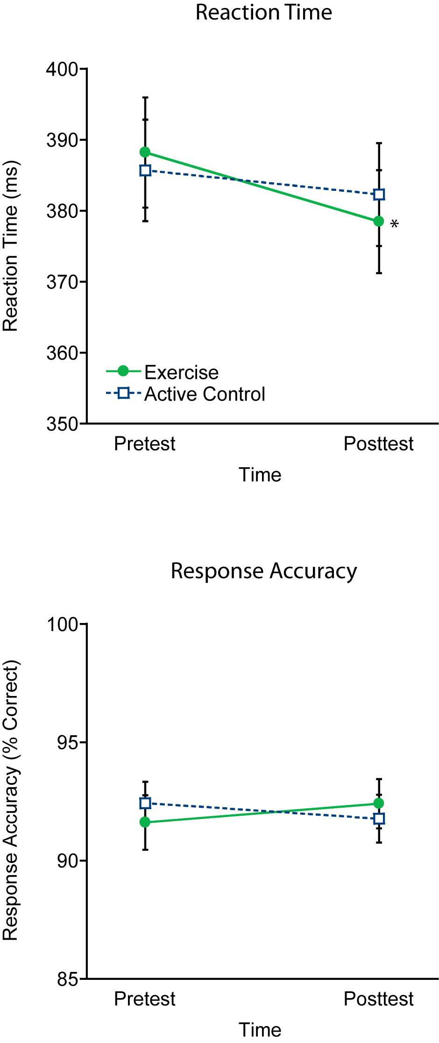
Acute Exercise Effects on Pupillometric Indices of Locus-Coeruleus Activation
McGowan et al., (2019). International Journal of Psychophysiology.
Notes:
Behavioral findings demonstrating superior performance on the inhibitory control task, such that reaction time was faster following a 20 minute bout of exercise (in green) relative to the active control condition (in blue)…

Slide 9
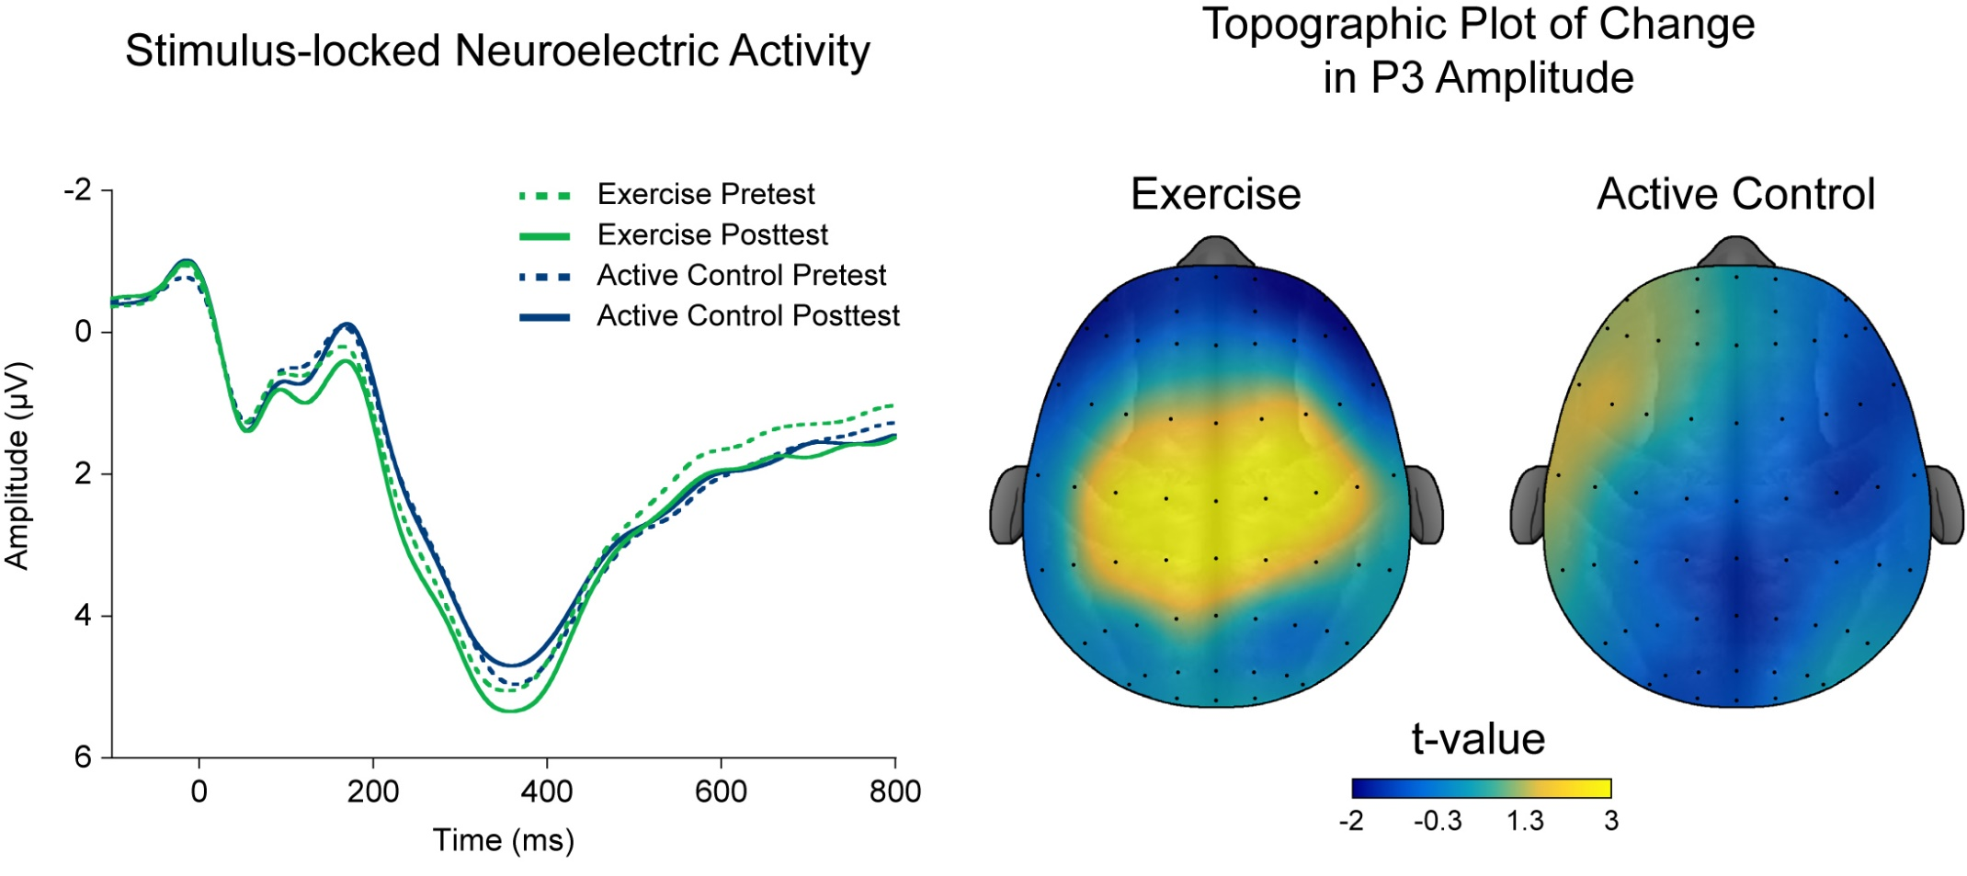
Acute Exercise Effects on Pupillometric Indices of Locus-Coeruleus Activation
McGowan et al., (2019). International Journal of Psychophysiology.
Notes:
And we further replicated the effect of acute exercise on neuroelectric indices of attention,
With a 20 minutes of exercise (in green) serving to enhance P3 amplitude overall, relative to the slight reduction in P3 amplitude observed in response to the 20 minute active control period (in blue).
Interestingly…

Slide 10
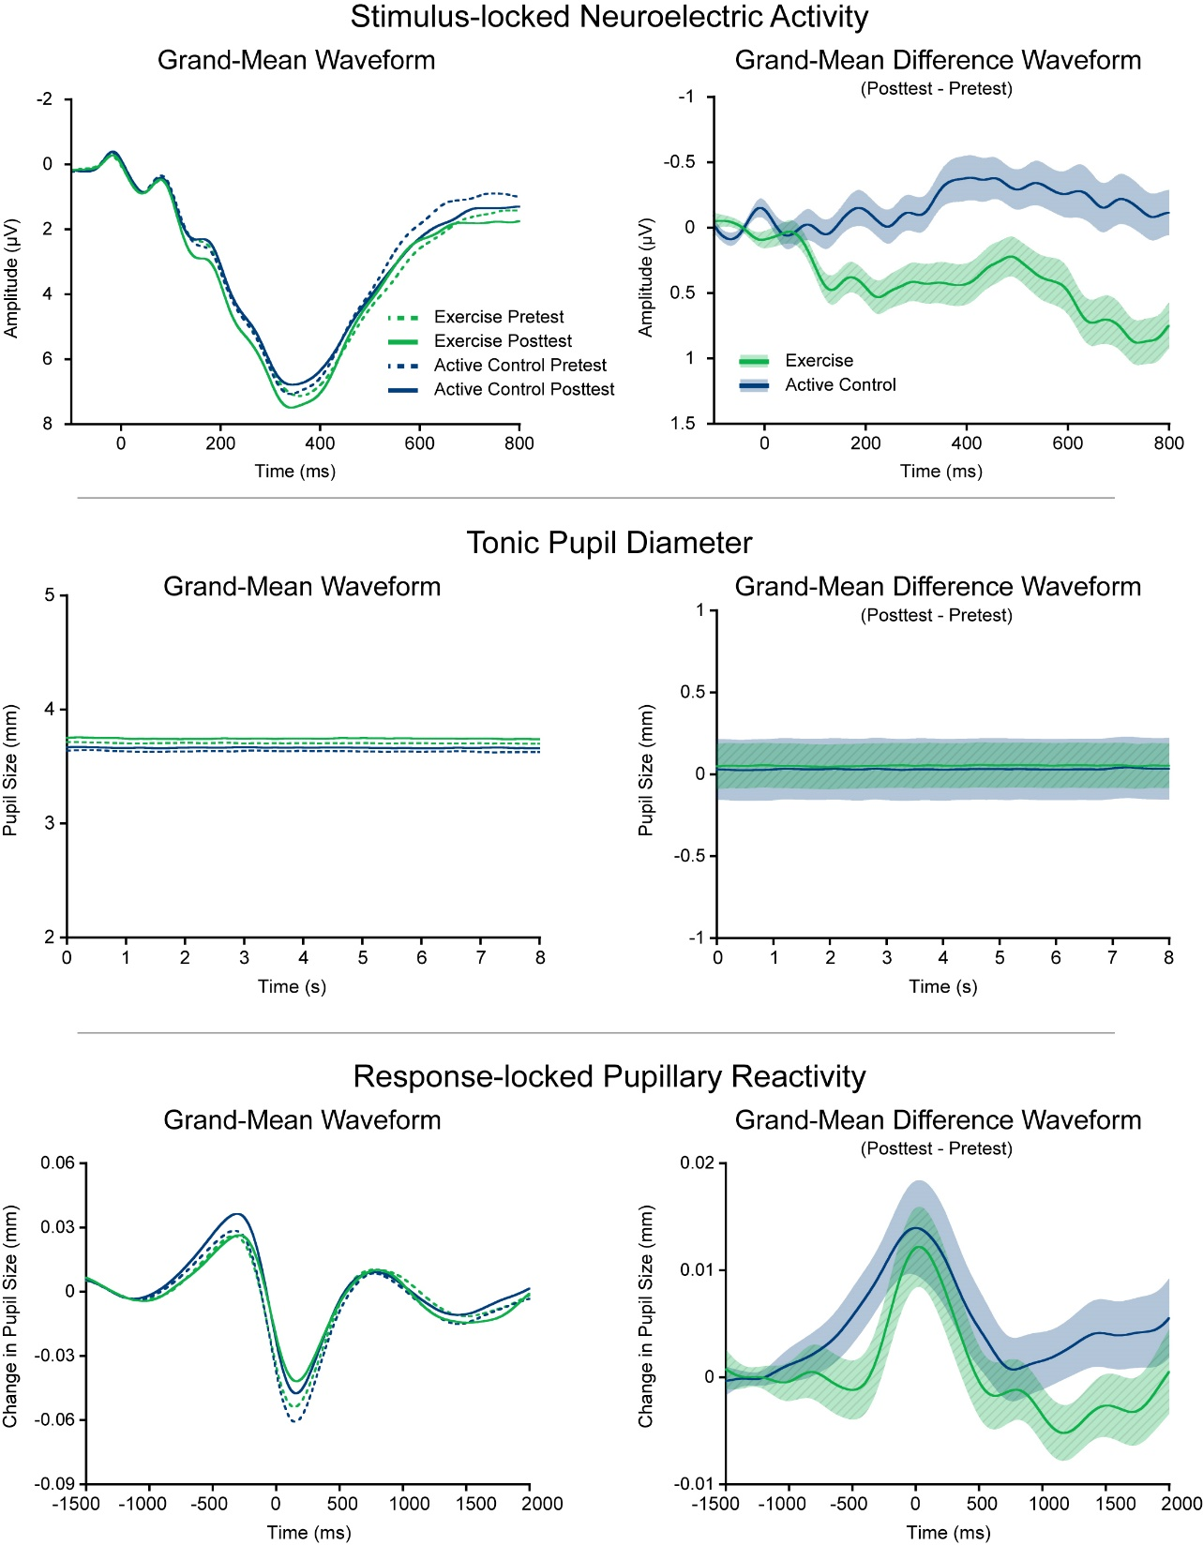
Acute Exercise Effects on Pupillometric Indices of Locus-Coeruleus Activation
McGowan et al., (2019). International Journal of Psychophysiology.
Notes:
No exercise induced modulations were observed for tonic activation of the locus-coeruleus which was assessed as the mean pupil diameter within both left and right pupils across 43 epochs of 8 seconds during non-task related fixation periods

Slide 11
Acute Exercise Effects on Pupillometric Indices of Locus-Coeruleus Activation
McGowan et al., (2019). International Journal of Psychophysiology.
Notes:
Similarly, the 20 minute bout of acute exercise was not observed to modulate phasic activity in the locus-coeruleus as assessed by changes in pupillary reactivity within -1,000 to 1,500 ms surrounding the response.
And the exercise induced changes in behavioral and neuroelectric activity was not observed to correlate with modulations of either tonic or phasic pupil size.
Thus these data provide initial evidence that exercise induced enhancements in cognition do not result from modulations of activity in the locus-coeruleus.

