Slide 1
Discussion Session Week 1
Command Line

Slide 2
A quick note before we start on scripting
Comments
Comment your code even if no one else is going to read it
Trust me on this
Comment style in C++
// for a single line comment
/* for a multi-line (block) comment */
Make sure that your comments are meaningful
A comment that just explains exactly what the code is doing is bad
Higher-level comments that explain the purpose of a line of code is better
On the other hand…
If you have to comment every line of code to understand that’s going on, you probably need to re-evaluate your code
Comments should never dominate your code

Slide 3
Command Line
Different OS distributions will have different command line interfaces
Windows uses one set of commands
Linux uses another
Programs designed to be run entirely on the command line are commonly known as “Shell Scripts”
bash (bourne again shell)
zsh (zshell)
etc.
Common commands
“dir” and “ls -l”
“copy” and “cp”
“del” and “rm”
etc...

Slide 4
Standard
Vast majority of software developers and companies will use Linux or some sort of linux system
Get used to shell scripting
bash for Windows
zsh for Mac
There are tons of commands
You will not always remember them all
Get used to navigating documentation
However, there are several key commands that you should remember (more on this later)

Slide 5
Before we get into bash, some background
When we work with bash we need to be familiar with the structure of Linux systems as there are multiple keywords that will tell you a lot about what’s going on
Treat this section as the backbone of your bash knowledge

Slide 6
Linux File System
The Linux file system can be viewed as a tree like structure
In order, the system is made up of
Directories,
Subdirectories
files
For the purposes of this class, almost all work is done in the path ~/
~ is the home directory

Slide 7
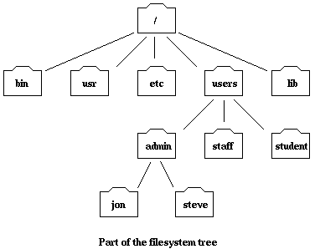
File System Overview
“Current Working Directory” (CWD/ CD)
Denoted as “.”

Slide 8
File System Overview
“Parent Directory”
Denoted as “..”

Slide 9
File System Overview
“Child Directory/Subdirectory”

Slide 10
Other Jargon
Commands
What you write on the command line to perform actions
Options
Add-ons to commands that change behavior of commands
Operators
Symbols such as +, -, >>, <<, |, &&, that perform specific actions

Slide 11
Commands/Operators
man
echo
ls
pwd
cd
cat (and other readers)
mkdir
rm, cp, mv
touch
grep
| (Pronounced “Pipe”)
&& (Pronounced “And”)
|| (Pronounced “Or”)
>> (Pronounced “Redirect”)

Slide 12
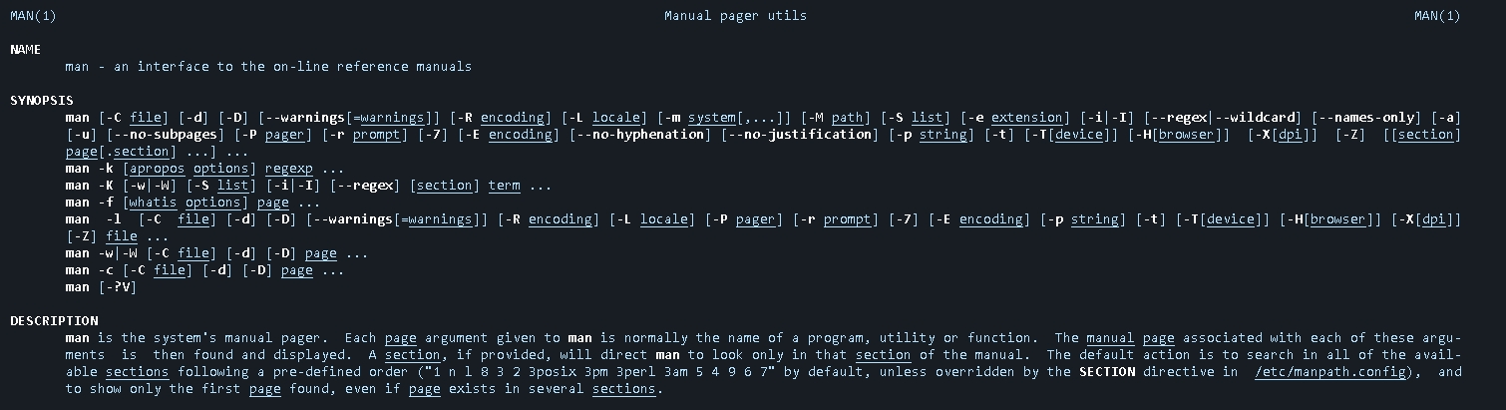
man
Displays the manual page for a given command
Usage: man {command}

Slide 13


When in doubt, look it up

Slide 14
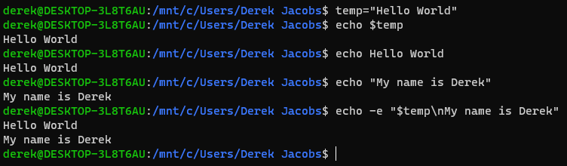
echo
Prints out a variable/string

Slide 15
ls
Used to list files and subdirectories in the current working directory
Particularly useful if you’re like me and constantly forget what you named something

Slide 16
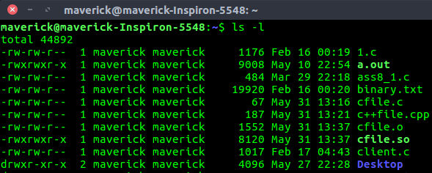
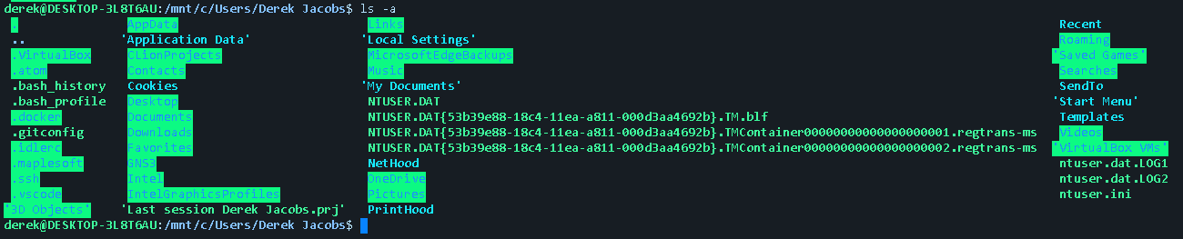
Useful ls options
-l
Lists in “long format”
-a
Lists all files, even hidden ones

Slide 17
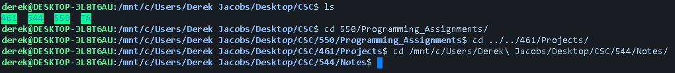
pwd/cd
pwd:
Prints the current working directory
cd:
Used to change the current working directory
Can use either a relative path or an absolute path
Relative: From current working directory to the desired directory.
Absolute: From the root directory, follows the tree branches up to the desired directory.

Slide 18
Exercise 1 (5 Min)
Provide a sequence of commands to
Print your current working directory
Print all files (including hidden ones) of your current working directory in long, human readable format
Hint: Use ‘man’
Change directory to a directory of your choice
Change back to your original path using a relative path

Slide 19
File Readers
Cat, more, less
Used to print out the contents of files
The difference lies in how it’s printed out

Slide 20
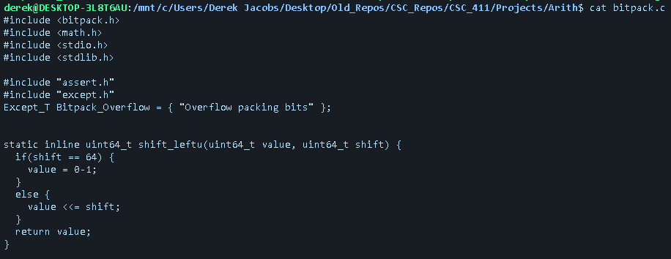
File Readers example

Slide 21
rm, cp, mv
mv
Used to move files or rename them mv ./file1 ../file1
cp
Used to copy files or directories
rm
Used to delete existing files or directories
Useful Options
-r Recursively delete contents of subdirectories
-f Force deletion

Slide 22
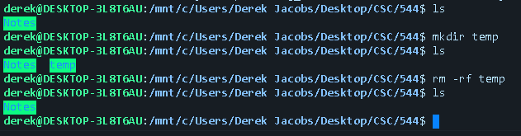
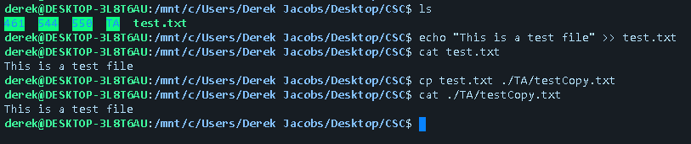
mkdir
Creates a new directory

Slide 23
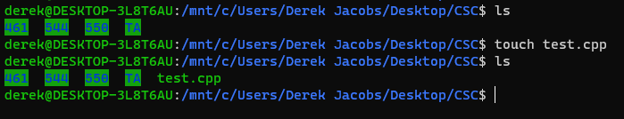
touch
Used to create files

Slide 24
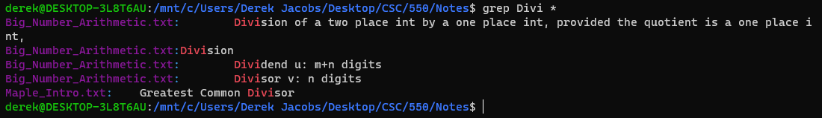
grep
Used to search for a phrase or word
Usage: grep {searchTerm} searchFile/Directory
Not available for mac command lines
zsh has just about all of the tools you’d ever need, but if you really want grep or other linux tools, you can look into “homebrew”
A word of warning: I do not have a mac and cannot help if you do this and things go south

Slide 25
Exercise 2 (10 Min)
Provide a sequence of commands to
Create a directory called “Exercise_2” and cd into that directory
Create a file called “bashIntro.txt”
Add the following string to the file
“I am learning bash!”
Output the contents of bashIntro.txt
Make 3 copies of bashIntro.txt, named “copy1.txt”, “copy2.txt”, and “copy3.txt”
Output a list of files containing the string “I am learning bash!”
You’ll need to use man again

Slide 26
| (Pipe)
Used to redirect output of one command to the input of another

Slide 27

&& (And)
Used to execute commands sequentially (if the left hand side succeeds)

Slide 28
|| (Or)
Used to complete commands sequentially regardless of success status

Slide 29
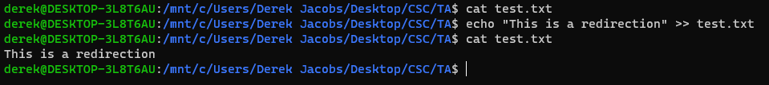
>>, << (Redirect)
Used for other manipulation of command outputs

Slide 30
Scripting
Scripts
Sequences of commands that are executed from start to finish
Commands may fail, but the script will not stop
Running a script:
bash {scriptName}

Slide 31
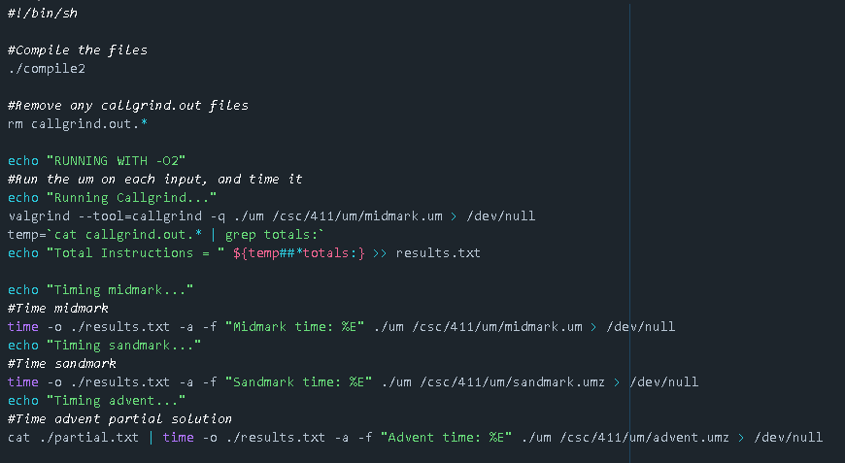
Sample script

