Slide 1
Discussion Session Week 4
Exam #1 Review - Basics of Programming, Logic, and C++

Slide 2
General Data Information
Data is stored in bits and bytes
1 bit is the smallest unit of data (0 or 1)
4 bits = 1 nibble
8 bits = 1 byte
1024 bytes = 1 kilobyte
1024 kilobytes = 1 megabyte

Slide 3
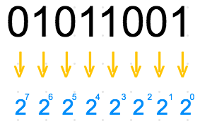

Representation of Numbers
Decimal (base 10)
Numbers you’re familiar with
Binary (base 2)
Powers of 2 and add
Can be x bits long, powers increase from right to left
Hexadecimal (base 16)
Powers of 16 and add
0-9, A-F
Octal (base 8)
Powers of 8 and add

Slide 4
Binary to Decimal
Let’s convert 01011001 to a decimal
Recall that binary is base 2 with a decreasing value from left to right
(0 * 2⁷) + (1 * 2⁶) + (0 * 2⁵) + (1 * 2⁴) + (1 * 2³) + (0 * 2²) + (0 * 2¹) + (1 * 2⁰)
0 + 64 + 0 + 16 + 8 + 0 + 0 + 1
64 + 16 + 8 + 1 = 89

Slide 5
Hexadecimal Conversions
Converting 7A to a decimal
Recall that hexadecimal numbers are in base 16
0-9, A-F
(7 * 16¹) + (10 * 16⁰)
112 + 10
= 122

Slide 6
Base Conversions (From Decimal)
To Binary
Divide the given number by 2, take the remainder, repeat
Write remainders backwards
To Hex
Same process, but split it into parts
We can get binary for 3, 4, and A more easily than the combined “34A” string
To Octal
Same process again, dividing by 8
Simplest way from one base to another is to go through base 10

Slide 7
Decimal to binary
Let’s convert the decimal value 14
Let’s convert the decimal value 21
Value | Remainder
14 / 2 = 7 | 0
7 / 2 = 3 | 1
3 / 2 = 1 | 1
1 / 2 = 0 | 1
Value | Remainder
21 / 2 = 10 | 1
10 / 2 = 5 | 0
5 / 2 = 2 | 1
2 / 2 = 1 | 0
1 / 2 = 0 | 1
14 = 1110
21 = 10101

Slide 8
Hexadecimal to binary
Let’s convert the decimal value 3B
Easiest way to do this is to convert each piece and push together
Value (B) | Remainder
11 / 2 = 5 | 1
5 / 2 = 2 | 1
2 / 2 = 1 | 0
1 / 2 = 0 | 1
Value (3) | Remainder
3 / 2 = 1 | 1
1 / 2 = 0 | 0
B = 1011
3 = 0011
3B = 00111011

Slide 9
Background on C++
C++ is a compiled language
There are many compilers, g++ is a common one
Code is translated into machine language for you through the compiler
Any syntax errors will prevent successful compilation
C++ is essentially C with libraries
Object oriented capabilities
Manual memory management
No garbage collection
Everything in C++ can be boiled down to bits of information, and everything is treated as either true or false.

Slide 10
Basic C++ Programming
All C++ programs require a main function in order to run
Main (usually) returns an integer and (usually) takes in two parameters, argc and argv
In general, the value returned from main indicates the error status of a program (0 means successful exit by standard, non 0 denotes unsuccessful)
C++ is strictly typed
Types of variables and return types of functions must be stated explicitly unlike Python
Lines of code are ended with semicolons
Comments can be written like so:
//Single line comments
/*
Multi Line comments
*/

Slide 11
C++ Data Types
Numbers
int
Signed integer values, 32 bits
1st bit is the “sign” bit
2^{n} - 1 is the maximum unsigned value for n bits
2^{n-1} - 1 is the maximum signed value for n bits
Modifiers
Long, short, unsigned
Change the max/min value, number of bits stored in an int
Unsigned long long is 64 bits
float/double
Decimal values (varying precision)

Slide 12
C++ Data Types (cont)
char
Characters (‘h’, ‘e’, ‘l’, ‘l’, ‘o’, etc)
Really anything that can be found on the ASCII table
bool
True/False
void
Valueless
Used as return types for functions that do not return values, or for polymorphism

Slide 13
Variables and Functions
Variables are a means of storing data
Syntax
dataType variableName = value;
Functions are blocks of code that can be repeated by calling them
Syntax
functionReturnType functionName(paramOneType paramOne, paramTwoType paramTwo...)
{
//Function body
}

Slide 14
Logic (Truth Tables)
Logic is the basis of programming
True can also be expressed as 1
False can be expressed as 0
Different types of logical operators
&& (and)
|| (or)
! (not)
P | Q | P && Q | P || Q
T | T | T | T
T | F | F | T
F | T | F | T
F | F | F | F

Slide 15
Extended Truth Table
P | Q | P && Q | P || Q | !P && Q | P && !Q | !P || Q | P || !Q | !!P && Q | P || !! Q
T | T | T | T | F | F | T | T | T | T
T | F | F | T | F | T | F | T | F | T
F | T | F | T | T | F | T | F | F | T
F | F | F | F | F | F | T | T | F | F

Slide 16
Let’s evaluate a boolean expression
a = 0, b = 1, c = 15, d = 5, e = 20
(!b && !!c) || ( d == e) || (!a && ((d+e) % 10 == 5));

Slide 17
Let’s evaluate a boolean expression
Note that this is not true && true, which is false
a = 0, b = 1, c = 15, e = 20
(!b && !!c) || (d == e) || (!a && ((d+e) % 10 == 5));
F || F = F T && T = T
Break this down by itself before and-ing
F || T = T

Slide 18
Other Operators
+, -, *, /
Addition, subtraction, multiplication, division
%
Modulo
<, <=, >, >=
Less than, less than or equal to, greater than, greater than or equal to

Slide 19
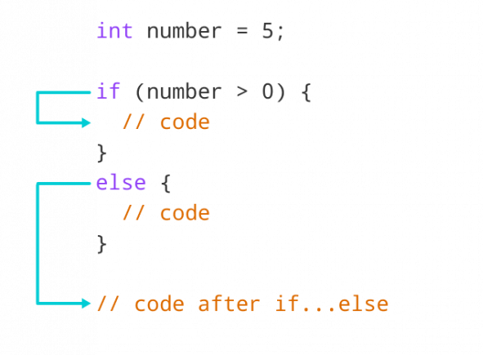
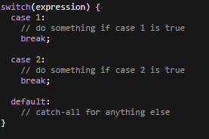
Conditionals
If else if else statements
The classic conditional branch
Traditional, ternary, one-liner
Switch Statements
Used for many different cases of a condition
Must have “default” case and “breaks”

Slide 20



Loops
For Loops
Pre-increment vs post-increment
While loops
Do While Loops
The body will always execute at least once

Slide 21
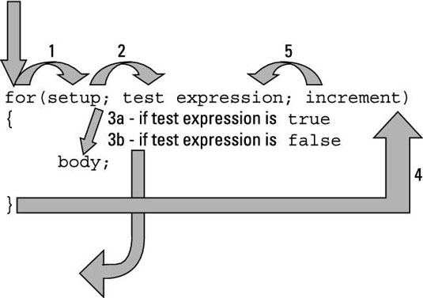
For Loops Expansion
More can be done with for loops
“setup” , “test expression”, “increment” can have really any code there, but it is always executed in the given order

Slide 22
The “++” Part
Libraries can be included into your files using #include
#include <libraryName>
#include “filename”

Slide 23
Tracing Code
When tracing code, we go sequentially and change data as told to
Recall your code tracing from 110
http://pythontutor.com/visualize.html#mode=edit
PythonTutor is a great resource for practice in tracing code
Write some programs like we’ve done in the assignments and view the stack while it executes for some great exam prep

