Slide 1
Discussion Session Week 5
Week 5:
Pointers and more on arrays

Slide 2
Pointers
A pointer is a variable that holds the memory address of another variable
A memory address is always a hex value
When defining a pointer, we must always set it equal to a memory address by using the ‘&’ symbol
In the rare case that we have nothing to set out pointer equal to, default it to NULL
Declaring a pointer
{type} *varName;
Accessing values within a pointer
*varName
Accessing the address of a pointer
varName

Slide 3
Pointers Visualized
int *a
*a = 5
char *temp = “Hello”
0x000001
5
H | e | l | l | o | \0
0x000001

Slide 4
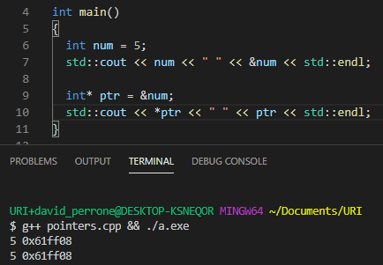
Example:
int* ptr declares a pointer to an integer.
*ptr de-references the pointer and lets us access the data being stored there

Slide 5
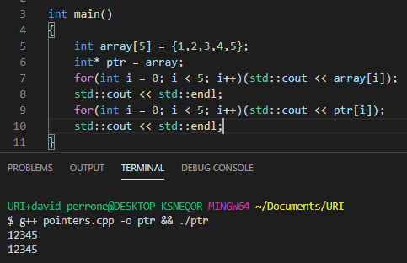
Arrays and Pointers
Ptr stores the memory address of array
This lets us access the elements in array
There is only one array being stored in memory here

Slide 6
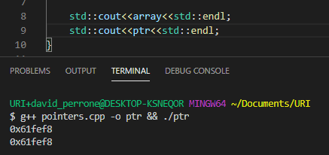
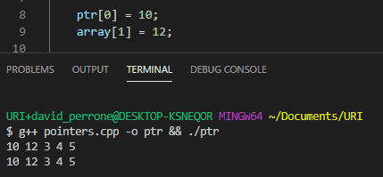
Arrays and Pointers
Array and ptr are both pointers to the same memory address
Changing an element in ptr will change the element in array (and vice versa)

Slide 7
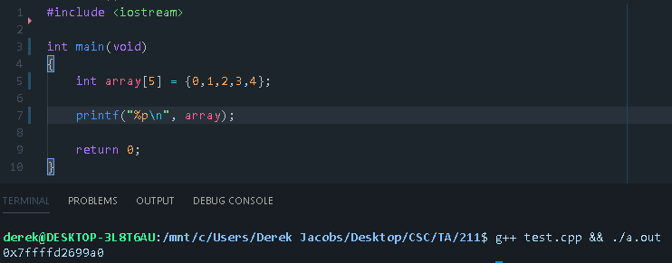
Arrays ~are~ pointers

Slide 8
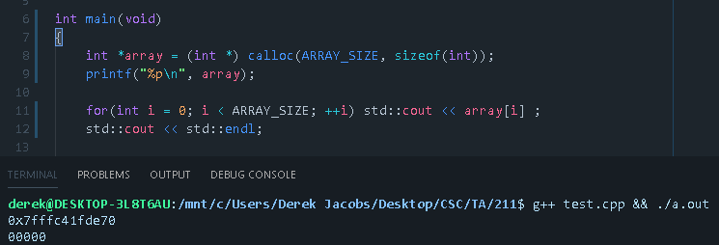
Creating an array without brackets

Slide 9
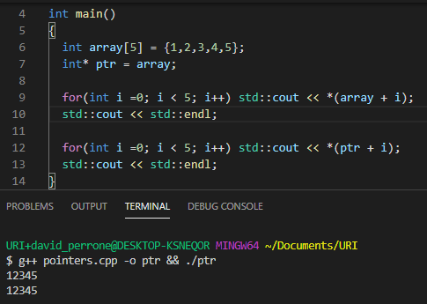
Pointer arithmetic
Because arrays are stored contiguously, we can use pointer arithmetic to iterate through an array

Slide 10
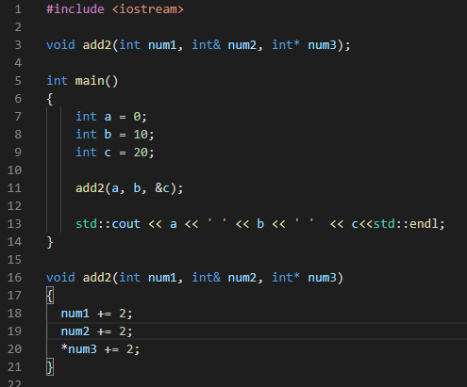

Pointers and functions
Functions in c++ can only return one variable
Pointers allow us to modify the value of variables without returning anything

Slide 11
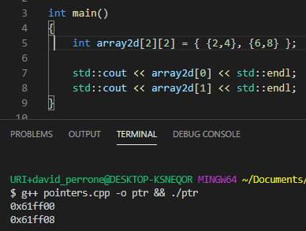
Multi-Dimensional Arrays
An array of arrays
Array2d[0] is a pointer to an array of integers {2,4} stored at memory address 0x61ff00
Array2d[1] is a pointer to an array of ints {6,8} stored at 0x61ff08.
We can predict this memory address because each array stores 2 integers (8 bytes)

Slide 12
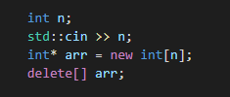
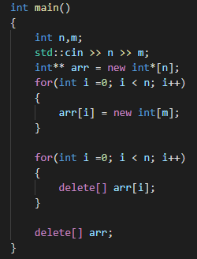
Dynamic Arrays
Static arrays - Size needs to be known at compile time
What if we don’t know how large the array will be?
The keywords “new” and “delete” are used to allocate and deallocate dynamic memory.

Slide 13
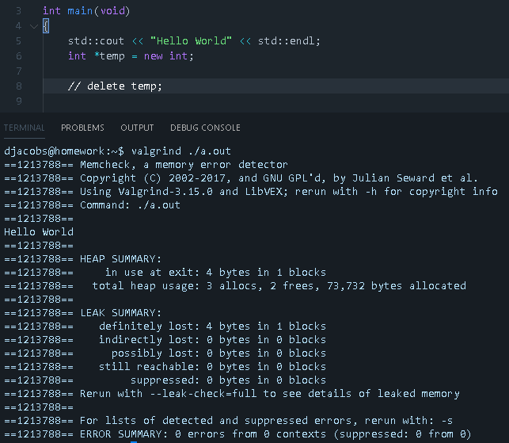
Valgrind
A very useful tool used to check for memory leaks (memory that has not been freed when allocated on the heap)

Slide 14
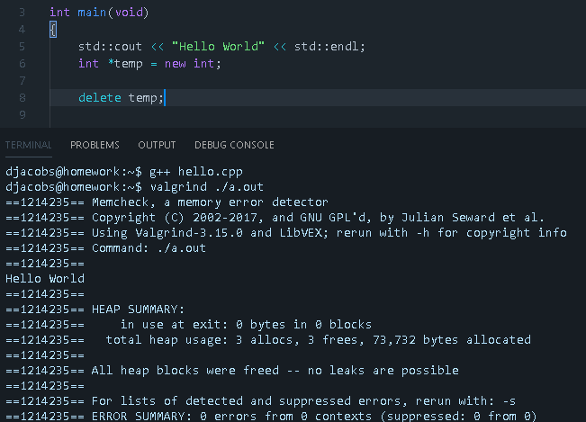

Slide 15
Exercise 1 (5 minutes)
Create a void function that takes in a pointer to an array and fills it with numbers 0 through n, where n is the length of the array

Slide 16
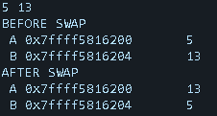
Exercise 2 (5 min)
Create a program that takes in 2 integers, swaps their values using pointers, printing the memory address of each variable and the value at each address along the way
Preserve the memory address of each variable

Slide 17
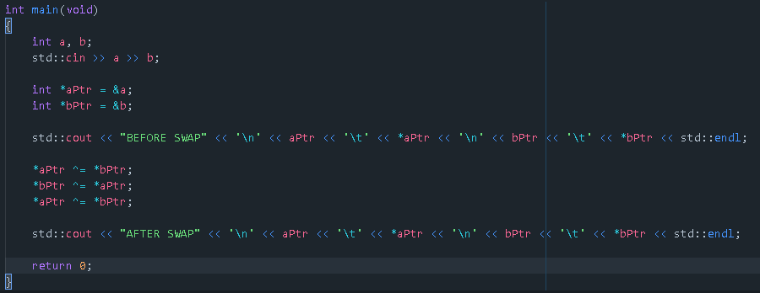
Exercise 2 Solution

Slide 18
Pointers vs references
Use references when you can and pointers when you have to
References are easier to implement and can do a lot of the same things as pointers but have less flexibility and aren’t able to be reassigned
Pointers are best for
If we need a NULL memory address for any reason
We need pointer arithmetic (such as traversing an array)
Implementing data structures
References are best for
Function parameters and return types

Slide 19
Final Remarks/Key Points
Pointers point
They point to memory addresses that hold values, but they themselves do not hold values
Important operators:
& “Address of” → Used when you are trying to access the memory address of a non-pointer
* “Value at” → Used to either de-reference a pointer to access the value at its memory address, or declare a pointer
[] Used when creating arrays

Slide 20
Questions?
On anything...beyond just pointers and what we’ve covered today

