Slide 1
Discussion Session Week 2
Basics of Programming/Early Practice

Slide 2
Learning To Code vs Learning To Program
Anyone can learn to code
While learning to program, you will learn to code
Programming is the process of solving a problem that’s been given to you
This is the key point to remember while working/learning
Coding is writing the code to support your solution to a problem in a given syntax
The best way to learn to program is to do it….A lot
LeetCode, Kattis, HackerRank, and Programiz are great websites to use for practice problems

Slide 3
C vs C++
You can think of C++ as just “C with Libraries”
C code can be used in C++ programs, C++ cannot be used in C programs
C has 32 keywords, C++ has 52
You don’t need to memorize them but you should be able to recognize when they come up
C++ is more object oriented, C is function-driven
In most of your classes, you’ll be working in C++ at URI
212 is typically taught in C++, 412 uses C early in the semester and C++ later on
Electives like 415 will also have you using C++

Slide 4
Refreshers
C and C++ are strictly typed
You must explicitly declare the type of a variable(or function) when creating it
If a function does not return anything (yes this is possible), then it must be declared as a void function
Main must always be declared as an int
Comments are your friend
Get used to writing them and reading them
Yes I will be mentioning this just about every week :)
All C/C++ programs must have a main function
We can get away with never writing a main function in Python, but a C/C++ program wouldn’t compile without it

Slide 5
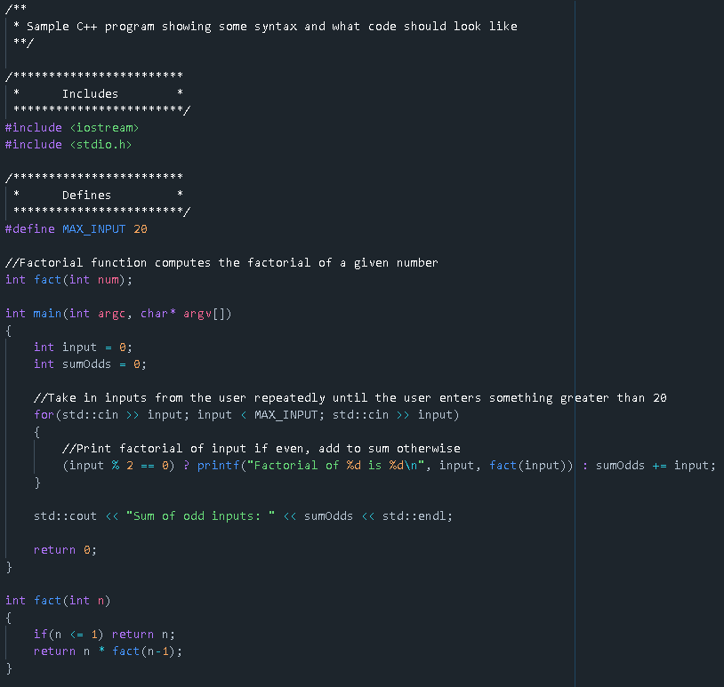
Sample Program
See if you can figure out what this program is doing by reading the comments

Slide 6
Types of Problems
Decision
Sorting
Search
Optimization

Slide 7
Functions
In general, you want as little code in Main as possible
Think of how we utilized main in 110 and how much work was being done
Typically you’ll use main to handle some basic I/O, and call helper functions to solve problems
Functions are essentially blocks of code that can be called repeatedly
Function syntax
functionReturnType functionName(param1Type param1Name, param2Type param2Name…...)
{
Function body
Return statement
}
Parameters are arguments to your functions
Think of parameters like x in the math expression f(x)

Slide 8
Best Practice
Some things are mandatory (we will receive compiler errors if they’re missing or wrong)
For instance, if a function is called in Main before it is declared, that’s an error
camelCase, PascalCase
Gives readability to your programs
Everyone will choose what suits them best, but I use
camelCase for variableNames
PascalCase for ClassNames and ConstructorNames
Common cpp file to get used to
Includes, defines, and other preprocessors are at the top
Local function declarations and contracts are written next
The main function follows those function declarations
The local functions are then defined below main

Slide 9
Exercise One
Write a program that does the following
Creates a function that does not return anything
In that function, print “Hello World”
Hint: Think about the kind of function definitions we’ve talked about
Creates another function that adds two integers together and returns that sum
Call both of these functions in main
Print out the result of your sum function

Slide 10
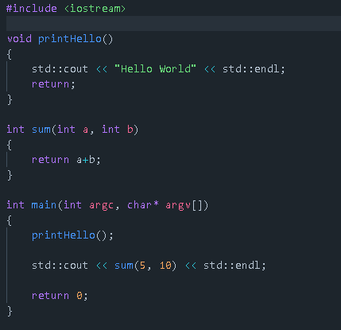
Solution
Note that main can come before or go after your functions

Slide 11
Reading Documentation
Cppreference is the goto resource for C++ programming
This website will give you just about everything you’d ever need to know about the language
It looks pretty antiquated, but it’s kept up to date and things are grouped together meaningfully
When you understand this site, you will outperform others who cannot understand it

Slide 12
Example of the site
Let’s take a look at std::min
Note the anatomy of the page
Where this function originates
Links to other reference pages (such as std::initalizer_list)
What the function does
Parameters
Examples

Slide 13
Preprocessors
#include
Access a user-defined or standard library
More or less “Copy and paste a file at this location”
#define
Create a variable or function (different use cases)
Typically comes before any functions and just after your includes
#define PI 3.14

Slide 14
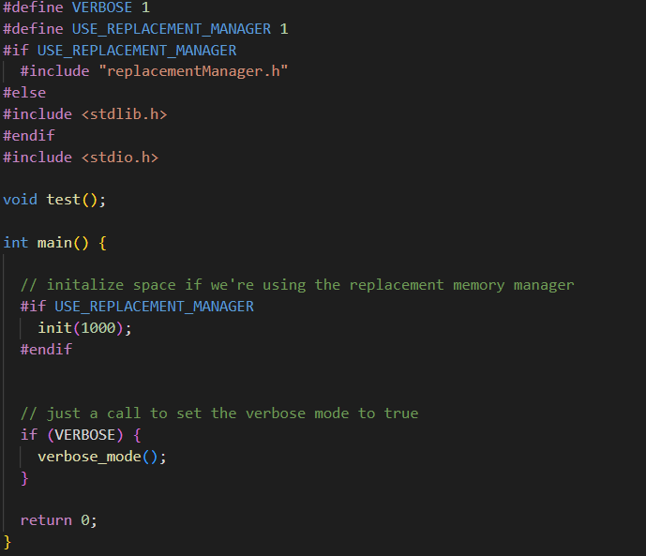
More niche preprocessors
#ifndef
Allows us to check if something is defined prior to compilation
If not, execute a block of code
There’s some discourse about choosing #if vs #ifdef vs #ifndef
#endif
Basically, these expressions occur before compilation

Slide 15
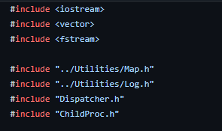
Include
This is where the “++” part of C++ comes in
There are many functions, classes, structs, and other artifacts predefined for you
If you want to use a function defined in a library, you must first include that library
#include <libraryName>
#include “localFileHeaderName”

Slide 16
Caveats
Although many utility functions are written for you in libraries, be careful when completing assignments
Something like std::accumulate only takes a few lines to write on your own and will give you some much-needed practice
The vast majority of the time, you will need to write your own functions (with some exceptions)
Sometimes you’ll be given starter code or work on similar problems in lab
Use these resources to help you
Many beginner level programs are solved widely online
Don’t copy and paste a solution….you’ll get caught
Even if you’re able to pass, you won’t learn anything and be in big trouble when you enter 212

Slide 17
Exercise Two
Using the cmath/math.h library, write a program that does the following
Takes in two numbers on standard input
Prints out the greater of the two numbers
Prints out the result of raising the larger number to the power of 6

Slide 18
Compiling
Exposure to g++ is really important (and will not become any less so as time goes on)
There are many other things that can be done besides simply compiling a program
Default executable name is a.out
-no-pie -g -O0 -Wall -Wextra -Werror -Wfatal-errors -std=c++11 -pedantic
And many, many other compiler flags
Each flag has its own purpose
Eventually (beyond scope of this course), you will learn about linking while compiling
Basically a means of including libraries that are not standard with C++
Libraries you have defined or downloaded locally
Learning some flags and using them will make you a better programmer
Werror treats warnings as errors and forces you to be more careful
Wall, Wextra, Weverything adds more warnings to your code
std=c++11 specifies that this program uses C++11
etc

