Slide 1
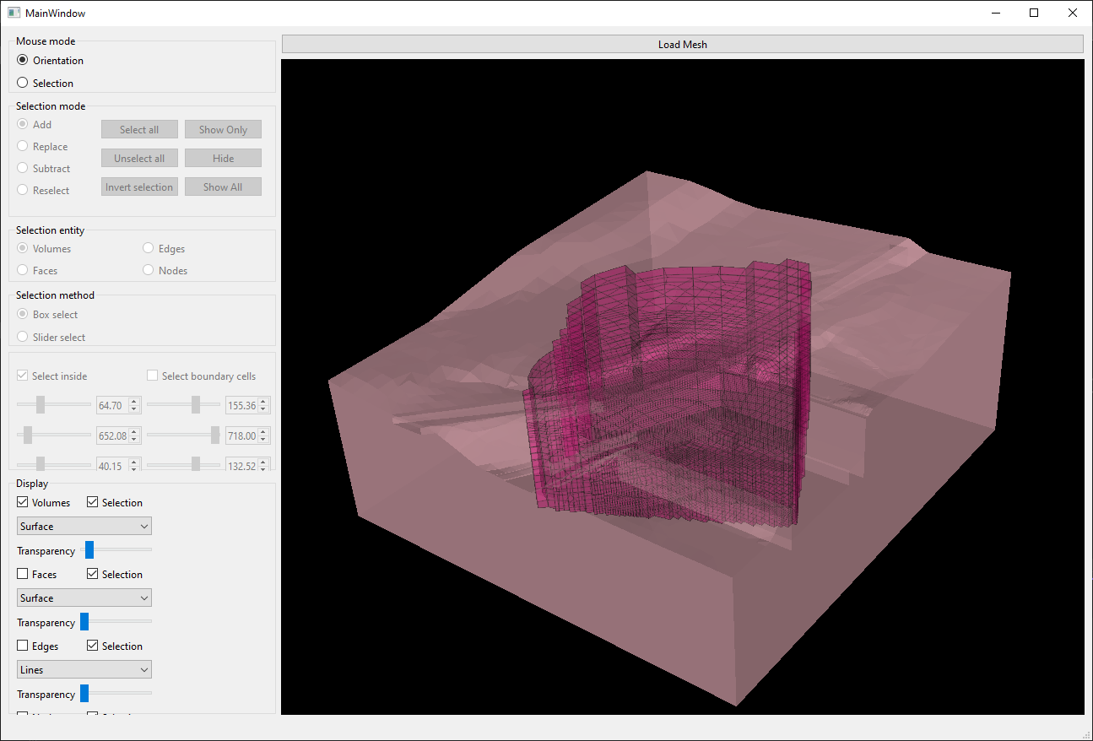

Slide 2
UpdateModelToSelection
Model
ModelVisible
Selection
Volume
Actor
Actor
Model
ModelVisible
Selection
Faces
Actor
Modèle 3D aux EF - maillage dans le plan

