Slide 2
Session 5
Bootstrap: Layout, Themes & Widgets

Slide 3
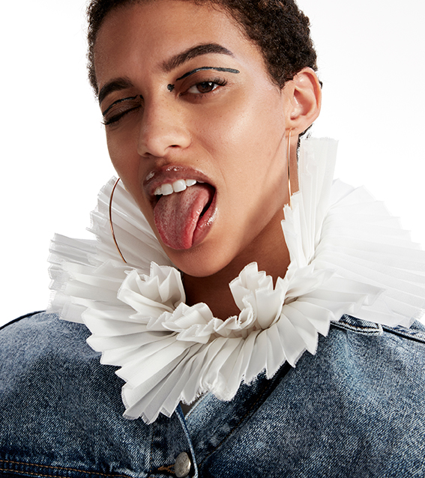
Building websites takes a lot of time
Up to now we’ve built our websites from scratch with a bit of help from bootstrap
Building a polished website from scratch is really slow!
We can take other people’s work (that’s been tried and tested) and build upon it using templates and themes

Slide 4

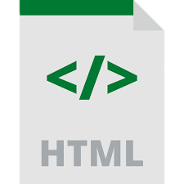

Recap – what’s a website framework?
JavaScript
The coded interactivity of the website
HTML
The structure of the website
CSS
The look and feel of the website

Slide 5
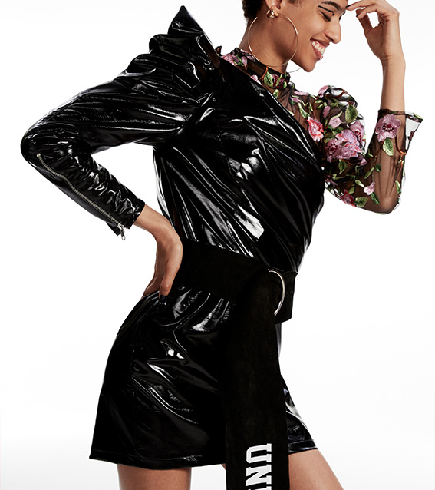
Widgets
Small components that can be used by your website or blog
Bootstrap provides automatic basic functionality and design for these
Examples are buttons, flyouts, carousels

Slide 6
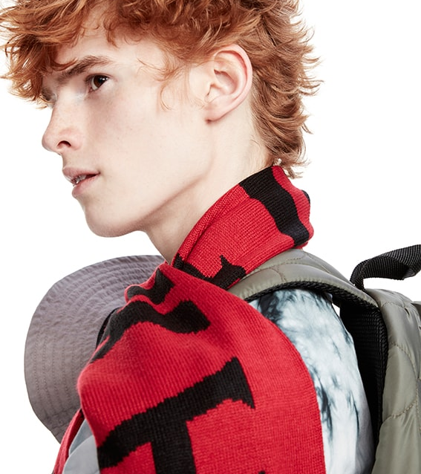
Layout
Until now we’ve done manual CSS layout which is pretty slow & tricky
You might want to have multiple columns, position things next to each other
We’ll be getting started with some grid based layout

Slide 7
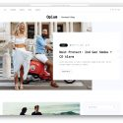


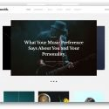



Themes
Using themes allows us to build professional designs more quickly. We’ve provided a selection of themes to play with.
Opium
Vespa inspired personal blog theme with a top menu. Focus on the text.
Original
Simple party themed blog design with lots of pictures. Top menu
Droppler
Funky animation & complete restyling of the site.
Wordsmith
Focus on music and design with a minimal homepage and carousel of pictures.
Standard Templates
Challenging
Libro
Fashion blog with fresh design and a grid of pictures. Menu pops up.
World
Basic blog theme with animation and large hero images
Food Blog
Attention grabbing recipe theme

Slide 8
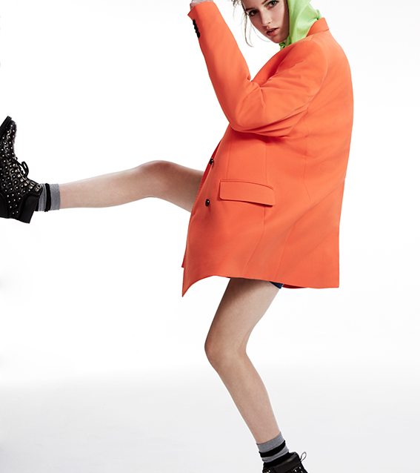
Exercises
Add a widget to the blog
Use Bootstrap grid layout to make your blog layout more interesting
Move content of your blog to a prebuilt template

Slide 9
Lets get cracking

