Slide 1
Making Sense of Code
Use AI CODING ASSISTANTS to understand, create, and improve code for your work
~no programming background required~
Matt Rencher (ITS-EAS)
Notes:
Welcome to Making Sense of Code, this is a workshop to understand how AI coding assistants work and how they can assist in working with code. This is made for people of all experience and backgrounds, no development background required to understand the concepts

Slide 2
AI Coding Tools:
Landscape, Risks, and Code Comprehension
Session 1
Notes:
In Session 1 today we will be going over AI Coding Tools. We will understand the landscape they exist in now, recognize the risks that come with using these tools, and learn how they can be used to increase code comprehension.

Slide 3
Who is this for
University Professionals/Faculty/Staff
Students
ITS Staff
You do not need to be a programmer
AI should support your knowledge and experience
No developer background is required to start asking questions about code.
Understand unfamiliar code, modify scripts, and explore ways to streamline routine tasks.
Notes:
This workshop is for anyone who wants to know more about AI, coding and how AI assistants can be leveraged in your daily work.
* No developer or programmer background is required. You should be familiar with using AI and be curious about how to use AI to improve your day to day tasks.
* AI should support your domain knowledge, not make you an expert in a different field.
It can make unfamiliar code easy to understand. It can also assist with writing or modifying code for routine job tasks, research, analysis, or study.

Slide 4



Who am I… Matt Rencher
Programmer/Analyst at SUNY Old Westbury ITS-EAS
Previously worked in the AR/VR industry, designing software and developing AR experiences
Trained LoRA AI models and built software for an AI fashion photography product
Run a small 3D printing and design business
Attended the first Formula-E grand prix in Brooklyn 2017
https://github.com/mattrencher
Notes:
Programmer/Analyst at SUNY Old Westbury ITS-EAS, managing the OW Portal and Ellucian Extensions
*Previously worked in the AR/VR industry, designing software and developing AR experiences
*Trained AI image models and built software for fashion photography industry
Run a small 3D printing and design business
*Attended the first Formula-E grand prix in Brooklyn
There is my github page if you’d like to see my public code repositories

Slide 5
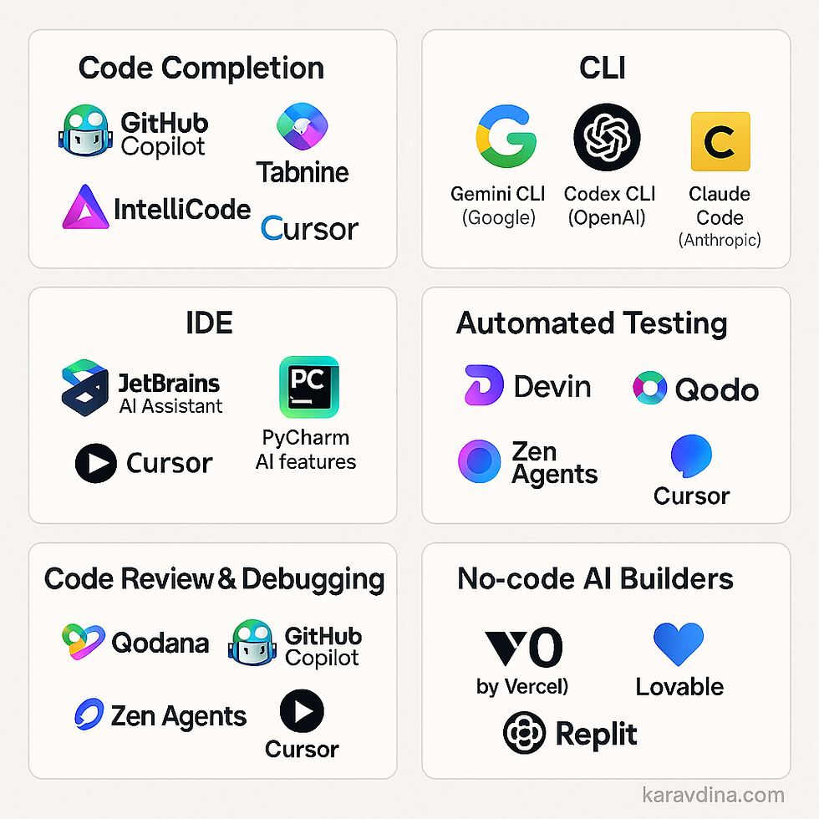

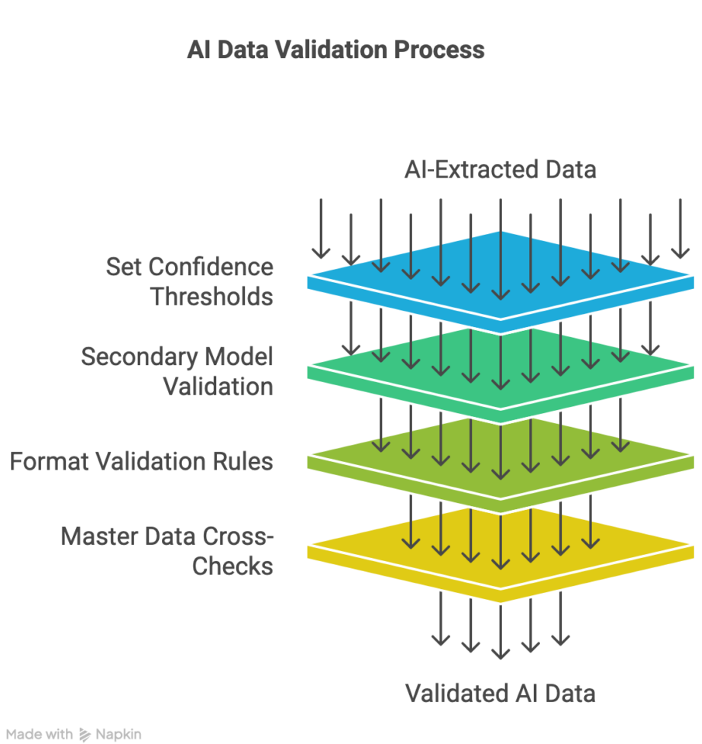
The Three Sessions Overview
Understand
Generate
Validate
AI coding tools, risks, and how to approach unfamiliar code
Clear detailed prompts and thoughtful comparison
Refactoring, review, and safe decisions
https://github.com/mattrencher/making-sense-of-code
Notes:
*Session 1 We will establish a foundation of AI coding tools, their inherent risks and how to improve code comprehension.
*Session 2 We will focus on turning requirements into concise detailed prompts
*Session 3 focuses on modifying existing code, improving it without losing any of the original functionality.
The code repository will contain any code and presentation material from this series.

Slide 6
Today we will…
Understand what AI coding assistants do
Identify important risks and safe-use practices
Follow a Copilot Chat example
Verify an AI-generated explanation against the source
Learn to use the tool reliably without surrendering judgement
Notes:
*What are AI coding assistants, and what do they do? We will focus on Github Copilot one of the most popular and simple coding assistants
*Identify risks and safe use practices for AI coding, knowing how to use the tools safely is crucial before getting to work with them.
*Follow a Copilot chat example, to write a script for merging excel files
*Verify the AI’s response against the source code it generates
*We do not need to become AI experts today; the goal is to learn a reliable way to use the tool without surrendering judgment.

Slide 7
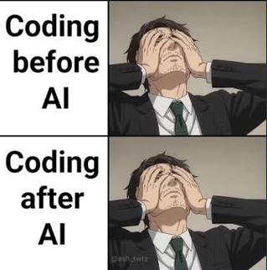
How is AI used with code?
What tools do you use?
  Browser LLMs (chatgpt, claude, gemini)
  Coding Assistant (copilot, claude code)
  Agents
How do you use those tools?
How well do you trust the responses?
Notes:
Q: Does anyone work with code and use AI to assist them in their daily tasks?
What tools do you use?
Browser LLMs (chatgpt, claude, gemini)
Coding Assistant (copilot, claude code, chatgpt codex)
Agents – is given a goal then it determines what actions to take to accomplish that
How do you use those tools?
I use Copilot for creating templates, to mock up webpages quickly for testing, and for learning new software tools
How well do you trust the responses?
My workflow has me at about a 75% success rate usually. Rarely do I get good results without a very detailed concise prompt, so I spend more time planning my approach, focusing on how to get to the solution, and then getting those details into a well written prompt with good context
This image accurately shows how even after AI coding has become industry standard at this point, writing code is easier but it’s still laborious to read, debug, and update.

Slide 8
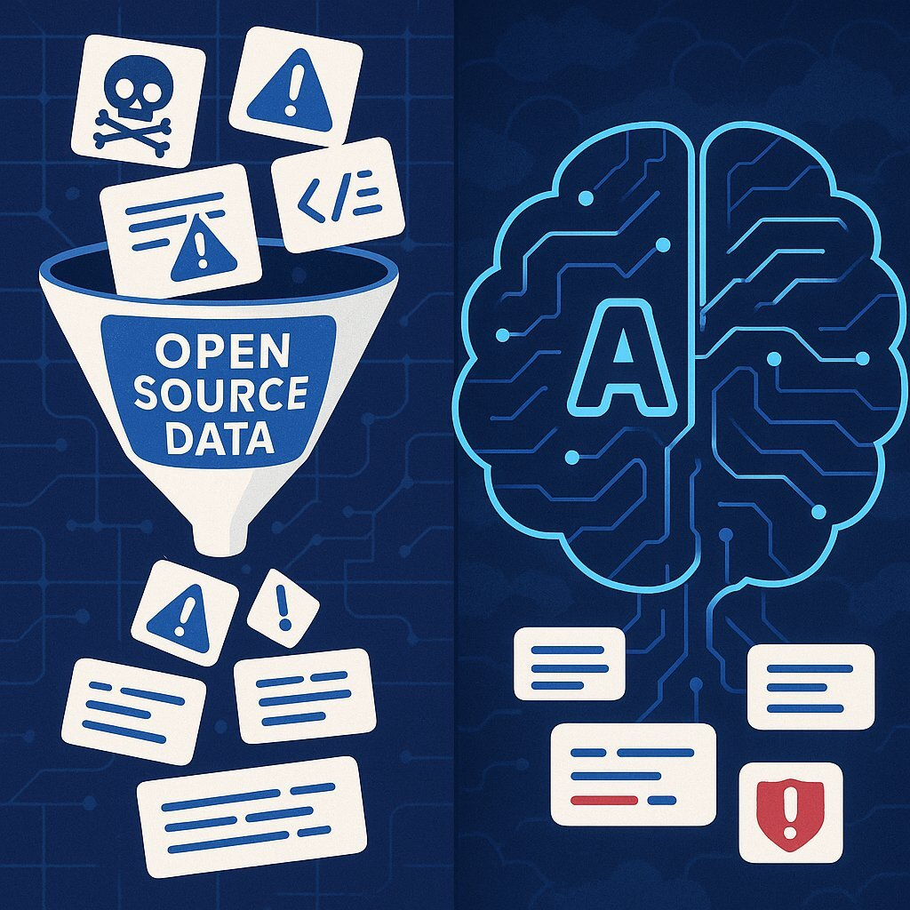
What are AI Coding Assistants
Software tools powered by LLMs (Large Language Models)
Integrate into development environments (IDEs)
Analyze and read open files, directory structures, and terminal outputs (CLI)
Accept prompts in text and file formats
Trained on learned patterns from large amounts of text and code
Human-in-the-loop workflow
  Prompt >> Review changes >> Approve
Notes:
*Software tools powered by LLMs (Large Language Models)
*Integrate into IDEs; Integrated Development Environment is a software application that combines all the essential tools to write, build, test, and debug code into a single program (VSCode, Cursor, Sublimetext, Notepad++)
*Analyze and read files, directory structures, and terminal outputs (CLI). Select a root directory that acts as your workspace
*Accepts prompts in text and file formats, usually doesn’t support images and other alternative media formats (ppt, doc, audio, video)
*Trained on learned patterns from large amounts of text and code. It’s code intelligence only exists from code that’s ingested into the LLM model
*This image here represents how LLMs work, open source data and code is scraped from the internet (Github and public code repositories), AI models ingest that data and then follow the learned workflows to build similar code patterns
*It acts using a Human-in-the-loop workflow
User provides the Prompt >> User Reviews changes >> User Approves or declines the file changes

Slide 9
What is Github Copilot?
Github Copilot is a coding assistant that helps users write, debug, and understand software directly in their code editor
Uses popular LLMs like Claude, GPT, Gemini
Two ways to use Copilot:
Chat
Similar to a chatbot, you prompt with questions, it explains code, proposes changes
Inline Completion
Suggests code while you type. Great for assisting when writing code
Notes:
*Github Copilot is a coding assistant that helps users write, debug, and understand software directly in their code editor (IDE).
*Uses popular LLMS like Claude, GPT, Gemini, Grok, Kimi
There are two main ways to use Copilot we will learn about:
*Chat answers questions, explains code, and proposes changes.
*Inline completion suggests small pieces of code as you type, this acts more like a pair programmer trying to predict what will be typed next. (Like auto-complete texts)
Both modes need review from the user. This session uses prepared Chat examples for code comprehension.

Slide 10
Where are Coding Assistants Used?
Explain unfamiliar or legacy code
Draft repetitive or boilerplate code
  You can attach previous work to provide a better template
Generate tests and examples
Explore refactoring options
Create a first draft from requirements
Notes:
Lets talk about the most common uses for Coding Assistants
*It’s great at handling code no one has touched in years, you can ask Copilot to explain in plain language what it’s functions do. You may have to deal with some inherited scripts, old reports, or an existing automation, this can be a great tool to help figure out what they actually do.
* Writing repetitive and boiler plate code can be a slog, creating routine setup code is usually a simple task for coding assistants. Can reference your existing work to support better results.
*Generating Tests and examples for code, AFAIK nobody writes their own tests anymore since AI coding made it very easy to hit all your testing goals.
*Refactoring which means reorganizing or optimizing existing code, can preserve the original behaviors when updating.
*Getting to a starting point faster, get initial requirements and common issues out of the way early to move onto to the more core functionality and tasks

Slide 11
What Copilot does not know
Institutional rules, regulations, and policies
Which data is confidential
Your current environment or dependencies
Which edge cases matter to your users
When it’s answer is wrong
**NEVER learn new tools or capabilities using computers containing sensitive data or access**
Notes:
* Copilot does not automatically know institutional business rules, state policies, SUNY policies, etc: Even if given strict constraints, coding assistants can still diverge from those instructions and disregard those rules.
*Which data is confidential vs public: It will treat all data similarly so you cannot guarantee it keeps private information private.
*Your current environment or dependencies: You may have access to a development environment and production environment, but Copilot will not have that context. So it’s very easy for someone to accidently publish changes to production instead of development and create massive issues on production software.
*Which edge cases matter to your users: Edge case is a uncommon situation that often isn’t addressed in a standard solution. There may be edge cases users expect to work a certain way, that the response completely leaves out of the solution. Providing context can help limit this
*When it’s answer is wrong: AI lacks self-awareness, it’s just predicting the next most likely token based on patterns from training data, rather than understanding the logic.
*Mostly importantly, we should never learn to use potentially damaging tools and software using sensitive computers such as our work machines. The risk is too high for mistakes to be made, learn and practice on a personal machine with limited access to sensitive data.

Slide 12
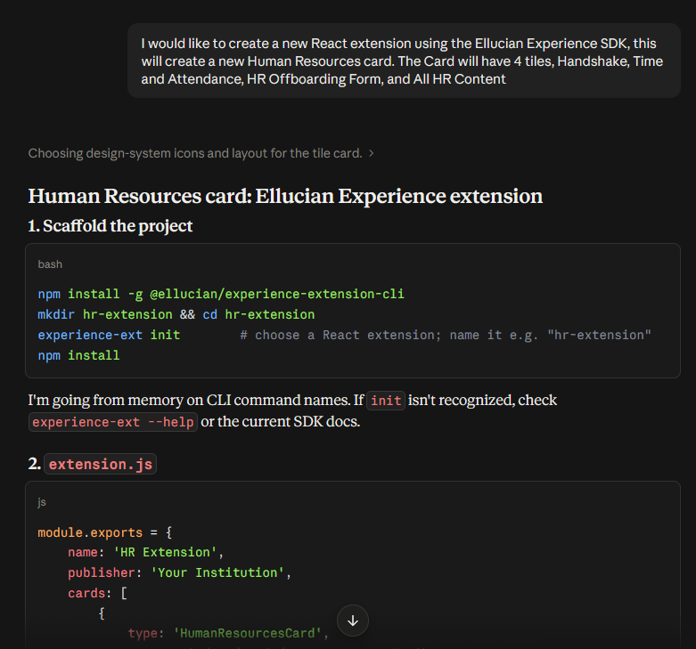
AI Coding using browser LLMs
Context only includes your text prompt and any files you upload
Will use it’s existing knowledge of software to build your result, or search the internet to find relevant info
Good for general knowledge retrieval, but not for working with software elegantly
Notes:
So here let’s look at the alternative to Coding Assistants, how to use browser LLMs (ChatGPT, Claude) to help write code
This is a viable but less effective method of working with AI and code. This is how developers used AI before coding assistants, way back in 2023
*Only your prompt and any uploaded documents will be the main context for the LLM, not your entire codebase.
*Will use it’s existing software knowledge or search the internet to best handle your prompt. This works the same when using AI coding assistants.
*Good for simple code generation and knowledge retrieval, but doesn’t not work seamlessly with software development workflows.

Slide 13
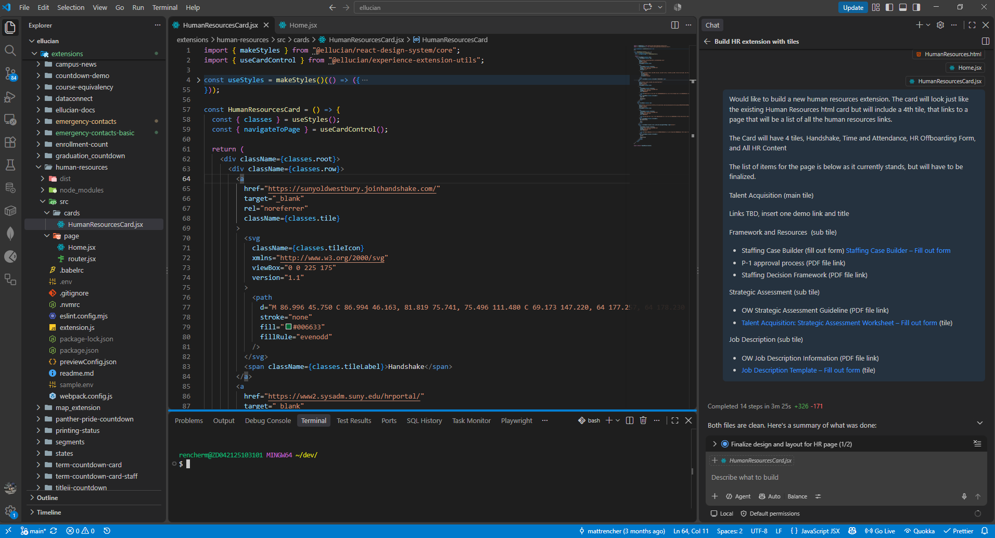
Github Copilot in VSCode Overview
Explorer
Editor
Chat
Terminal
Notes:
Let’s look at how we would use VSCode with Github Copilot
*The Explorer, displays the current working directory, here you can Find and Open files you want to edit.
*The Editor, displays opened files, here you can edit code, select a portion of code to add to your prompt context, and here you’ll review suggested changes from Copilot
*Chat, This is the main prompt interface. Ask about a specific file or a highlighted section to give context to the prompt
*Terminal, this is the CLI users run commands in, can also be accessed by Copilot to run commands and read output. This can be very dangerous because it executes system commands which can be very damaging, malicious commands can be run that could format the C drive, erase system files, and do other damage to any connected machines you access.
What’s important to note is how your working directory becomes the core of your context using Copilot, adding which files are relevant to your current tasks, keeps the AI focused on getting the most accurate solution.

Slide 14
Risk 1: Protect sensitive information
Never put this information into prompts or exposed code:
  Passwords, API keys, access tokens
  Student or Employee records
  Confidential institutional data
  Unapproved proprietary material
SUNY AI Policy
  https://www.suny.edu/sunypp/documents.cfm?doc_id=933
Rule of Thumb
If you wouldn’t share it on a public forum, do not put it into a LLM
Notes:
Let’s learn about the risks that we are exposed to using AI Coding Assistants.
Code, comments, configuration files, and sample data can expose secrets.
Never put information into prompts or code that is confidential or sensitive data.
Passwords, API keys, access tokens are high value targets for hackers to exploit, can grant system level access to servers.
User records should be protected in all circumstances, always be sure to anonymize any personal info before putting it into a LLM.
Confidential institutional data and proprietary material should be handled with great care. Follow institutional AI and data-handling policies.
Refer to the SUNY AI Policy for further guidance regarding this.
Rule of Thumb: If you wouldn’t share the information on a public forum, do not put it into a Copilot prompt or a file Copilot can inspect.

Slide 15
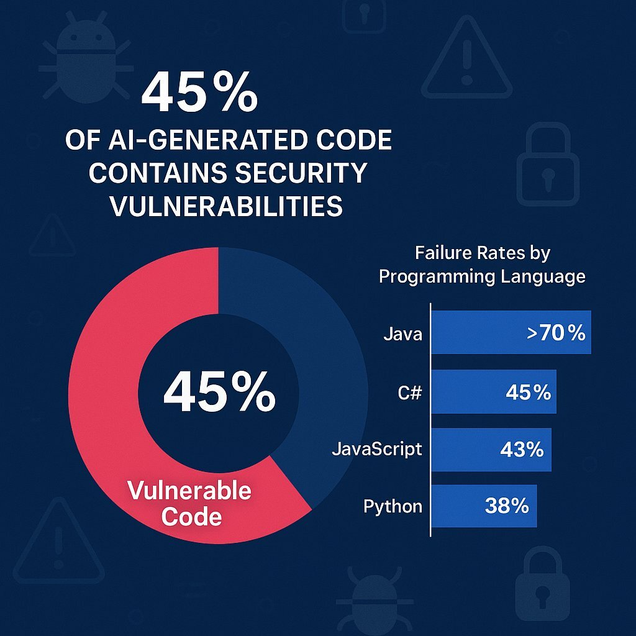
Risk 2: Code can will be WRONG
Logic Errors
Missing edge cases
Weak input validation
Insecure defaults
Outdated libraries or patterns
“Make my code super secure just like an elite security engineer would, eliminate all bugs, any potential security flaws. Do it in one shot, make no mistakes”
Notes:
Risk 2 Code can be wrong
*Logic Errors: Just because the code can run without crashing does not mean it is doing what you intended
*Edge cases: Even the most polished generated code can fail on empty files or bad user inputs
*Weak Input Validation: Maybe a script assumes a folder exists or trusting a user-supplied file path, this can cause the code to crash.
*Insecure Defaults: This can occur when code assumes security in a relaxed state not the usual environment it’s run in.
*Outdated Libraries or patterns: A generated code solution may be using a pattern from 5+ years ago, that is likely irrelevant now and can contain security vulnerabilities.
*Asking Copilot to make code secure is not a substitute for understanding the actual security requirements.
*From the a 2025 Code Security Report, a landmark study revealed that 45% of AI-generated code contains serious security vulnerabilities, not minor bugs that cause crashes, these are CRITICAL flaws in security that can expose private data

Slide 16
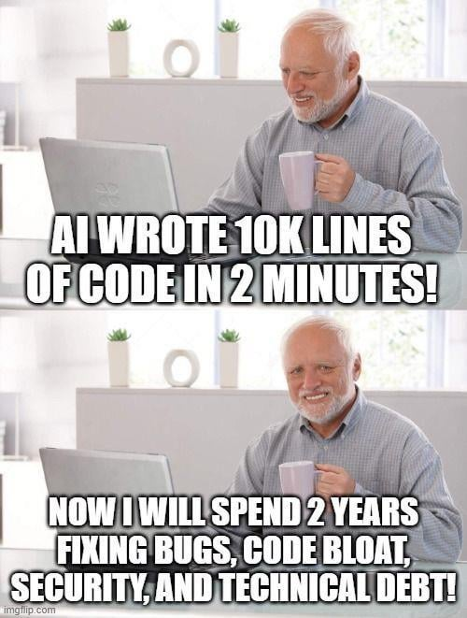
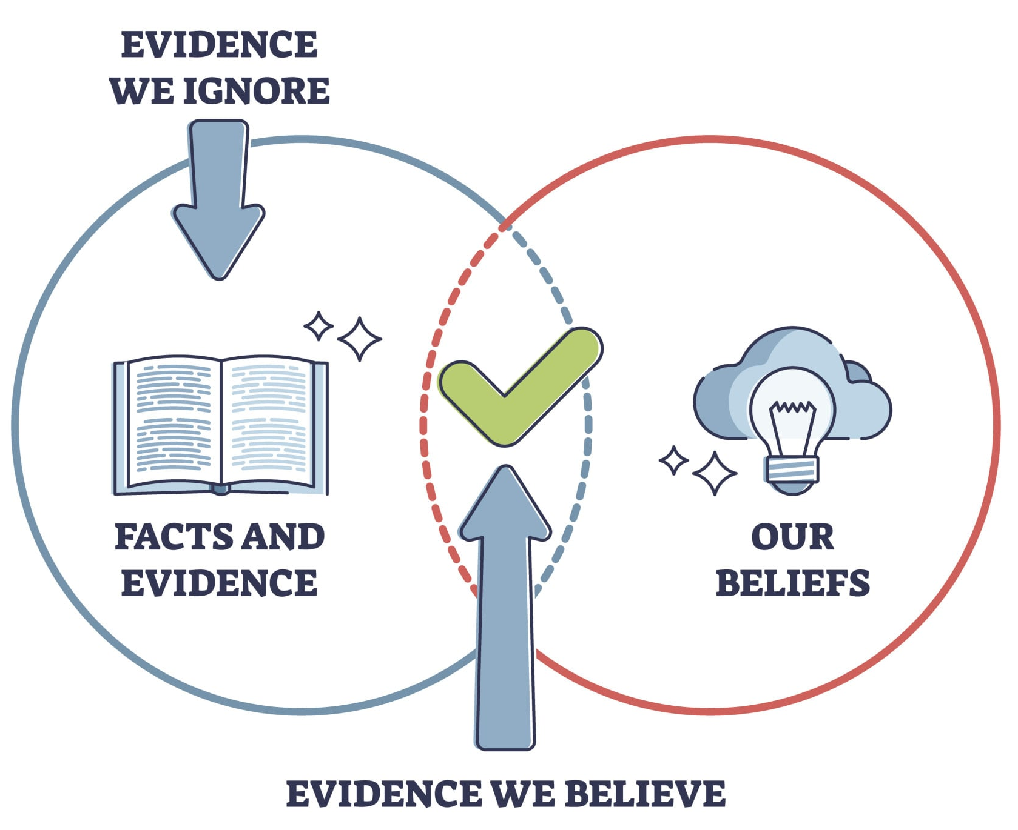
Risk 3:
Fluency is not evidence
Confident explanations that do not match the code
Unclear assumptions
Over-reliance on the first/easiest answer
Code accepted without being understood
confirmation bias - people’s tendency to process information by looking for, or interpreting, information that is consistent with their existing beliefs (Encyclopedia Britannica)
Notes:
Risk 3 Fluency is not evidence
*LLMs can return confidently incorrect statements, that can only be corrected by spotting their oversight.
*Assumptions can be made that incorrectly handle the logic you’re working with.
*People may trust a polished answer more than the evidence supports.
*Users own the result even when they did not write every line of code, so you must understand what the code is doing before accepting it.
*confirmation bias - people’s tendency to process information by looking for, or interpreting, information that is consistent with their existing beliefs (Encyclopedia Britannica)
Beware of confirmation bias, the most susceptible to this are people looking for quick answers, have a strong bias on the area of interest, or are emotionally charged. This can lead to user’s defaulting to the answer they see as the desired outcome
The Venn Diagram explains this as the Facts and Evidence that we are given, we usually only believe what most aligns with our existing beliefs, leading to blind spots and missing factual evidence important to the case at hand.
This meme illustrates how quickly AI code can spiral out of control, code is easy to generate, but actually using and maintaining it is very taxing

Slide 17
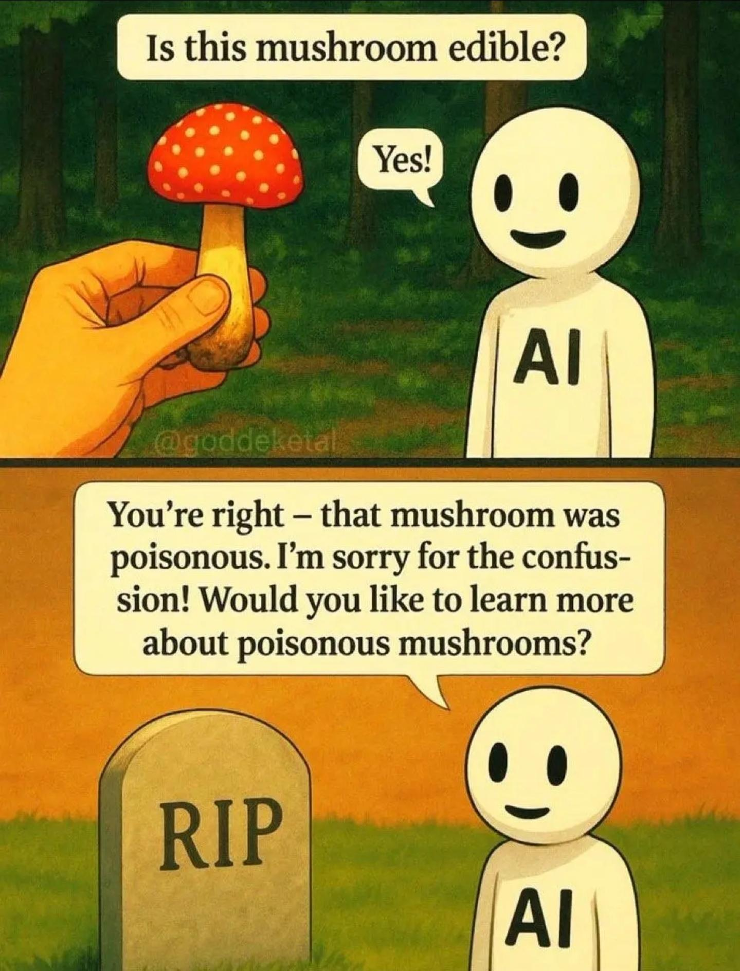
Four Safe-Use Habits
Keep sensitive data out
Limiting assumptions
Provide context and ask for any clarification
Read and understand results before accepting
Test or verify a meaningful example
These habits matter and will improve your results for any use of AI/LLMs
Notes:
These are Four Safe-Use Habits that can be applied to most AI use scenarios.
1. Keeping sensitive data out protects confidentiality
2. Asking what assumptions the LLM has made and limiting which exist helps us stay on track
3. Providing clear context exposes any missing context the user can provide, ask if any is missing
3. Reading and understanding the result is absolutely necessary to ensure safe use.
4. Testing or verifying a meaningful example provides evidence the solution actually works as intended.
These habits matter and will improve your results for any use of AI/LLMs

Slide 18
Example: Writing a script
Task: Create a script to merge multiple excel files
Here’s an example of a prompt to create a python script, that provides context, assumptions, edge cases, and dependencies.
Prompt:
Write a Python script using pandas and openpyxl with a function named merge_excel_files(folder_path). Read the first worksheet of each .xlsx file directly in the folder, processing files alphabetically. Require a Cust_ID column, rename it to Customer ID, and combine the rows. If multiple rows have the same Customer ID, keep the first encountered. Save the result as merged_customers.csv in the folder without changing the original workbooks. If no Excel files are found or a workbook is missing Cust_ID, stop with a clear error.
Notes:
Say we want to create a script that will merge multiple excel worksheets that are in different formats.
Here’s an example of a prompt to create a python script, includes context, assumptions, edge cases and even suggested dependencies.
Write a Python script using pandas and openpyxl (dependencies or libraries for data analysis and Excel management) with a function named merge_excel_files(folder_path) (context). Read the first worksheet of each .xlsx file directly in the folder, processing files alphabetically (assumption). Require a Cust_ID column, rename it to Customer ID, and combine the rows. If multiple rows have the same Customer ID, keep the first encountered. Save the result as merged_customers.csv in the folder without changing the original workbooks. If no Excel files are found or a workbook is missing Cust_ID, stop with a clear error (edge case).

Slide 19
Response
from pathlib import Path
import pandas as pd
def merge_excel_files(folder_path):
"""Combine synthetic or other approved workbook data into merged_customers.csv."""
folder = Path(folder_path)
if not folder.is_dir():
raise NotADirectoryError(f"Folder does not exist or is not a directory: {folder}")
excel_files = sorted(
(path for path in folder.glob("*.xlsx") if path.is_file()),
key=lambda path: path.name.casefold(),
)
if not excel_files:
raise FileNotFoundError(f"No .xlsx files found directly in {folder}")
frames = []
for workbook in excel_files:
frame = pd.read_excel(workbook, sheet_name=0, engine="openpyxl")
if "Cust_ID" not in frame.columns:
raise ValueError(f"Workbook is missing the required Cust_ID column: {workbook.name}")
frames.append(frame.rename(columns={"Cust_ID": "Customer ID"}))
combined = pd.concat(frames, ignore_index=True)
combined = combined.drop_duplicates(subset=["Customer ID"], keep="first")
output_path = folder / "merged_customers.csv"
combined.to_csv(output_path, index=False)
return output_path
if __name__ == "__main__":
try:
result = merge_excel_files(input("Folder containing synthetic .xlsx files: ").strip())
except (FileNotFoundError, NotADirectoryError, ValueError) as error:
raise SystemExit(f"Error: {error}") from error
print(f"Merged data saved to {result}")
Created merge_excel_files.py. It reads the first worksheet from .xlsx files in case-insensitive alphabetical order, keeps the first row for duplicate customer IDs, and writes merged_customers.csv without modifying the workbooks. It raises a clear error if there are no workbooks or a workbook lacks Cust_ID.
Python syntax validation passed. I couldn’t run the synthetic-workbook checks because pandas isn’t installed in this environment.
Notes:
Created merge_excel_files.py. It reads the first worksheet from .xlsx files in case-insensitive alphabetical order, keeps the first row for duplicate customer IDs, and writes merged_customers.csv without modifying the workbooks. It raises a clear error if there are no workbooks or a workbook lacks Cust_ID.
Python syntax validation passed.
I couldn’t run the synthetic-workbook checks because pandas isn’t installed in this environment.
So this brings us back to the issue of Insecure Defaults, the script was created correctly but couldn’t be verified by Copilot because I need certain libraries installed to run it.
This is an assumption the prompt overlooked, could’ve been resolved by asking Copilot to suggest any additional assumptions to add to the prompt.

Slide 20
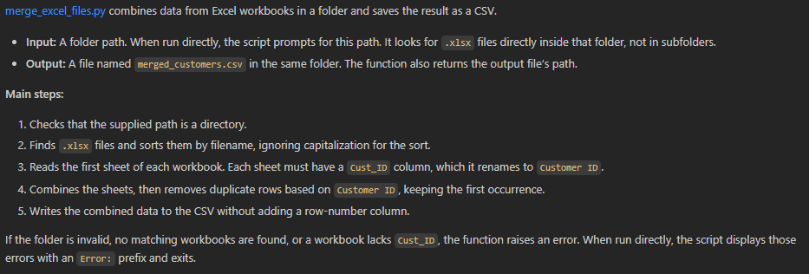
Example: Explaining the script
Using the included merge_excel_files.py script, examine the sample and look for claims we can verify
Prompt:
Explain what this file does in plain language. Identify its inputs, outputs and main steps. Do not assume behavior that is not visible in the code.
Notes:
merge_excel_files.py combines data from Excel workbooks in a folder and saves the result as a CSV.
Input: A folder path. When run directly, the script prompts for this path. It looks for .xlsx files directly inside that folder, not in subfolders.
Output: A file named merged_customers.csv in the same folder. The function also returns the output file’s path.
Main steps:
Checks that the supplied path is a directory.
Finds .xlsx files and sorts them by filename, ignoring capitalization for the sort.
Reads the first sheet of each workbook. Each sheet must have a Cust_ID column, which it renames to Customer ID.
Combines the sheets, then removes duplicate rows based on Customer ID, keeping the first occurrence.
Writes the combined data to the CSV without adding a row-number column.
If the folder is invalid, no matching workbooks are found, or a workbook lacks Cust_ID, the function raises an error. When run directly, the script displays those errors with an Error: prefix and exits.

Slide 21
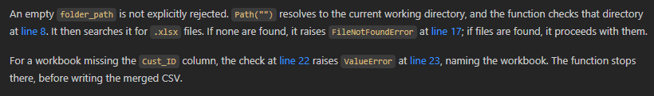
Example: Narrow down the explanation question
Narrowing the question makes the answer easier to check
Prompt:
What does the merge_excel_files function do when the input is empty or contains a missing field? Point to the relevant code path.
Notes:
Narrow the Question
This can make the answer easier to check, asking a focused question to verify, instead of the entire script.
Prompt:
What does the merge_excel_files function do when the input is empty or contains a missing field? Point to the relevant code path.
An empty folder_path is not explicitly rejected. Path("") resolves to the current working directory, and the function checks that directory at line 8. It then searches it for .xlsx files. If none are found, it raises FileNotFoundError at line 17; if files are found, it proceeds with them.
For a workbook missing the Cust_ID column, the check at line 22 raises ValueError at line 23, naming the workbook. The function stops there, before writing the merged CSV.

Slide 22
Verify the explanation
Where?
What assumption?
What test?
Where is the claim shown in the code?
What is the answer assuming about the input or environment?
What harmless input or example can you use to test the claim?
Notes:
So to verify the explanation given how can we evaluate that?
Where is the claim shown? Choose one claim from the prepared answer and verify it against the code line by line.
What assumptions were made? Check what the answer assumes about your input or the environment it runs in.
What tests can be done? What inputs or examples can be used to test the claim safely in case there are issues
Verification is how a plausible answer becomes useful understanding.

Slide 23
Practice: How to Approach Unfamiliar Code
When using VSCode and Github Copilot, choose an unfamiliar safe file then
Ask for a plain-language explanation
Ask one follow-up about a specific function or input
Verify one claim against the source code
Record one thing to investigate further
Notes:
If you would like to practice what we’ve learned today, once you get access to Copilot, find an unfamiliar sanitized file, ask for an explanation, ask a focused follow-up, verify one claim, and record an open question. Remember to not include sensitive workplace files or real institutional data. The shared sample repository is the default practice option.

Slide 24
AI Can Suggest
You must understand, verify, and decide if the solution is viable
NEXT SESSION:
Prompt for Code Generation
Notes:
AI can suggest, but people must understand, verify, and decide if the solution is viable
Feel free to check out the workshop repository for the slides and materials from this workshop

Slide 25
Reference Links
SUNY AI Policy
  https://www.suny.edu/sunypp/documents.cfm?doc_id=933
Workshop Repo, PPTs and samples
  https://github.com/mattrencher/making-sense-of-code

