Slide 1
LifeGuide
Team:
Aleksandar Botev
Liam de Valmency
Dionisio Perez-Mavrogenis
Kim Svensson

Slide 2
Project Overview
LifeGuide – web based research application for staging online interventions
Randomised control trials
Main problem: LifeGuide logic is convoluted
Main goal: Self contained software module

Slide 3
Project Progress
Interface design
Randomisation implementation
Minimisation implementation
Unit and harness testing
Database integration in progress

Slide 4
Project Process
Weekly meetings (3+ times)
Weekly coding crunch
Supervisor weekly meeting
Scheduled client meeting and correspondence
Version Control using Git@Bitbucket

Slide 5
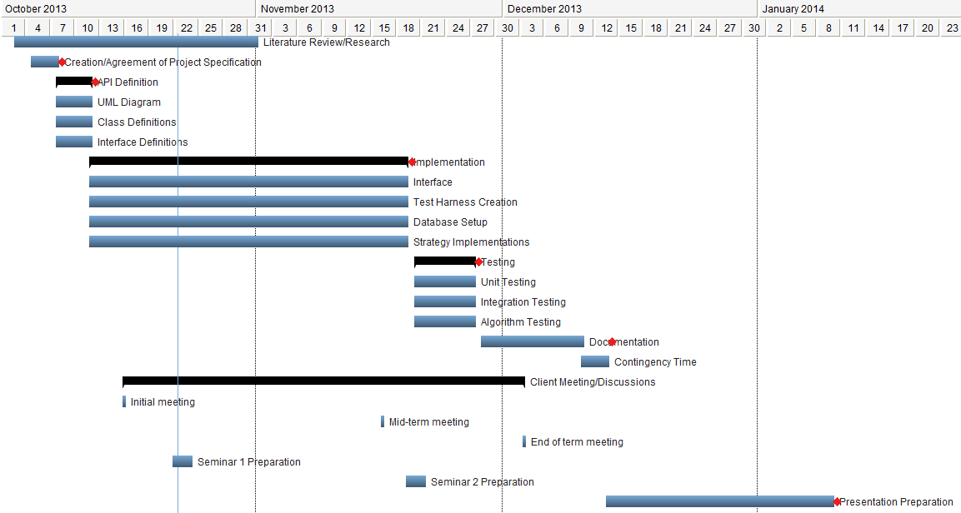
Project Plan

Slide 6
Questions

