Slide 1
LifeGuide GDP
Aleksandar Botev,
Dionisio Perez-Mavrogenis
Kim Svensson
Liam de Valmency
Notes:
~20s
Introduce group, give presentation overview

Slide 2
Overview
Project Introduction
Project Results
Allocation Strategies
System Design
Demonstration
Discussion of Impact
Questions
Notes:
~20s
Introduce group, give presentation overview

Slide 3
Project Introduction
LifeGuide – web based research application for staging online interventions
Randomised control trials
Various allocation strategies
Main problem: LifeGuide logic is convoluted
Notes:
~2 mins
Discuss LifeGuide + problem

Slide 4
Project Results
Self contained software module
Ease of integration
Intuitive trial setup
Algorithmic variety
Verifiable correctness
Notes:
~1 mins
Discuss goals

Slide 5
Allocation Strategies
Simple randomisation

Slide 6
Allocation Strategies
Blocked randomisation

Slide 7
Allocation Strategies
Stratification

Slide 8
Allocation Strategies
Minimisation

Slide 9
Software Design
Modularity and ease of integration
Self contained module
Provided basic integration code
Extensibility
Strategy interface
Flexibility
Database interface
Robustness

Slide 10
Demonstration

Slide 11
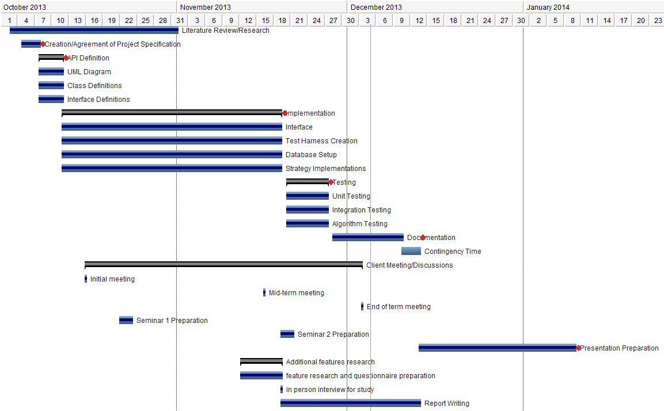
Project Management
Notes:
First few weeks: research + gather requirements
Requirements informed design process, more complex than we thought at the outset
Implementation How we did it as a group (sessions, version control etc.) Meeting with people etc. Quick progress leading to extension work
Testing, user acceptance => iteration on some implementation details
Final group work, i.e. report/presentation preparation

Slide 12
Discussion and Impact
Academic applications
Actively used in the School of Psychology
Trials with up to 15,000 participants
Commercial applications
Highly expensive
Restrictive for small trials
Not open source

Slide 13
Questions

