Slide 1
LifeGuide
Team:
Aleksandar Botev
Dionisio Perez-Mavrogenis
Kim Svensson
Liam de Valmency

Slide 2
Project Overview
LifeGuide – web based research application for staging online interventions
Randomised control trials
Main problem: LifeGuide logic is convoluted
Main goal: Self contained software module for allocating trial participants

Slide 3
Project Impact
Academic applications
Actively used in the School of Psychology
Trials with up to 15,000 participants
Commercial applications
Highly expensive
Restrictive for small trials
Not open source

Slide 4
Progress Recap
Literature review
Interface definitions
Initial algorithm implementations
Basic local database
Basic unit tests

Slide 5
Project Progress
Algorithm refinement and finalisation
Iterated database design
Integration considerations
Testing
Questionnaire
User study
Offline application
Documentation

Slide 6
Software Topology
SQL
Binary Storage
Flat File
Application Interface
LifeGuide
Our GUI Frontend
Storage Interface
Our Software Module
Block Randomisation
Minimisation
Further Strategies
Simple Randomisation
Strategy Interface

Slide 7
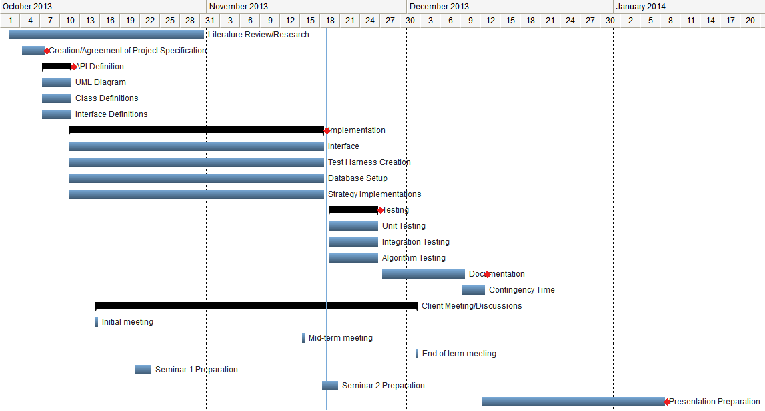
Project Plan

Slide 8
Questions

