Slide 1
Containers Everywhere* in Azure!
Jordan Bean and Matt Ruma
* Almost everywhere in Azure
Notes:
Welcome!
[ACTION] Jordan and Matt introduction

Slide 2
Session learning objectives
At the end of this session, you should be better able to…
Containerize .NET Core apps
Deploy containers with GitHub Actions to different container hosting options in Azure :
App Services for Containers
Azure Container Instances (ACI)
Azure Kubernetes Service (AKS)
Azure Container Apps (ACA)
Choose the right hosting option for your containers
If you want to follow along with the code and files, check out
the GitHub repository at https://aka.ms/containers-everywhere-in-azure
Notes:
In this session we are going to help a fictional company, Board Game Nerd, explore migrating their applications to containers.
We tried to make it as simple as possible.
Focused on the most popular hosting options, and in our opinion, the most viable, for containers in Azure.
Before we get started, let’s take a quick look at the GitHub repository.
The GitHub repository has the instructions for how setup the environment in your Azure subscription.
[ACTION] In the Browser, show https://aka.ms/containers-everywhere-in-azure, the README.md file, the required Secrets and the Environment file.
[ACTION] In the Browser, show https://github.com/mattruma/containers-everywhere-in-azure/actions
[ACTION] In the Browser, show https://github.com/cardinalby/export-env-action GitHub action that reads variables from a file and loads them as Environment variables.

Slide 3

We won’t talk about
Virtual Machines
Azure Batch
Azure Functions
Azure Service Fabric
Azure Spring Cloud
Azure Red Hat OpenShift
Notes:
These are other hosting options in Azure, but we won’t talk about those today.

Slide 4

Background
BoardGameNerd is an online resource and community that aims to be the definitive source for board game and card game content.
BoardGameNerd features reviews and ratings from board game nerds around the world.
BoardGameNerd is new to containers and would like to get a better understanding of what it would take to containerize their applications and explore container hosting options in Azure.
Notes:
Back to our fictional company, Board Game Nerd.
[ACTION] In the Browser, show https://mjrbgnappdemo.azurewebsites.net

Slide 5
Objectives
Review current application architecture
Containerize current applications
Create Docker Files
Deploy to Azure Container Registry (ACR)
Explore Azure hosting options for containers
Web App for Containers
Azure Container Instances (ACI)
Azure Kubernetes Service (AKS)
Azure Container Apps (ACA)
Choose the right container hosting option

Slide 6




Review current application architecture
Server
BoardGameGeek JSON API
Internet
App Service
Plan
Client
Application
Insights
Diagnostics Logs
Notes:
The current environment hosted in Azure; apps are running as Azure App Services.
[ACTION] In the Browser, show https://mjrbgnappapp.azurewebsites.net
[ACTION] In the Browser, show https://mjrbgnappconapi.azurewebsites.net/swagger/index.html
Both applications are written in .NET 6.
The Server application, or API, is a .NET Core Minimal API.
Minimal APIs are architected to create HTTP APIs with minimal dependencies. They are ideal for microservices and apps that want to include only the minimum files, features, and dependencies in ASP.NET Core.
We are leveraging App Settings to store configuration.
[ACTION] In the Azure Portal, show the App Services and the Configuration settings for the Client and Server applications.
Both the Client and Server applications have application settings for the instrumentation key of the Application Insights resource.
The Client application has an additional application setting for the endpoint of the API.
[ACTION] In the Browser, show Program.cs and builder.Configuration.AddEnvironmentVariables() this loads application settings into the Environment variables.
Using Environment Variables, so don’t have to make any code changes. The applications can run on an App Service where the configuration is pulled directly from the App Settings, or as a container, where the App Settings are injected as Environment Variables.
Looked at the current environment, seems straight forward, frontend application and a backend api calling a downstream api.
Currently BGN averages 1,000 requests a day and is looking to double those requests every two months for the next two years.

Slide 7
Containerize current applications
What is a container?
Why containers?
What is Azure Container Registry (ACR)?
Create containers
Deploy containers to ACR
Tagging strategies, why we chose the one we did?
Notes:
Before we get too deep, we thought it wise to spend some time with BGN developers upfront.
Explain what a container is and the “real” reason why moving to containers might be a good move for them.

Slide 8
What is a container?
A standard unit of software that packages up code and all its dependencies
Run quickly and reliably from one computing environment to another
Includes everything needed to run the application: code, runtime, system tools and libraries as well as settings
Multiple containers are run by a single OS kernel, therefore are more lightweight than virtual machines

Slide 9
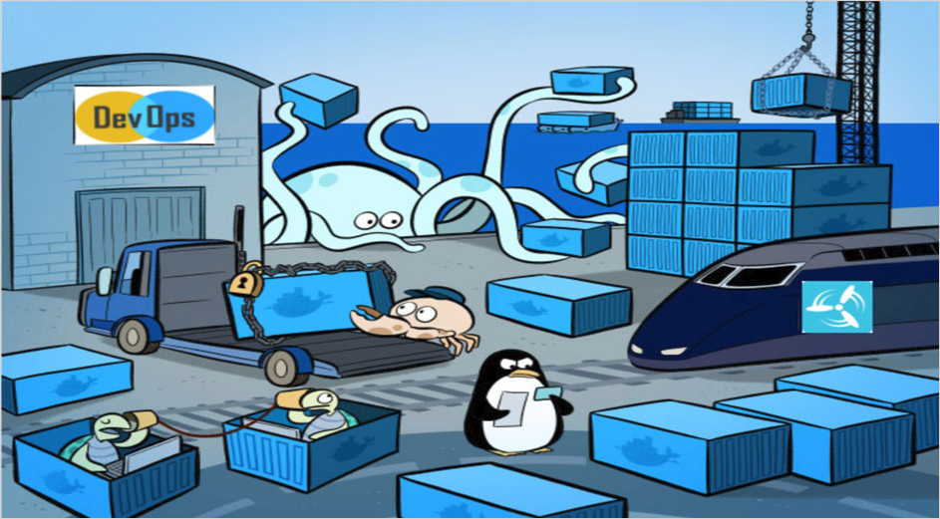
Why containers?
Flexible
Lightweight
Interchangeable
Portable
Scalable
Stackable
Notes:
Flexible: Even the most complex applications can be containerized.
Lightweight: Containers leverage and share the host kernel.
Interchangeable: You can deploy updates and upgrades on-the-fly.
Portable: You can build locally, deploy to the cloud, and run anywhere.
Scalable: You can increase and automatically distribute container replicas.
Stackable: You can stack services vertically and on-the-fly.

Slide 10
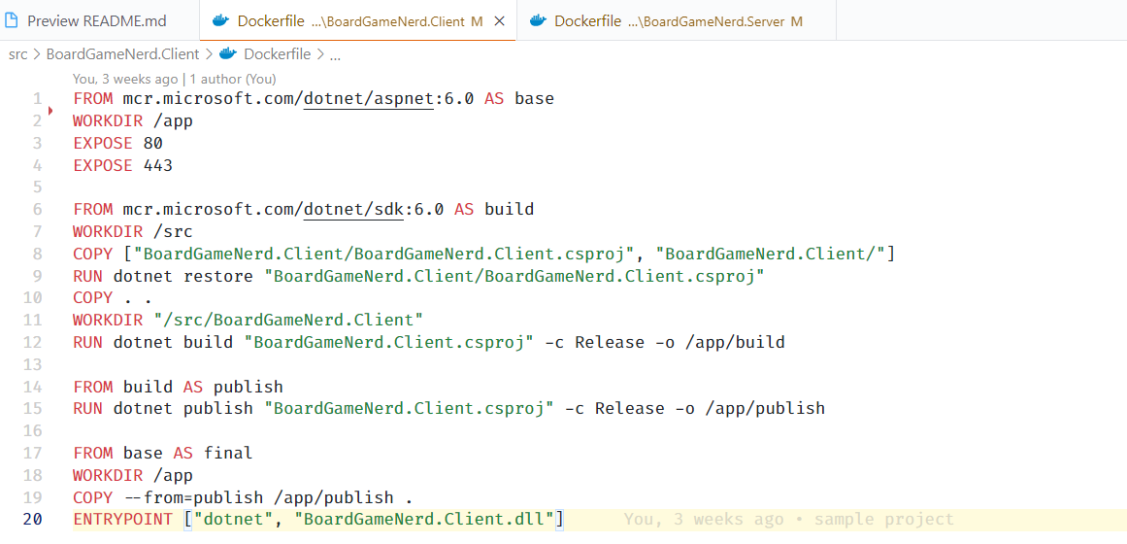
Create containers
In the folder of each project create a Dockerfile
Start with a base image
Run the standard .NET restore, build and publish commands
Copy to the files to a folder on the container
ENTRYPOINT, tells Docker to configure the container to run as an executable
When the container starts, the ENTRYPOINT command runs
Notes:
[ACTION] In VS Code, show the Docker file for the Server Dockerfile and the Client Dockerfile

Slide 11

What is Azure Container Registry?
Azure Container Registry is a managed, private Docker registry service
Use with your existing container development and deployment pipelines or use Azure Container Registry Tasks to build container images in Azure
Pull images from an Azure container registry to various deployment targets:
Scalable orchestration systems that manage containerized applications across clusters of hosts, including Kubernetes
Azure services that support building and running applications at scale, including Azure Kubernetes Service (AKS), App Service, and others
https://docs.microsoft.com/en-in/azure/container-registry/container-registry-intro
Notes:
A container registry is a resource for storing containers.
Azure Container Registry is a managed, private Docker registry service based on the open-source Docker Registry 2.0.
Create and maintain Azure container registries to store and manage your private Docker container images and related artifacts.
Use Azure container registries with your existing container development and deployment pipelines or use Azure Container Registry Tasks to build container images in Azure.
Build on demand, or fully automate builds with triggers such as source code commits and base image updates.
Pull images from an Azure container registry to various deployment targets:
Scalable orchestration systems that manage containerized applications across clusters of hosts, including Kubernetes, DC/OS, and Docker Swarm.
Azure services that support building and running applications at scale, including Azure Kubernetes Service (AKS), App Service, Batch, Service Fabric, and others.
Developers can also push to a container registry as part of a container development workflow.
Configure ACR Tasks to automatically rebuild application images when their base images are updated, or automate image builds when your team commits code to a Git repository. Create multi-step tasks to automate building, testing, and patching multiple container images in parallel in the cloud.
Azure provides tooling including Azure Command-Line Interface, Azure portal, and API support to manage your Azure container registries.
Optionally install the Docker Extension for Visual Studio Code and the Azure Account extension to work with your Azure container registries. Pull and push images to an Azure container registry, or run ACR Tasks, all within Visual Studio Code.
https://docs.microsoft.com/en-in/azure/container-registry/container-registry-intro

Slide 12
Deploy containers to Azure Container Registry
Pick a container tagging strategy
We used two tags for each container that we pushed
One tag is the version number, e.g., 1.0 or 2.0
The other tag is latest
All our container deployments to various hosting options will pull from the latest tag
See the GitHub workflow to build and push containers to Azure Container Registry
Notes:
Use stable tags to maintain base images for your container builds.
A framework team ships version 1.0. They know they’ll ship updates, including minor updates. To support stable tags for a given major and minor version, they have two sets of stable tags.
1 – a stable tag for the major version. 1 represents the “newest” or “latest” 1.* version.
1.0- a stable tag for version 1.0, allowing a developer to bind to updates of 1.0, and not be rolled forward to 1.1 when it is released.
The team also uses the :latest tag, which points to the latest stable tag, no matter what the current major version is.
We are using the :latest tag for all our container deployments.
[ACTION] In VS Code, show the 04-containers.yaml and break it down. Look at a run.
Is there a way to build the image once and push to Docker as a different tag? Not sure, but if there was, would save some build time.
[ACTION] In the Azure Portal, show the repositories and images in the Azure Container Registry.
Now that we have our images in the Azure Container Registry, we are ready to start deploying them to various Azure Hosting Options.
Jordan will now walk us through how to deploy our containers.

Slide 13
Host in Web App for Containers
Easily deploy and run containerized applications that scale with your business
Fully-managed platform to perform infrastructure maintenance
Built-in auto scaling and load balancing
Streamline CI/CD with Docker Hub, Azure Container Registry, and GitHub
https://azure.microsoft.com/en-us/services/app-service/containers
Notes:
Look at infrastructure and code deployments.
[ACTION] In VS Code, review infra/compute/app-service-container/app-service-container.bicep and .github/workflows/05-app-service-container-infra.yaml
[ACTION] In VS Code, review .github/workflows/05-app-service-container-code.yaml

Slide 14
Host in Azure Container Instances (ACI)
Focus on designing and building your applications instead of managing the infrastructure that runs them
Use ACI to provision additional compute for demanding workloads whenever you need
Provides fast, isolated compute to meet traffic that comes in spikes, without the need to manage servers
Must deploy infrastructure each time, no “real” separate code deployment
No https out of the box, see Enable a TLS endpoint in a sidecar container or Enable HTTPS using Application Gateway
https://azure.microsoft.com/en-us/services/container-instances
Notes:
Look at infrastructure and code deployments.
[ACTION] In VS Code, review infra/compute/aci/aci.bicep and .github/workflows/07-aci-infra-and-code.yaml
[ACTION] In VS Code, review .github/workflows/07-aci-infra-and-code.yaml

Slide 15
Host in Azure Kubernetes Service (AKS)
Built-in best practices
Receive proactive and actionable recommendations for securing resources, maintaining cluster hygiene, and increasing operational efficiency.
Enterprise support
Get support from Kubernetes Certified Service Providers and a self-service experience for faster diagnostics and troubleshooting.
Multilayer security
Implement hardened security and layers of isolation across compute resources, data, and networking.
Unified management
Enable consistent configuration and governance across clouds, on-premises, and the edge with Azure Arc.
https://azure.microsoft.com/en-us/overview/kubernetes-on-azure
Notes:
Look at infrastructure and code deployments.
[ACTION] In VS Code, review infra/compute/aks/ and .github/workflows/09-aks-infra.yaml
[ACTION] In VS Code, review .github/workflows/09-aks-code.yaml

Slide 16
Host in Azure Container Apps (ACA)
Optimized for running general purpose containers, especially for applications that span many microservices deployed in containers
Powered by Kubernetes and open-source technologies like Dapr, KEDA, and envoy
Supports Kubernetes-style apps and microservices with features like service discovery and traffic splitting
Enables event-driven application architectures by supporting scale based on traffic and pulling from event sources like queues
Support of long running processes and can run background tasks
Doesn't provide direct access to the underlying Kubernetes APIs
Must deploy infrastructure each time, no “real” separate code deployment
Excellent SPARK talk Why Are Azure Container Apps And Serverless Containers A Game Changer For Customers
https://azure.microsoft.com/en-us/services/container-apps
Notes:
Look at infrastructure and code deployments.
[ACTION] In VS Code, review infra/compute/aca/aca.bicep and .github/workflows/08-aca-infra-and-code.yaml
[ACTION] In VS Code, review .github/workflows/08-aca-infra-and-code.yaml

Slide 17
Choose the Right Container Hosting Option
If You Want To | Use This
Deploy and scale containers on managed Kubernetes Microservices, DAPR, KEDA, etc. | Azure Kubernetes Service (AKS)
Build and deploy modern apps and microservices using serverless containers Microservices, DAPR, KEDA, etc. | Azure Container Apps
Run containerized web apps on Windows and Linux Small Workloads, Monoliths | Web App for Containers
Launch containers with hypervisor isolation AKS Bursting, Development and Test | Azure Container Instances
https://docs.microsoft.com/en-us/azure/container-apps/compare-options
Notes:
Hosting option may change, if apps containerized properly, little to no changes to move to a different hosting option
Environment Variables – Set appropriately based on hosting environment
Which options support DAPR? AKS, ACA and VM
https://docs.microsoft.com/en-us/dotnet/architecture/modernize-with-azure-containers/modernize-existing-apps-to-cloud-optimized/choosing-azure-compute-options-for-container-based-applications
https://techcommunity.microsoft.com/t5/azure-architecture-blog/running-containers-on-azure-all-options-explained/ba-p/1795938
https://docs.microsoft.com/en-us/dotnet/architecture/modernize-with-azure-containers/modernize-existing-apps-to-cloud-optimized/when-to-deploy-windows-containers-to-azure-vms-iaas-cloud

Slide 18
Choose the Right Container Hosting Option
Azure Container Instances
Azure App Service
Azure Container Apps
Azure Kubernetes Service
Complexity

Slide 19
Session learning objectives
Containerize .NET Core apps
Deploy containers with GitHub Actions to different container hosting options in Azure :
App Services for Containers
Azure Container Instances (ACI)
Azure Kubernetes Service (AKS)
Azure Container Apps (ACA)
Choose the right hosting option for your containers

Slide 20


Slide 21
Final Thoughts
GitHub Repository
https://aka.ms/containers-everywhere-in-azure
Links
Azure Container Registry
App Service - Web App for Containers
Azure Container Instances (ACI)
Azure Container Apps
Azure Kubernetes Service (AKS)
Contact Us
Jordan Bean Cloud Solution Architect jordanbean@microsoft.com
Matt Ruma Cloud Solution Architect maruma@microsoft.com

Slide 22
Thanks!

