Slide 1
Cisc366: Multi-Agent Systems
CTAEMS Problem generation controller

Slide 2
Outline
Multi-Agent Systems
CTAEMS
My Research
The Project

Slide 3
Multi-Agent systems

Slide 4



Why Multi-agents?
An intelligent agent is a persistent entity capable of flexible, autonomous action in some environment. "Flexibility" includes proactive, reactive, and social behavior: - proactive: it decides how it should achieve its goals - reactive: it reacts to changes in its environment - social: in general, it can't achieve goals by itself

Slide 5
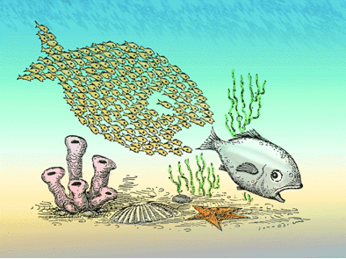
Example

Slide 6
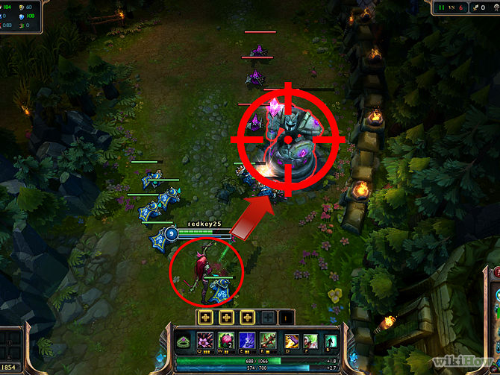
Example
Cooperating, but self-interested
5 vs. 5 Adversarial environment
Agent Capabilities/Performance change over time
Partially Observable Dynamic Environment

Slide 7
Other Examples
Robotic soccer teams (or rescue teams)
Cars, such as electric cars, which collaborate to sell electricity regulation capability to the power grid (V2G: effectively behaving as a large virtual battery)
Buying/selling stocks or bidding for Google AdWords

Slide 8
CTAEMS
A Framework for Coordination, Task Analysis, Environment Modeling, and Simulation.

Slide 9
Hierarchical structure
Leaves are methods (aka “actions”) that can be executed by the agent.
Actions take duration to complete and produce a final quality/reward/value
Non-leaves are tasks/goals: children are “subtasks”
Each Non-leaf node has a Quality Accumulation Function (QAF), such as “and”, “or”, “sum,” and others (be abstract)
And indicates every subtask needs to be completed in order for the task to be completed
Or indicates that one subtask needs to be completed in order for the task to be completed

Slide 10
Non-local effects (NLE’s)
Enables: Indicates that doing one task allows you to do another task
Disables: Indicates that doing one task allows you to never do another task
Facilitates: Indicates that doing one task helps you do another task
Hinders: Indicates that doing one task makes it harder to do another task (can be represented as a negative value of fascilitation)

Slide 11
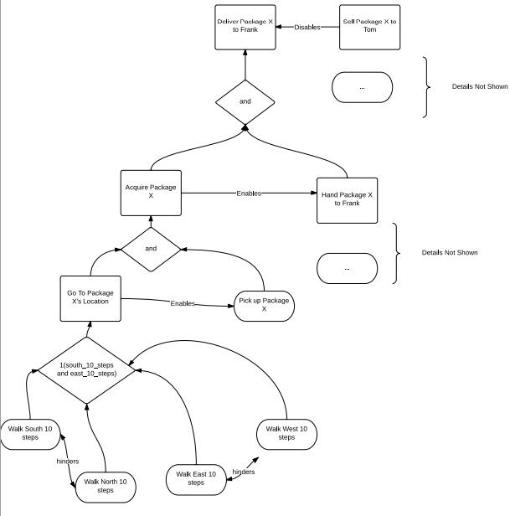

Slide 12
My Research
prescheduling

Slide 13
Interested in
AI applied to MAS Scheduling: Prescheduling, Model Staleness, Adaptive Contingency Planning. (Smoothing away uncertainty)
Prescheduling: The act of scheduling a task prior to its known arrival time. If I preschedule, can it be useful? If so, how well does the predictive model have to be to have gain?
Model Staleness: If everyone has a predictive model of a task set, how quickly does it become outdated? How much communication is needed to prevent loss? How does the qualities of each agent’s model affect the system?
Adaptive Contingency planning: If I know what other agents are doing and a problem happens, how can we adapt rather than communicate?

Slide 14
The Project
CTAEMS Problem Generation Controller

Slide 15
Motivation
Large project that integrates with an even larger project.
That is : You will be working on a 1) Problem Generation Controller that creates input to 2) a MAS Simulator that communicates with 3) different kinds of agents.
Hands-on experience with developing state-of-the-art technology
Learn leading software engineering techniques.
Helps a fellow UD student.

Slide 16
Problem Generation Controller
Constitutes of:
Task Set Controller
what are the tasks that need to be done
How many subtasks?
How connected is the task set? NLE’s
Deadline Tightness, Load, Payoffs (make abstract if can if decide to consider other variables)
Agent-Belief Interface Controller
What are the initial beliefs? (static)
When are certain beliefs introduced/Quality? Need Pay for a belief (dynamic)

Slide 17
CTAEMS Task Set Controller
Controls how many tasks and how many of their respective subtasks, and connectedness (NLE’s)
Needs to be able to create/modify task sets to/from file (using a preset grammar)
Example : <taskname>:{<subtask_1>,…<subtask_n>}, <QAF>, [NLE_1,…NLE_n]
Auto generate task sets based on how many tasks, and how many subtasks they have using uniform, random, Gaussian, and Bi-modal (with their respective inputs , for example Gaussian needs to have a mean and an Standard Dev) and be able to be modified by user-input. Can possibly use sliders.
Be able to auto-generate/control NLE’s via 4 probability sliders (enable, disable, facilitates, facilitates magnitude) that represent the probability to be connected to other tasks.(example, .2 enablement means that the task enables on average 20 out of every 100 tasks)
Need to be able to graphically see/modify the NLE’s and task sets. (example. click a button to destroy 10% of the enablement relationships)

Slide 18
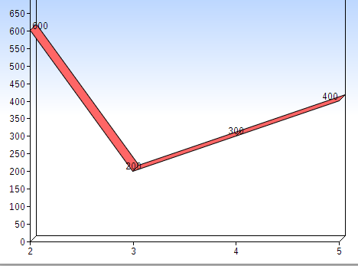
Task Set Controller
Controls Rewards, deadline tightness, and load of tasks
Want to be able to manually click values on graph.
For anything individually task related (reward, deadline tightness), let’s say reward, I want to click on point (3,200) for any task that arrives at time 3, the reward should be 200. If any task that arrives at time 4, then the reward should be 300.
For anything taskset related (load), similarly for load, if the time = 2, the load is 600, time = 3 the load = 200, etc.
Preset curves (uniform, random, Gaussian, Bi-modal) should be auto-generate for these two controllers (with their respective inputs, for example Gaussian needs to have a mean and an Standard Dev) and be able to be modified by user-input.

Slide 19
Agent-Belief Controller
Initially: all agents have beliefs of whatever tasks are known at the present time. Nothing can be learned (no information gathering) prior.
If have time, a controller which skews (random, Gaussian, manual etc) the task information (reward, constraints, etc) from the task set.

