Slide 1




CIS3187 (5 ECTS) Coursework Coursework 2019-20
John Abela
Department of CIS
Faculty of ICT
University of Malta
john.abela@um.edu.mt
+ 365 79367936
Room 1A/27
FICT Building
©John Abela 2019-2020
Faculty of
ICT
Department of
Computer Information Systems
Last Updated
02-Nov-2019

Slide 2




CIS 3187 Coursework Implementing a Multi-Layer Perceptron
Coursework
2019-20
Important Note!
Students taking CIS3087 are advised that, although they do not have to implement a multi-layer perceptron in code, they have to understand how error back propagation works.
There is always a question about neural networks in the CIS3087 & the CIS 3187 exams.
It is therefore probably not wise to not pay attention to this presentation.
ICT

Slide 3


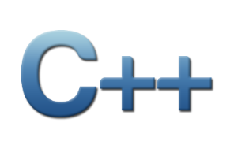




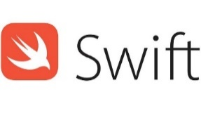


CIS 3187 Coursework Deliverables (1) Implementing a Multi-Layer Perceptron
Coursework
2019-20
The objective of this assignment is to learn how artificial neural networks work and how to implement a multi-layer perceptron in a high-level language trained using the error back propagation algorithm.
Implement an artificial neural network that learns a Boolean function. The Boolean function must map 5 bits into 3 bits. You must create a Boolean function yourself in a spread sheet. You will have 32 inputs and output. Randomly choose 26 of the input-output pairs for training and the rest for testing.
The neural network must have 5 input neurons, 4 hidden neurons, and 3 output neurons. Use the Sigmoid transfer function, 0.2 error threshold and 0.2 learning rate. You are encouraged to experiment with more hidden neurons.
Implement the Error Back Propagation algorithm for training the weights.
You must use a high-level language such as C++, C, Java, C#, Swift, Objective-C, Go, Python, Rust, or Scala.
ICT

Slide 4

CIS 3187 Coursework Deliverables (2) Implementing a Multi-Layer Perceptron
Coursework
2019-20
You may not use Python AI or Machine Learning packages. The implementation must be your own. You can, however, use matrix/vector arithmetic packages such as NumPy or Pandas.
You must plot the bad facts vs the epochs graph to show convergence.
You can use RapidMiner (instead of writing and implementing your own neural network) but the marking will then be out of 50%. If you are going to use RapidMiner then implement a 5 to 1 Boolean function.
Documentation must include source code, data sets, epochs graph, problems encountered, choices made, testing results, plus any comments you wish to make.
The network should converge in less than 1000 epochs.
ICT

Slide 5
Submission Deadline and Notes
Coursework
2019-20
Deadline is Monday 13th January, 2020 at Noon.
Do not forget the Plagiarism Declaration Form which must be signed.
Do not forget a Statement of Completion
Submit the printed coursework to the secretary of the Department of CIS. You must also upload the assignment, as a single Word or PDF file to Turnitin. You must include all the code in this document. Put soft copy of the document, all code, data, and binaries on a CD or DVD. Pendrives may not be returned.
Drawings and images in the documentation are encouraged. Font must be Calibri 11pt.
You can quote other work as long as this is clearly indicated.
If you use images from 3rd parties simply caption with ‘reproduced from…’
Make sure you include your full name, ID or passport number, and the degree programme.
You may work in groups as long as the work you submit is your own and only your own.
ICT

Slide 6


Help & Contact Hour
Coursework
2019-20
If you get stuck ask for a contact hour.
This is strictly for problems of an academic nature.
My email is john.abela@um.edu.mt
In emergencies my mobile is 79367936. Please text before calling.
Please note that I cannot do debugging.
ICT

