Slide 1
HERO METRIC
Profiler-guided optimization turns 147,734 cycles into 1,184.
The win is a systematic ladder: remove work, specialize, vectorize, expose independence, then schedule the machine.
124.8x faster
147,734 cycles
>
1,184 cycles
fixed grader workload
10
cumulative presentation stages
0
1
2
3
4
5
6
7
8
9
largest drop: stage 4 vectorization
stage 8 VLIW scheduling
Every checkpoint is cumulative and correctness-preserving.
Trace interpretation drives the next optimization, not a one-off trick.
1

Slide 2
PROBLEM
Batched binary tree traversal is a repeated value/index update.
Each of 256 inputs walks a perfect tree for 16 rounds and must match the reference final values.
Perfect binary tree: depth 0 through depth 10
One round dataflow
>
d0
highlighted path
>
>
value + index
>
node lookup
>
hash/mix
>
branch bit
d1
d1
>
>
>
>
d2
d2
d2
d2
v
next index + next value
>
collapsed lower tree
depths 3...10 contain the remaining nodes; the slide shows concept, not all 2,047 nodes.
batch_size = 256 independent inputs
depth sequence: 0,1,2,3,4,5,6,7,8,9,10,0,1,2,3,4
2

Slide 3
MACHINE MODEL
One cycle issues a bounded VLIW packet across five engines.
Perfetto traces show which engine slots are busy over time; blank regions are idle capacity or dependency bubbles.
Per-cycle issue packet
ALU
VALU
LOAD
STORE
FLOW
ALU: scalar arithmetic, comparisons, address math
VALU: vector arithmetic across 8 lanes
LOAD: memory reads
STORE: memory writes
FLOW: control operations
Trace strip: slot filled = issued operation
ALU
VALU
LOAD
STORE
Dense bars mean useful issue bandwidth.
Blank gaps mean idle engine slots or dependency stalls.
3

Slide 4
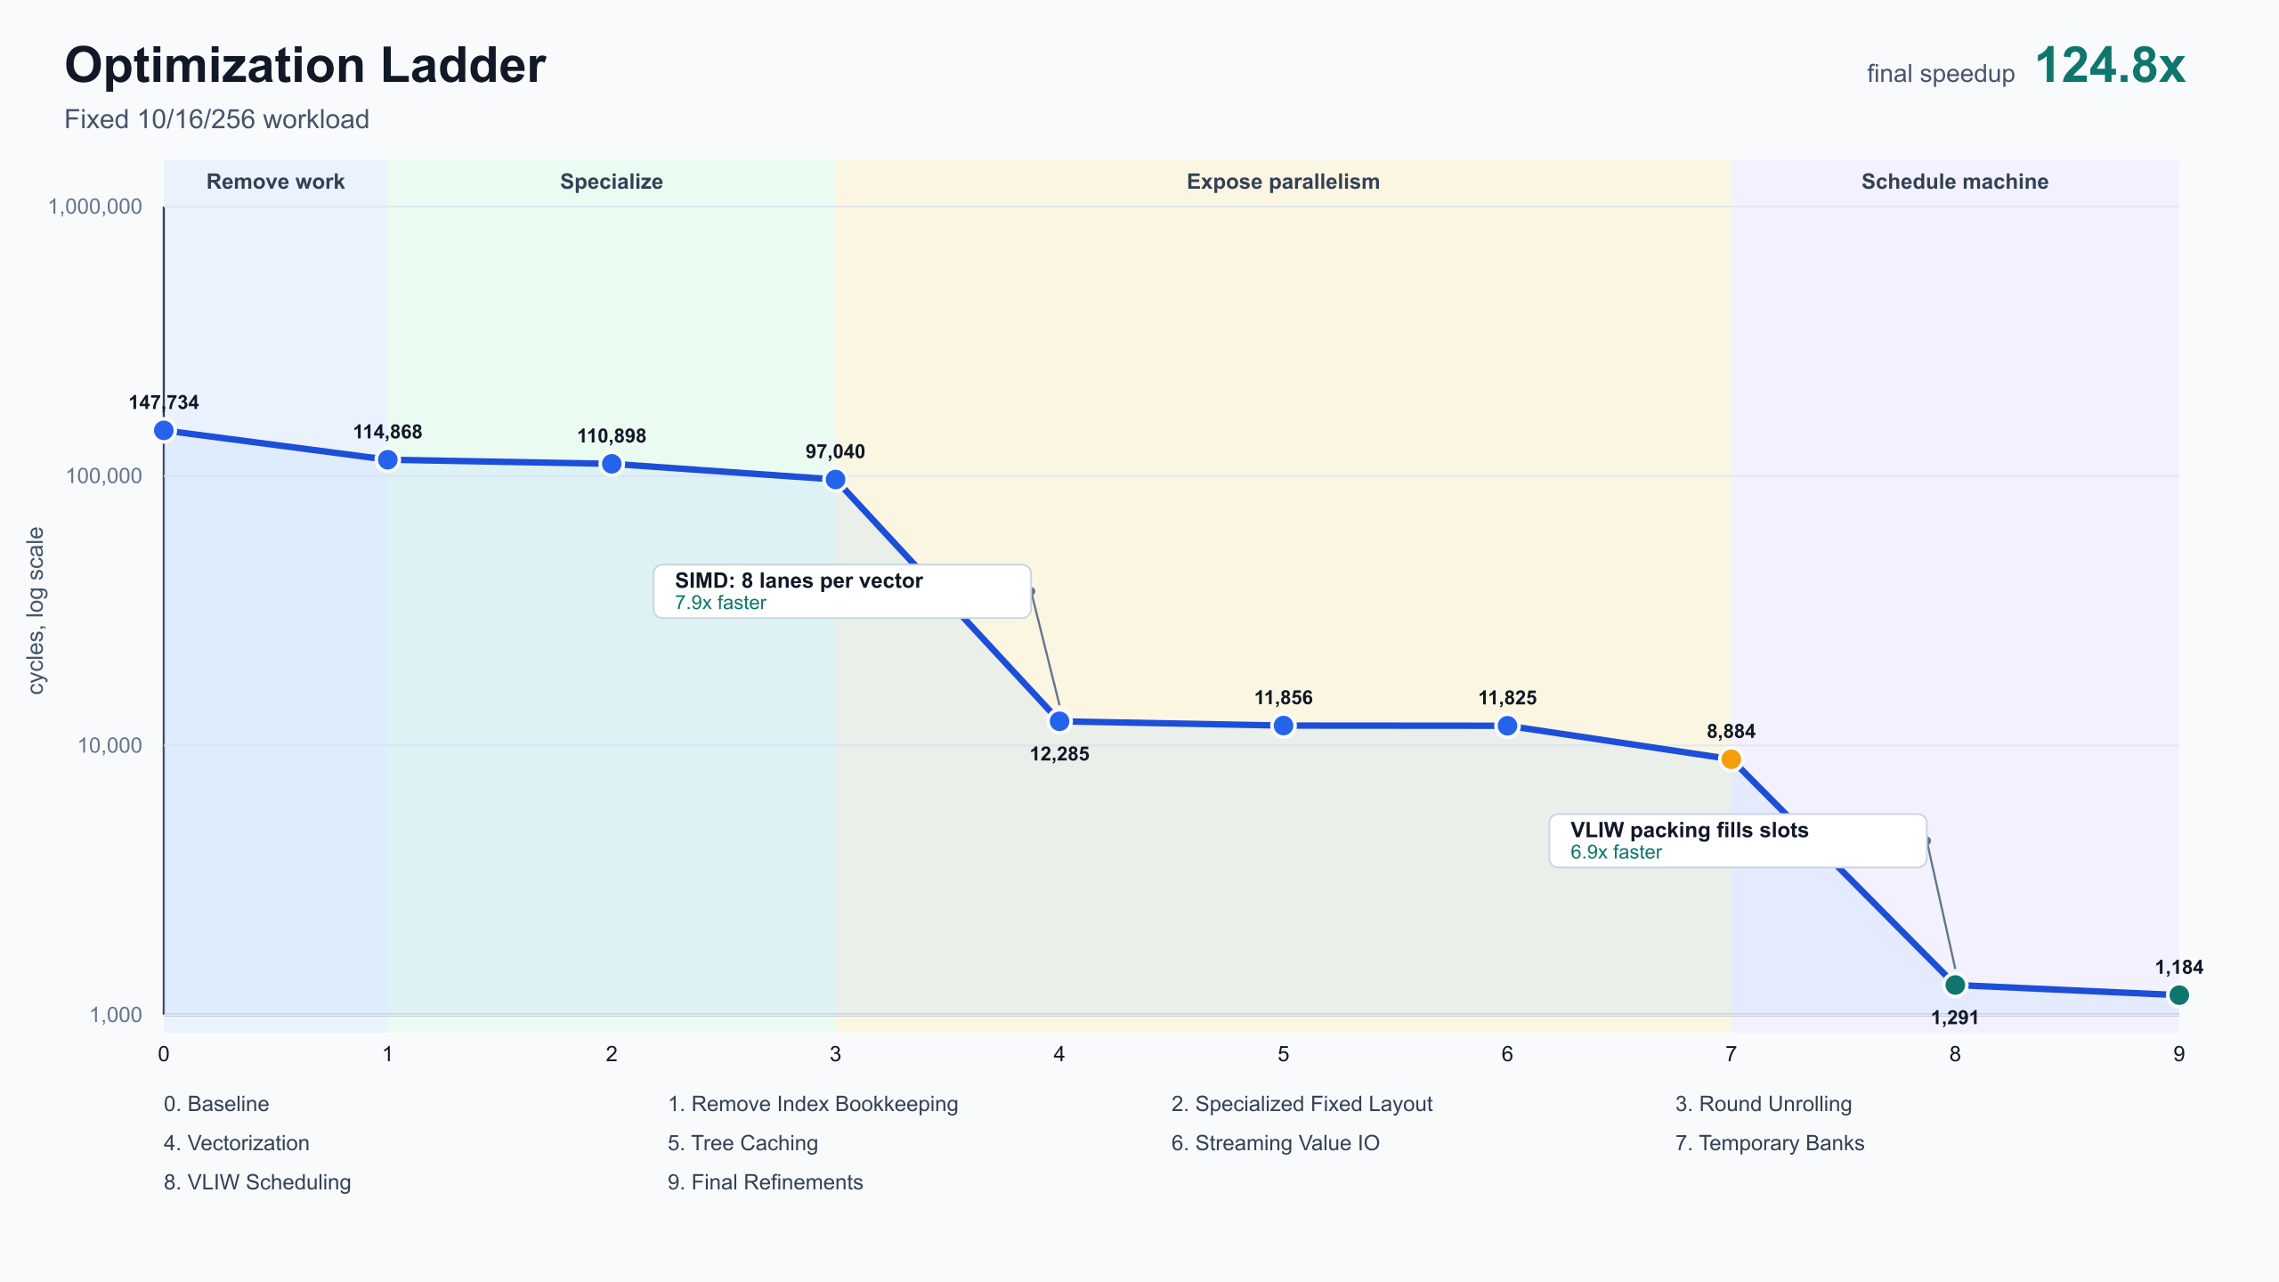
ROADMAP
The roadmap is cumulative progress, not independent ablations.
The story moves from removing waste to changing program shape, then scheduling the exposed work.
97,040 -> 12,285
stage 4 vectorization
8,884 -> 1,291
stage 8 VLIW scheduling
First remove work that the grader does not require.
Then exploit fixed workload shape and SIMD batching.
Finally pack ready operations under engine slot limits.
remove work
specialize
vectorize + memory
expose work
schedule
4

Slide 5
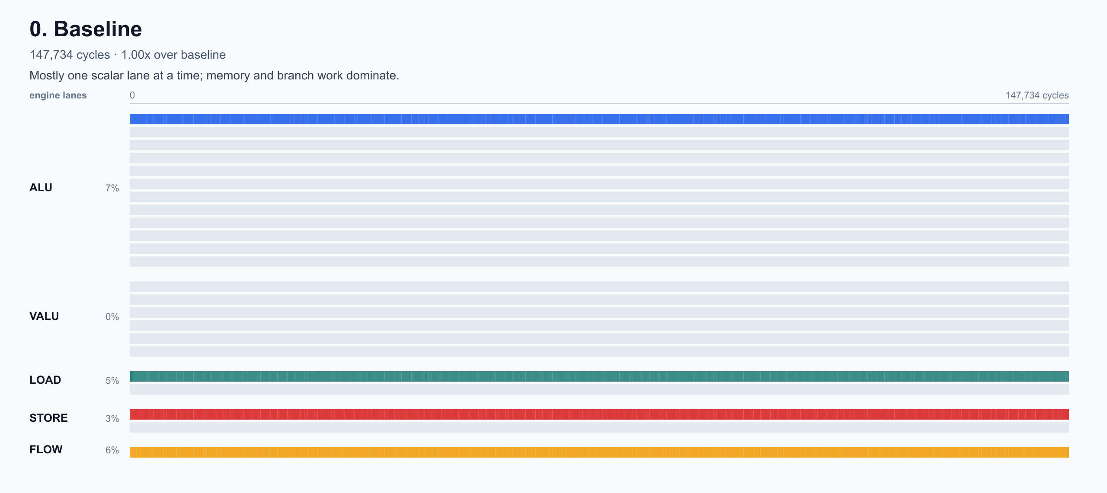
BASELINE
The baseline trace shows serialization and unused machine capacity.
The first trace-reading goal is to separate useful work from bookkeeping, memory traffic, and bubbles.
147,734
baseline cycles
>
scalar lane activity
>
idle VALU capacity
>
index memory traffic
>
dependency/control bubbles
The first goal is to remove bookkeeping and memory traffic before deep scheduling.
5

Slide 6
REMOVE WORK
Index bookkeeping can stay close to compute instead of round-tripping memory.
Stage 1 combines test-contract cleanup with scratch-resident live traversal indices.
147,734 -> 114,868
remove ungraded work + scratch index
Before: memory index traffic every round
After: live scratch index
load index from memory
scratch index
v
v
compute next index
compute next index
v
store index to memory
v
scratch index
final index write
final index write removed
6

Slide 7
SPECIALIZE
Fixed benchmark knowledge turns runtime control into a known 16-step strip.
Specialization and unrolling simplify the kernel while it is still mostly scalar.
114,868 -> 110,898
110,898 -> 97,040
fixed layout
round unrolling
Generic loop
Specialized emitted strip
baked-in pointers / layout constants
read layout
0
>
1
>
2
>
3
>
4
>
5
>
6
>
7
v
check depth
v
8
>
9
>
10
>
0
>
1
>
2
>
3
>
4
loop branch
v
compute
Tradeoff: instruction file grows, but the score is simulator cycles.
7

Slide 8
SIMD
SIMD batching changes 256 scalar walks into 32 vector groups.
The hash pipeline, value update, branch bit, and many index updates become lane-wise vector operations.
97,040 -> 12,285
stage 4 vectorization
one 8-lane vector
s0
s2
s4
s6
>
s1
s3
s5
s7
0
1
2
3
4
5
6
7
lane 0 ... lane 7
vector operation block
256 inputs / 8 lanes = 32 vector groups
hash
value update
branch bit
index update
Trace shifts toward VALU as the main engine.
8

Slide 9
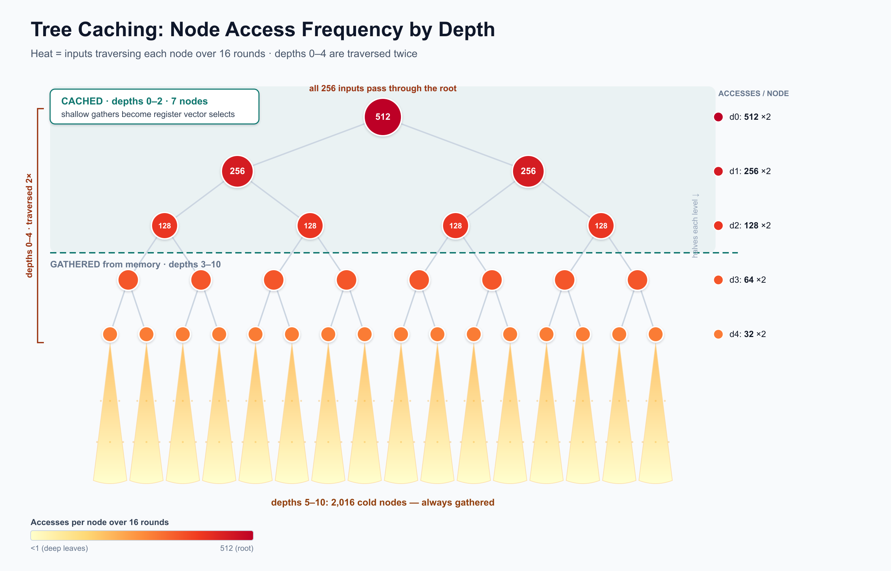
MEMORY
After SIMD, memory pressure moves to hot upper tree nodes.
Caching the shallow nodes and streaming value I/O produce modest but important bottleneck transitions.
12,285 -> 11,856
11,856 -> 11,825
tree caching: 7 hottest nodes
streaming value I/O
Hot upper nodes
LOAD each time
>
scratch cache
vector select
Streaming value I/O
before: scattered address recomputation
>
after: base pointer + stride
9

Slide 10
PARALLEL WORK
Temporary banks expose independent work to the scheduler.
A fully unrolled vector program has independent groups, but reused temp names can make them look serialized.
11,825 -> 8,884
stage 7 temporary banks
Before: false dependency chain
After: independent temp banks
group 1 -> temp bank A
>
vector group 1: temp0 -> temp1
v
vector group 2: temp0 -> temp1
group 2 -> temp bank B
>
v
vector group 3: temp0 -> temp1
group 3 -> temp bank C
>
same scratch names force order
Rename temps to expose independence.
10

Slide 11
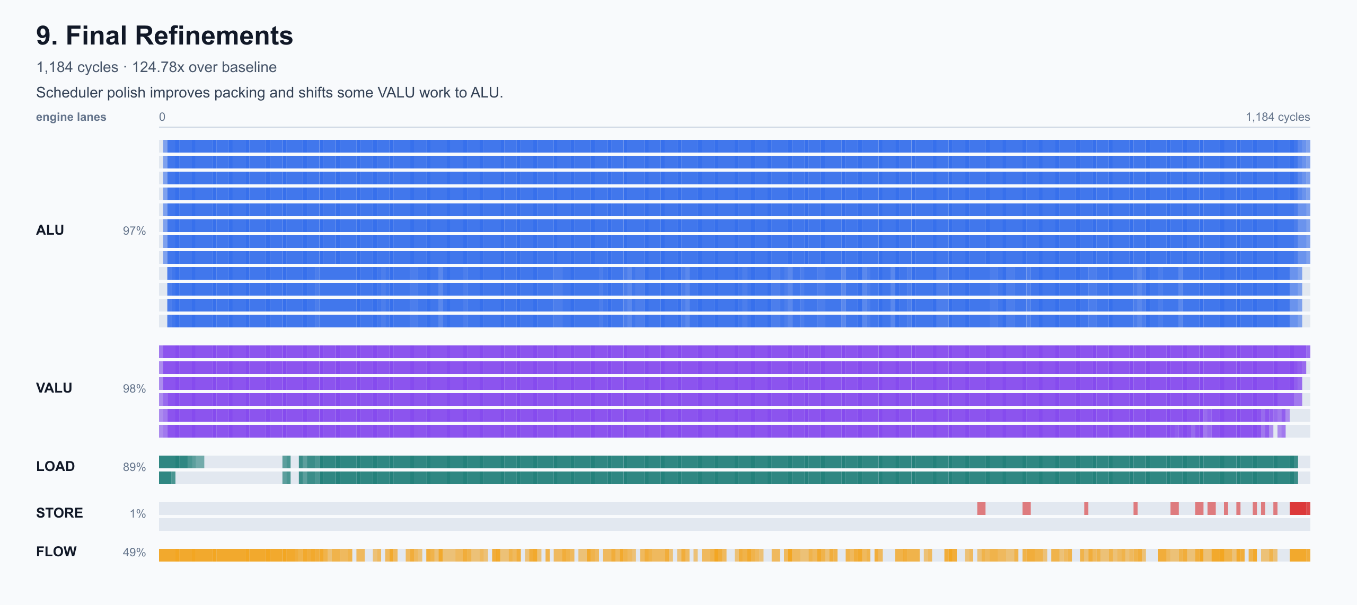
SCHEDULING
A dependency-aware scheduler packs ready ops into VLIW slots.
Each operation has an engine type plus explicit read/write sets; hazards define the legal schedule.
8,884 -> 1,291
1,291 -> 1,184
global VLIW scheduling
final refinements
Dependency DAG
Ready queue
ALU
Packed VLIW packets
RAW
critical path 42
cycle N
LOAD
>
>
WAR
critical path 37
cycle N+1
VALU
critical path 31
STORE
WAW
>
ALU
critical path 20
Inset: dense final trace utilization after safe WAR relaxation and VALU-to-ALU fallback.
11

Slide 12
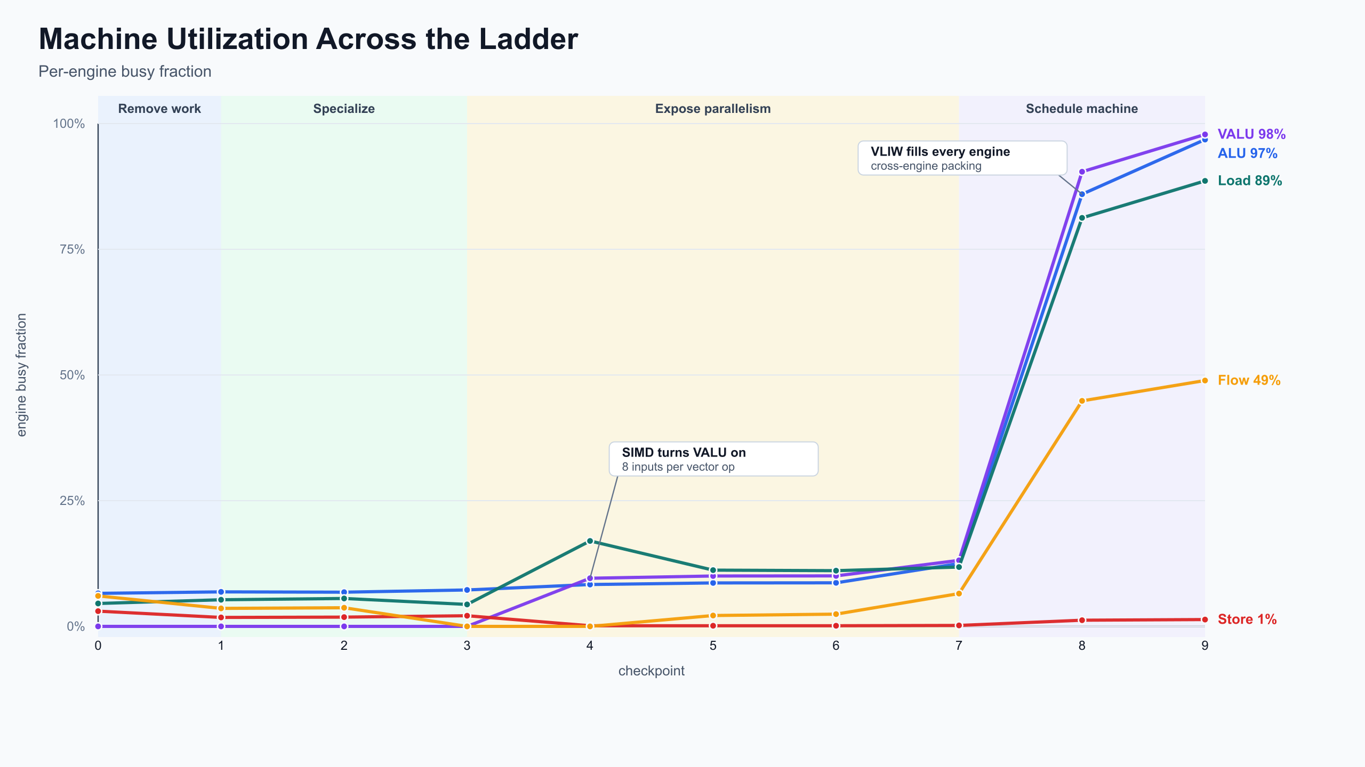
RESULTS
The binding constraint moves as each bottleneck is removed.
Early gains reduce wasted work; late gains are scheduling quality, not just fewer logical operations.
SIMD
VLIW scheduling
124.8x
1,184
>
>
>
serialization
memory pressure
exposed independence
scheduling
final speedup over baseline
final cycle count
12

Slide 13
LIMITATIONS
The final kernel is fast because it is intentionally specialized.
The remaining risks are real compiler-engineering tradeoffs, not mystery performance issues.
Highly specialized workload
Generated code size increases
Assumes forest_height = 10, rounds = 16, batch_size = 256, and stable memory layout.
Unrolling and specialization remove runtime overhead but produce a larger instruction stream.
Scheduler is heuristic
Scratch allocation is manually tuned
Profiler interpretation is still manual
Dependency analysis and priority rules guide packing, but this is not an optimal solver.
Temp banks expose parallelism; a full liveness-aware register-coloring pass is still future work.
Perfetto traces guided the path, but bottleneck classification and goodput metrics are not fully automated.
13

Slide 14
NEXT STEPS
Next steps generalize the hand-built ladder into a compiler pipeline.
The formal dependency graph is the anchor: it supports correctness, allocation, and schedule search.
trace metrics
>
dependency graph
>
register coloring
>
scheduler search
>
verified VLIW program
goodput
hazards
liveness
engine slots
verification
<
>
feedback from traces
Formal dependency model
Represent every instruction as a graph node with explicit reads, writes, engine constraints, and RAW/WAR/WAW edges.
14

