Slide 1
Profiler-Guided Compiler Optimization
Anthropic compiler performance take-home: from scalar tree traversal to scheduled VLIW/SIMD kernel
• Project result: 147,734 cycles to 1,184 cycles on the fixed grader workload.
• Final speedup: approximately 124.8x over the supplied baseline.
• The presentation is trace-backed: every major optimization is tied to what the profiler showed.
[Placeholder: PowerPoint diagram: hero metric visual with large 147,734 cycles -> 1,184 cycles arrow, 124.8x speedup callout, and a tiny 10-rung ladder sparkline.]

Slide 2
Problem Description: Batched Binary Tree Traversal
Each input repeatedly walks a perfect binary tree and updates its value through a hash pipeline.
• The take-home asks candidates to minimize cycle count for a fixed workload.
• Workload constants: forest_height = 10, rounds = 16, batch_size = 256.
• A perfect binary tree of height 10 has 2,047 nodes.
• Each input maintains a current value and a current tree index.
• One round: read current index, read tree node value, compute myhash(input_value ^ node_value), choose left or right child from hash parity, then update value and index.
• The depth sequence is deterministic: 0,1,2,3,4,5,6,7,8,9,10,0,1,2,3,4.
• Correctness target: final values must match the reference implementation.
• Strategy: remove unnecessary work, specialize the workload, exploit SIMD, reduce memory pressure, expose independent work, and schedule aggressively.
[Placeholder: PowerPoint diagram: clean concept diagram with depth-10 binary tree on left, one highlighted input path, and one-round dataflow on right: value + index -> node lookup -> hash -> branch bit -> next index/value.]

Slide 3
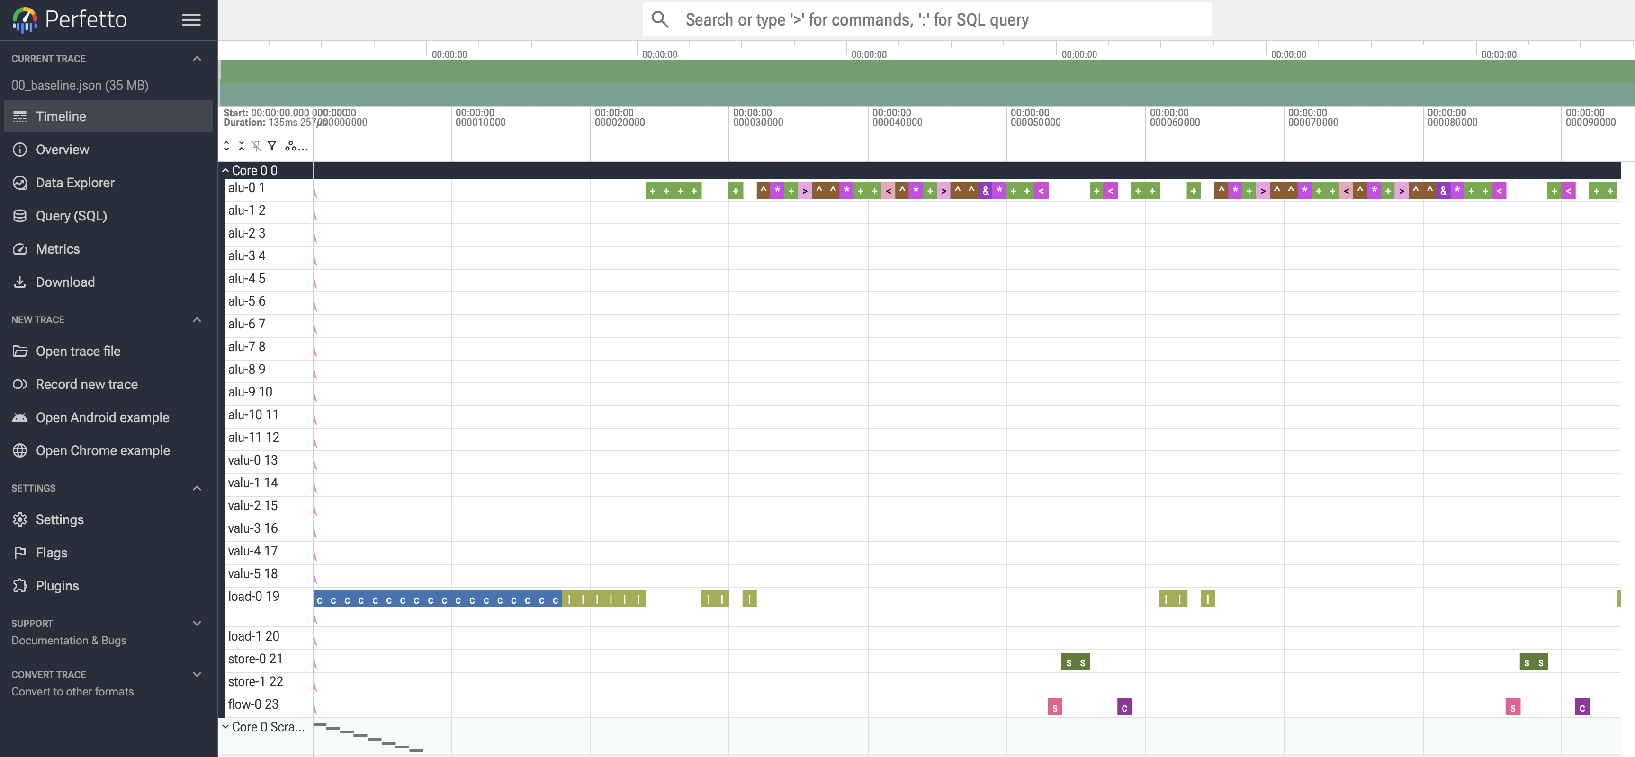
Machine Model And Perfetto Tooling
The simulator behaves like a restricted VLIW/SIMD machine with separate execution engines.
• VLIW means multiple independent operations can issue in the same cycle if their engines have open slots.
• SIMD means one vector instruction applies the same operation across multiple lanes; here the vector width is 8.
• Engine slot limits per cycle: alu = 12, valu = 6, load = 2, store = 2, flow = 1.
• alu handles scalar arithmetic, comparisons, and address math.
• valu handles vector arithmetic across eight lanes.
• load/store handle memory reads and writes; flow handles control operations.
[Placeholder: PowerPoint diagram: VLIW/SIMD machine model with one issue-packet row: 12 ALU slots, 6 VALU slots, 2 LOAD, 2 STORE, 1 FLOW; small legend explaining that Perfetto is supporting evidence.]

Slide 4
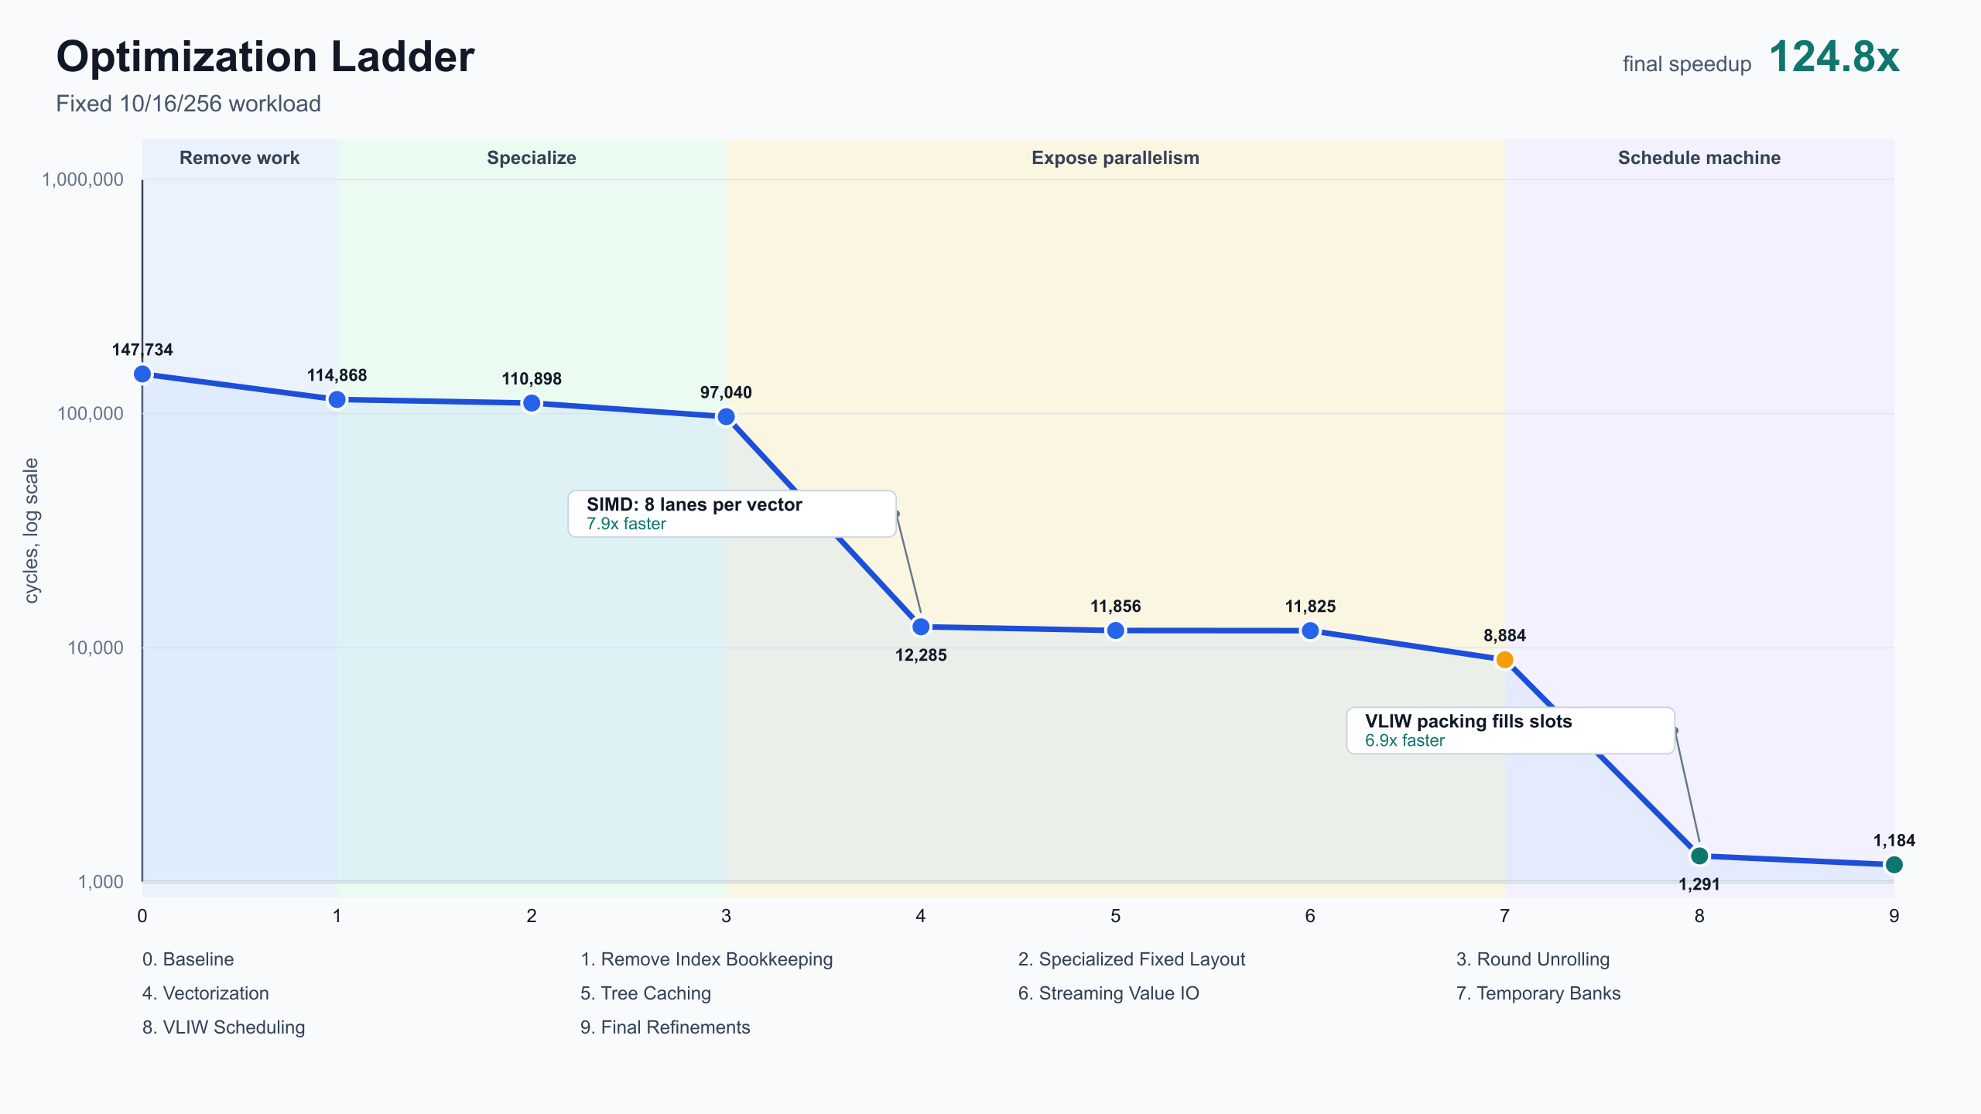
Optimization Roadmap: Cumulative Checkpoints
These are cumulative checkpoints, not independent ablations.
• 0 Baseline: 147,734 cycles.
• 1 Remove index bookkeeping: 114,868 cycles.
• 2 Specialized fixed layout: 110,898 cycles.
• 3 Round unrolling: 97,040 cycles.
• 4 Vectorization: 12,285 cycles.
• 5 Tree caching: 11,856 cycles.
• 6 Streaming value I/O: 11,825 cycles.
• 7 Temporary banks: 8,884 cycles.
• 8 VLIW scheduling: 1,291 cycles.
• 9 Final refinements: 1,184 cycles.
[Placeholder: Codebase image: use optimization_ladder/results/charts/optimization_ladder.svg, the 10-rung line chart grouped into phases: remove work, specialize, vectorize/memory, expose work, schedule machine.]

Slide 5
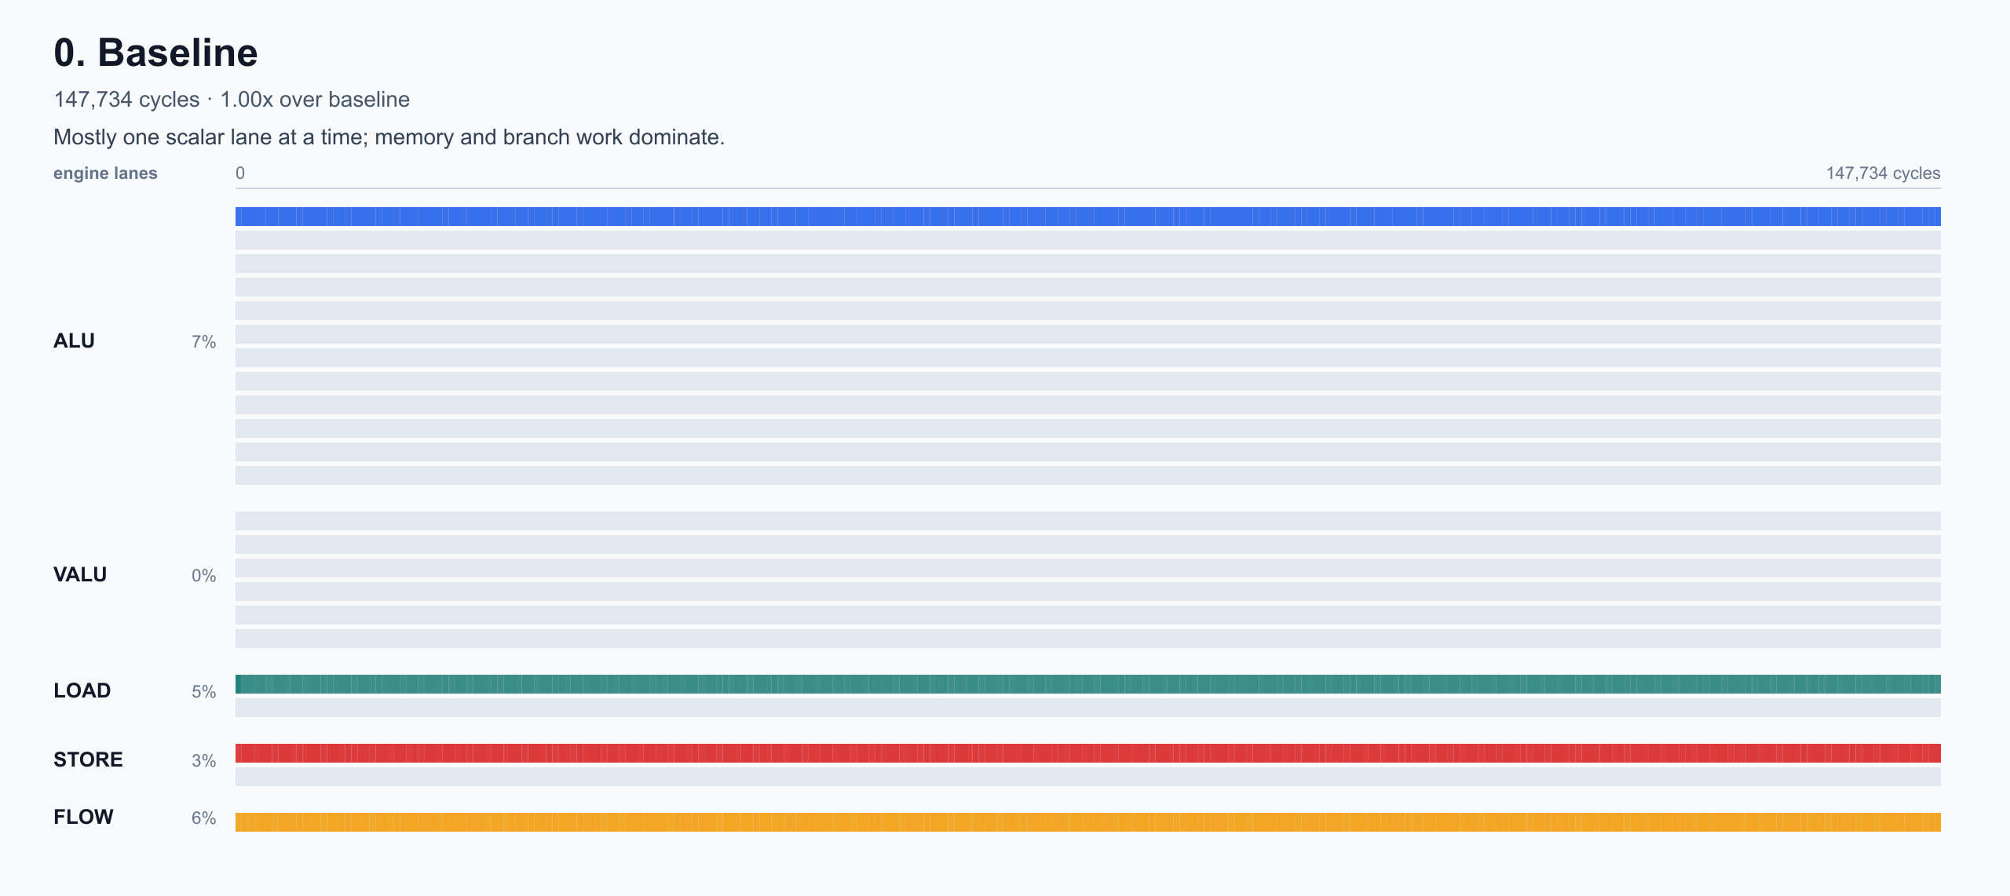
Stage 0: Baseline
Current: 147,734 cycles
The starting point does correct work, but leaves most available machine capacity unused.
• The trace shows entirely scalar-style execution.
• Vector lanes are largely unused.
• Index state repeatedly moves through memory even though it is only needed to choose future nodes.
• Loop/control overhead and address recomputation occur before useful tree-walk work.
[Placeholder: Codebase image + PowerPoint callouts: use trace_visuals/00_baseline.svg, then annotate scalar lane activity, idle VALU capacity, index memory traffic, and dependency/control bubbles. This is the main trace-reading teaching slide.]

Slide 6
Stage 1: Removing Unnecessary Work
Current: 114,868 cycles
The first improvements align the kernel with exactly what the grader checks.
• Stage 1, remove index bookkeeping: 147,734 -> 114,868 cycles.
• The grader never checks indices.
• Traversal indices still matter during execution, but they can live in scratch instead of memory between rounds.
[Placeholder: PowerPoint diagram: before/after state diagram. Before shows index loaded/stored through memory every round plus final index write; after shows index in scratch and final index write removed. Include 147,734 -> 114,868 cycle delta.]

Slide 7
Stages 2 & 3: Specializing for the Fixed Workload
Current: 97,040 cycles
Known benchmark shape lets the generated program remove general-purpose control and layout handling.
• Stable memory pointers and workload dimensions become constants instead of runtime setup.
• The kernel emits the exact operation stream for all 16 known rounds instead of a runtime loop.
• The deterministic depth sequence exposes known leaf reset behavior.
• Tradeoff: instruction file size grows, but the benchmark scores execution cycles.
[Placeholder: PowerPoint diagram: specialization comparison. Left side generic loop with runtime layout/depth checks; right side fixed 16-step strip showing depths 0,1,2,3,4,5,6,7,8,9,10,0,1,2,3,4 and baked-in memory layout.]

Slide 8
Stage 4: Leveraging SIMD
Current: 12,285 cycles
Vectorization is the first structural change that dramatically changes the cycle curve.
• SIMD vector width is 8.
• batch_size = 256, so the kernel processes 32 vector groups.
• The hash pipeline, value update, branch-bit calculation, and many index updates operate lane-wise.
• The trace shifts from scalar bookkeeping toward the VALU engine as the main workhorse.
[Placeholder: PowerPoint diagram: SIMD batching. Eight scalar inputs collapse into one 8-lane vector group; 256 inputs become 32 vector groups; show value/hash/index operations applied lane-wise.]

Slide 9
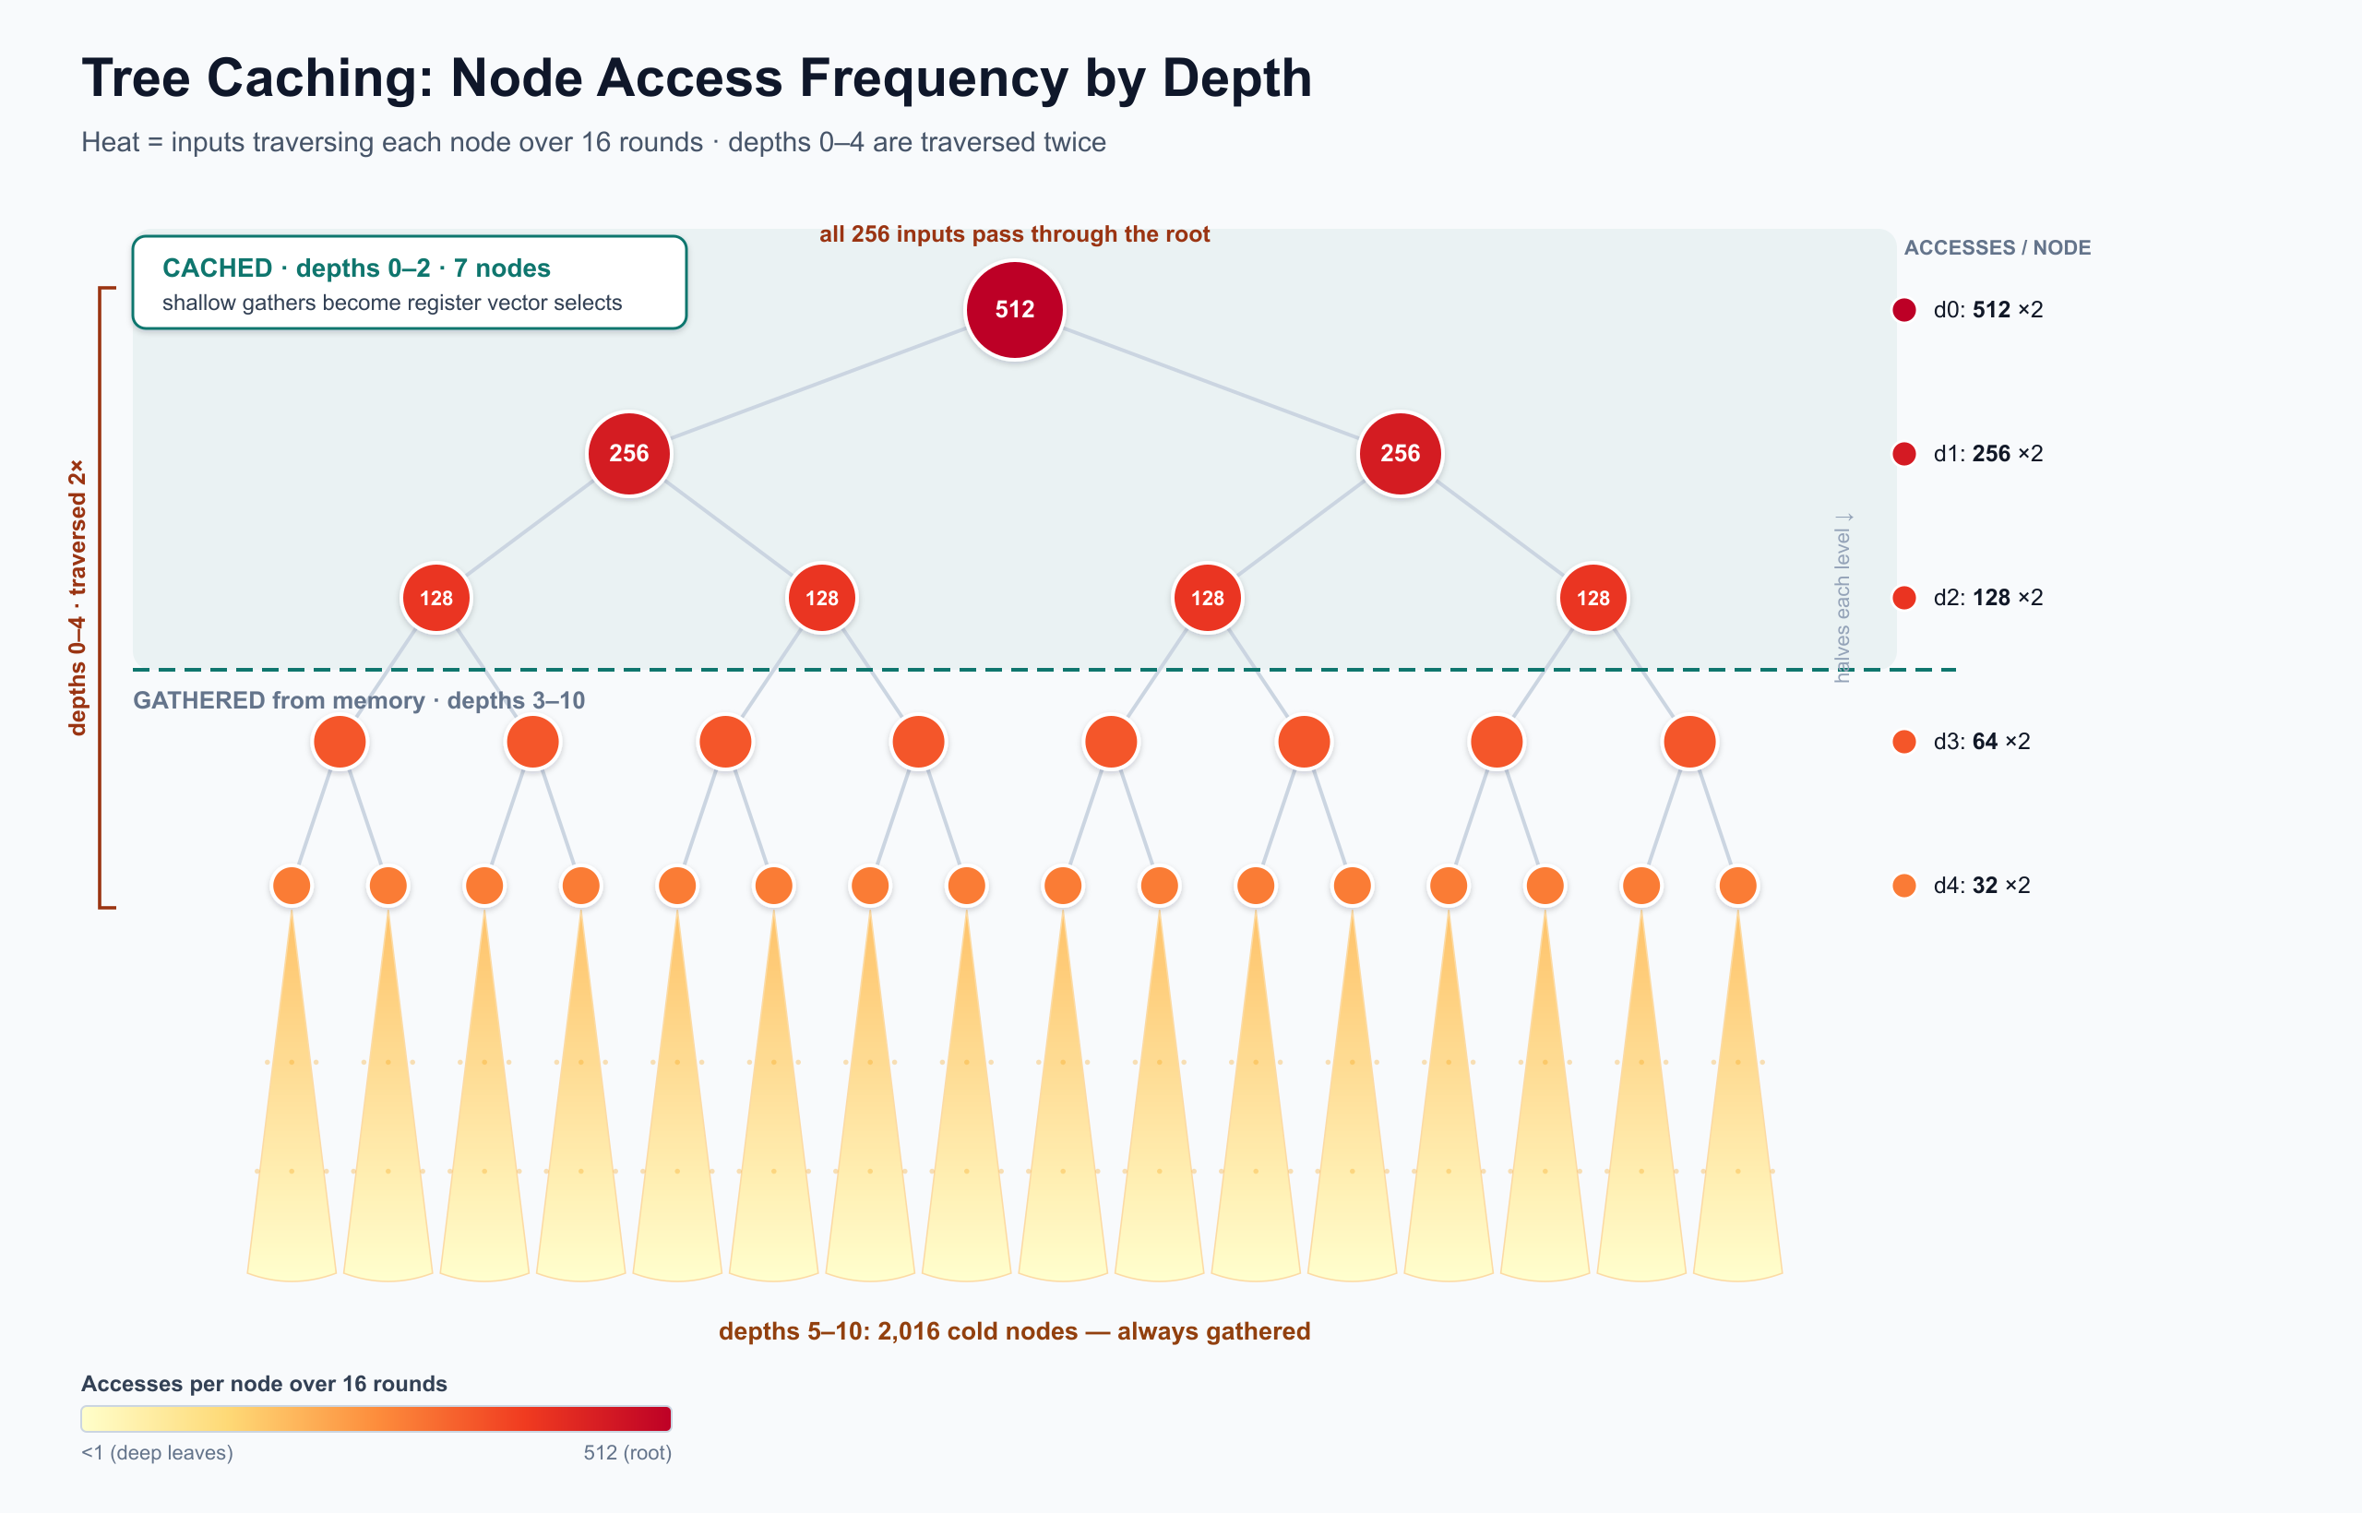
Stages 5 & 6: Bottleneck Analysis and Memory Pressure
Current: 11,825 cycles
After SIMD, remaining gains come from reducing repeated memory work and regularizing I/O.
• Stage 5, tree caching: 12,285 -> 11,856 cycles.
• Upper tree nodes are reused by many inputs.
• The root is touched by every input; reuse roughly halves at each tree depth.
• Caching shallow nodes replaces repeated gathers with scratch/vector selects.
• Stage 6, streaming value I/O: 11,856 -> 11,825 cycles.
• Streaming value I/O makes address generation a compact moving-pointer pattern.
[Placeholder: Codebase image + PowerPoint inset: use charts/tree_cache_heatmap.svg or charts/tree_cache_heatmap_rounds.svg for reuse; add scratch-cache inset showing hot nodes moved from repeated LOADs into scratch/vector selects, plus a small streaming-pointer strip for value I/O.]

Slide 10
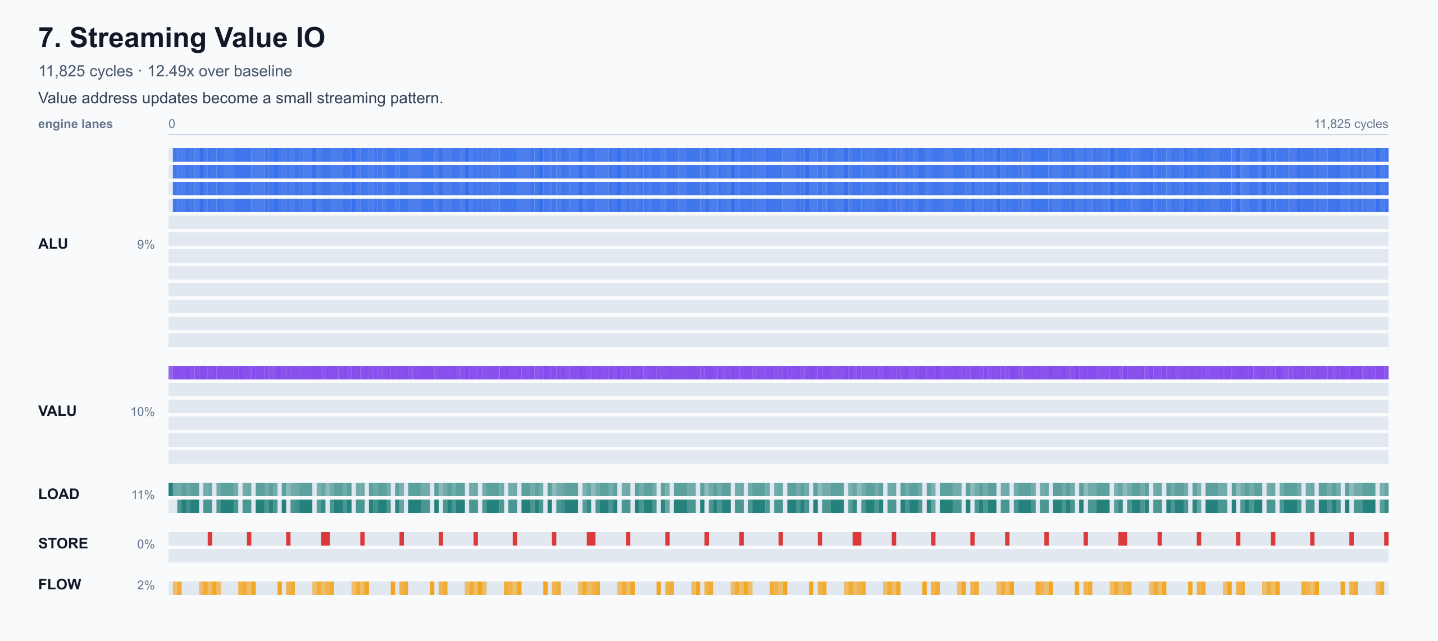
Stage 7: Exposing Independent Work
Current: 8,884 cycles
The scheduler can only pack operations that look independent in scratch/register space.
• A fully unrolled vector program has many logically independent vector groups.
• If unrelated groups reuse the same scratch names, dependency analysis treats them as serialized.
• Multiple temporary banks give independent groups separate scratch names.
• This exposes more ready work before global scheduling.
• Stage 7 does local packing, but it is not yet the full global VLIW scheduler.
[Placeholder: PowerPoint diagram: false-dependency before/after. Before shows independent vector groups serialized through the same temp names; after shows multiple temp banks exposing parallel lanes of ready work.]

Slide 11
Stages 8 & 9: Packing Independent Ops Into VLIW Slots
Current: 1,184 cycles
The final major gain comes from dependency-aware cross-engine scheduling.
• Stage 8, VLIW scheduling: 8,884 -> 1,291 cycles.
• Stage 9, final refinements: 1,291 -> 1,184 cycles.
• The scheduler assigns every operation an engine type and read/write sets.
• RAW hazard: a consumer reads a value after a producer writes it.
• WAW hazard: two writes to the same target must stay ordered.
• WAR hazard: a later write must not clobber an earlier read; final refinements relax safe same-cycle WAR cases because reads happen at cycle start and writes commit at cycle end.
• Ready operations are prioritized by critical path and packed under engine slot limits.
[Placeholder: PowerPoint diagram + codebase inset: draw dependency graph with RAW/WAR/WAW edges feeding a VLIW packing table; include small trace_visuals/10_final_refinements.svg inset only as proof of dense engine utilization.]

Slide 12
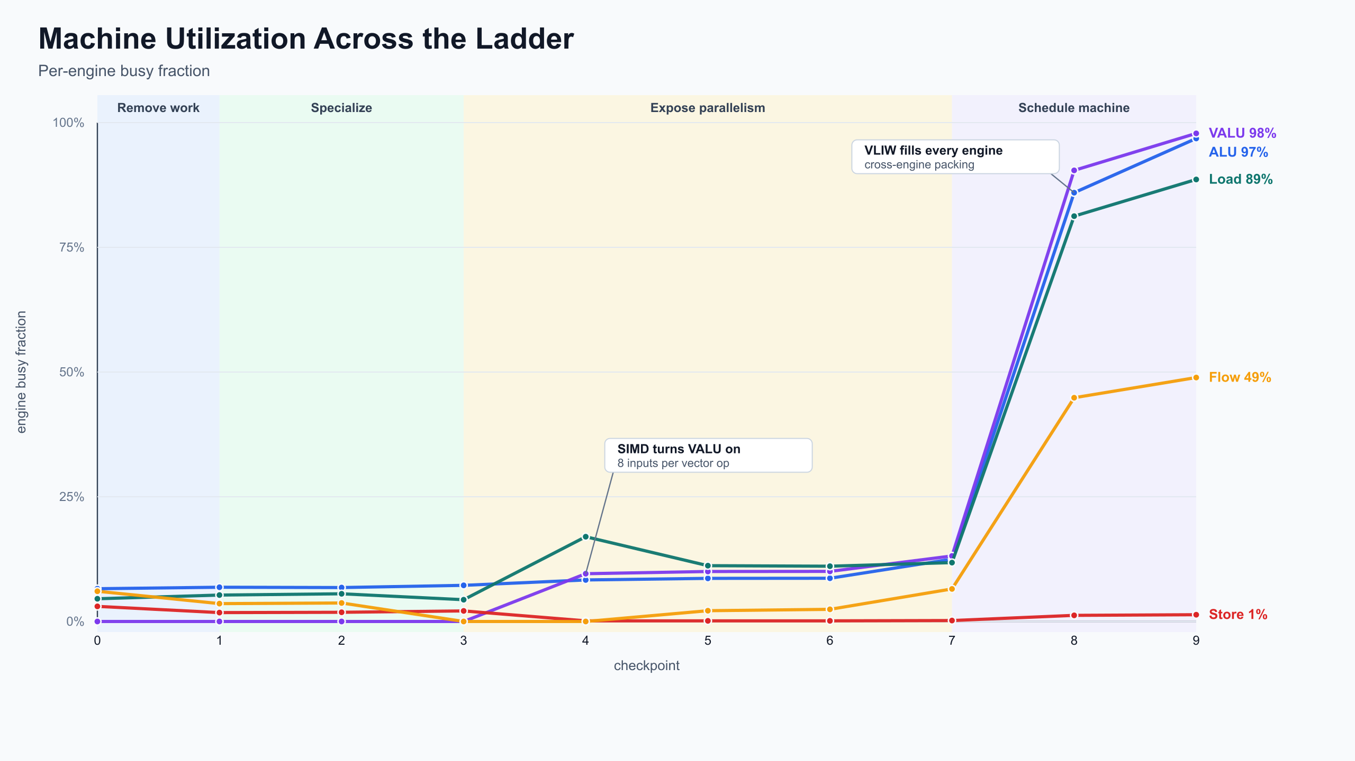
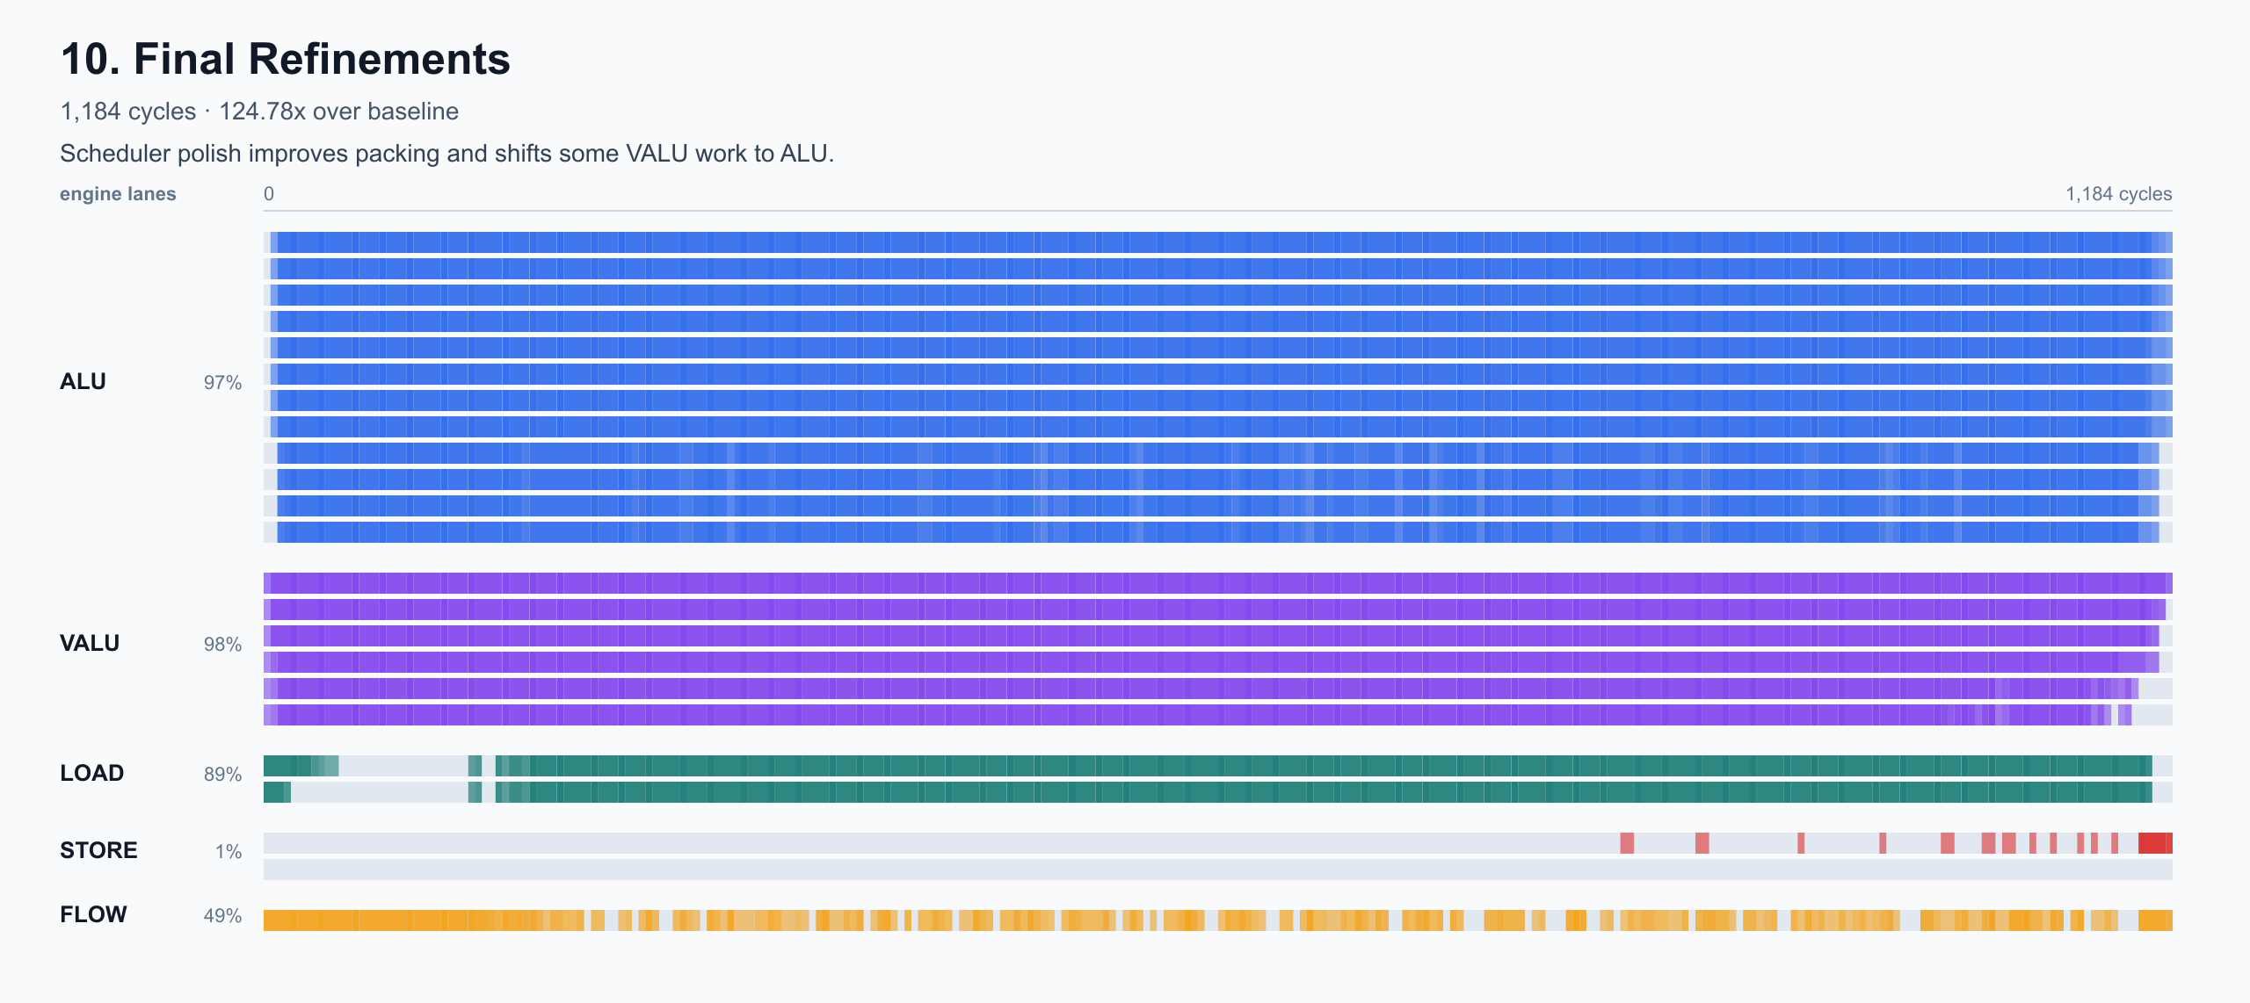
Results: The Binding Constraint Moved Over Time
The strongest story is not one trick; it is a sequence of bottlenecks found and removed.
• Final result: 1,184 cycles.
• Final speedup: approximately 124.8x over the 147,734-cycle baseline.
• Early gains came from removing unneeded bookkeeping and memory traffic.
• Middle gains came from specializing the fixed workload and vectorizing across the batch.
• Late gains came from exposing independent work and scheduling it across the VLIW engines.
• The optimization ladder is useful because it shows how profiler interpretation evolved as each bottleneck moved.
[Placeholder: Codebase images: use charts/optimization_ladder.svg plus charts/utilization_ladder.svg or charts/issue_density.svg; annotate the two major inflections: SIMD and VLIW scheduling.]

Slide 13
Limitations
The final kernel is fast because it is intentionally specialized; that creates real engineering tradeoffs.
• Highly specialized workload: the generated kernel assumes forest_height = 10, rounds = 16, batch_size = 256, and a stable memory layout.
• Generated code size increases: unrolling and specialization remove runtime overhead but produce a larger instruction stream.
• Scheduler is heuristic: it uses dependency analysis and priority rules, but it is not an optimal solver.
• Scratch allocation is manually tuned: temp banks expose parallelism, but the current allocator is not a full liveness-aware register coloring pass.
• Profiler interpretation is still manual: Perfetto traces guided the optimization path, but bottleneck classification and goodput metrics are not fully automated.

Slide 14
Next Steps
Turn the one-kernel optimization into a more systematic compiler pipeline.
• Register coloring: use liveness analysis to assign scratch locations systematically and reduce false dependencies.
• Goodput calculator: compute useful work per cycle, engine utilization, idle slots, memory pressure, and stall categories directly from traces.
• Profiler/tooling automation: automatically identify bubbles, saturated engines, load/store bottlenecks, and before/after deltas.
• Automated schedule search: explore scheduler priorities, tie-breaks, and packing choices programmatically.
• Formalized dependency model: represent every instruction as a graph node with explicit reads, writes, engine constraints, and RAW/WAR/WAW edges. Use the graph to prove schedule correctness and search for better VLIW packing.
[Placeholder: PowerPoint diagram: compiler pipeline roadmap: trace metrics -> dependency graph -> register coloring -> scheduler search -> verified VLIW program.]

