Slide 1
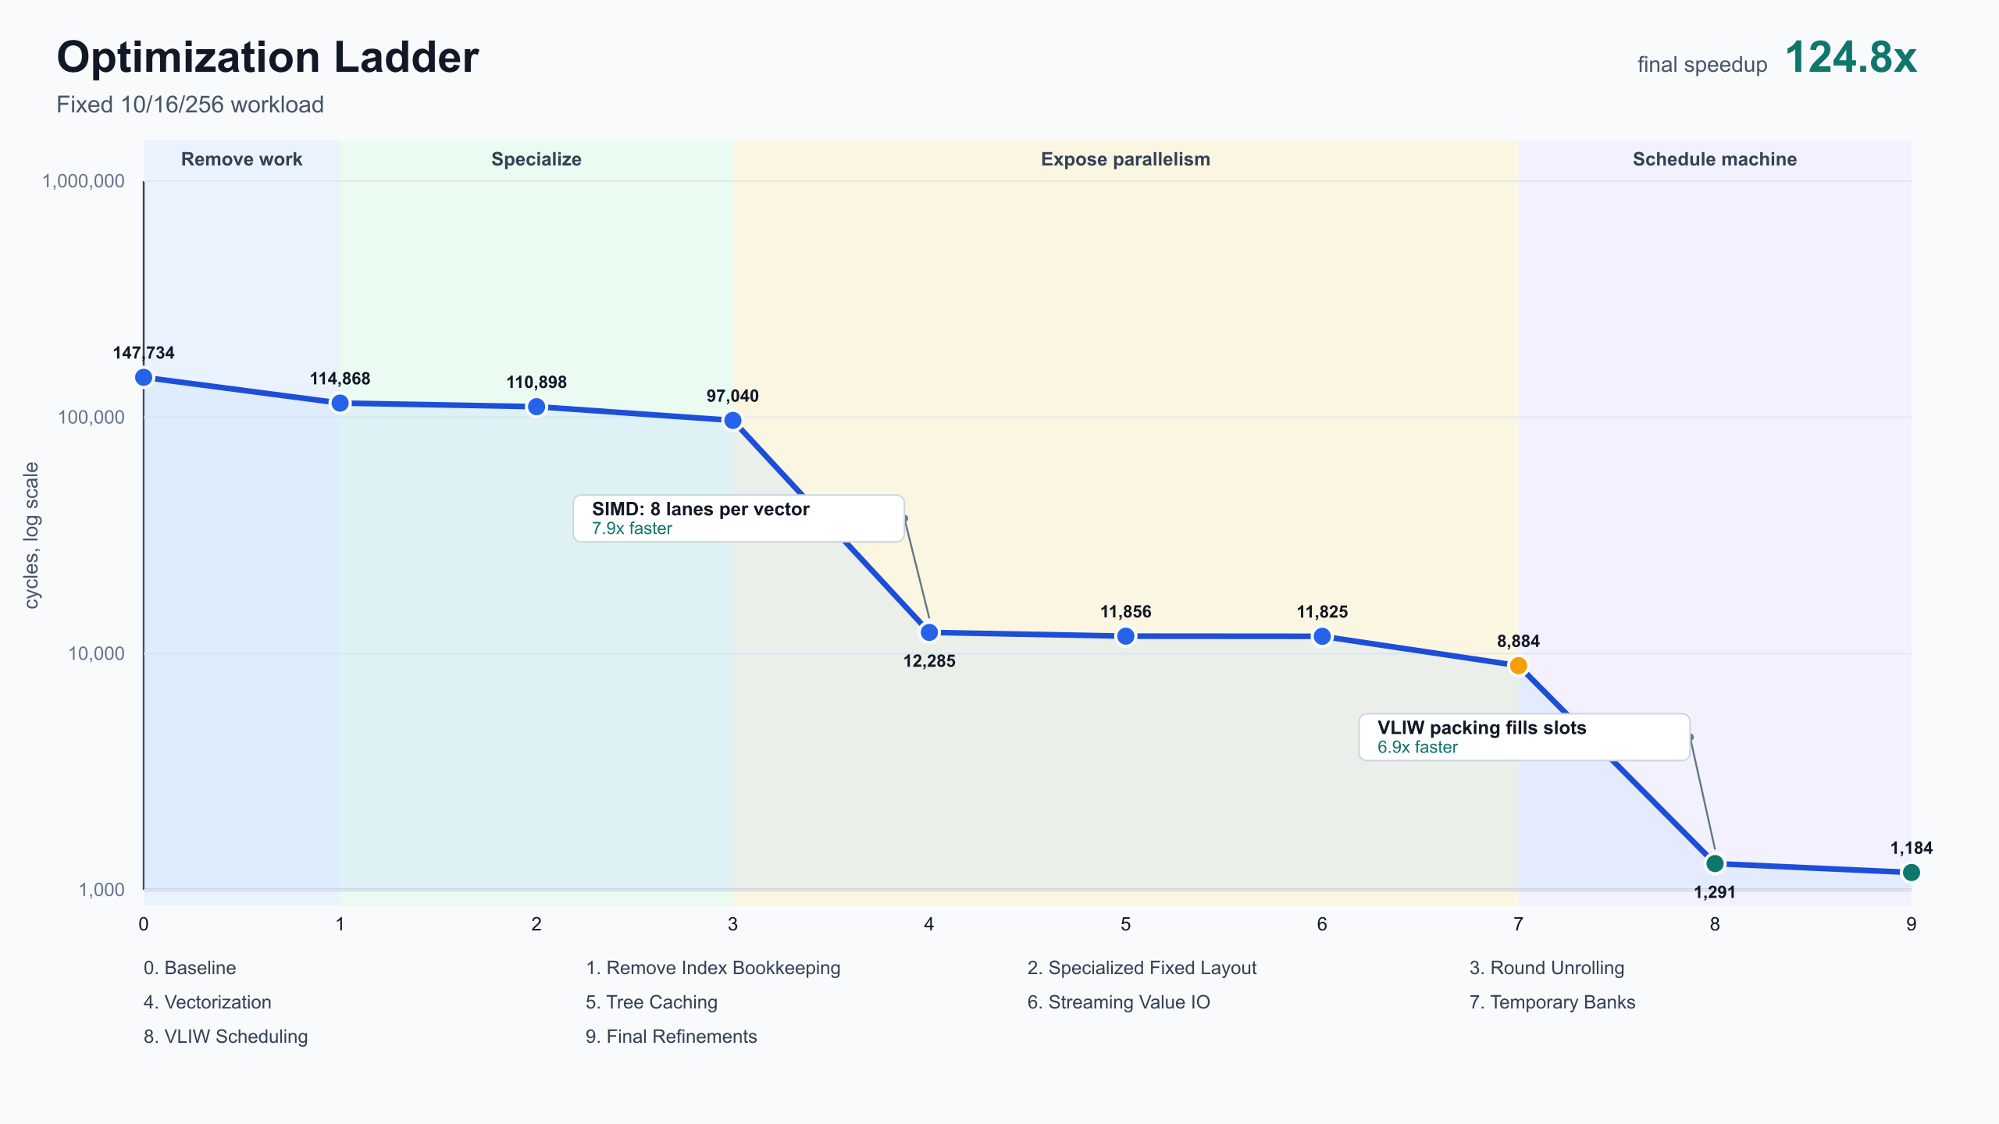
TITLE
Profiler-Guided Compiler Optimization
Anthropic compiler performance take-home: from scalar tree traversal to scheduled VLIW/SIMD kernel
147,734 -> 1,184
124.8x
11
cycles on the fixed grader workload
speedup over supplied baseline
cumulative checkpoints in the optimization ladder
Narrative: remove waste, specialize the workload, exploit SIMD, reduce memory pressure, then schedule independent work.
The key deliverable is not just a fast kernel; it is a trace-backed explanation of why each optimization matters.
1

Slide 2
BACKGROUND
Background: A Compiler Challenge, Not Python Tuning
Python emits a low-level program for a simulated CPU; the score is total simulator cycles.
The take-home asks candidates to generate a correct kernel for a fixed workload and minimize cycle count.
Anthropic Speed Thresholds
Correctness is checked against the reference problem; performance is measured by the simulator cycle counter.
Baseline
< 147,734
The interesting work is compiler work: code generation, specialization, memory placement, vectorization, dependency analysis, and scheduling.
Updated starter
< 18,532
Opus 4 many hours
< 2,164
Best human-ish / casual
< 1,790
Advanced harnesses
< 1,579 / 1,548 / 1,487 / 1,363
This project
1,184 cycles
All thresholds
final kernel passes every listed speed tier
2

Slide 3
PROBLEM
Problem Description: Batched Binary Tree Traversal
Each input repeatedly walks a perfect binary tree and updates its value through a hash pipeline.
Fixed workload
One round of reference behavior
forest_height = 10: a perfect binary tree with 2,047 nodes.
1
->
3
->
5
batch_size = 256: 256 independent inputs are processed together.
Read current node index
Hash input_value ^ node_value
Update value and current index
rounds = 16: each input takes 16 tree steps.
2
4
Read tree node value
->
Use hash parity to choose left/right child
->
Depth sequence is deterministic: 0,1,2,3,4,5,6,7,8,9,10,0,1,2,3,4.
Correctness target: final values match reference
Optimization target: fewer simulator cycles
3

Slide 4
MACHINE MODEL
Machine Model And Perfetto Tooling
The simulator behaves like a restricted VLIW/SIMD machine with separate execution engines.
Per-cycle engine slots
How to read traces
alu
12 slots
scalar arithmetic, comparisons, address math
Rows are engine lanes; time moves left to right.
valu
6 slots
SIMD vector arithmetic, 8 lanes per instruction
Colored spans are issued operations.
Blank gaps are idle capacity caused by dependencies, memory pressure, or lack of ready work.
load
2 slots
memory reads
The goal is not simply fewer operations; it is denser useful work per cycle.
store
2 slots
memory writes
flow
1 slots
conditional jumps / control
4

Slide 5
ROADMAP
Optimization Roadmap: Cumulative Checkpoints
Each rung preserves correctness and adds one narrative capability.
0 Baseline
supplied reference point
147,734
1 Remove work
remove index bookkeeping
114,868
2-3 Specialize
fixed layout + unroll
97,040
4 SIMD
8 inputs per vector op
12,285
5-6 Memory
cache hot nodes + stream I/O
11,825
7-9 Schedule
temp banks + VLIW + refinements
1,184
The story is chronological: remove unnecessary work first, then unlock hardware parallelism.
The largest drops happen when the program shape changes: scalar to SIMD, then unscheduled to VLIW-packed.
5

Slide 6
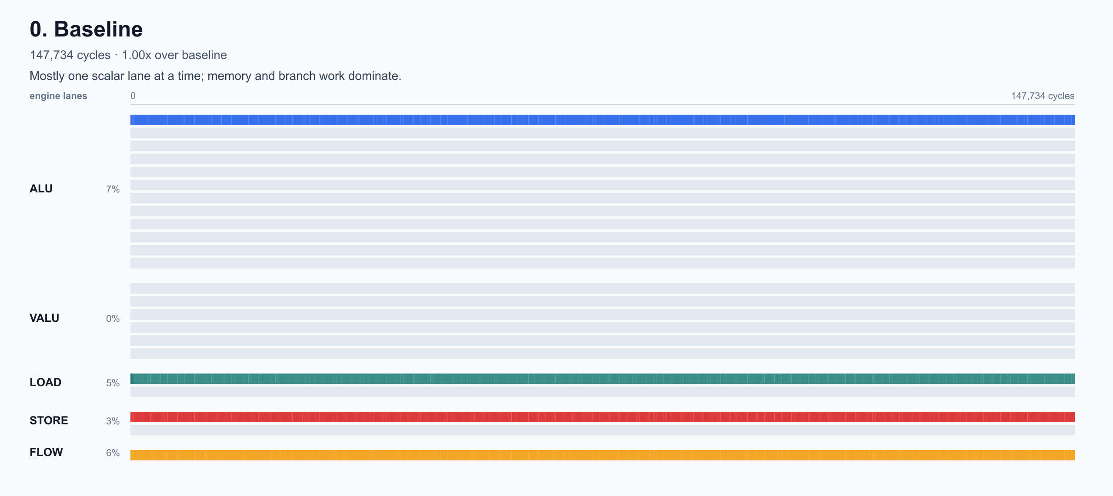
BASELINE
Baseline: The Trace Shows Serialization And Waste
The starting point does correct work, but it leaves most available machine capacity unused.
147,734
baseline cycles
Scalar execution dominates; vector lanes are largely unused.
Index state repeatedly moves through memory even though it is only needed to choose future nodes.
Loop/control overhead and address recomputation are visible before the useful tree-walk work.
This trace established the first goal: remove bookkeeping before tuning deep scheduling.
6

Slide 7

REMOVE WORK
Easy Wins: Remove Ungraded And Unnecessary Work
The first improvements come from aligning the kernel with exactly what the grader checks.
147,734 -> 114,868
remove index bookkeeping
Final values are graded; final index state is not. The last round can compute values without storing final indices.
Live traversal indices still matter during execution, but they can live in scratch instead of memory between rounds.
This combines the old test-contract and scratch-indices checkpoints because both remove index work from the graded path.
Narrative role: these are low-risk cleanup passes before specialization.
7

Slide 8
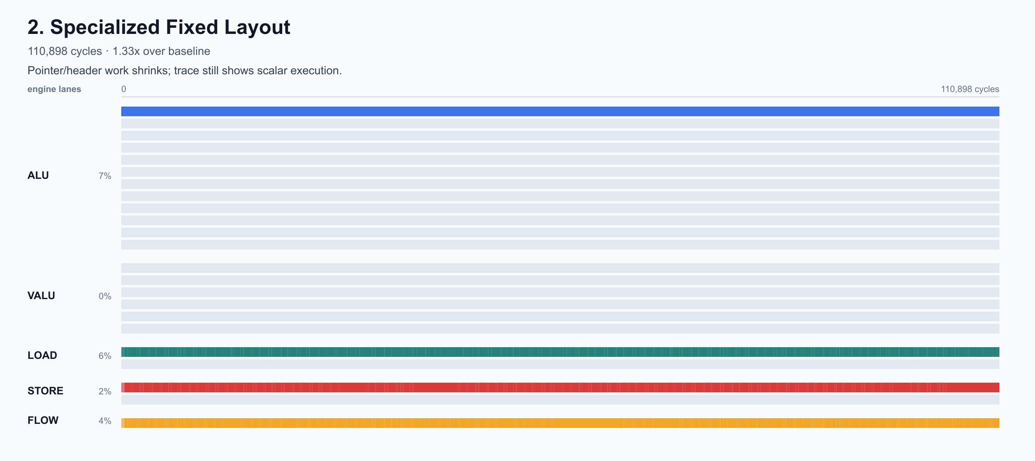
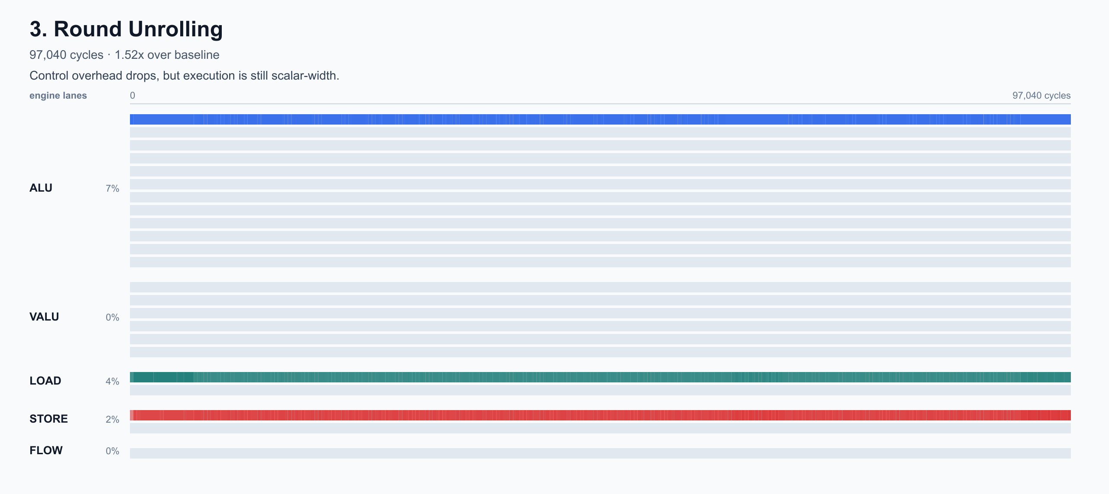
SPECIALIZATION
Specialization: Make The Fixed Workload Explicit
Once the benchmark shape is known, the generated program can remove general-purpose control and layout handling.
114,868 -> 110,898
110,898 -> 97,040
bake in fixed layout
unroll 16 known rounds
Fixed layout: stable memory pointers and dimensions become constants instead of runtime setup.
Round unrolling: the depth sequence is known, so the kernel emits the exact operation stream for all 16 rounds.
Leaf behavior is predictable: after depth 10, traversal resets to root.
Tradeoff: instruction file size grows, but this benchmark scores execution cycles.
8

Slide 9
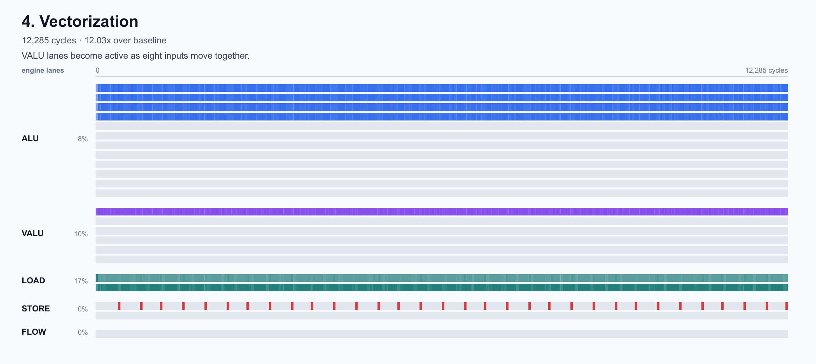
SIMD
Leveraging SIMD: Turn 256 Scalar Walks Into 32 Vector Groups
Vectorization is the first structural change that dramatically changes the cycle curve.
97,040 -> 12,285
cycles after SIMD vectorization
Batch geometry
256 inputs / 8 SIMD lanes = 32 vector groups
The hash pipeline, value update, branch-bit calculation, and many index updates operate lane-wise.
The trace shifts from scalar bookkeeping toward the VALU engine as the main workhorse.
Narrative role: this is where hardware parallelism becomes central.
9

Slide 10
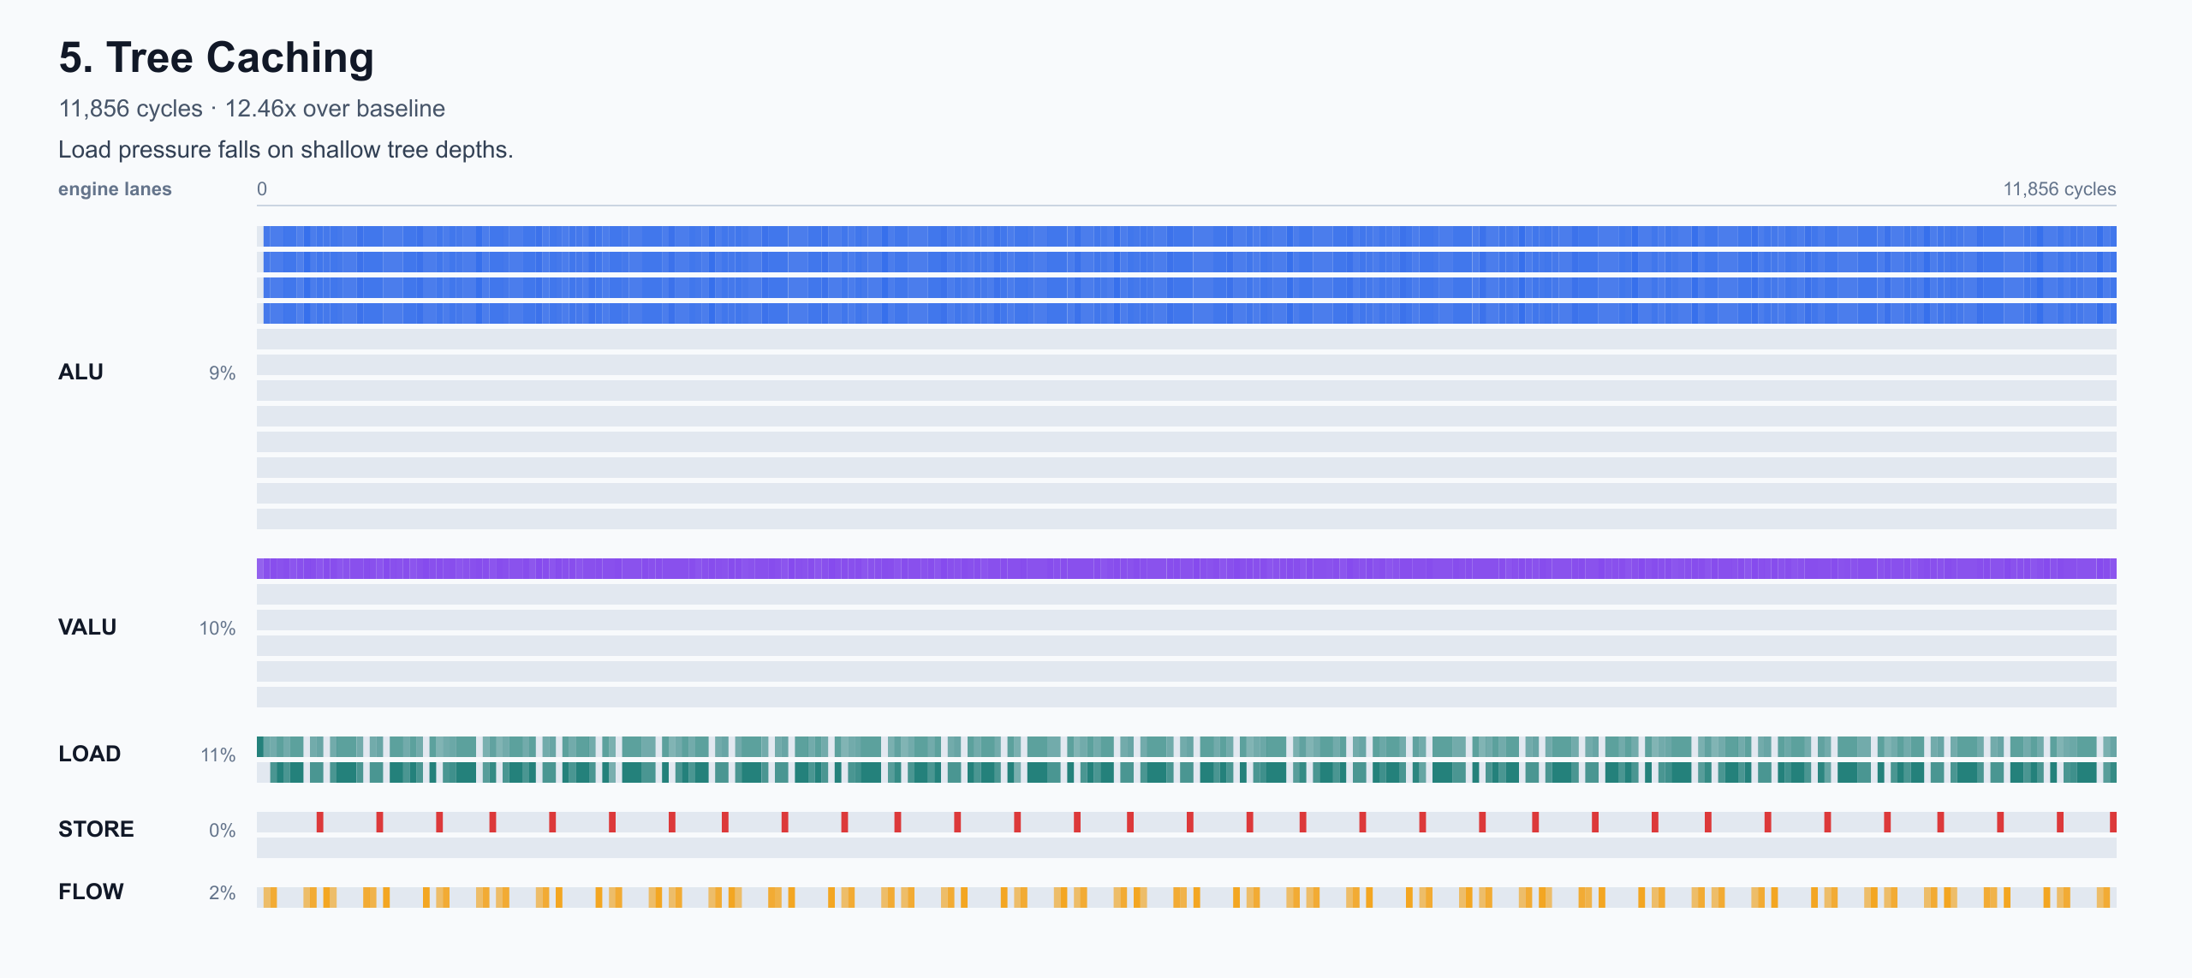
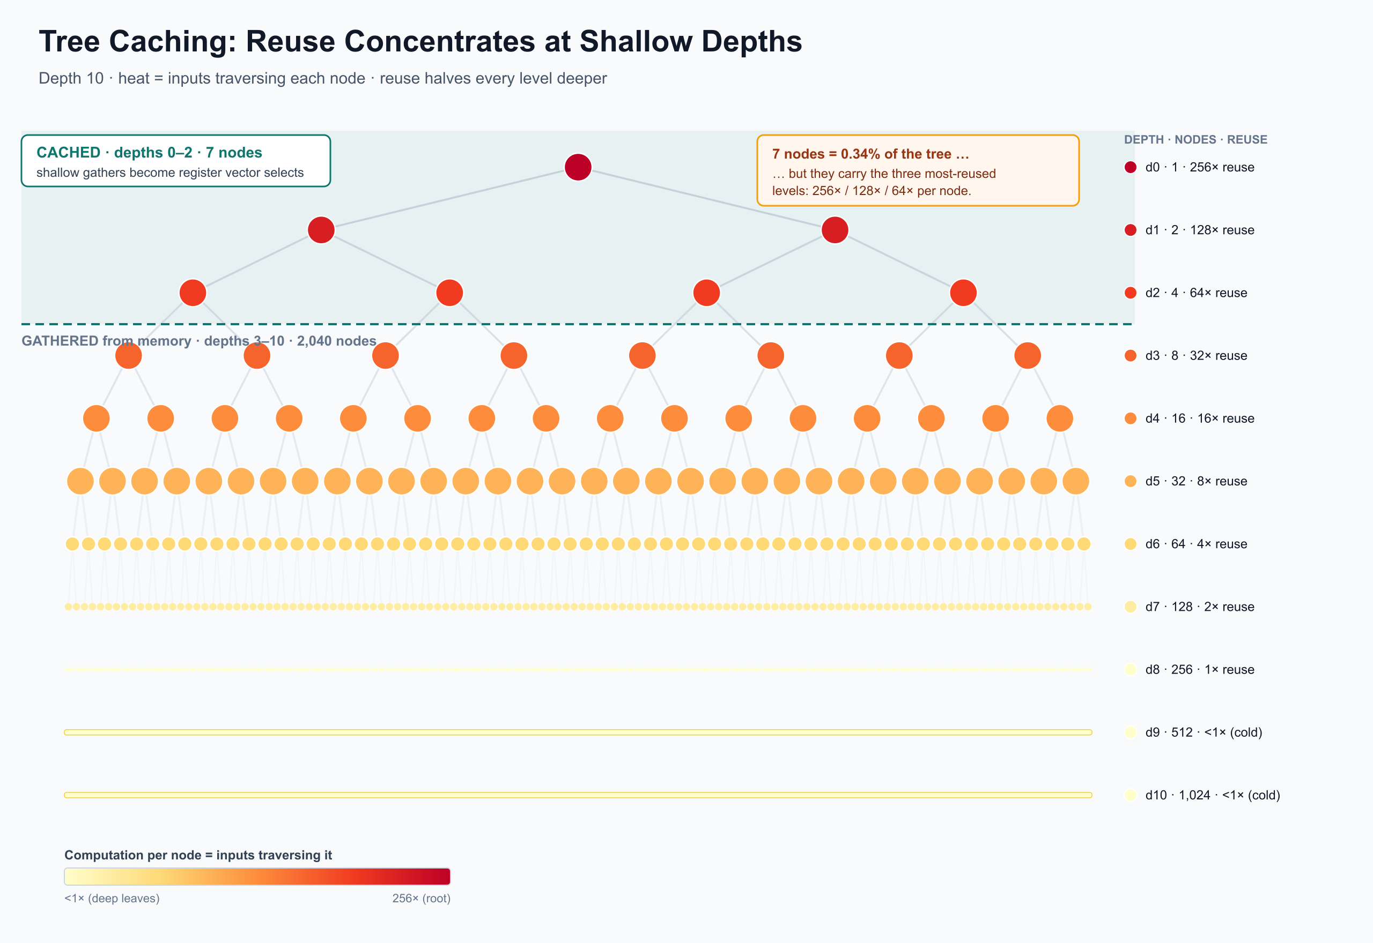

MEMORY
Bottleneck Analysis: Memory Pressure Moves To Hot Tree Nodes
After SIMD, the remaining gains come from reducing repeated memory work and regularizing I/O.
12,285 -> 11,856
cache hot upper tree levels
11,856 -> 11,825
stream value address updates
Upper tree nodes are reused by many inputs. The root is touched by every input; reuse halves each depth.
Caching shallow nodes replaces repeated gathers with scratch/vector selects.
Streaming value I/O makes address generation a compact moving-pointer pattern.
Narrative role: Perfetto shifts the question from 'can I vectorize?' to 'what resource is binding now?'
10

Slide 11
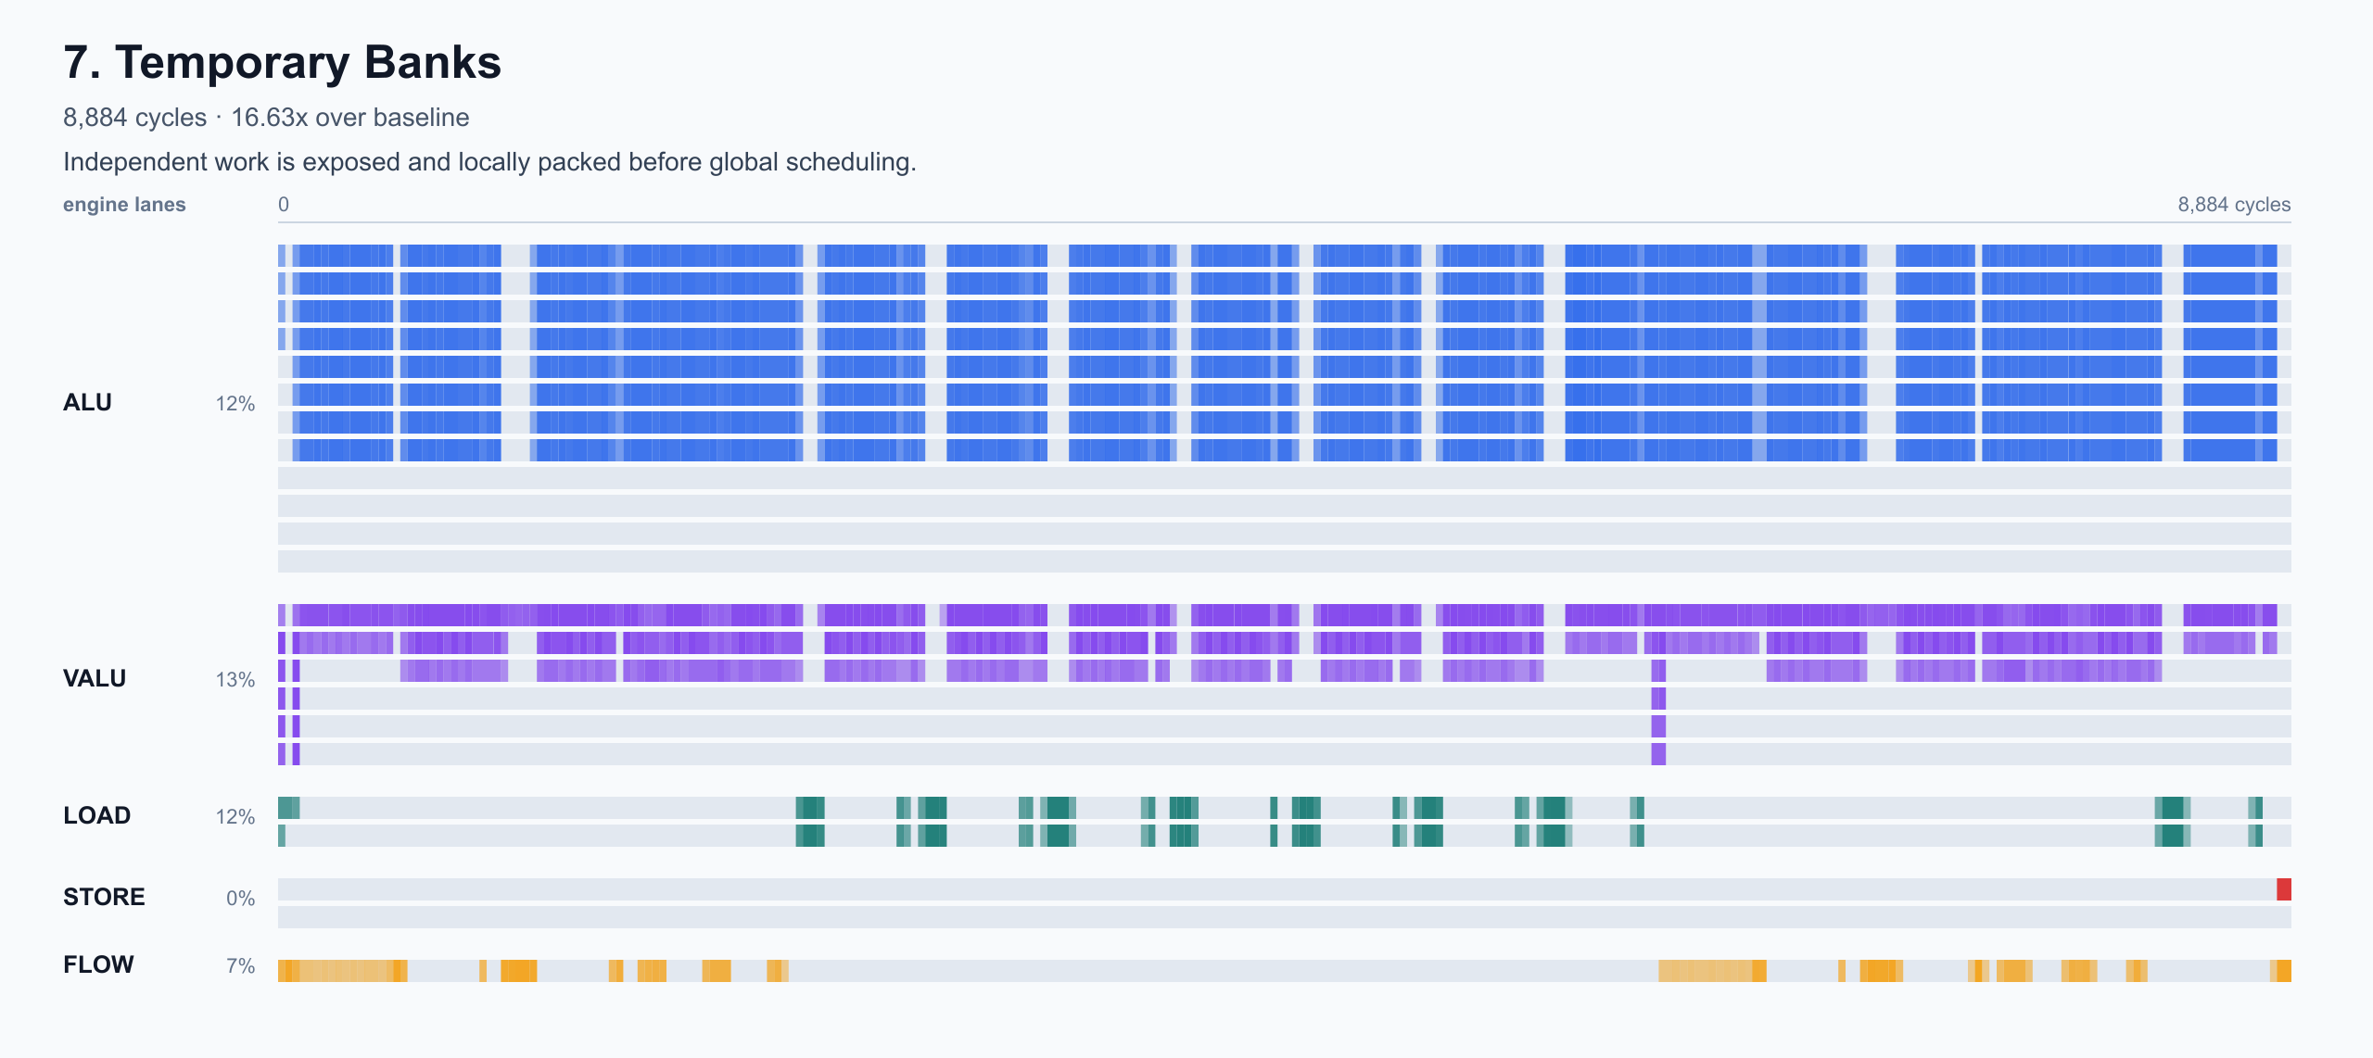
PARALLEL WORK
Exposing Independent Work: Temporary Banks
The scheduler can only pack operations that look independent in scratch/register space.
11,825 -> 8,884
cycles after temp banks and local packing
Why temp banks matter
If unrelated vector groups reuse the same scratch names, dependency analysis treats them as serialized. Multiple temp banks give independent groups separate names so more operations can be ready at the same time.
This is not yet the global VLIW scheduler.
It prepares the program so a real scheduler has enough independent work to choose from.
Narrative role: separate algorithmic parallelism from whether the generated code exposes that parallelism.
11

Slide 12
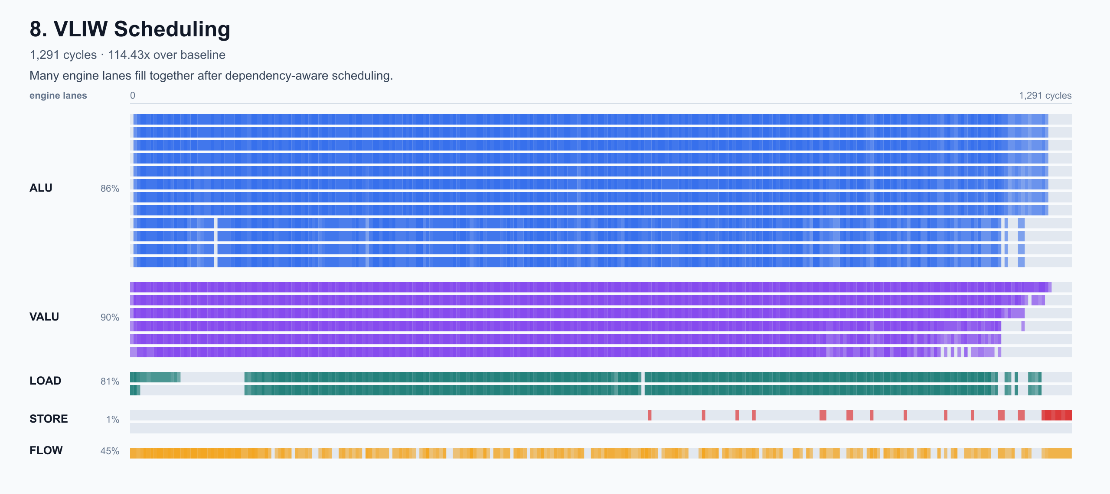
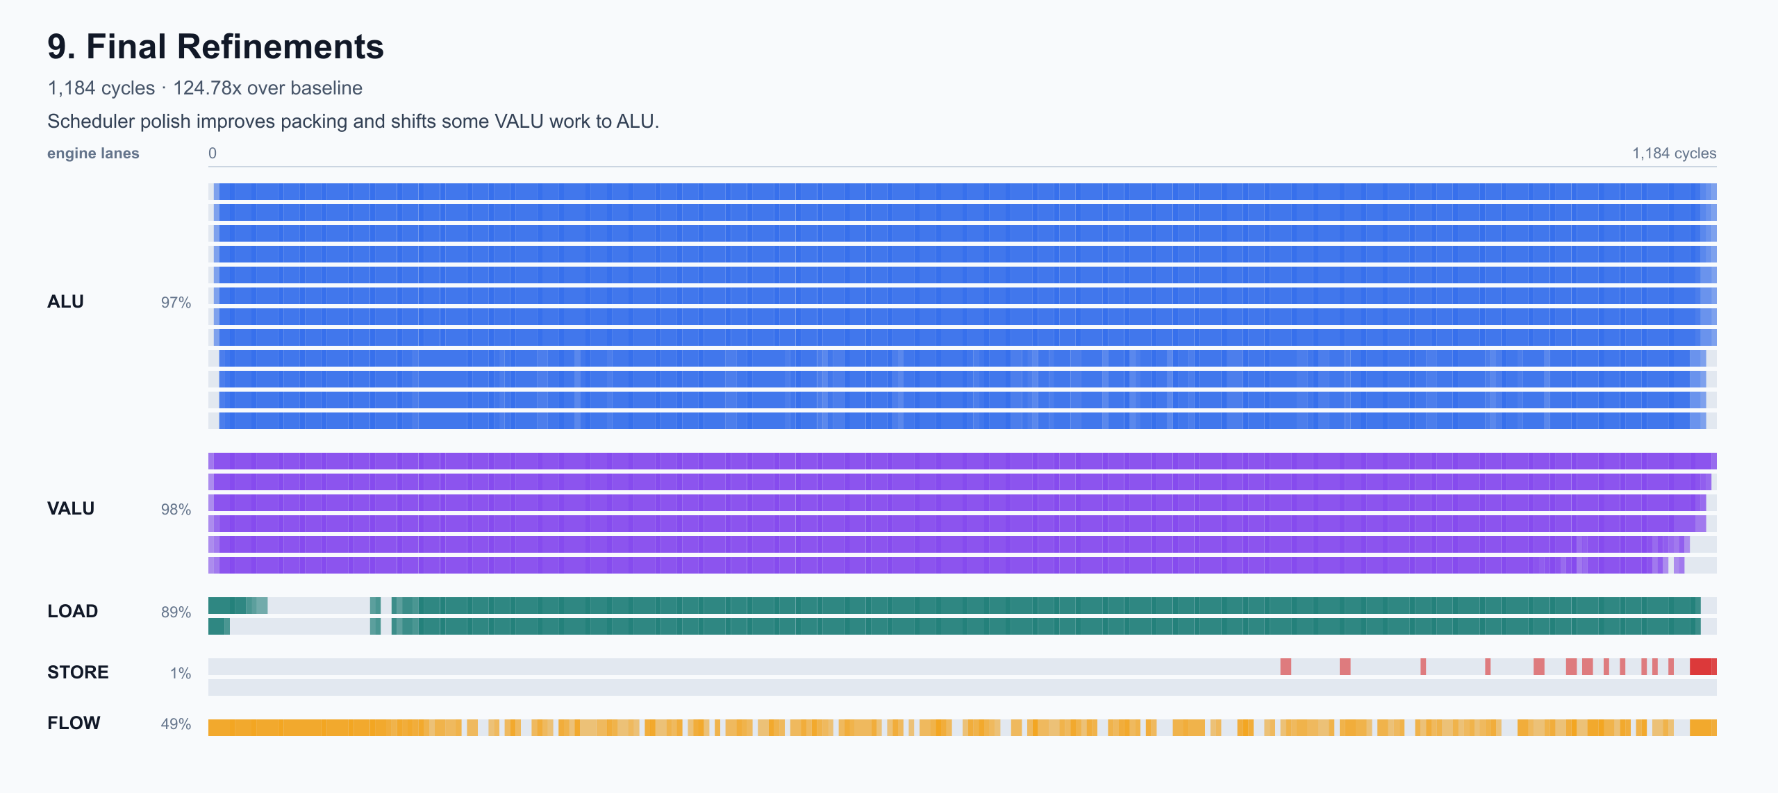
SCHEDULING
A Better Scheduler: Pack Independent Ops Into VLIW Slots
The final major gain comes from dependency-aware cross-engine scheduling.
8,884 -> 1,291
1,291 -> 1,184
global VLIW scheduling
final scheduler refinements
Dependency hazards modeled by the scheduler
RAW: consumer reads a value after producer writes it
WAW: two writes to the same target must stay ordered
WAR: later write must not clobber an earlier read
Each operation gets read/write sets and an engine type.
Ready operations are prioritized by critical path and packed under engine slot limits.
Final refinements relax safe WAR hazards and use VALU-to-ALU fallback when vector lanes are saturated.
12

Slide 13
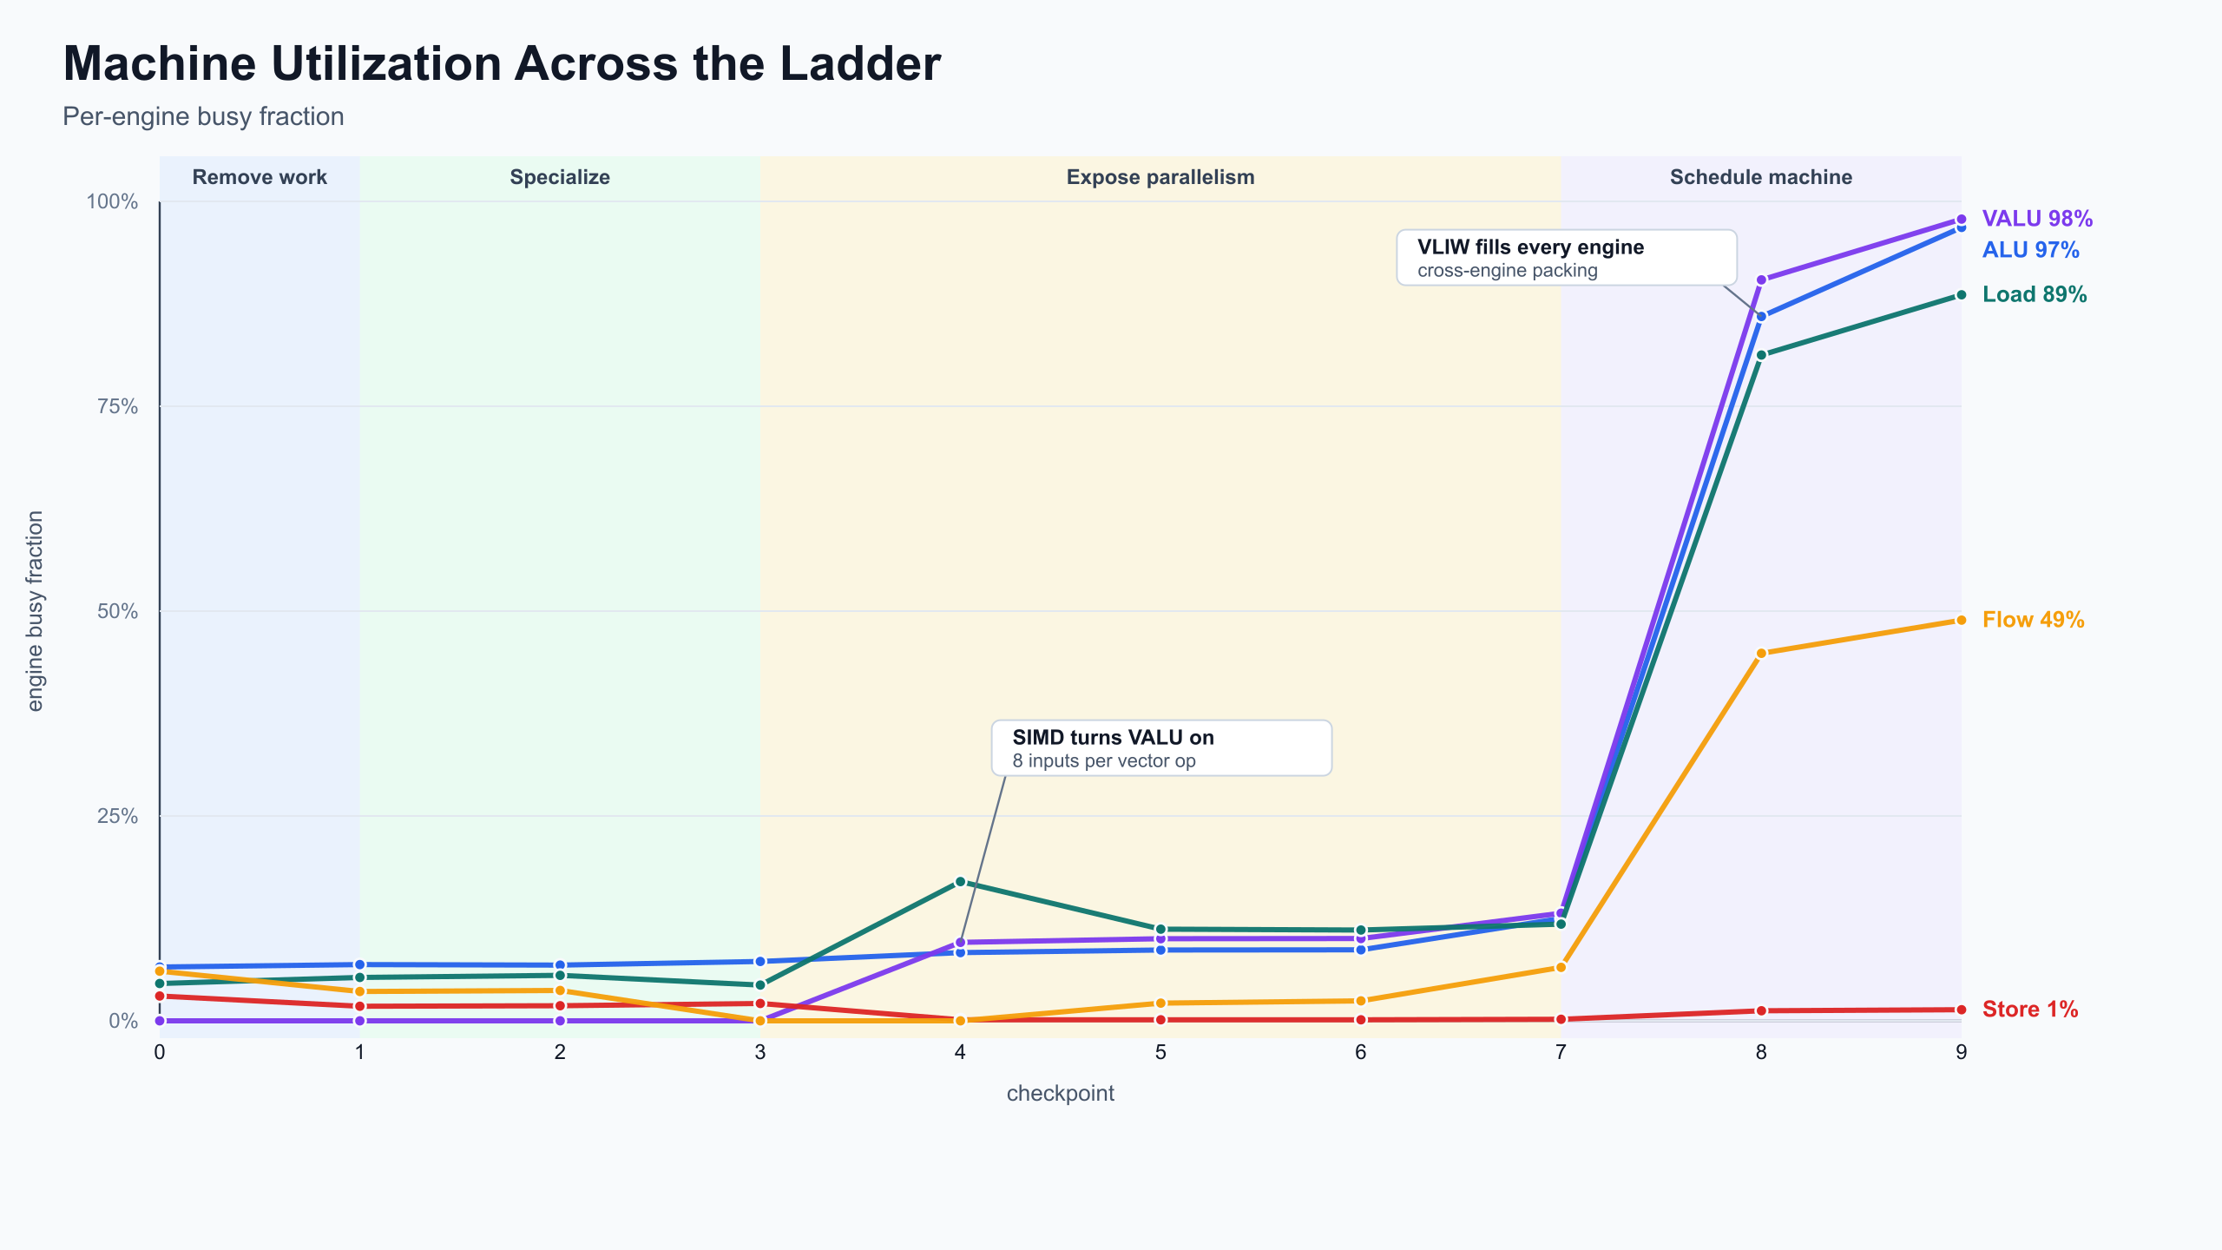
RESULTS
Results: The Binding Constraint Moved Over Time
The strongest story is not one trick; it is a sequence of bottlenecks found and removed.
124.8x
1,184
Early: remove bookkeeping and memory traffic.
final speedup over baseline
final cycle count
Middle: specialize the fixed workload and vectorize across the batch.
Late: expose enough independent work for a VLIW scheduler to fill the machine.
13

Slide 14
LIMITATIONS
Limitations
The final kernel is fast because it is intentionally specialized; that creates real engineering tradeoffs.
Highly specialized workload
Generated code size increases
The generated kernel assumes forest_height=10, rounds=16, batch_size=256, and a stable memory layout. Generalizing it would require a broader code generator.
Unrolling and specialization remove runtime overhead but produce a larger instruction stream. That is acceptable for this simulator, but real instruction cache behavior could matter.
Scheduler is heuristic
Scratch allocation is manually tuned
The VLIW scheduler uses dependency analysis and priority rules, but it is not an optimal solver and does not prove the best possible packing.
Temporary banks expose parallelism, but the current allocator is not a full liveness-aware register coloring pass.
Profiler interpretation is still manual
Perfetto traces guided the optimization path, but bottleneck classification and goodput metrics are not yet fully automated.
14

Slide 15
NEXT STEPS
Next Steps
Turn the one-kernel optimization into a more systematic compiler pipeline.
Register coloring
Use liveness analysis to assign scratch locations systematically, reducing false dependencies without hand-tuned temp-bank counts.
Goodput calculator
Compute useful work per cycle, engine utilization, idle slots, memory pressure, and stall categories directly from traces.
Profiler/tooling automation
Automatically identify bubbles, saturated engines, load/store bottlenecks, and before/after deltas instead of relying on visual inspection alone.
Automated schedule search
Explore scheduler priorities, tie-breaks, and packing choices programmatically rather than hand-tuning heuristics.
Formalized dependency model
Represent every instruction as a graph node with explicit reads, writes, engine constraints, and RAW/WAR/WAW edges. Use the graph to prove schedule correctness and search for better VLIW packing.
15

