Slide 1
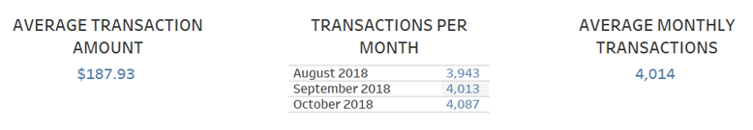
DATA EXAMINATION
EXPLORATORY DATA ANALYSIS
There are no data issues other than missing data in some columns. However, these columns are specific to either SALES-POS, POS or PAY/SALARY transaction types. These columns were not relevant for this analysis.
DATA SUMMARIES

Slide 2
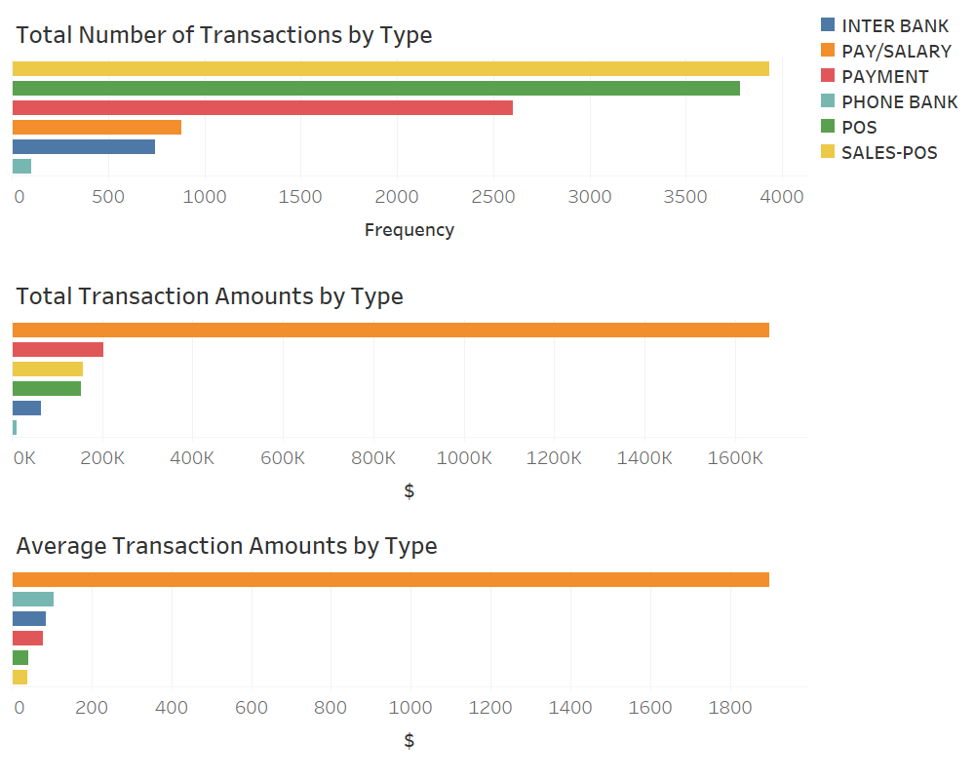
TRANSACTION TYPES
KEY POINTS
POS and SALES-POS represent over 60% of all transactions while only being responsible for just under 14% of all transactions in dollars. On average they are the smallest transaction amounts.
PAY/SALARY represents less than 10% of all transactions yet is responsible for approximately 74% of all the transaction amounts in dollars.
PHONE BANK represents less than 1% of all transactions yet the average transaction amount is higher than all transactions types other than PAY/SALARY.

Slide 3
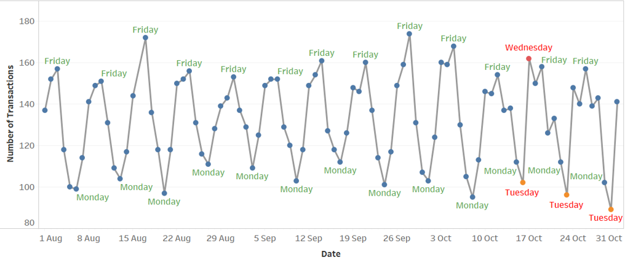
TRANSACTIONS PER DAY
The highest number of transactions for each week occur on Friday for all but one week in October. The lowest number of transactions for the week occur on Monday until the last 3 weeks in October where it occurs on Tuesdays. As the lowest transactions of the week occurs on either Monday or Tuesday, it can still be said that the day with the lowest number of transactions occurs early in the week.

