Slide 1
Category review: Chips
June 2020
Retail Analytics
Brand note: If client logo is not required, use alternate title page layout right click slide thumbnail > Layout > Title

Slide 2
Notes:
To view Privacy video explaining how important data privacy is to Quantium, please click here: https://www.youtube.com/watch?v=Zq1QDAkoRzU
or here Q:\Company Reference\Brand & Design\Brand videos\Q Privacy.mp4
At Quantium, we believe that data is the behavioural footprint of humanity and that it has to be treated with the utmost care and responsibility.
Histories, attitudes, indeed lives are stored within it in ways that aren’t always apparent – and that’s what makes its potential so powerful.
To work with it responsibly, sensitively, we set ourselves the highest data privacy protection and governance standards.
We have spent 17 years perfecting privacy-by-design and secure-by-design principles. Central to this is not holding any personally identifiable information about people –
we neither receive it, and put the necessary protections in place to be unable to decipher it.
Every aspect of handling data is safeguarded: from its de-identification, to its encryption – data security is paramount and of the highest grade.
We pride ourselves on gaining the trust of iconic organisations around the world through years of securely working with their data,
and in turn the trust that builds with their stakeholders.

Slide 3
Executive summary
01
Task 1
The majority of customers are represented by 3 approximately evenly proportioned life stage groups which includes retirees, older single/couples and young single/couples. When examining the premium status across all customers, only a small proportion have premium status. The most common status is mainstream. When combining these groups together, budget families had the highest overall sales,. However, they do not represent a significant proportion of customers. The customer segment with the next highest sales is mainstream young single/couples which also represents the highest proportion of customers. This customer segment also pays more, on average, for a packet of chips. Additionally, further insights have been found about this customer segments purchasing preferences. Therefore, mainstream young single/couples is the customer segment that should be considered for targeting in future promotions.
02
Task 2
The trial layouts in stores 77, 86 and 88 do appear to have made some impact but not for the entire 3 months. Store 77 recorded increases for the first and second months of the trial period for sales and number of customer purchases. However, there was only a noticeable difference in the first month for stores 86 and 88. For the months that the trial stores recorded significant increases, their control stores were suffering declines from the previous months suggesting further significance in the change. Although the sales and number of customers for store 88 was within the confidence interval for the second and third month, it was still noticeably higher than its control store.

Slide 4
01
Category

Slide 5
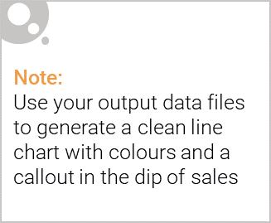
Reasons to target mainstream young single/couples in future promotions:
Represent highest proportion of purchases over financial year (nearly 8000 of 71517 customers)
Only customer segment to spend over $4 on average for a packet of chips (suggests impulse buying behaviour)
23% more likely to purchase Tyrrells chips compared to the rest of the population
Most likely to buy pack sizes of 270 grams (suggests either a higher preference for this size packet or for Twisties)

Slide 6

Affluence and its effect on consumer buying for chips
The highest proportion of customers had mainstream status followed by budget
Premium status customers represent the lowest proportion of customers
Average number of packets per purchase similar for budget, mainstream and premium customers
Only mainstream mid-age and young single / couples on average paid more per packet of chips otherwise no noticeable difference between the 3 groups

Slide 7
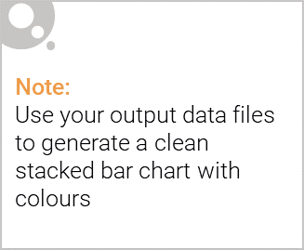
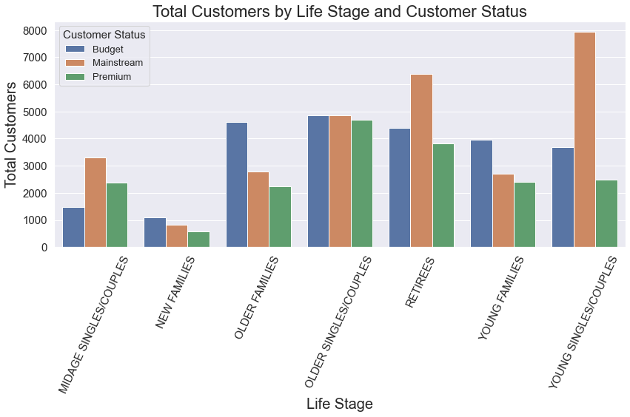
Editable (delete this)

Slide 8
02
Trial store performance

Slide 9
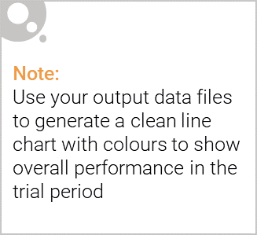
Control Store Selection
Selection of the control stores based on the similarity of sales and customers for each of the 7 months prior to the commencement of the trial
Store 233 was selected as the control store for trial store 77
Store 155 was selected as the control store for trial store 86
Store 237 was selected as the control store for trial store 88

Slide 10
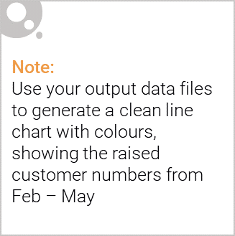
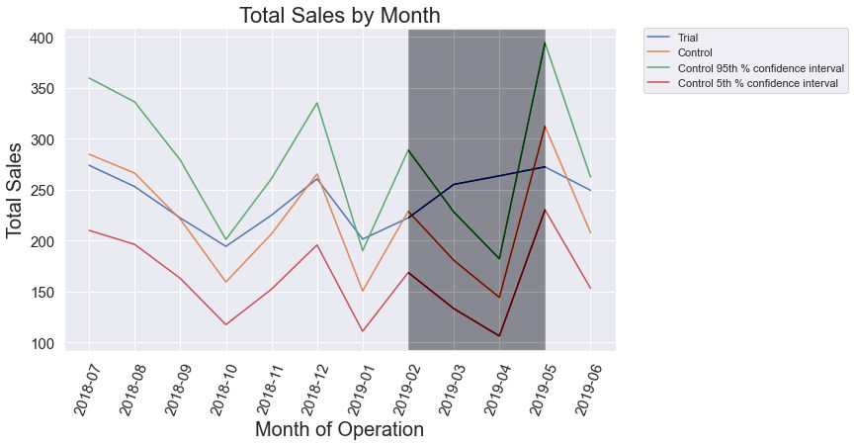
Trial Store 77
Clear increase in sales and number of customer purchases for the first 2 months of the trial period at same time the values for the control were decreasing
Continued growth into third month but still lower than control which had a dramatic rise from previous month

Slide 11
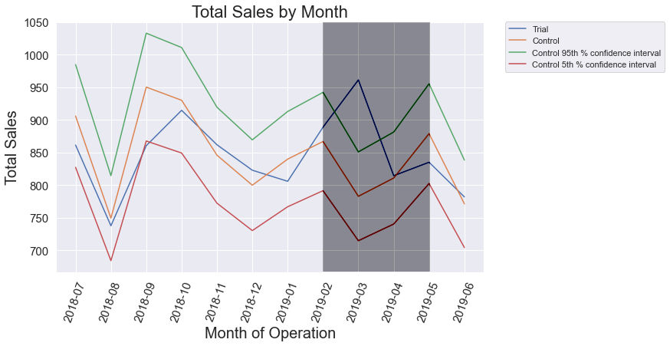
Trial Store 86
Clear increase in sales and number of customer purchases for the first month only when the control’s values were decreasing
No significant difference to the control in the second and third month

Slide 12
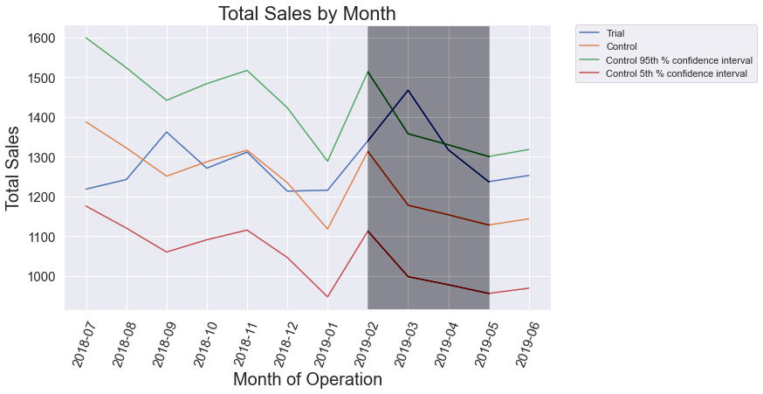
Trial Store 88
Clear increase in sales and number of customer purchases for the first month only when the control’s values were decreasing
Within the confidence interval for the second and third month but still higher than the control

