Slide 1
AUTONOMOUS SECURITY OPERATIONS
Prioritizing what’s important

Slide 2
Key Investors
JASK Overview
Founded: 2016
Founders:
Greg Martin
Damian Miller
Size: 50 Employees
Funding:- $14.5 Million
TenEleven Ventures
Battery Ventures
Dell

Slide 3
The SOC has evolved SIEM has not.
Notes:
The SOC has evolved beyond SIEM.
JASK is…..

Slide 4

Cybersecurity is no longer a human scalable problem
The SOC:
Old model, human dependent
Expensive to manage
Not responsive enough
The Tech:
Outdated, not sufficient
Signatures & correlations
Laborious to normalize
Humans:
Don’t scale to the threat
Skill shortage
Manual analysis

Slide 5











INTRODUCING JASK
JASK is modernizing security operations to reduce organizational risk and improve human efficiency.
Through technology consolidation, enhanced AI and machine learning, the JASK Autonomous Security Operations Center (ASOC) platform automates the collection, correlation and analysis of alerts, helping SOC analysts focus on highest-priority threats, streamlining investigations and delivering faster response times.
Trusted by Top Organizations
Notes:
perfection

Slide 6

AUTONOMOUS
Modern Security Operations Platform Powered by AI
JASK’s ASOC platform speeds and improves the quality of data ingestion and correlation to get to faster insights and answers about possible threats.
Deployable in a single day, on-premise or cloud, your current investments are more powerful with better enterprise threat visibility and prioritiztion.
RAPID
CLOUD-BASE/ SCALABLE
JASK ASOC™
LEARNING/ SHARING
OPEN/FLEXIBLE
CONSOLIDATING
Notes:
Needs to become a feature of JASK ASOC slide

Slide 7
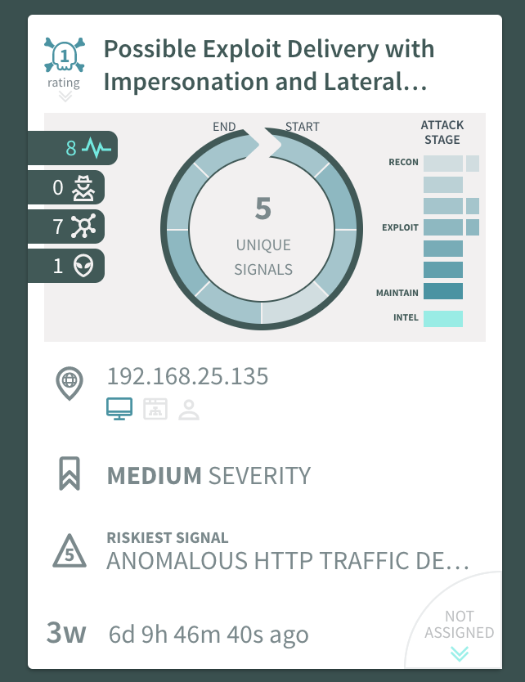
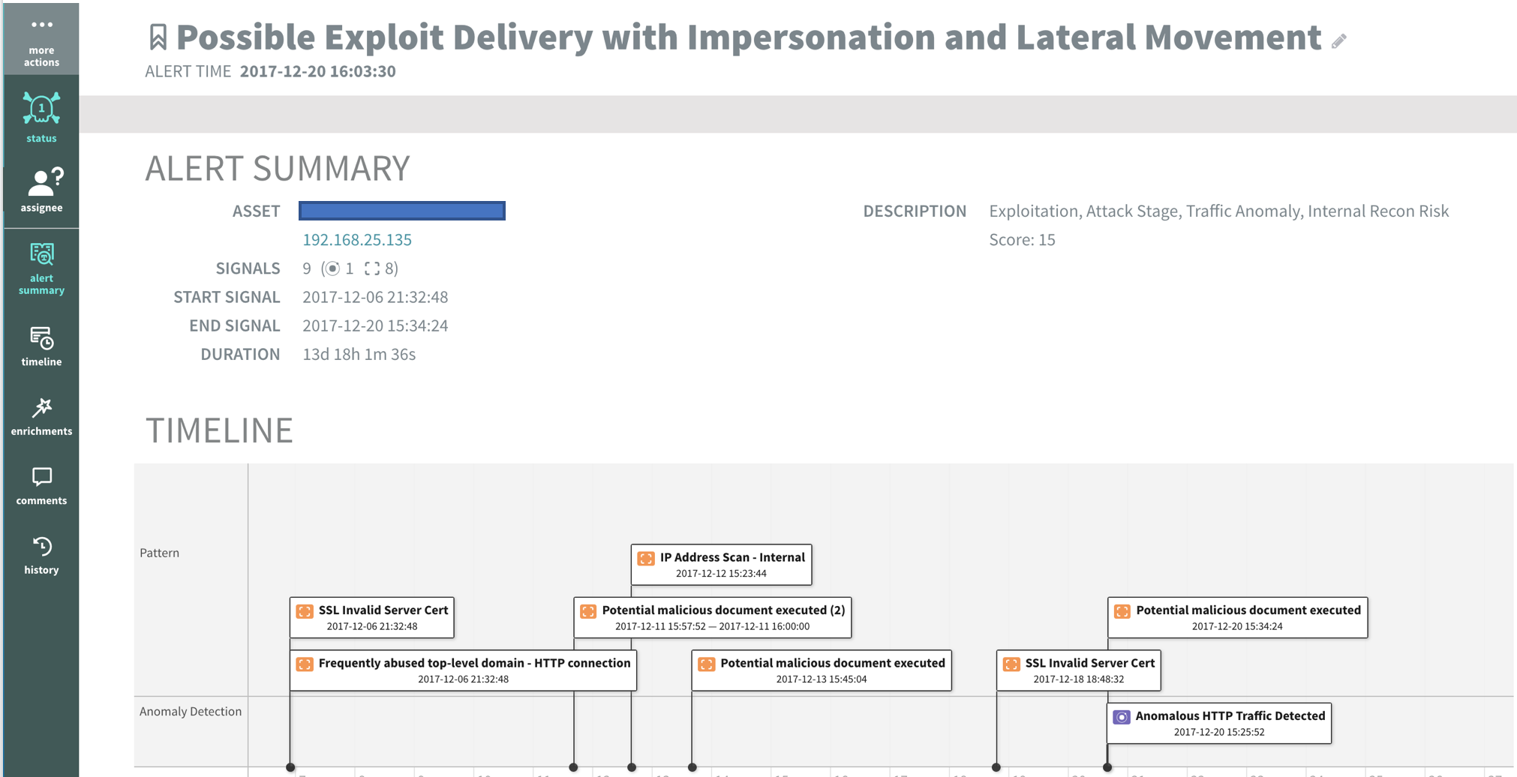
Autonomous Platform JASK ASOC platform features Autonomous Alert triage allowing your SOC to focus on reducing risk and not asking endless questions.
Notes:
Redo infographics - MAYBE ADD PRODUCT SLIDE HERE

Slide 8
Security Data Graph
Security Data Graph is JASK’s advanced data ingest capability that gives you true security ‘data lake’ capability without the pains of maintaining custom log parsers.
Network- DPI
Device
Data
User
Applications
Advanced Mapping, Enrichment, Correlation & Analysis (Visibility & Context)

Slide 9
Technology Stack Built for the Future
Rest API available
STIX/TAXII support with built-in open threat feeds
Technology Integrations with: Cylance, Carbon Black, Anomali, Splunk
Custom data investigations and visualizations

Slide 10

Technology Stack Built for the Future
JASK
CLUSTER
Customer Environment
On-Premise
Data Processing
Artificial Intelligence
Elastic Storage
NW Sensor
Enrichment
Threat Detection
DATA
Logs
Network
Signals
GeoIP
Local Model
(Neural Network)
ML / Analytics
Log Sensor
Domain Rank
STIX/ TAXII
Threat Intelligence
Global Model
(Neural Network)
Cloud Sensor
Custom API
Patterns

Slide 11







JASK Logical Deployment
Monitor VLAN
Customer Database
Critical Assets
Identity Management
Perimeter Firewall (Capture Point #1)
Asset VLANs (Capture Point X, Y, Z)
Encrypted Meta-data
SPAN/TAP
SPAN/TAP
JASK Trident Platform
Firewall
JASK Sensor
Monitor VLAN
JASK Sensor
IoT
Executive Workstations

Slide 12
JASK Case Studies

Slide 13
CHALLENGE
Lack of visibility across multiple remote sites
No way to look at data in the network to ID point of entry
Inability to see traffic patterns in real time – historical investigation painful
FINANCIAL SERVICES
“JASK has helped us detect threats and gain insights that our other cyber security tools missed altogether.”
Sr. Security Engineer
SOLUTION
Deployed in days, increasing visibility in weeks.
Platform analyzes previously unmanageable alert volume.
Team reached new levels of efficiency, expanding solution to offices around the world.

Slide 14
CHALLENGE
Victim of highly-sophisticated cyber attack
Needed new way to ID and respond to these new threats
Required an alternative solution to SIEM, that was not meeting their needs
LARGE TECH COMPANY
$1B dollar publicly-traded conglomerate headquartered in New Jersey, experienced in the need to identify and respond to cyber attacks.
SOLUTION
JASK deployed in an hour, giving visibility into dark spots without flood of alerts.
Intuitive interface helped team delve into high value security attacks.
JASK’s innovation and flexibility to new integrations enabled SIEM replacement and vision for adding new solutions forward forward.

Slide 15
CHALLENGE
Lack of visibility across multiple remote sites
No way to look at data in the network to ID point of entry
Inability to see traffic patterns in real time – historical investigation painful
GOVERNMENT SOLUTIONS PROVIDER
SOLUTION
Deployed JASK in minutes, enhancing visibility
Quickly identified an infected, connected (IoT) device
Amplified capabilities of security team, without adding resources
“JASK’s approach is a great fit for an organization like ours...though we have multiple remote sites, JASK has allowed us to apply a new level of protection across the board.”
Director, Security Operations

Slide 16
JASK Partners

Slide 17
Who To Target
Enterprise Customers
SOC operation
1000+ employees
Multi- Location
Problems Hiring
Ideal customer
Cross Vertical-
Financial Services
Healthcare
Retail
Education
SEIM project
Inefficient SOC
Fans of AI

Slide 18
Opportunity Recognition
Alert Fatigue
Hundreds to thousands of alerts
High employee turnover in SOC- Tedious repetition
Enterprise Visibility
Multiple, disparate systems- Correlation and analysis across security operations
Early Adapters
Customers interested in next generation technology
Unhappy with current SEIM
A lot of investment with minimal ROI

Slide 19
JASK- Customer Benefits
The Jask ASOC Platform Prioritizes How SOC Analysts Manage Threat Detection
Reduce organizational risk
Context: Advanced insights
Speed response times
Enable analysts to do what they were meant to do, creatively hunt threats.
Proactively identify new threats based on business insights
Improve SOC efficiency and effectiveness
Consolidate existing technologies, simplify processes.
As a community we will identify new threat identification patterns, and subsequently deliver the community higher fidelity detection through those shared insights.

Slide 20
JASK Sales Process
STEPS | Resources Available
Territory Mapping- Identify target prospects | Regional Director of Sales and Account Executives
Call –Qualify potential prospects- Project, Budget, timeframe, Champion | Regional Director of Sales and Account Executive
Analyze – customer “pain” points | JASK Security Engineer (Sales Team)
Presentation- JASK Demonstration and Technical Overview | Customer presentation, live demo
Procurement Process- Criteria, process, commitment | JASK Sales team and management
Proof of Concept- Understand success criteria, 14-days, weekly flow-up | Sales and Security Engineer
Quote | Pricing is controlled by your discount and regional sales manager
Close | JASK Team

Slide 21
Marketing Support
Collateral and Videos- www.jask.ai- Coming Soon!!
Co-Branded Materials- Collateral, events, etc.
MDF- Proposal Based- Complete MDF form- Return to Jen Winters
Partner Development
Seminars
Executive Dinners
Regional events
Bi-Weekly Webinars- Specific link to track partner contributions
Blogs- Guest blogs, links
Logos
Marketing Request- Jen Winters, jen.winters@jask.ai

Slide 22
Deal Registration
Benefits
Extra discount
Exclusive support
Protection good for 90 days/Extensions- Additional 90 day periods (3)
Process
Send email to dealreg@jask.ai with:
Name of the company
Key contact
What you have done to qualify the opportunity
Key customer need
Next steps
JASK will review opportunity and reply with acceptance or rejection- 72 Hours

Slide 23
JASK 1st Half Spiff
$250 for each Qualified Deal Registration
$500 for Qualified POC- each for Sales Representative and SE
$1,500 for Win- each for Sale Representative and SE*
AND
Deals over $1,000,000 (Net) to JASK, and we’ll deliver a Bit Coin each to the Sales Representative and the SE**
All deals must be submitted to JASK Deal Registration at dealreg@jask.ai
Deal registrations and POC’s must be approved by JASK Sales Team
Minimum deal size is 1000 employees
*JASK will pay an additional $1,500 each for deals over 10,000 employees
**Cash substitute is available , with amount determined by price of Bit Coin on day of deal close

Slide 24

Key Contacts
Marc Davis- VP of Channel & Partners, marc.davis@jask.ai, (858) 245-7690
Jen Winters- Director of Field & Channel Marketing, jen.winters@jask.ai, (602) 689-9491
Andrew Maloney, VP Customer Success, andrew.maloney@jask.ai, (703) 209-5230
Eric Parker, Sr. Security Engineer, eric.parker@jask.ai, (703) 577-4446

Slide 25
Thank You and Good Selling!!!

