Slide 1
Sales Map: AMERICAS

Slide 2
North Central:
CAM – Dirk Recker - 847-415-3320
Field Marketing – Gwen Bailey – 773-951-8812
BDR – Tu Tran – 408-986-5580
Renewals Specialist – Erin McCarty – 408-986-4452
Infoblox North Central Region (Great Lakes)
Regional Director – Doug Ennis - 312-823-9833
SE Manager – Ed Fee – 630-464-8218
VP of Sales, Americas West Area, Jim Pickering – 312-343-8445
Territory: WI, IL (847,224)
Al Rosman – AE – 414-915-7211
Dan Collier – SE – 414-350-7885
David Gundacker – ISR – 408-986-5594
Territory: MI
Des Rafferty – AE – 810-333-2479
Mike Reed– SE – 517-614-8387
Scott Serpa – ISR – 408-986-4727
Territory: MN/IA/ND/SD
Mike Johnson - AE – 612-232-1918 / michaelj@infoblox.com
Matt Baxter – SE – 612-217-1138
David Gundacker – ISR – 408-986-5594
Territory: OH (less 513)
Matt Miller – AE – 847-970-8002
Steve Barber – SE – 614-371-1290
Scott Serpa – ISR – 408-986-4727
Territory: IN, KY, So. OH (513)
Open– AE –
Tion Helaire – SE - 630-414-2196
Mike Reed– SE – 517-614-8387
Scott Serpa – ISR – 408-986-4727
Territory: IL (no 847/224)
Donja Dziak– AE – 863-832-9991
Tion Helaire – SE - 630-414-2196
David Gundacker – ISR – 408-986-5594
Key:
E-mail: firstinitiallastname@infoblox.com
AE – Account Executive (Territory and Named)
SE – Systems Engineer (Pincipal, Snr, SE)
ODR – Opportunity Development Rep
ISR – Inside Sales Representative
Territory: Named (IL, KY, IN)
George Harrison – AE – 312-505-7280
Mark Degner– SE – 312-504-1344
Scott Serpa – ISR – 408-986-4727
08/22/16
Notes:
2

Slide 3
Infoblox South Central Region:
Director of Sales – Charlie Bollom 281.253.0906
SE Manager – Keith Berton 617.538.0681
Channel Account Manager – Scott Unger 847.840.0975
VP of Sales, West Area, Jim Pickering 312.343.8445
South Central Resources:
Inside Sales Rep – Scott Serpa 408.986.4727
Business Development Rep – Sharon Haahr 408.986.5358
Field Marketing – Gwen Bailey 773.951.8812
Renewals Specialist – Erin McCarty 408.410.5824
Territory: KS, MO, NE
Jim Kimberling – TAM 913.219.1163
Scott Baker – SE 314-265-2776
SLED Account Manager (minus AZ, NM)
Lance Haile – TAM 512.795.4545
Shared based on GEO - SE
Named Account Manager, North TOLA
Eric Smith – NAM 817.505.9341
Howard Johnson – SE 972.342.9082
Territory Account Manager: South TX, LA
Greg Lindsay – TAM 713.553.0452
Amar Patel - SE 917.863.5053
Territory Account Manager: North TOLA
Craig Stock – TAM 214.282.9165
Keith Vrba – SE 214.603.0122
Territory Account Manager: AZ and NM
Vihar Chokshi – 480.236.4424
Mike Williams – SE 623.606.8604
Named Account Manager, South TX
Jeff Schulz – NAM 512.917.2193
Brad Andersen – SE 512.961.1639
Major Account Team – George Palermo 713.410.7950, SE: Scott Friedman 248.390.9164
Walmart, PepsiCo, Tyson, American Airlines, Conoco, Phillips66, Exxon Mobile, Waste Management, Valero, Marathon Oil, Halliburton, Sysco Foods
07/06/2016
Notes:
3

Slide 4

Territory: WA, OR, ID, AK
Ethan Woodward – AE – 415-941-5651 Jorge Figueira/Sif Baksh, SE’s
Territory: Northern California
Ross Beheshti – AE – 408-986-5589
Josh Lyford/Ryan Ettl – SE
Washington
Montana
Northern California Named Accounts
Brett Nunes – AE – 925-640-9415
Josh Lyford – SE – 831-207-1974
Territory: Mountain States Chris Hendee – AE - 480-560-5268 Sif Baksh – SE – 719-510-0056
Oregon
Idaho
Territory: SoCal LA to San Luis Obispo
Mark Shapiro – AE – 805-427-5999
Bob Smiley – SE – 805-300-7997
Wyoming
Nevada
Utah
Territory: SoCal (OC, SB, SD, RS, IMP, HI, Legal)
Kari Kritzer – AE- 858-254-8768 Alex Del Rio/Bob Smiley –SE’s
Colorado
California
Infoblox Pacific Region
Regional Dir– Jacob Webb - 978-761-3454
SE Manager – Jorge Figueira – 408-679-1326 VP, West – Jim Pickering – 312-343-8445 Field Marketing – Alicia Belford – 970-846-5350
CAM – Casey Earle – 858-405-2432 CAM SE – Richard Aviles – 805-991-9673 BDR – Joy Hanh – 408-986-5614 ISR – Dave Gundacker – 408-986-5594
Territory: Named Accounts
And Southern NV
Brad Rodgers – AE – 858-564-9355 Alex Del Rio – SE – 619-301-1675
Hawaii
Territory: CA, NV SLED
Fernando Gaudy – AE – 916-294-9874
Ryan Ettl – SE – 916-365-5844

Slide 5
Sales Map: New England/ Canada Region
Territory: New England/ Canada
Senior Sales Director – Northeast: TBD
Director Sales Northeast – NYC: Chris Mitchell, cmitchell@infoblox.com
Director of Sales Northeast – Boston: David Greene, dgreene@Infoblox.com
CAM: Jim Kelly Jkelly@Infoblox.com
Channel SE: open
FMM: Melissa Mertl, mmertl@infoblox.com
Territory: Canada – AB / QC / SK / MBNamed & AB
AM: Gabe Bahou, gbahou@infoblox.com
SE: Joe Briante jbriante@infoblox.com
SE Marc Bourget Mbourget@Infoblox.com
YT
Territory: Canada – MB, SK, ON
AM: Blair Singler, bsingler@infoblox.com
SE: Joe Briante jbriante@infoblox.com
SE Marc Bourget Mbourget@Infoblox.com
NT
NU
Territory: MA / NH / VT / ME/RI
AM: David Balan, dbalan@infoblox.com (named Accounts)
AM: Open
AM: Sean Dillon Sdillon@Infoblox.com
SE: Brian Hebert, bhebert@infoblox.com
SE: Open
ISR: Sebastian Amaya samaya@infoblox.com
BC
AB
NL
SK
MB
CANADA
ON
QC
PE
NB
Territory: Canada – BC, NB, NS, PE, NL, NT, NU, YT, QC,ON
AM: Pete Dow gbahou@ Pdow@infblox.com
SE: Joe Briante jbriante@infoblox.com
SE Marc Bourget Mbourget@Infoblox.com
NS
ME
CT went to Chris Mitchell team RI stayed in new England
USA
(New England Region)
VT
NH
MAM – Major Account Manager
AM – Account Manager
SE – Systems Engineer
ISR – Inside Sales Rep
CAM – Channel Account Manager
FMM – Field Marketing Manager
MA
CT
RI

Slide 6
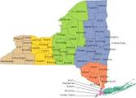
NY Metro:
CAM – Gregg O’Neill- 631-826-9335
Field Marketing – Melissa Mertl – 773-951-8812
Renewals Specialist – Rehka Gupta – 408-986-4452
Infoblox New York Metro Region NY,PA,DE,NJ & SLG
Regional Director – Chris Mitchell- 631-416-1353
SE Manager – Ben Shelston– 647-980-2853
Territory: NY Territory Mngr
Dan Sommerman– AE – 917-254-3243
Nathan Snook– SE – 973-794-0091
Anthony DiSanti– ISR – 646-801-5926
Paul Andal – BDR -561-706-4191
Territory: NJ Territory Manager
James Piazza– AE – 551-804-6488
OPEN– SE –
Anthony Disanti– ISR – 646-801-5926
Paul Andal – BDR -561-706-4191
Territory: Philadelphia Metro & Deleware
Joe Dimond- AE – 484-880-3063
John Leibel– SE – 215-962-8455
Anthony DiSanti – ISR – 646-801-5926
Paul Andal – BDR -561-706-4191
Territory: NY Named Accts
Adam Rann – AE – 201-410-5391
James Borstock – SE – 614-371-1290
Anthony DiSanti– ISR – 646-801-5926
Paul Andal – BDR -561-706-4191
Territory: Pittsburgh & Erie County
TBH– AE –
TBD– SE -
Anthony DiSanti– ISR – 646-801-5926
Paul Andal – BDR -561-706-4191
Territory: CT & Upstate NY
John Stroiney – AE – 860-519-9655
Dave Iannacone– SE – 517-614-8387
Anthony DiSanti– ISR – 646-801-5926
Paul Andal – BDR -561-706-4191
Territory: State & Local Gov’t
Michael Katz– AE – 914-525-2903
Dave Iannacone– SE – 312-504-1344
Anthony Disanti– ISR – 646-801-5926
Paul Andal – BDR -561-706-4191
08/22/16
Notes:
6

Slide 7
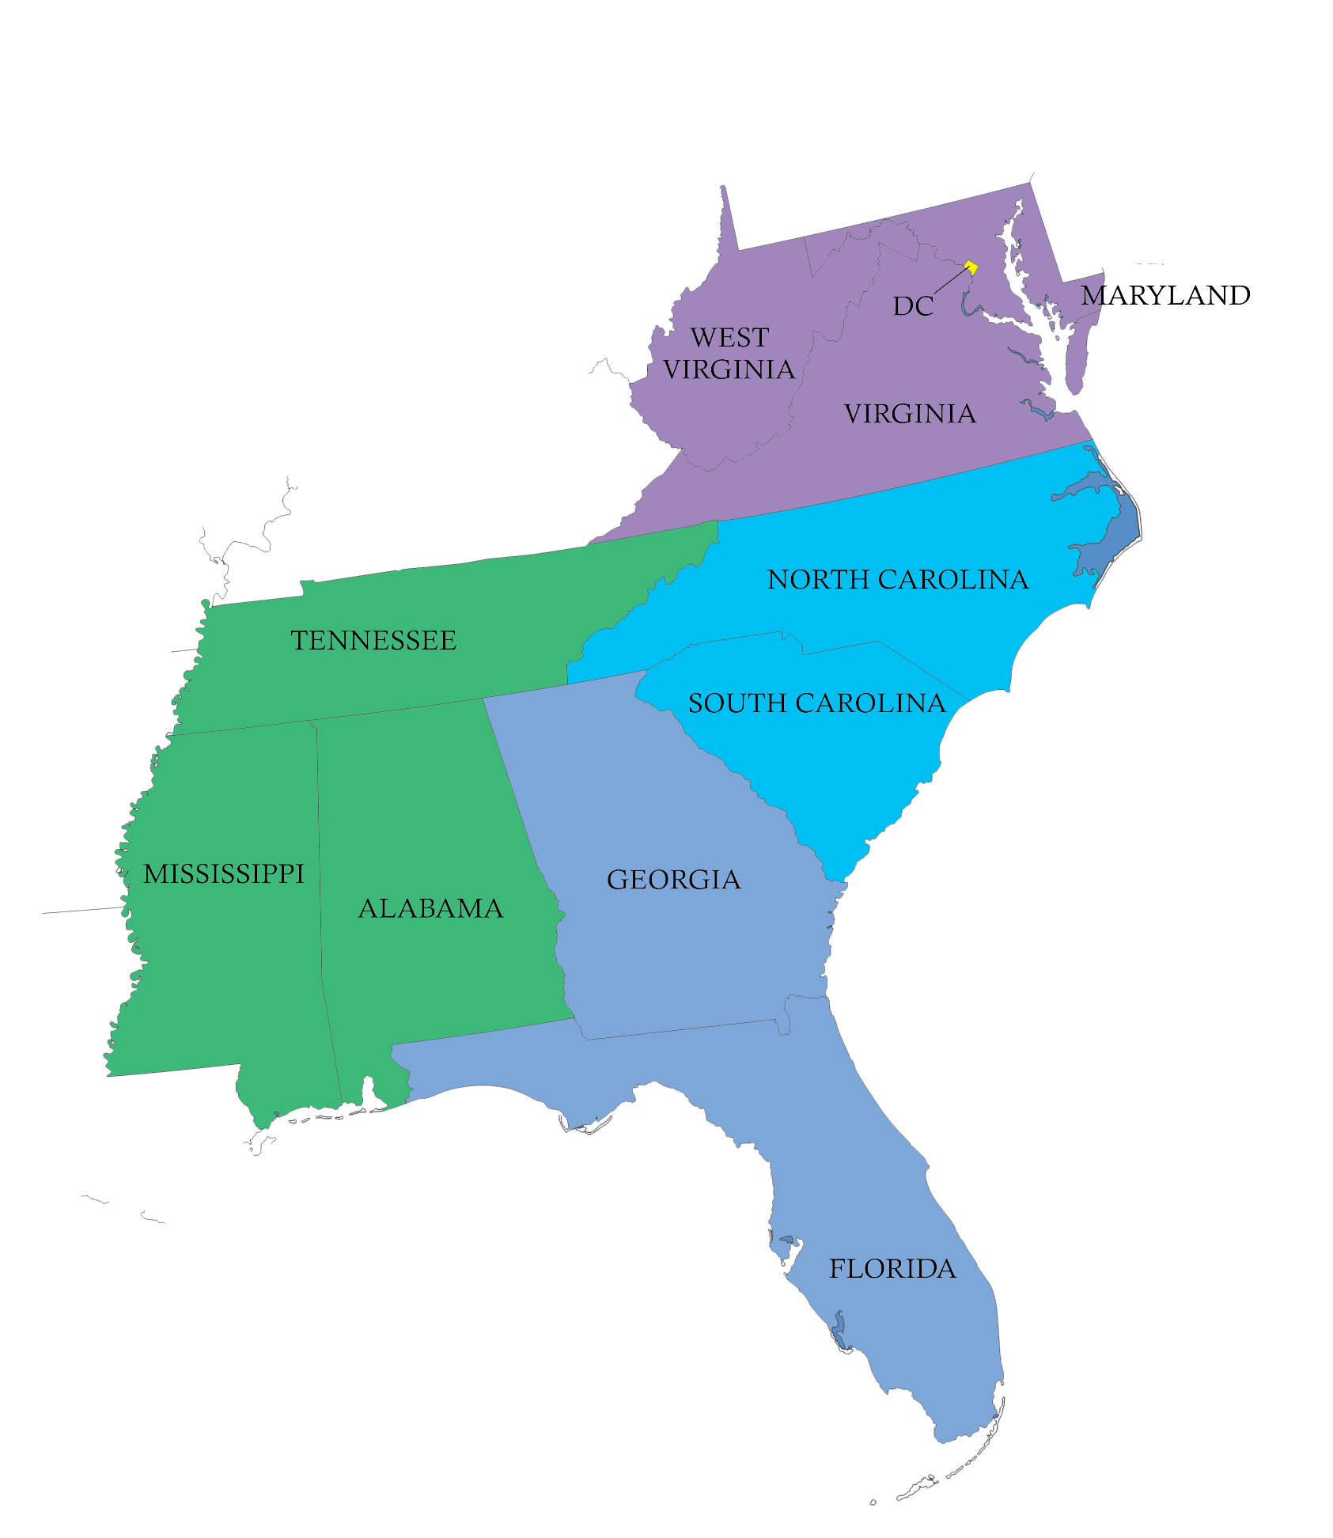
Infoblox Southeast Region
Regional Sales Director: Rob Bolton (571) 388-8353
Systems Engineering Director: Don Smith (804) 426-0572
Channel Account Manager: Tom Thomas (770) 335-3578
Field Marketing Manager: Michelle Dunne (408) 460-1428
Inside Sales (ISR): Leland Hicks (919) 899-9611 Ken, Rick & Gary
Edric Carreon (571) 748-4508 Al, Jennifer & Lesley
Paul Andal (443) 333-8018 Amir & Kelly
Territory: WV/ VA / DC
NAM: Albert Zanger (410) 241-7509 TAM: TBH (Rob Bolton covering)
SE: Jeff Cummings (703) 470-7761
Ross Gibson (804) 476-0852
Territory: MD
TAM: Lesley Ransom (404) 353-3156 SE: Jeff Cummings (703) 470-7761
Ross Gibson (804) 476-0852
Territory: NC / SC
NAM: Rick Cagle (919) 906-3006
TAM: Ken Newbill (704) 774-5894
SE: Keith Lynch (704) 957-5604
Territory: GA / Parts of FL
TAM: Amir Bayani (770) 377-4465
SE: Chris Elmore (678) 983-9610
Territory: S. Florida + Tampa
TAM: Gary Lee (305) 281-9203
Office: 954-607-2235
SE: Stephen Holland (678) 804-7908
Territory: MS / TN / AL / GA
TAM: Kelly Mock (678) 995-2162
SE: Michael Leighty (404) 775-6226
Territory: Major Accounts
MAM: Derek Terry (678) 362-4709
SE: Marc Perrella (678) 965-6951
MAM: Steve Meadows (678) 429-4652
SE: Sam Smart (678) 448-6873
MAM: Major Account Manager
NAM: Named Account Manager
TAM: Account Executive
SE: Systems Engineer
ISR: Inside Sales Rep

Slide 8
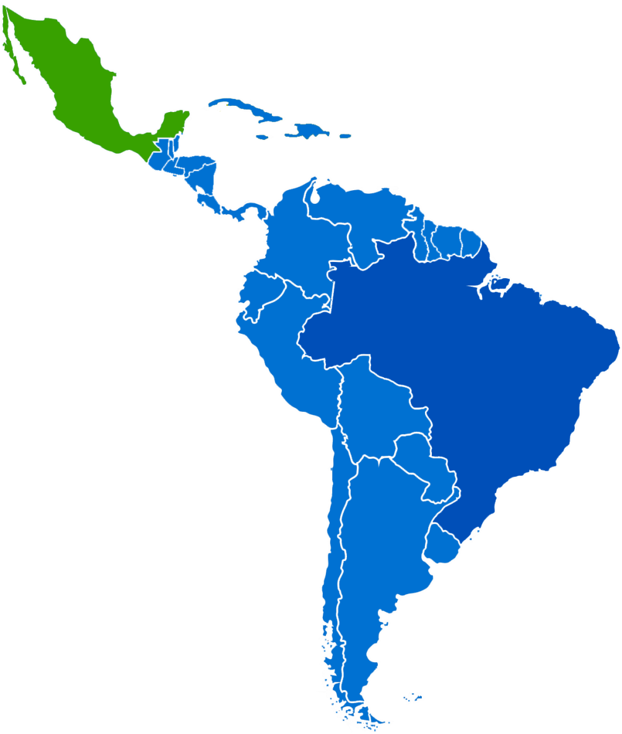
Sales Map: LATAM Region
Territory: LATAM Region
Director of Sales: Alex Maduro, amaduro@infoblox.com
SEM: Alejandro Aguila, aaguila@infoblox.com
FMM: Lorena Munevar, lmunevar@infoblox.com
Mexico
Territory: Brazil Enterprise
AM: Marcelo Alongi, malongi@infoblox.com
SE: Paulo Gracia, pgracia@infoblox.com
Territory: Mexico
AE: Ivan Sanchez, isanchez@infoblox.com
SE: Francisco Osornio, fosornio@infoblox.com
Brazil
Territory: CCA and ROLA
AE: Saul Escalante, sescalante@infoblox.com
SE: Juan Chamorro, jchamorro@infoblox.com
MAM – Major Account Manager
AE – Account Executive
SE – Systems Engineer
ISR – Inside Sales Rep
CAM – Channel Account Manager
FMM – Field Marketing Manager

Slide 9
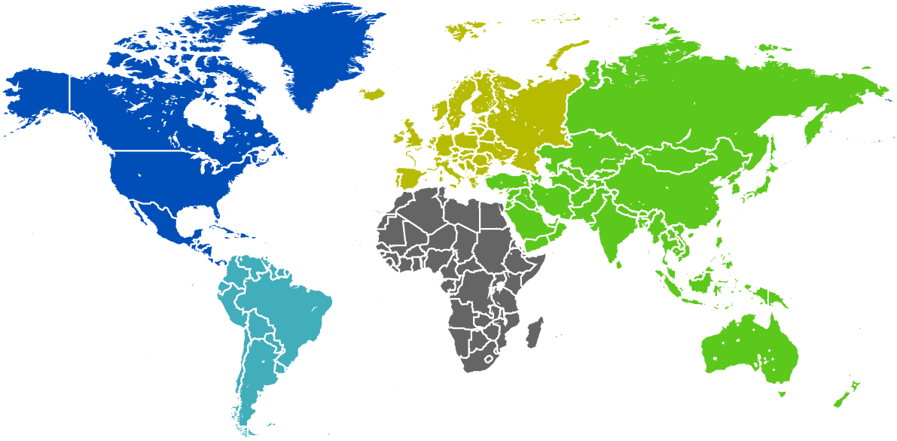
Worldwide Channel Map
Territory: Worldwide Channel Sales VP Worldwide Channel Sales: Ricardo Moreno, rimoreno@Infoblox.com
Territory: EMEA Channel Sales
Acting Channel Director: Alexander Foroozande, aforoozande@infoblox.com
WEUR CAM: Justine Weinblatt-Weir, jweinblatt@infoblox.com
SEUR CAM: Paolo Lauretti, plauretti@infoblox.com
NEUR CAM: Tom Hollanders, thollanders@infoblox.com
CEUR CAM: Salih Dik-Fesci, sfesci@infoblox.com
ME, Africa, Turkey CAM: Alexander Foroozande, aforoozande@infoblox.com
Territory: Americas Channel Sales
Channel Director: Mark Fitzmaurice, mfitzmaurice@infoblox.com
Pacific CAM: Casey Earle, cearle@infoblox.com
North Central CAM: Dirk Recker drecker@infoblox.com
South Central CAM: Scott Unger, sunger@infoblox.com
Southeast CAM: Tom Thomas, tomt@infoblox.com
New York (NY/NJ/PA/DE) CAM: Greg O’Neill, goneill@infoblox.com
New England/CAN CAM: Jim Kelly, jkelly@infoblox.com
Acting Federal: Ralph Havens, rhavens@infoblox.com
Territory: APJ Channel Sales
Channel Director: Hwa Cheong Wong, hwong@infoblox.com
Channel SE: Bob Chan bchan@infoblox.com
Global Channel: Major Account Managers
SI MAM: Mark Fitzmaurice, mfitzmaurice@infoblox.com
SI MAM: Eric Rupert, erupert@infoblox.com
SI MAM: Alan Kastner, akastner@infoblox.com
Channel Programs:
Director, Channel Programs: Sandy Janes, sjanes@infoblox.com
Channel Programs Specialist: Noemi Van Nest, nvannest@infoblox.com
Channel Sales Engineering:
Channel SE AMS West: Richard Aviles, raviles@infoblox.com
Channel SE AMS East: Asif Husain, ahusain@infoblox.com
SI Channel SE: Jim Zelnosky, jzelnosky@infoblox.com
09/27/2016

Slide 10















Global Director, SP
CAM: Alan Kastner, akastner@infoblox.com
SE: Jim Zelnosky, jzelnosky@infoblox.com
National Channel Account Manager
CAM: Eric Rupert, erupert@infoblox.com
SE: Asif Husain, ahusain@infoblox.com
Sales Director – Global SI/Alliances
CAM: Mark Fitzmaurice, mfitzmaurice@infoblox.com
SE: Asif Husain, ahusain@infoblox.com
Channel - SI
TBH
SP – Service Provider SI – System Integrator
Notes:
Removed Xerox 8/30/15 – Acquired by Atos
10

Slide 11
AM: Mark Belen, mbelen@infoblox.com
SE: Frank Hecker, fhecker@infoblox.com
ISR: William Cahillane, wcahillane@infoblox.com
AM: Mark Chrisp, mchrisp@infoblox.com
SE: Joe Kattner, jkattner@infoblox.com
ISR: Avonne Thompson, vthompson@infoblox.com
AM: Walter Henderson, whenderson@infoblox.com
SE: Fred Reitberger, freitberger@infoblox.com
ISR: William Cahillane, wcahillane@infoblox.com
AM: Chris Wilkinson, cwilkinson@infoblox.com
SE: David Williams, dwilliams@infoblox.com
ISR: Avonne Thompson, avthompson@infoblox.com
DHS, Treasury, Interior, SEC, FDIC, NARA, Legislative
Navy, Marine Corps, DHA, DREN, DARPA
DISA, Army, Air Force, DLA, Pentagon
Special Programs
AM: Rick Knapp, rknapp@infoblox.com
SE: Bob Kloak, rkloak@infoblox.com
ISR: William Cahillane, wcahillane@infoblox.com
AM: John Sullivan, jsullivan@infoblox.com
SE: Paul Parker, paulp@infoblox.com
ISR: Avonne Thompson, vthompson@infoblox.com
AM: Orlando Zayes, ozayes@infoblox.com
SE: TBH
ISR: William Cahillane, wcahillane@infoblox.com
Energy, HHS, State, Transportation, VA, Commerce, EPA, FTC, OPM, USPS
Special Programs, CTBER Command
Labor, Justice, USAID, Education, HUD, NASA, EEOC, SSA, USDA, US Courts
AM – Account Manager SE – Systems Engineer ISR – Inside Sales Rep
Regional Sales Director - Federal: Ralph Havens, rhavens@infoblox.com
Federal Account Manager: Chris Wilkinson, cwilkinson@infoblox.com
Notes:
11

Slide 12
MAM – Major Account Manager
SE – Systems Engineer
ISR – Inside Sales Rep
CAM – Channel Account Manager
MAM Map – West
South West
MAM: Tony Costello, tcostello@infoblox.com
SE: Robert Davis, rdavis@infoblox.com
CAM: TBH
ISR: Jeff Francis jfrancis@Infoblox.com
Lockheed Martin
American Express
Ingram Micro
Northrup Grumman
DiVita Health
Liberty Global
Honeywell
Western Union
Dish
Catholic Health Initiatives
AECOM
Farmer’s Insurance
Boeing
Jacobs Engineering
Silicon Valley
MAM: Marty Kibiloski mkibloski@Infoblox.com
SE: Steve Salo ssalo@Infoblox.com
CAM: TBH
ISR: Ryan Allyn
Safeway/Alnertson’s
Kaiser Permanente
Chevron
Intel
Apple
Oracle
McKesson
Cisco
eBay
PG&E
Visa
Facebook
North West (OR/WA)
MAM: Travis Moroch tmoroch@Infoblox.com
SE: Steve Salo ssalo@Infoblox.com
CAM: TBH
ISR: Ryan Allyn
Costco Wholesale
Amazon.com
Nike
Starbucks
Nordstrom
Microsoft
Weyerhauser
Precision Castparts
Paccar
Micron
Boise Cascade
Notes:
12

Slide 13
MAM – Major Account Manager
SE – Systems Engineer
ISR – Inside Sales Rep
CAM – Channel Account Manager
MAM Map – Central
North Central (IL)
MAM: Frank Depizzo, fdepiizo@infoblox.com
SE: Mike Zera mzera@Infoblox.com
CAM: Dirk Recker drecker@Infoblox.com
ISR: Jeff Francis jfrancis@Infoblox.com
Archer Daniels Midland
Caterpillar
Deere & CO
State Farm Insurance
United Airlines
Abbott Labs
AbbVie
Walgreens
Johnson Controls
Allstate
McDonald’s
Anthem
North Central (MN)
MAM: Rob Slaughter, rslaughter@infoblox.com
SE: Steve Makousky, smakousky@infoblox.com
CAM: Dirk Recker drecker@Infoblox.com
ISR: Ryan Allyn rallyn@Infoblox.com
3M
Best Buy
Target
UnitedHealth Group
Cargill
Medtronic
Thompson Reuters
Principal Financial
CH Robinson
General Mills
CHS
Xcel Energy
TOLA (Houston)
MAM: George Palermo gpalermo@Infoblox.com
SE: Scott Freidman sfriedman@Infoblox.com
CAM: Scott Unger, sunger@infoblox.com
ISR: Jonathan Wolf jwolf@Infoblox.com
Exxon Mobil
Valero Energy
Marathon Petro
Sysco Corporation
Halliburton (Baker Hughes)
Waste Management
Wal-Mart Stores
P66
ConocoPhillips
Southwest Airline
Tyson Foods
America Airlines
Notes:
13

Slide 14
MAM – Major Account Manager
SE – Systems Engineer
ISR – Inside Sales Rep
CAM – Channel Account Manager
MAM Map – East
New England
MAM: Paul Duato pduato@Infoblox.com
SE: Chris De Los Reyes cdelosreyes@Infoblox.com
CAM: TBH
ISR: Johnathan Wolf jwolf@Infoblox.com
CIGNA
Raytheon
TJMaxx
Aetna
Mass Mutual
CVS/Caremark
UTC
Dupont/DOW
Textron
Thermo Fisher Scientific
Praxair
NY (Financial)
MAM: Al Onove
SE: Joe Possert, jpossert@infoblox.com
CAM: Brett Johnson bjohnson@Infoblox.com
ISR: Jeff Francis jfrancis@Infoblox.com
Bank of America
IBM
Metslife
CBS
Morgan Stanley
Goldman Sachs
AIG
Pfizer
Merck
Prudential
South East
MAM: Steve Meadows, smeadows@infoblox.com
SE: Marc Perella mperrella@Infoblox.com
CAM: Tom Thomas, tomt@infoblox.com
ISR: Jeff Francis jfrancis@Infoblox.com
International Paper
HCA Holdings
FedEx Corp
Lowe's
Wells Fargo Bank
Deloitte
Freddie Mac
Duke Energy
AFLAC
TIAA-CREF
Autozone
South East
MAM: Derek Terry, dterry@infoblox.com
SE: Marc Perrella, mperrella@infoblox.com
CAM: Tom Thomas, tomt@infoblox.com
ISR: Jeff Francis jfrancis@Infoblox.com
Publix
Coca-Cola Company
General Electric
Home Depot
ADP
Disney
HD Supply
PWC
UPS
First Data Corporation
AutoNation
Notes:
14

