Slide 1
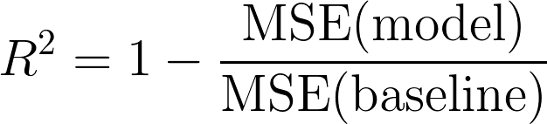
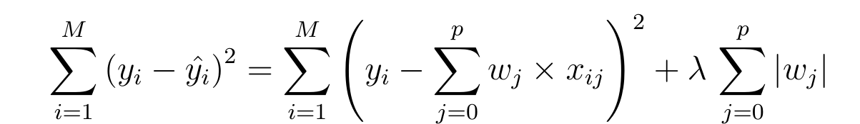
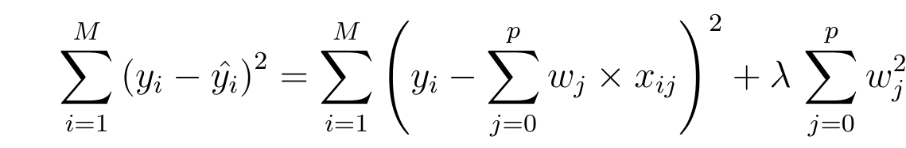
Regression(with numerical data)
Model | Coefficient of Determination(R^2)
Linear Regression | 0.81538
Linear Regression after normalization | 0.81530
Linear Regression after PCA (error 0.15) | 0.79563
Linear Regression with log y | 0.87591
Lasso(lambda = 0.1) | 0.87614
Ridge(lambda =1) | 0.86978
Lasso
Ridge

Slide 2
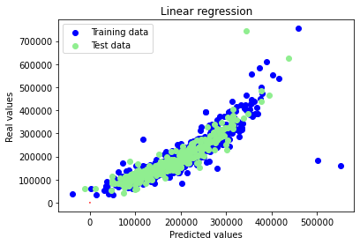
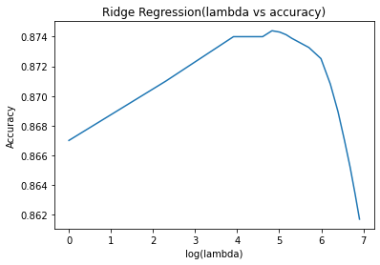

Slide 3
Clustering
Model | Overall Accuracy | Class 0 | Class 1 | Class 2 | Class 3 | Class 4
Kmeans with categorical data | 0.272 | 0.377 | 0.0399 | 0.117 | 0.6234 | 0.587
Kmeans with numerical data | 0.178 | 0.781 | 0.0159 | 0.349 | 0.081 | 0.013
Agglomerative Clustering with categorical data | 0.349 | 0. | 0.625 | 0.078 | 0.243 | 0.502
Agglomerative Clustering with Numerical data | 0.127 | 0.167 | 0.096 | 0.271 | 0.019 | 0.013

