Slide 1
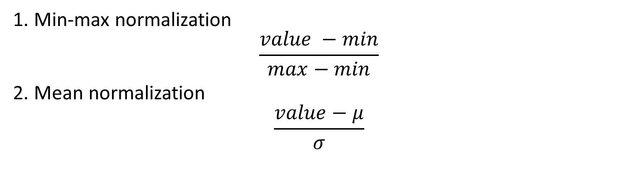
Normalization
1. Min-max normalization
$$\frac{value −min}{max−min}$$
2. Mean normalization
$$\frac{value−μ}{σ}$$

Slide 2
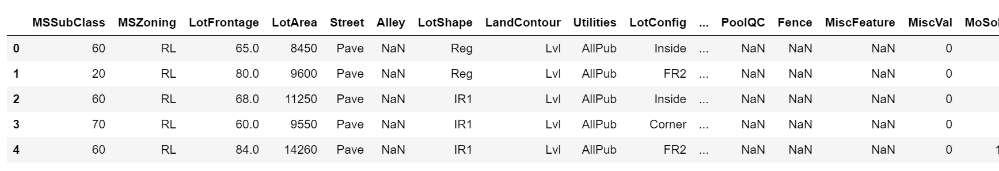
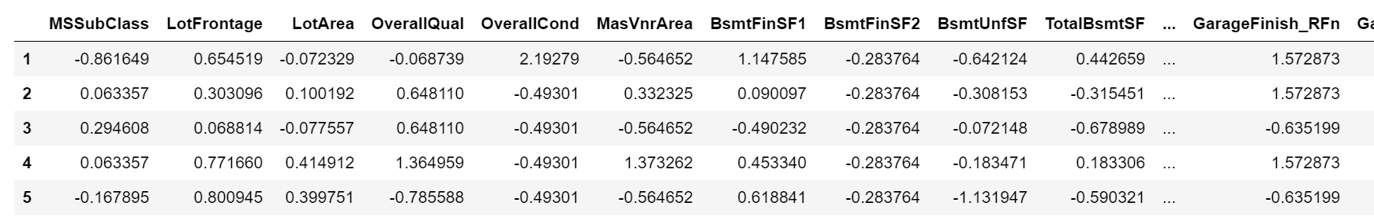
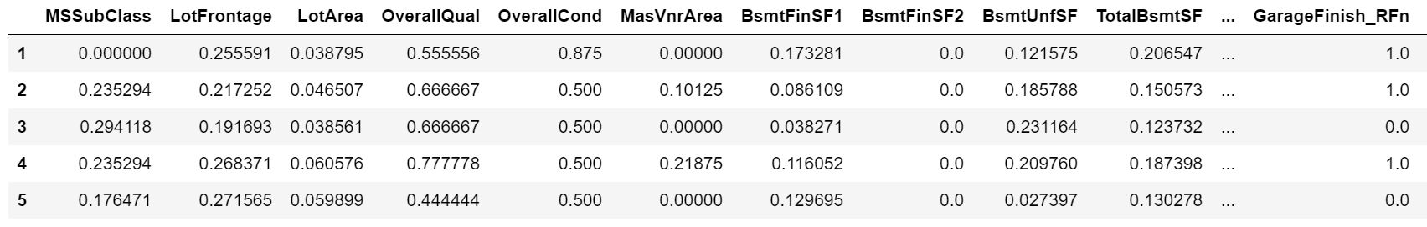
Normalization Con’t
Figure 1. A glance of the original dataset
Figure 2. Dataset after mean normalization
Figure 3. Dataset after min-max normalization

Slide 3
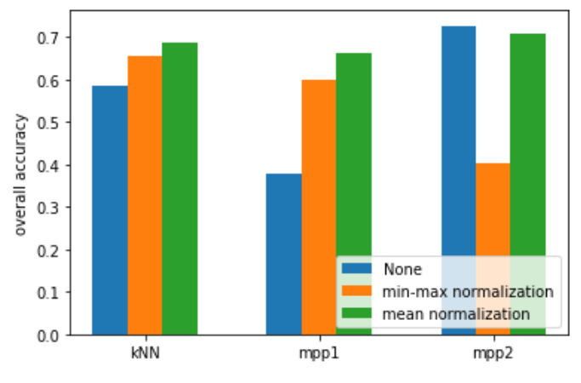
Normalization Con’t

Slide 4
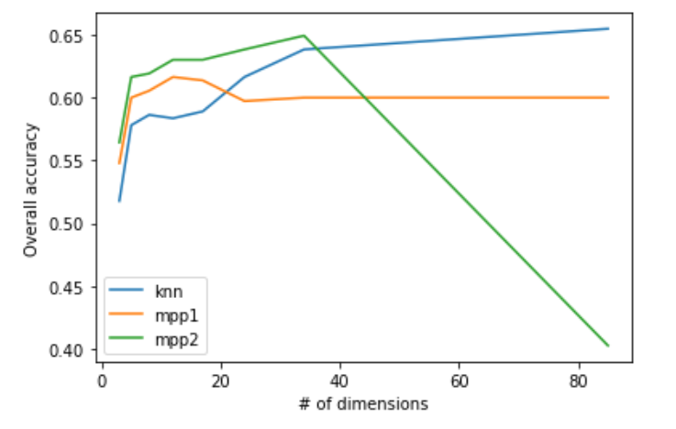
Dimension Reduction

Slide 5
With or without categorical data
 | With Categorical Data | Remove Categorical Data
MPP1 | 0.531 | 0.663
MPP2 | 0.592 | 0.688
Decision Tree | 0.548 | 0.690
SVM | 0.641 | 0.734

