Slide 1


Tech ABC Corp - HR Database
[Student Name & Date]

Slide 2
Business Scenario
Business requirement
Tech ABC Corp saw explosive growth with a sudden appearance onto the gaming scene with their new AI-powered video game console. As a result, they have gone from a small 10 person operation to 200 employees and 5 locations in under a year. HR is having trouble keeping up with the growth, since they are still maintaining employee information in a spreadsheet. While that worked for ten employees, it has becoming increasingly cumbersome to manage as the company expands.
As such, the HR department has tasked you, as the new data architect, to design and build a database capable of managing their employee information.
Dataset
The HR dataset you will be working with is an Excel workbook which consists of 206 records, with eleven columns. The data is in human readable format, and has not been normalized at all. The data lists the names of employees at Tech ABC Corp as well as information such as job title, department, manager's name, hire date, start date, end date, work location, and salary.
IT Department Best Practices
The IT Department has certain Best Practices policies for databases you should follow, as detailed in the Best Practices document.

Slide 3
Step 1
Data Architecture Foundations

Slide 4
Step 1: Data Architecture Foundations
Hi,
Welcome to Tech ABC Corp. We are excited to have some new talent onboard. As you may already know, Tech ABC Corp has recently experienced a lot of growth. Our AI powered video game console WOPR has been hugely successful and as a result, our company has grown from 10 employees to 200 in only 6 months (and we are projecting a 20% growth a year for the next 5 years). We have also grown from our Dallas, Texas office, to 4 other locations nationwide: New York City, NY, San Francisco, CA, Minneapolis, MN, and Nashville, TN.
While this growth is great, it is really starting to put a strain on our record keeping in HR. We currently maintain all employee information on a shared spreadsheet. When HR consisted of only myself, managing everyone on an Excel spreadsheet was simple, but now that it is a shared document I am having serious reservations about data integrity and data security. If the wrong person got their hands on the HR file, they would see the salaries of every employee in the company, all the way up to the president.
After speaking with Jacob Lauber, the manager of IT, he suggested I put in a request to have my HR Excel file converted into a database. He suggested I reach out to you as I am told you have experience in designing and building databases. When you are building this, please keep in mind that I want any employee with a domain login to be able to access the database. I just don't want them having access to salary information. That needs to be restricted to HR and management level employees only.
I also want to make sure you know that am looking to turn my spreadsheet into a live database, one I can input and edit information into. I am not really concerned with reporting capabilities at the moment. Since we are working with employee data we are required by federal regulations to maintain this data for at least 7 years; additionally, since this is considered business critical data, we need to make sure it gets backed up properly.
I am looking forward to working with you and seeing what kind of database you design for us.
Thanks,
Sarah Collins
Head of HR

Slide 5
Data Architect Business Requirement
Purpose of the new database
The idea is to correctly and efficiently store HR Data in a SQL Database. The purpose is having a better process to manage the employees of the company, since the company is growing and managing this info in a spreadsheet is far from a good practice.
Data to be stored
Some of the data attributes we’ll be capturing:
Emp_ID, Emp_Nm, Email, Hire_DT, Job_Title, Salary, Department, Manager of Employee, Start_Dt, End_Dt; Location, Address, City, and State of where the employee works and the employee’s education level.
Who will own/manage data
The Technology department owns the database and the infrastructure, and the HR Organization owns the data that’s being added and its quality.
Who will have access to database
HR Managers can have access to their own Organization
HR Admins can have access to the whole database
Business Partners with Admin access can access the whole db.

Slide 6
Data Architect Business Requirement
Estimated size of database
The database will have around 7 tables, starting with about 200 emplooyes, since we’ll have a historical table where one employee can appear more than one time, let’s say we’ll start with 400 rows, with the potential in a year or two to grow about 200% - no concerns about this part, the number of rows is pretty small.
Estimated annual growth
The maximum estimated growth by year should be 100%.
Is any of the data sensitive/restricted
We have PII data (name, email, salary), gotta be careful with it.
Data retention and backup requirements
Data will be retained permanently.
We’ll be doing weekly backups with incremental daily backups, just to make sure we don’t risk to lose any data due to any type of problems.

Slide 7
Data Architect Technical Requirement
Justification for the new database
The way HR is storing data on the company employees is not reliable at all, it is very prone to human error, implementing a SQL DB can help with that – improves reliability
With the SQL DB we can have data stored in an efficient way, in a way that will work in the short, medium, and long term – improves scalability
Database objects
Tables:
public.employees, public. employees_hist, public.city, public.state, public.address, public.location, public.job_titles, public.departments, public
View:
Public.vw_employees_hist
Data ingestion
We’ll use a stored procedure with SQL queries to create the tables, and to insert the data from staging into our 3NF model.

Slide 8
Data Architect Technical Requirement
Data governance (Ownership and User access)
Ownership: The HR Department of the company is the owner of the Database.
User Access: HR Leaders can have access to all of the data,
Managers can have access to their Organization’s data.
Scalability & Flexibility considerations
List at least 2 examples of considerations taken to ensure data scalability and flexibility, and provide an explanation
Storage & retention
Storage (disk or in-memory): Data will be stored in Disk.
Retention: Indefinitely, there’s no need to erase the data since it’s not a huge amount of information that we’ll be storing.
Backup
Weekly backups with Daily incremental backups.

Slide 9
Step 2
Relational Database Design

Slide 10
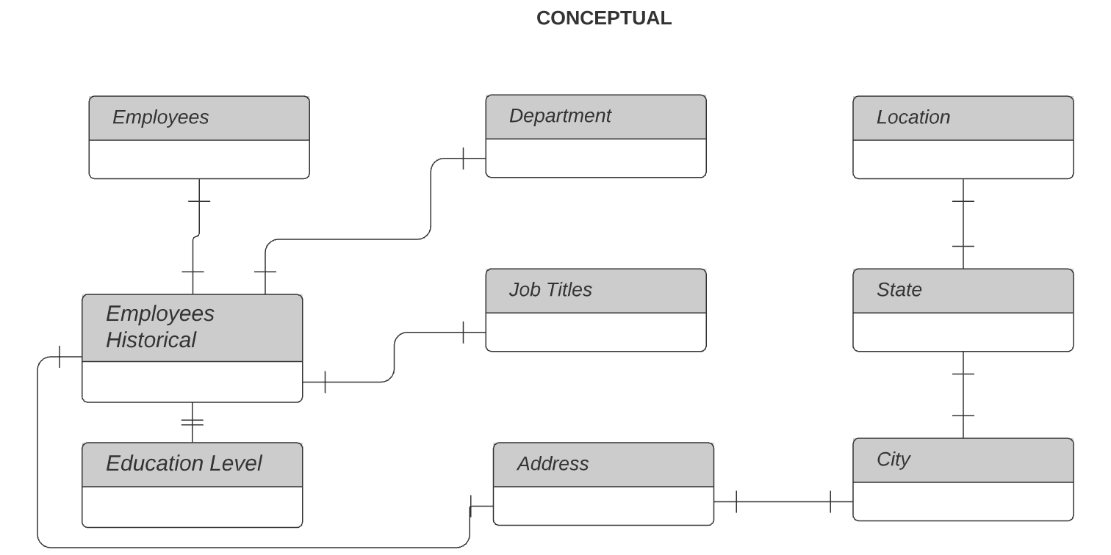
Step 2: Relational Database Design - ERD
Conceptual

Slide 11
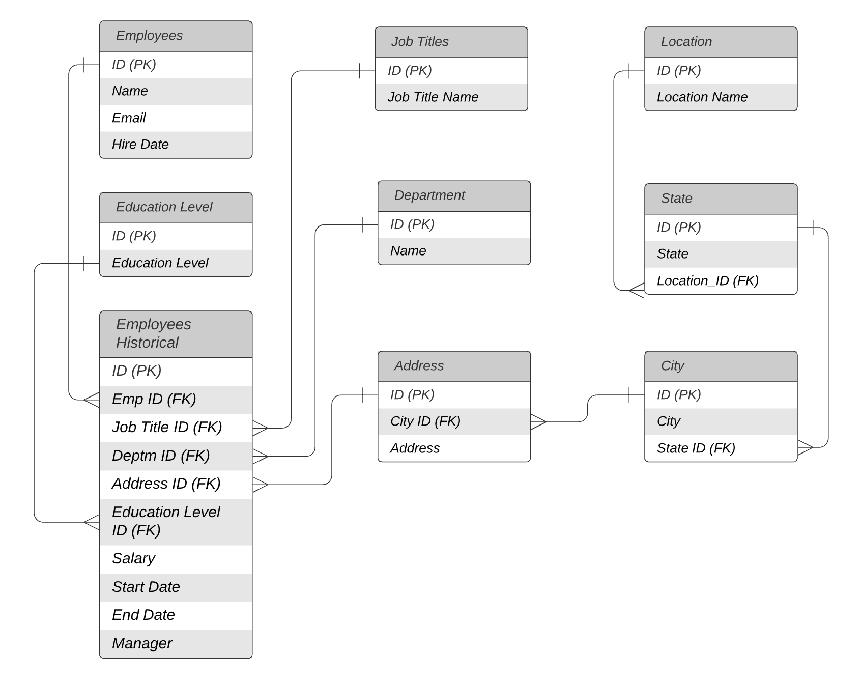
ERD
Logical

Slide 12
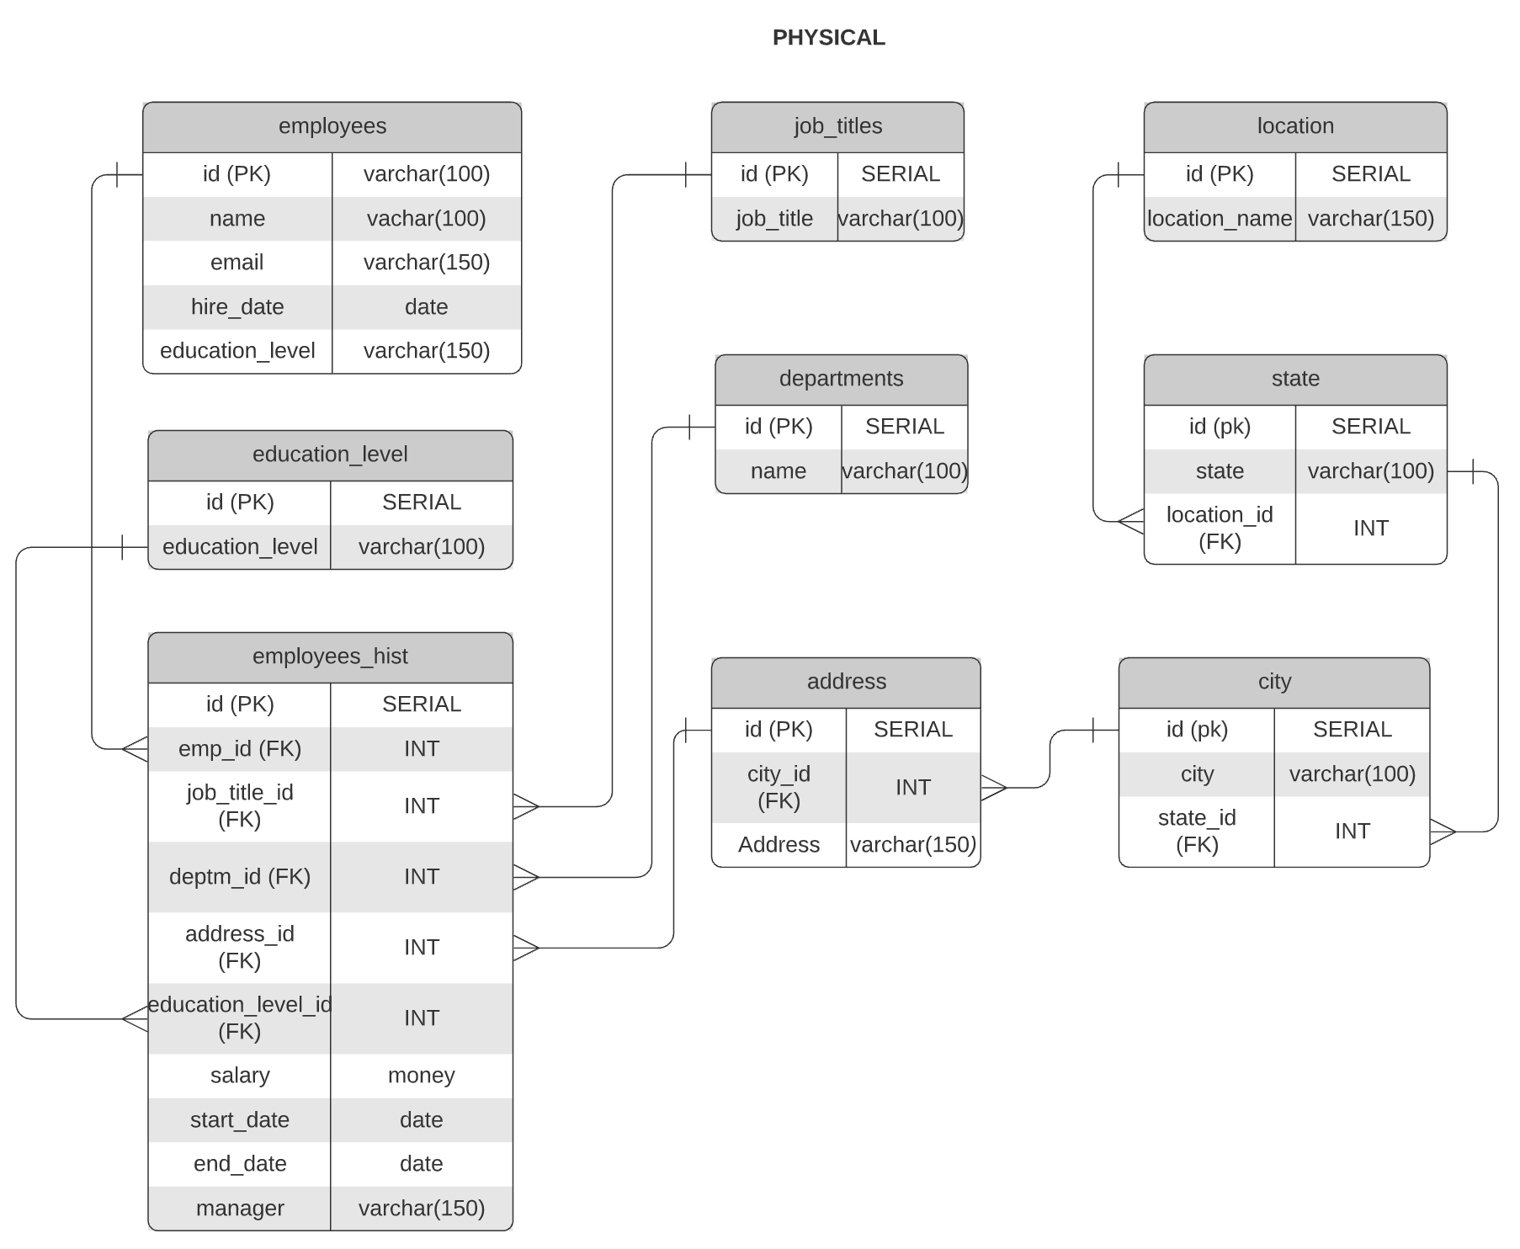
ERD
Physical

Slide 13
Step 3
Create A Physical Database

Slide 14
Step 3: Create A Physical Database
In this step, you be turning your database model into a physical database. will
You will:
Create the database using SQL DDL commands
Load the data into your database, utilizing flat file ETL
Answer a series of questions using CRUD SQL commands to demonstrate your database was created and populated correctly
Submission
SQL QUERIES:
SQL Queries to create tables:
https://drive.google.com/file/d/1-SAUzp_Yjqm60mkX09bNWhbxhZmLQn9w/view?usp=sharing
SQL Queries to insert data into created n normalized tables:
https://drive.google.com/file/d/17GVf2pwpWpL_Tazf1Eog-fwEByporc9Z/view?usp=sharing
SQL Queries for Crud Exercises (1 to 7):
https://drive.google.com/file/d/1dbB8e4KZknZZRQSAbL8cTrYUhsr5v6p5/view?usp=sharing

Slide 15
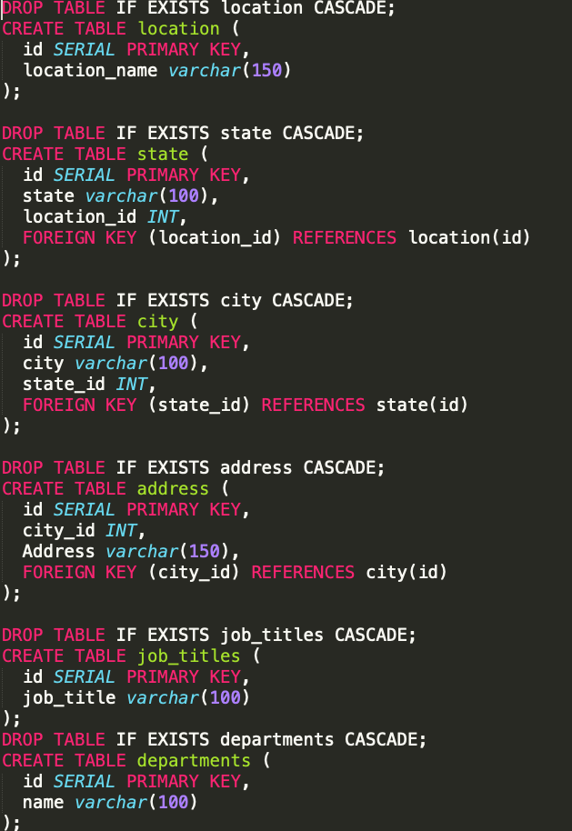
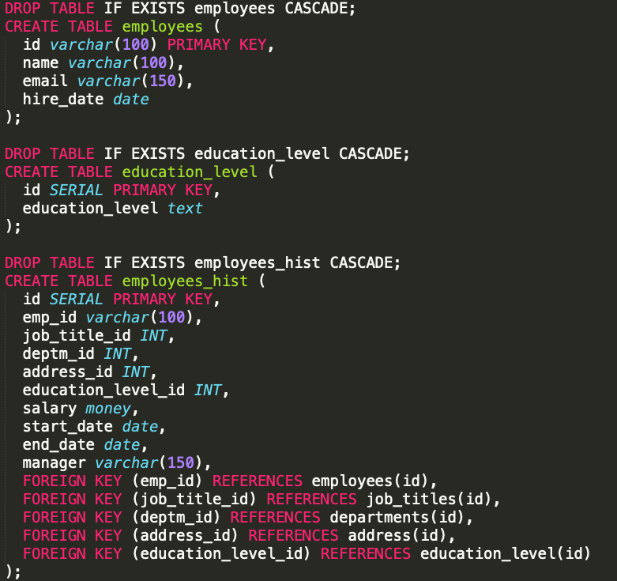
DDL
Create a DDL SQL script capable of building the database you designed in Step 2

Slide 16
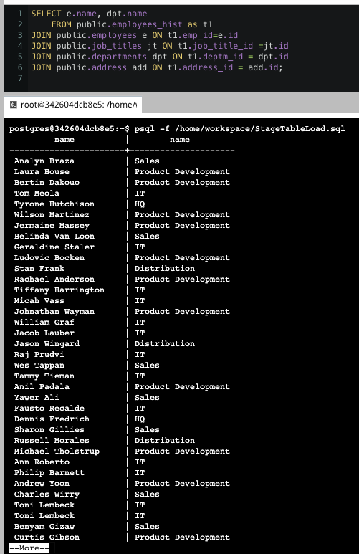
CRUD
Question 1: Return a list of employees with Job Titles and Department Names

Slide 17
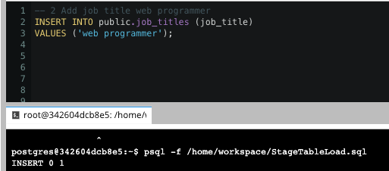
CRUD
Question 2: Insert Web Programmer as a new job title

Slide 18
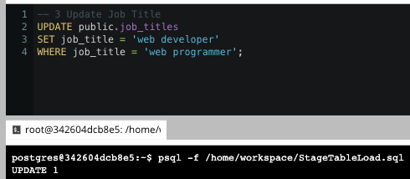
CRUD
Question 3: Correct the job title from web programmer to web developer

Slide 19
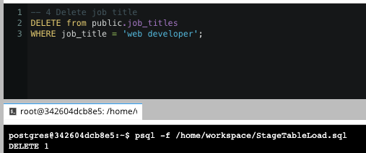
CRUD
Question 4: Delete the job title Web Developer from the database

Slide 20
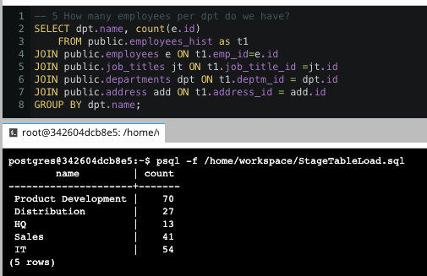
CRUD
Question 5: How many employees are in each department?

Slide 21
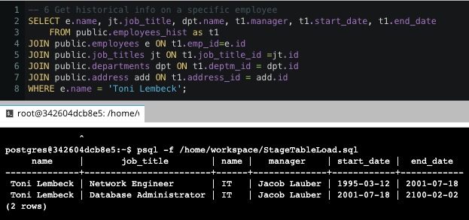
CRUD
Question 6: Write a query that returns current and past jobs (include employee name, job title, department, manager name, start and end date for position) for employee Toni Lembeck.

Slide 22
CRUD
Question 7: Describe how you would apply table security to restrict access to employee salaries using an SQL server.
Answer:
The simplest way is just create a view where the salary field is not available, then we give access to the view only for people that want access to the data, and the salary won’t be there.

