Slide 1
Produce Ripeness Classification
Using Convolutional Neural Nets to Identify banana ripeness and streamline grocery store operations

Slide 2
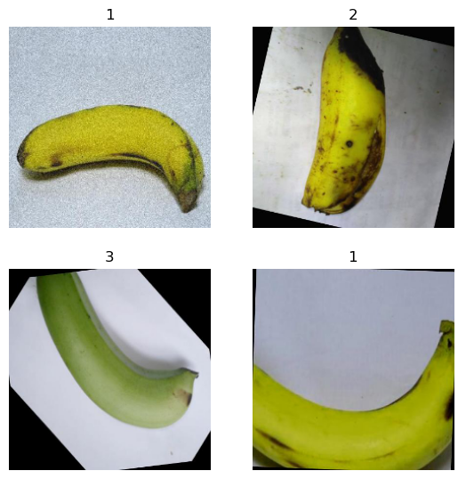
Dataset
Kaggle provides a “banana Ripeness” dataset with 13k images of bananas broken into 4 different classes of ripeness.
These are divided into train and test sets.
* For compute purposes we have used a subset of this dataset for training and validation

Slide 3
Motivation
Manual Checks are slow and subjective
Over-ripe fruit results in lost sales
Goal
Classify Banana ripeness with > 90% target accuracy to streamline order frequency and check-up processes.

Slide 4
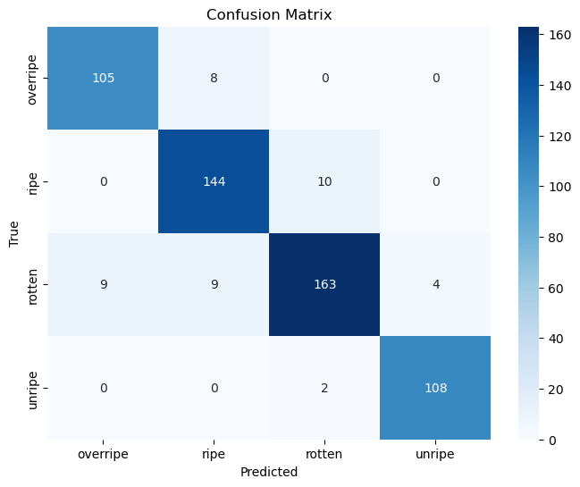
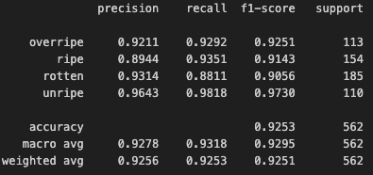
Initial Findings
Initial Model achieves balanced performance with weighted Test F1 around .93 on reduced dataset.

Slide 5
Thank you

