Slide 1
Getting Started
With RISC-V, Fedora, and AI

Slide 2

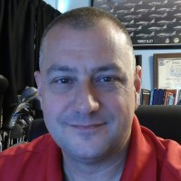
Introductions
Yuning Liang CEO
Deep Computing
Matt St. Onge Associate Principal Solutions Architect
Red Hat

Slide 3


Session Overview

Slide 4
Creating the Image
Walkthrough

Slide 5
Creating the Fedora Image
Download the DC Roma II Fedora 42 image
http://120.92.155.32:8082/artifactory/virtOS/eswin-fedora/fedora-42-20250908.img.zip

Slide 6
Creating the Fedora Image
Uncompress the downloaded Image file
$ ls -l *.zip
-rw-r--r--. 1 mstonge mstonge 6102037516 Oct 1 19:09 fedora-42-20250908.img.zip
$ unzip fedora-42-20250908.img.zip
$ ls
fedora-42-20250908.img.zip
sdcard.img

Slide 7
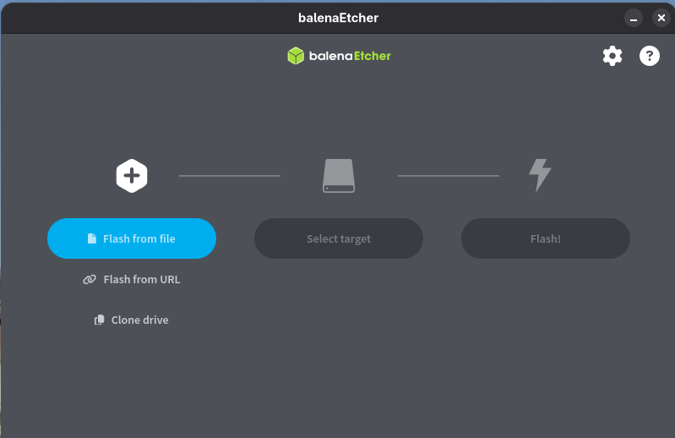
Creating the Fedora Image
Open Balena Etcher
NOTE: If you don’t already have it - download it from here: https://etcher.balena.io/

Slide 8
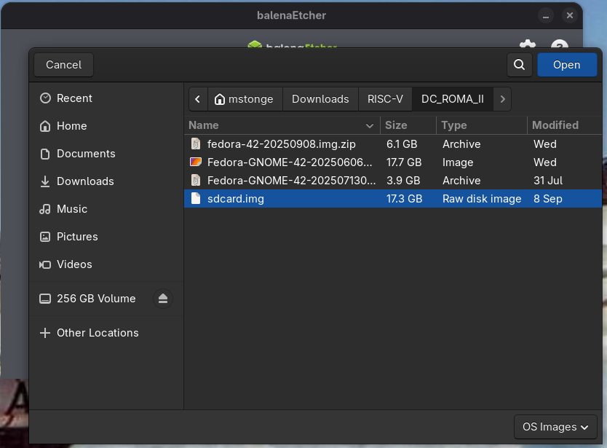
Creating the Fedora Image
Click on Flash from file
Then select the image file you choose to flash with…

Slide 9
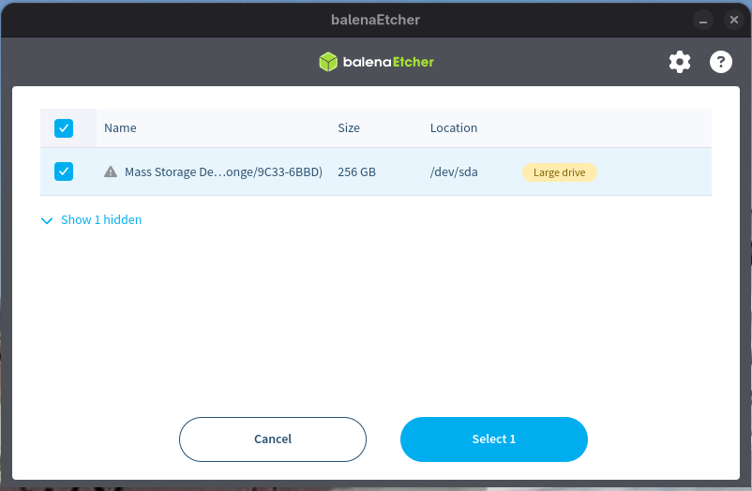
Creating the Fedora Image
Click on Select target
Then select your microSD card
Then click on Select 1

Slide 10
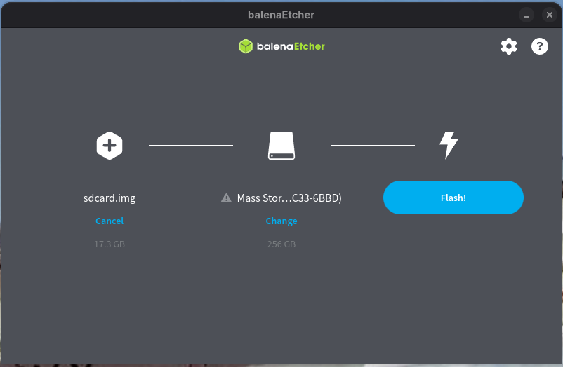
Creating the Fedora Image
Now click on Flash!

Slide 11
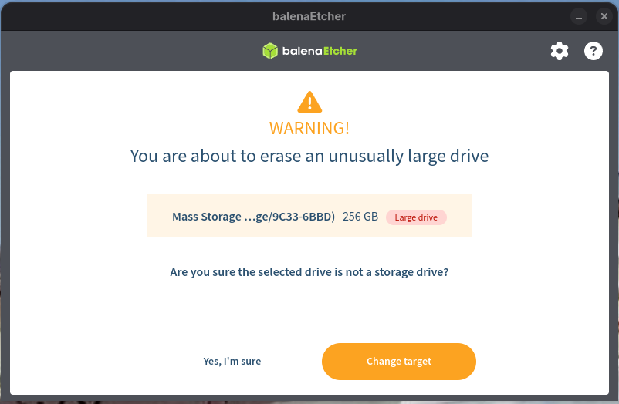
Creating the Fedora Image
Confirm that you want to proceed by clicking on the Yes, I’m sure button…

Slide 12
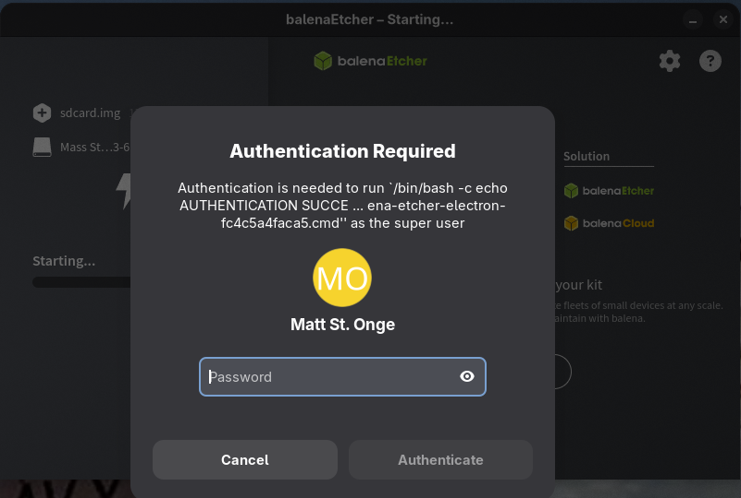
Creating the Fedora Image
The Balena Etcher needs you to authenticate (sudo privileges)... Enter your password…

Slide 13
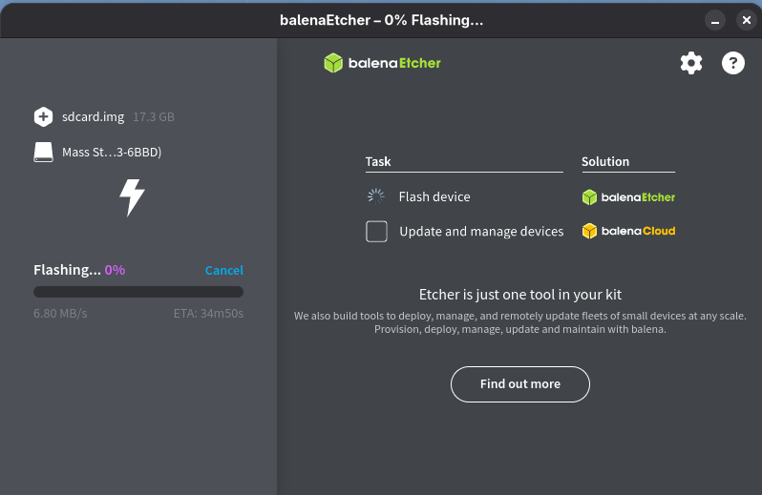
Creating the Fedora Image
Now the waiting game…
The program will flash and verify the image…
This takes a MANY minutes…

Slide 14
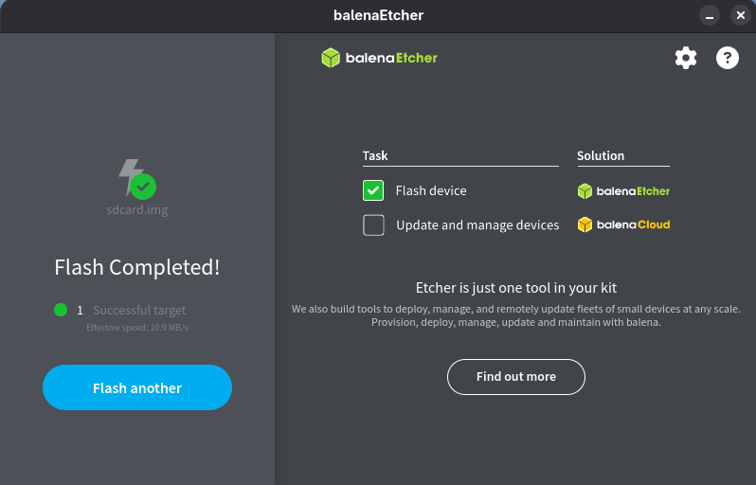
Creating the Fedora Image
Done!!!
You can now remove the media from your machine and close Balena Etcher…

Slide 15
Installing Fedora

Slide 16
Installing Fedora

Slide 17
Installing Fedora

Slide 18
Installing Fedora

Slide 19
Installing Fedora

Slide 20
Installing Fedora

Slide 21
Installing Fedora

Slide 22
Installing Fedora

Slide 23
Installing Fedora

Slide 24
Installing Fedora

Slide 25
Installing Fedora

Slide 26
Optimization

Slide 27
Optimization

Slide 28
Optimization

Slide 29
Optimization

Slide 30
Optimization

Slide 31
Optimization

Slide 32
Optimization

Slide 33
Optimization

Slide 34
Optimization

Slide 35
Running AI

