Slide 1
Final Project
Group 9

Slide 2

Premier League Home Team vs Away Team Goal Analysis

Slide 3
Tool Used: Tableau
Tableau is an interactie, self-service reporting analytics tool that enables to integrate and combine data from multiple sources into visualizations.
20XX | 20XX | 20XX | 20XX

Slide 4

Interactive Elements Description
Table description:
Total Amount of Goals: visualizes the total amount of goals by the Home Teams vs Away Teams
Average Of Goals Made by Home Teams vs Away Teams
Total Goals per Home Team
Total Goal per Away Team

Slide 5
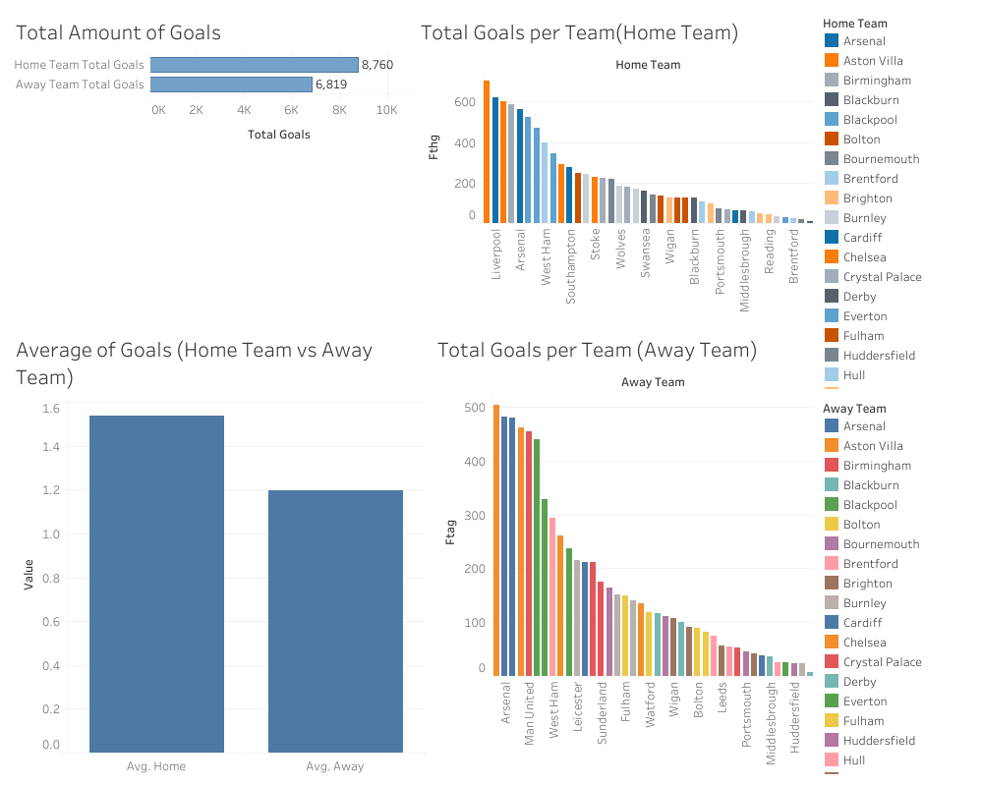
Dashboard

